Slide 1

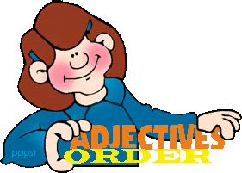
Mega Goal 4
Unit 1 - There’s No Place Like Home
Grammar
Adjective Order – Too and Enough
By: Essa Al Hussaini

Slide 2
Objectives
Use "adjective order" correctly
Use "enough" with adjectives correctly.
Write a correct infinitive phrase included "too"
01
02
03
04
05
Use “too" with adjectives correctly.
Write a correct infinitive phrase included “enough"

Slide 3
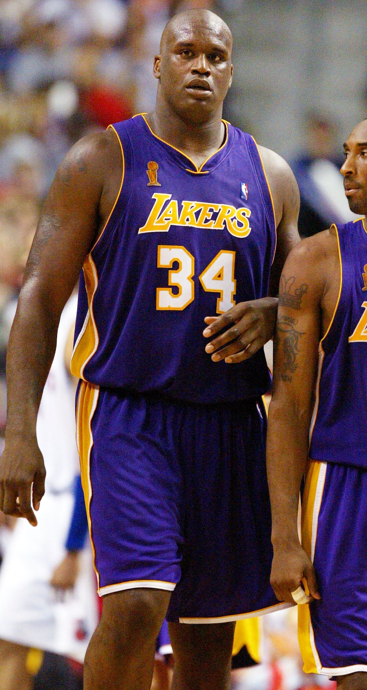
Warm Up
Choose the correct order of the adjectives
A black, tall, American basketball player.
A tall, black, American basketball player.
An American, tall, black basketball player.

Slide 4
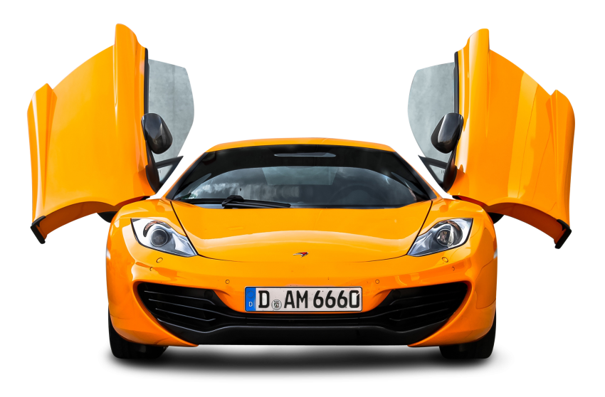
Warm Up
Choose the correct order of the adjectives
It’s a beautiful, new, yellow car.
It’s a yellow, new, beautiful car.
It’s a new, beautiful, yellow car.

Slide 5
HOW to place ADJECTIVE in order?
Adjective Order
expensive
When you use more than one adjective before a noun,
the adjectives
USUALLY following this order
Opinion
large / round
Size / Shape
Age
old / new
color
red
Usually 1 – 3 adjectives are used to modify a noun at a time
Use a comma between two adjectives
Nationality
(origin)
Saudi
Material
glass
O S A C O M

Slide 6
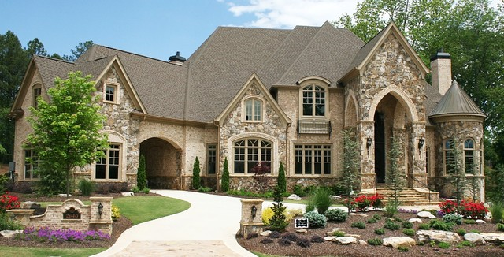
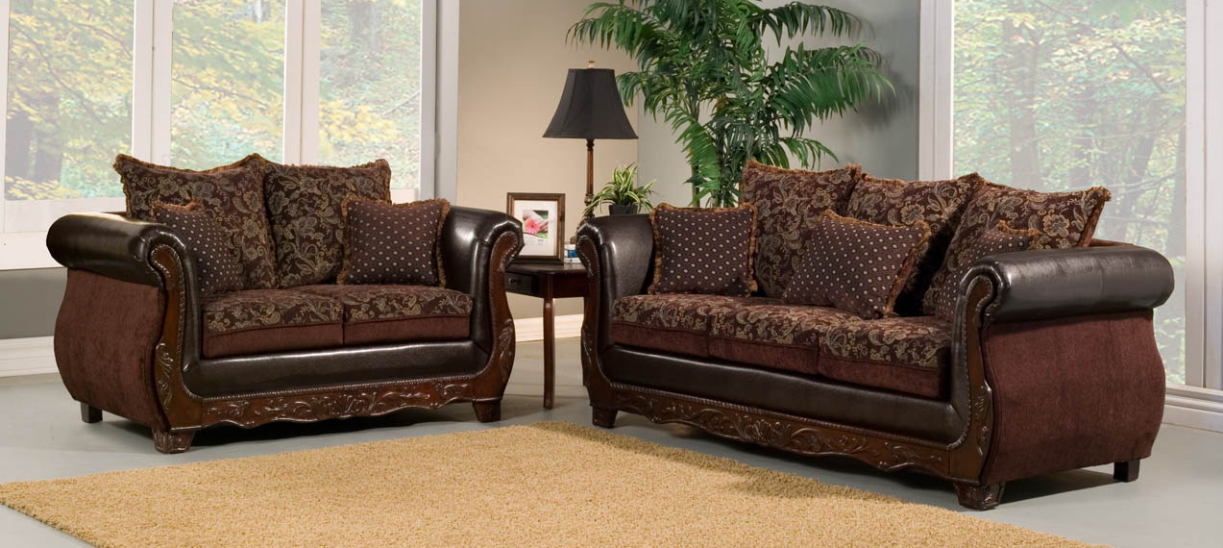
Adjective Order
expensive
Opinion
large / round
Size / Shape
Age
old / new
The beautiful, old, stone house.
color
red
Nationality
(origin)
Saudi
Material
glass
I have two large, brown sofas.
O S A C O M

Slide 7

Practice makes Perfect

Slide 8
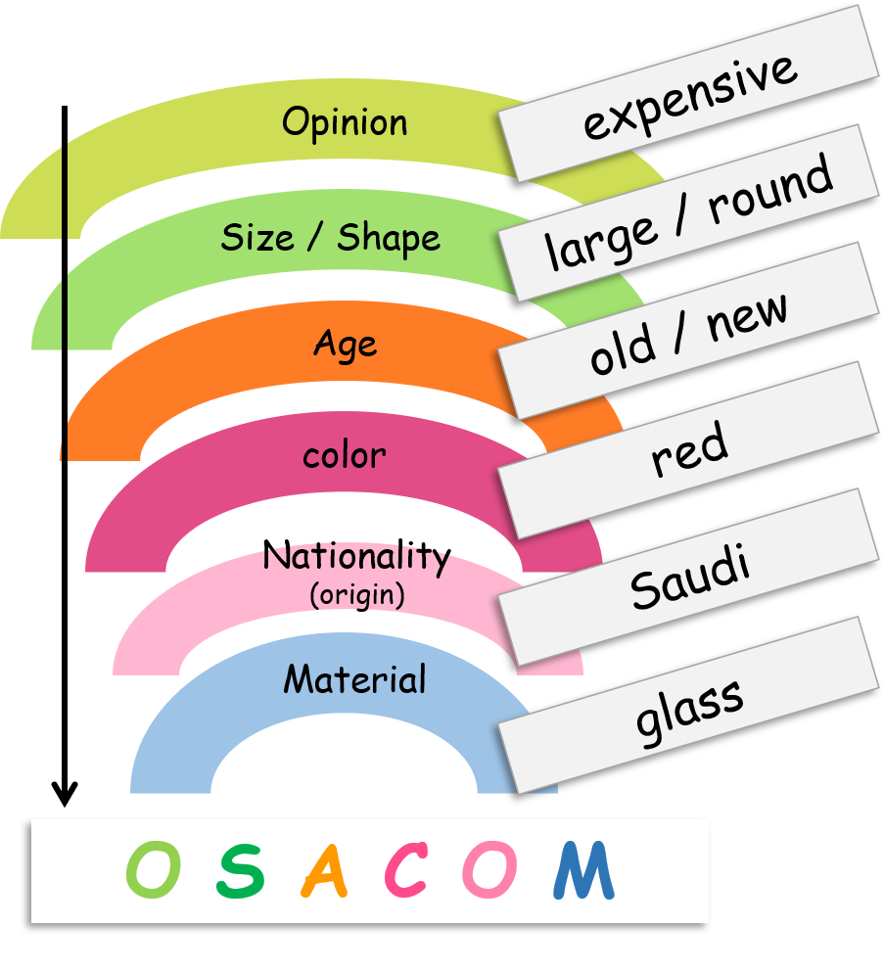
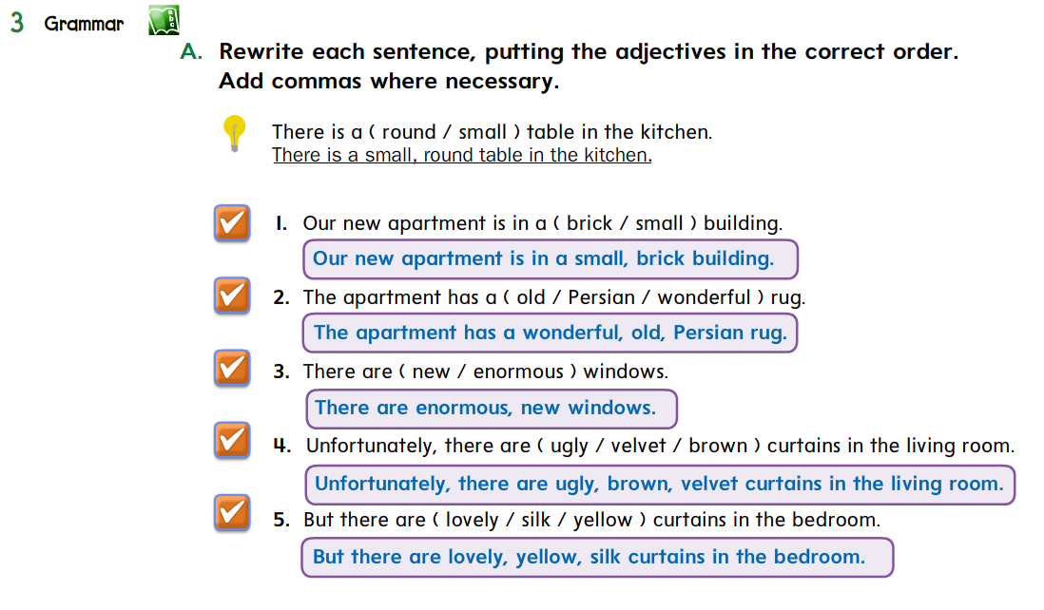


Slide 9
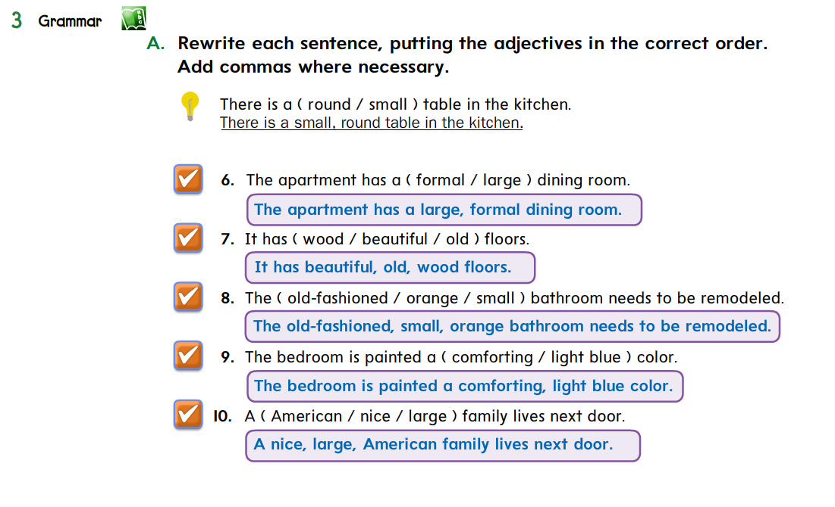

Slide 10

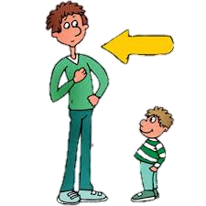
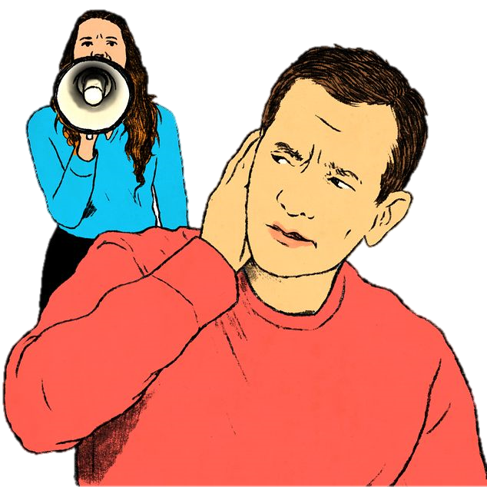
Too & Enough
It’s too small car.
It’s small too car.
Choose
Too … (more than is necessary)
goes before Adj & Adv
He is too tall.
You’re talking too loudly

Slide 11


Too & Enough
It’s enough hot.
It’s hot enough.
Choose
enough … (sufficient)
goes after Adj & Adv
He can reach the book. He’s tall enough.
You’re talking loudly enough. Everyone can hear you.

Slide 12

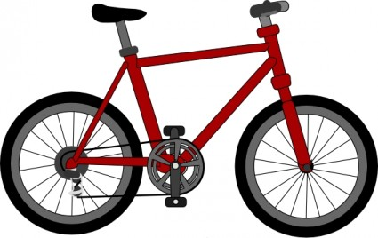
Too & Enough
2. It’s hot enough.
Choose
enough … (sufficient)
goes before nouns
He will buy a bike. He has enough money.

Slide 13
Too & Enough
to + verb ……….
Too / Enough are followed by an infinitive phrase
He is too young to drive a car.
He is tall enough to play basketball.

Slide 14


Too & Enough
before Adj & Adv
He is too tall.
You’re talking too loudly
after Adj & Adv
He’s tall enough.
You’re talking loudly enough.
before nouns
He has enough money.
Too
Enough
Too + adj or adv
Additional
Language Builder
Adj or adv + enough
Enough + noun

Slide 15
Practice makes Perfect

Slide 16
Insert too or enough into the correct place in each sentence
This house is big. (too)
You’re driving quickly. (enough)
They have bathrooms for everybody. (enough)
I’m not rich to buy that house. (enough)
You’re walking slowly. (too)
You’re short to play basketball. (too)
This house is too big.
You’re driving quickly enough.
They have enough bathrooms for everybody.
I’m not rich enough to buy that house.
You’re walking too slowly.
You’re too short to play basketball.

Slide 17

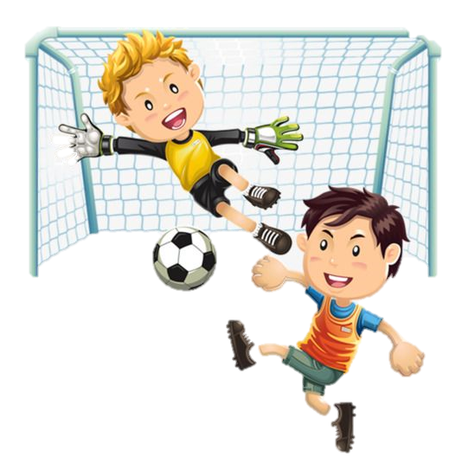
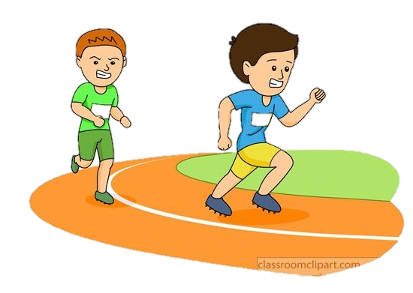

Complete with an infinitive phrase
He was late ……... (too)
They have time …….. (enough)
Ahmed is not fast …………... (enough)
She is sick …….. (too)
He was too late to catch the bus.
They have enough time to play football.
Ahmed is not fast enough to win the race.
She is too sick to leave the house today.

Slide 18
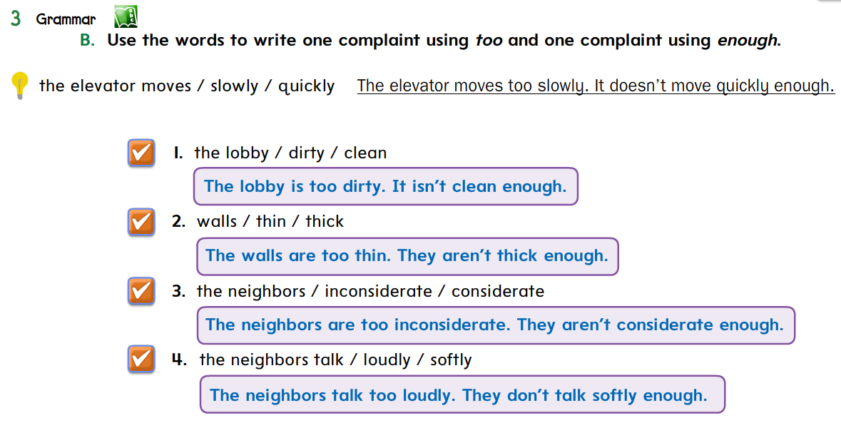

Slide 19
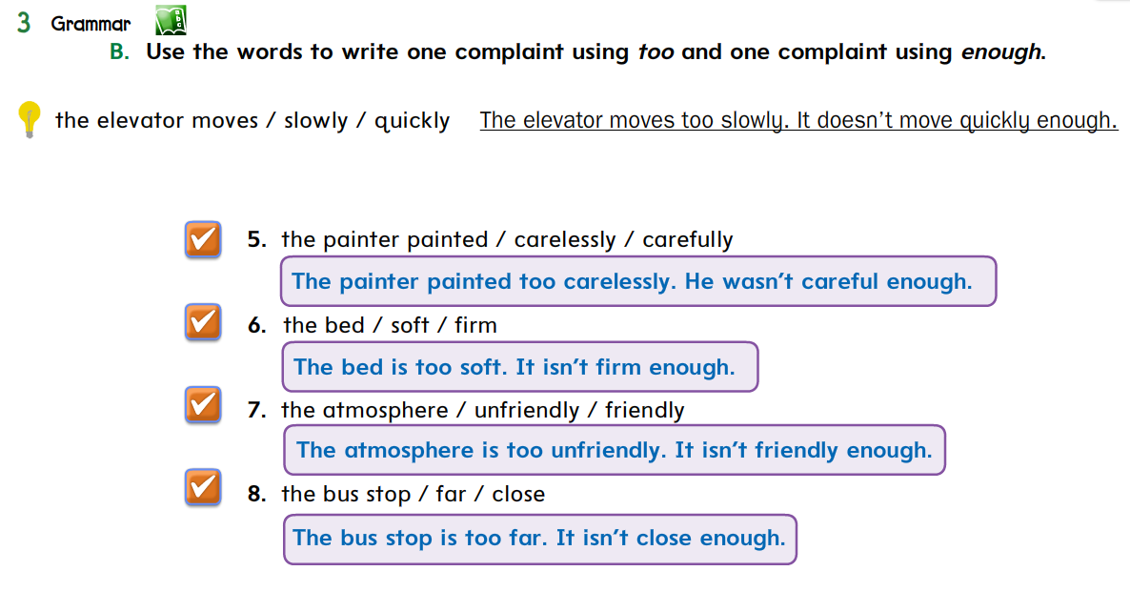

Slide 20
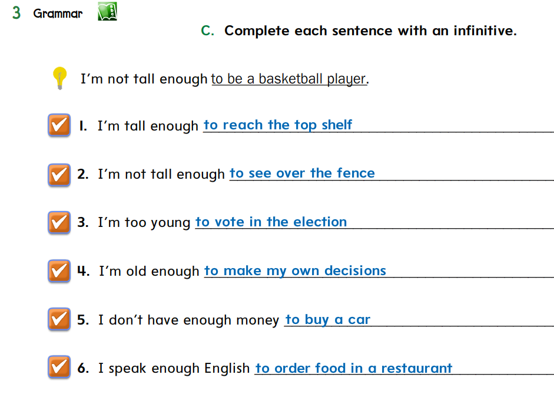
Suggested Answers

Slide 21
HOMEWORK
2
Workbook pages
Exercise C
3
Exercises E & F
4
Exercise H

Slide 22



Slide 24
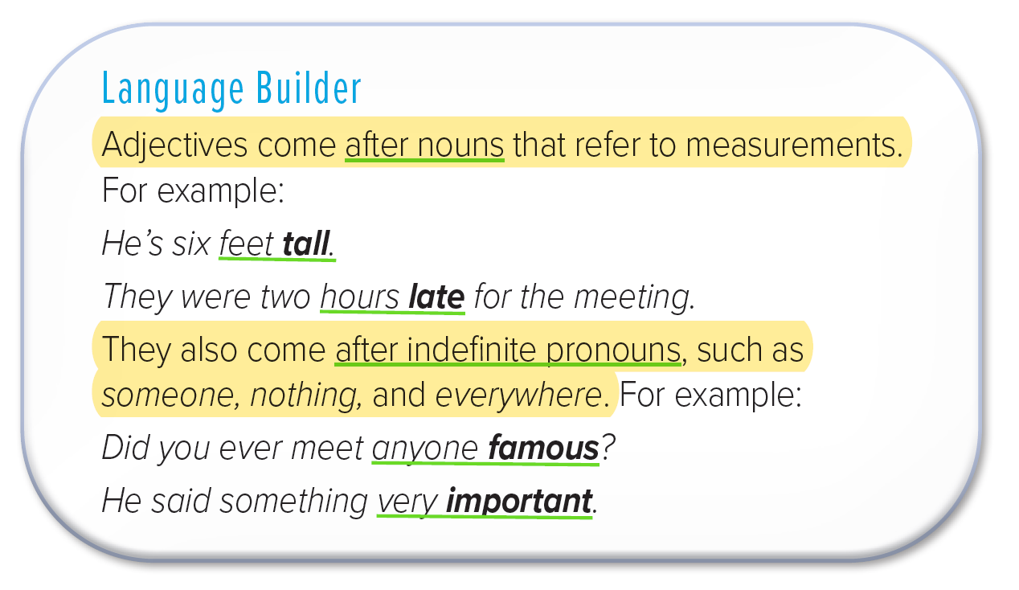


BACK to Lesson

