Slide 1


Good Morning

Slide 2

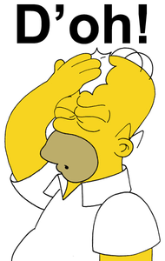

Mega goal.3.2
Everyone Makes Mistakes
Form , Meaning & Function

Slide 3
Objectives:
Recognize words that are connected with Business
Make use of "some/any' according to the sentence
Jan
Feb
Mar
Apr
May
Jun
Jul
Aug
Sep
Oct
Nov
Dec
Jan
Feb
Mar
Apr
May
Jun
Jul
Aug
Sep
Oct
Nov
Dec
Use articles correctly
Express quantity using count/noncount noun
Inspect the count/non count nouns

Slide 4
Words Connected with Business
Articles
Count/Noncount Nouns
Expressions of Quantity: Some/Any
Expressions of Quantity: A Lot of, Much, Many, Enough, Plenty of, (A) Few, Little, Hardly Any

Slide 5
Words Connected with Business

Slide 6
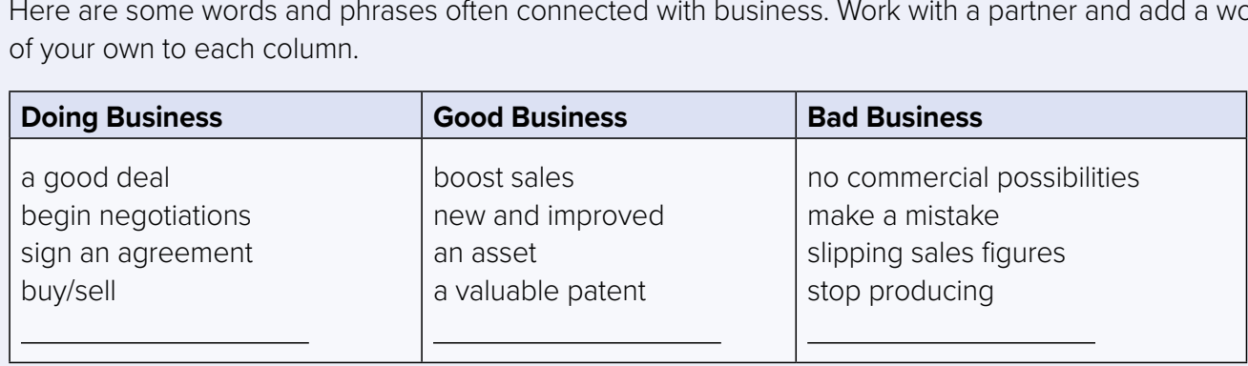

Here are some words and phrases often connected with business. Work with a partner and add a word or phrase of your own to each column
Read the texts on pages 96 and 97 and find the vocabulary
Notes:
read the texts again on pages 96 and 97 and find the vocabulary items from the chart

Slide 7

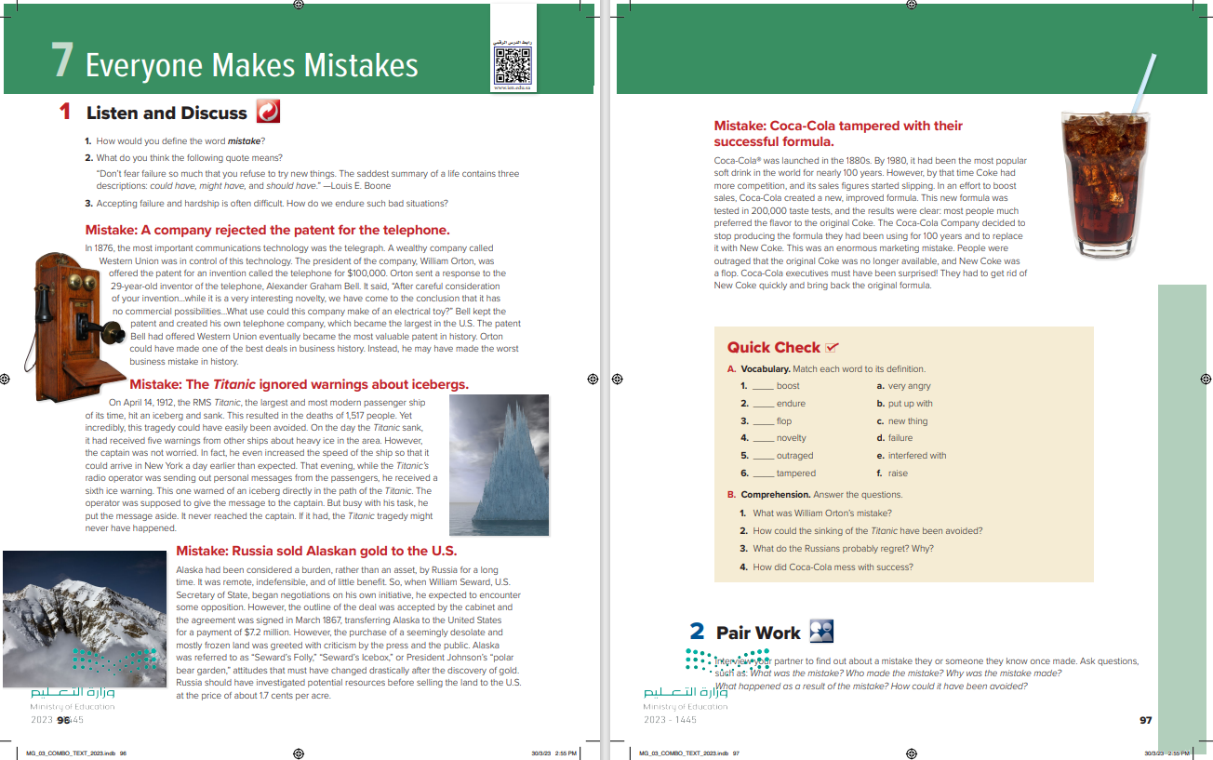
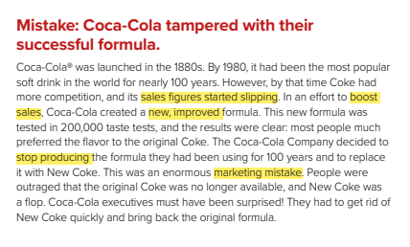
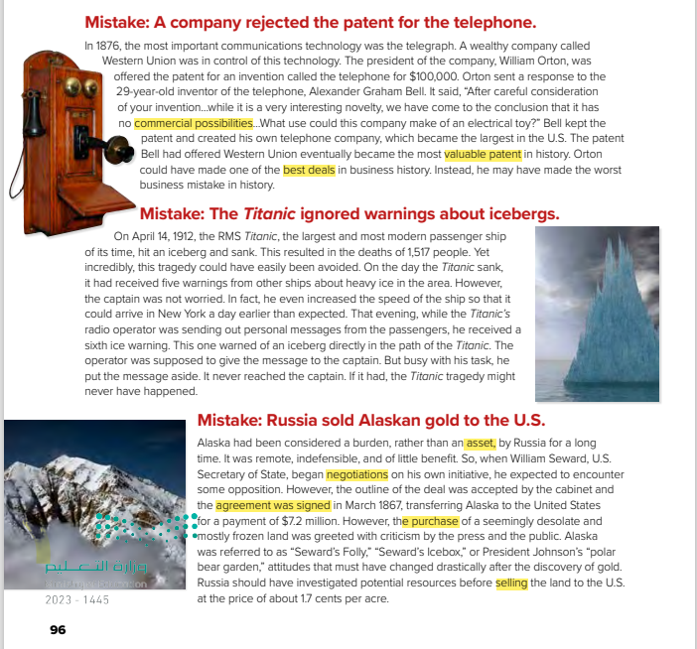
Practice Makes It Perfect

Slide 8
Practice Makes It Perfect

Slide 9




B. Work with a partner. Imagine you work in your ideal job. Ask and answer about the following things:
your salary and perks your working environment your colleagues
travel opportunities recent business deals mistakes you have made

Slide 10
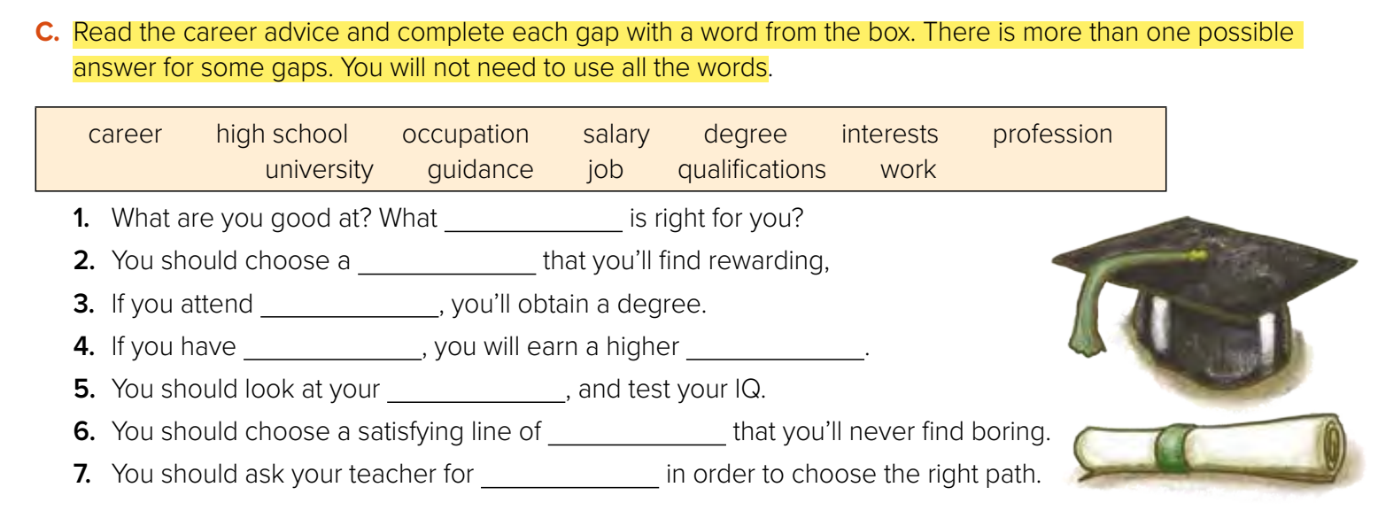
career/occupation/profession/job
career/occupation/profession/job
university
qualifications
salary
interests
work
guidance

Slide 11

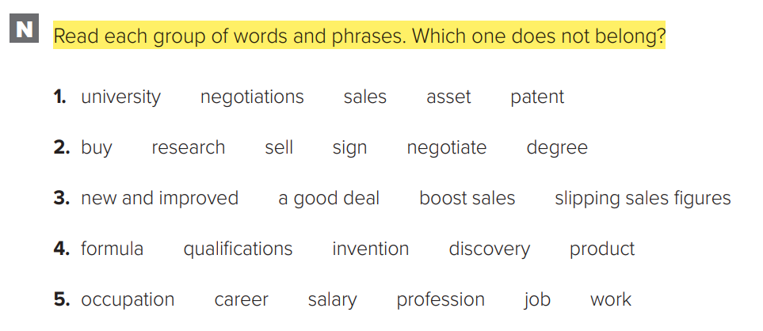
W.B.P.297

Slide 12
Articles

Slide 13
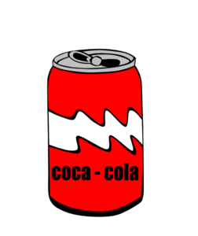
Use the indefinite article a/an before singular count nouns when we refer to the noun in a general sense, and when we mention something for the first time
In an attempt to boost sales, a well-known soft drinks company created
a new, improved formula.

Slide 14
The new formula, which was tested in 200,000 taste tests replaced the original formula
We use the definite article the before singular and plural nouns when we refer to something already known, mentioned or defined

Slide 15
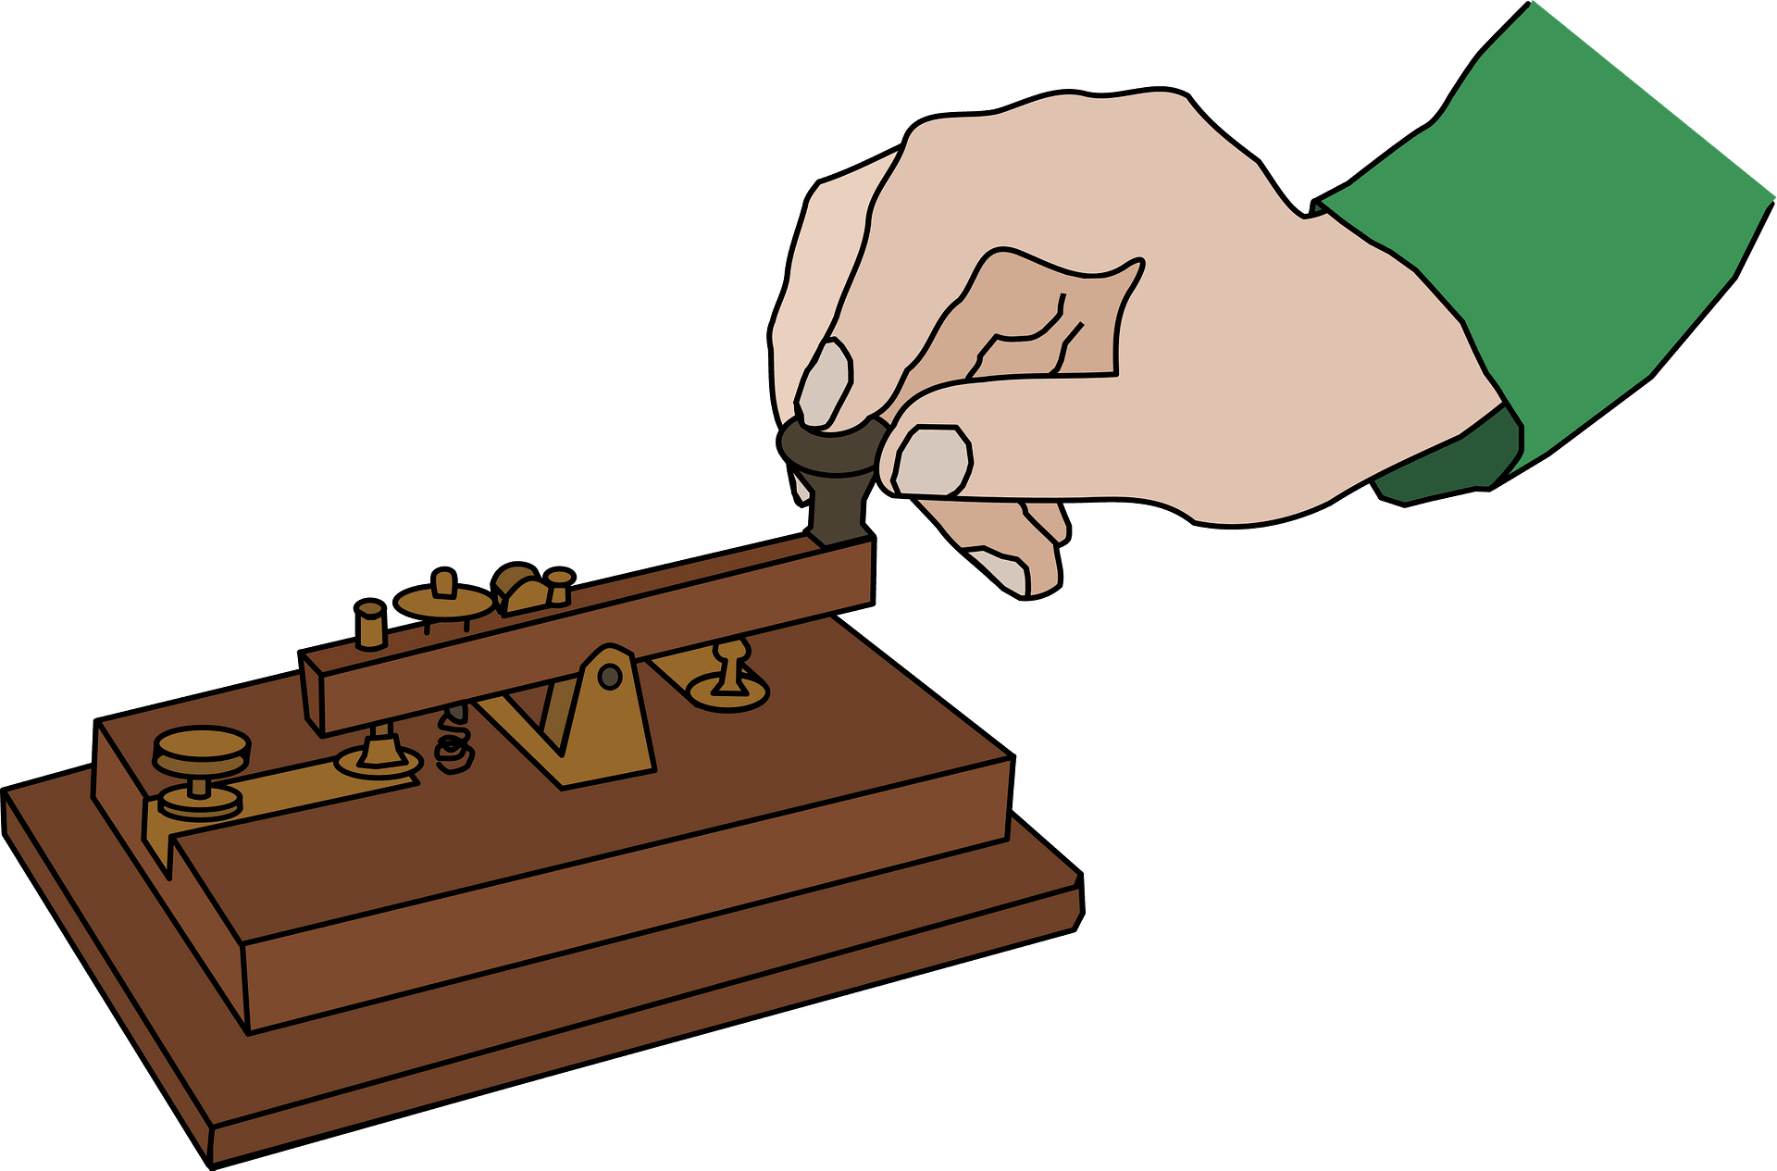
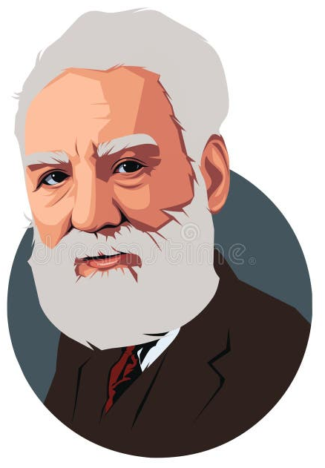

In 1876, the most important communications technology was the telegraph
Use the with superlative and comparative adjectives and adverbs.
Alexander Graham Bell invented the telephone
Use the to refer to inventions.
Practice Makes It Perfect
Fahd is my brother. He lives on Main Street. He’s in Dubai on vacation.
Don’t use the before the names of people, streets, cities, and countries.

Slide 16
Practice Makes It Perfect

Slide 17
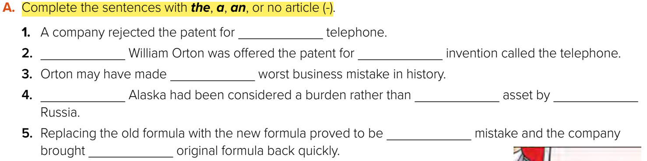
the
---
an
the
--
an
--
a
the

Slide 18

Count/Noncount Nouns
Count Nouns
Noncount Nouns

Slide 19


Count Nouns
Noncount Nouns
Singular Count Nouns Plural Count Nouns
a warning two warnings
an iceberg three icebergs
advice, information, news,
time, furniture.
Count nouns name things that you can count. They have singular and plural forms
Noncount nouns name things that you can’t count They don’t use a/an. They don’t have plural forms.

Slide 20
Expressions of Quantity: Some/Any

Slide 21
Affirmative (+) Negative (–) Questions (?)
There is some news.
There are some newspapers.
There isn’t any news.
There aren’t any newspapers.
Is there any news?
Are there any newspapers?
Use some in affirmative statements.
Use any in negative statements and in questions.
. Use some/any with noncount nouns and with plural nouns.

Slide 22
Expressions of Quantity: A Lot of, Much, Many, Enough, Plenty of, (A) Few, Little, Hardly Any

Slide 23
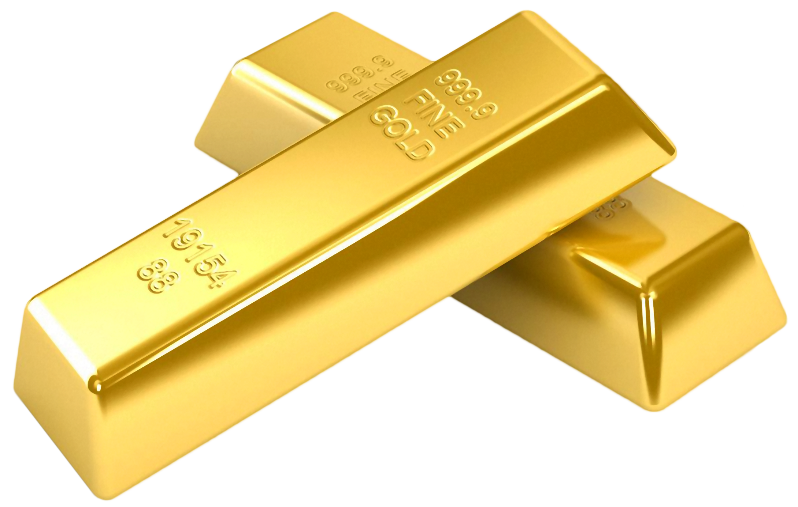

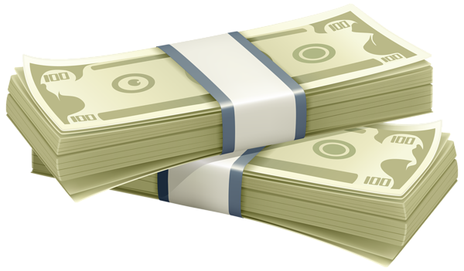
Count Nouns
How many jobs have you had?
He only has (a) few friends.
Noncount nouns.
How much gold did they sell?
There’s little money left.
Practice Makes It Perfect
Use plenty of, a lot of, hardly any and enough for both plural count and noncount nouns.
She has plenty of/hardly any friends. She has plenty of/hardly any money.

Slide 24
Practice Makes It Perfect

Slide 25
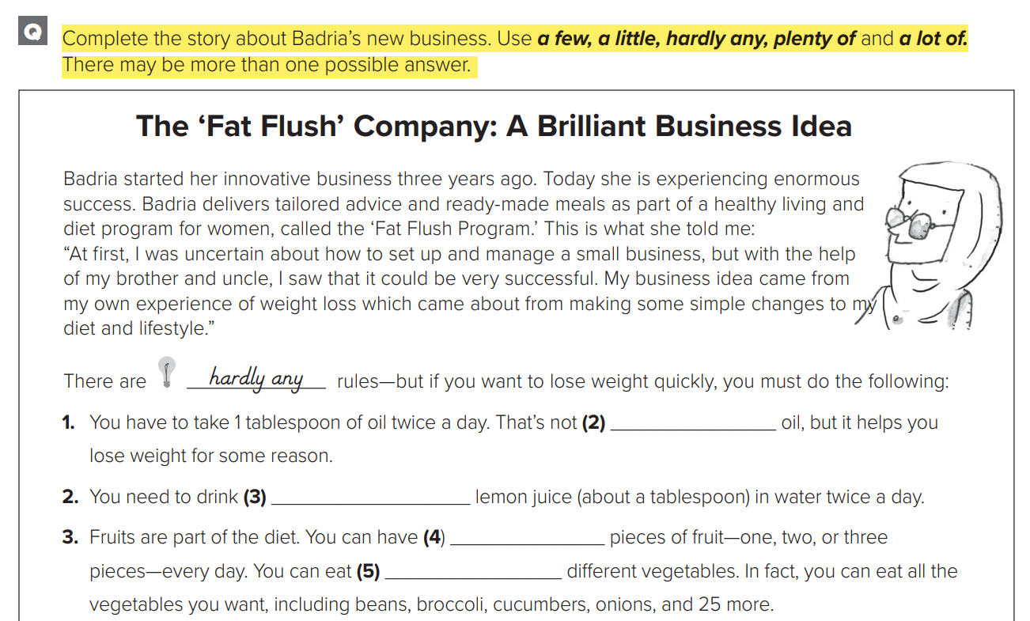
W.B.P.298
A lot of
A little
A few
A lot of /plenty of

Slide 26

Funding
Hissah Alotaibi​

