Slide 1


Good Morning

Slide 2

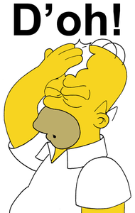
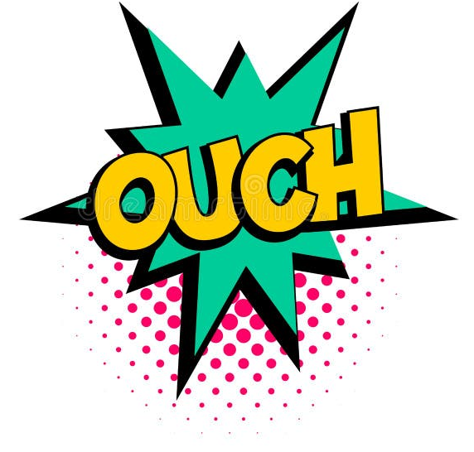
Mega goal.3.2
Everyone Makes Mistakes
Listen & Discuss
Pair Work

Slide 3
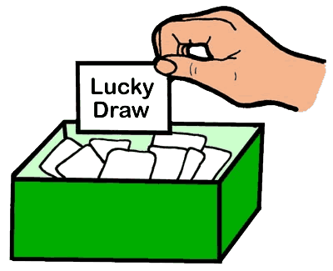
Whose story is it?
Start this game by writing your funniest or weirdest story on a small piece of paper.
The facilitator or the person leading the program randomly reads every story and group members guess who the writer is.
Story

Slide 4
Objectives:
Explain a quote about mistakes
Find the mistake of each person in the text
Mention a way to make use of a mistake
Jan
Feb
Mar
Apr
May
Jun
Jul
Aug
Sep
Oct
Nov
Dec
Jan
Feb
Mar
Apr
May
Jun
Jul
Aug
Sep
Oct
Nov
Dec
Perform an interview with a partner
Choose definition for mistake
Match new words with definition

Slide 5
Listen & Discuss

Slide 6
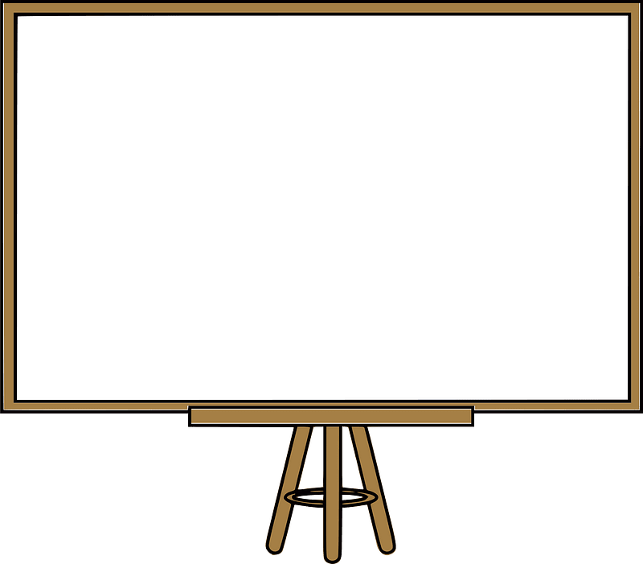

What is..?
mistake
It is something that you wish you hadn’t done.
small mistake might be an error on a test.
big mistake, such as quitting school, might affect the rest of your life.

Slide 7
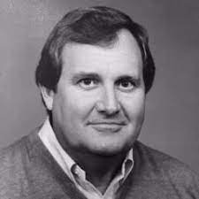
2-What do you think the following quote means?
“Don’t fear failure so much that you refuse to try new things. The saddest summary of a life contains three descriptions: could have, might have, and should have.” —Louis E. Boone
3. Accepting failure and hardship is often difficult. How do we endure such bad situations?

Slide 8
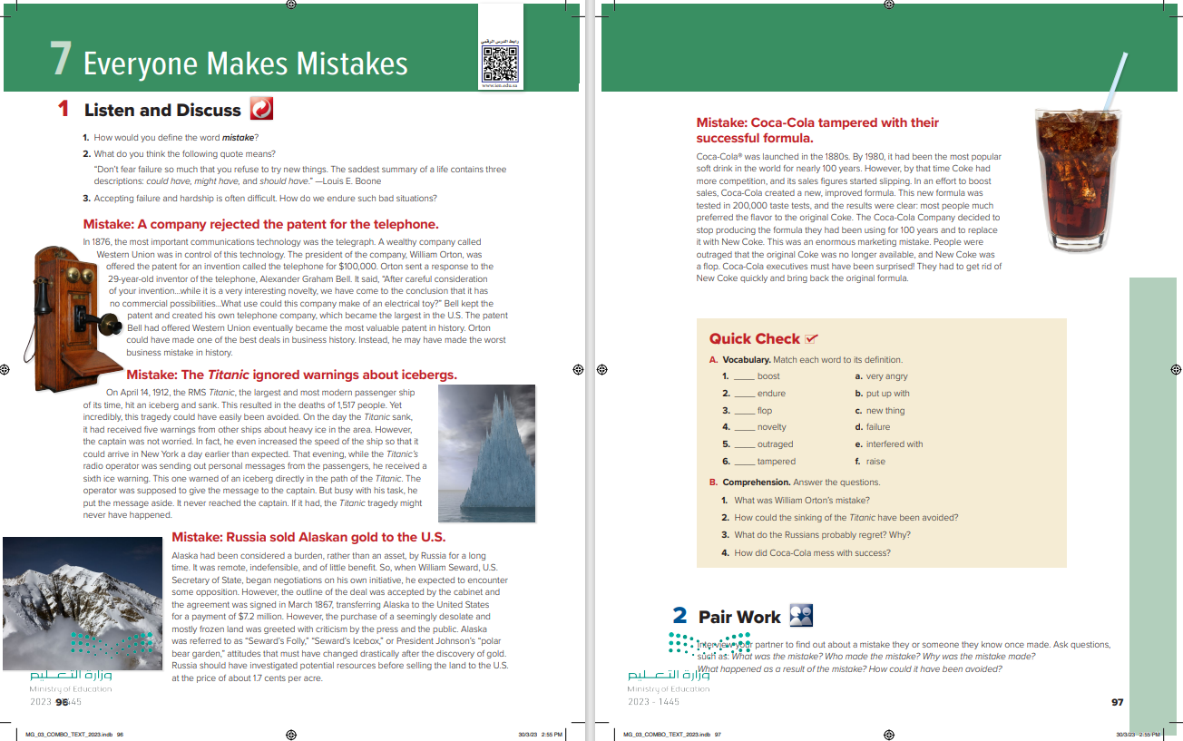

Students Book
P.65-66

Slide 9
4
1
-----Stories are there?
--------- Titles?
--------Pictures?
2
3

Slide 10



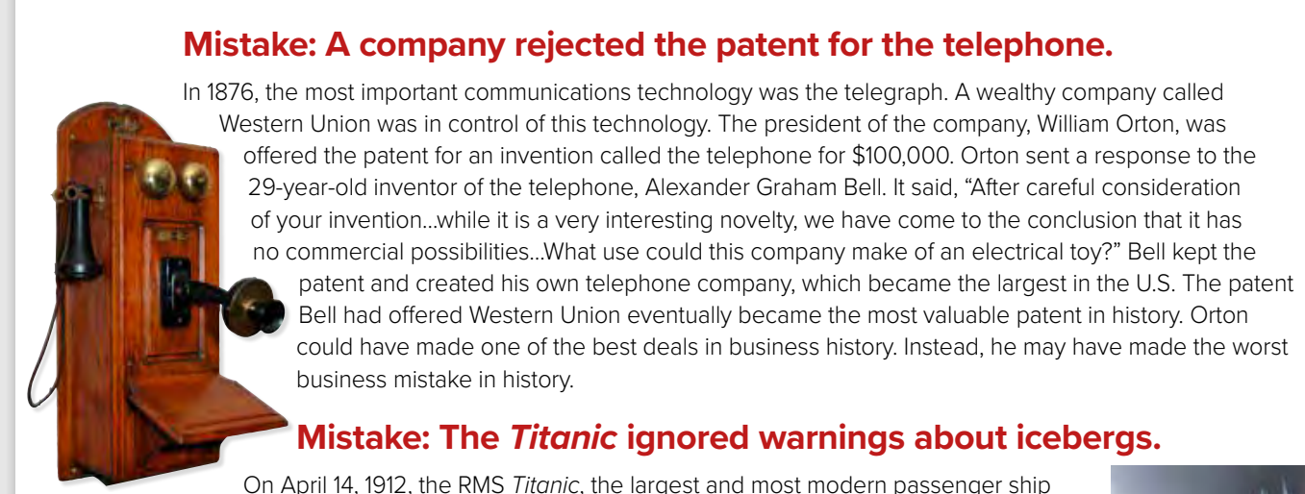
Close Your Books & Listen

Slide 11
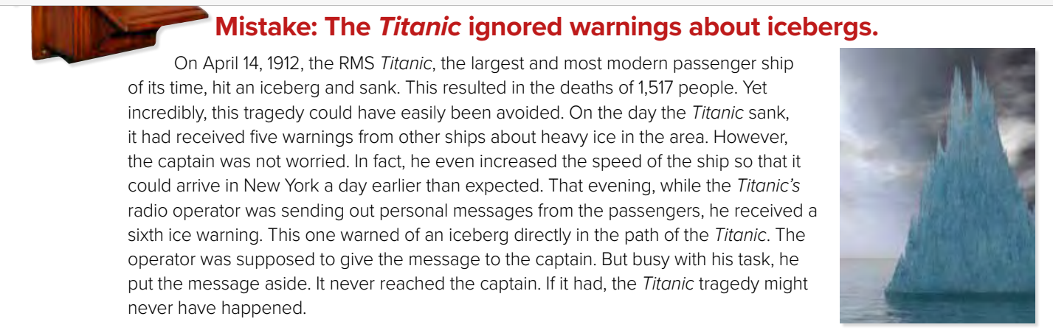
What was the mistake?
Why was this a mistake?
Western Union rejected the patent for the telephone.
The company would have made a lot of money.

Slide 12
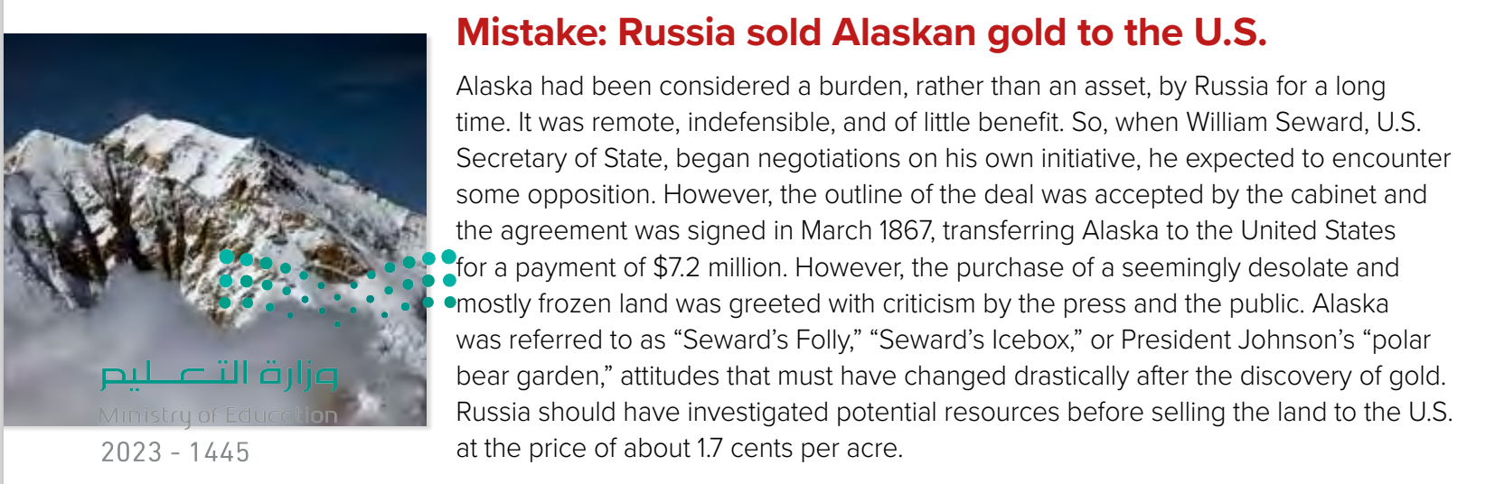
The captain ignored five warnings about icebergs and the radio operator didn’t give the captain another warning.
What was the mistake?
Why was this a mistake?
It resulted in the deaths of 1,517 people.

Slide 13
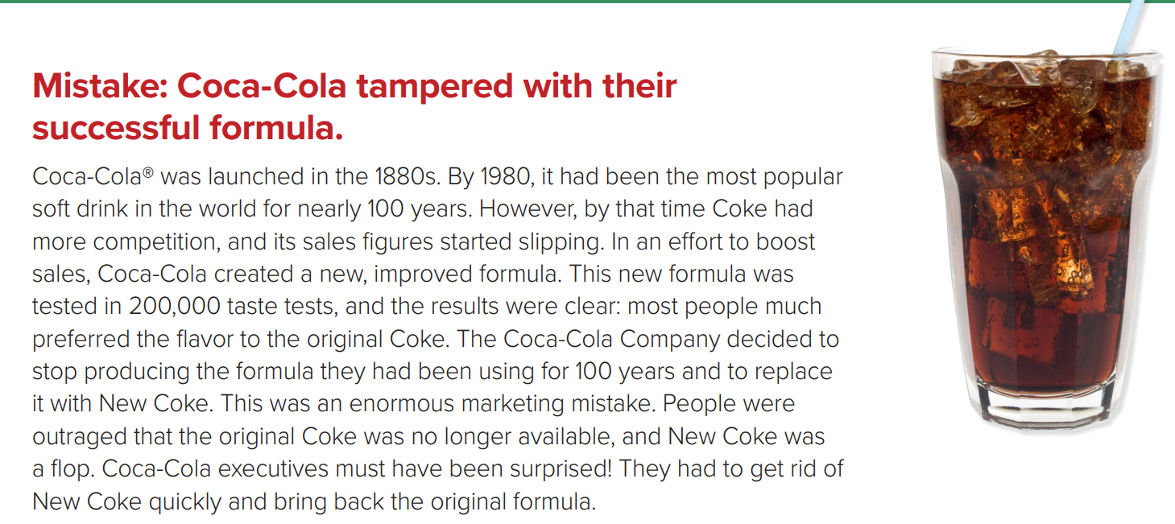
What was the mistake?
Why was this a mistake?
Russia sold Alaska to the United States for 1.7 cents per acre.
There was gold in Alaska.

Slide 14
What was the mistake?
Why was this a mistake?
Coca-Cola changed their formula and taste.
People were outraged that the original Coke was not available

Slide 15
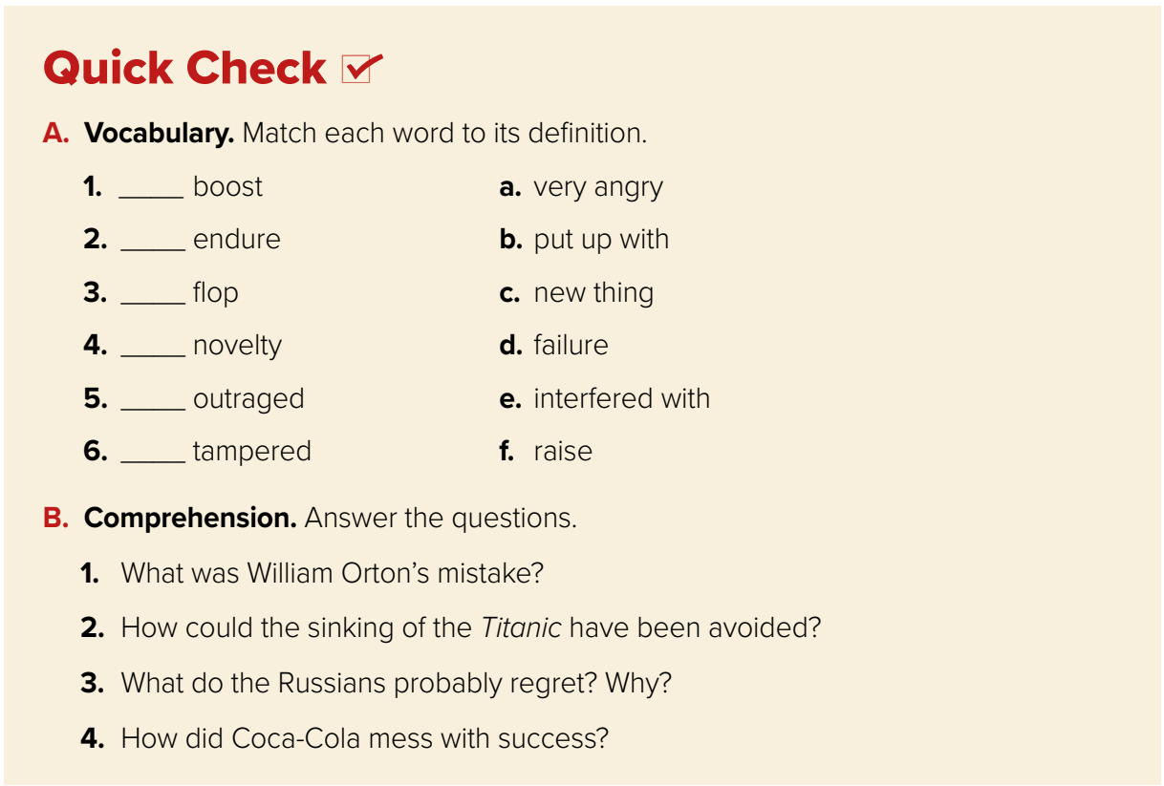
1.William Orton did not realize that the telephone would become the most valuable patent in history.
2. If the radio operator had given the warning to the captain about the iceberg that was directly in the ship’s path, the Titanic might not have sunk.
3. Russia probably regretted selling Alaska to the United States since the Americans discovered gold.
4. Coca-Cola tried to change the formula of the soft drink that had been the most popular in the world for over 100 years.
f
b
d
c
a
e

Slide 16
Pair Work

Slide 17

Interview your partner to find out about a mistake they or someone they know once made. Ask questions, such as:
What was the mistake?
Who made the mistake?
Why was the mistake made?
What happened as a result of the mistake?
How could it have been avoided?

Slide 18


Slide 19

Funding
Hissah Alotaibi​

