Slide 1

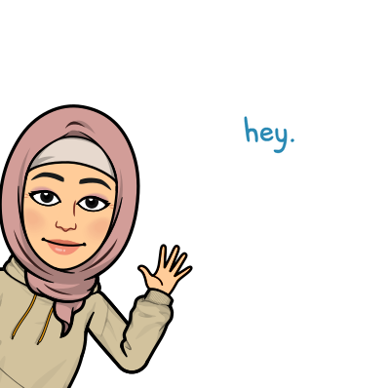
Good Morning

Slide 2

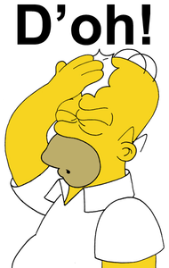

Mega goal.3.2
Everyone Makes Mistakes

Slide 3
Listening
Pronunciation
Vocabulary Building

Slide 4
Objectives:
Find specific information in an audio
Find the meaning of new word
Jan
Feb
Mar
Apr
May
Jun
Jul
Aug
Sep
Oct
Nov
Dec
Jan
Feb
Mar
Apr
May
Jun
Jul
Aug
Sep
Oct
Nov
Dec
Pronounce the reductions of modals correctly

Slide 5

Listening

Slide 6
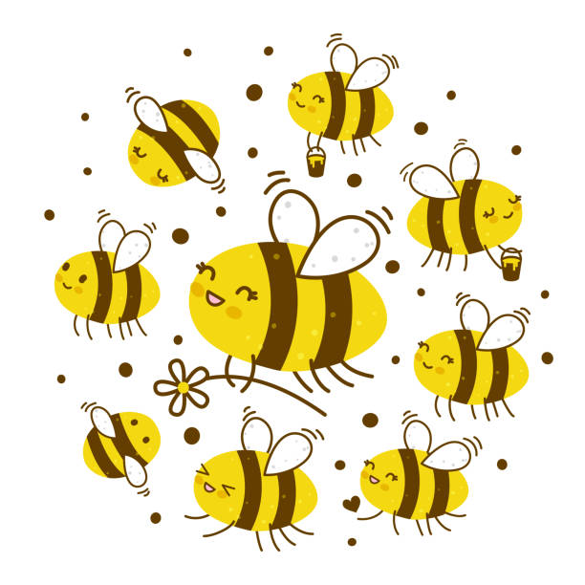


What information will you listen for?
 |  | The Bee Story | The Ring Story
1. | What was the person’s goal?
2. | Did the person achieve the goal?
3. | What mistake did the person make?
4. | What were the consequences of the mistake?

Slide 7
Listen to the stories about two silly mistakes. Then fill in the chart
 |  | The Bee Story | The Ring Story
1. | What was the person’s goal?
2. | Did the person achieve the goal?
3. | What mistake did the person make?
4. | What were the consequences of the mistake?
to get rid of the bees
to give his wife an anniversary ring
yes
no
He set his shed on fire.
The wind pulled the balloon from his hand
The fire caused $80,000 worth of damage..
He lost a $10,000 ring

Slide 8

Pronunciation

Slide 9
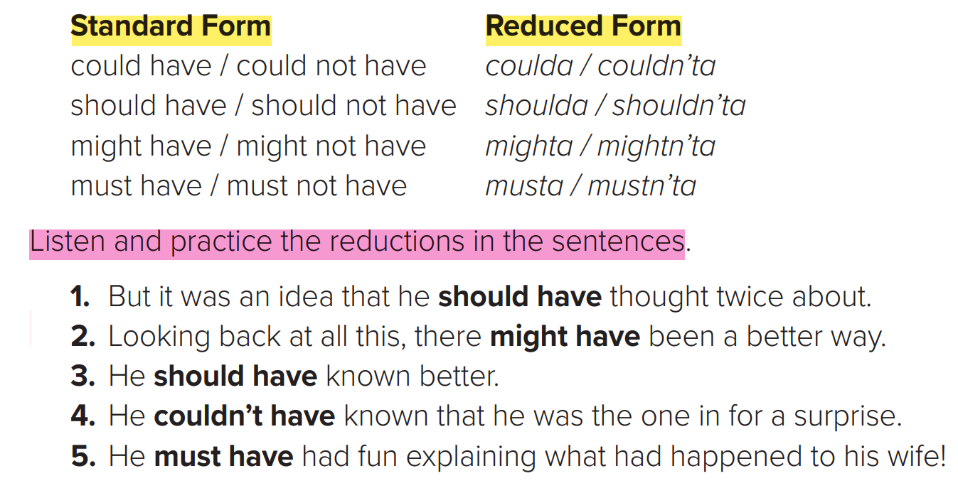

Slide 10
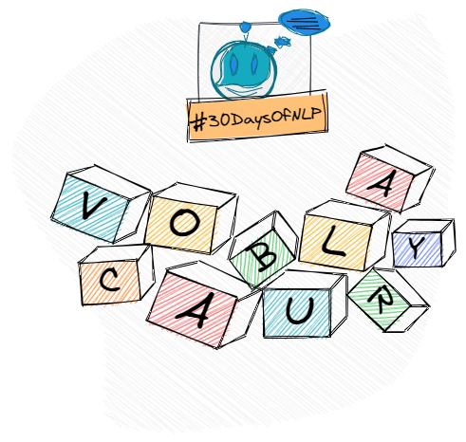
Vocabulary Building

Slide 11

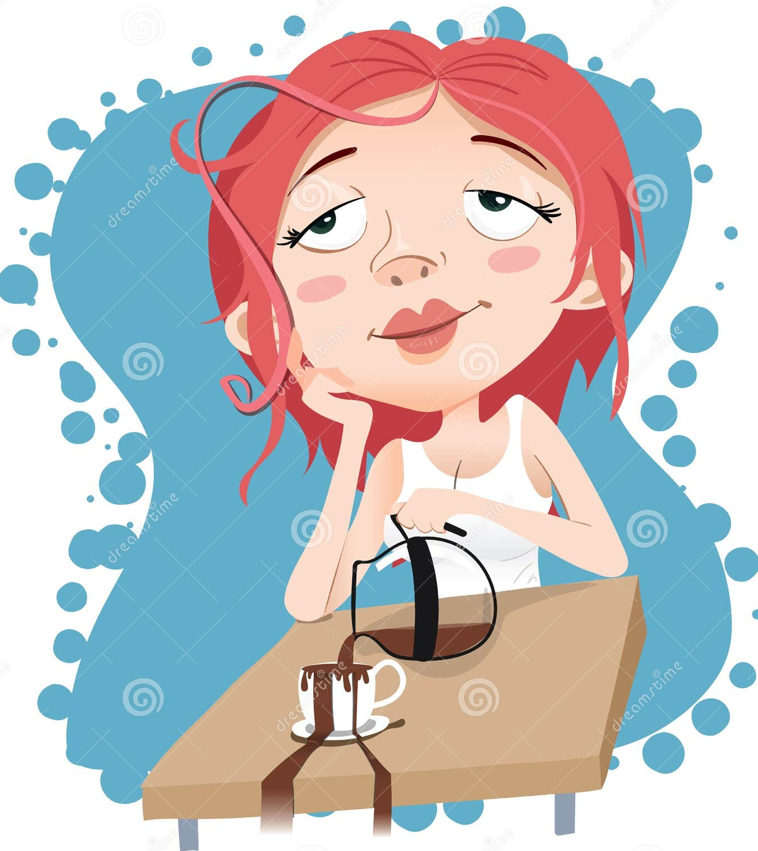
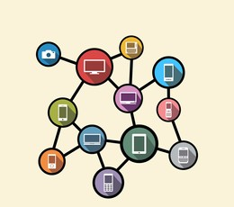
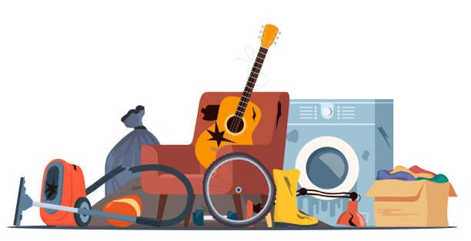
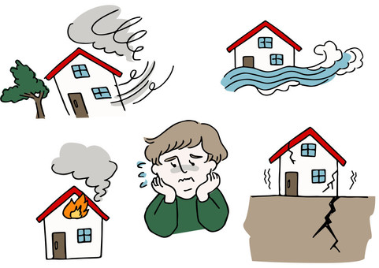
adhesive
absent-minded
ubiquitous
damage
discarded

Slide 12
A. You will see the following words in the reading on pages 102 and 103. Match the words with their meanings.
e
1. ______ absent-minded | a. found everywhere
2. ______ adhesive | b. harm
3. ______ automatically | c. a material that causes two materials to stick together
4. ______ damage | d. something done without thought, as is done by a machine
5. ______ discarded | e. forgetful, distracted
6. ______ ubiquitous | f. thrown away
c
d
b
f
a

Slide 13

Funding
Hissah Alotaibi​

