Slide 1


Good Morning

Slide 2
Mega goal.3.2
Everyone Makes Mistakes

Slide 3

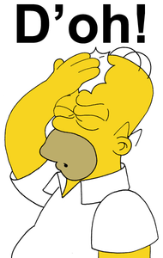

Reading
Speaking

Slide 4
Objectives:
Explain the term (happy accident)
Name one of the happy accidents
Correct some information about the text
Jan
Feb
Mar
Apr
May
Jun
Jul
Aug
Sep
Oct
Nov
Dec
Jan
Feb
Mar
Apr
May
Jun
Jul
Aug
Sep
Oct
Nov
Dec
Find the meaning of new words
Find the main idea for each paragraph
List the steps of discovering the penicillin

Slide 5
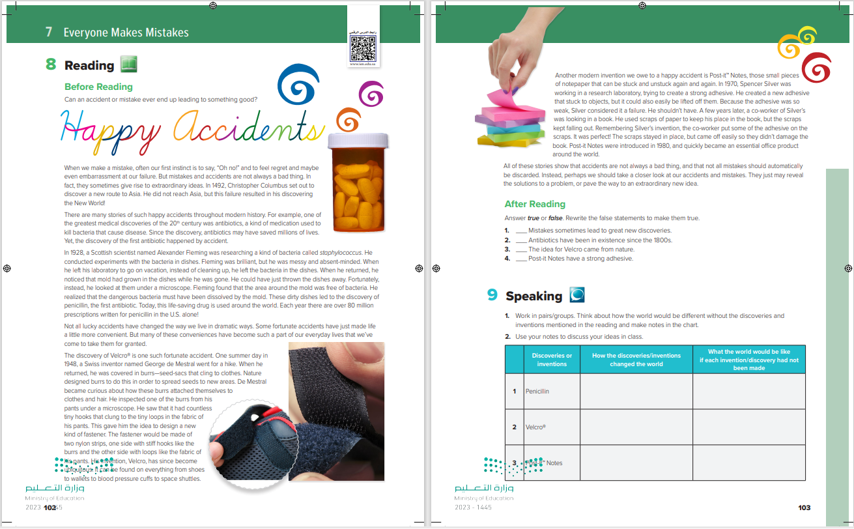

Students Book
P.102-103

Slide 6
6
1
7
2
3
Can an accident or mistake ever end up leading to something good?
………Title ?
……….Paragraphs?
Does anyone know how any of these objects were invented?
4
5
Notes:
e.g. Last week, I overslept one morning. I left my home a half hour later than usual, thinking I would be late for work. It turned out to be lucky. If I had left earlier, I probably would have been caught in an awful traffic jam, caused by a multiple car accident.

Slide 7
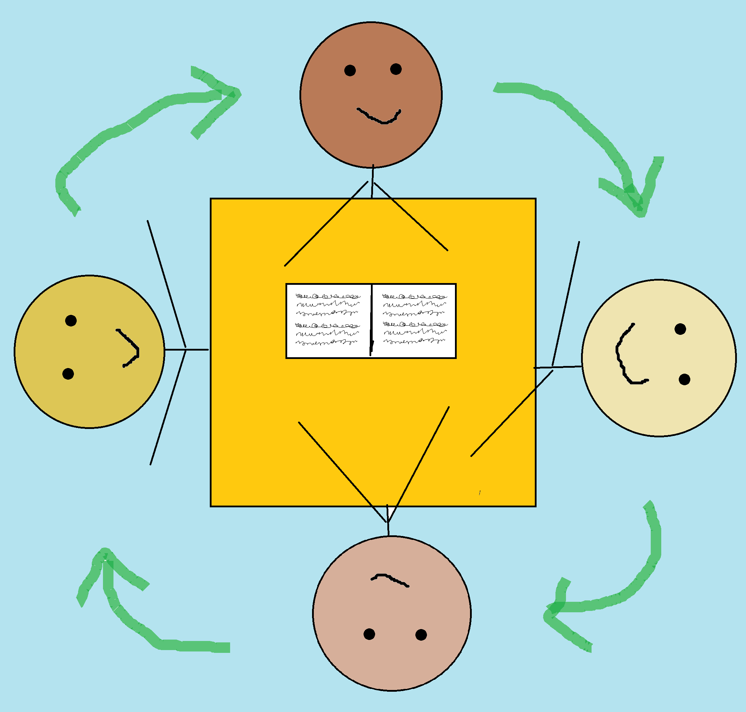
READING STRATEGY
Reciprocal Learning
Student 1 is the summarizer
Student 2 is the questioner
Student 3 is the clarifier
Student 4 is the predictor

Slide 8
How did using this strategy help you understand the article better?
Notes:
students read the first four paragraphs of the article silently. You might ask them to draw a line underneath the fourth paragraph before they begin reading as a reminder to stop-have them discuss what they read. The summarizer gives a brief summary of the paragraphs, retelling just the main points. -The questioner asks questions about any points that he or she is unsure about, or asks questions about the characters or content to extend the discussion. The clarifier tries to answer all of the questions. The predictor makes guesses about what the remainder of the article will contain-a Have groups repeat the procedure with the second half of the article. This time, ask group members to switch roles. Student 1 becomes Student 2, Student 2 becomes Student 3, Student 3 becomes Student 4, and Student 4 becomes Student 1

Slide 9



Read as long as you Listen

Slide 10
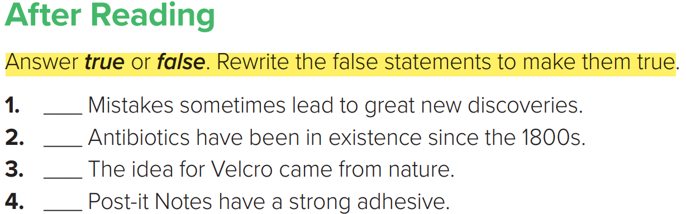

true
false
(The first antibiotic was discovered in 1928.)
true
false
(Post-it Notes have a weak adhesive.)

Slide 11
Speaking

Slide 12
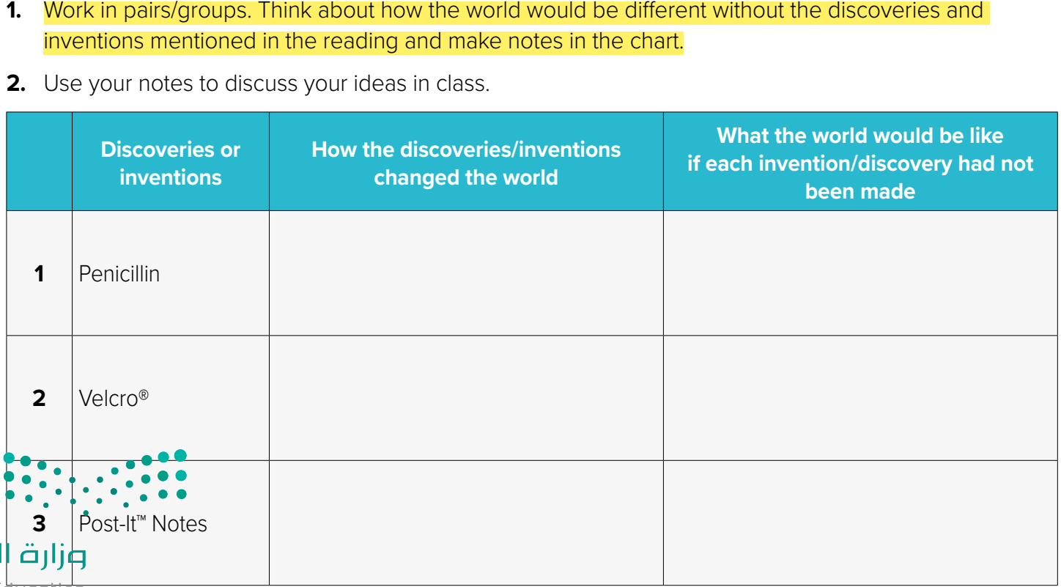


Slide 13
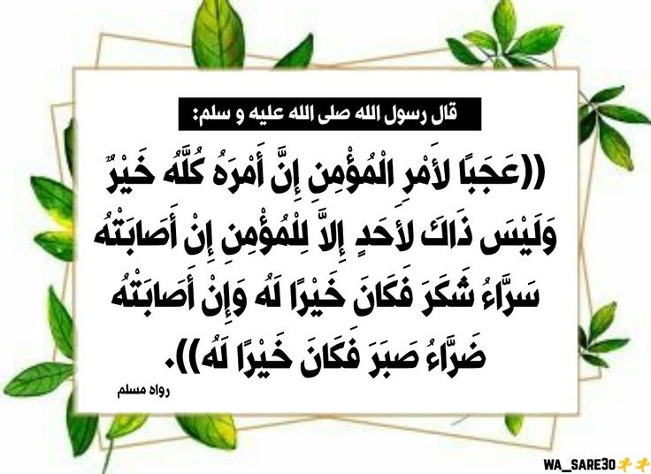

Slide 14

Funding
Hissah Alotaibi​

