Slide 1

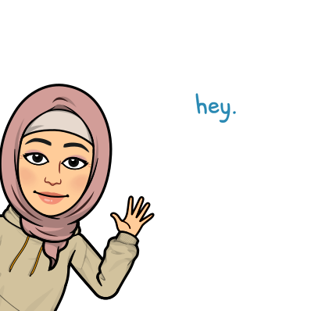
Good Morning

Slide 2

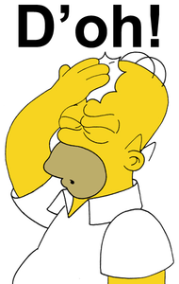

Mega goal.3.2
Everyone Makes Mistakes
Writing

Slide 3
Objectives:
Identify the paragraphs function
Describe the people in the text
Outline story about an accident
Jan
Feb
Mar
Apr
May
Jun
Jul
Aug
Sep
Oct
Nov
Dec
Jan
Feb
Mar
Apr
May
Jun
Jul
Aug
Sep
Oct
Nov
Dec
Find information about the text
Write a descriptive essay about an accident turned good

Slide 4
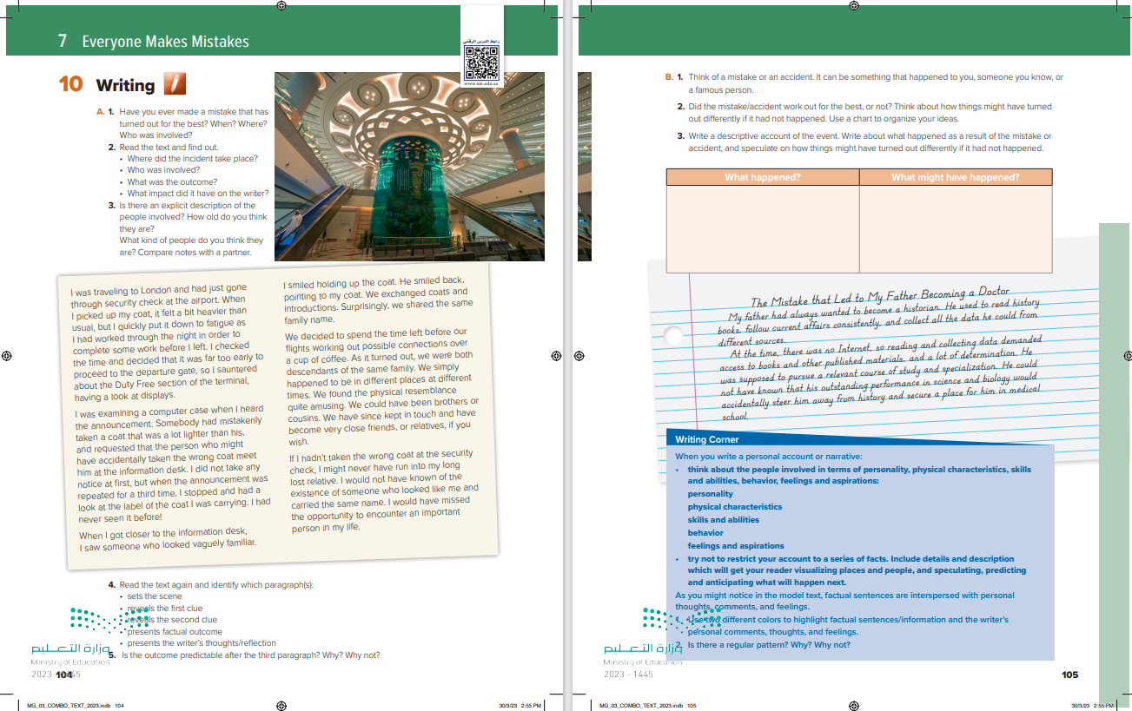

Students Book
P.104-105

Slide 5
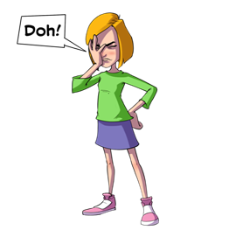

A. 1. Have you ever made a mistake that has turned out for the best? When? Where? Who was involved?

Slide 6
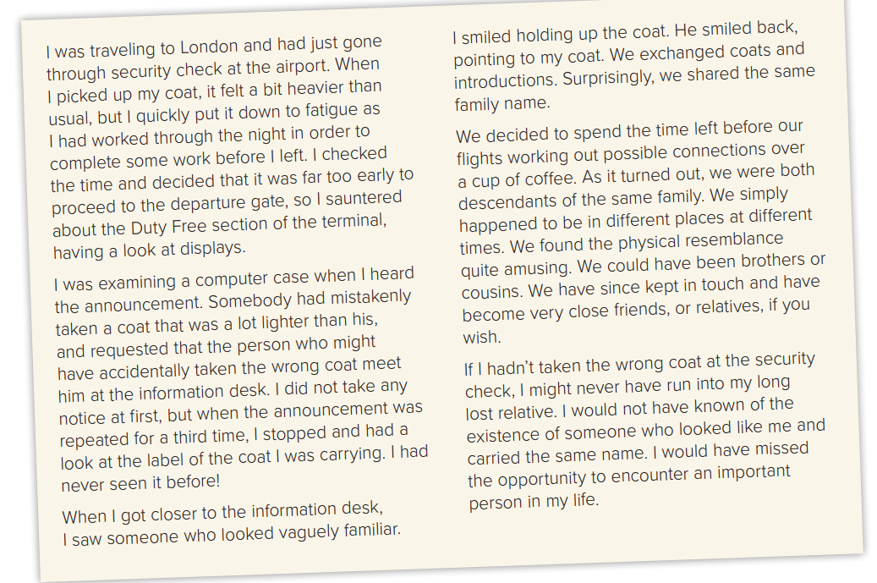

2. Read the text and find out.
• Where did the incident take place?
• Who was involved?
• What was the outcome?
• What impact did it have on the writer?
At the airport terminal
The writer and the person who looked like him and had the same family name.
They got to know each other and found out that they were descendants of the same family.
He gained a close friend and relative that he would never have met if he hadn’t mistakenly picked up the wrong coat.

Slide 7
3. Is there an explicit description of the people involved? How old do you think they are?
What kind of people do you think they are? Compare notes with a partner.

Slide 8
4. Read the text again and identify which paragraph(s):
• sets the scene
• reveals the first clue
• reveals the second clue
• presents factual outcome
• presents the writer’s thoughts/reflection
The first paragraph
The second paragraph
The Third paragraph
The Fourth paragraph
The Final paragraph
5. Is the outcome predictable after the third paragraph? Why? Why not?
• Yes, it is as there is mention of the fact that they looked alike and shared the same family name.

Slide 9
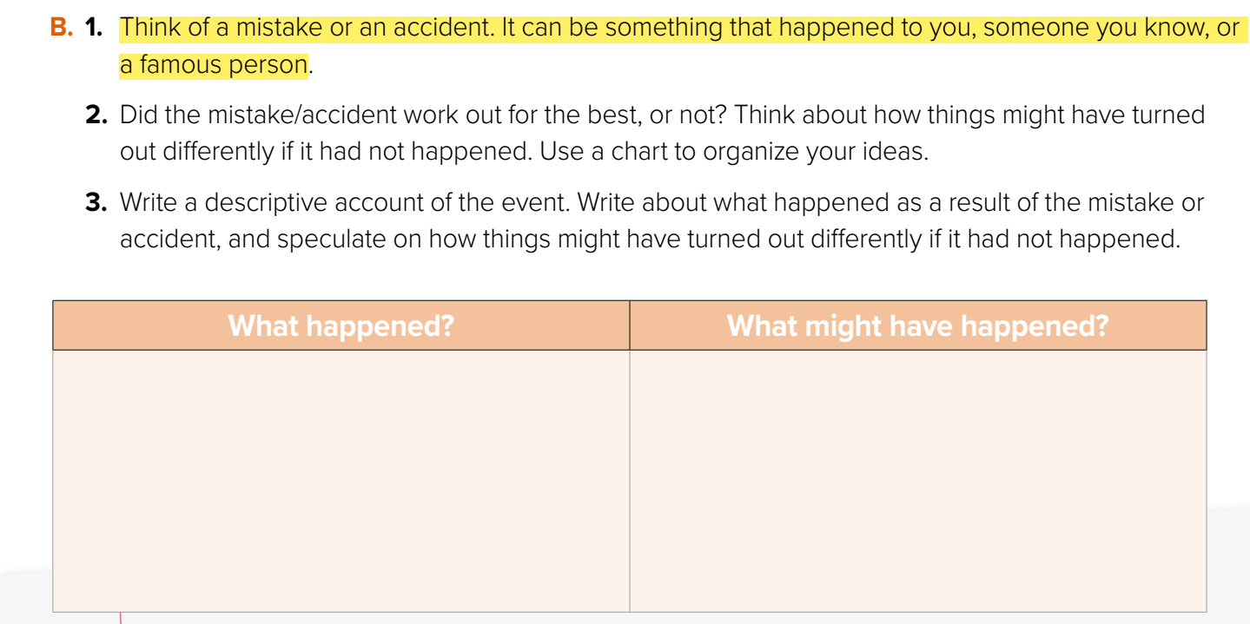

Slide 10
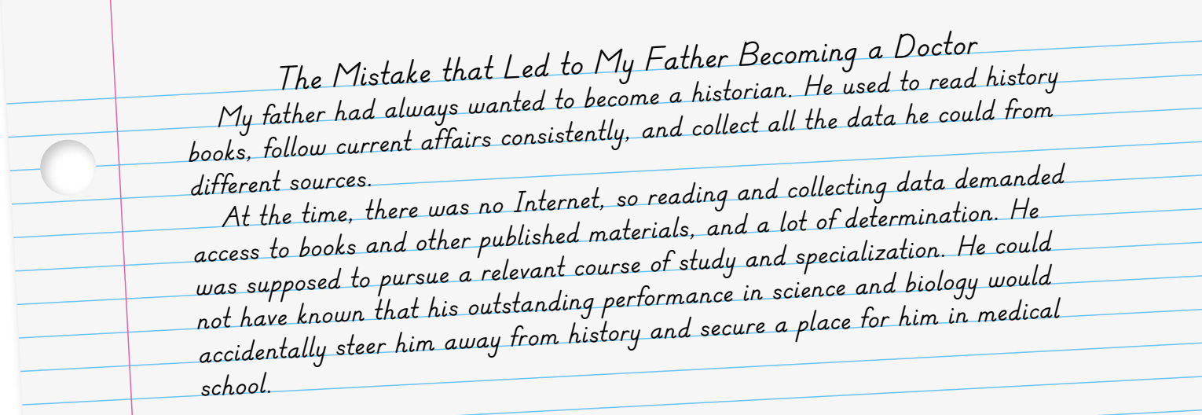

Slide 11
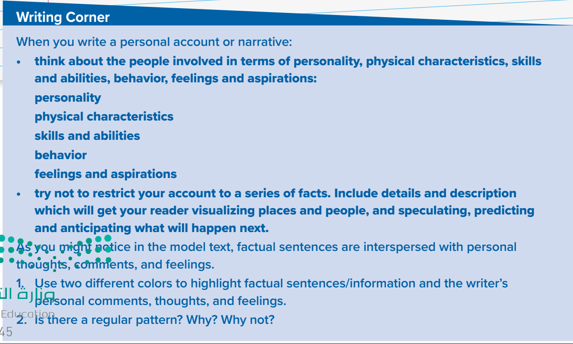

Slide 12

Funding
Hissah Alotaibi​

