Slide 1



Mega goal.3.2
The Gender Divide.
Writing

Slide 2
Objectives:
Act out a silent conversation
Write about communication approaches
Find information in the text

Slide 3

How do we communicate?
Do we mostly communicate through verbal or non-verbal language?
2. Try communicating these to your partner without speaking.
• Can I have your pen, please?
• Are you going to call me after school? • I went shopping yesterday.
3. Now write two of your own messages on a piece of paper, fold it, and set it aside or give it to your teacher. Use nonverbal language to communicate your message. Check. How successful were you?
4. “A picture is worth a thousand words.” Explain

Slide 4
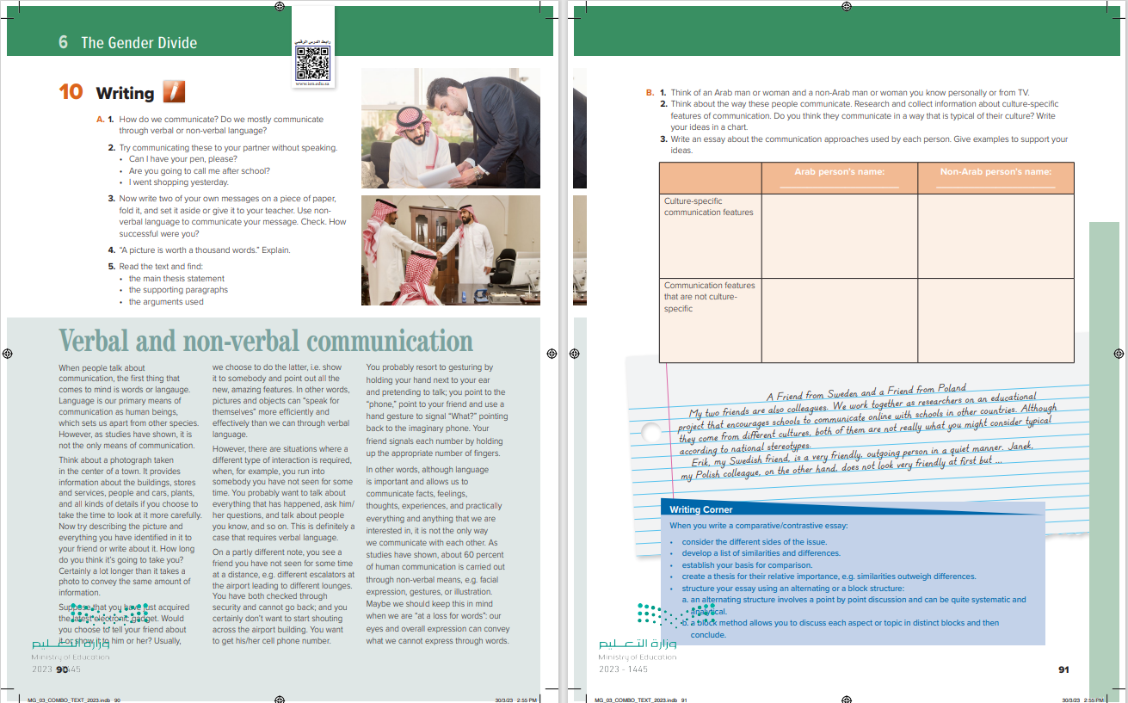

Students Book
P.90.91

Slide 5
What is the origin of each person in the picture?
Do they both come from the same country?
How do you think they communicate?

Slide 6

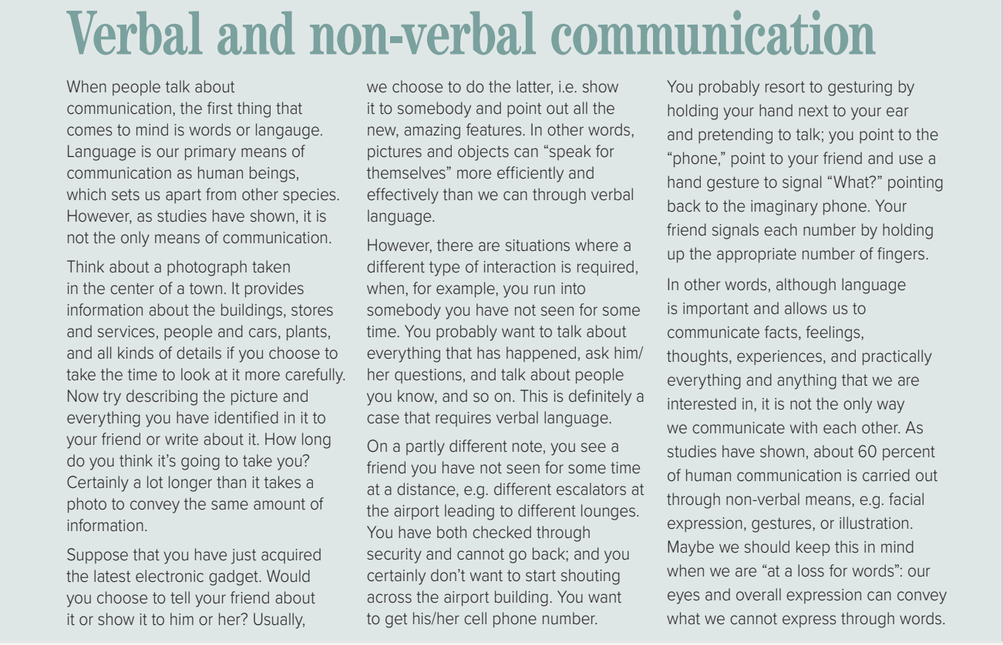


Read as long as You Listen

Slide 7
5. Read the text and find:
• the main thesis statement
• the supporting paragraphs
• the arguments used
Arguments: describing as opposed to looking at a photograph of the center of town (par.2)
• Showing or telling a friend about a new gadget (par. 3)
• Situations where verbal language is required, for example when running into someone you haven’t seen for a long time (par. 4)
• Having to communicate with someone at a distance/at the airport to get his phone number (par. 5)
• According t studies 60% of communication is carried out through non-verbal means. (par. 6)

Slide 8
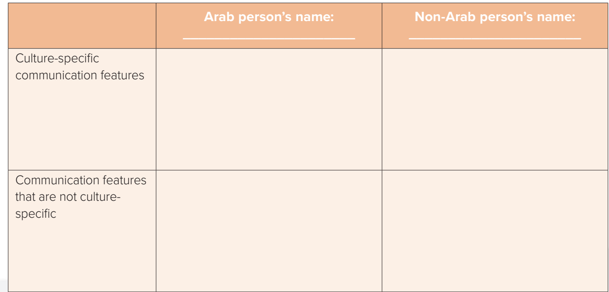
B. 1. Think of an Arab man or woman and a non-Arab man or woman you know personally or from TV.
2. Think about the way these people communicate. Research and collect information about culture-specific features of communication. Do you think they communicate in a way that is typical of their culture? Write your ideas in a chart.
3. Write an essay about the communication approaches used by each person. Give examples to support your ideas.

Slide 9
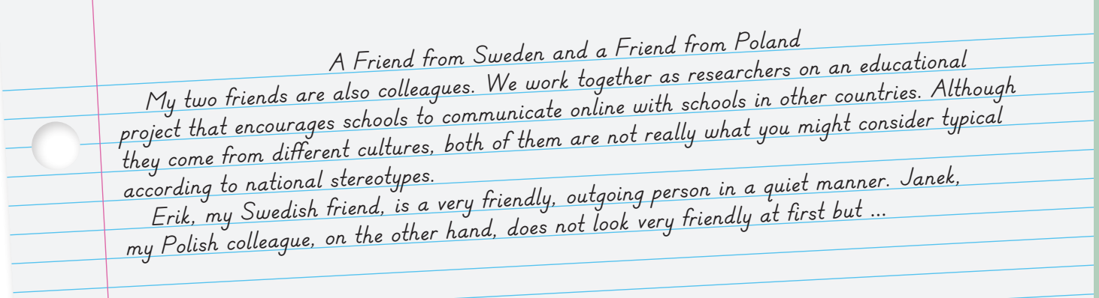
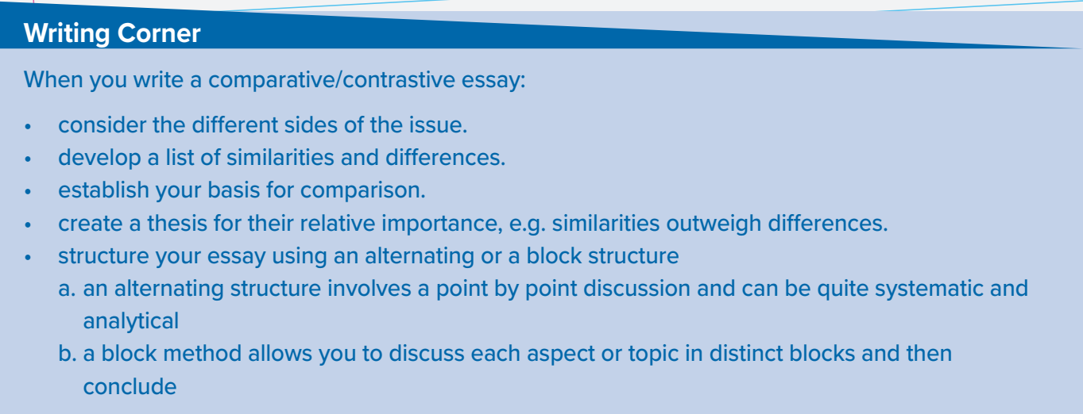

Slide 10


