Slide 1




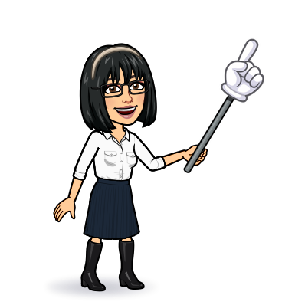

3 grammar
Today:
Date:
- -
Page 74
By: Dalal Al-Juaid

Slide 2


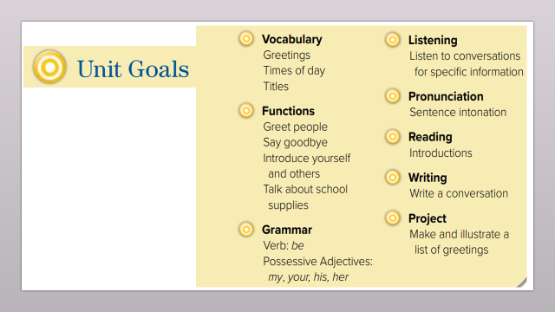
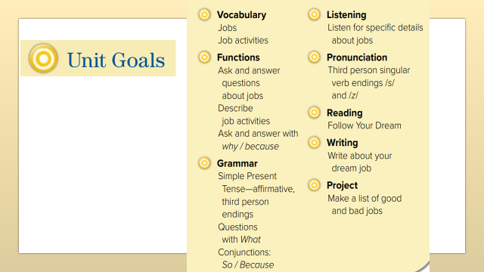
Use present simple tense in sentences
Build up questions and answers using ( what)
Warm up
1-Listen
Use ( what do you do ) to ask about jobs
New words
Quick check
2-Pair work

Slide 3
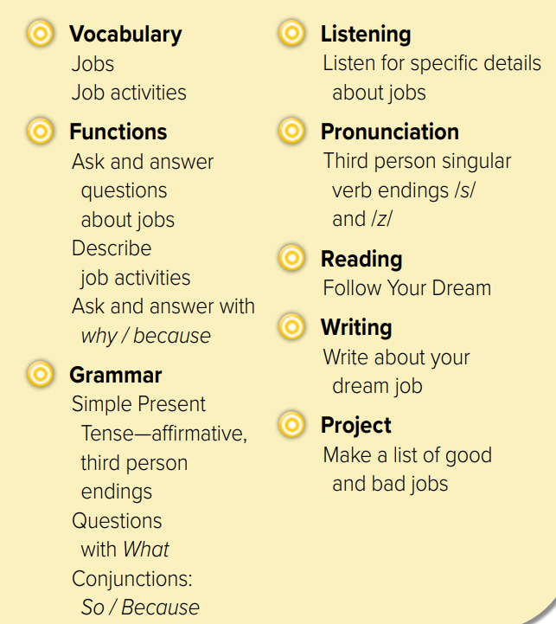
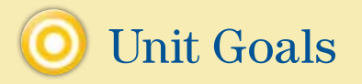

Slide 4
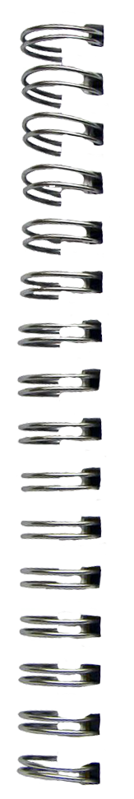



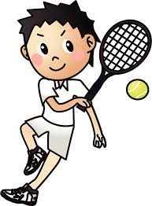


Revision
design clothes : ………
takes photo: ………
sells clothes: ………
….
…..
….
……

Slide 5









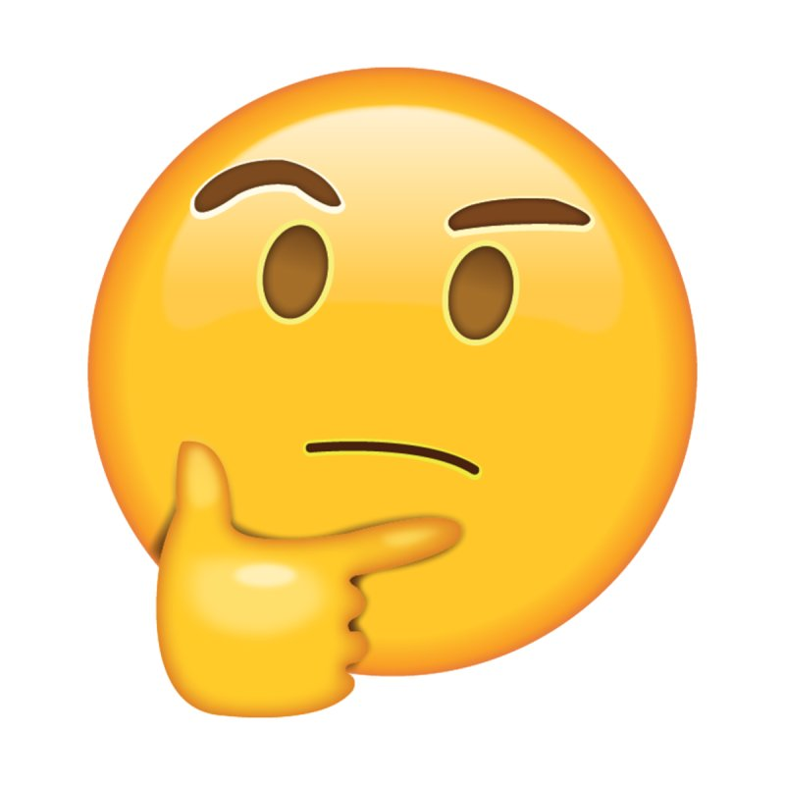
Answer with emoji
Warm up
1-Listen
Tennis player
New words
High-tech
lawyer
Quick check
photographer
mechanic
2-Pair work

Slide 6

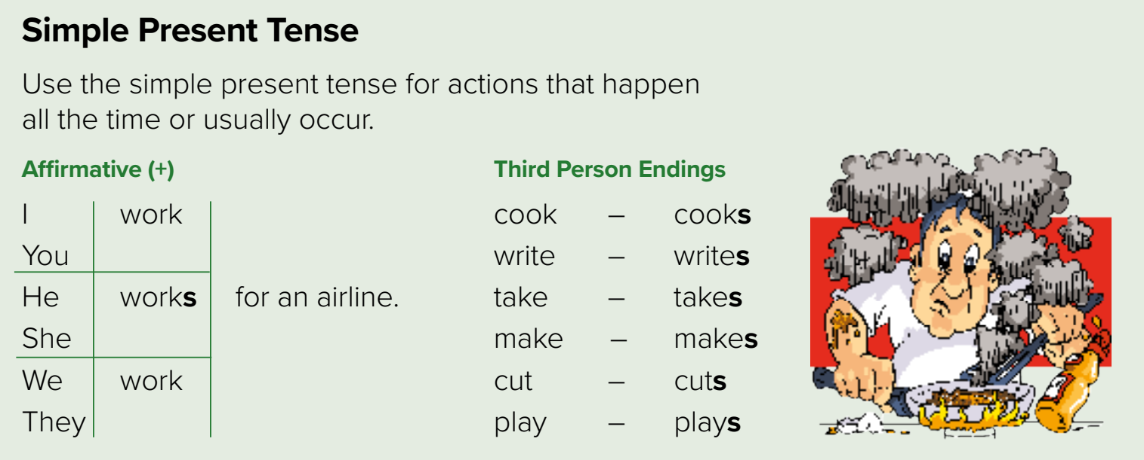













She
Page 74
S + V 1
V 1 - s
Warm up
1-Listen
New words
We read a book
reads a book
Quick check
You speak E
He
speaks E
2-Pair work

Slide 7
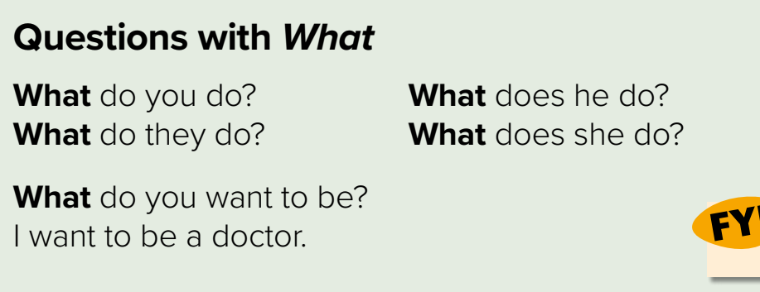












Page 74
(Q) H v + S + V 1
Warm up
1-Listen
New words
They read a book
What do they do?
Quick check
She writes
What does she do ?
2-Pair work

Slide 8
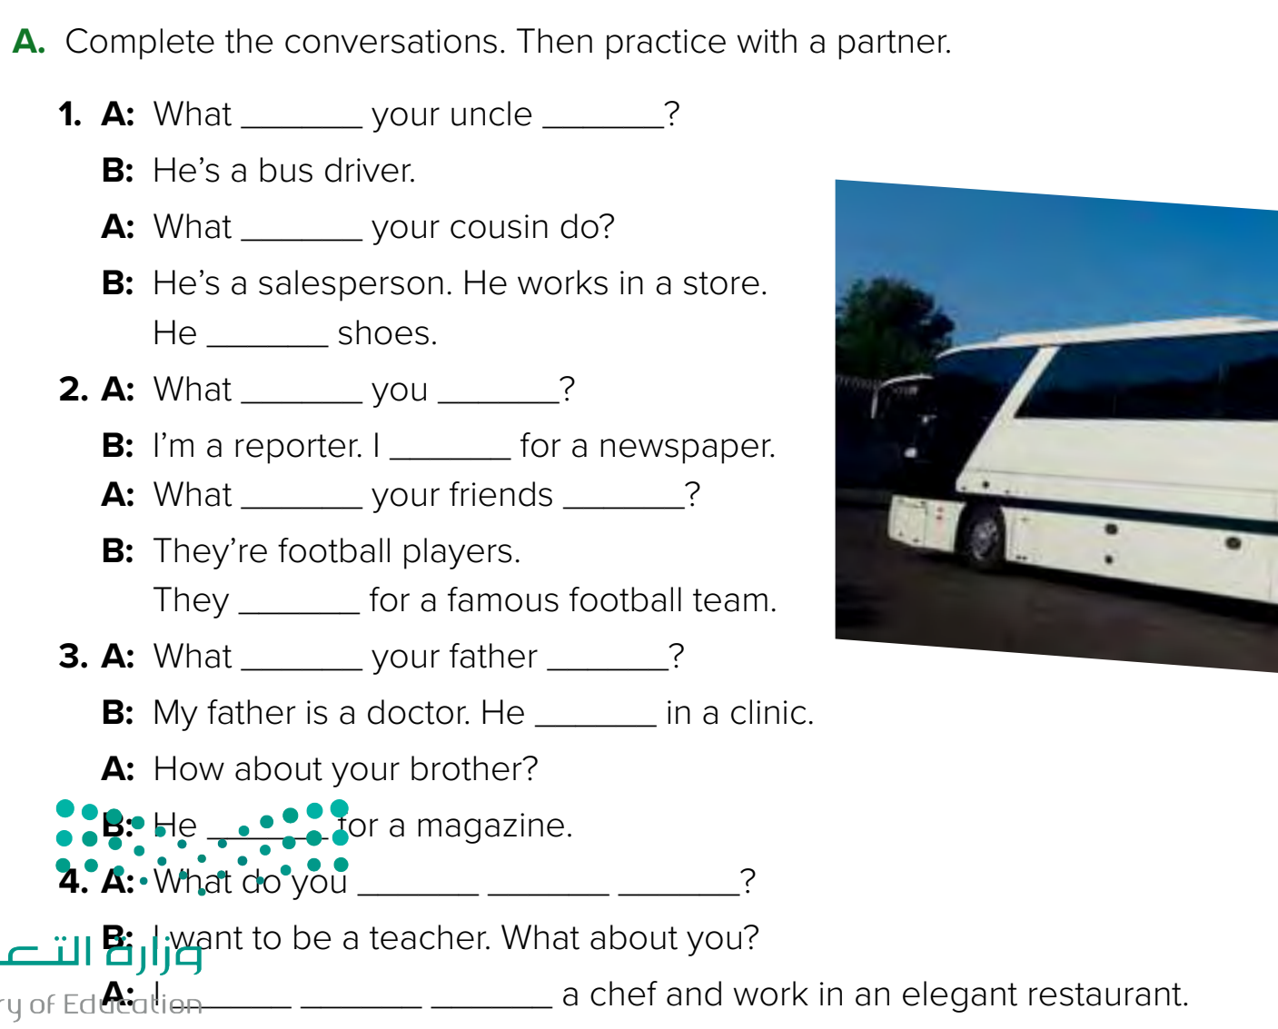

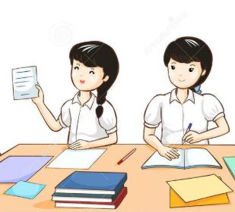
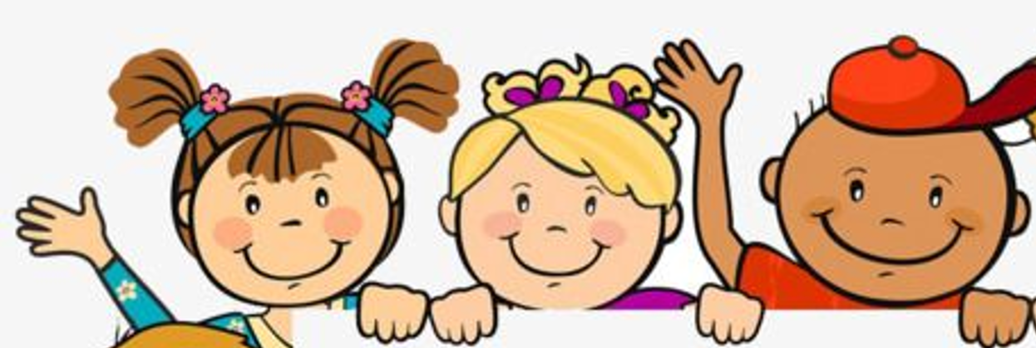
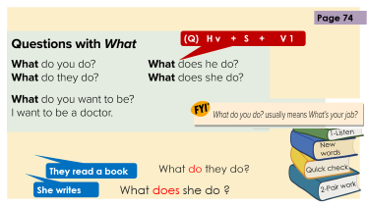

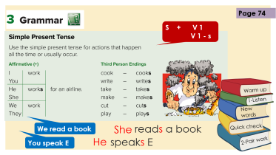

Page 74
does
do
does
sells
do
do
work
do
do
Think pair share
play
Warm up
does
do
1-Listen
works
New words
works
want
to
be
Quick check
2-Pair work
want
to
be

Slide 9
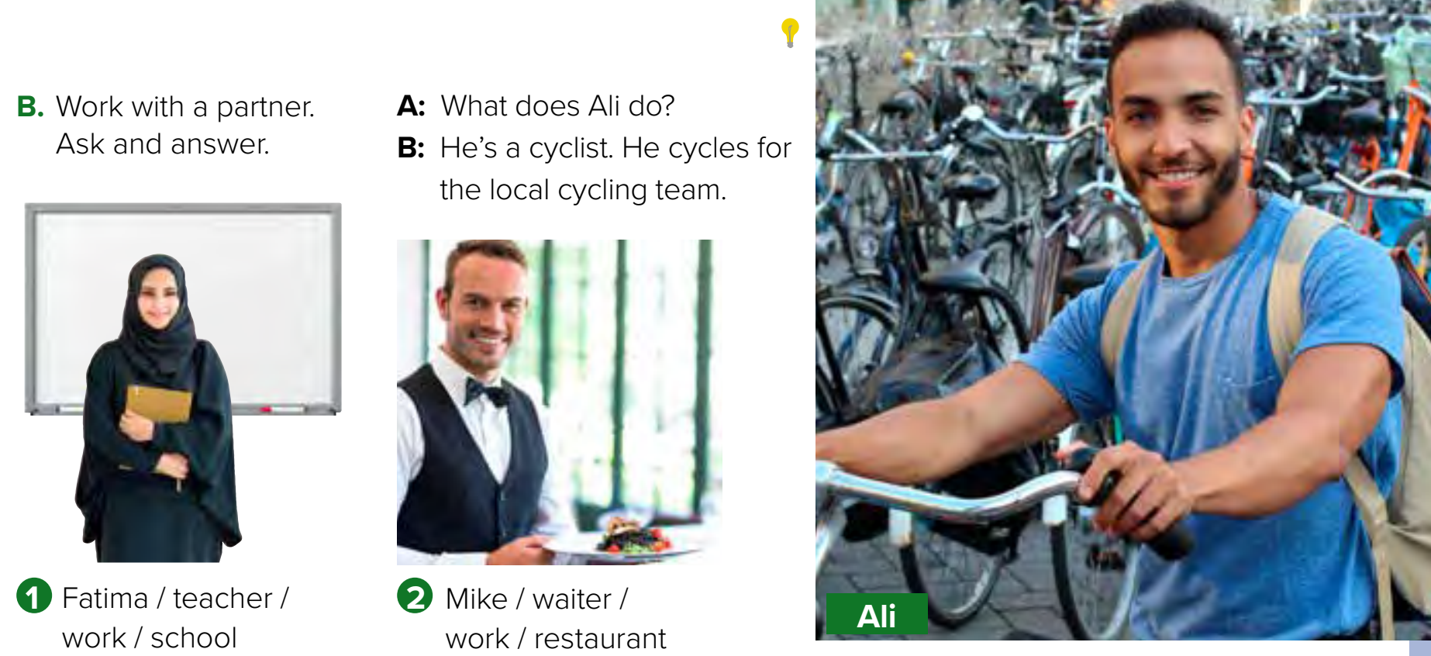
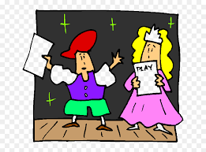

Page 75
Role paly
Warm up
1-Listen
What does she do?
What does he do?
New words
She’s a teacher. She works in a school.
He’s a waiter. He works in a restaurant.
Quick check
2-Pair work

Slide 10


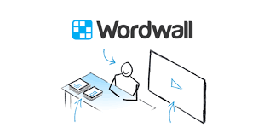
Lets play
Warm up
1-Listen
New words
Quick check
2-Pair work

Slide 11

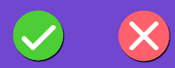
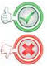
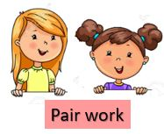
Name jobs in KSA?
 | 1- She work in school
 | 2- I reads a book
 | 3- What does they do ?
 | 4- What do you do ?
 | 5- He plays football
 | 6- What do she do ?
 | 7- My father work in a bank
 | 8- What does your mom do?
 | 9- Khaled & Ahmad play
 | 10- He drives a taxi
Warm up
1-Listen
3 class group
New words
Quick check
2-Pair work

Slide 12
Write in your notebook
Like final test أسئلة للاختبار النهائي
Choose:
Mmmmmmm ………. mmmmmmm
( ssss – ssss – sssss)
Make a question

Slide 13





page 222 Ex(B)
for practice grammar
Warm up
1-Listen
New words
Quick check
2-Pair work

Slide 14
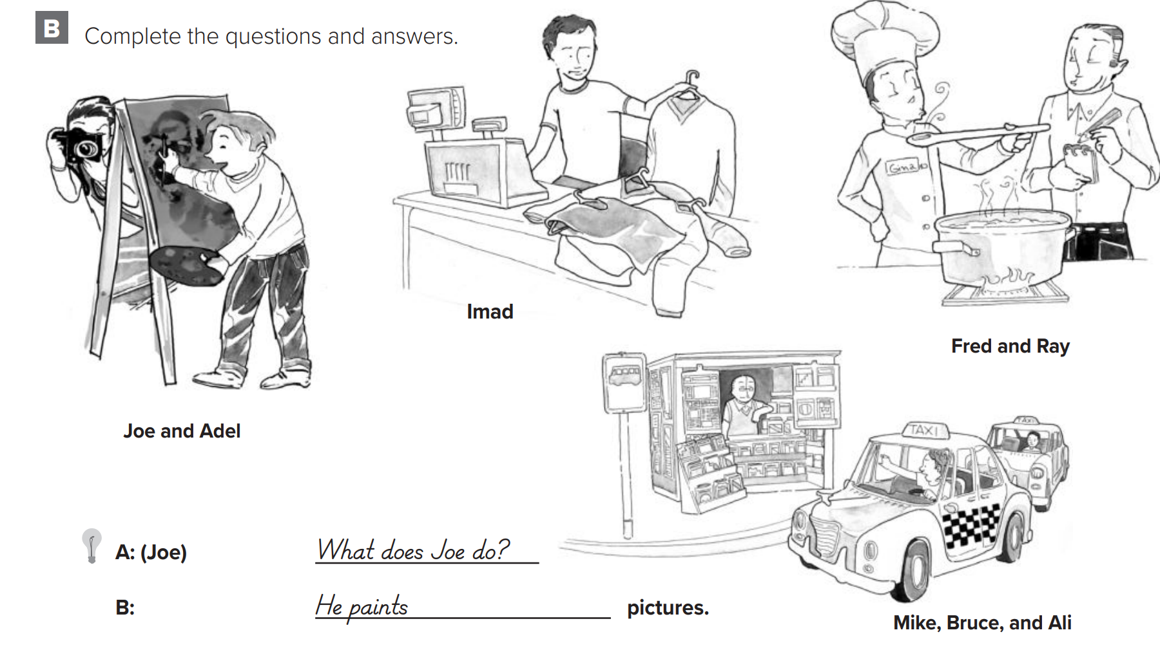
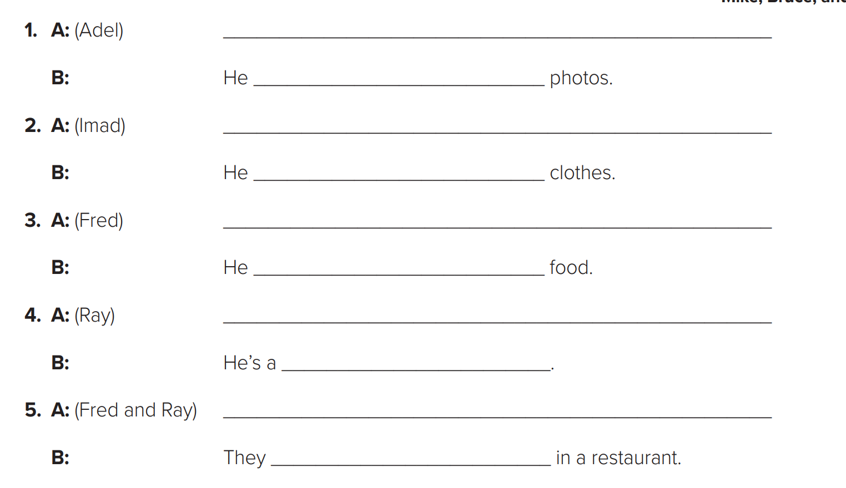
p.222
What does Adel do ?
takes
What does Imad do ?
sells
Warm up
What does Fred do ?
1-Listen
cooks
New words
What does Ray do ?
waiter
Quick check
What do Fred & Ray do ?
work
2-Pair work

