Slide 1

Unit 8 What’s wrong?
Workbook pages (217 – 220)

Slide 2
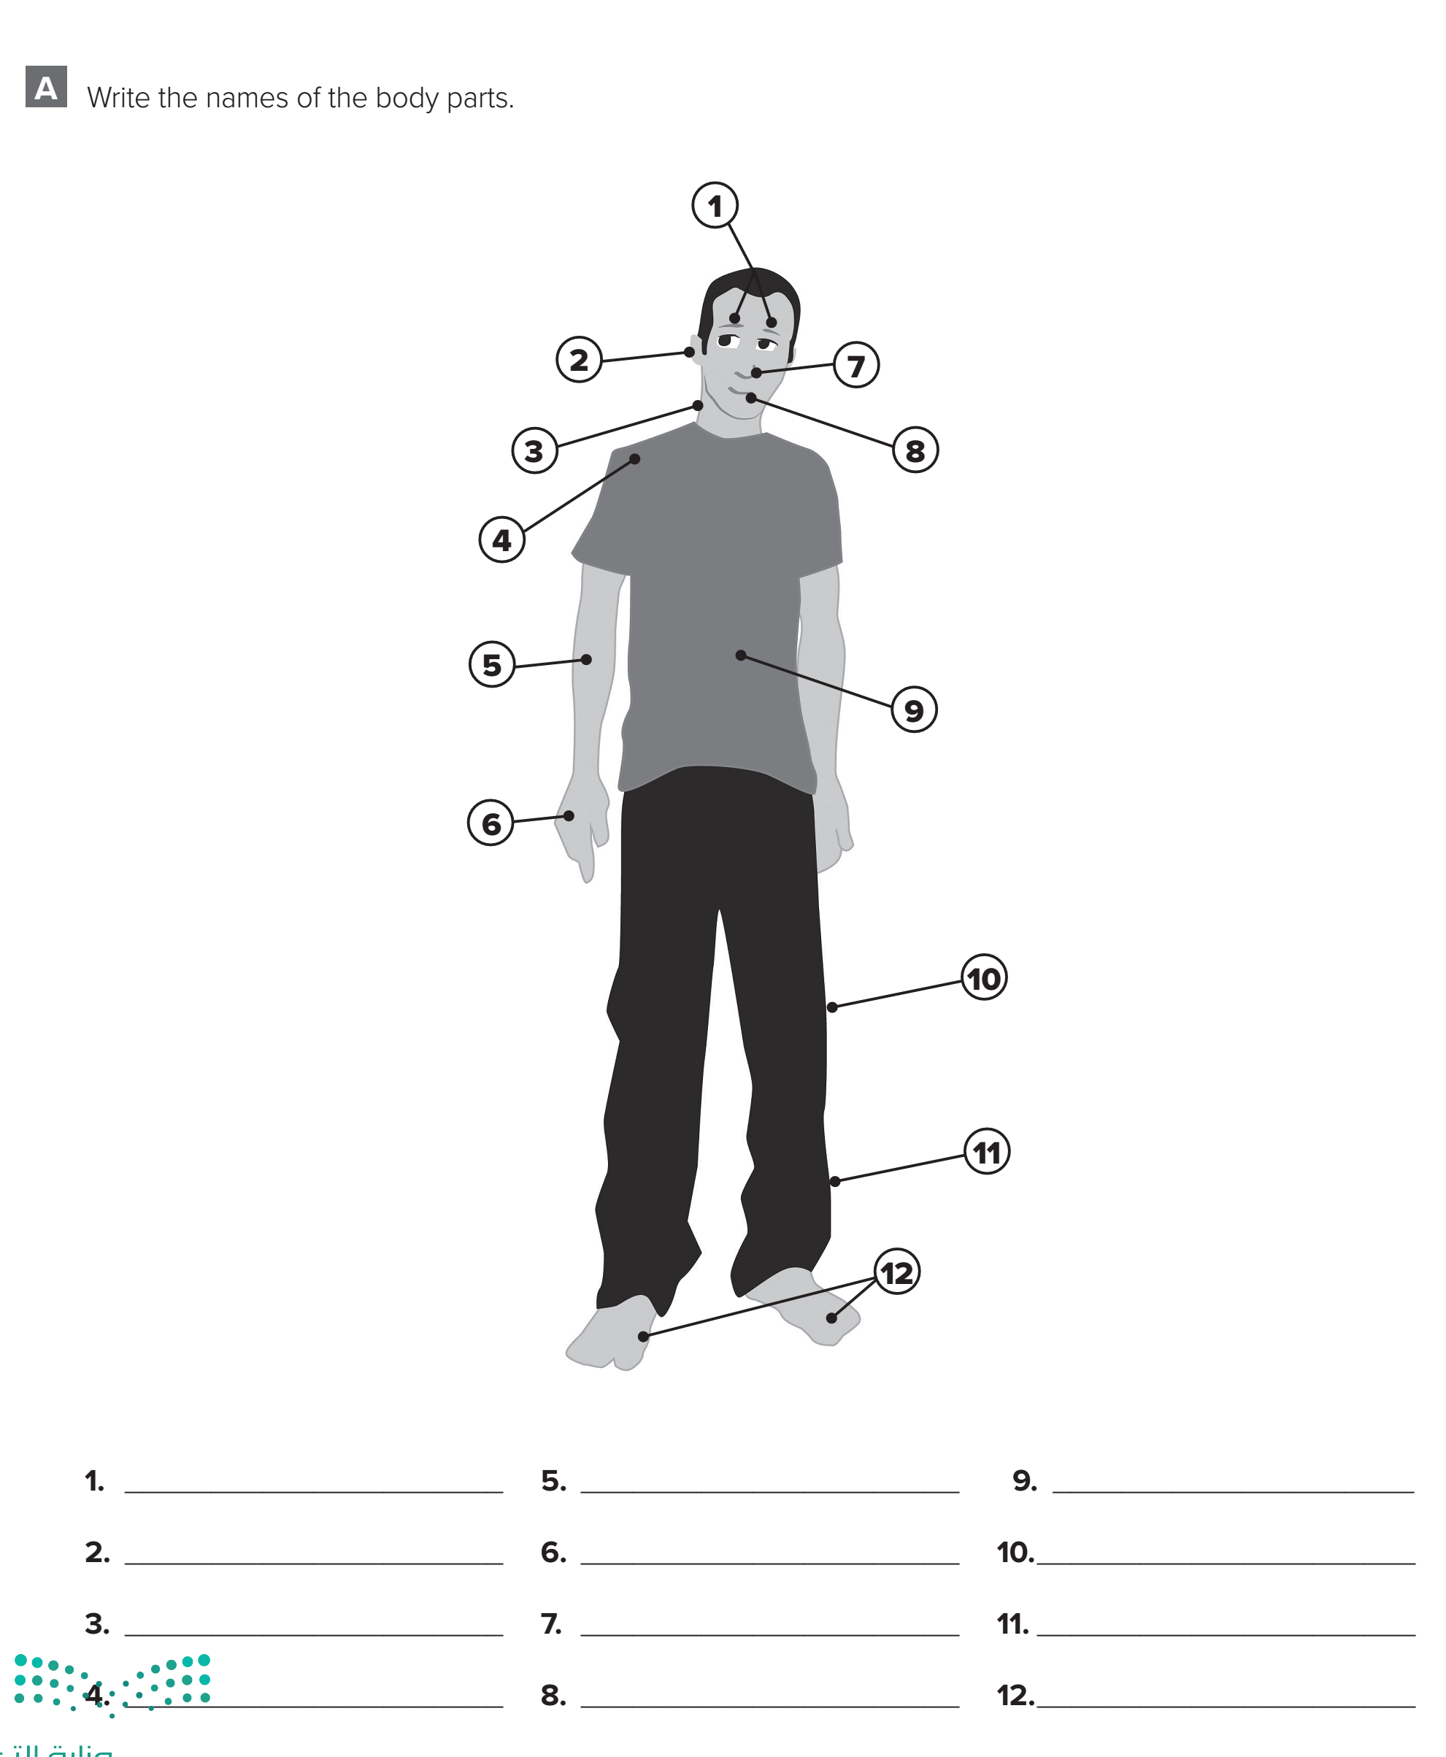

p.217
eyes
arm
stomach
ear
hand
knee
neck
nose
leg
shoulder
mouth
feet

Slide 3
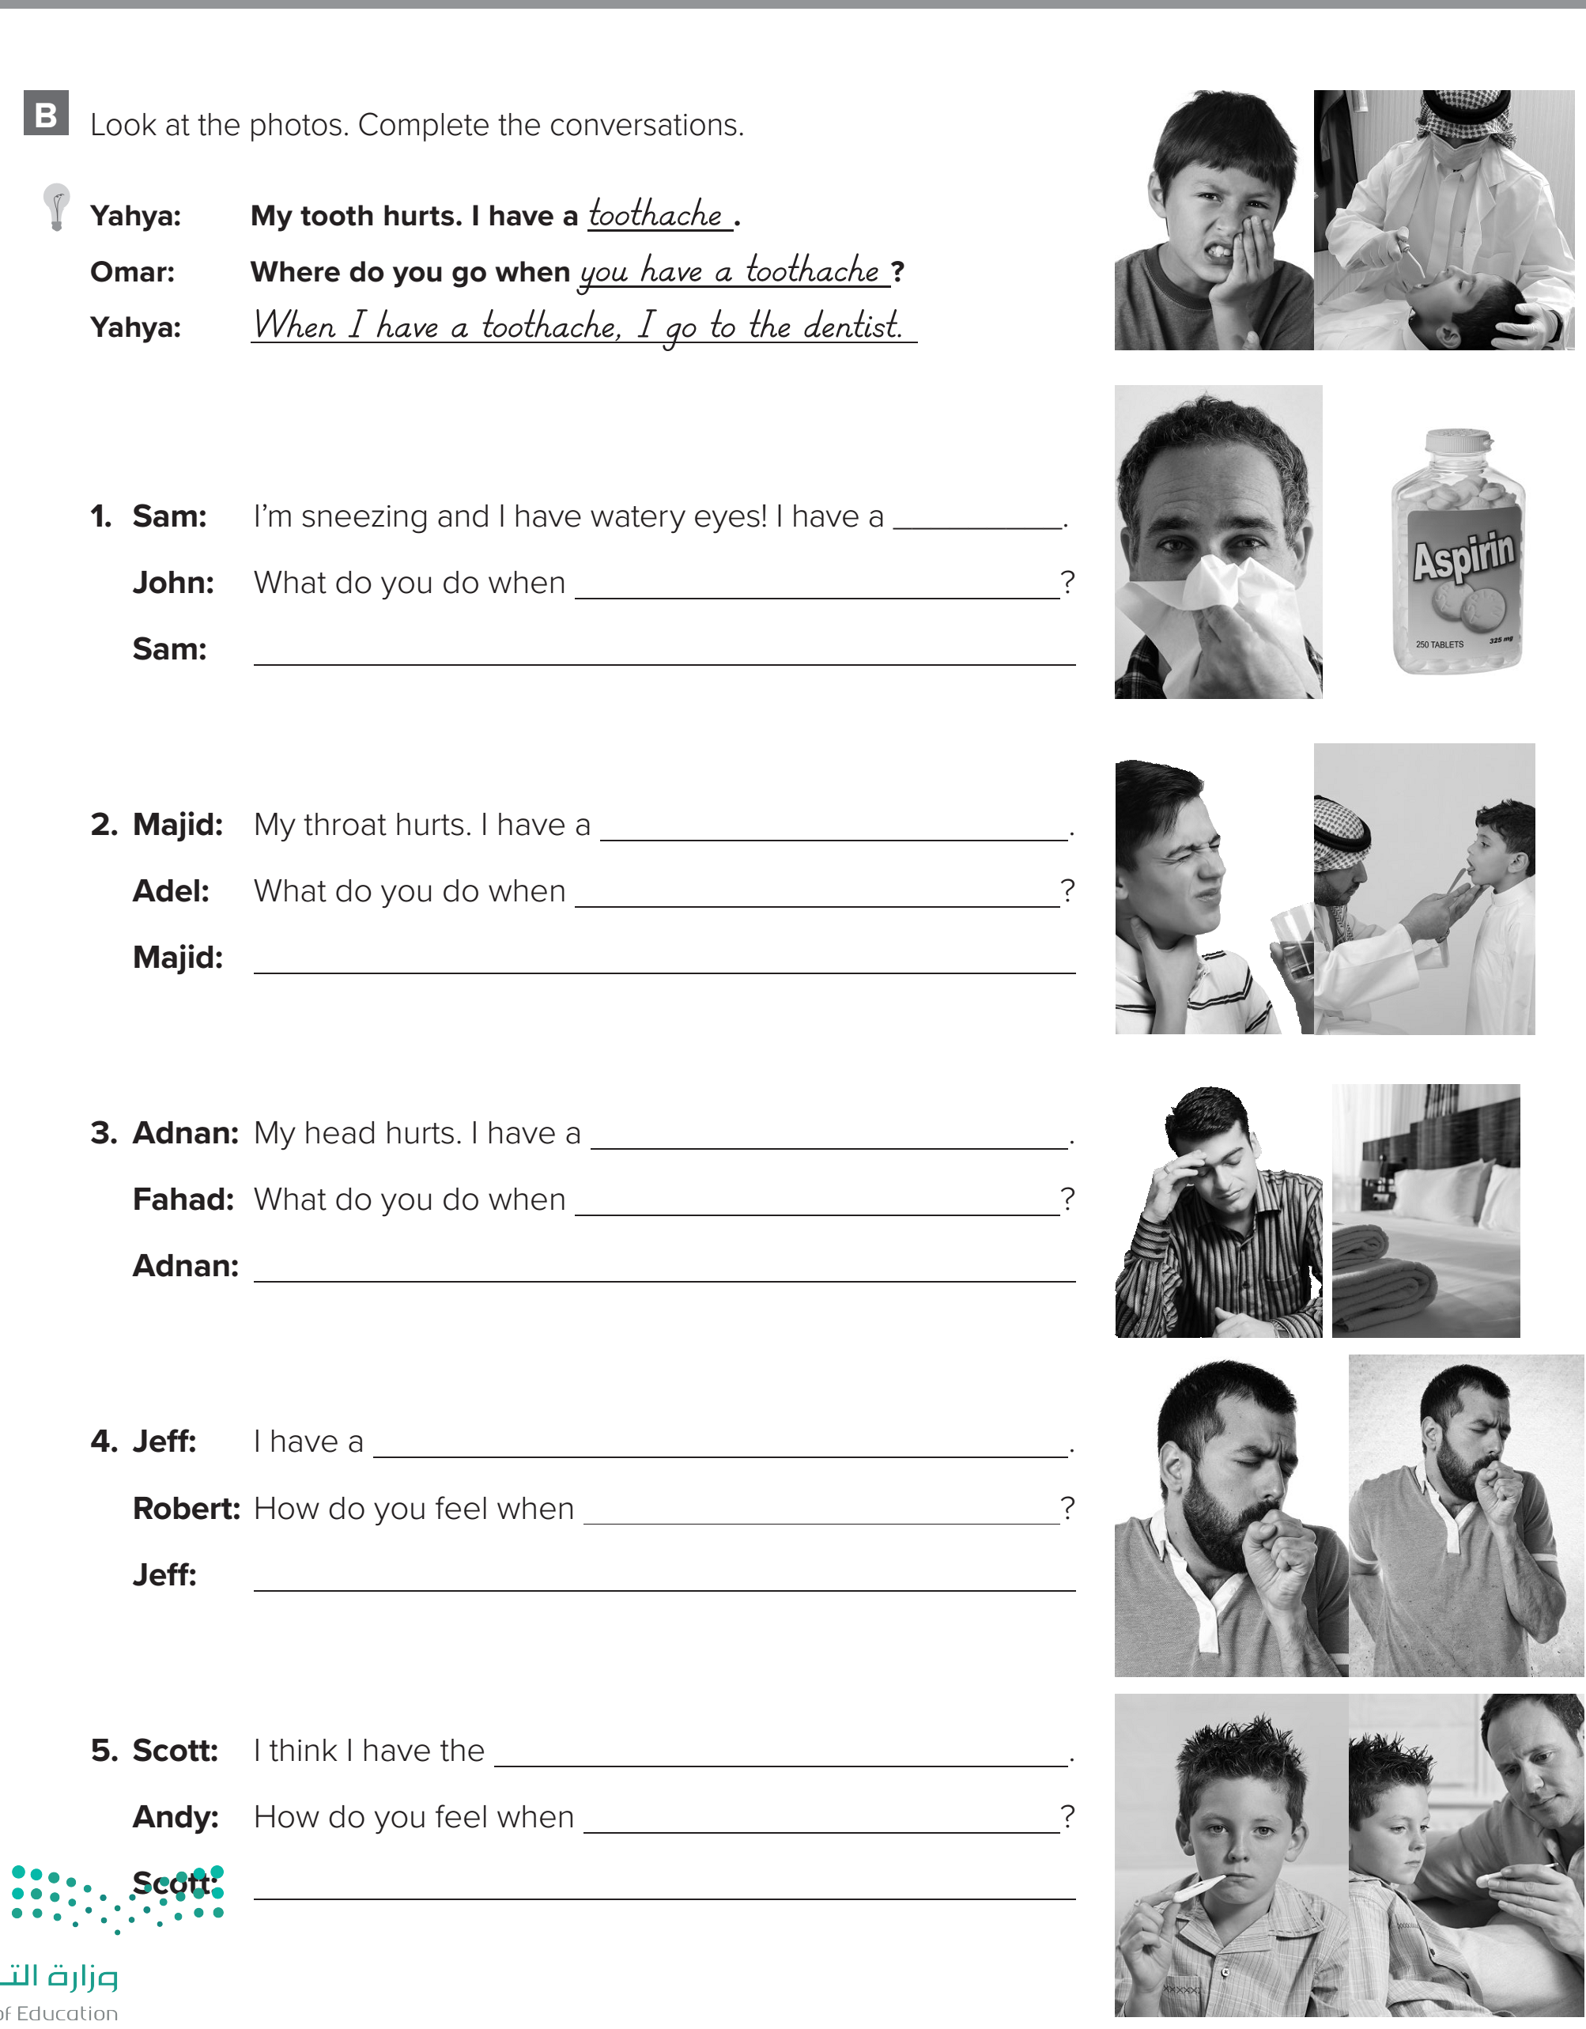

p.218
cold.
you have a cold?
When I have a cold, I take aspirin.
sore throat.
you have a sore throat?
When I have a sore throat, I go to
the doctor.

Slide 4

p.218
headache
you have a headache?
When I have a headache, I go
to bed.
cough.
you have a cough?
When I have a cough, I have
a sore chest.
flu.
you have the flu?
When I have the flu, I have
a headache and I have a fever.

Slide 5

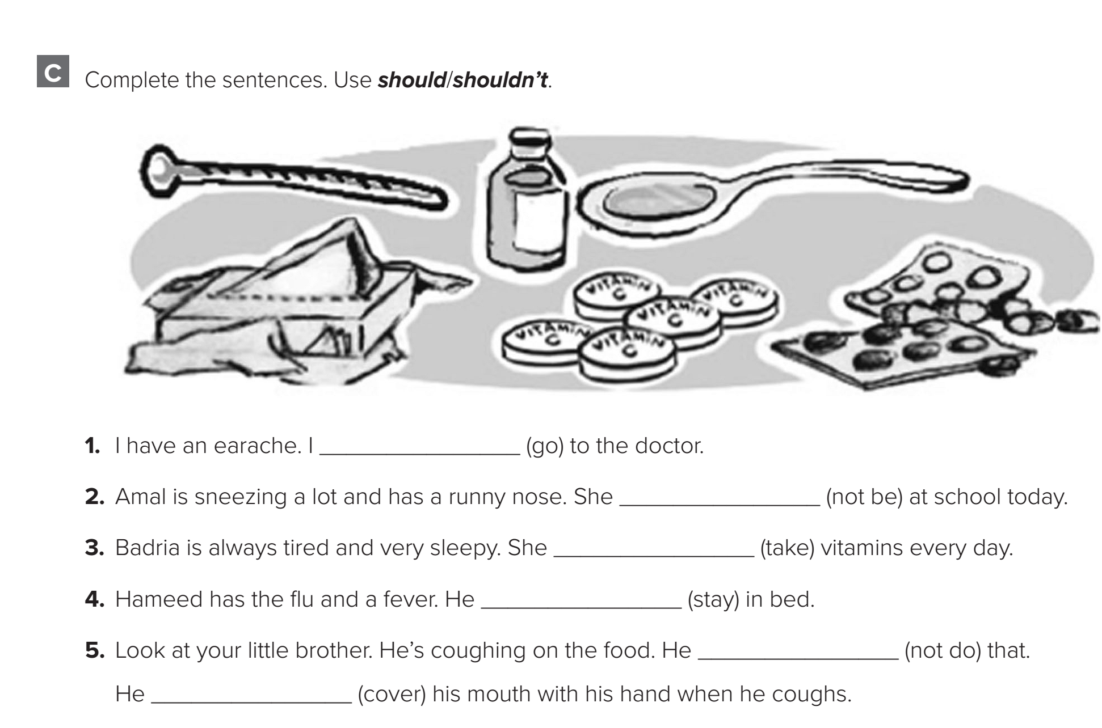
p.219
should go
shouldn’t be
should take
should stay
shouldn’t do
should cover

Slide 6
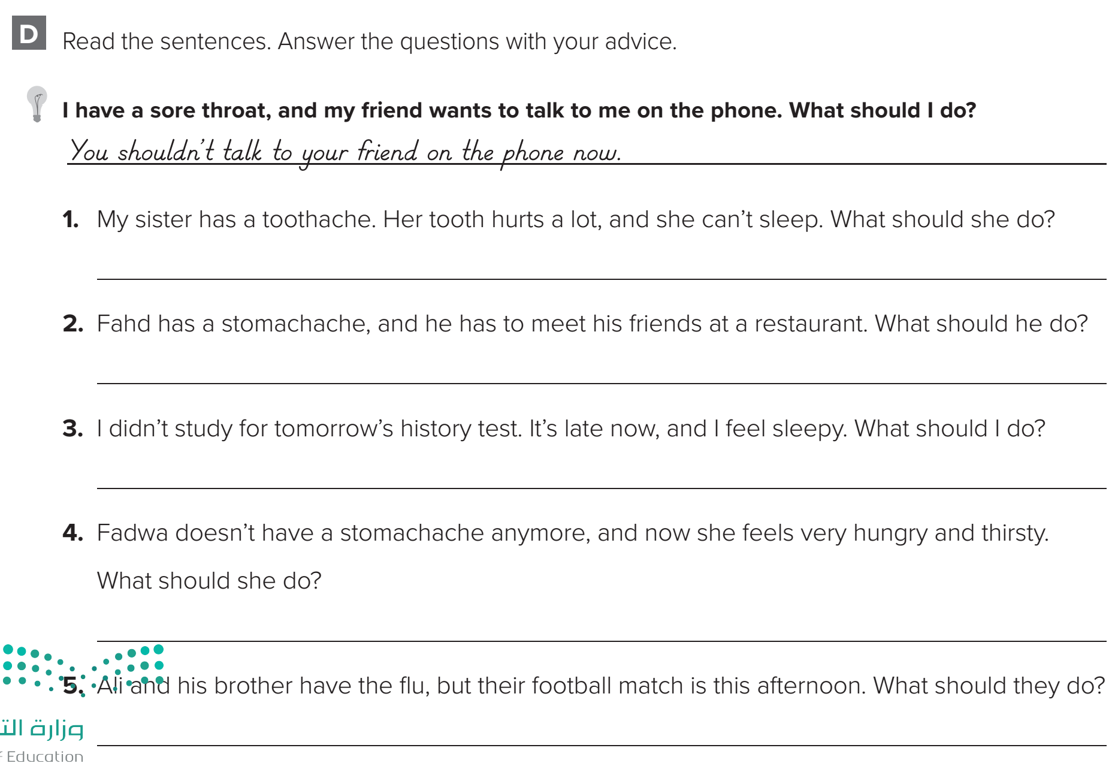

p.219
She should go to the dentist.
He shouldn’t meet his friends at a restaurant.
You shouldn’t study now.
She should eat some soup and drink some juice.
They shouldn’t play football this afternoon.
They should stay in bed.

Slide 7
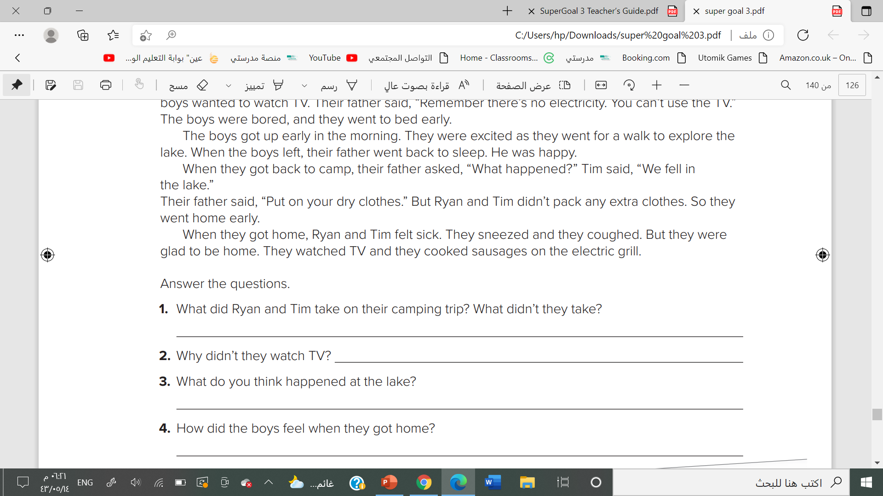
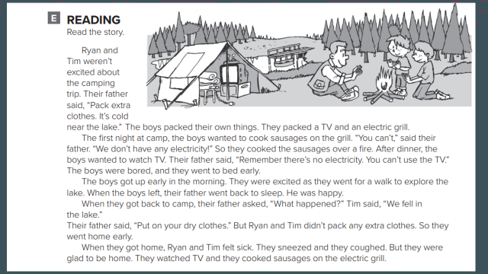
p.220
They took a TV and an electric grill. They didn’t take extra clothes.
Because they didn’t have any electricity.
They wanted to fall in the lake because they wanted to go home
They felt sick when they got home.

Slide 8
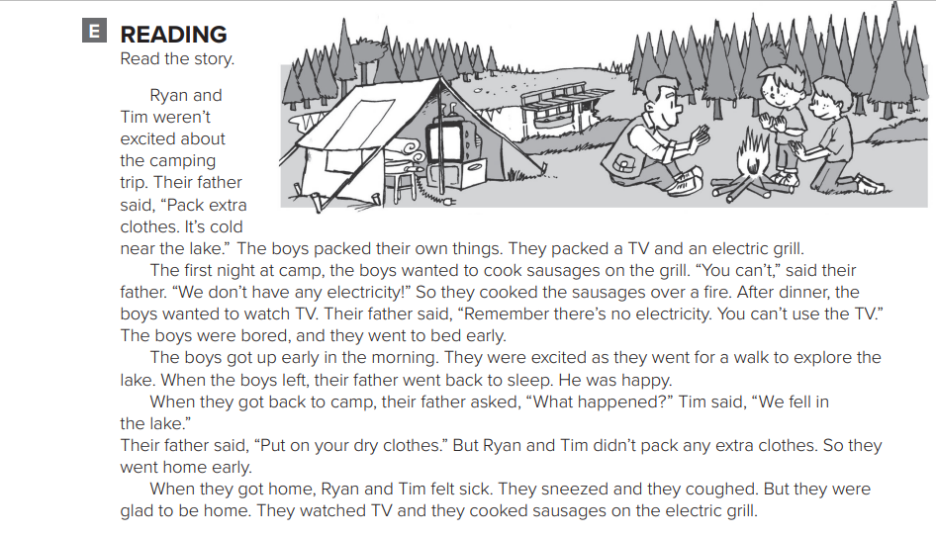

Slide 9
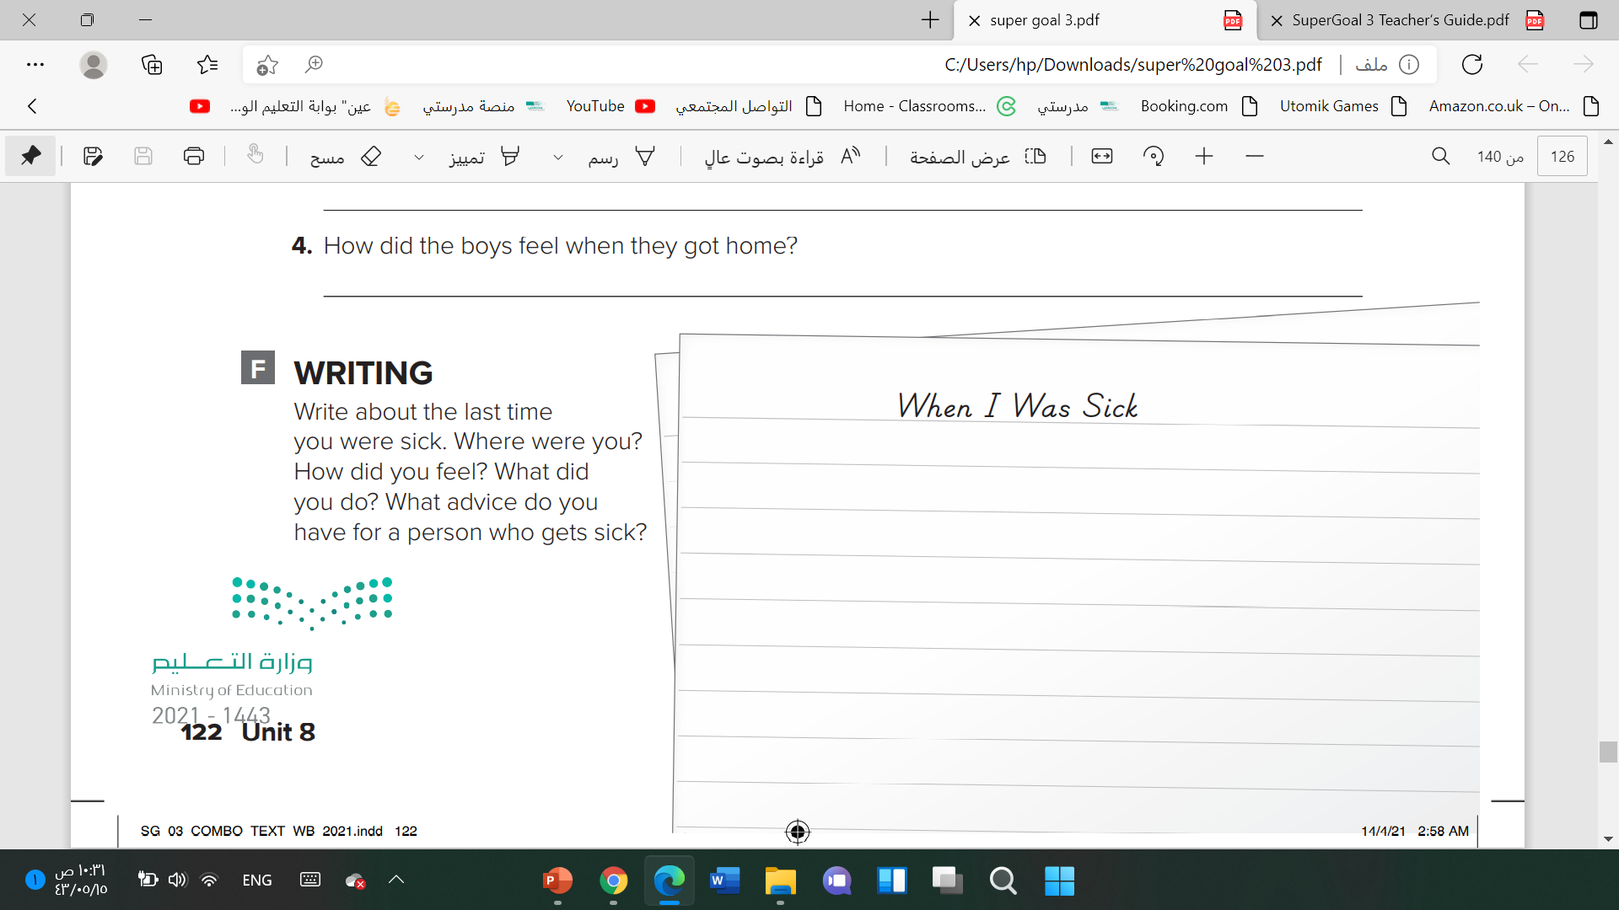

p.220
I was sick on vacation last winter. We were on a trip. I was already sick when I arrived. I had a sore throat and a headache. I still went shopping. That was not a good idea. When I finished shopping, I had a fever and an earache. I stayed in bed the rest of the vacation. When you start to feel sick, you shouldn’t go out!

