Slide 1



Slide 2
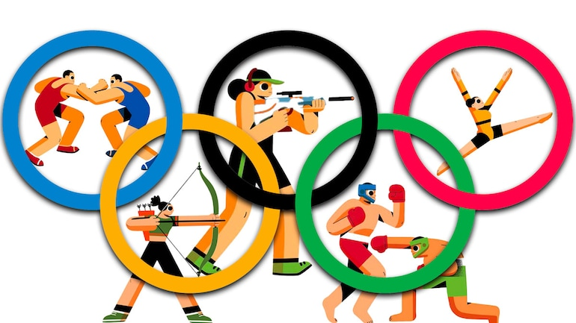
Uint-4-
The Sporting Life

Slide 3
Listen & Discuss
Pair Work

Slide 4
Objectives
Infer the important information form a text.
Design an Olympic flag.
To use new words in sentences
List facts about the Olympics
To explain the main ideas of a text
Conclude sentences about the Olympics.
Write sentences using new words.
Correct information according to the text.

Slide 5
Listen & Discuss

Slide 6
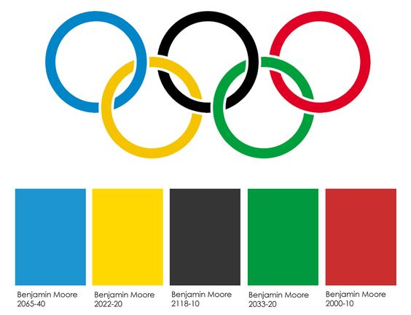







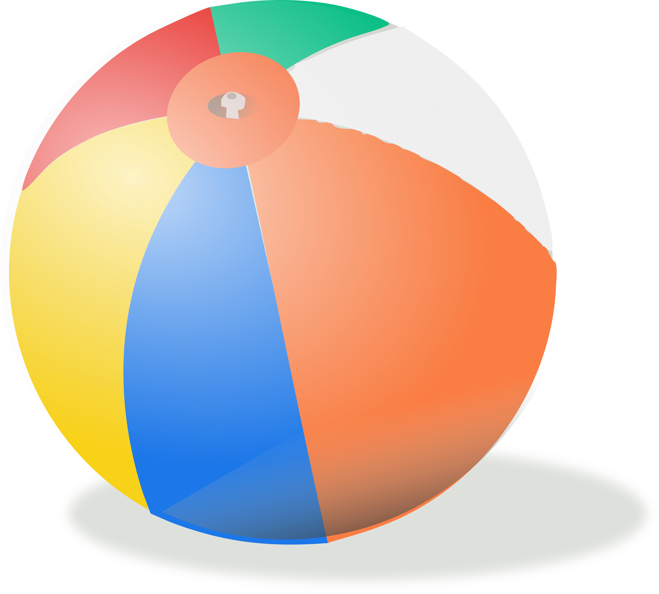
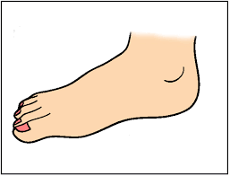

Let’s solve the PUZZLE
Warm Up
What’s the sport?
s
ing
ing

Slide 7
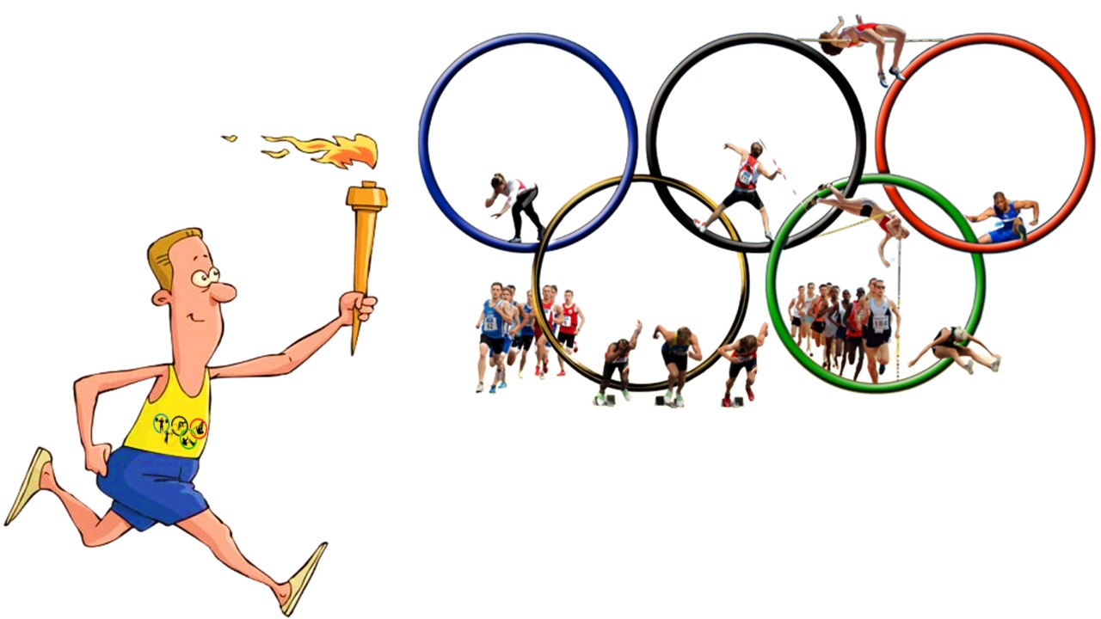

Warm Up
What do the pictures refer to?
How often do they occur?
Have you ever seen the Olympic Games, either in person or on television?
What sports are included?
What is your favorite sport to watch during the Olympics?
Have you ever met an Olympic athlete?

Slide 8
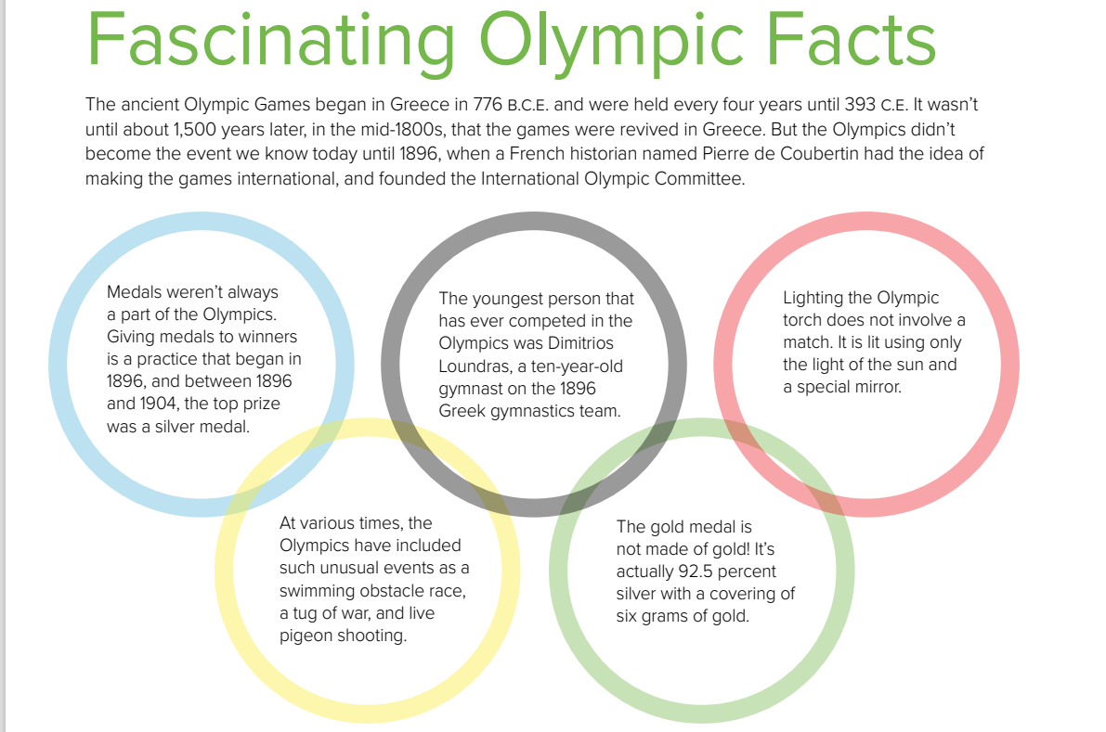
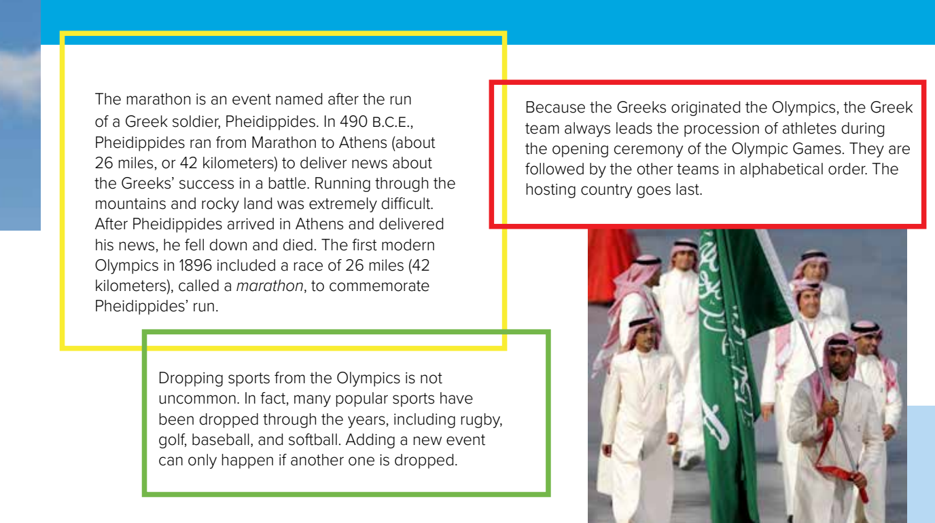


Read along as you listen

Slide 9
When
Names & Dates
was the youngest person
competed in the Olympic Games ?
were medals
given to winners?
was a marathon game
included in the Olympic Games ?
did the Olympic Games become
international?
were the Olympic Games
revived?
did the Olympic Games
begin?
Scan
776 BCE
began
Mid-1800s
revived
1896
international
Youngest athlete
Giving medals
Marathon

Slide 10
Who
was the messenger
about the Greeks’ success?
had the idea of making
the games international?
was the youngest person competed in the Olympic Games?
originated
the Olympic Games?
Scan
a French historian
Pierre de Coubertin
a Greek soldier Pheidippides
a Greek gymnast
Dimitrios Loundras
the Greek

Slide 11
Vocabulary
.. stand for?
Before the Common Era
the Common Era
A word means
a game in which two teams pull on a rope
A word means
Something used to start a fire

Slide 12
A word means
A member of the military
A word means
Excluded or removed from a group

Slide 13
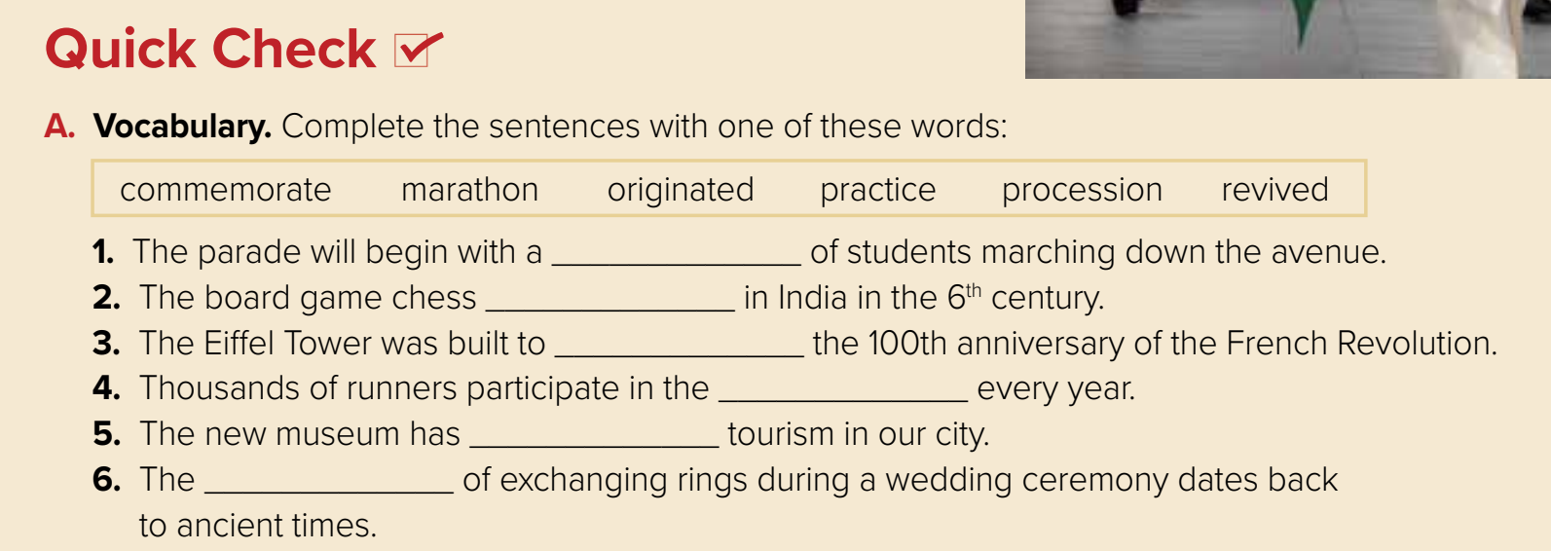
procession
originated
commemorate
marathon
revived
practice

Slide 14
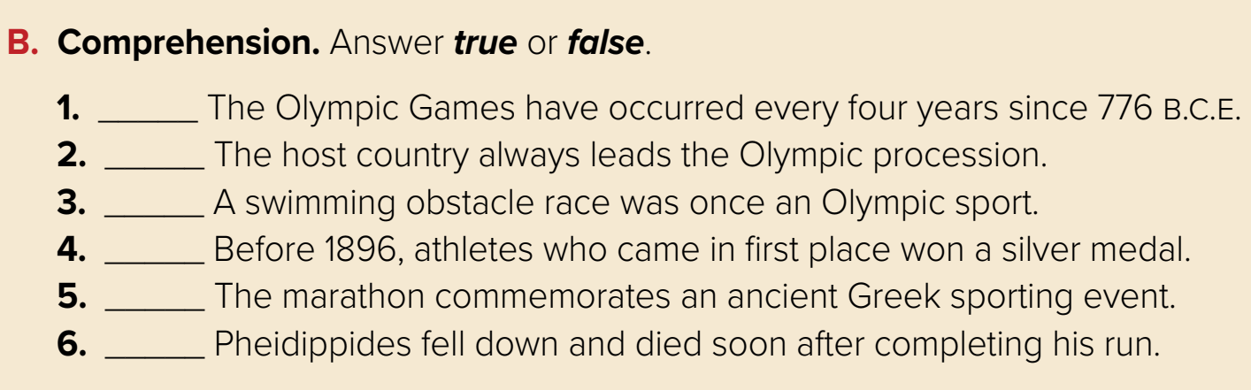
false
false
true
false
false
true

Slide 15
Pair Work

Slide 16

Work with your partner to design a new Olympic flag. What will each color or symbol represent? Draw your flag and explain it to your classmates.

Slide 17


