Slide 1



Slide 2
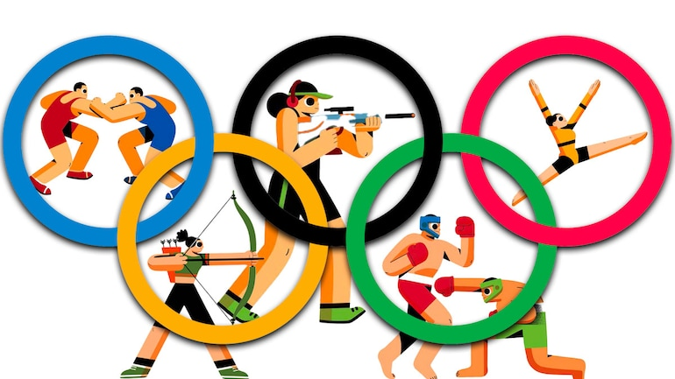
Uint-4-
The Sporting Life

Slide 3
5 Listening
6 Pronunciation
7 Vocabulary Building

Slide 4
Objectives
Complete the chart according to the profiles audio
Find
the meaning of new words
Differentiate between pronunciations of letters (th)

Slide 5
5 Listening

Slide 6



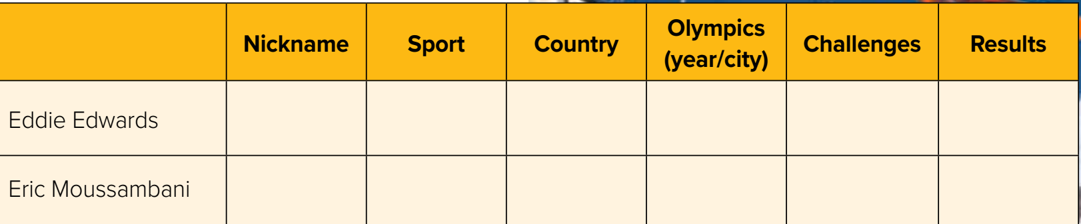
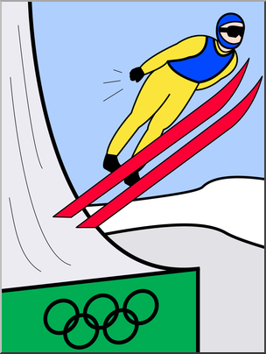
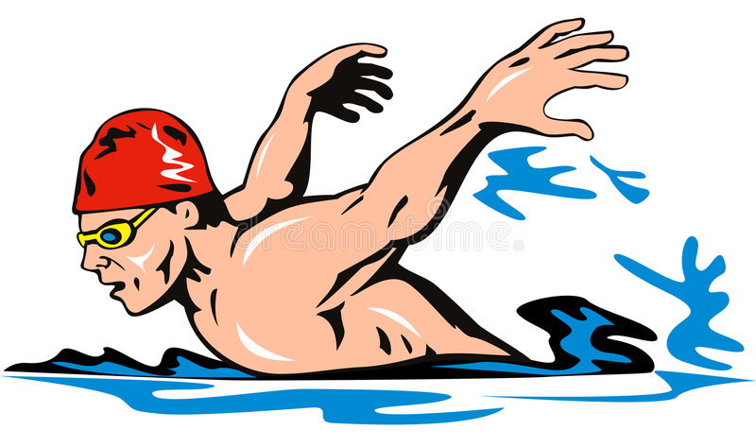
Listen to the profiles of unusual Olympic athletes and complete the chart

Slide 7
Results | Challenges | Olympics (year/city) | Country | Sport | Nickname
finished last in event | * heavier than competitors * near-sighted * only practiced for 2 seasons | 1988, Calgary | Great Britain | Ski jumping | The Eagle | Eddie Edwards
finished a full minute behind any competitive time | * only been swimming for 8 months * Never seen an Olympic-sized pool | 2000, Sydney | Equatorial Guinea | Swimming | The Eel | Eric Moussambani

Slide 8
6 Pronunciation

Slide 9
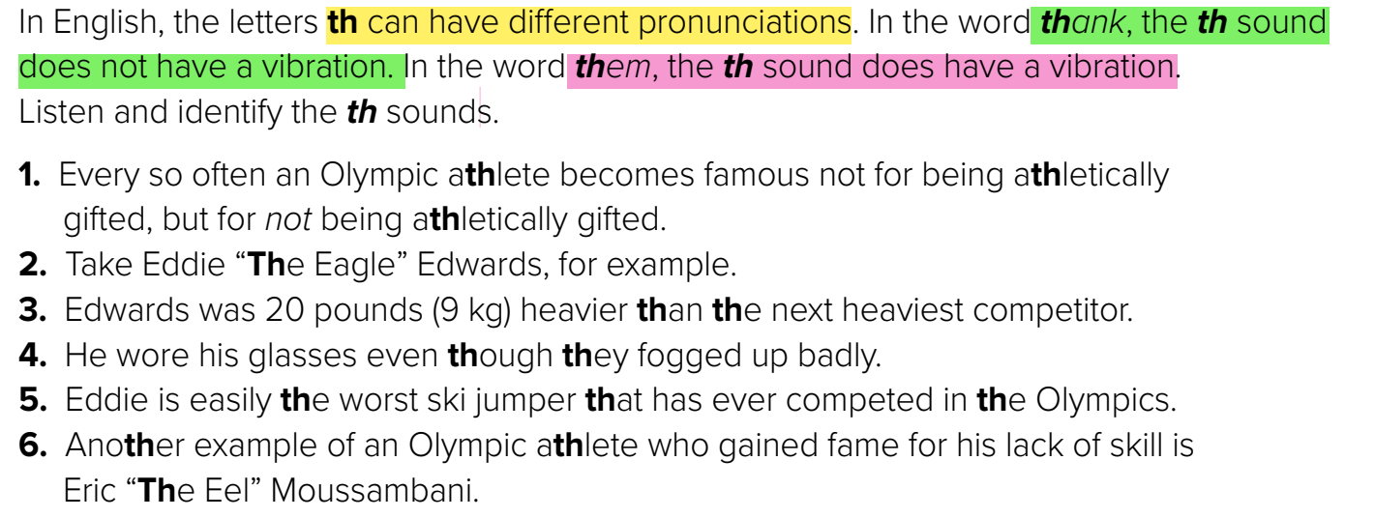

Slide 10
7 Vocabulary Building

Slide 11
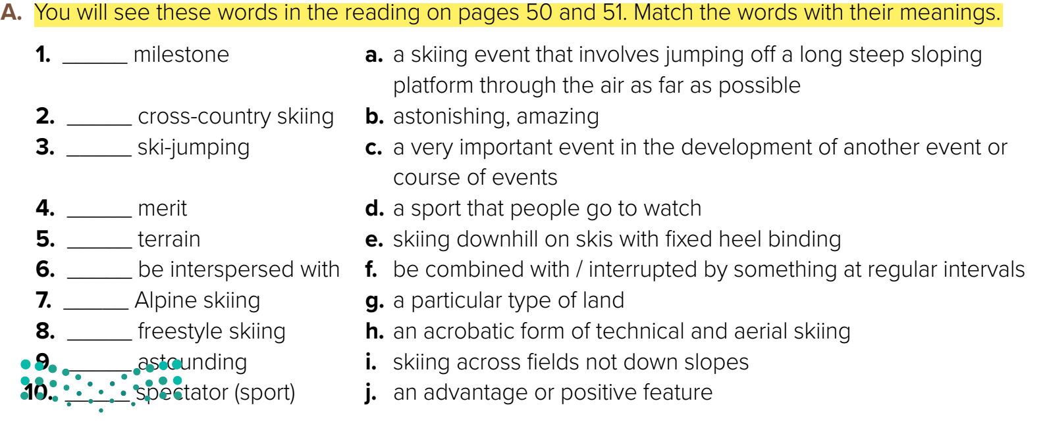
c
i
a
j
g
f
e
h
b
d

Slide 12


