Slide 1



Slide 2

    Unit -3-
    There is No Place Like Home

Slide 3
    10 Writing

Slide 4
Objectives
The students will be able to :
Analyze the text to main elements .
Describe some unusual houses correctly .
Complete house parts description .
Write a descriptive essay about a house .
.

Slide 5
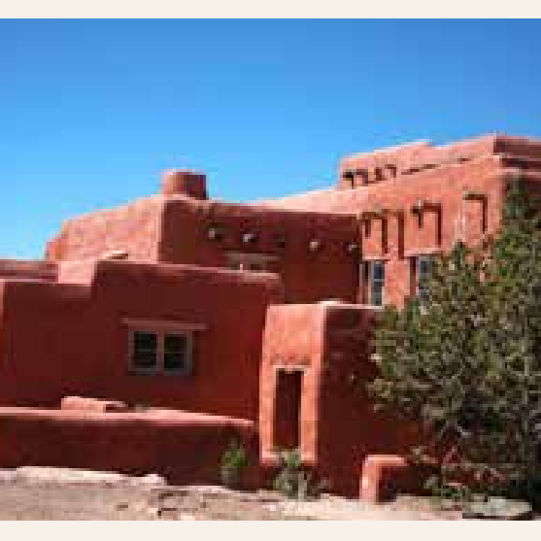
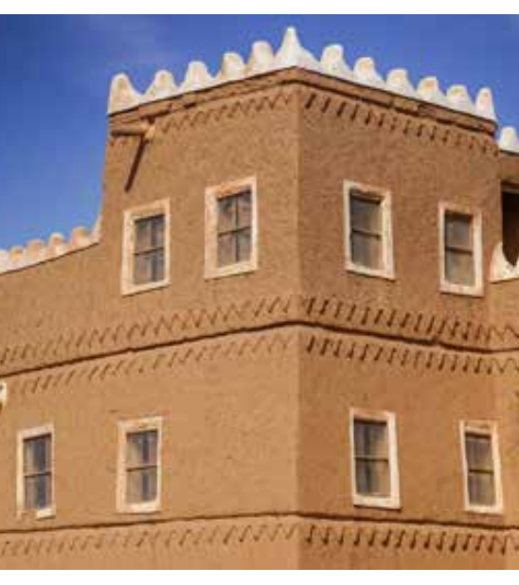
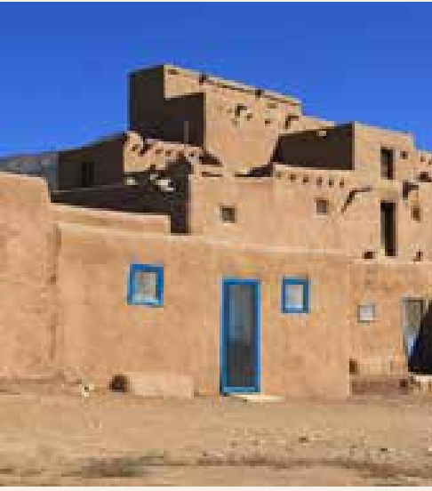
Have you seen houses like the ones in the photos anywhere?
Where do you think these houses are?
They are historical and old houses .
What are they made of?
They are made of sand & clay .

Slide 6
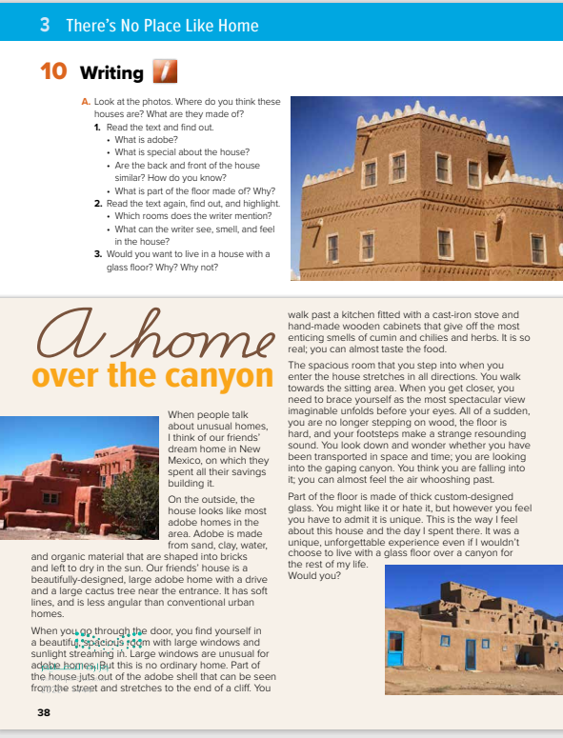
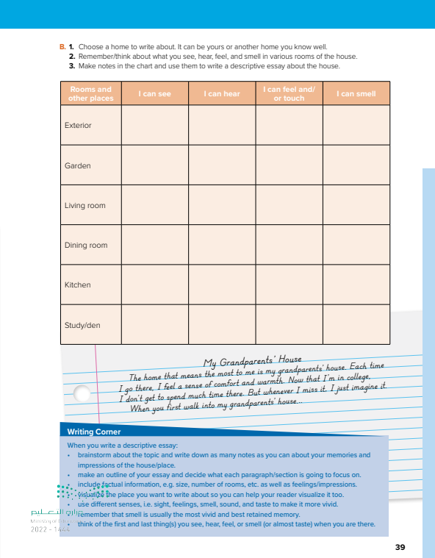
How many paragraphs ?
Students Book
P.38-39
What is the title of the text?

Slide 7
What is the title of the text?
4
1
How many paragraphs ?
2
5
3

Slide 8

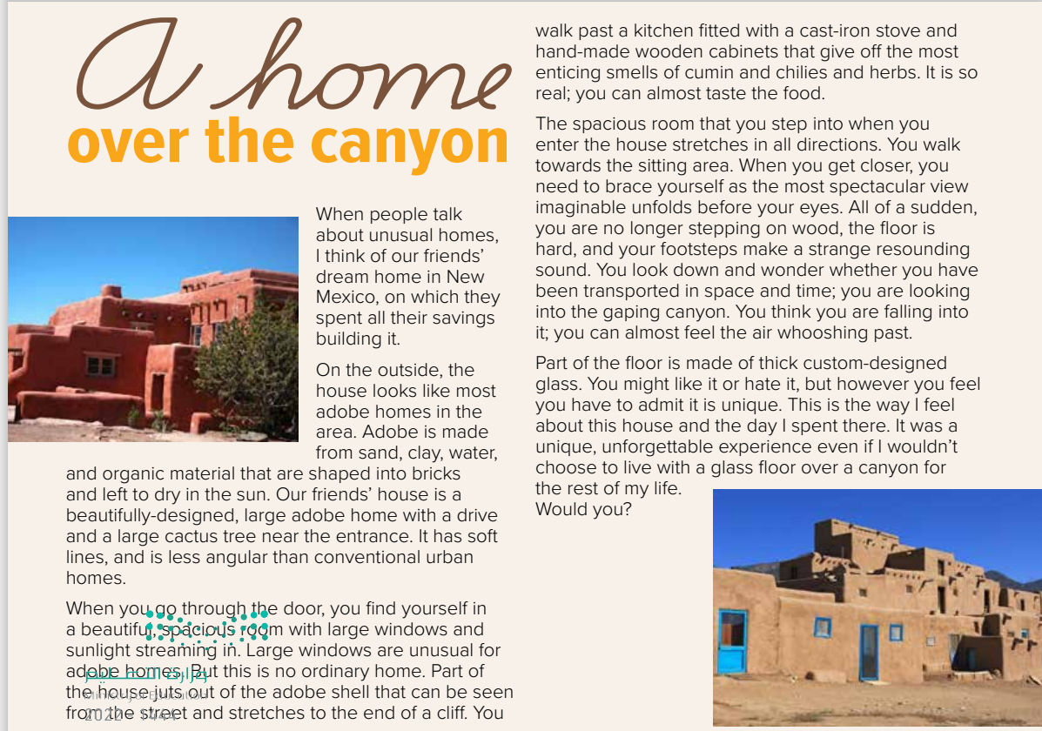

Read as long as U listen

Slide 9
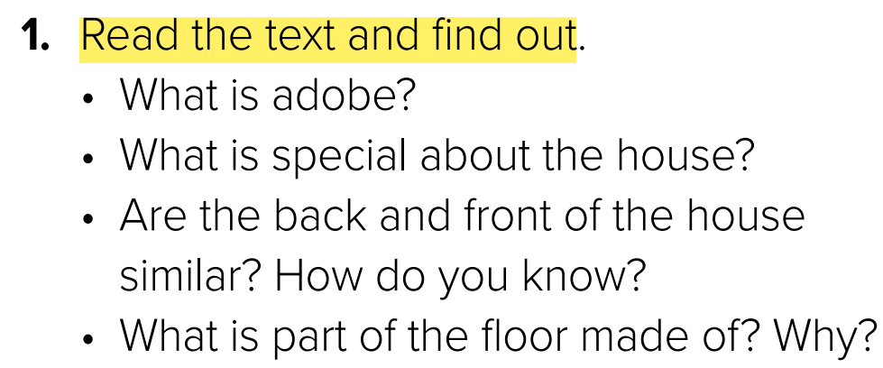
No, they aren’t. The front of the house that can be seen from the street is that of a large adobe home with a drive and a cactus tree at the entrance. The back of the house has large windows and stretches to the end of the cliff
to allow a unique view of the canyon below.

Slide 10
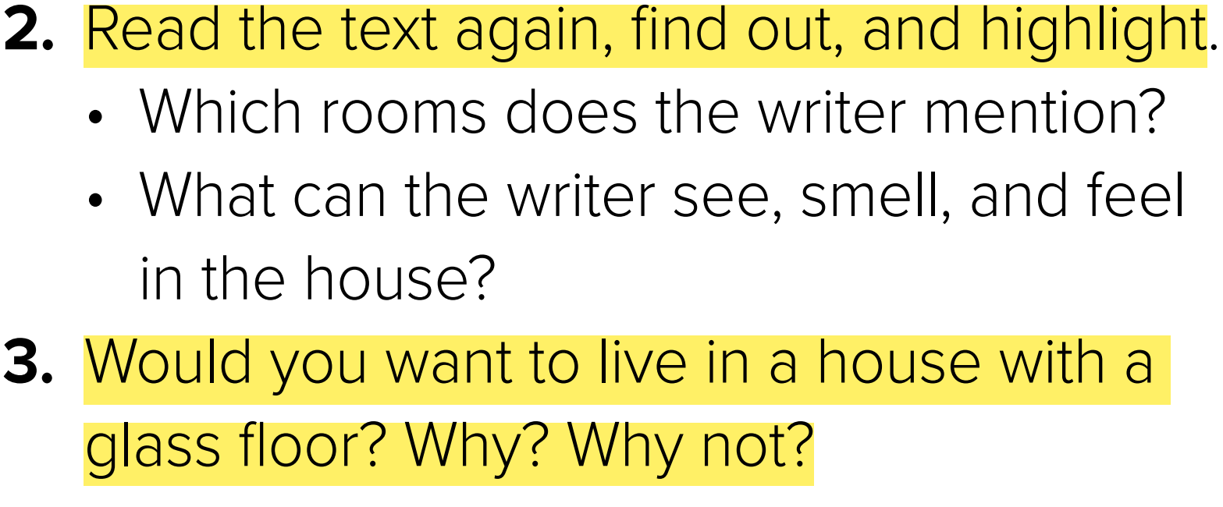
He can see: the door, large windows, sunlight streaming in, the street, the cliff, the kitchen, the wooden cabinets, the sitting area, a spectacular view, the gaping canyon
He can smell: the most enticing smells of cumin and chilies and herbs.
He can feel: the hard floor, the air whooshing past (he imagines this)

Slide 11
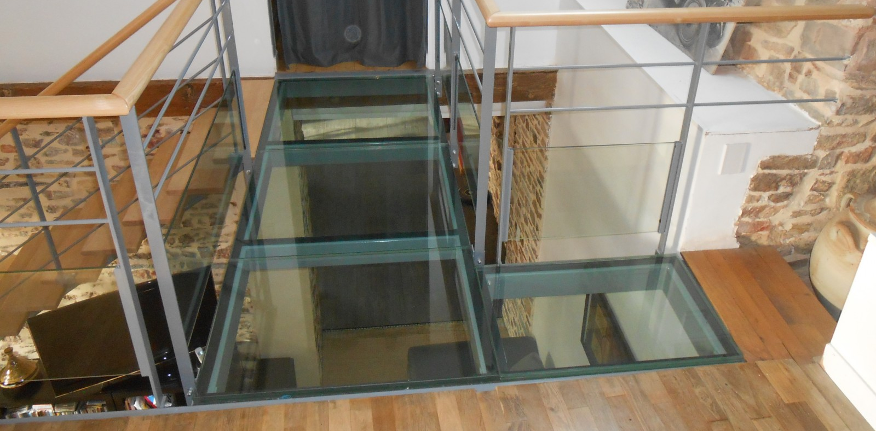

Slide 12
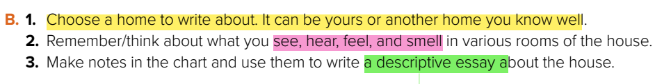

Slide 13
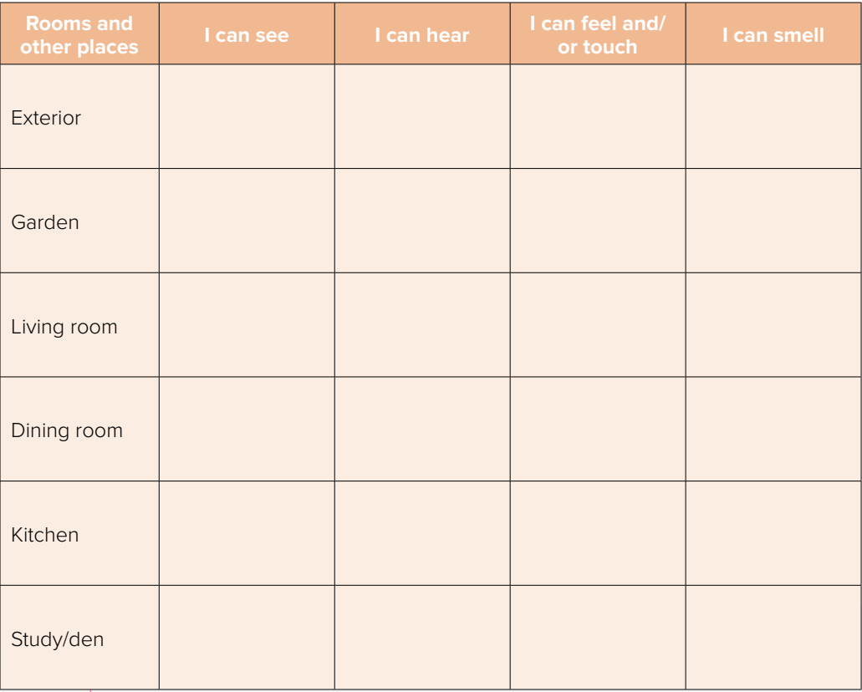
The streets
The house
Birds
cars
Fresh air
The building
grass
Birds
The flowers
Grass smell
Flowers smell
Remote
The sofa
TV
TV
Perfume
Family
Plates
spoon
food
Table
food
Dishwasher
plates
food
refrigerator
Book
Pencils
perfume
ink
Desk
Book
Teacher
Talking

Slide 14

Descriptive Essay
A type of essay that describes something like object, person, experience, place or emotion .
What is a thesis statement ?
The thesis statement is the sentence that tells the main idea of the whole essay. It usually comes at or near the end of the introductory paragraph.

Slide 15
Descriptive Essay
1st paragraph
Introduction ( background & Thesis statement )
2nd paragraph
Body ( Least important point )
3d paragraph
Body ( Next least important point )
4th paragraph
Body ( Most important )
5th paragraph
Conclusion ( needs to come to a satisfying end )

Slide 16
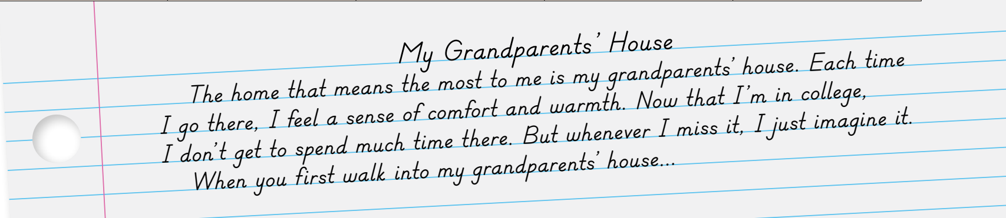
Example of descriptive essay

Slide 17
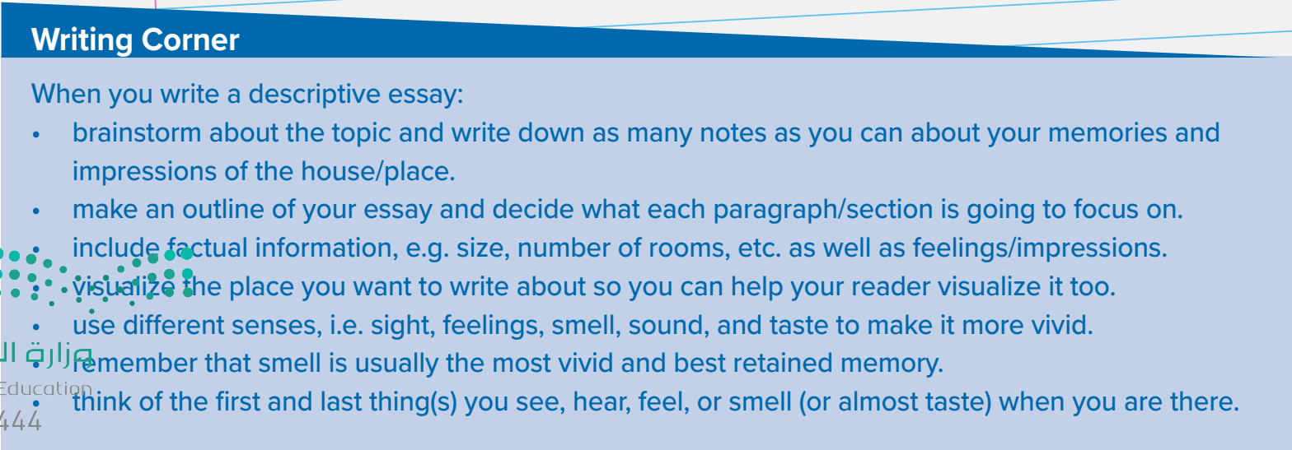

Slide 18

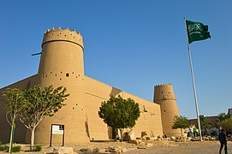


Slide 19


