Slide 1
We can 1
hello

Slide 2


Slide 3




Slide 4


Unit 5
Lesson 4

Slide 5
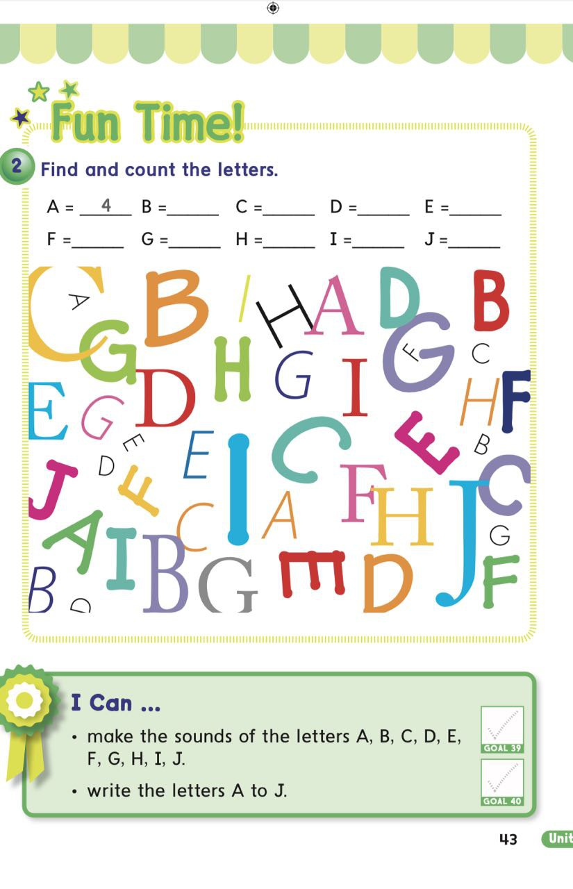
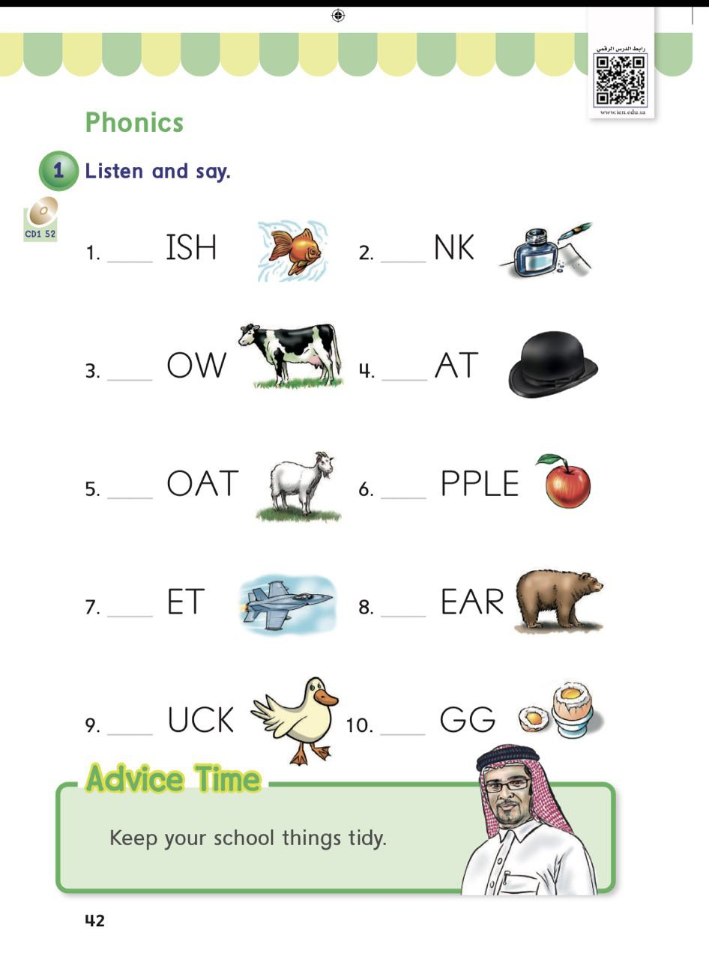
PAGES 42 & 43

Slide 6

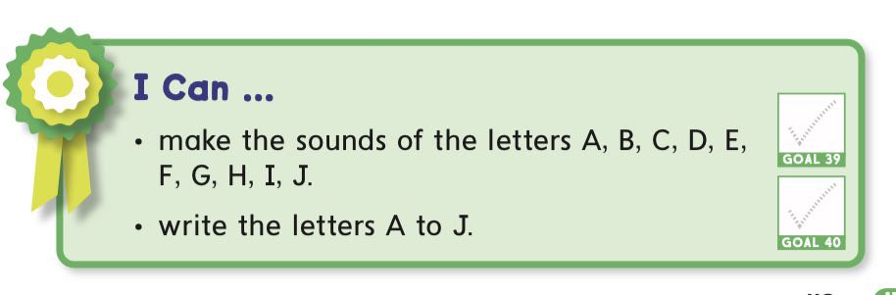

Slide 7


Slide 8
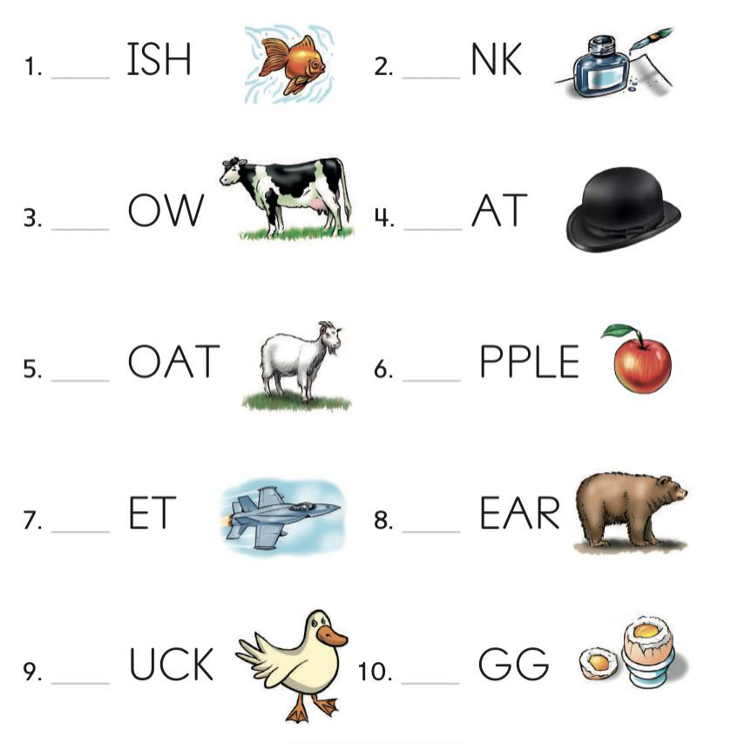

Slide 9
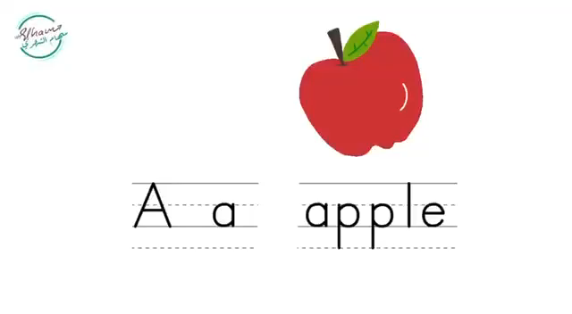

Slide 10
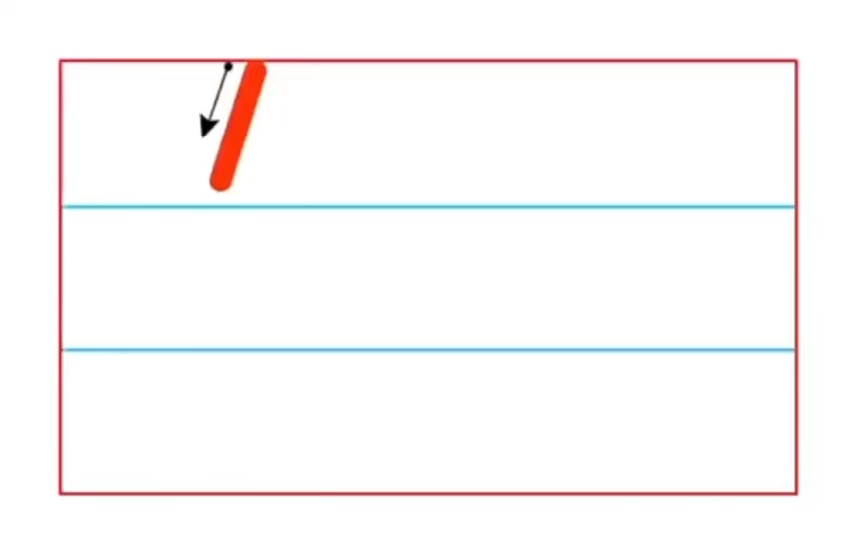


Slide 11





1
4
2
3

Slide 12





1
3
4
2

Slide 13


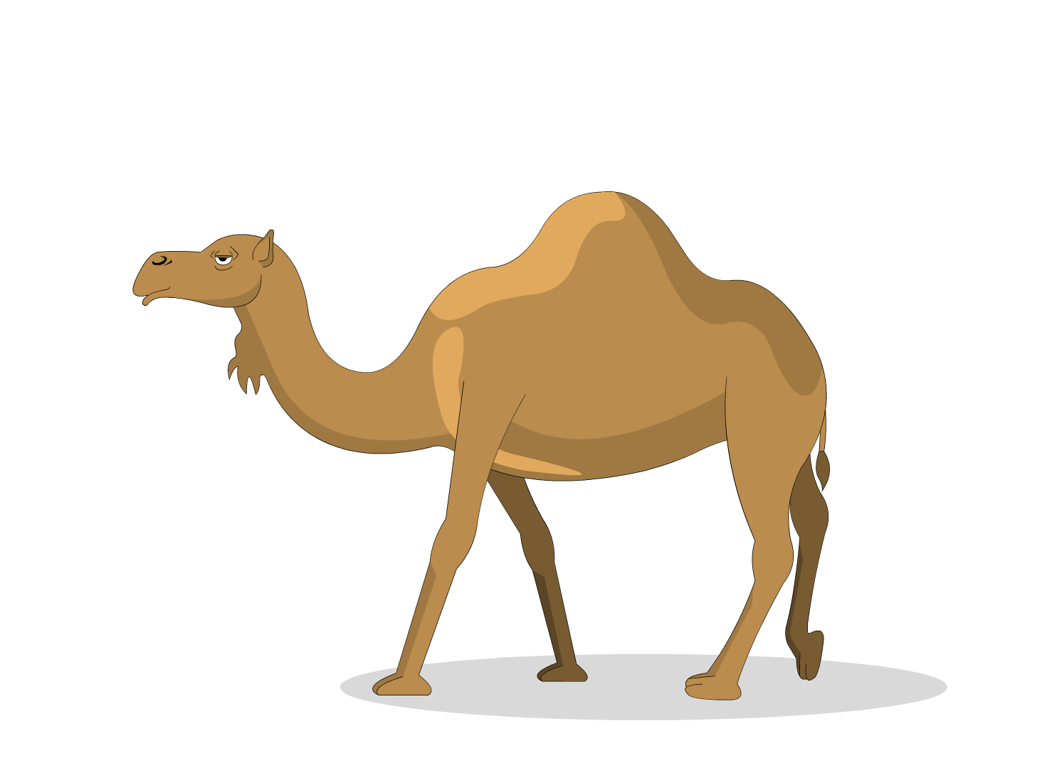
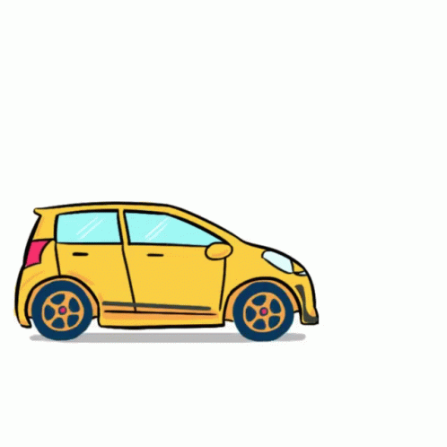
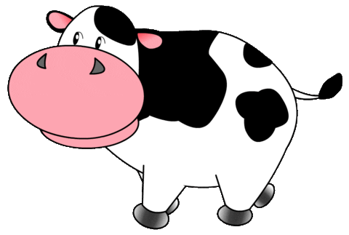
1
4
3
2

Slide 14



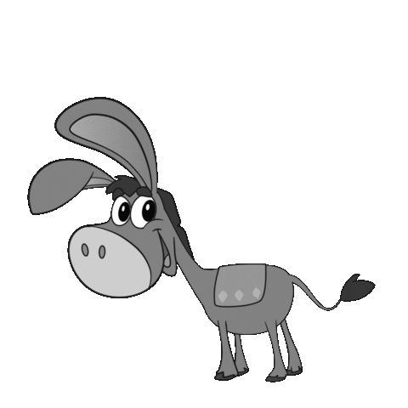

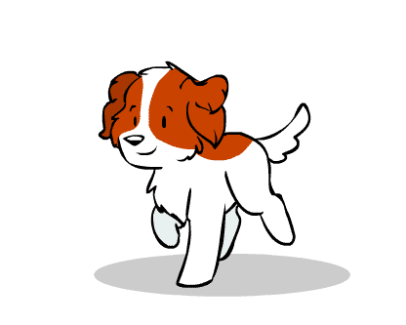
1
3
4
2

Slide 15






1
3
4
2

Slide 16



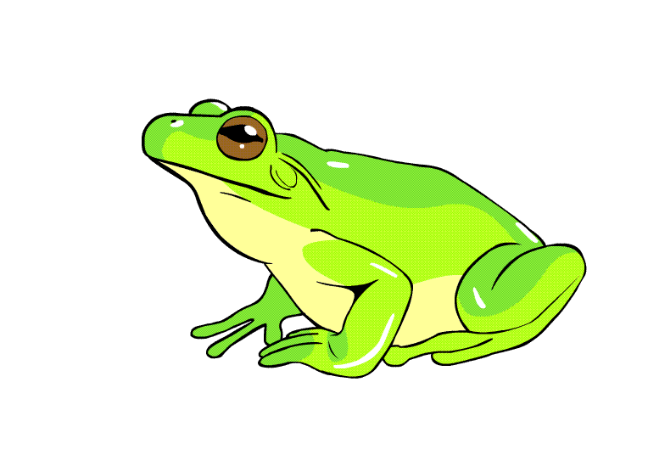


1
3
4
2

Slide 17

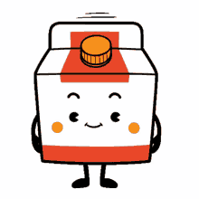

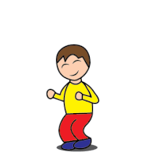
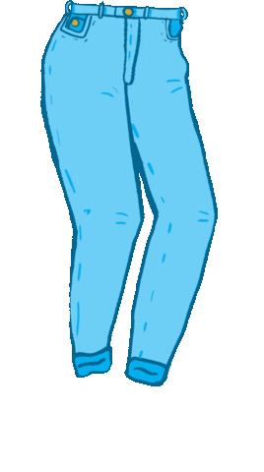

1
3
4
2

Slide 18
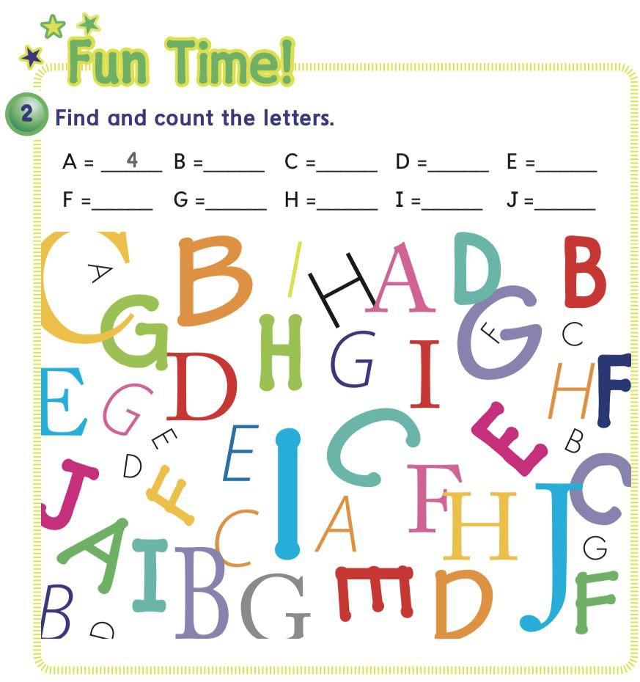

Slide 19


Slide 20



Slide 21


Slide 22


Slide 23
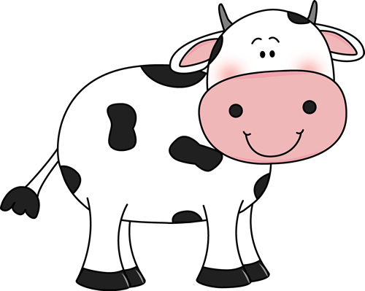

Slide 24
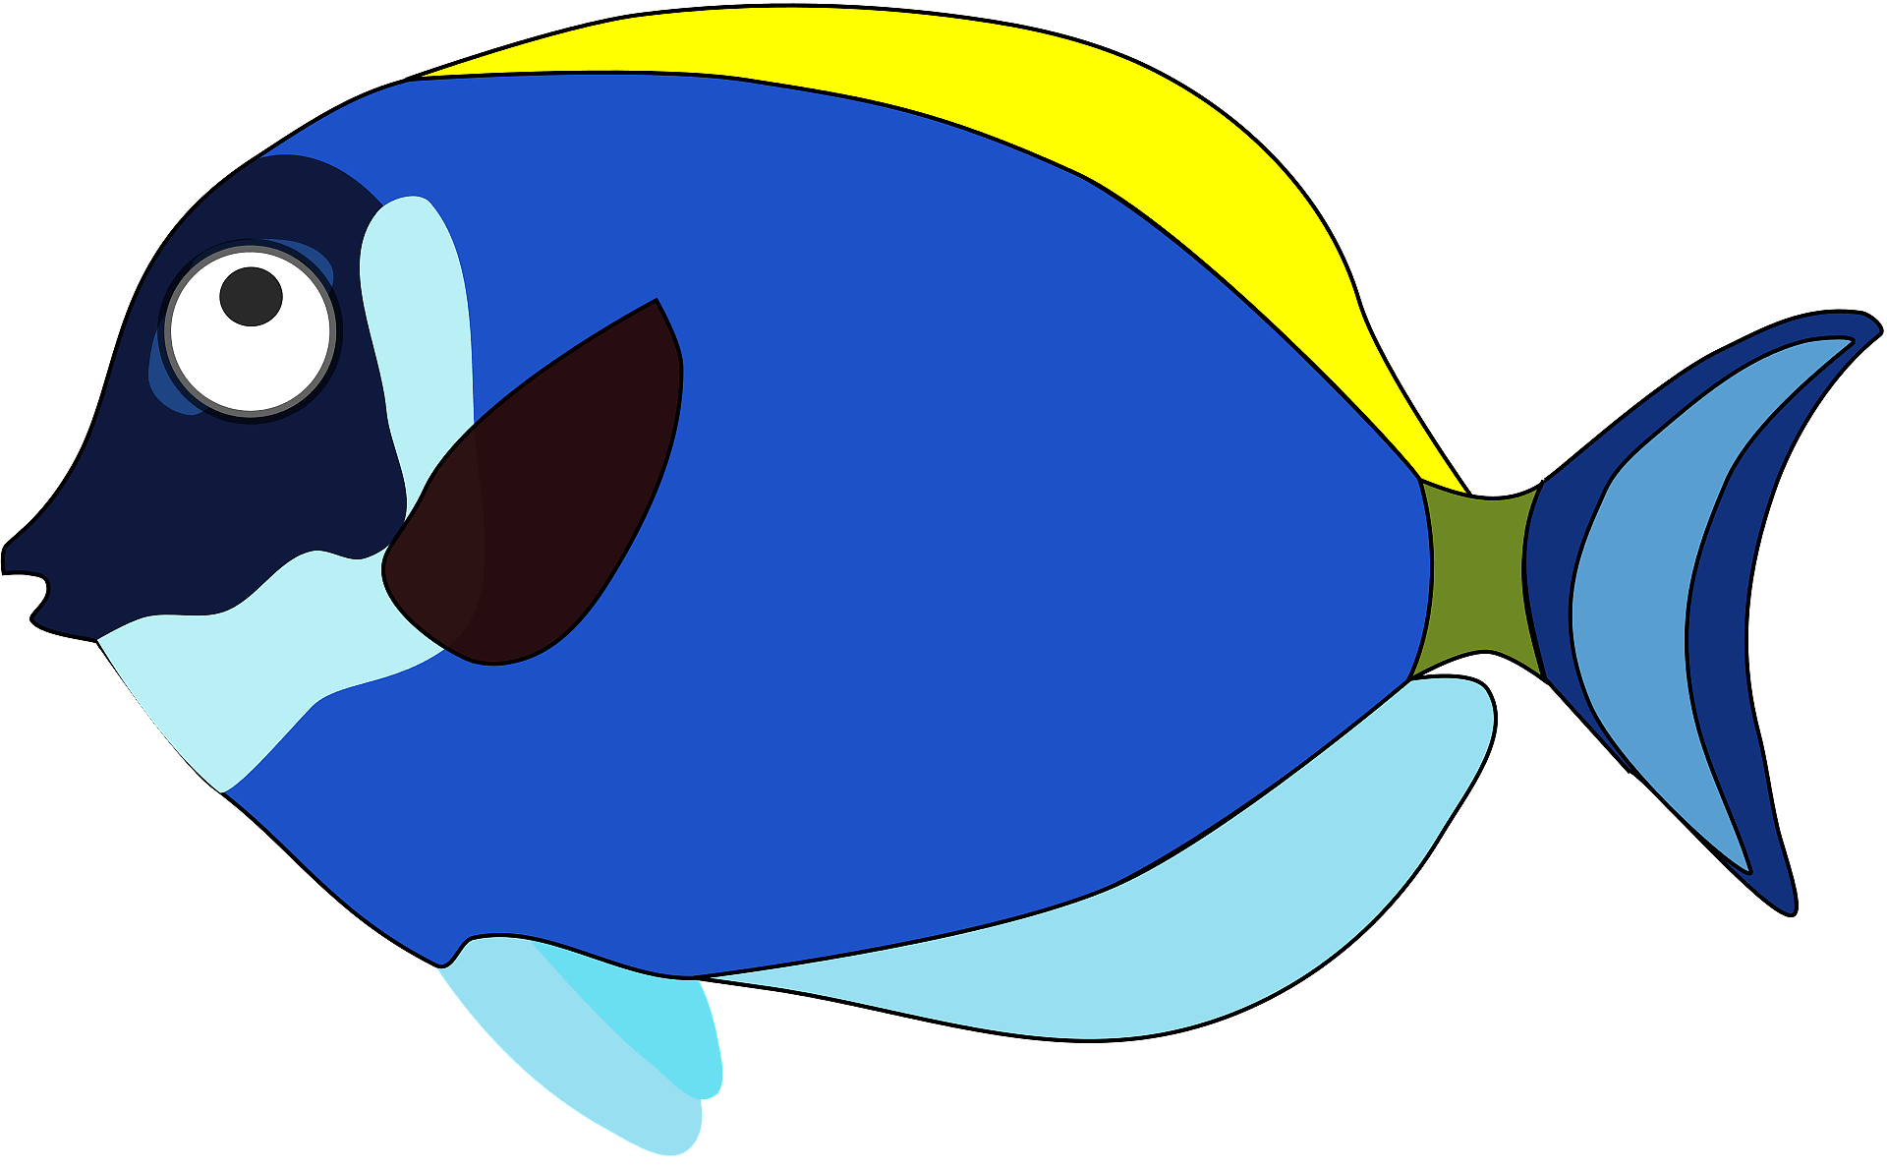

Slide 25


Slide 26



Slide 27
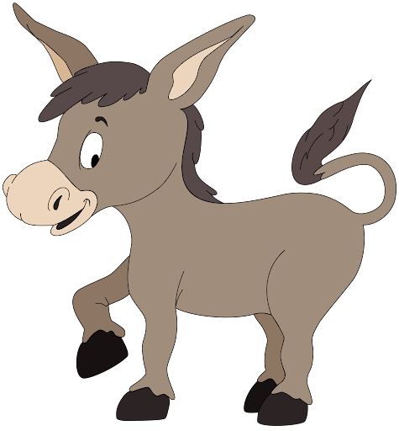

Slide 28
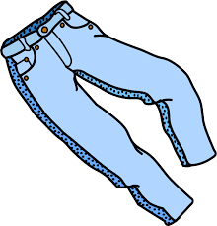

Slide 29


Slide 30


Slide 31
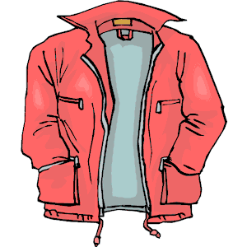

Slide 32


Slide 33
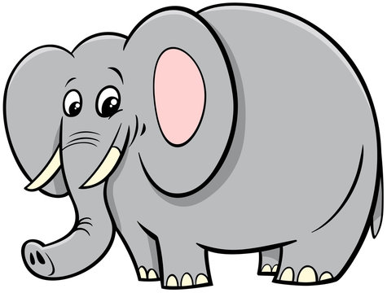

Slide 34



Slide 35



Slide 36


Slide 37

workbook pages 101&102

Slide 38

Home work at

