Slide 1
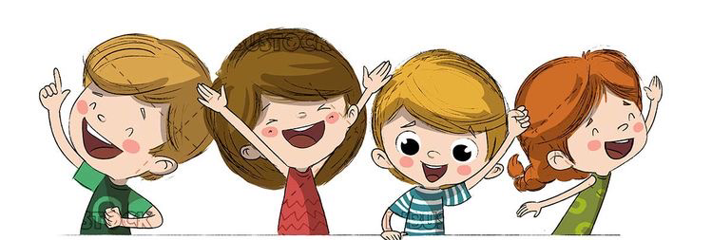
Hello
We can 6

Slide 2

Welcome back

Slide 3
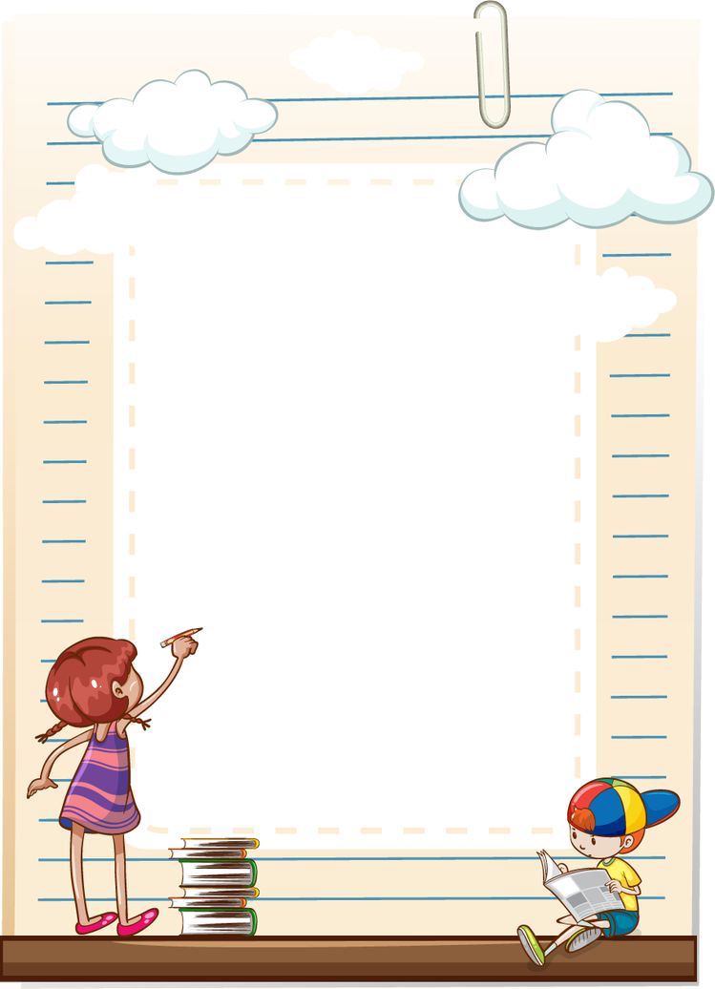
Sunday
/ 6/1442

Slide 4
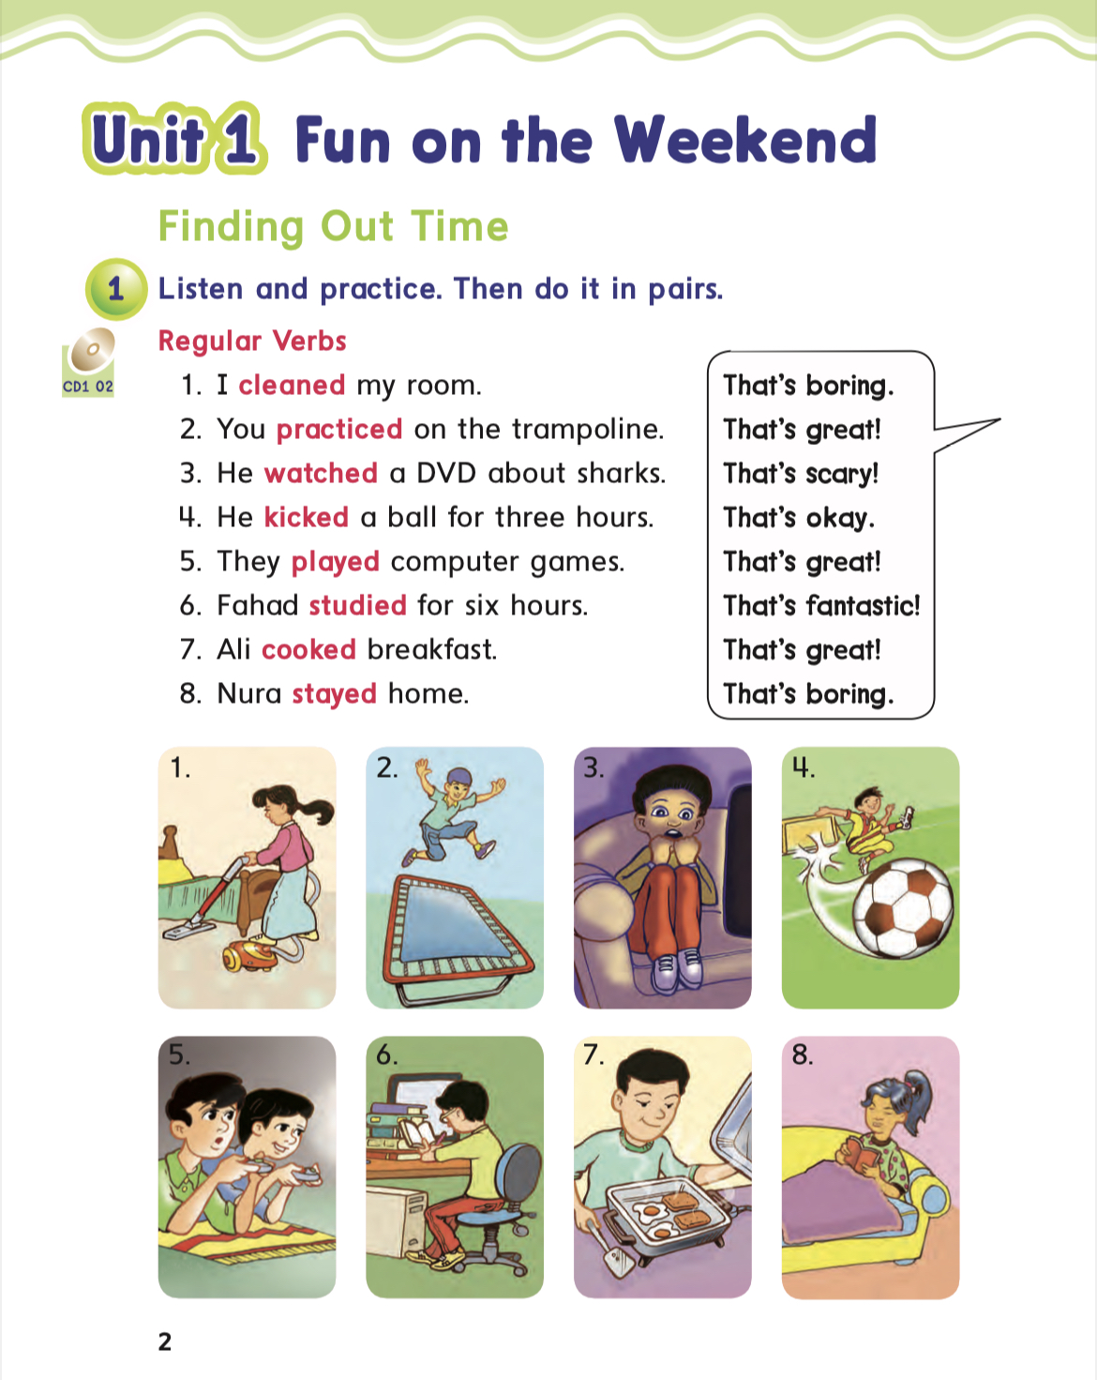
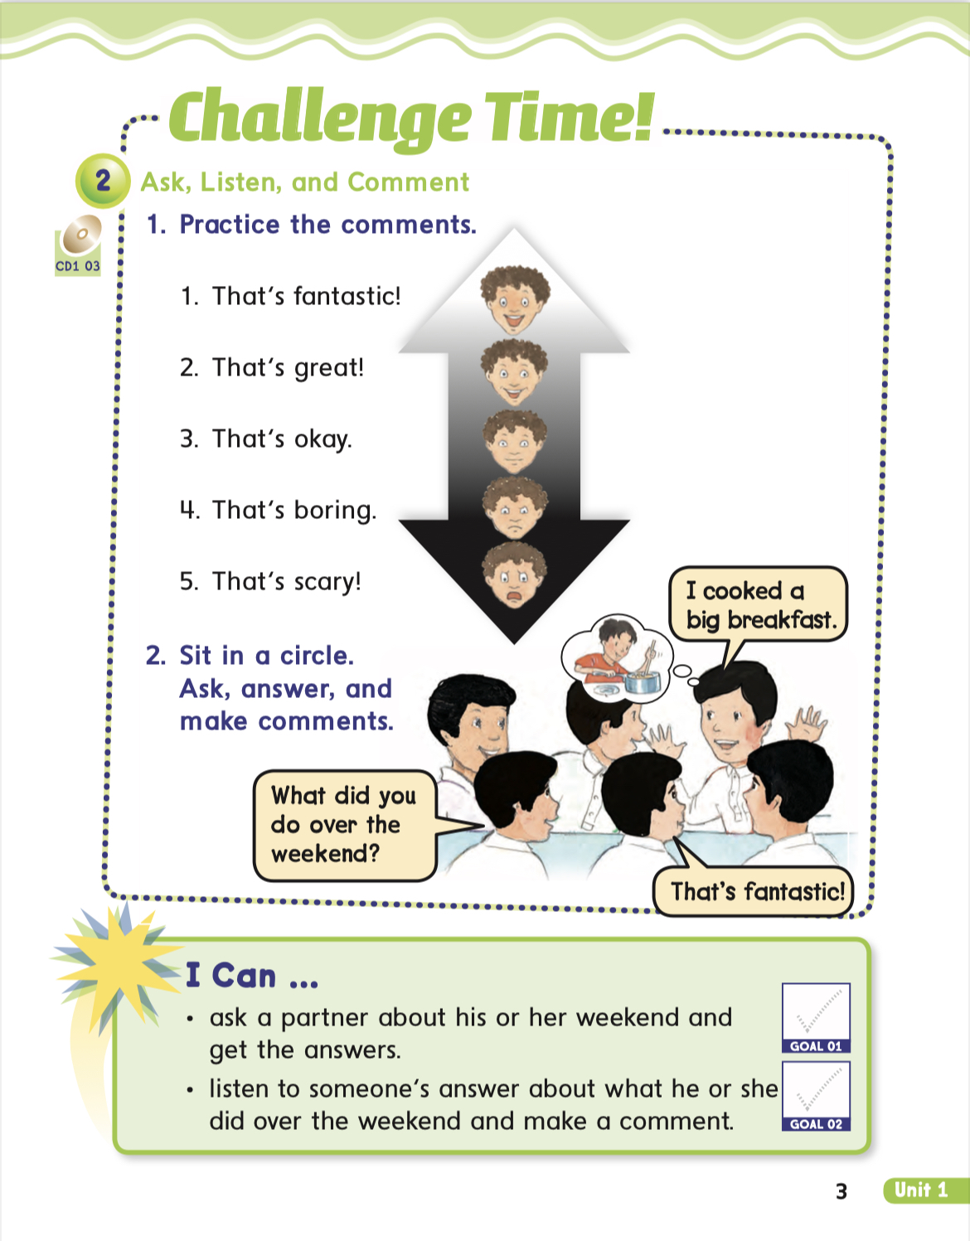
Unit1 (finding out Time)pages 2&3

Slide 5
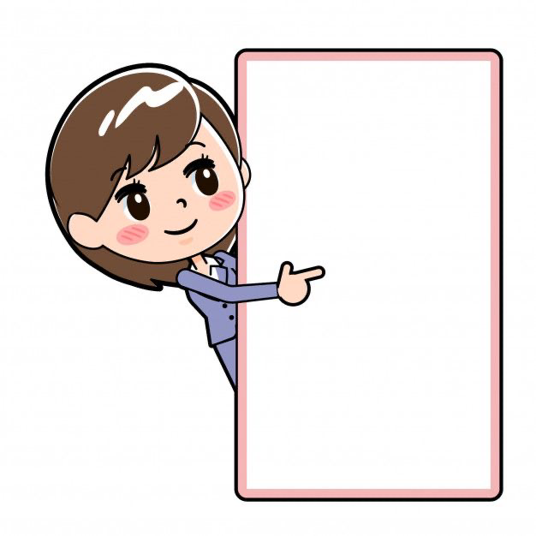
I can :
Ask a partner about her weekend and get the answers.
-listen to someone’s answer about what she did over the weekend and make a comment.

Slide 6
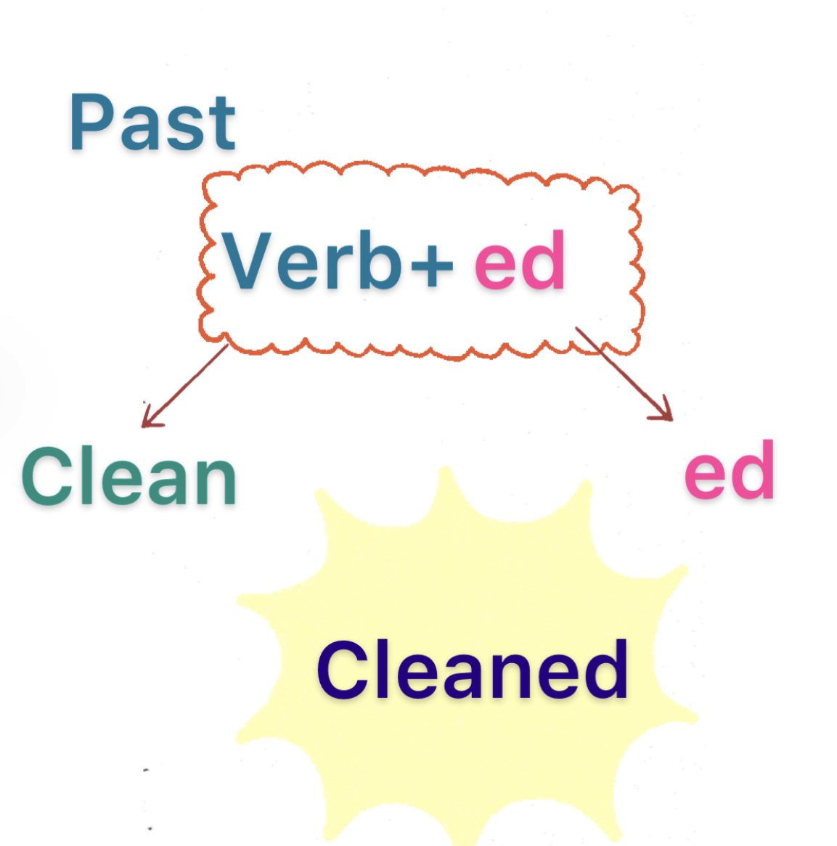

Slide 7
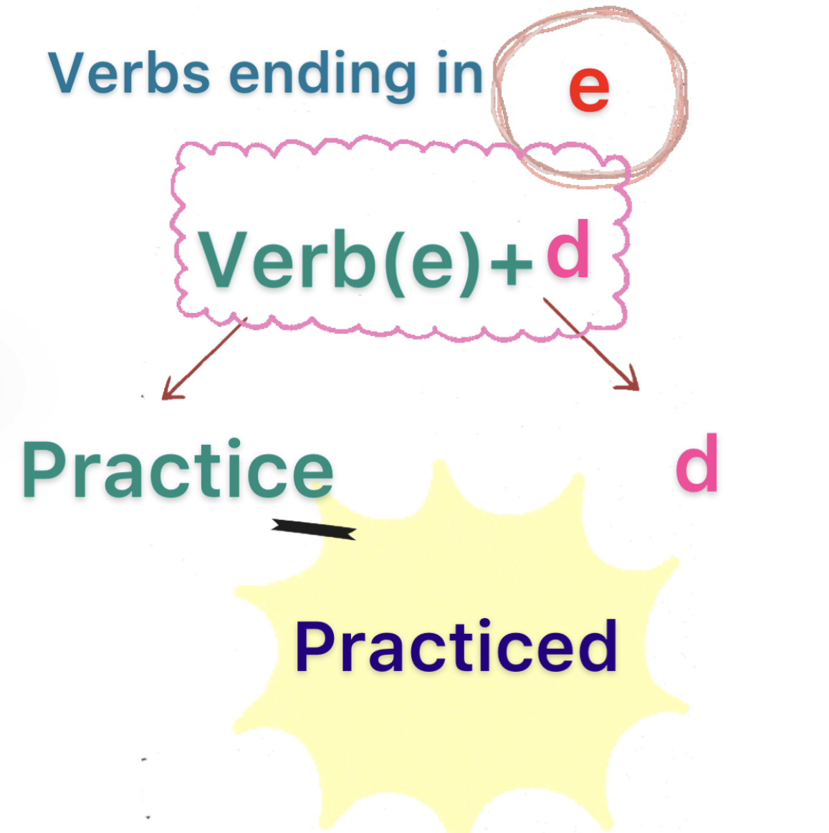

Slide 8
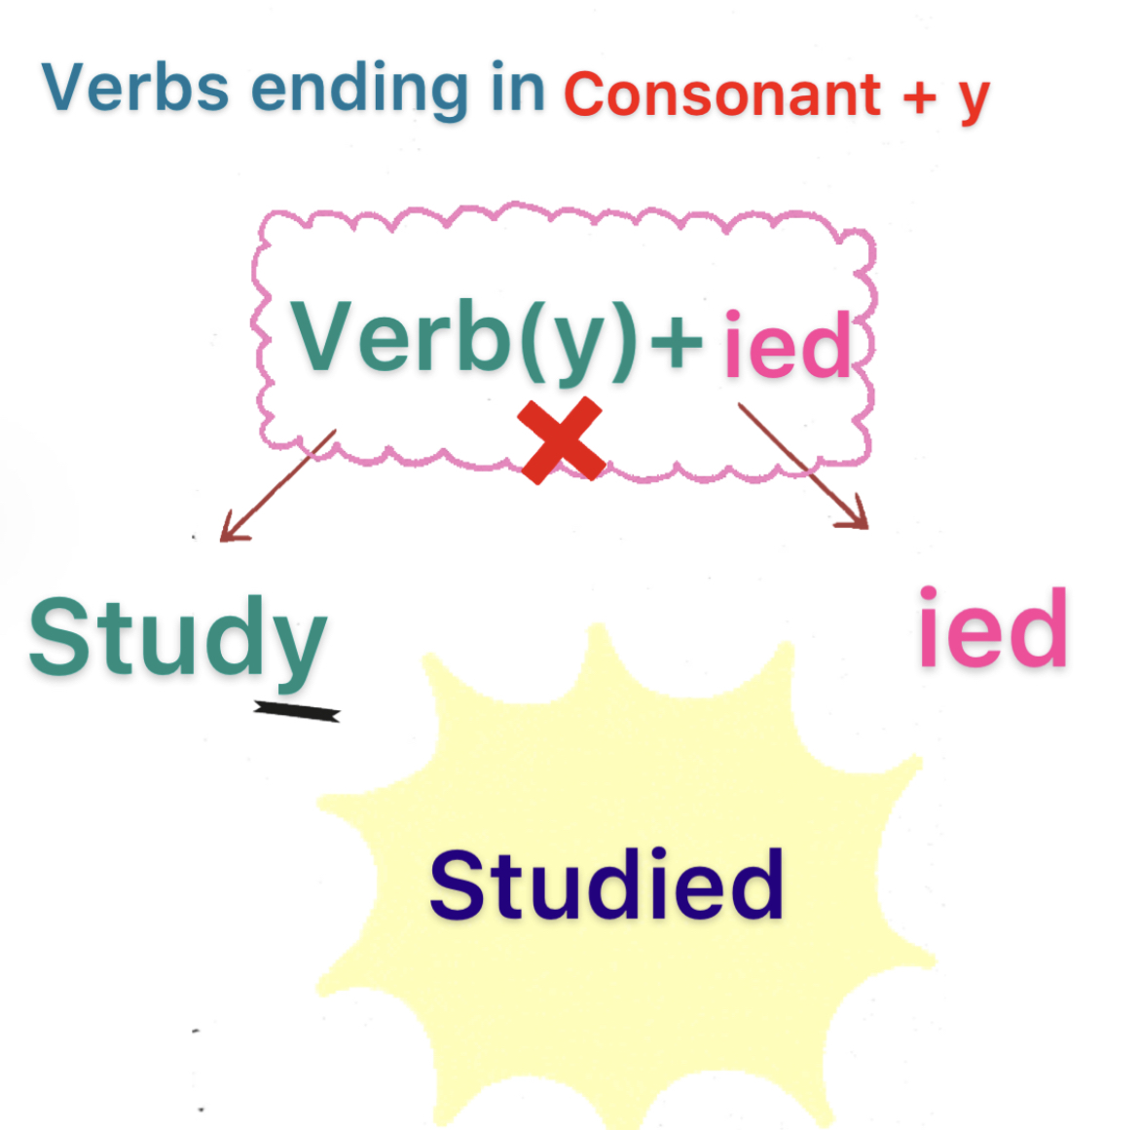

Slide 9
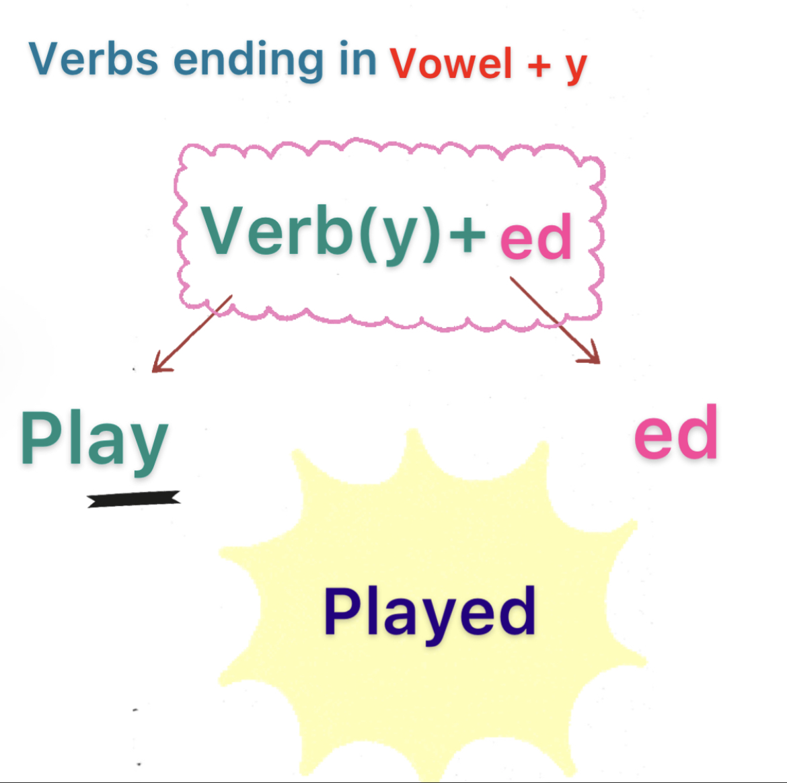

Slide 10
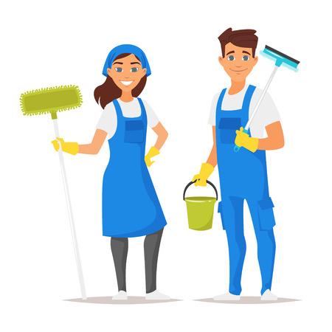
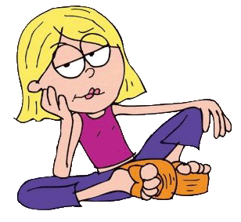
Cleaned
That’s boring.

Slide 11

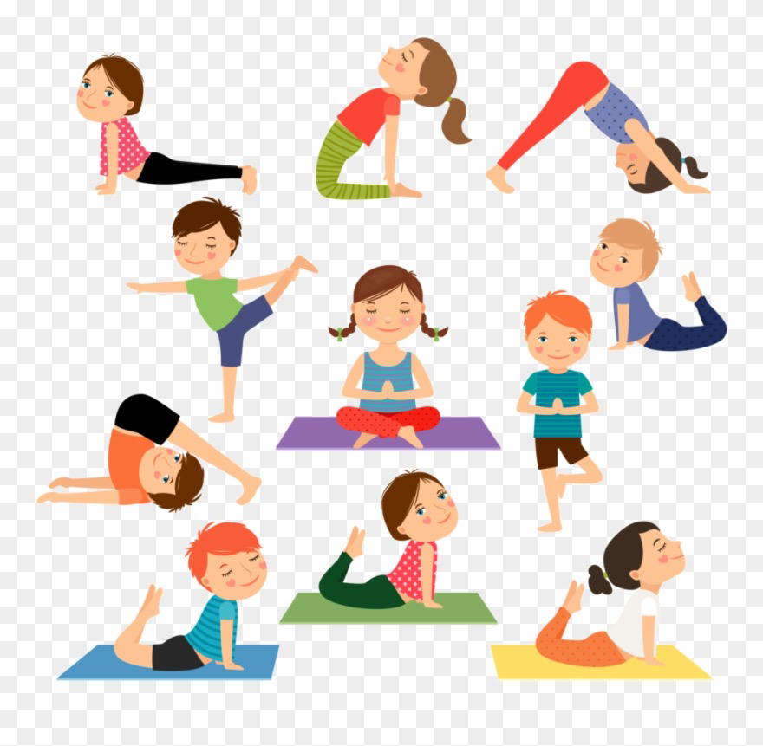

Practiced
That’s great.

Slide 12
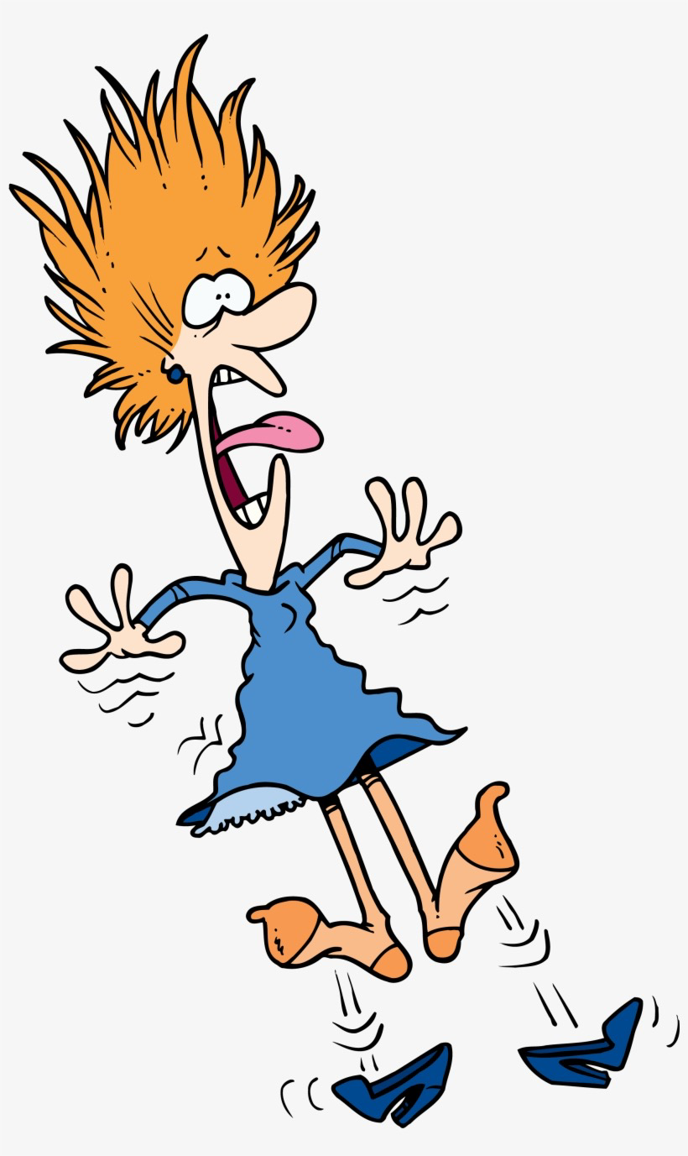
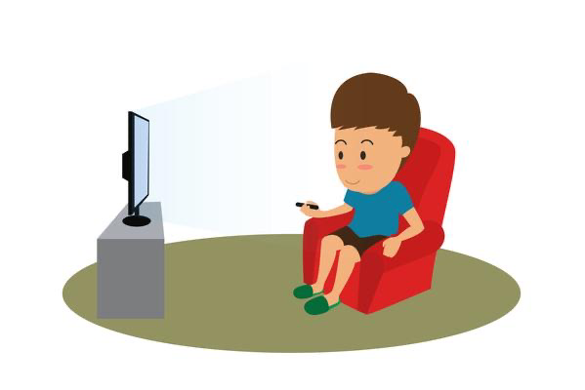
Watched
That’s scary!

Slide 13
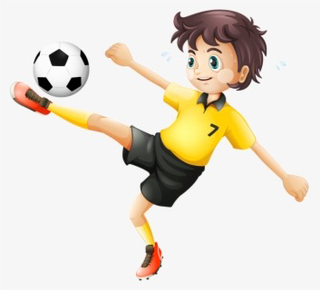

Kicked
That’s okay.

Slide 14
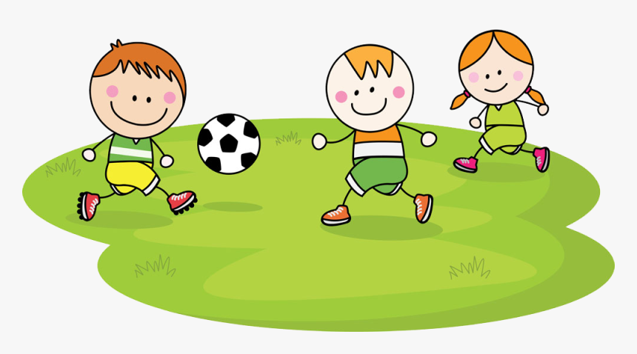
Played
That’s great!

Slide 15


Studied
That’s fantastic!

Slide 16
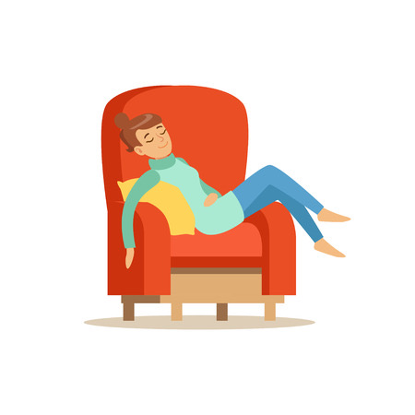
Stayed
That’s boring.

Slide 17
📖 Reading time 🤗

Slide 18
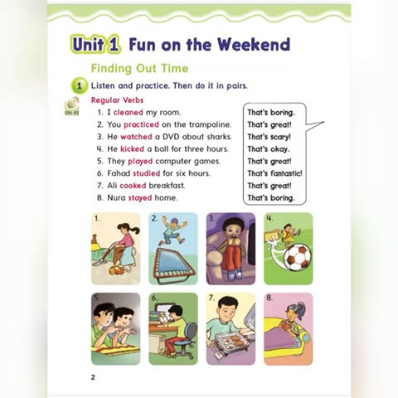

Slide 19
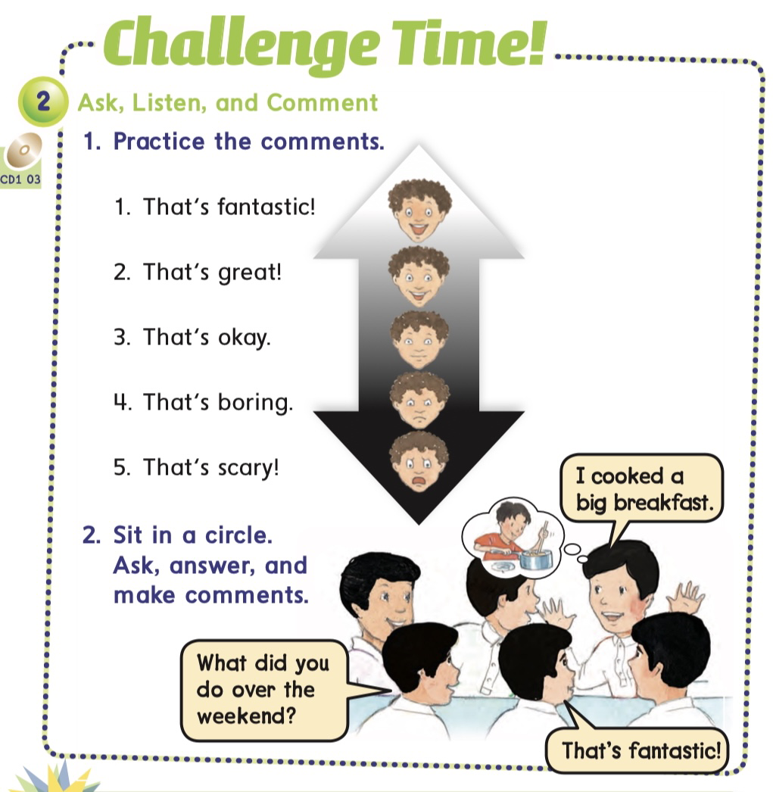

Slide 20


Slide 21
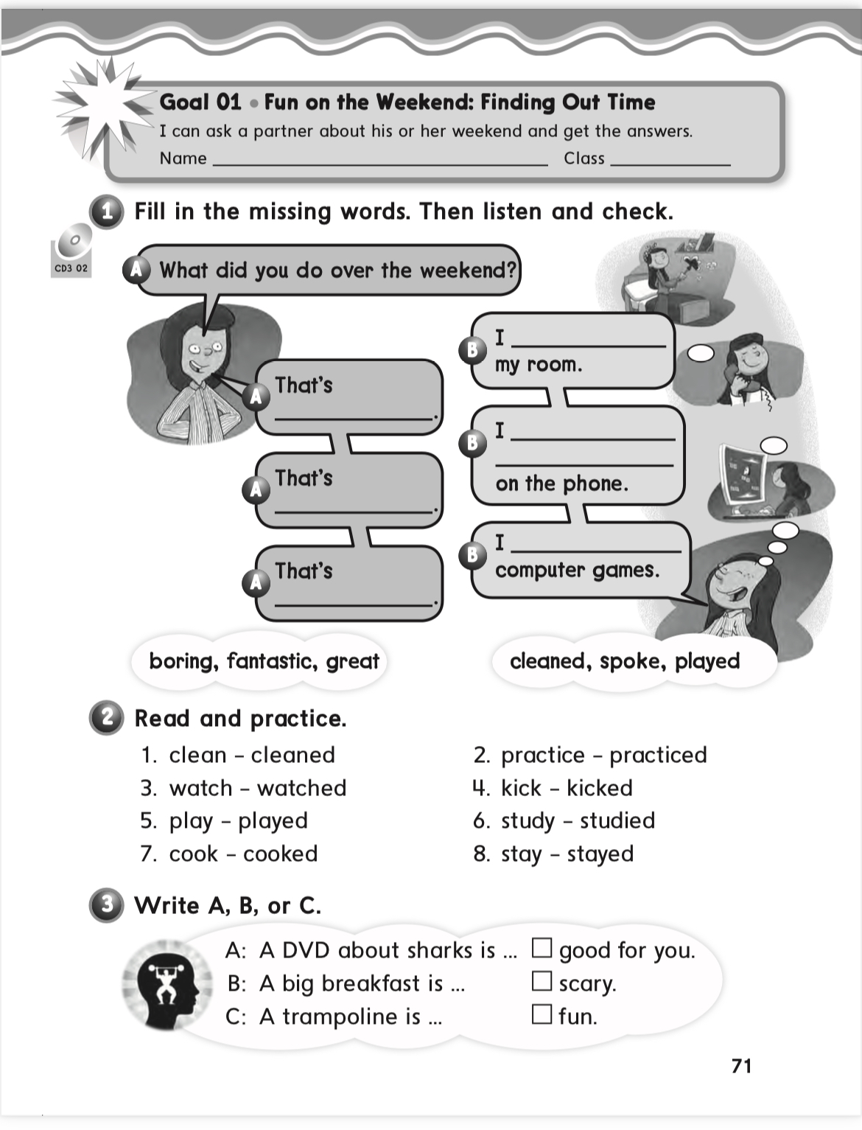
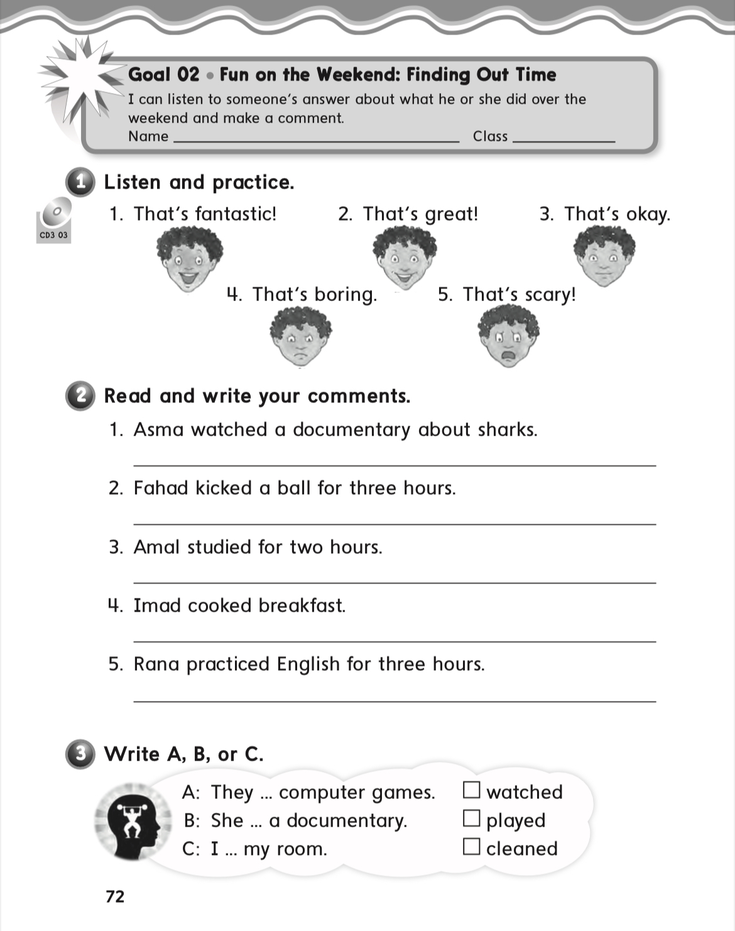
Homework pages(71&72)

