Slide 1
Revision
Mega Goal 1.2
T. Hadeel Khabti

Slide 2
Grammar

Slide 3
Q1: Choose the correct answer:
1. I saw _____ in the mirror.
A | myself | B | herself | C | himself
2. I went to the doctor _____ I was sick.
A | because | B | so | C | neither
3. I am happy.
A | So do I. | B | So am I. | C | So can I.
4. It was very hot, _____ I opened the window.
A | because | B | neither | C | so
5. You _____ stop at red light.
A | must | B | mustn't | C | should
6. Smoking is bad habit. You _____ stop smoking.
A | must | B | mustn't | C | should

Slide 4
Q1: Choose the correct answer:
7. The bank is _____ the hotel and restaurant.
A | on | B | between | C | next to
8. Where is the pharmacy? - _____ straight ahead on this street.
A | Go | B | Turn | C | Take
9. Abdullah doesn't drive _____ .
A | care | B | careful | C | carefully
10. You should _____ to lose weight.
A | try | B | tries | C | trying
11. He _____ study harder if he wants to pass the exam.
A | might | B | had better | C | could
12. They _____ (postpone) the meeting until next week.
A | put off | B | gave up | C | take up

Slide 5
Q1: Choose the correct form in brackets:
13. Don’t _____ (discard) your old clothes.
A | take up | B | turn down | C | throw away
14. How _____ money have you got ?
A | much | B | many | C | long
15. How _____ cars in the gallery ?
A | much | B | many | C | long
16. We have _____ chairs here. We need more.
A | many | B | a few | C | much
17. He put _____ sugar in his coffee .
A | many | B | a few | C | a little
18. What do you do _____ you have a cold?
A | where | B | when | C | who

Slide 6
Vocabulary

Slide 7
Q2: Circle the odd words:
itself | D | finger | C | eye | B | ankle | A | 1
break | D | cut | C | door | B | burn | A | 2
hurt | D | injured | C | got a shock | B | fine | A | 3
rash | D | happy | C | cough | B | flu | A | 4
toothache | D | angry | C | strong | B | glad | A | 5
cola | D | fries | C | burger | B | apple | A | 6

Slide 8
Q3: Match the word with the meaning:
get better |  | junk food | 1
fight against |  | feeling down | 2
feeling depressed |  | guess | 3
not totally sure |  | recover | 4
fast food |  | keeping fit | 5
being in good health |  | challenge | 6
4
6
2
3
1
5

Slide 9
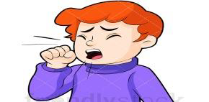
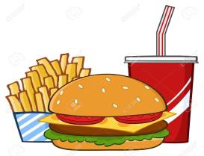

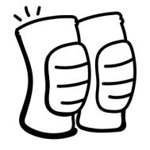
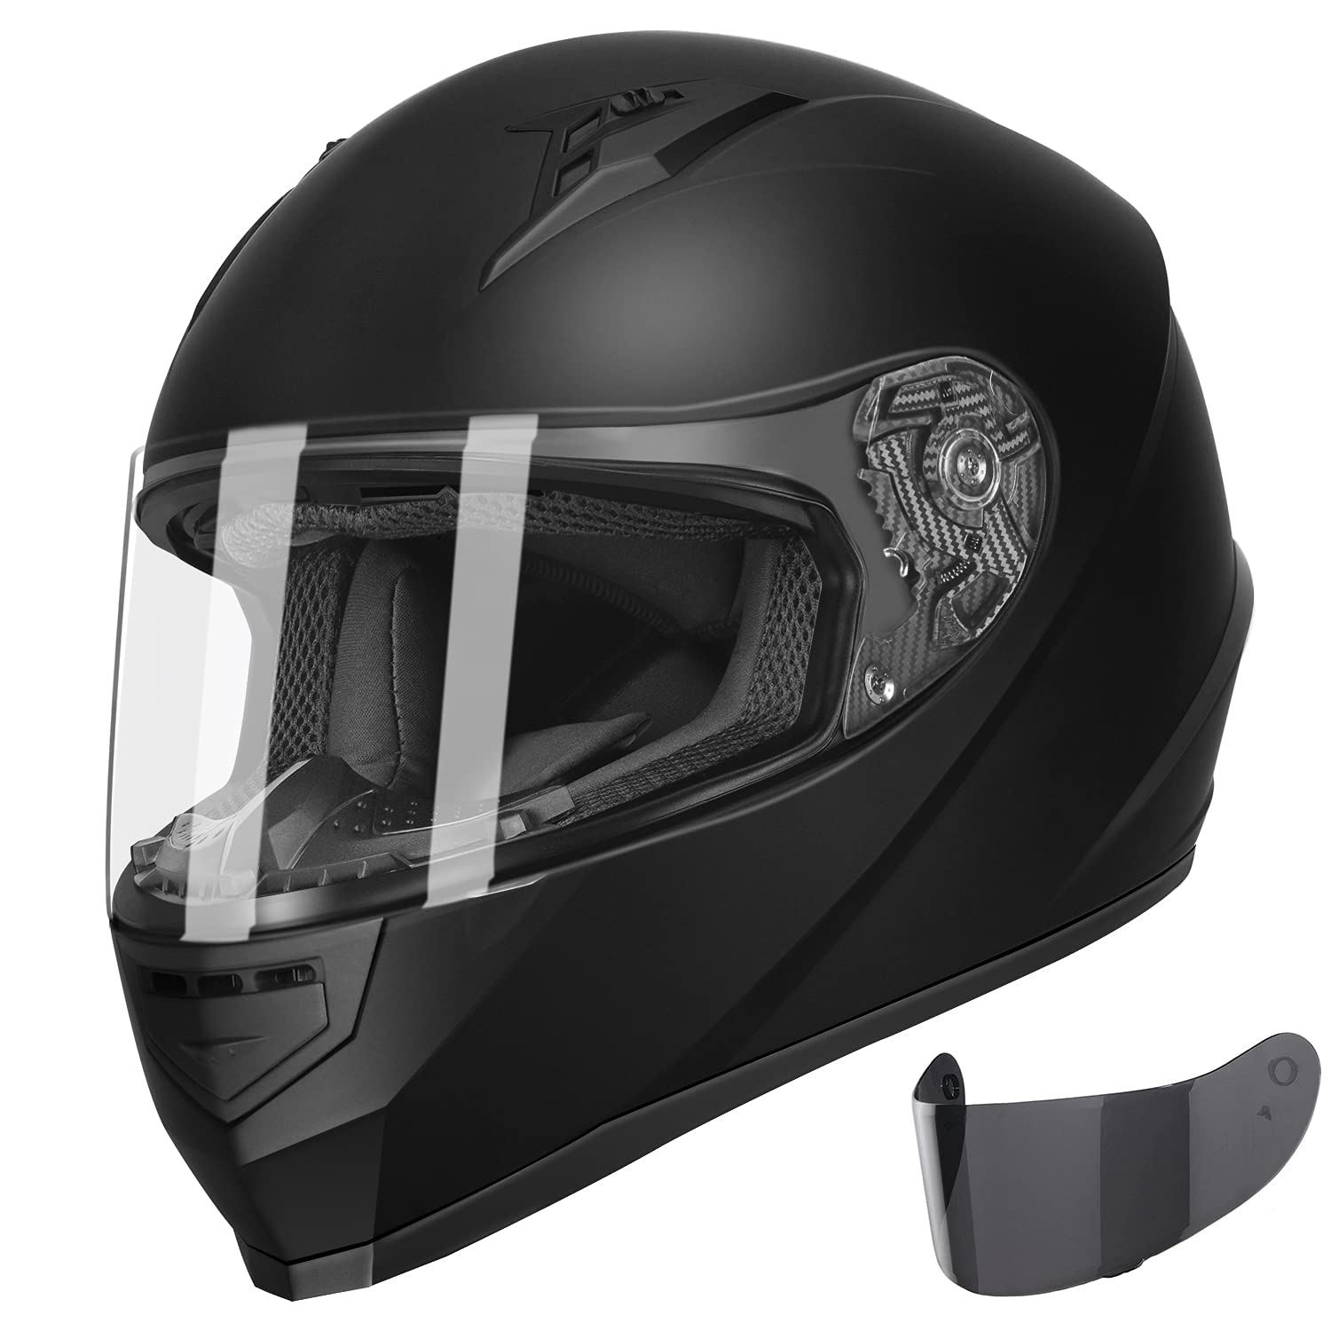
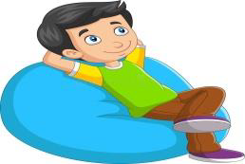
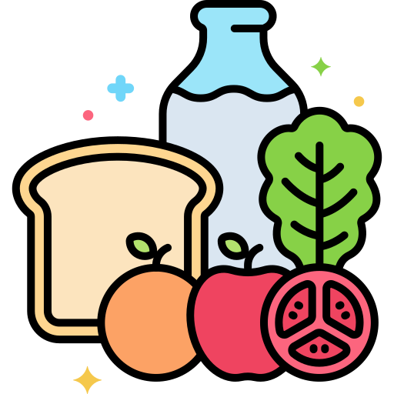
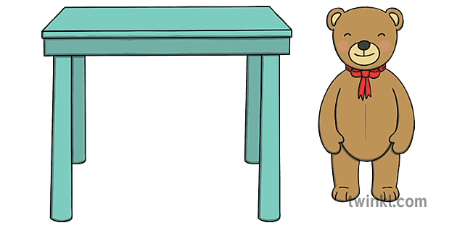
Q4: Write the correct word for each pictures :
junk food – healthy food – next to – helmet – knee pads – turn right – cough – relax
turn right
cough
junk food
knee pads
_______________ _______________ _______________ _______________
helmet
relax
healthy food
next to
_______________ _______________ _______________ _______________

Slide 10
Good Luck

