Slide 1
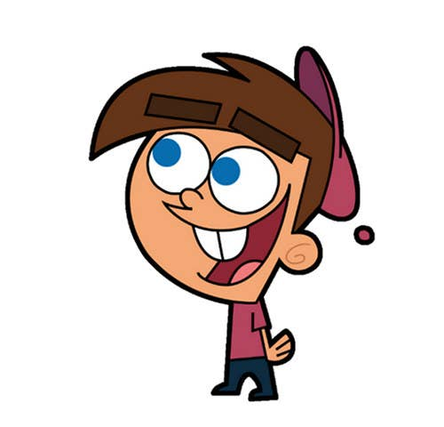


Welcome to class

Slide 2
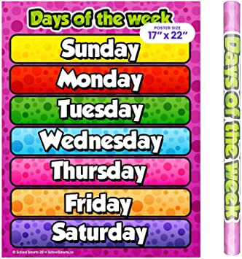

Slide 3
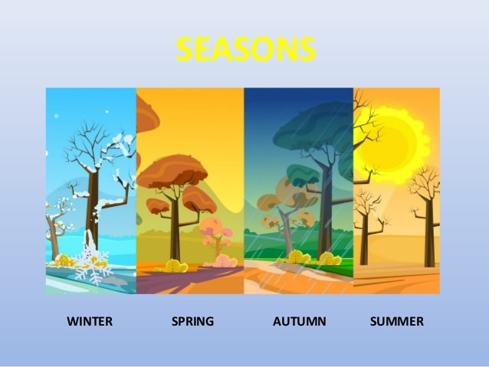

Slide 4
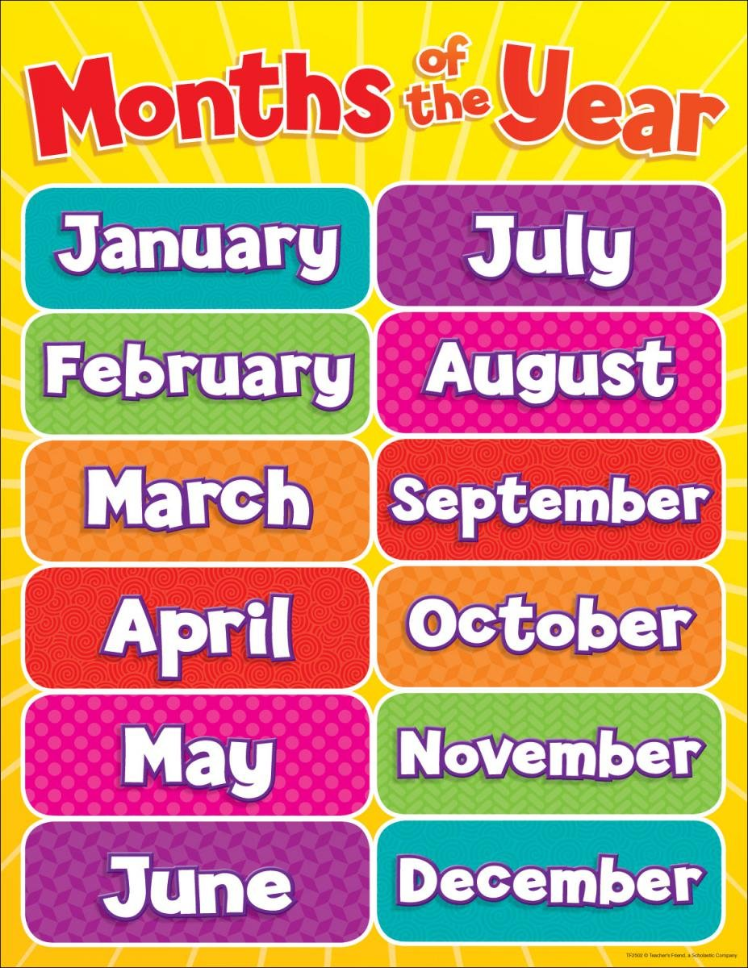

Slide 5
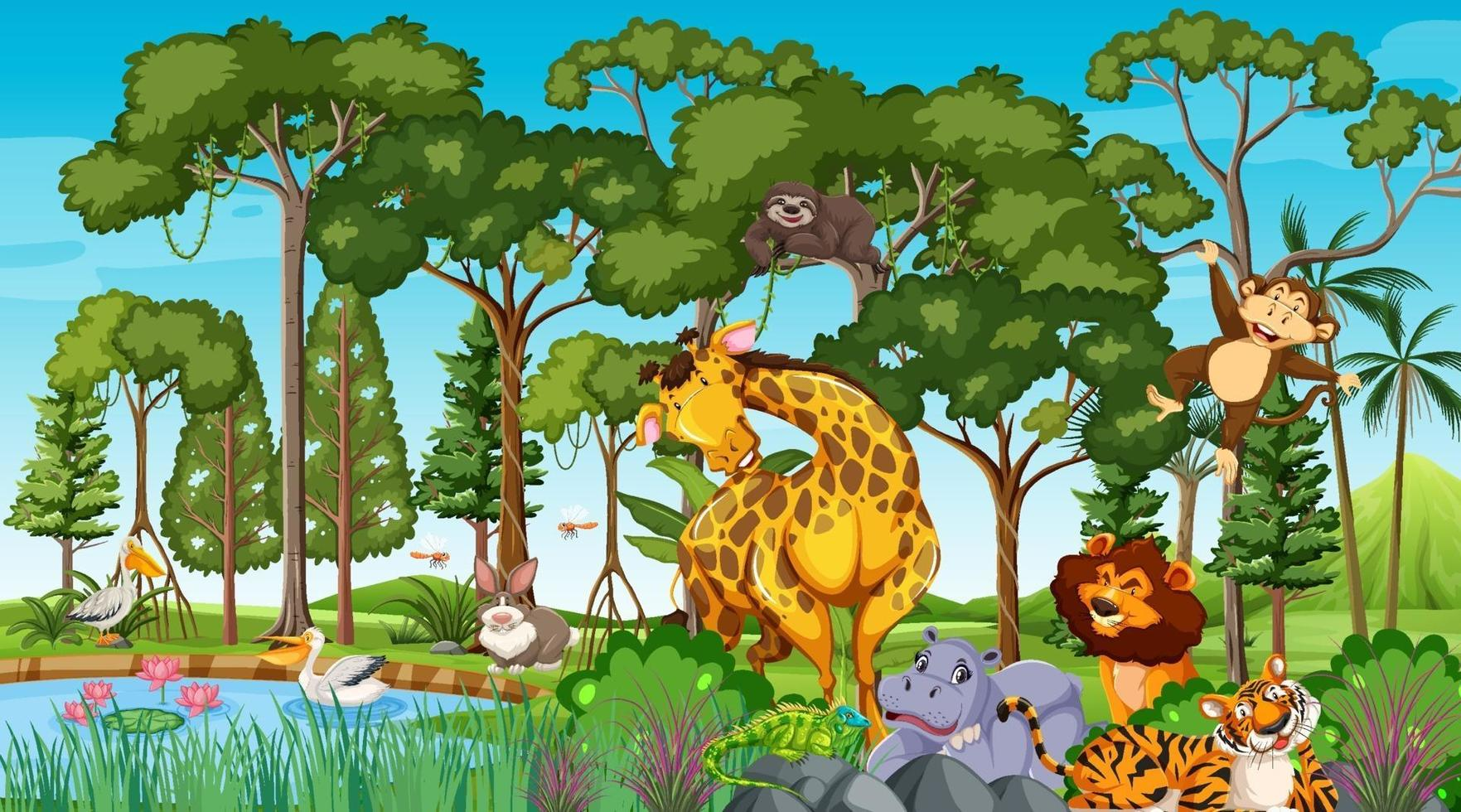

Wild animals
Lesson1

Slide 6
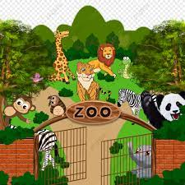
zoo

Slide 7
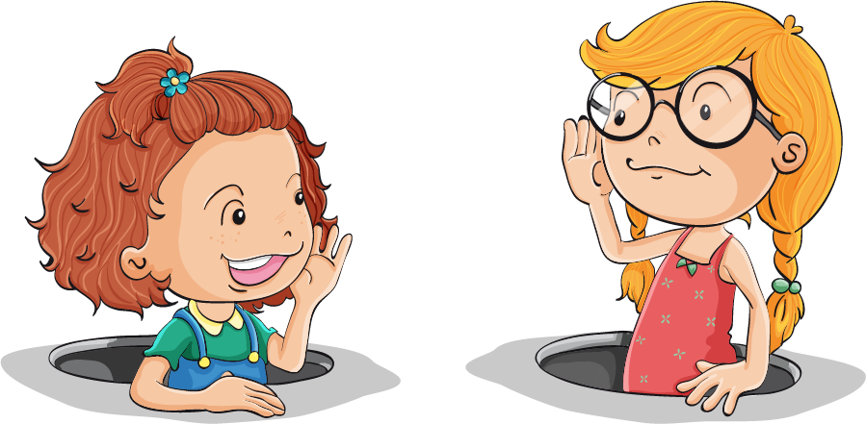
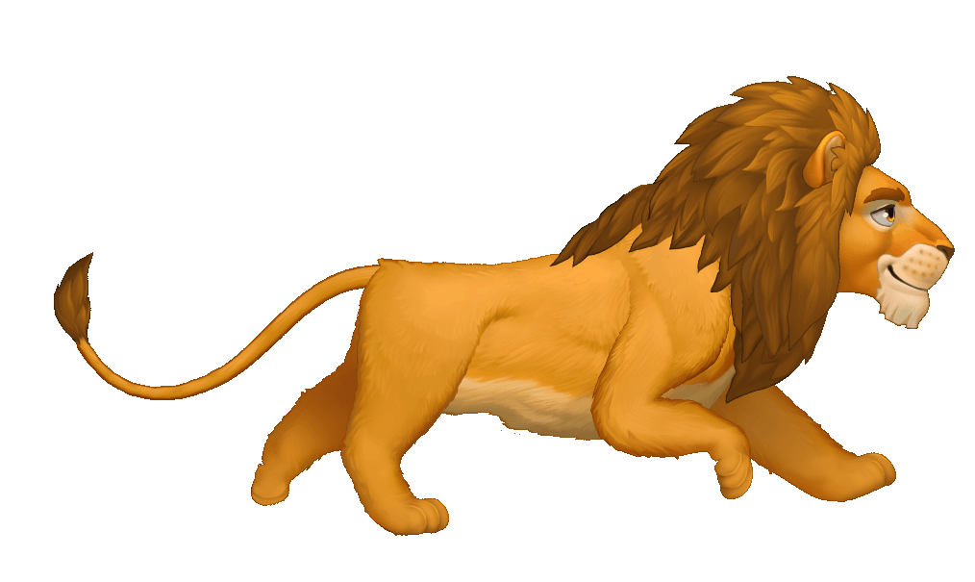
Listen and say
Listen and say
Lion
Lions

Slide 8
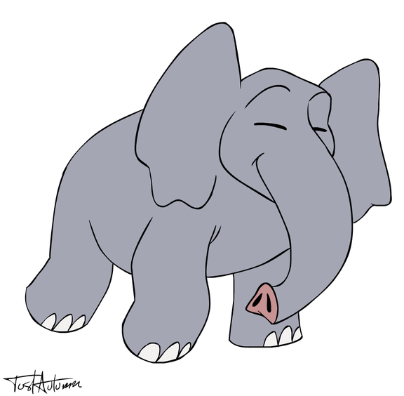
Listen and say
Listen and say
elephant
elephants

Slide 9
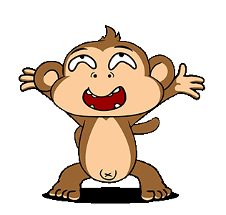
Listen and say
Listen and say
monkeys
monkey

Slide 10
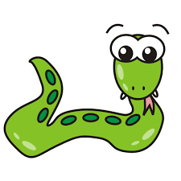
Listen and say
Listen and say
Snakes
Snake

Slide 11
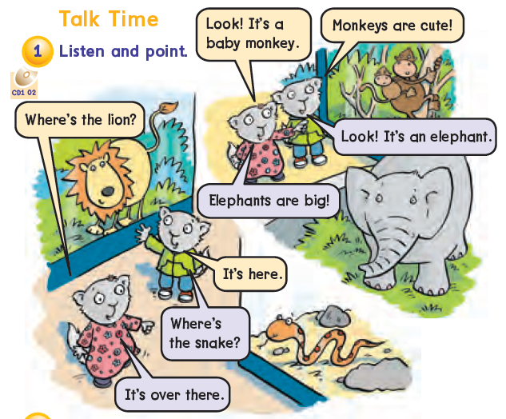
where are Safroota and Safroot?
They are at the zoo.

Slide 12


Slide 13

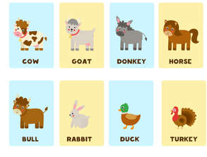
What animals are cute?
Monkeys are cute.
Ducks are cute.
Rabbits are cute.
Horses are cute.

Slide 14
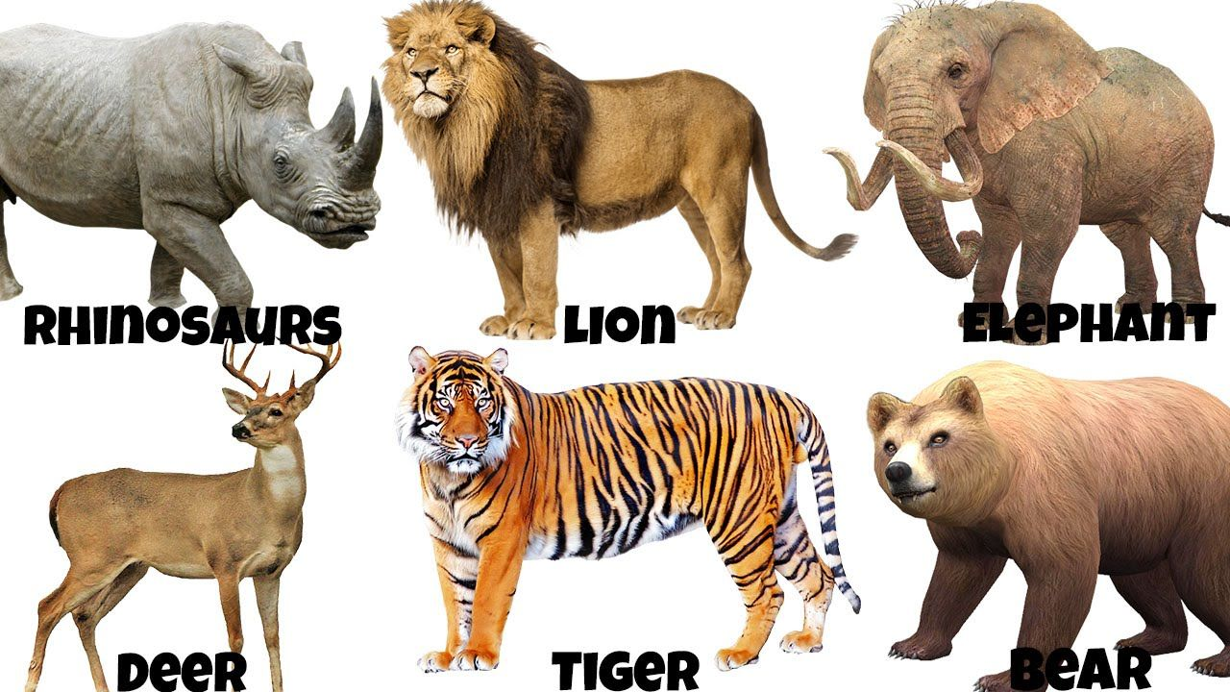
What animals are big?
Elephants are big.
Tigers are big.
bears are cute.
Lions are cute.

Slide 15
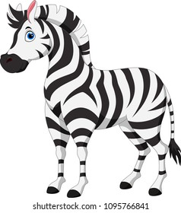
How about elephants?”
Are zebras big?
Yes, they are.
Elephants are very big.

Slide 16

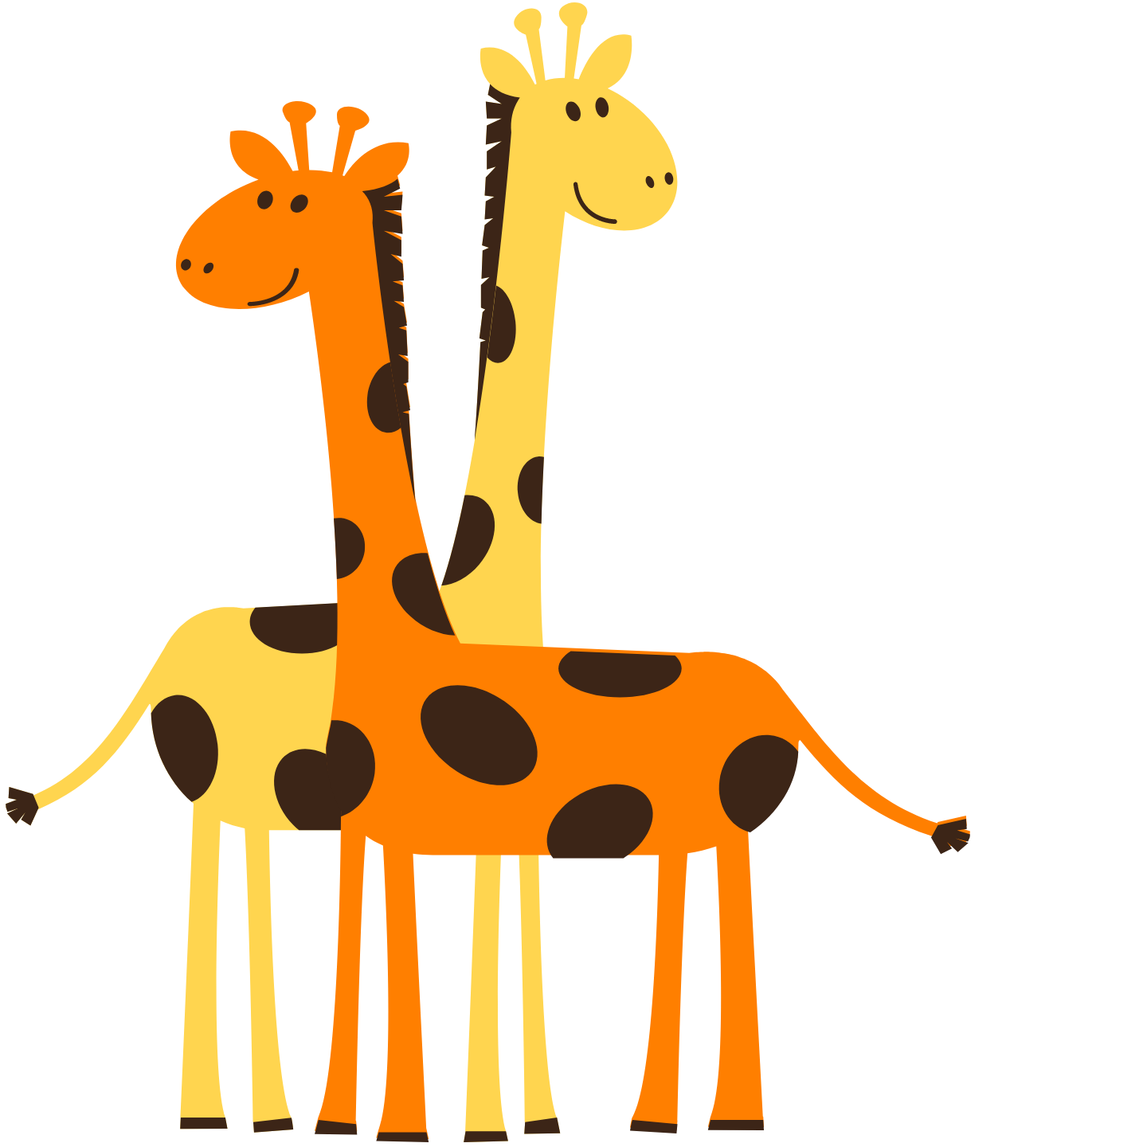

Use ‘very”
Giraffes are very tall.
Giraffes + tall

Slide 17
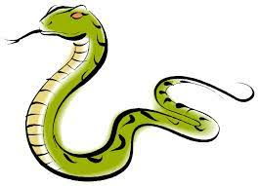
Use ‘very”
snakes are very scary.
Snakes + scary

Slide 18
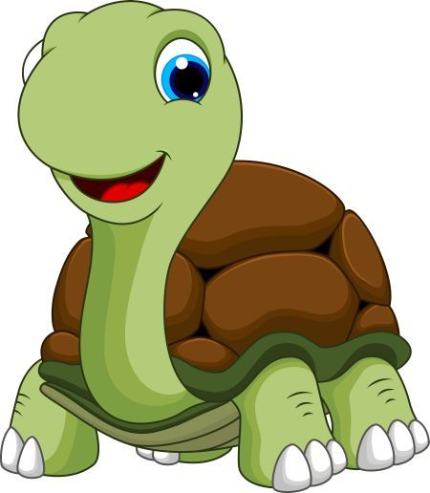
Use ‘very”
Turtles are very slow.
Turtles + slow

Slide 19
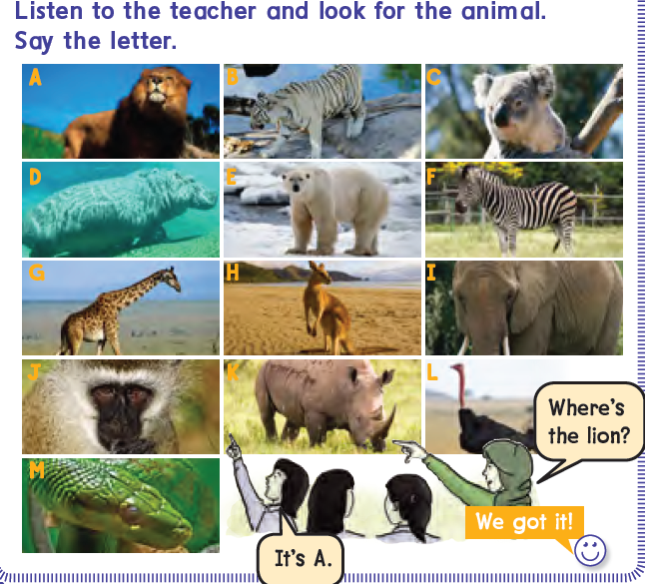

Slide 20


