Slide 1
We can
4
hello

Slide 2
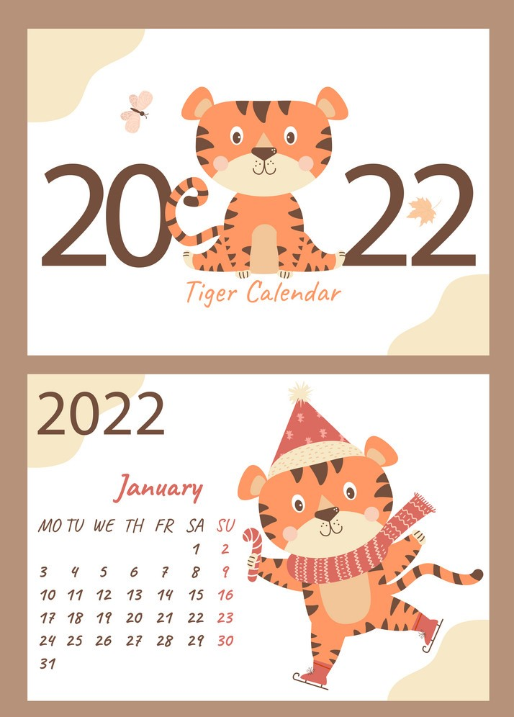
Day :
Date :

Slide 3



Slide 4

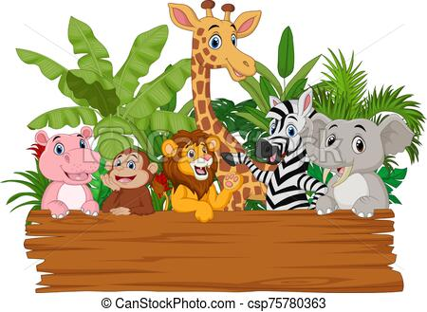

Unit 1
Lesson 4

Slide 5
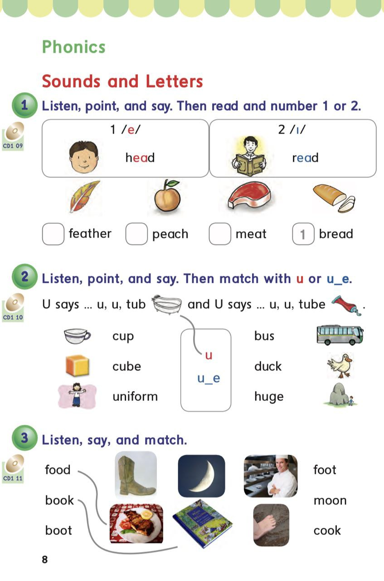
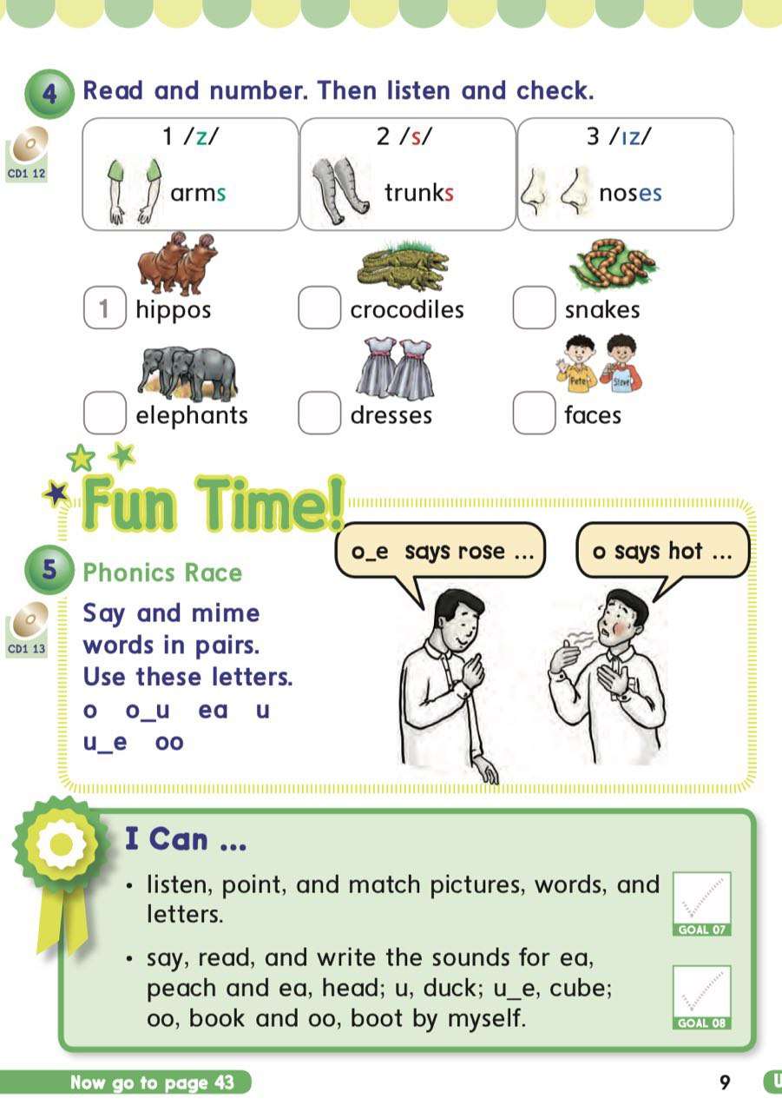
PAGES
8&9

Slide 6












I can ….. Listen, point, and match pictures ,words , and letters.
Say, read , and write the sounds
For ea, peach and ea, head; u, duck; U_e, cube; oo book and oo, boot
by myself.

Slide 7


Slide 8

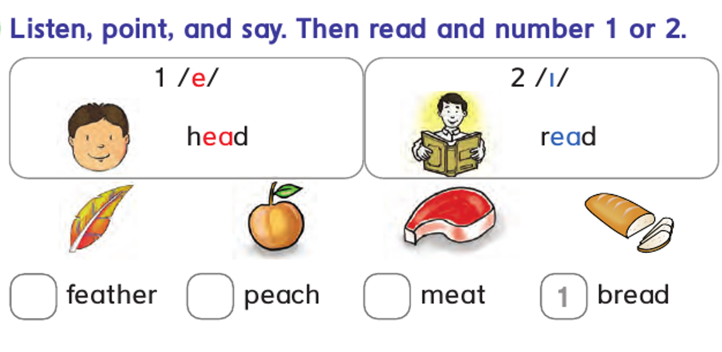

Slide 9


Slide 10
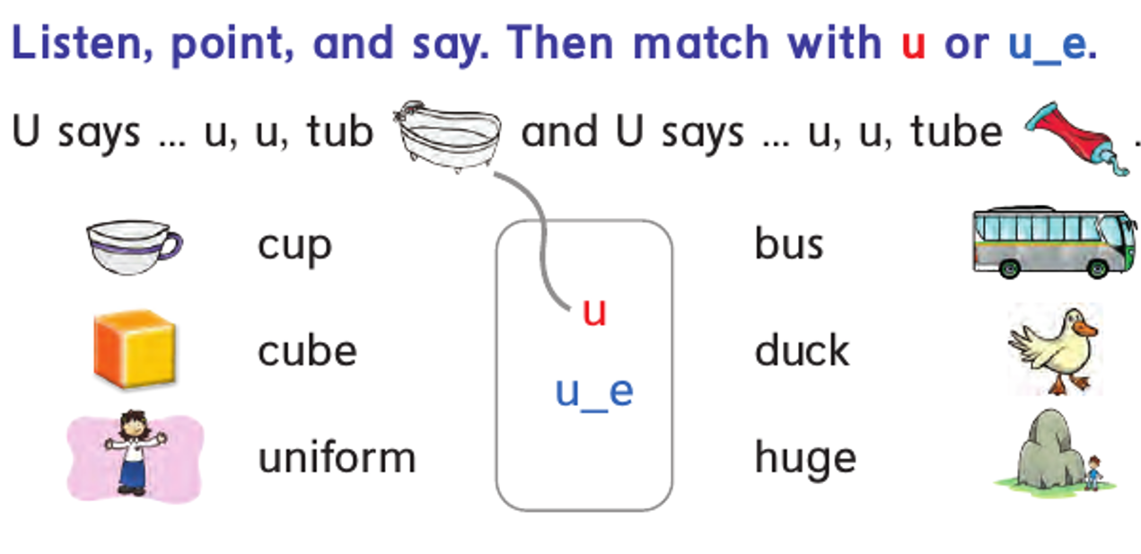

Slide 11


Slide 12
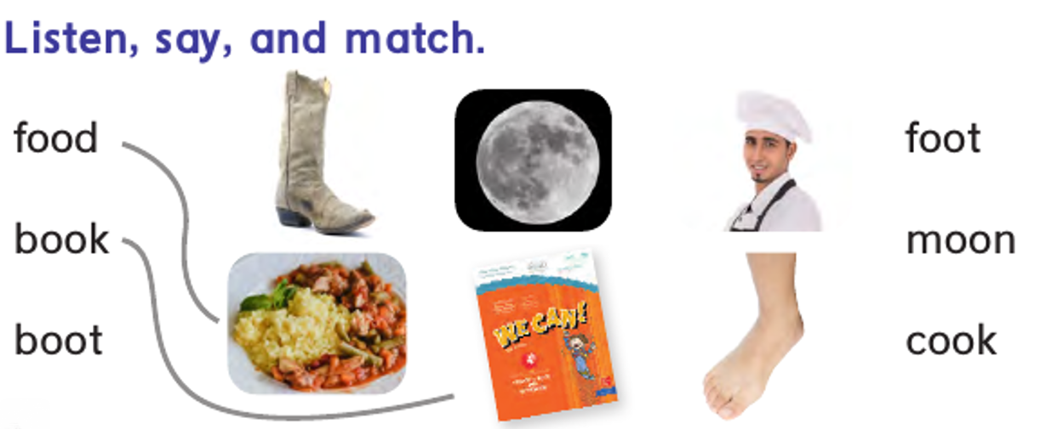

Slide 13


Slide 14
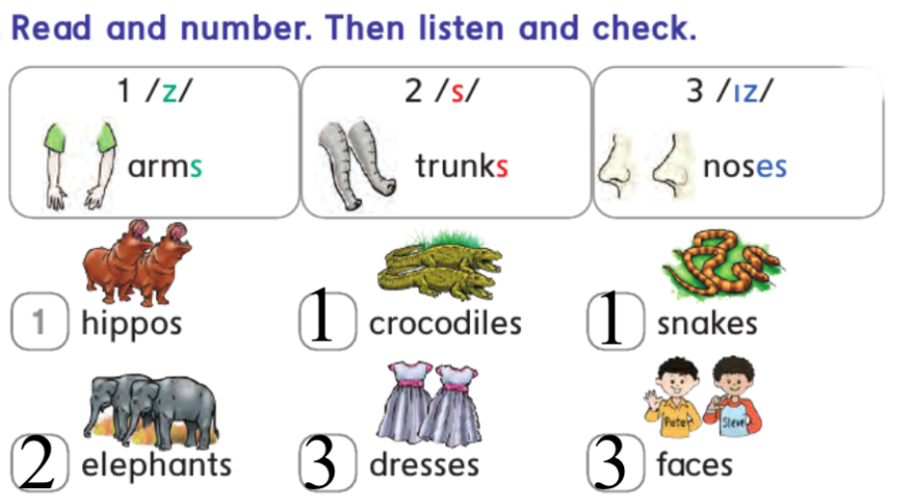

Slide 15


Slide 16

ea
u
U e
oo

Slide 17

ea
u
U e
oo

Slide 18

ea
u
U e
oo

Slide 19

ea
u
U e
oo

Slide 20

ea
u
U e
oo

Slide 21

ea
u
U e
oo

Slide 22
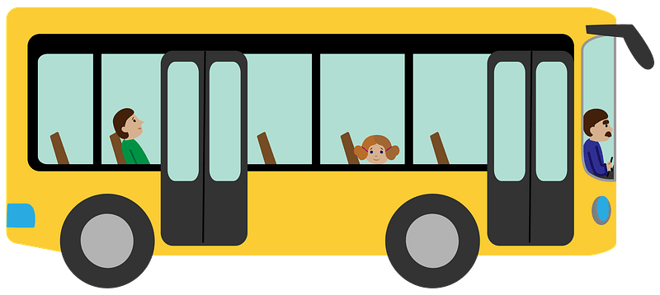
ea
u
U e
oo

Slide 23

ea
u
U e
oo

Slide 24

ea
u
U e
oo

Slide 25
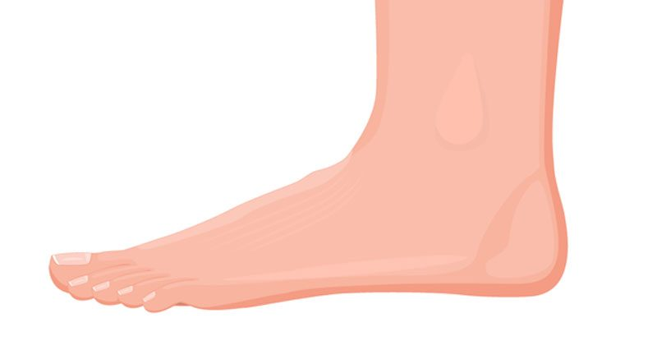
ea
u
U e
oo

Slide 26

ea
u
U e
oo

Slide 27



Slide 28



Slide 29

Open your book pages 69&70

Slide 30


Home work at

