Slide 1


WE CAN 2
Unit 3 lesson2 +3
2nd Term 2023

Slide 2

Lesson 2
Rhythms and Listening

Slide 3
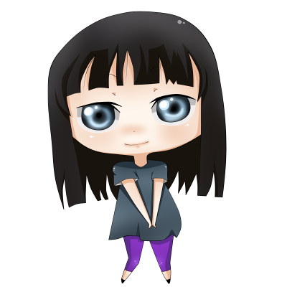
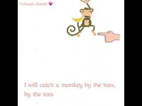
Animal Chant

Slide 4

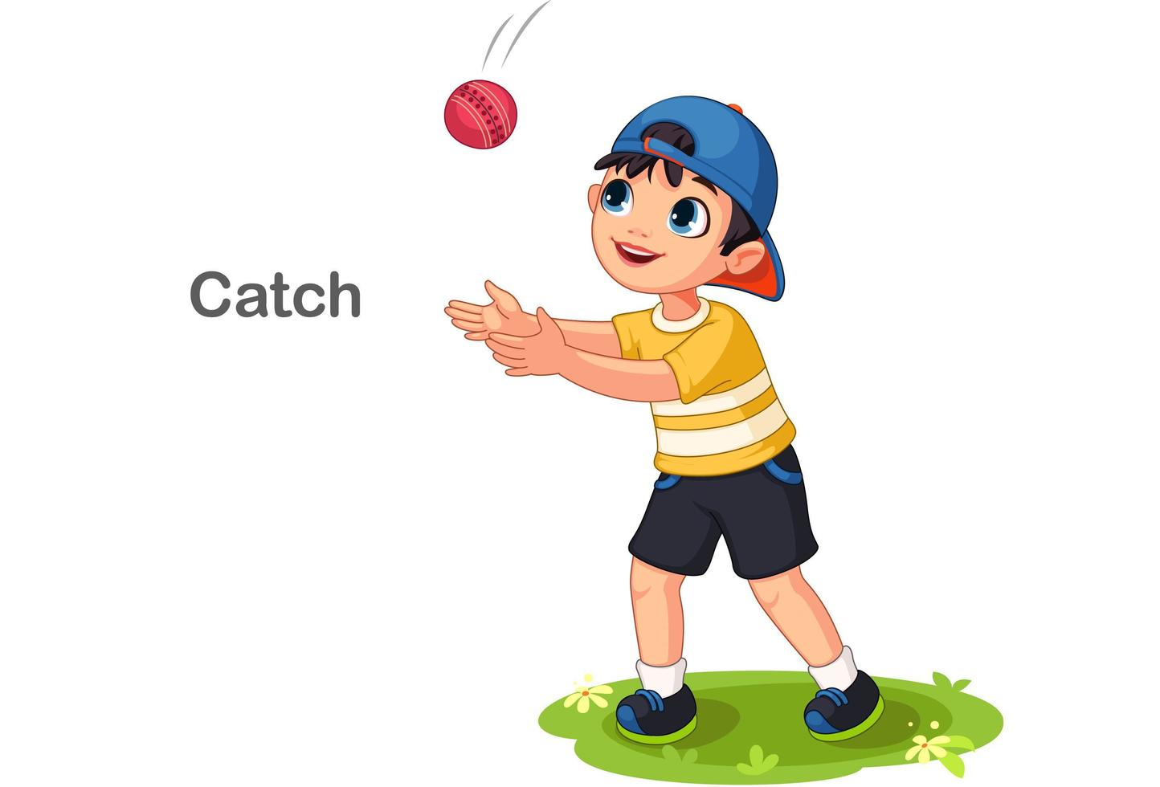
catch

Slide 5
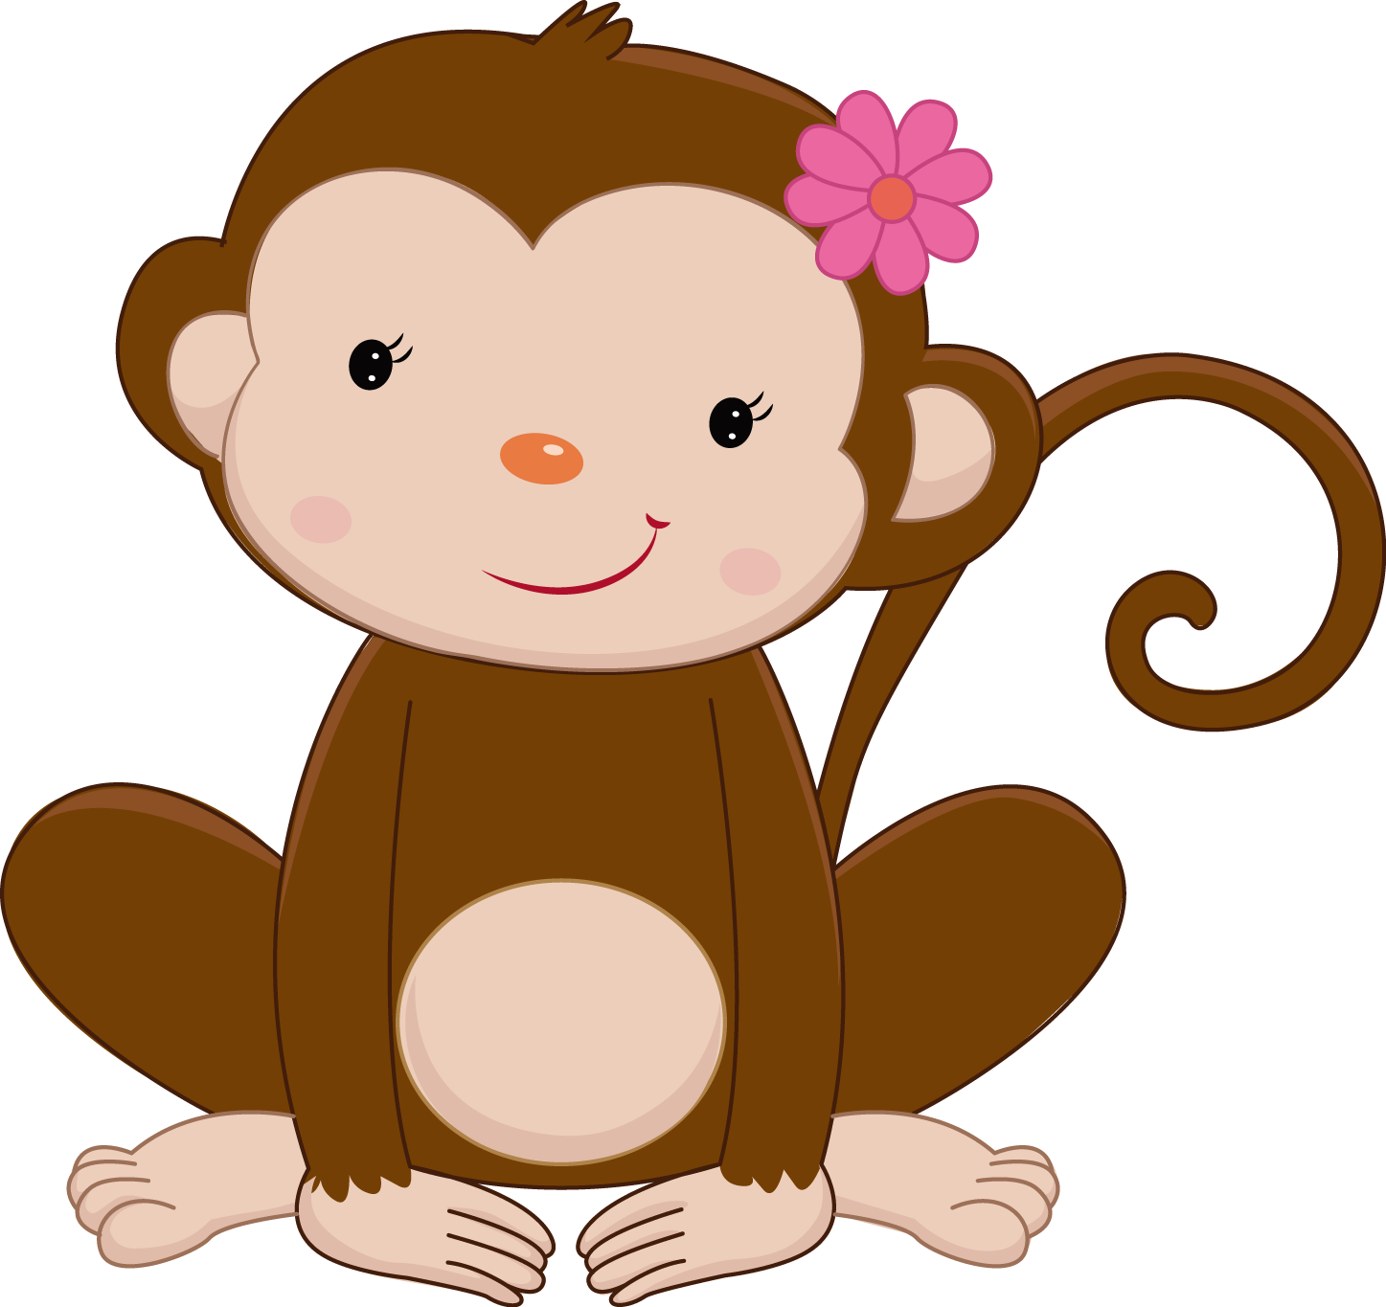
monkey
toes

Slide 6

elephant
trunk

Slide 7

tiger
tail

Slide 8


Snake
head

Slide 9

bear
nose

Slide 10
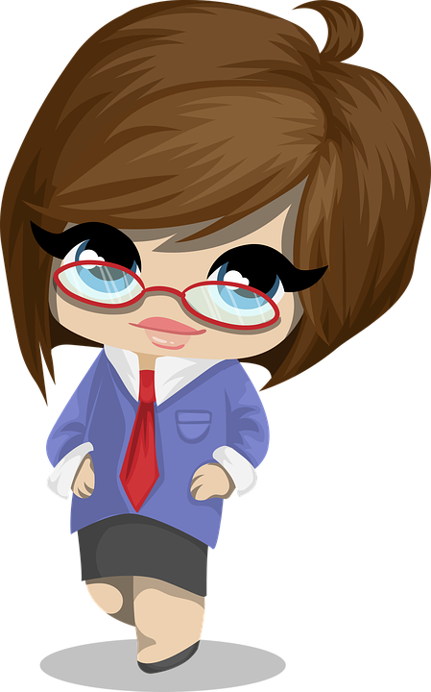


Sound and letters
o_e
O
Octopus
Rose

Slide 11
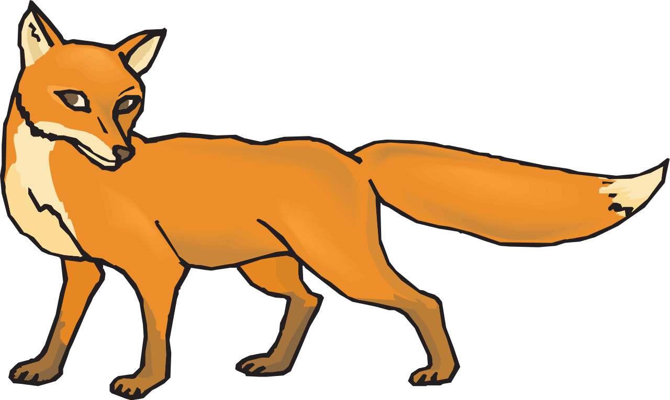

Sound and letters
o_e
O
fox
Rope

Slide 12



Slide 13
Lesson 3
Words in Action

Slide 14



Can you help Nina
to read the sentences?
Yes
No

Slide 15



Slide 16


Pick a Balloon
Pick a Balloon
1
3
2
4
5
6

Slide 17


Elephants are big.
They have trunks.

Slide 18

Zebras are black and white.
They have strips.

Slide 19


Crocodiles are scary.
They have big teeth.

Slide 20
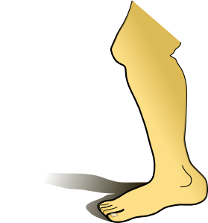

They have no arms
or legs.
Snakes are long.

Slide 21

Hippos are fat.
They have big mouth.

Slide 22
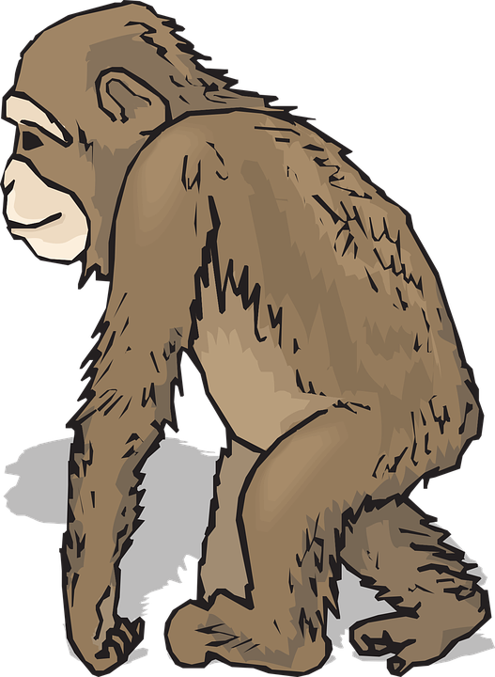
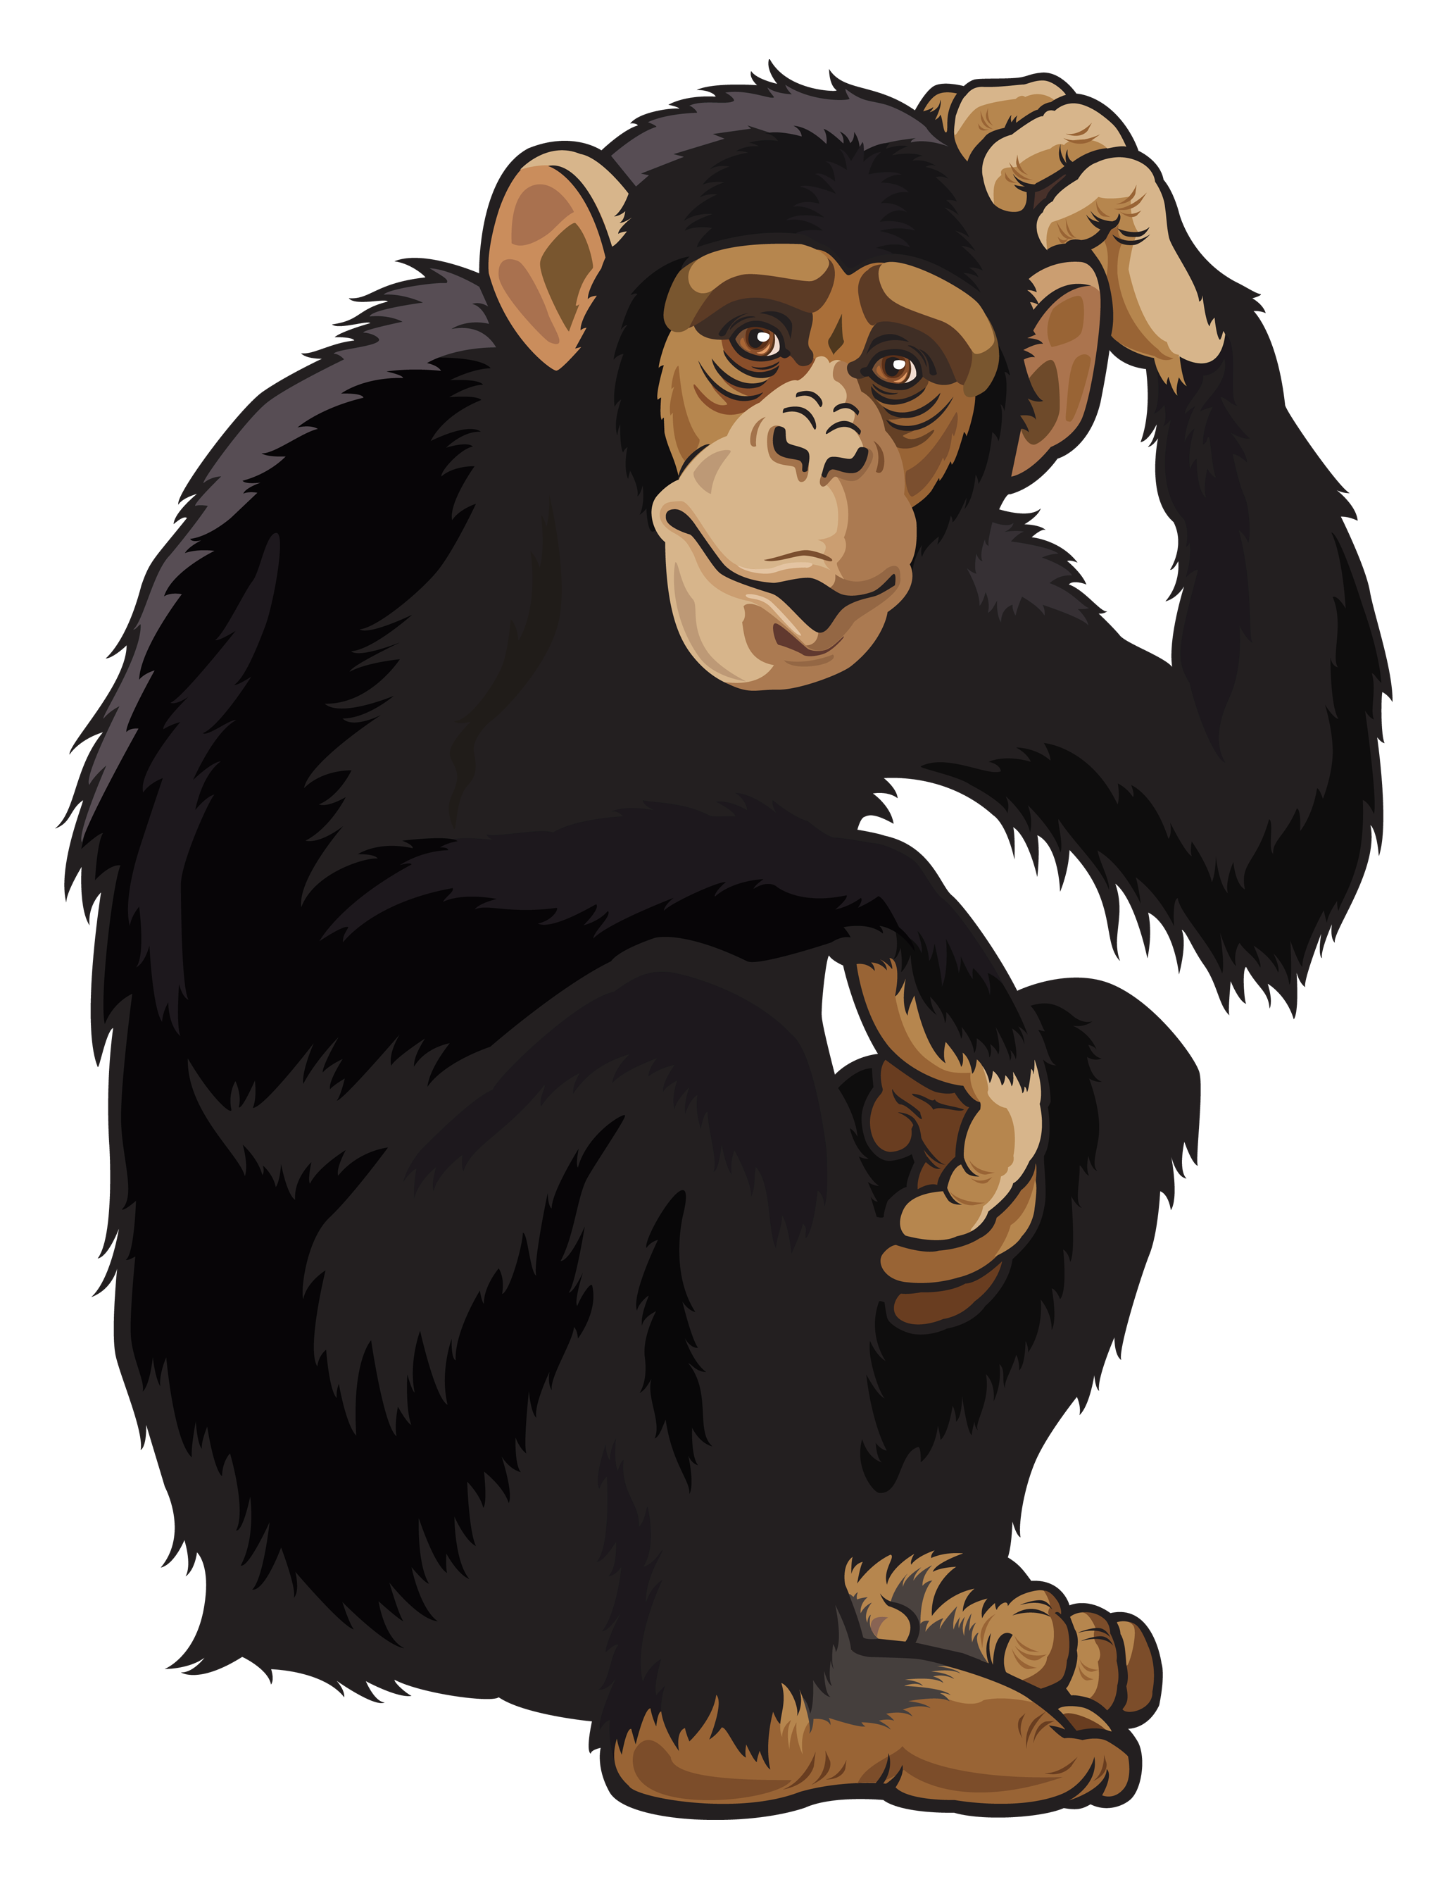
Chimpanzees are smart.
They have long arms.

