Slide 1

Unit 7
It’s a Good Deal , Isn’t It ?
Reading
Page 70, 71

Slide 2
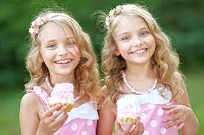
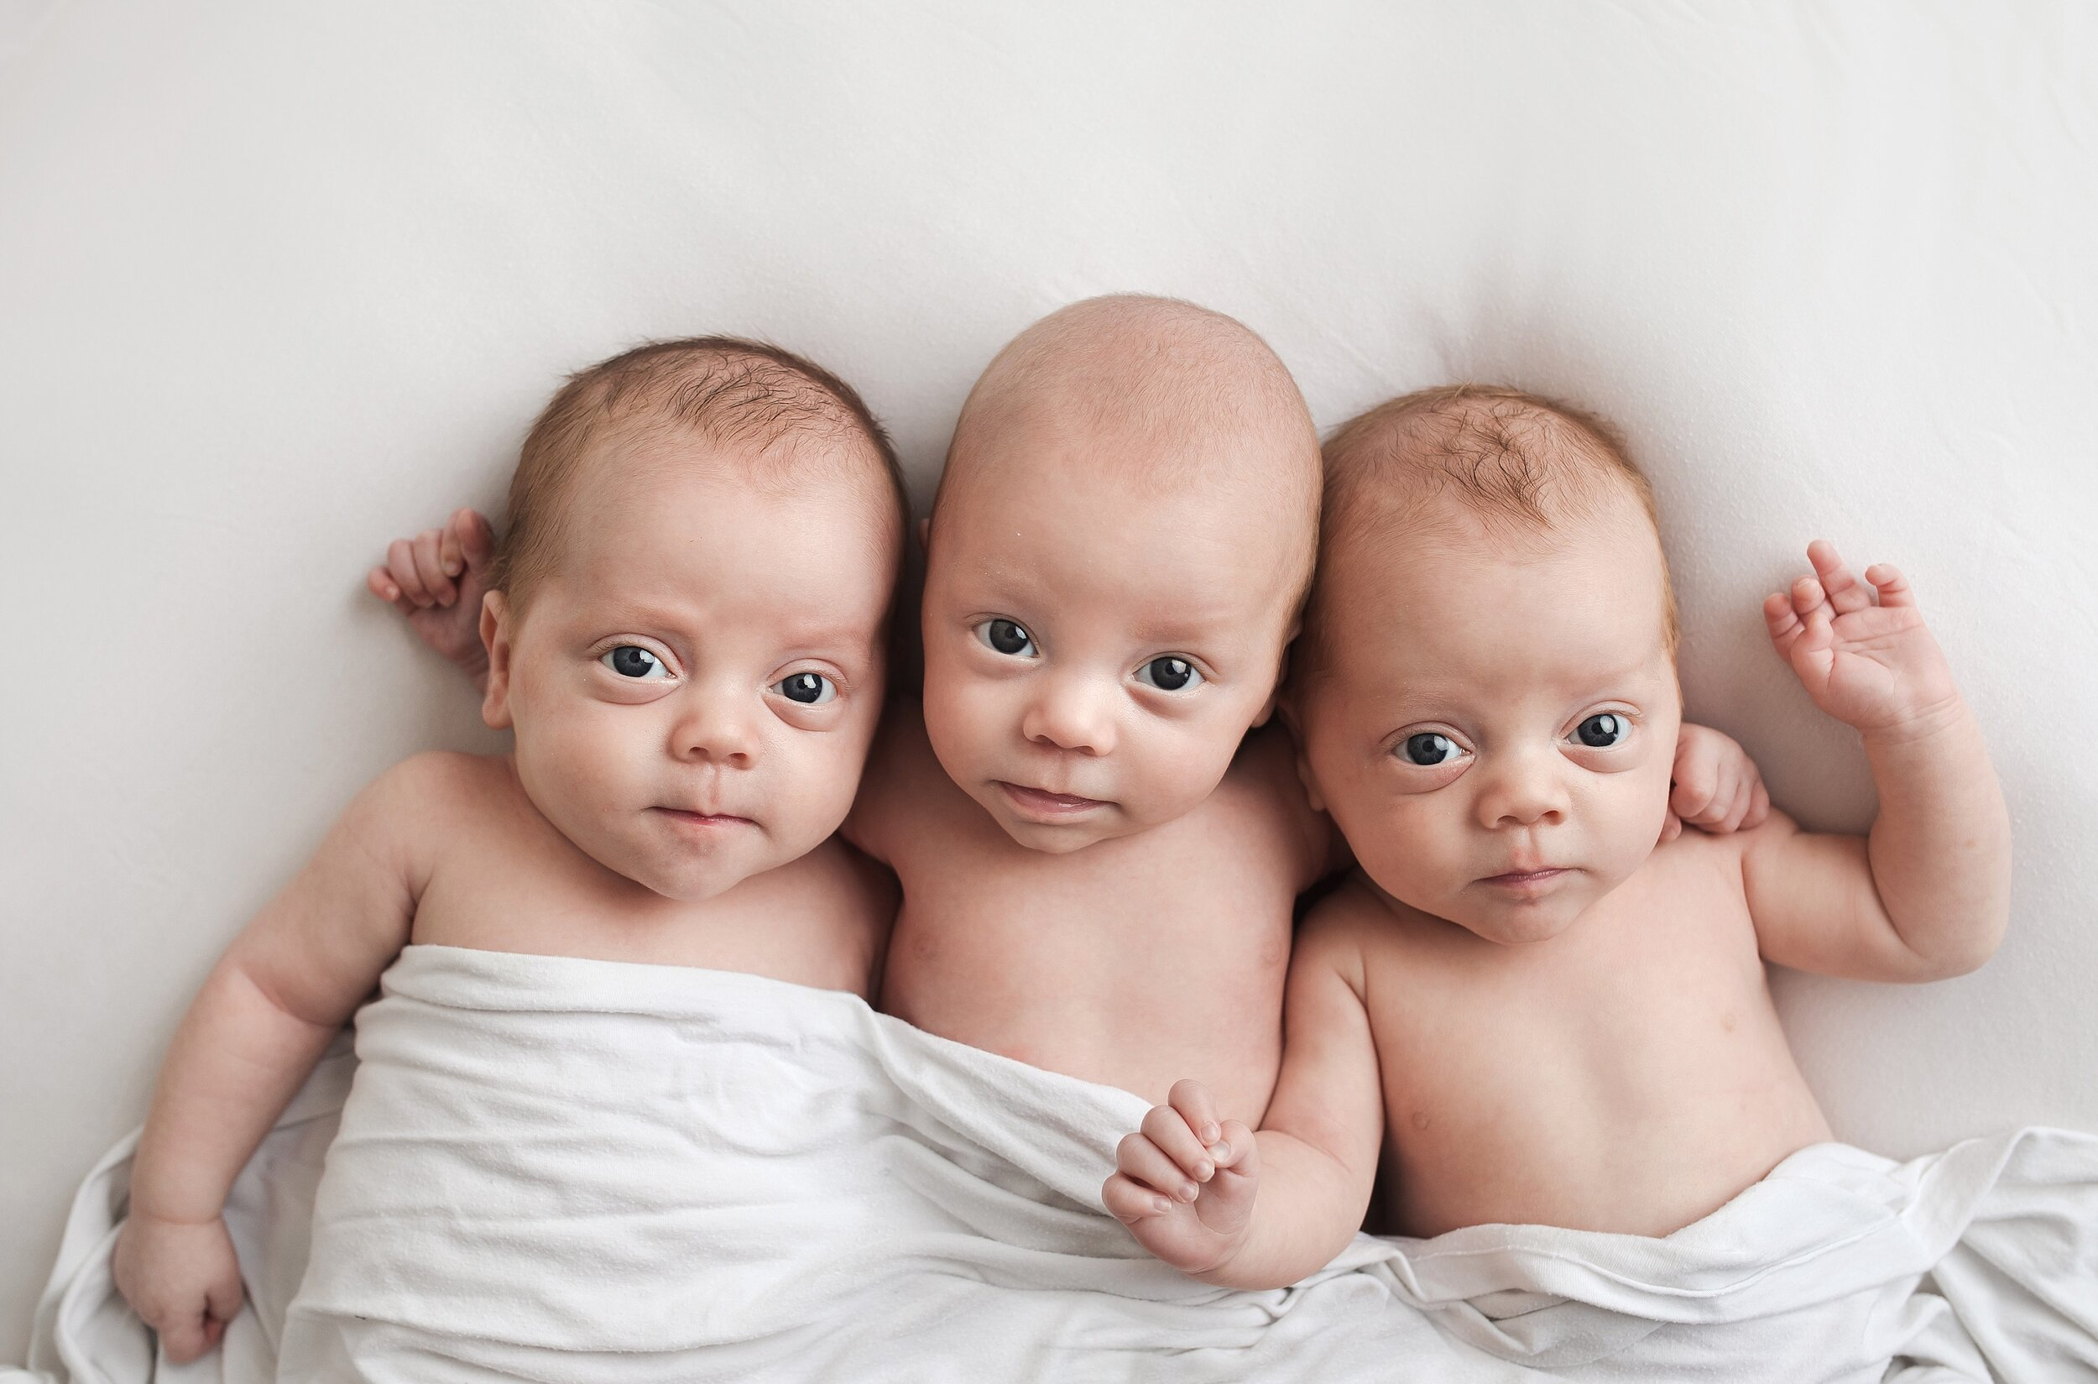
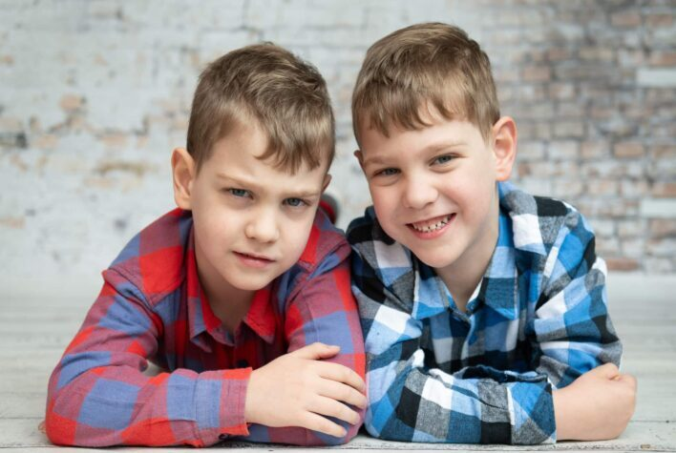
What do you know about twins?
Have you ever met one?
triplets
twins

Slide 3

Scan the text to give a title for each paragraph
Answer some questions by reading
Match the words with their meanings

Slide 4
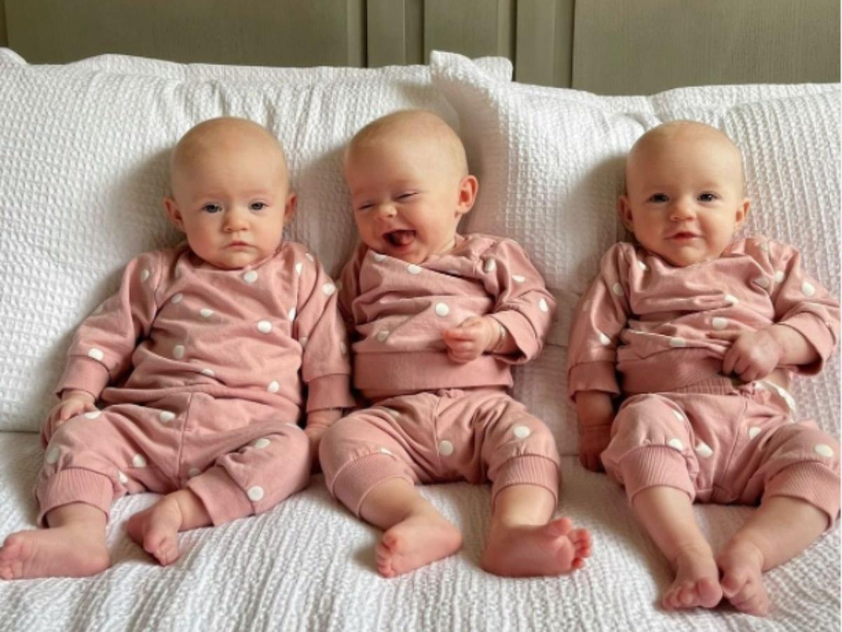
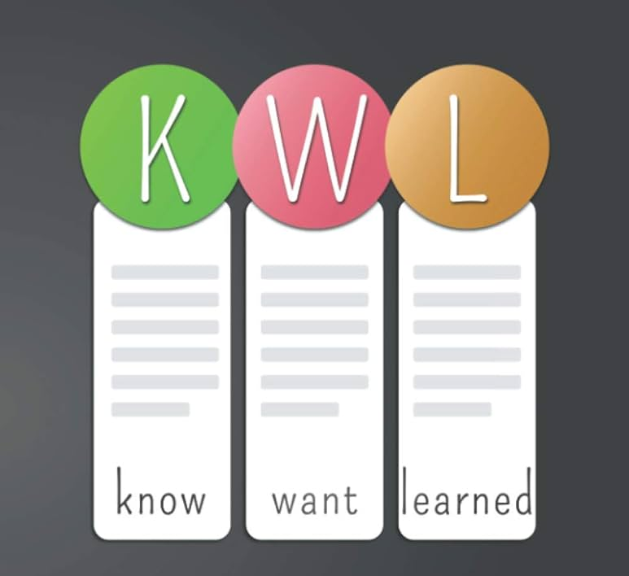

Slide 5
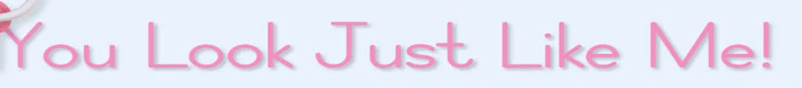
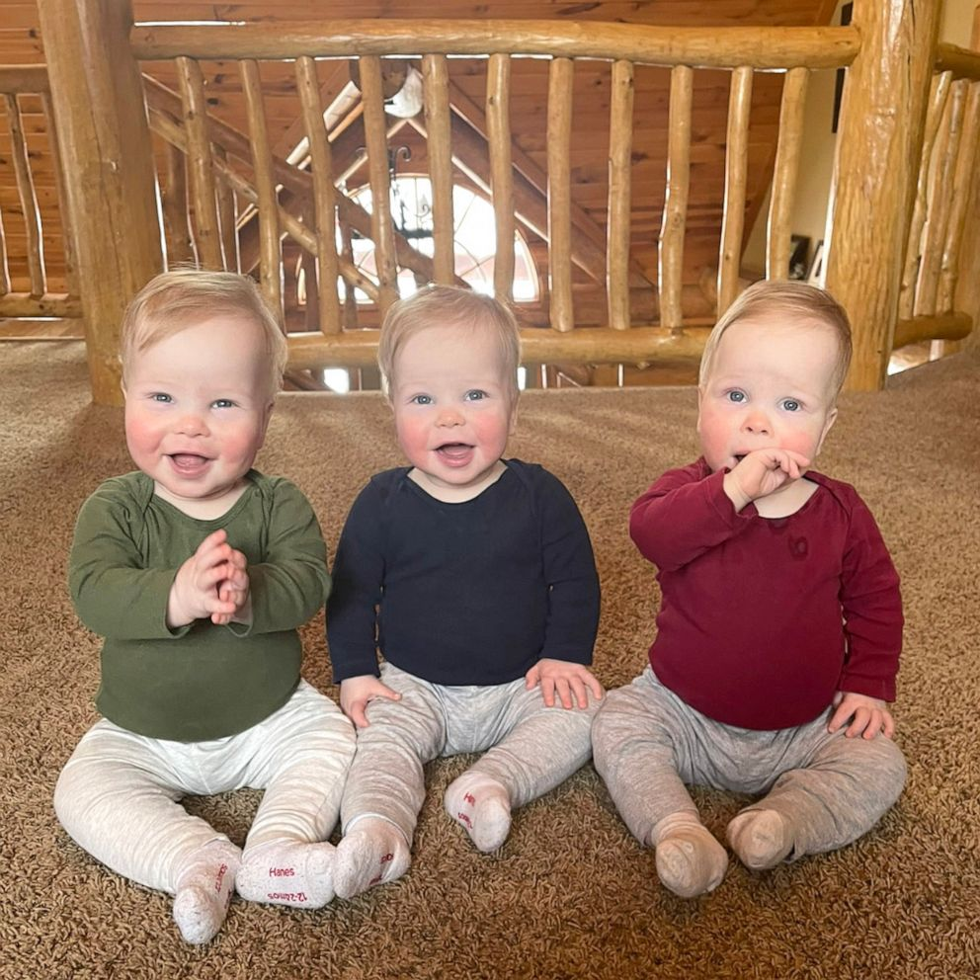

Slide 6
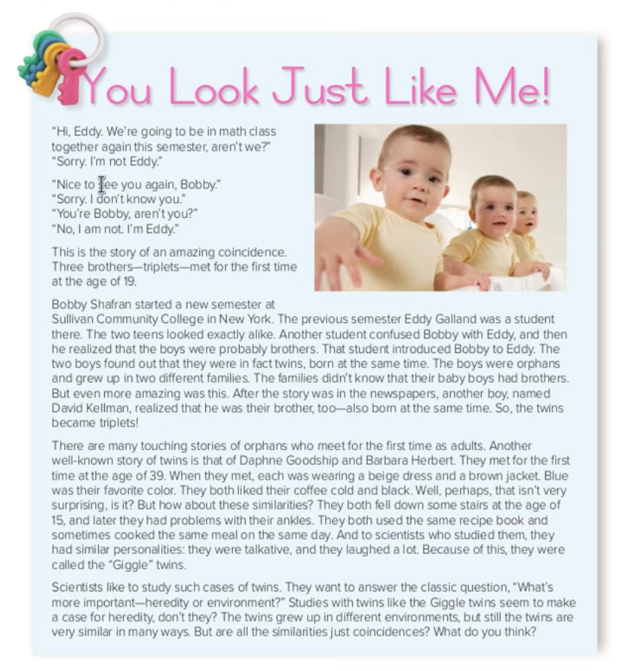






What is the title ?
How any paragraphs are there?

Slide 7
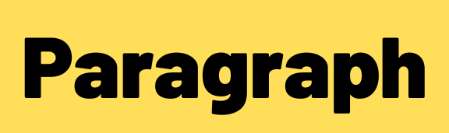

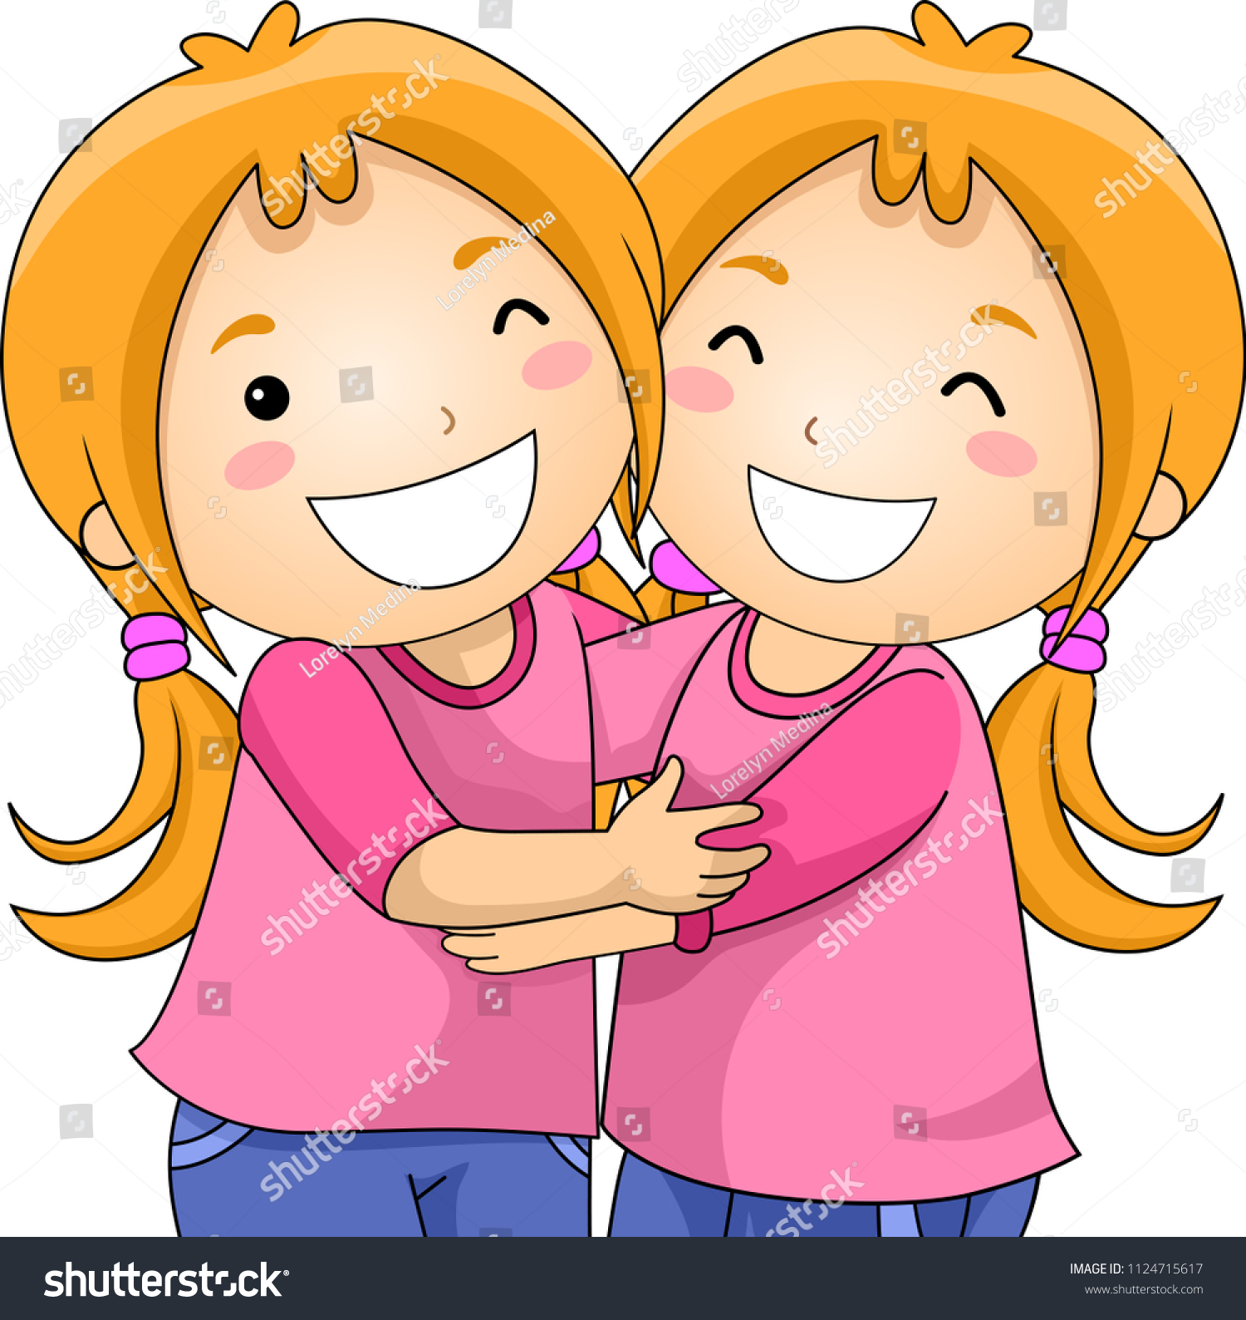
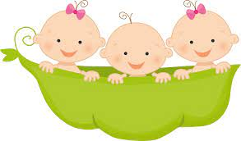
Amazing Coincidence
Triplets’ Story
Twins’ Story
Heredity or Environment

Slide 8
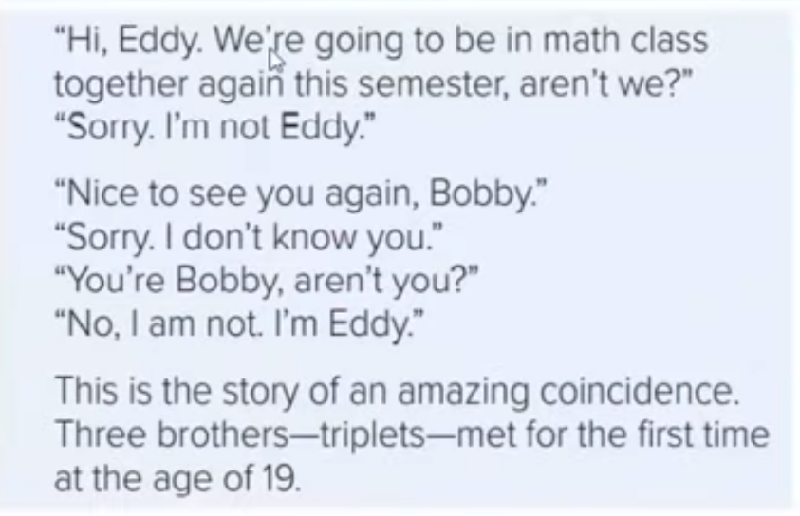

Amazing Coincidence
When two things happen together by chance
1- How did Bobby and Eddy first meet?
They met by an amazing coincident at the age of 19

Slide 9
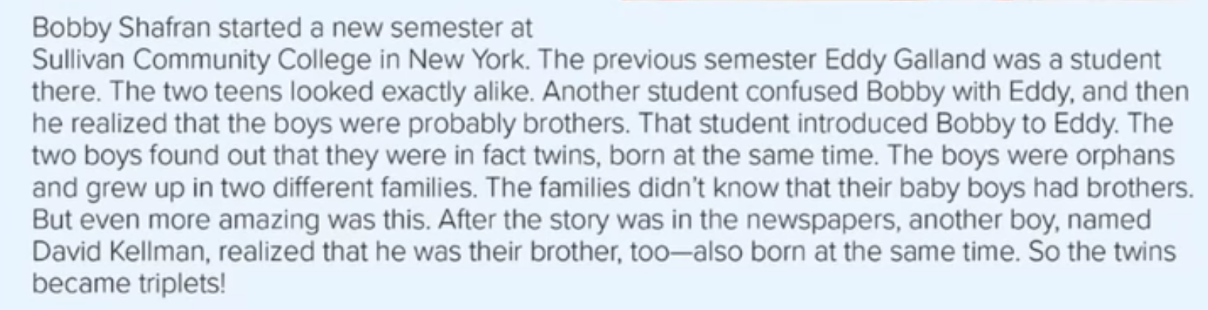
Triplets’ Story
Think wrongly that a person is someone else
A child who lost his parents
three children born at the same time
2- What happened when David read the newspaper?
He realized that he is their brother too! So, the twins became triplets

Slide 10


Slide 11
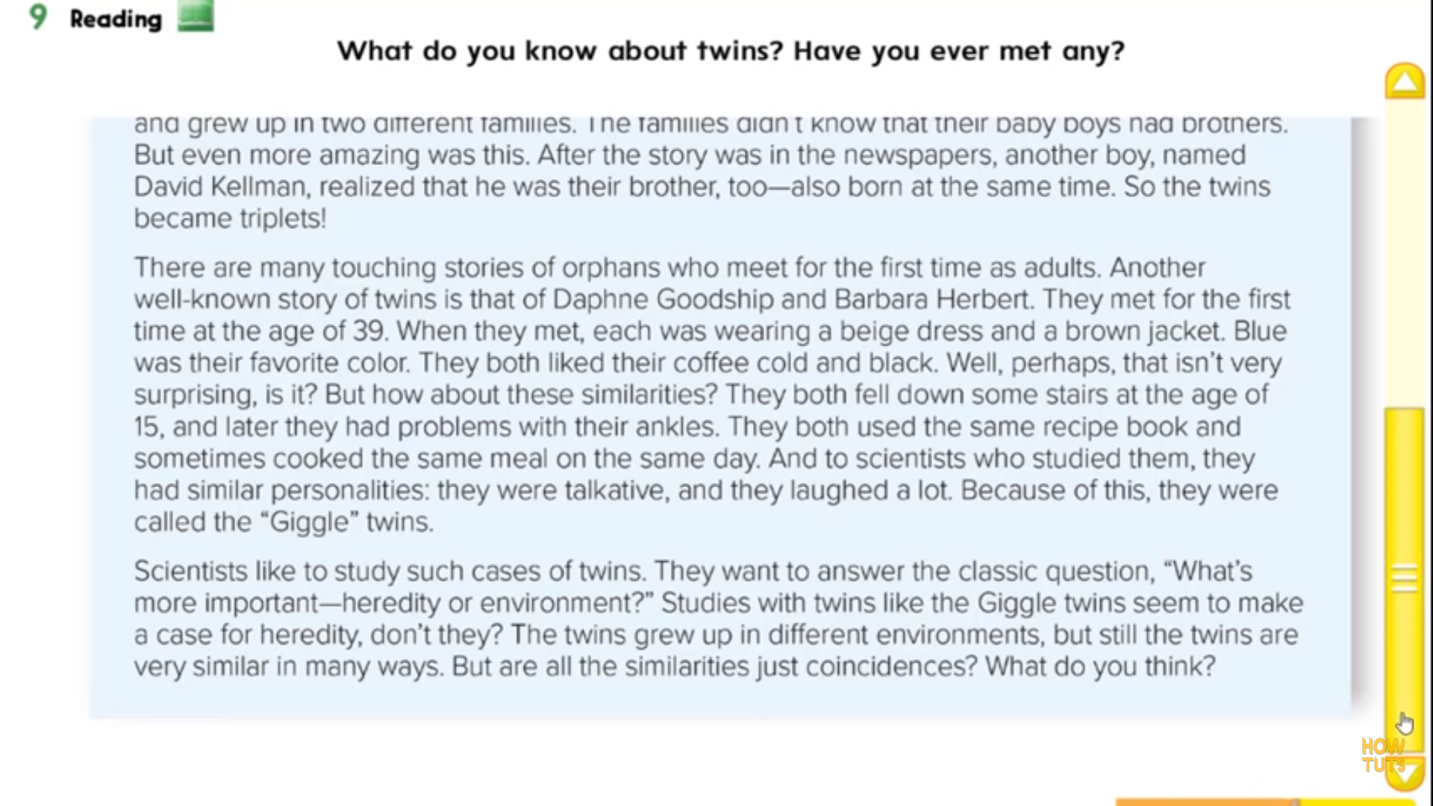
Twins’ Story
Having emotional effect
3- How were the Giggle twins similar?
Blue was their favorite color, They both like cold and black coffee , They both fell down some stairs at age of 15 . They were talkative and laughed a lot
4- Why were they called the “Giggle” twins?
Because they were talkative and laughed a lot

Slide 12
Heredity or Environment
what you get from your parents
4- Why is the case of the “Giggle” twin thought to be heredity?
Because they grew up in different places. Still they are very similar

Slide 13
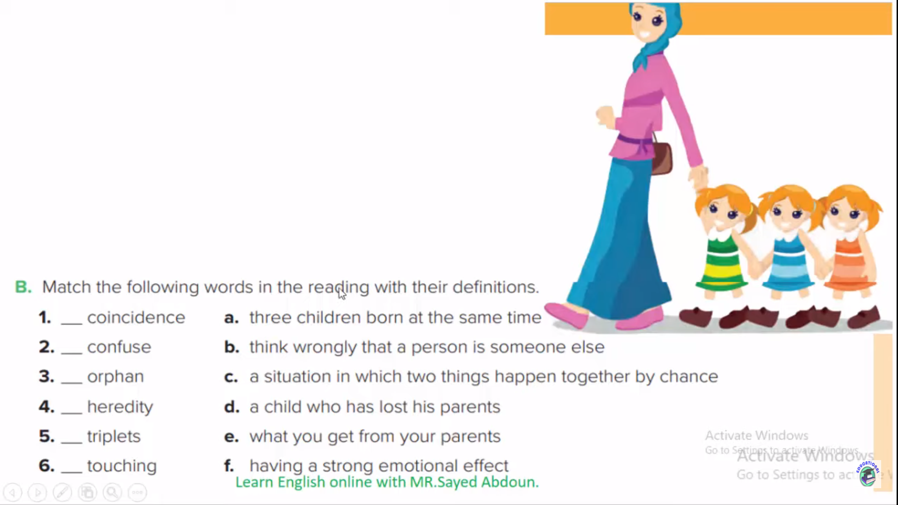
c
b
d
e
a
f

Slide 14
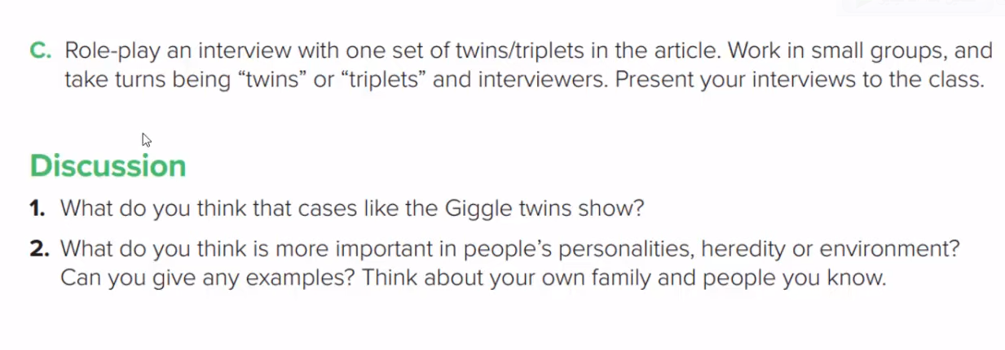

Slide 15
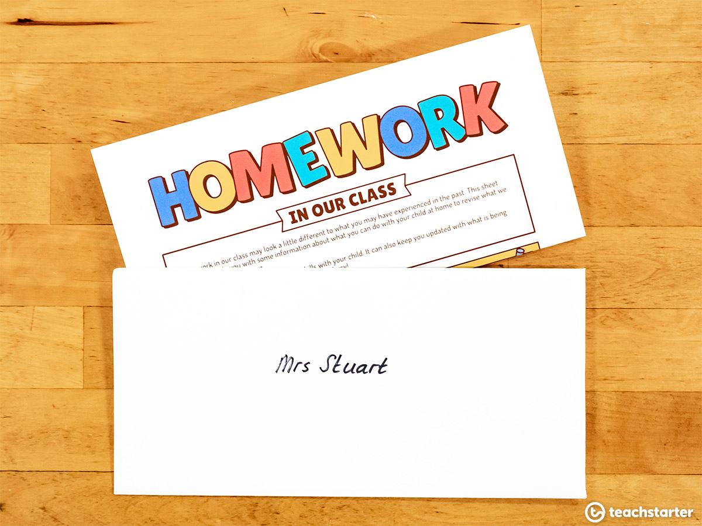
Work Book page 201
Tr.Kholud

Slide 16


