Slide 1
7 Everyone Makes Mistakes Listening & Pronunciation P. 101

Slide 2
LESSON CONTENT
01
02
03
Listen
Pronounce
Learn
To two stories
Reduced modals
New vocabulary

Slide 3
01
Listening

Slide 4
Guess the Topics
What do you think you will listen about?

Slide 5

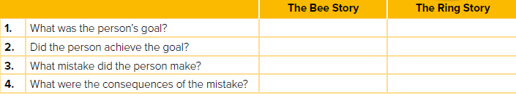
Listen to two stories about silly mistakes. Then fill the chart.

Slide 6
Listen to two stories about silly mistakes. Then fill the chart.
Bees Story
The Ring Story
1. What was the person’s goal?
to get rid of the bees
to give his wife an
anniversary ring.
2. Did the person achieve the goal?
Yes
No
3. What mistake did the person make?
He set his shed on fire
The wind pulled the balloon from his hand.
4. What were the consequences of the mistake?
The fire caused $80,000
worth of damage.
The wind pulled the balloon from his hand.

Slide 7
01
Pronunciation

Slide 8
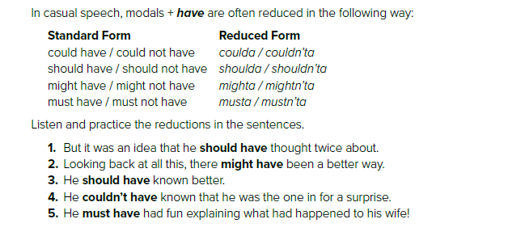
Listen and Practice.

Slide 9
01
Vocabulary Building

Slide 10
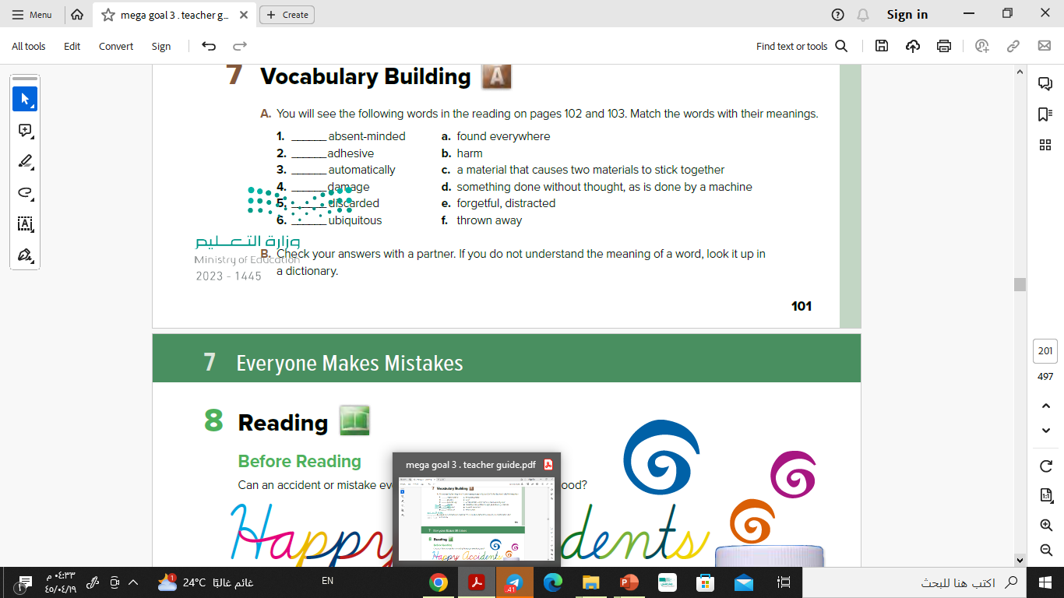
Find the meanings of new vocabulary.

Slide 11
Have a Nice Day!

