Slide 1
7 Everyone Makes Mistakes
CONVERSATION
P. 100

Slide 2
LESSON CONTENT
01
02
03
STUDY
LEARN
ROLE PLAY
The conversation
New words and expressions
Apologizing and responding to apology

Slide 3
01
conversation
LISTEN AND ANSWER QUESTION

Slide 4
DESRCIBE THE PICTURE
What do you think happened?

Slide 5
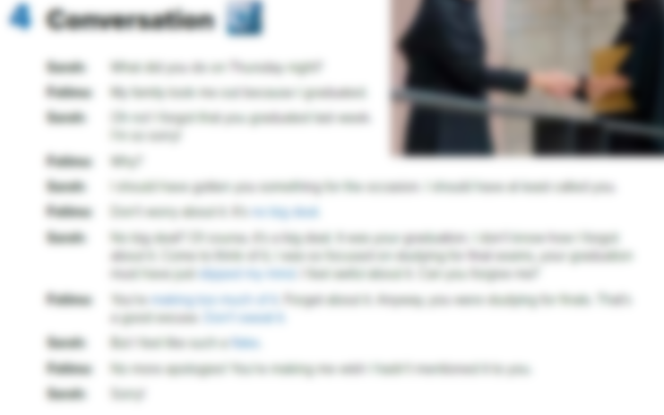

Listen and find out!
Books should be closed!

Slide 6
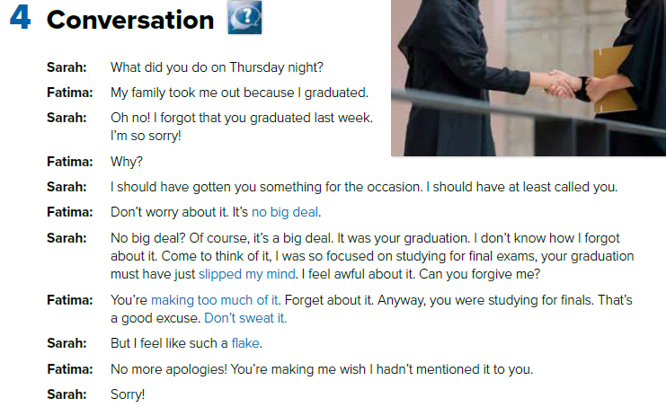
Listen and read!

Slide 7
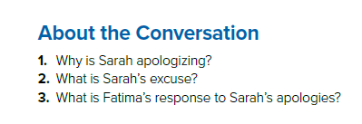
Answer

Slide 8
About the Conversation
1. Why is Sarah apologizing?
2. What is Sarah’s excuse?
3. What is Fatima’s response to
Sarah’s apologies?
She’s apologizing for forgetting Fatima’s graduation day.
Sarah was focused on studying for final exams.
Fatima doesn’t mind. She tells Sarah not to worry about it.

Slide 9
02
Real Talk
Learn & Practice

Slide 10
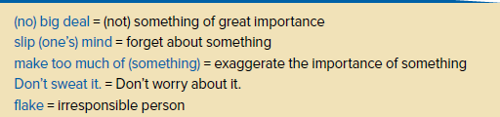
Real Talk
Who said each one and why?

Slide 11
Let’s Practice!
1. Would you like people to make a big deal about your graduation?
2. Has someone’s graduation or another important
event ever slipped your mind? How did you feel?
3. Tell about a situation when someone apologized
to you. Did the person make too much of it?
4. Have you ever felt like a flake?

Slide 12
03
Your Turn
Role Play Activity

Slide 13
01
Apologizing
02
Responding to an Apology
Can you forgive me? Don’t sweat it.
I feel awful about this. Don’t worry about it.
I’m so sorry. Forget about it.
I’m sorry. I should (not) have… It’s no big deal.
Please excuse me for… That’s OK.

Slide 14
Your Task
Role-play with a partner. Choose a situation
in which one person apologizes to another.
Use phrases for apologizing and responding
to an apology.

Slide 15
Have a Nice Day!

