Slide 1





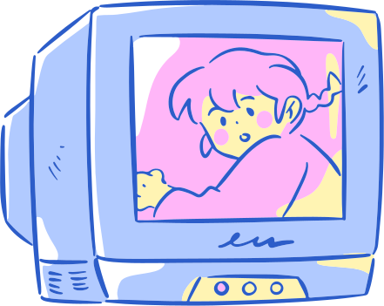

we can 3
5TH - 6TH GRADE
PRESENTED BY T: HIND M ALMUTAIRI

Slide 2
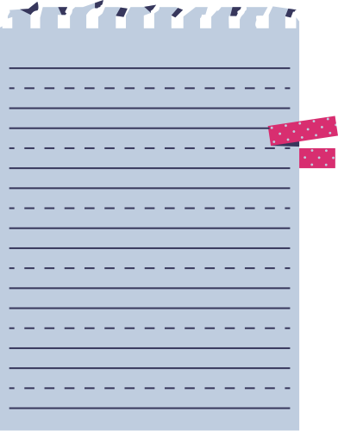

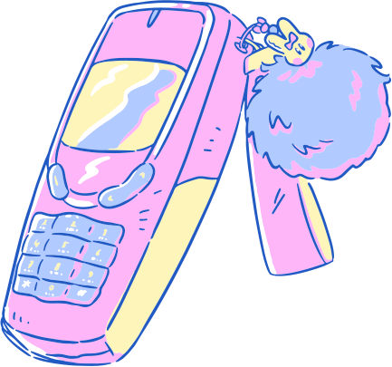
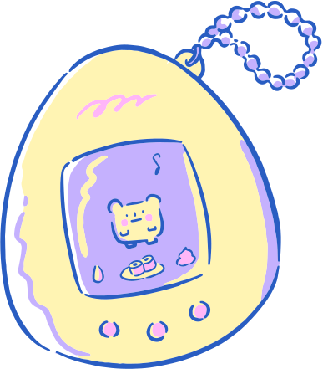
DAY
SUNDAY
DATE
11 - 6 - 1445
season
winter

Slide 3
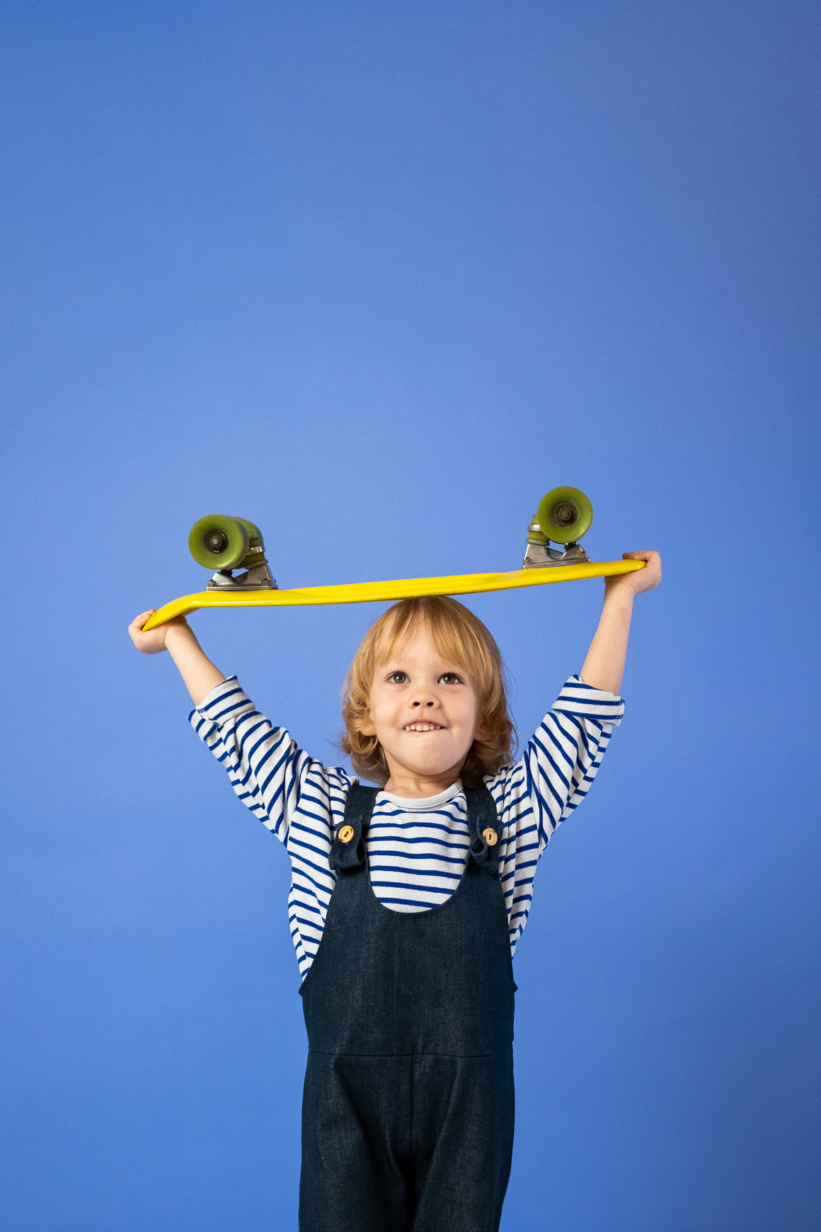



warm up
what is your weekend mood ?

Slide 4



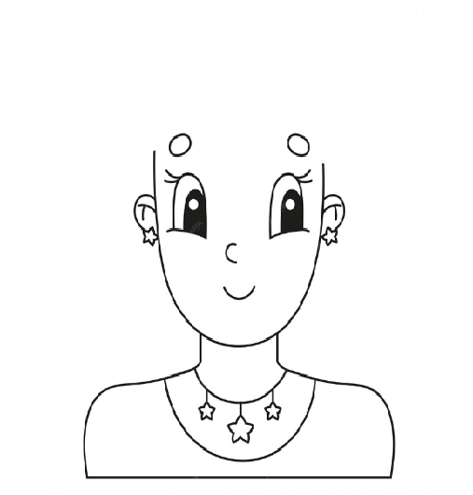
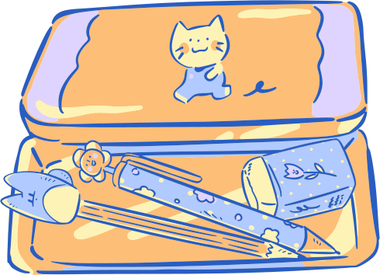
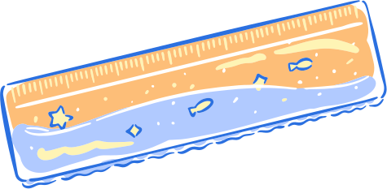
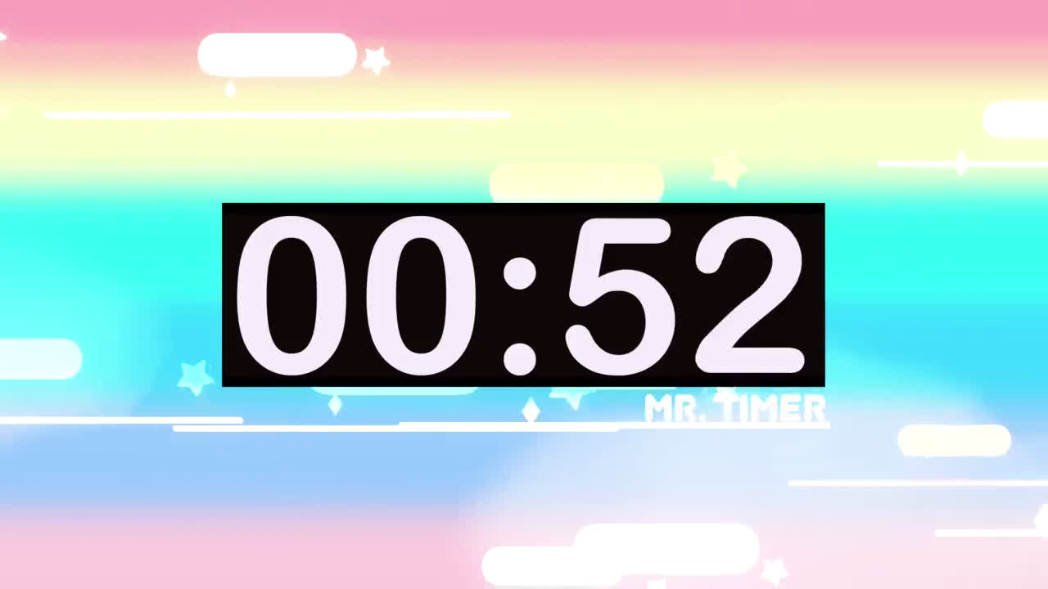
Draw your hair the way your weekend mood was. Explain?

Slide 5
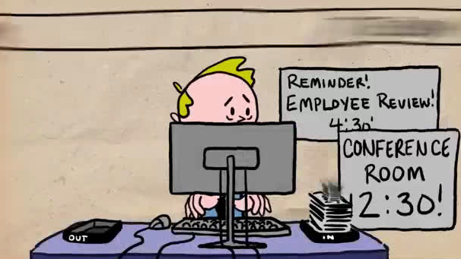

Slide 6
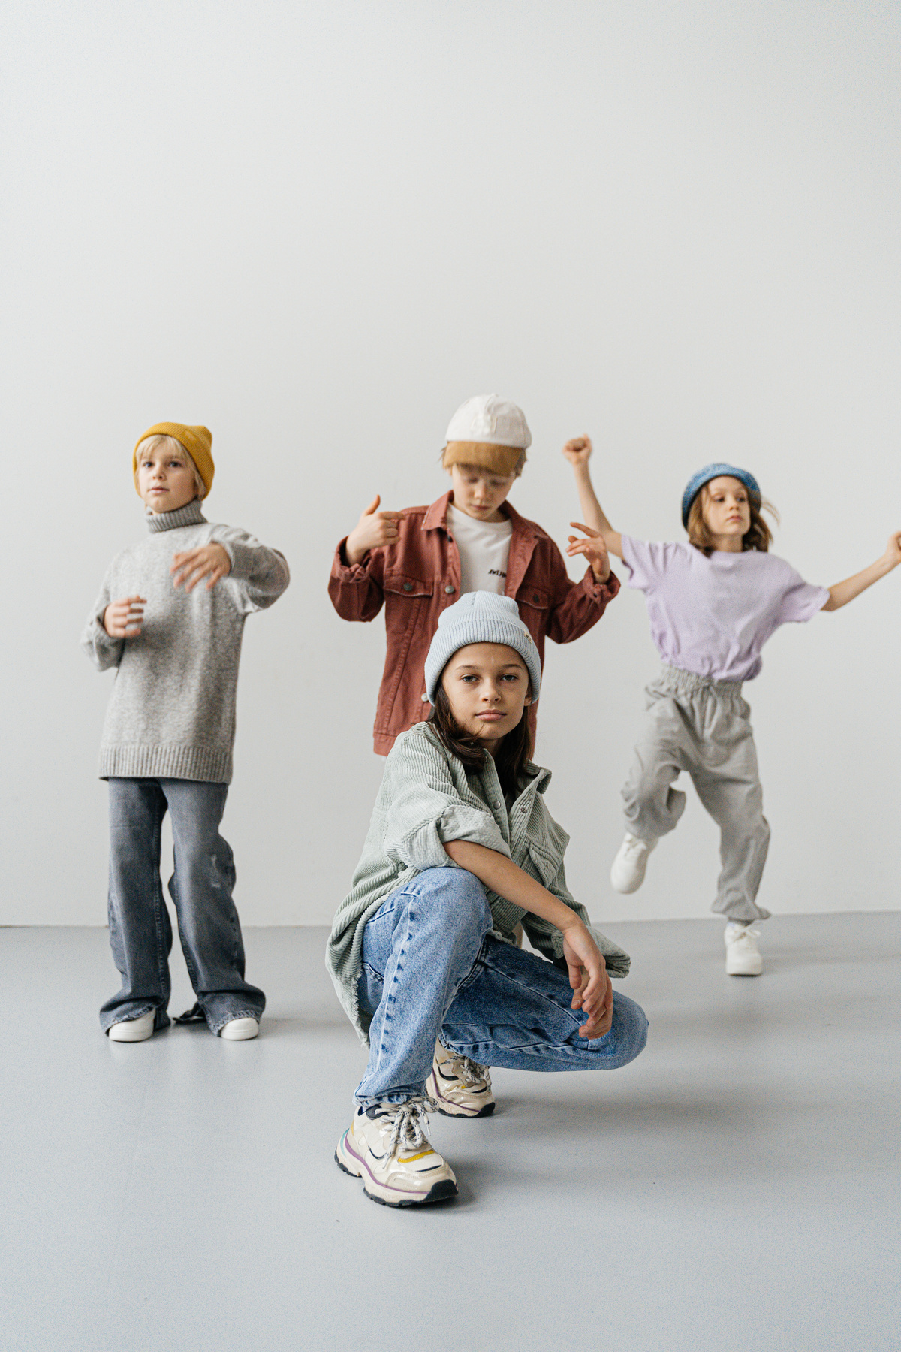




fun on weekend

Slide 7



unit 7
finding out time

Slide 8

1. To ask and answer about the weekend.
2. To talk about what he did over the weekend.
3. To describe things using adjectives.
4. To form the past simple of regular verbs.
objectives

Slide 9

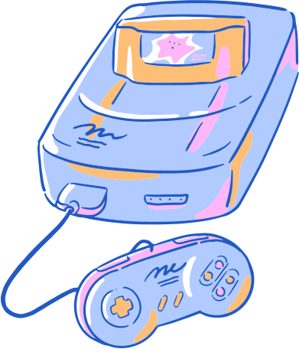
time line
( irregular verb )
present
past
future
went
did
came
took
ate
go
do
come
take
eat

Slide 10
time line
( regular verb )
+ ed
present
past
future
cleaned
watched
stayed
cooked
jumbed
clean
watch
stay
cook
jumb

Slide 11
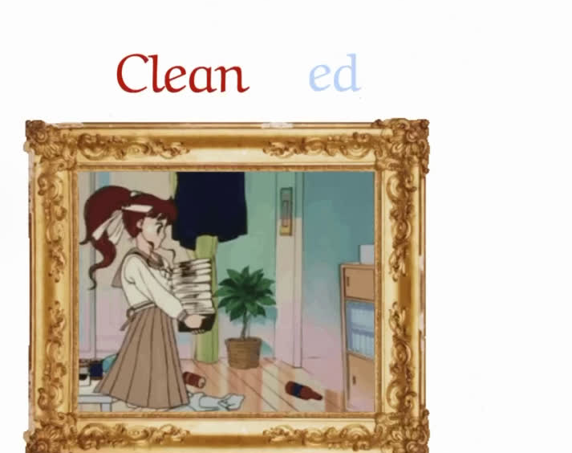
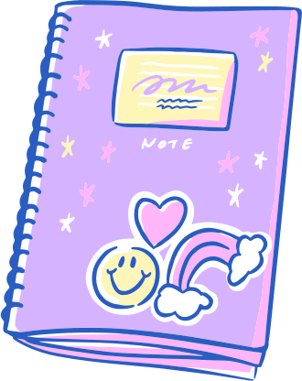

Slide 12


What did you do over the weekend ?

Slide 13
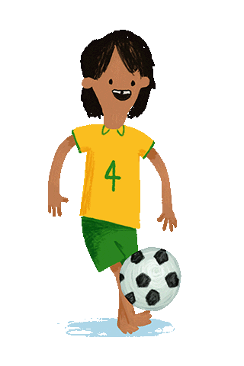
What did you do over the weekend ?

Slide 14

What did you do over the weekend ?

Slide 15

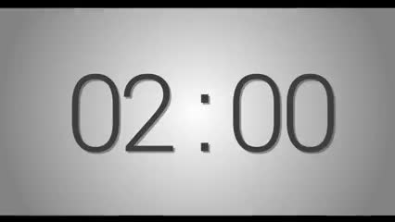
challenge
time !
page : 51
group work

Slide 16
check :
press here

Slide 17
homework
page : 187-188

Slide 18

Have a nice day

