Slide 1




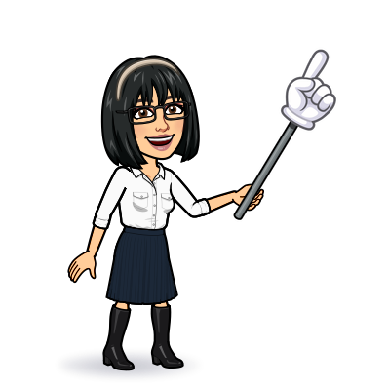

9 writing
10 project
11 form, meaning & function
Today:
Date:
- -
Page 70
By: Dalal Al-Juaid

Slide 2


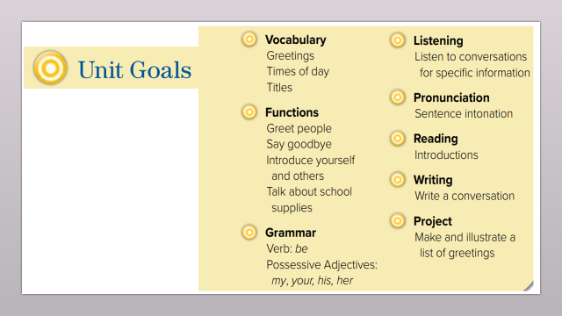
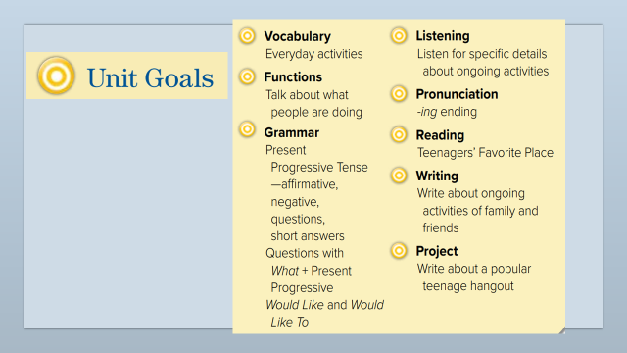
compose sentences from scrambled words
use "would like" correctly in sentences
Warm up
Write about what others are doing
Make qusetions

Slide 3
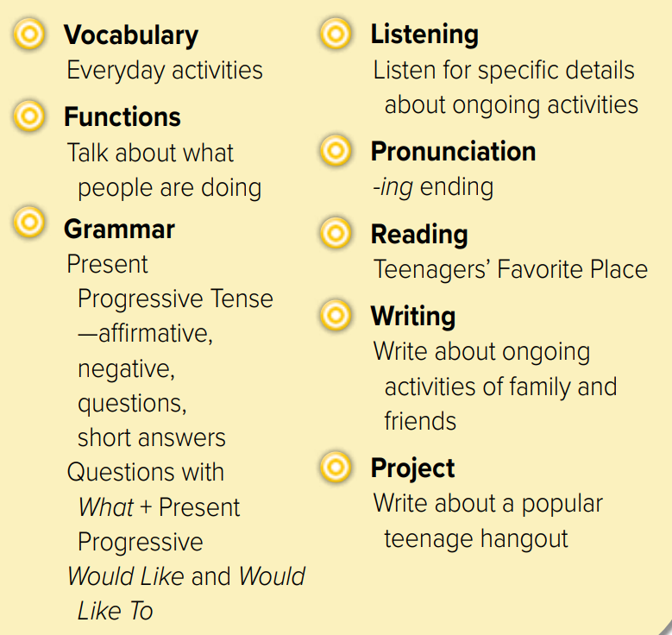
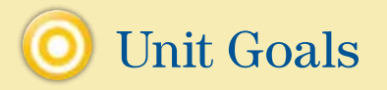

Slide 4
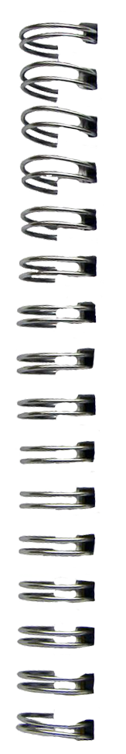
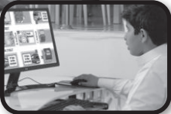
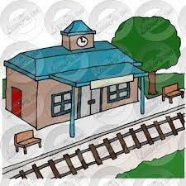

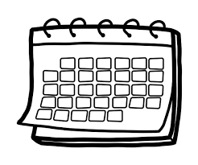
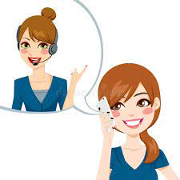

Revision
What ………… doing?
…..
Hot line to ask questions
…….
#
busy
..........

Slide 5



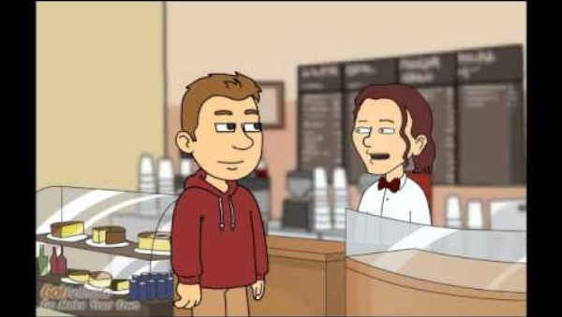

Warm up

Slide 6
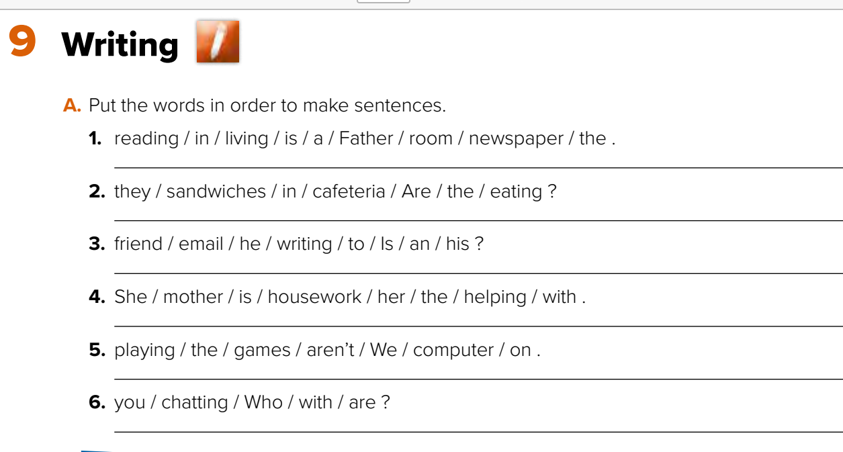
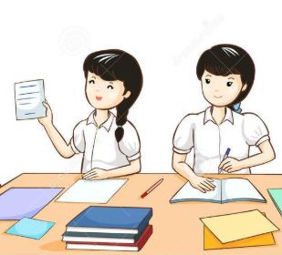



















verbs
Page 70
capital
Think pair share
Father is reading the newspaper in the living room.
Are they eating the sandwiches in the cafeteria?
Is he writing an email to his friend?
Warm up
She is helping her mother with the housework.
We aren’t playing games on the computer.
Who are you chatting with?

Slide 7
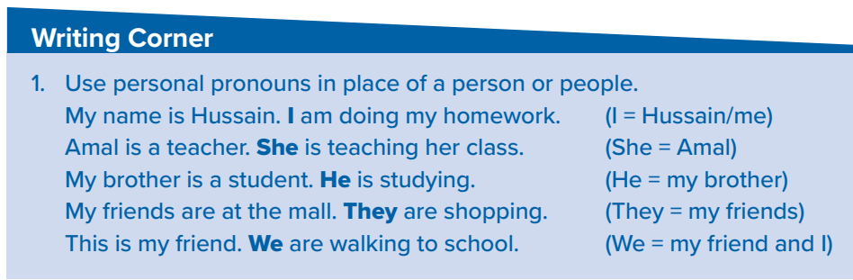
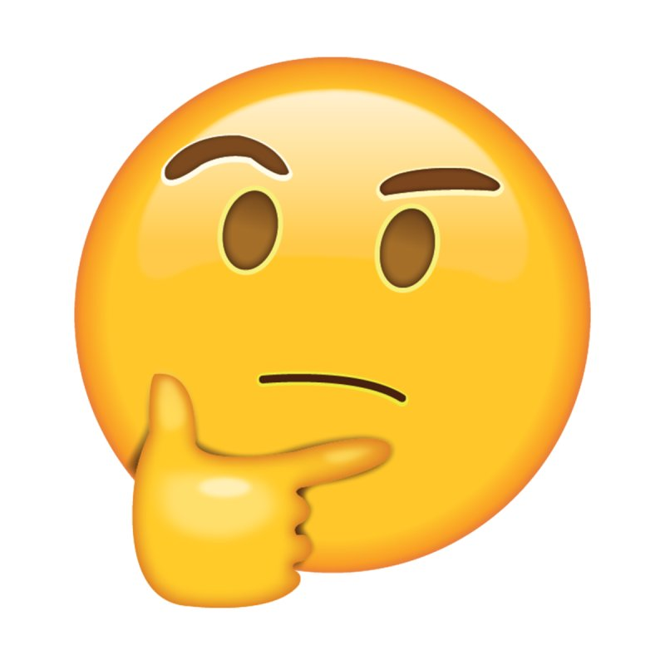


















Page 70
Give examples
Warm up
Choose:
Sara is a student. ………. is Saudi.
( He – She – I )

Slide 8
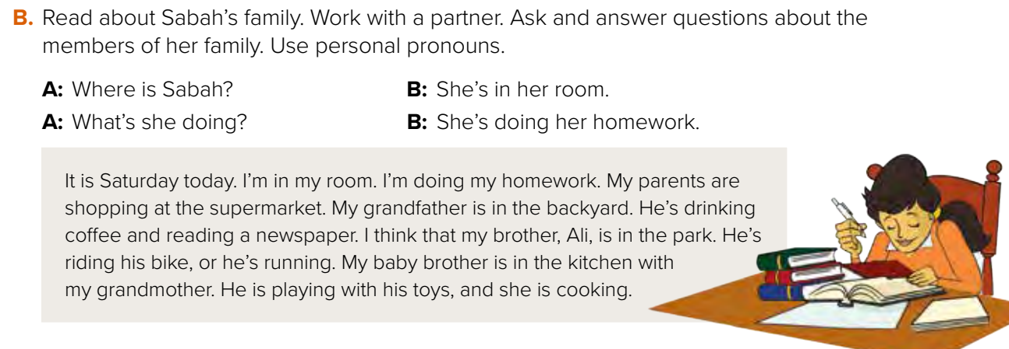






Where are her parents?
What are they doing?
Think pair share
Warm up

Slide 9

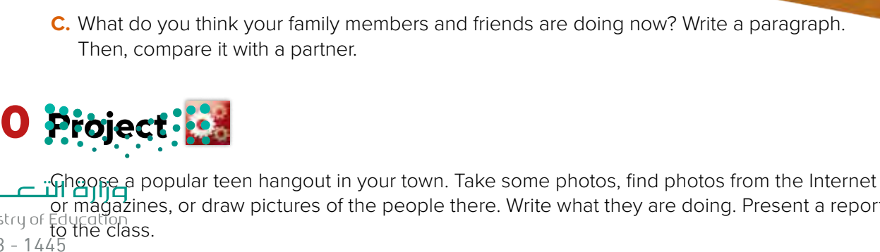

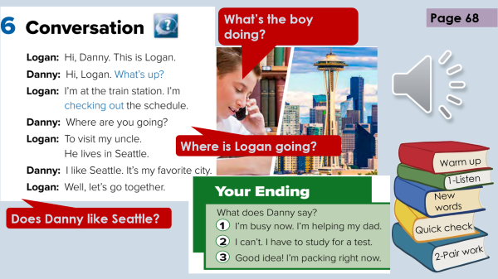
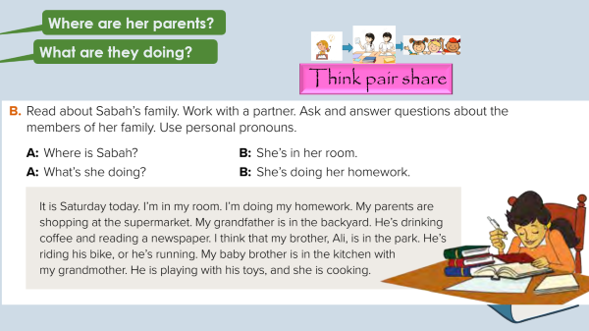
……..
Warm up

Slide 10
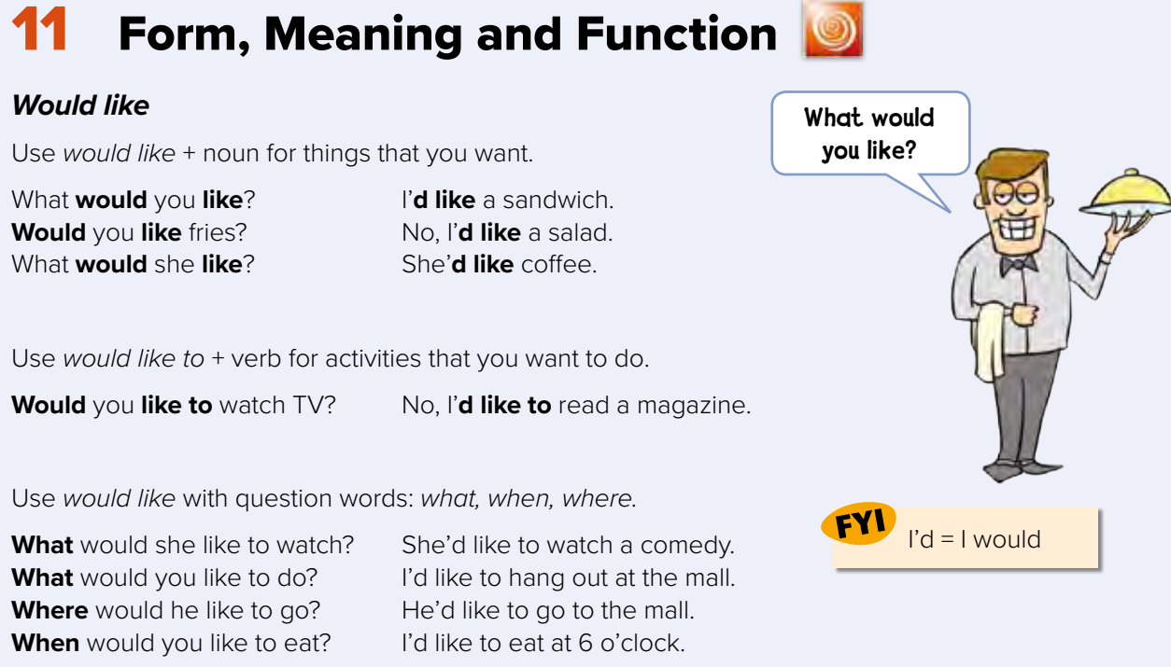













Page 71
Warm up

Slide 11
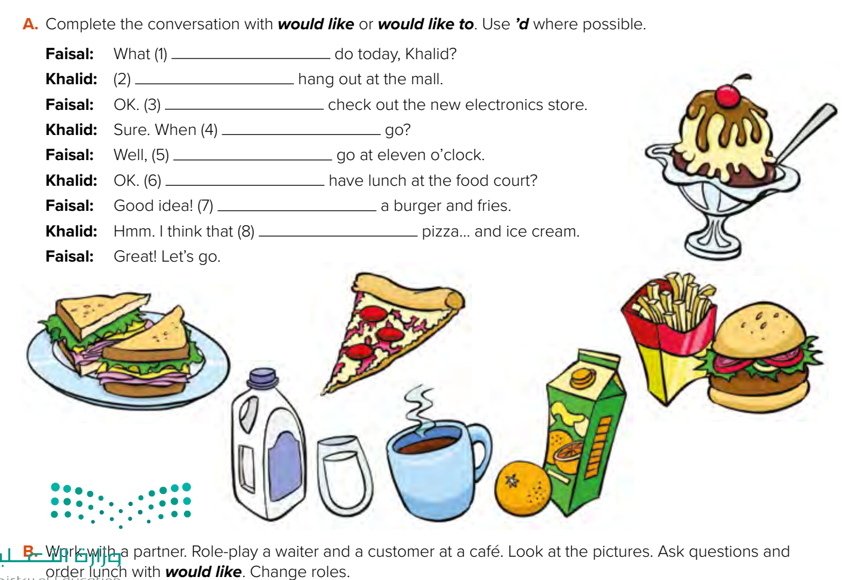
Page 71
would you like to
I’d like to
I’d like to
would you like to
I’d like to
Would you like to
I’d like
I’d like
Make a question

Slide 12
Write in your notebook
Like final test أسئلة للاختبار النهائي
Choose:
Sara is a student. ………. is Saudi.
( He – She – I )
Make a question

Slide 13


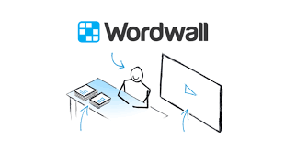
Lets play
Warm up

Slide 14





page 220 Ex(F)
for practice writing
Warm up

Slide 15
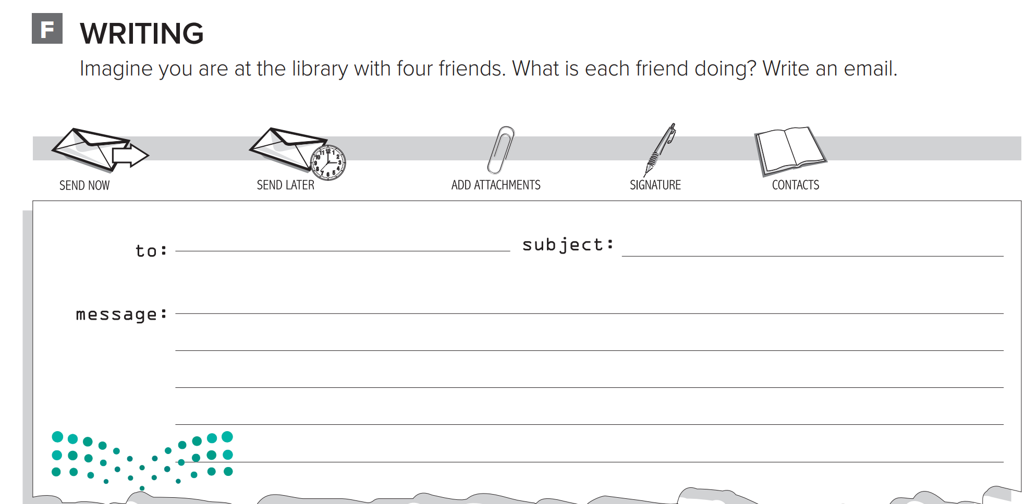
p.220
Hi Lujain,
I’m sitting at the library with four friends. Joud
is doing research. Ghena is studying for the exams. Manal is writing an essay. Hala is
looking for a book. What are you doing with
your friends? Bye for now, Dalal
Warm up

Slide 16


What ……. You doing ?
What’s opposite of ( break)?
……. a hot line to ask & talk.
x-o game
he is ……. an email to customer
What’s up= …
Teenagers are ( school– mall) generation
Warm up
What’s the opposite of ( busy )?
I ( would like – would like to) eat
(Are – Is – Am) you studying?

