Slide 1
We can
4
hello

Slide 2
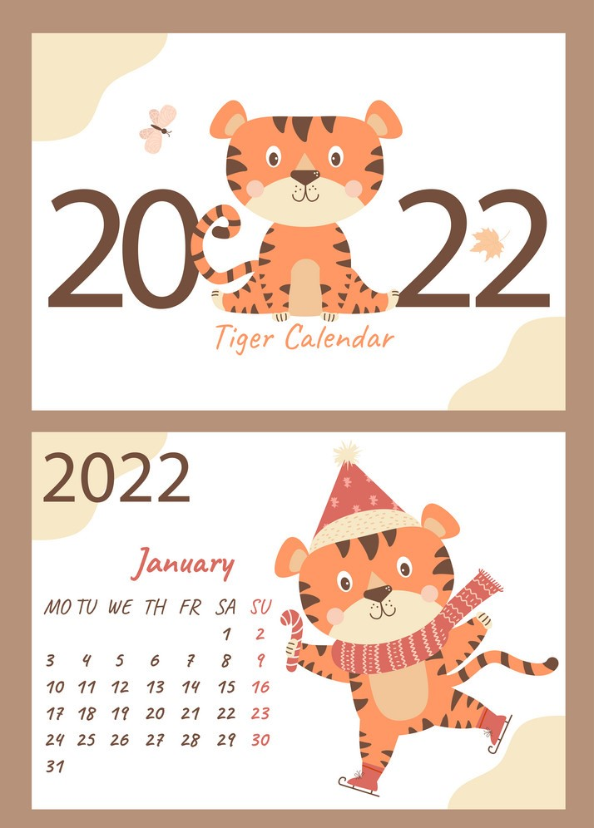
Day :
Date :

Slide 3



Slide 4

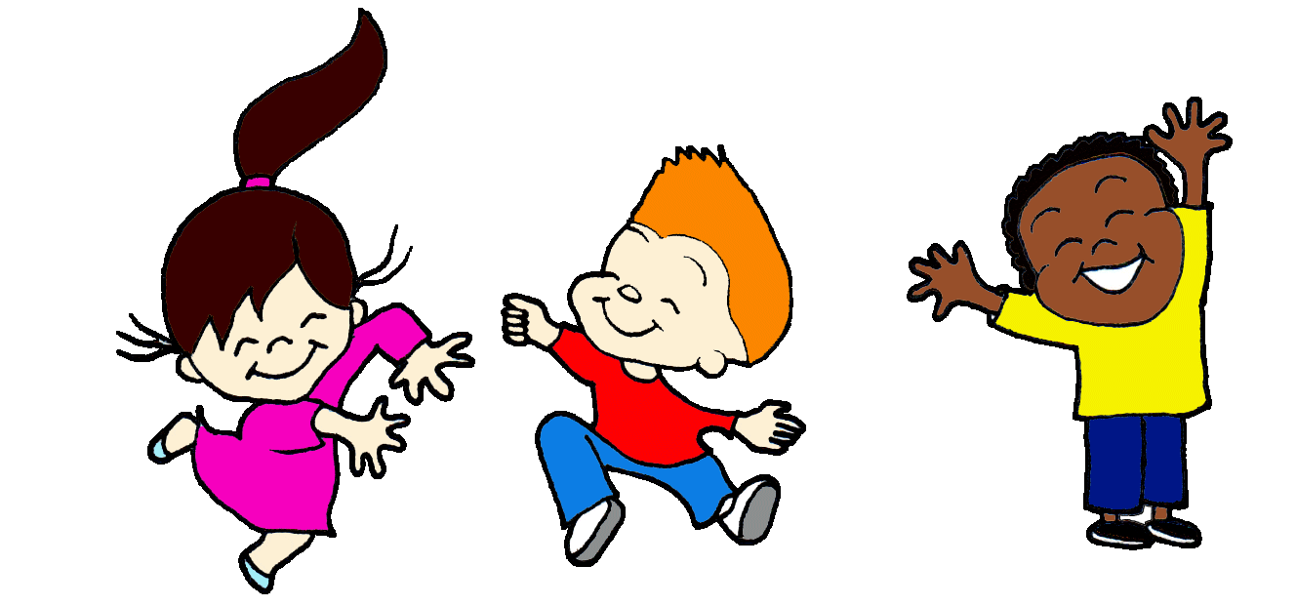
Unit 1
Lesson 3

Slide 5
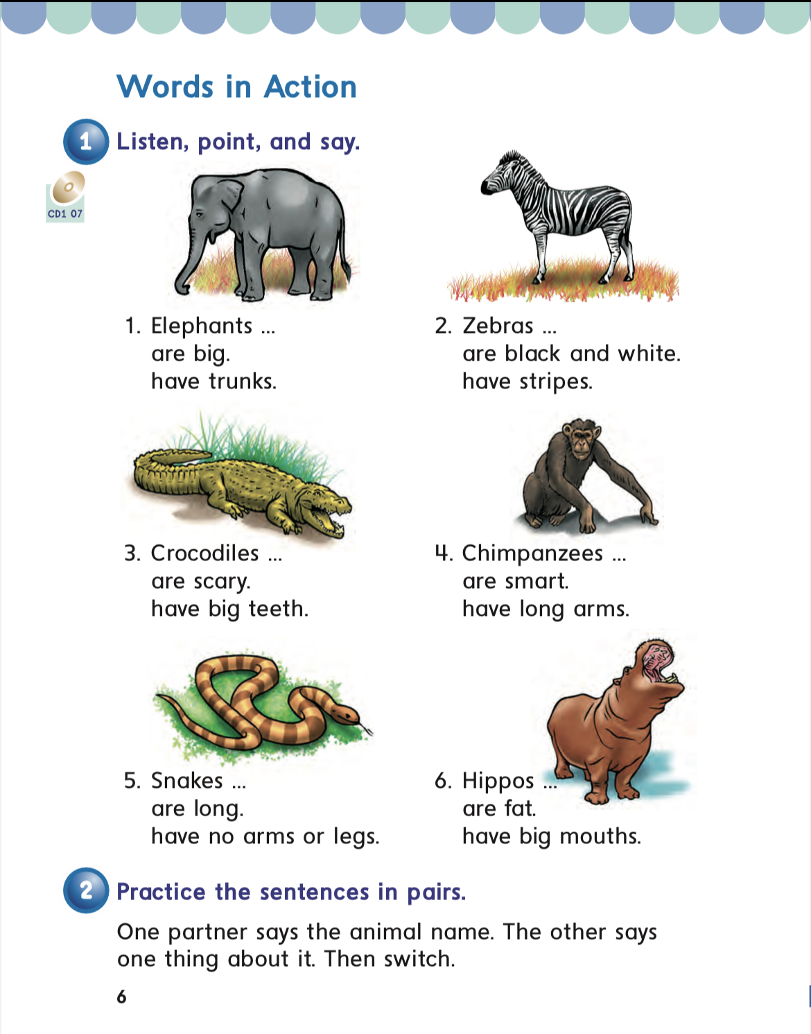
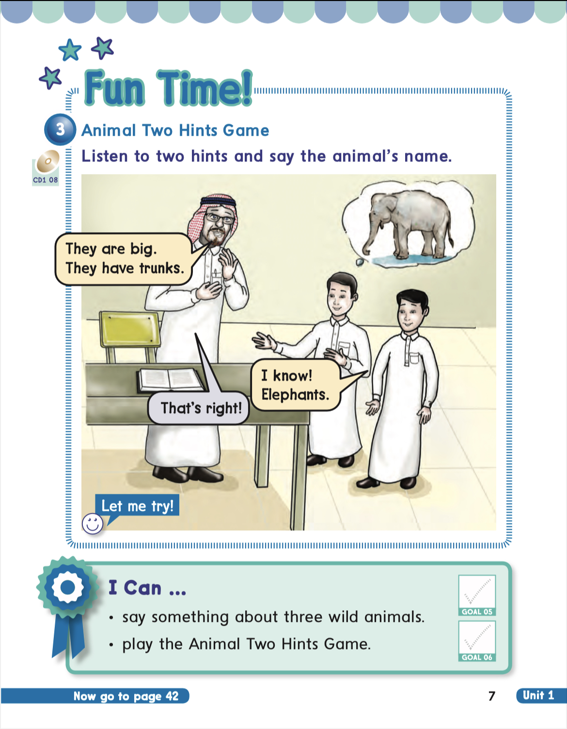
PAGES
6&7

Slide 6



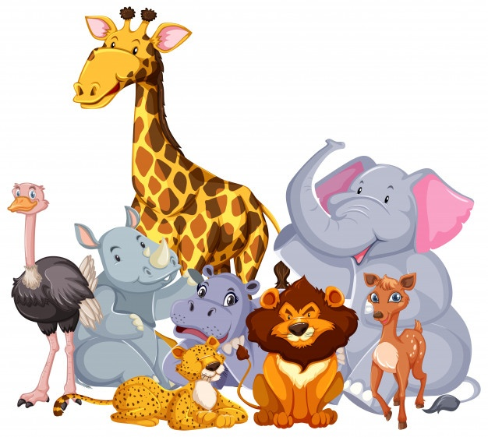
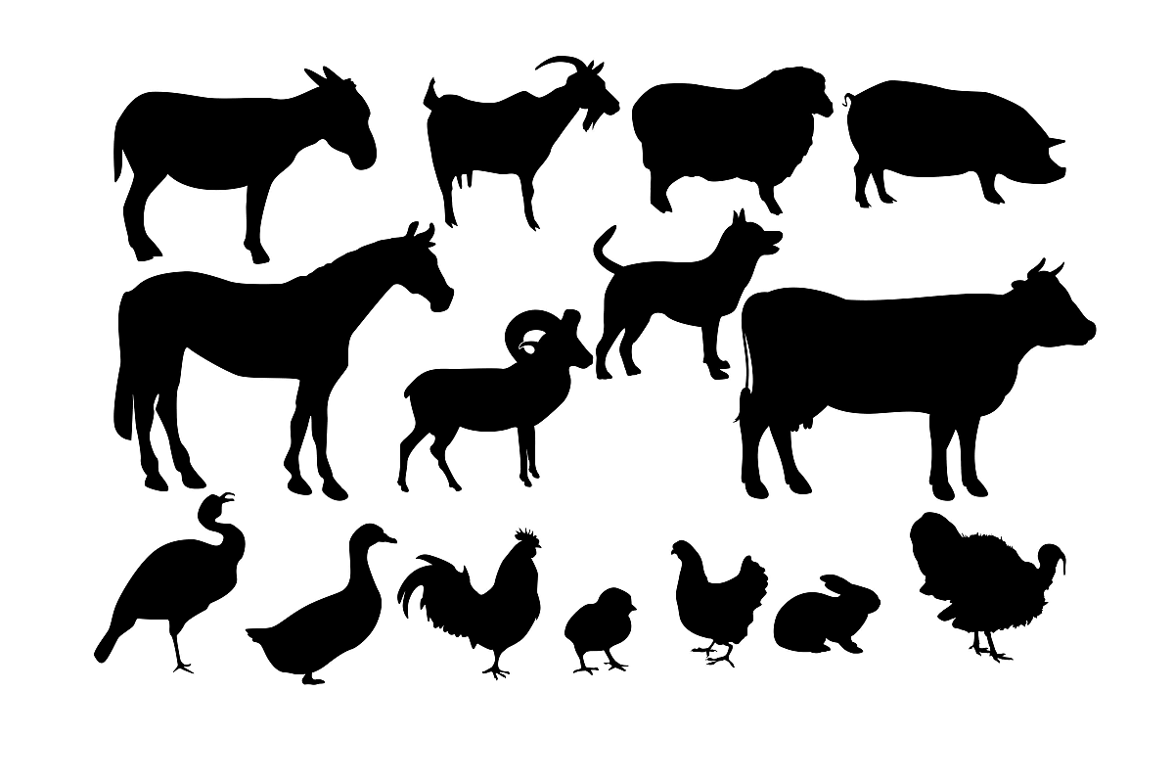



I can..,
-say something about three wild animals.
-play the animals two Hints Game.

Slide 7


Slide 8
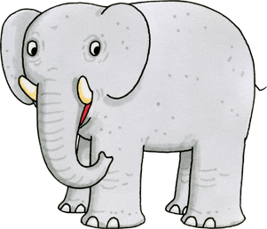


Elephants are big

Slide 9
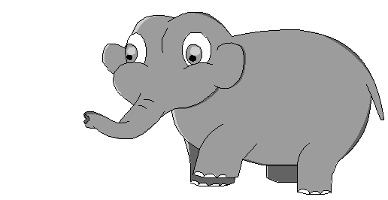



Elephants have trunks

Slide 10
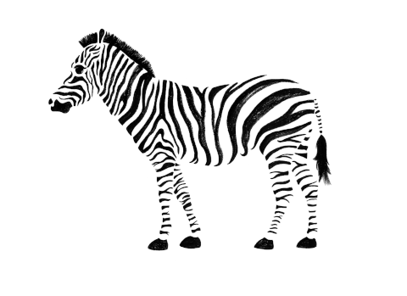

Zebras are black and white

Slide 11

Zebras have stripes

Slide 12
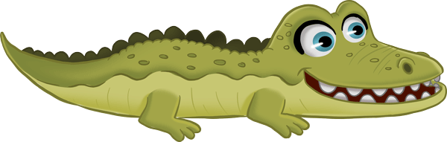
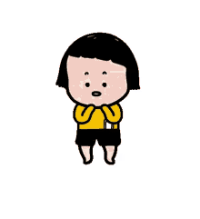
Crocodiles are scary

Slide 13
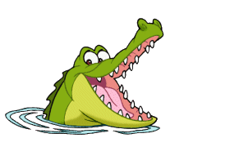
Crocodiles have big teeth

Slide 14
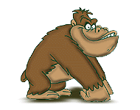

Chimpanzees are smart

Slide 15
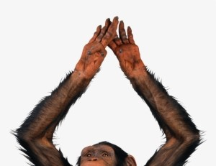
Chimpanzees have long arms

Slide 16
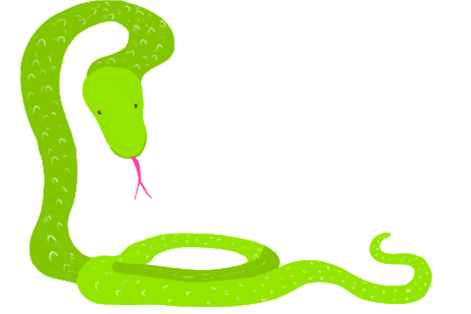
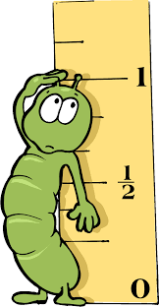
Snakes are long

Slide 17

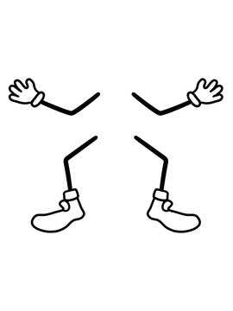
Snakes have no legs or arms

Slide 18
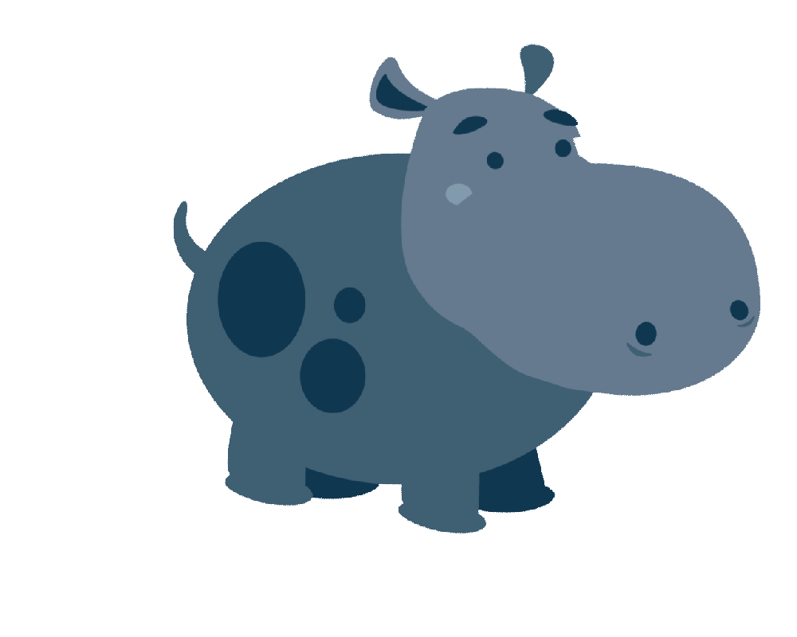

Hippos are fat

Slide 19
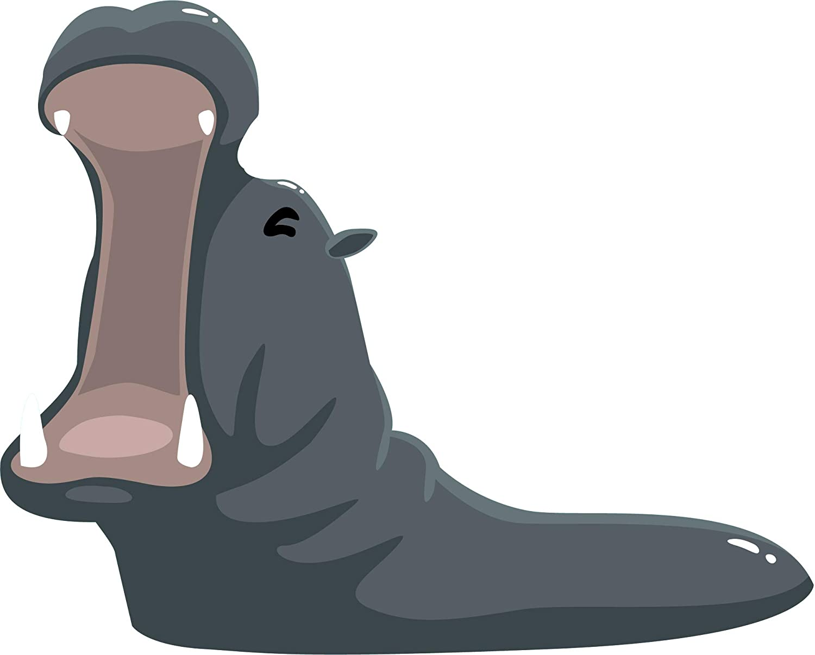
Hippos have big mouth

Slide 20
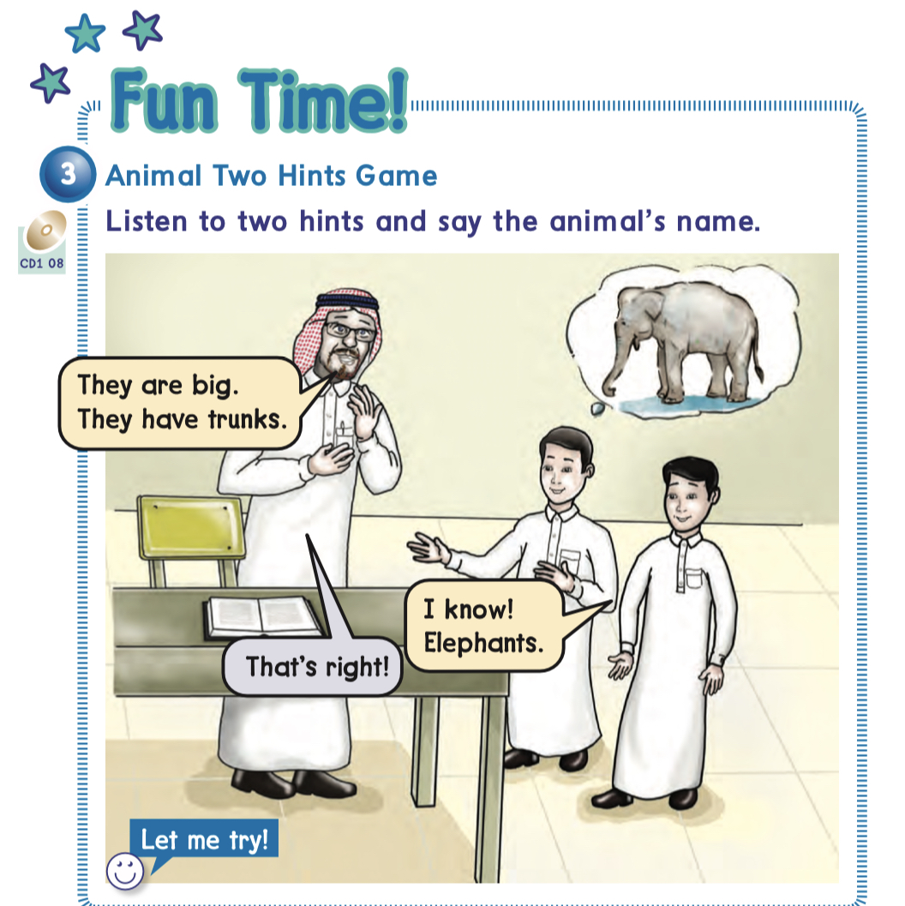

Slide 21


Slide 22
What animal is it ?
.
.
.
.
.
.
scary
Has a big teeth

Slide 23
What animal is it ?
crocodile

Slide 24
What animal is it ?
.
.
.
.
.
.
smart
Has long arms

Slide 25
What animal is it ?
chimpanzee

Slide 26
What animal is it ?
.
.
.
.
.
.
big
Has trunk

Slide 27
What animal is it ?
elephant

Slide 28
What animal is it ?
.
.
.
.
.
.
Black and white
Has stripes

Slide 29
What animal is it ?
zebra

Slide 30
What animal is it ?
.
.
.
.
.
.
fat
has big mouth

Slide 31
What animal is it ?
hippo

Slide 32
What animal is it ?
.
.
.
.
.
.
long
Has no arms or legs

Slide 33
What animal is it ?
snake

Slide 34


Slide 35



Slide 36

Open your book pages 67&68

Slide 37
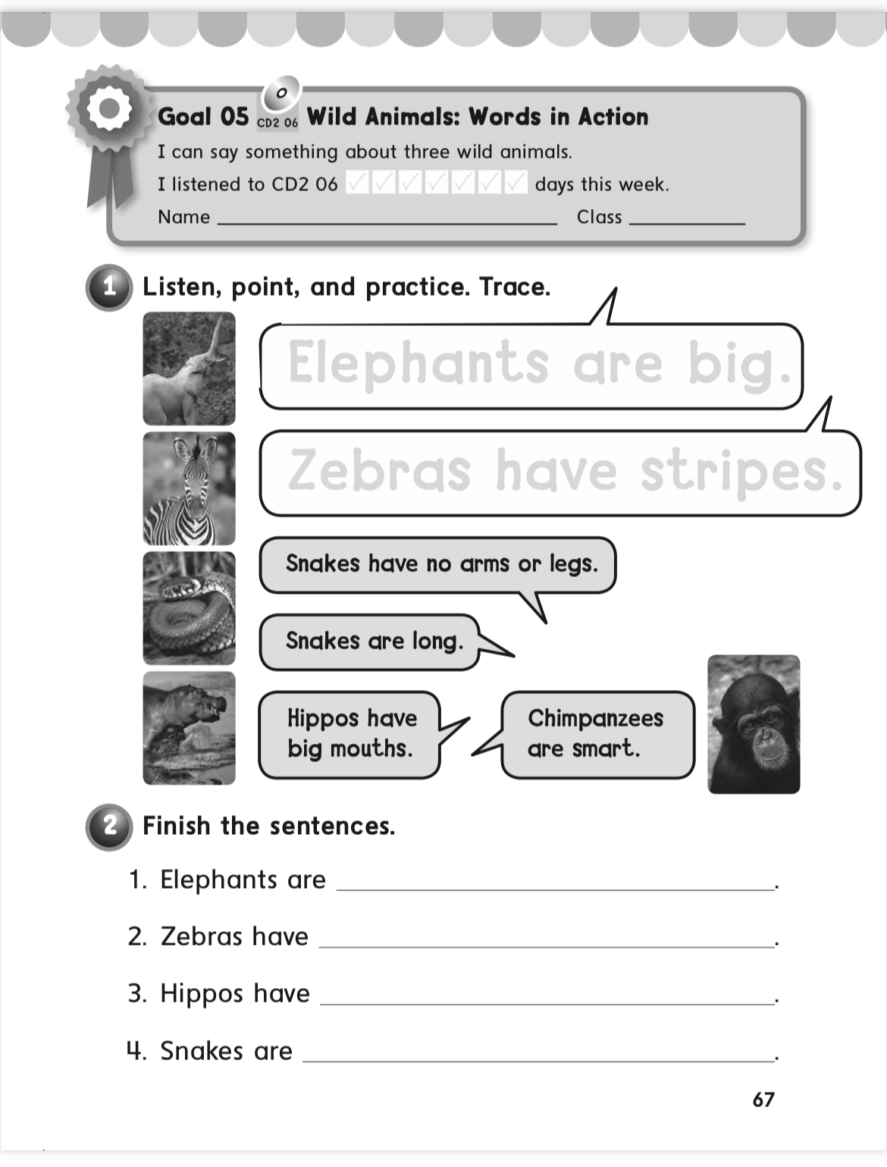
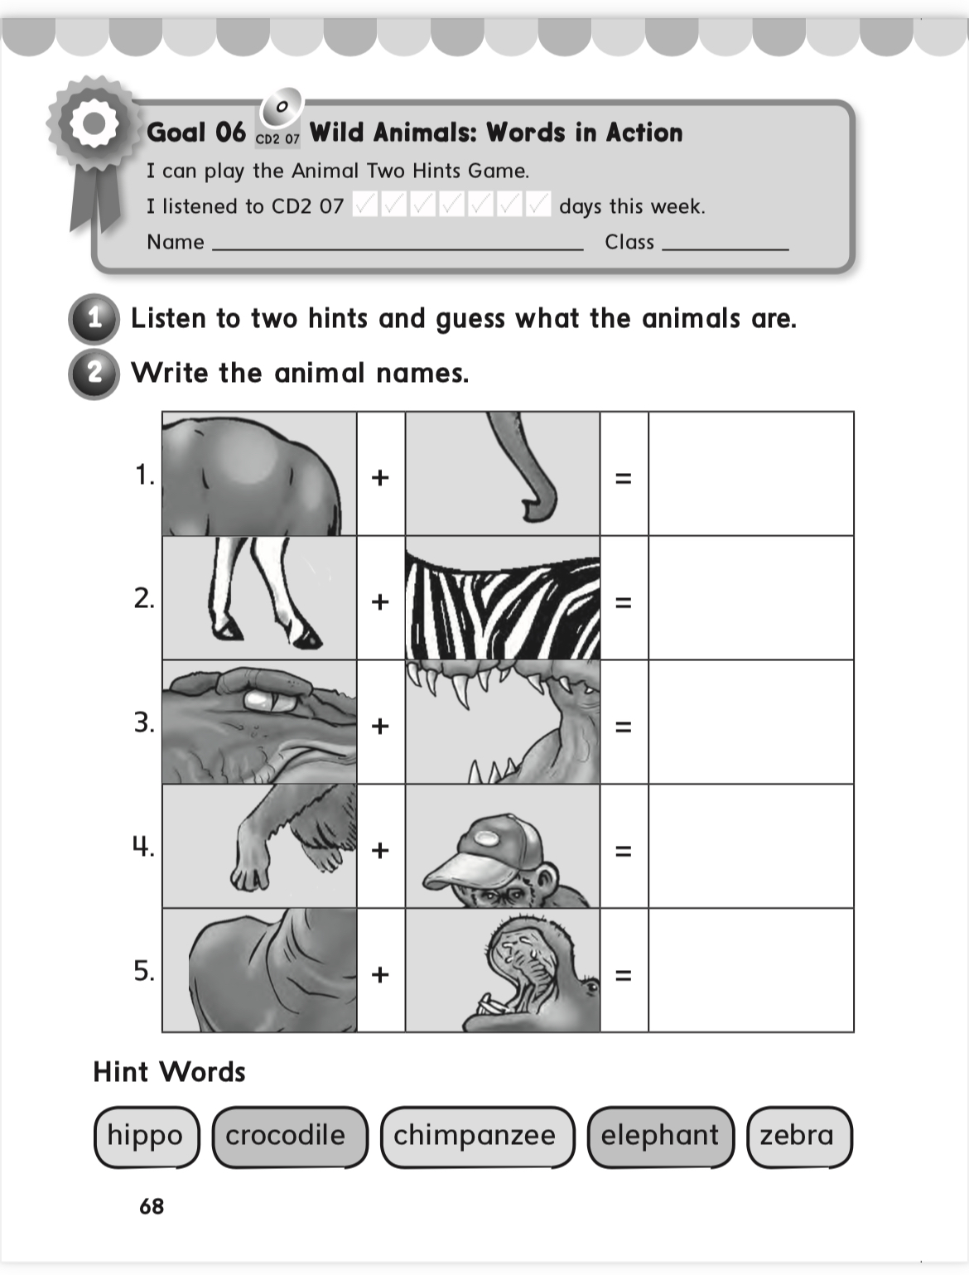

Slide 38


Home work at

