Slide 1
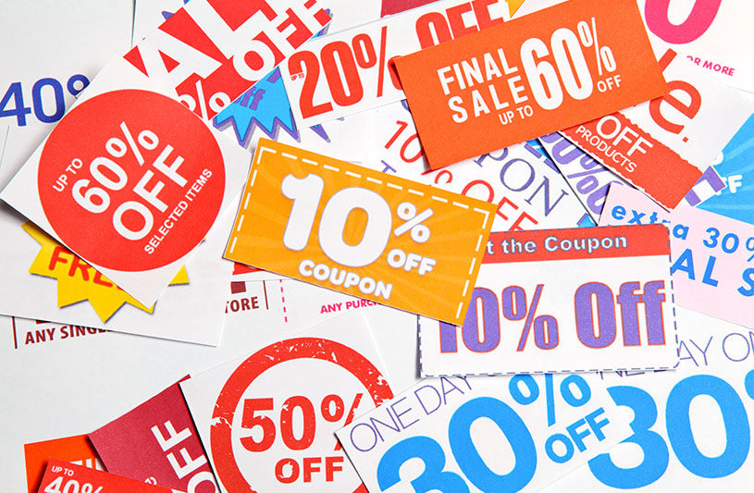

Slide 2

Unit 7
It’s a Good Deal , Isn’t It ?
Page 68, 69

Slide 3
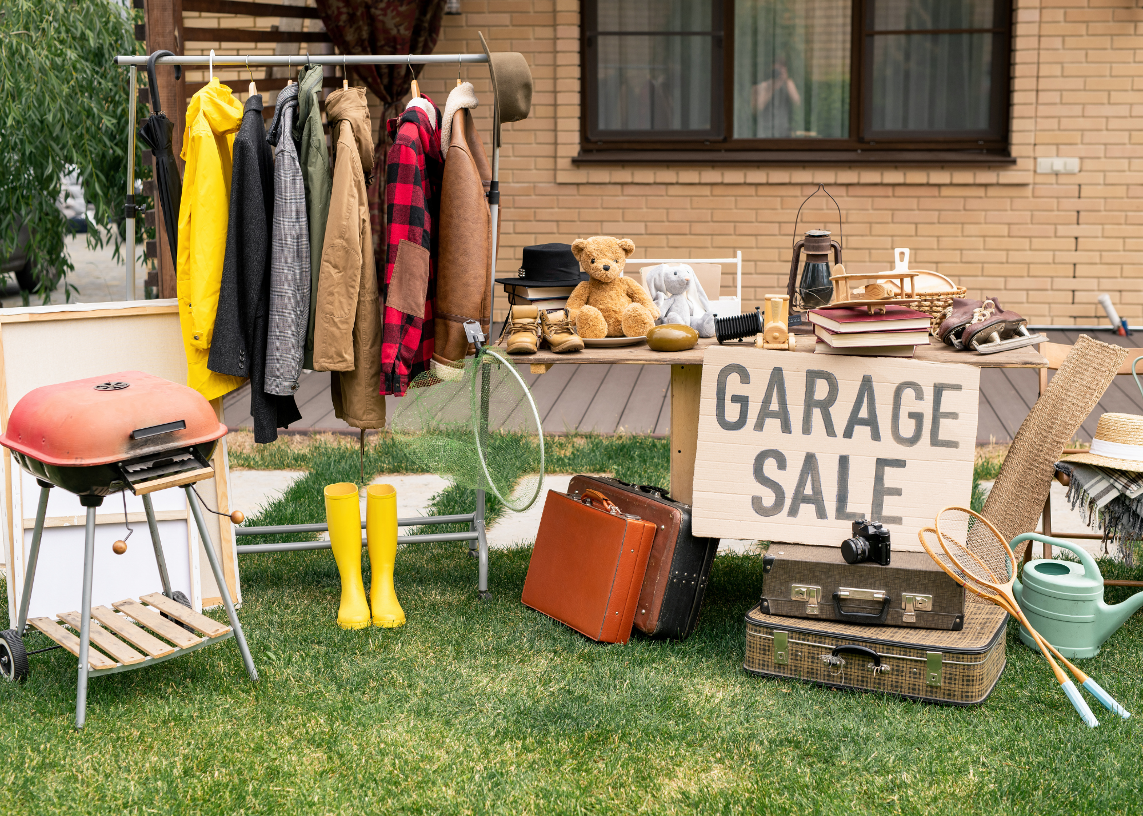
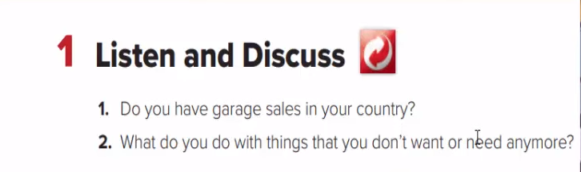

Slide 4
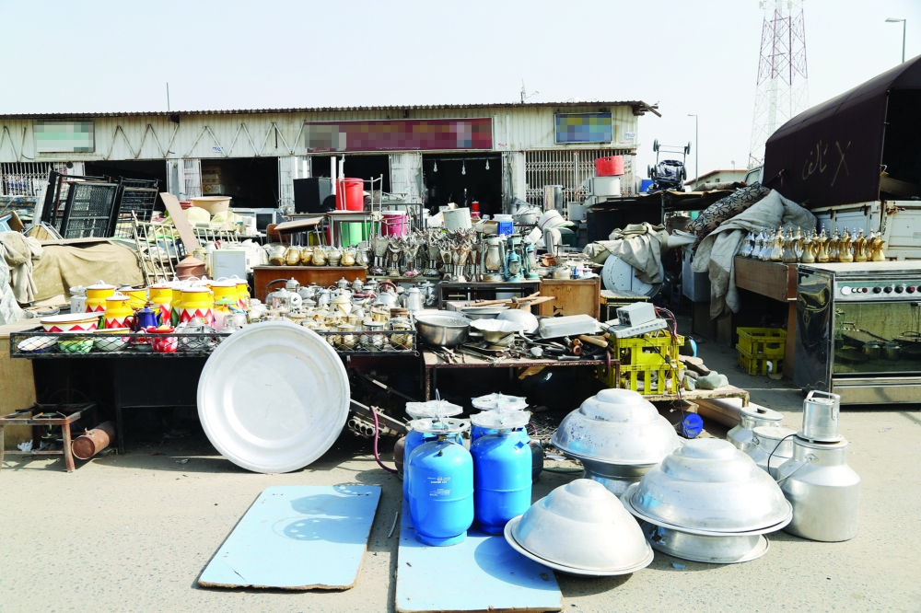

Slide 5

Learning Objectives
Find out new Vocabulary
Name the things in the picture
Classify things used in cooking , cleaning , repairing
Answer questions after listening

Slide 6
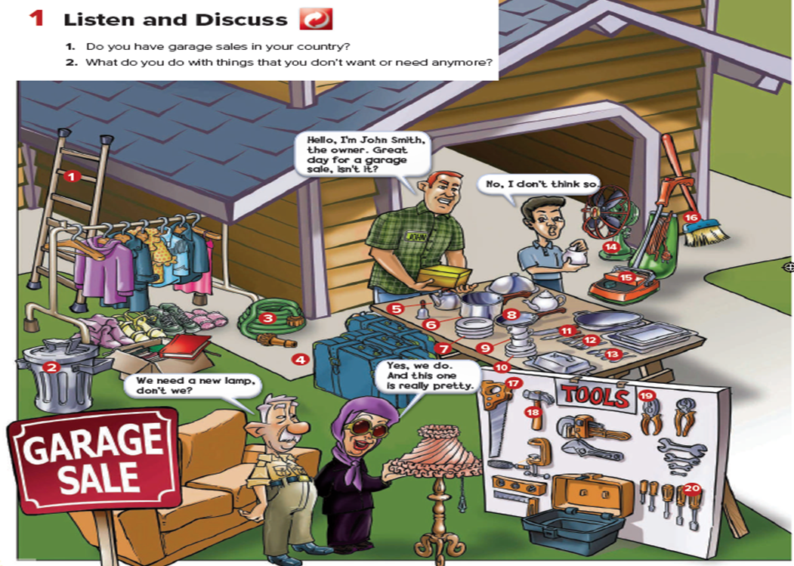


Slide 7
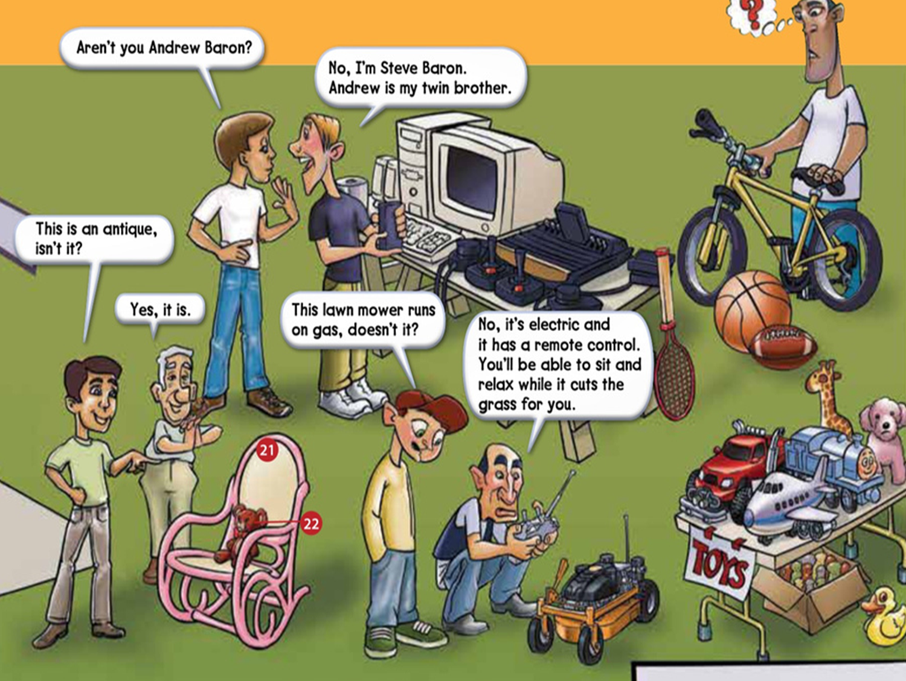

Slide 8
page 69
A.List the things that you use for cooking, cleaning, and repairing
1. ladder
2. garbage can
3. hose
4. luggage
5. teapot
6. pot
7. plates
8. frying pan
9. cups
10. saucers
11. knives
12. forks
13. spoons
14. fan
15. vacuum cleaner
16. broom
17. saw
18. hammer
19. pliers
20. screwdriver
21. rocking chair
22. teddy bear

Slide 9



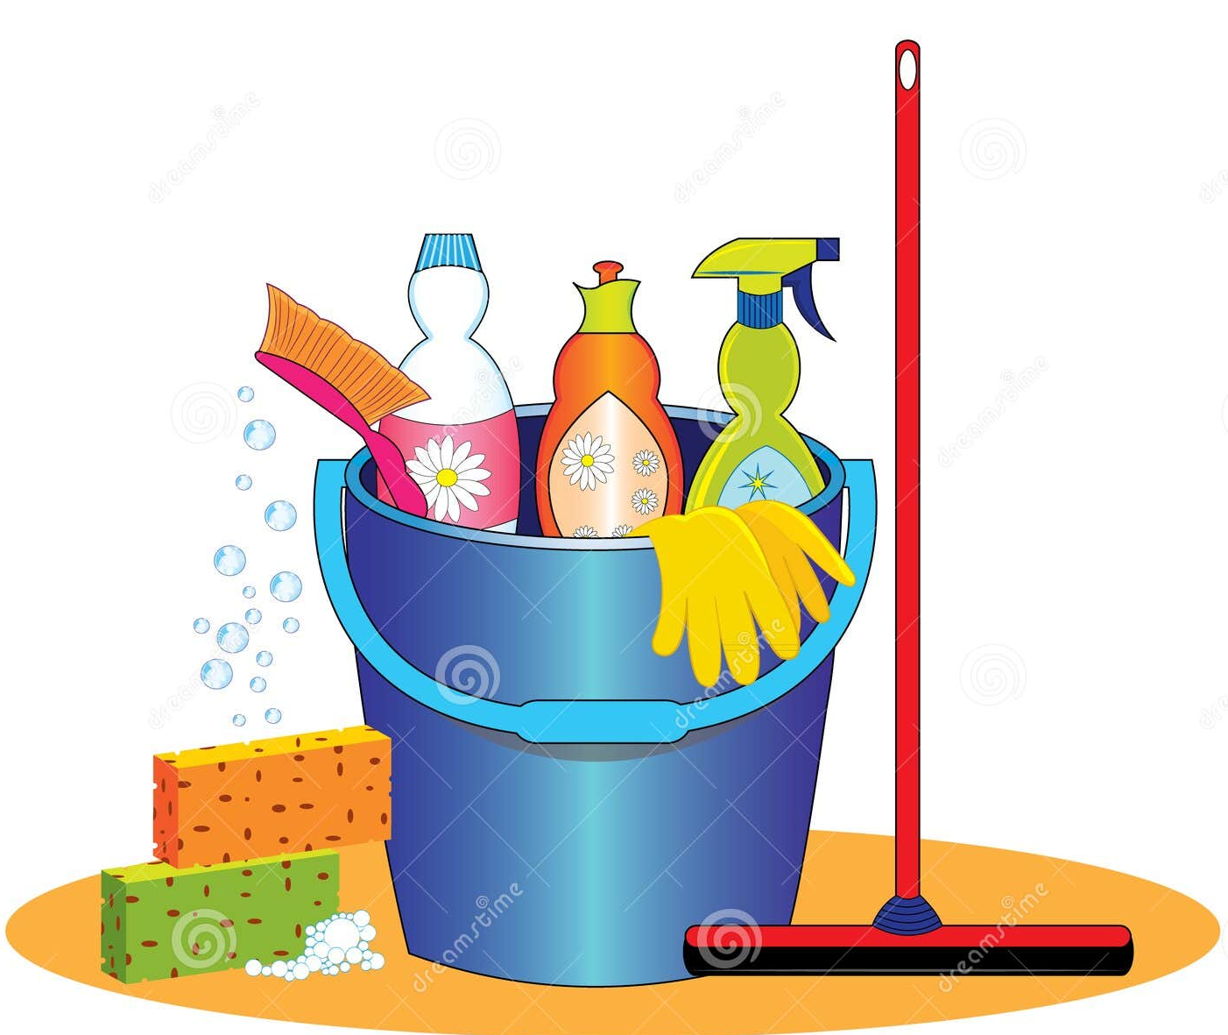
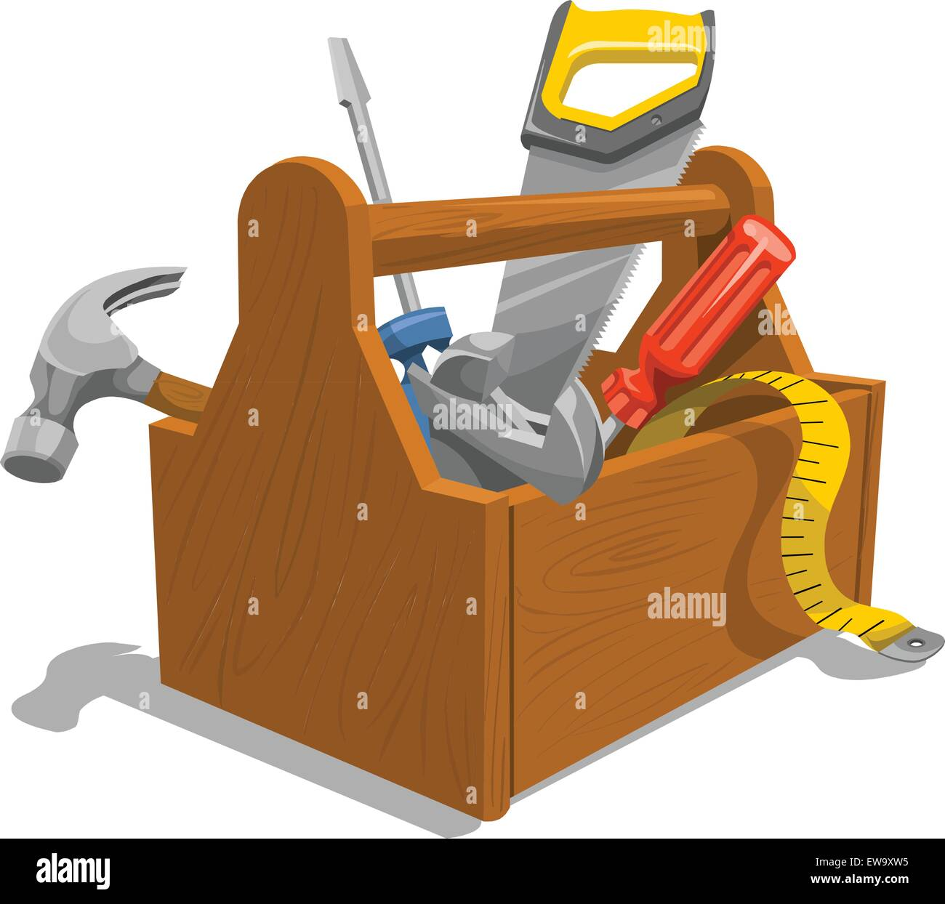
teapot
saw
pot
plates
hose
cups
hammer
frying pan
vacuum cleaner
saucers
pliers
knives
forks
spoons
screwdriver
broom
cooking
cleaning
repairing

Slide 10
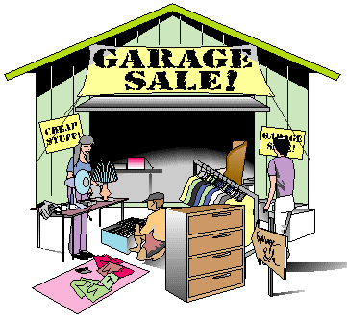
page 69
B. Comprehension. Answer about the garage sale.
Andrew doesn’t have a brother, does he?
2. John Smith is organizing a garage sale, isn't he?
3. The lawn mower runs on electricity, doesn’t it?
4. The elderly couple need a new lamp, don’t they?
5. There aren’t any plants for sale, are there?
1. Yes, he does.
2. Yes, he is.
3. Yes, it does.
4. Yes, they do.
5. No, there aren’t.

Slide 11


Work Book page 209 : A , B
Tr.Kholud

Slide 12



Slide 13
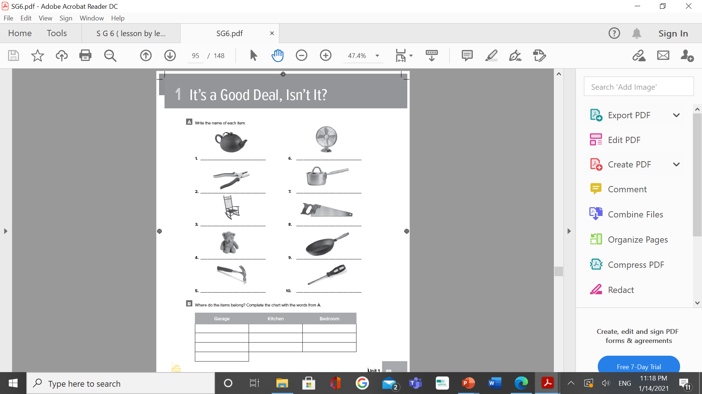
W. B. p. 89
teapot
fan
pliers
pot
rocking chair
saw
teddy bear
frying pan
hammer
screwdriver

Slide 14
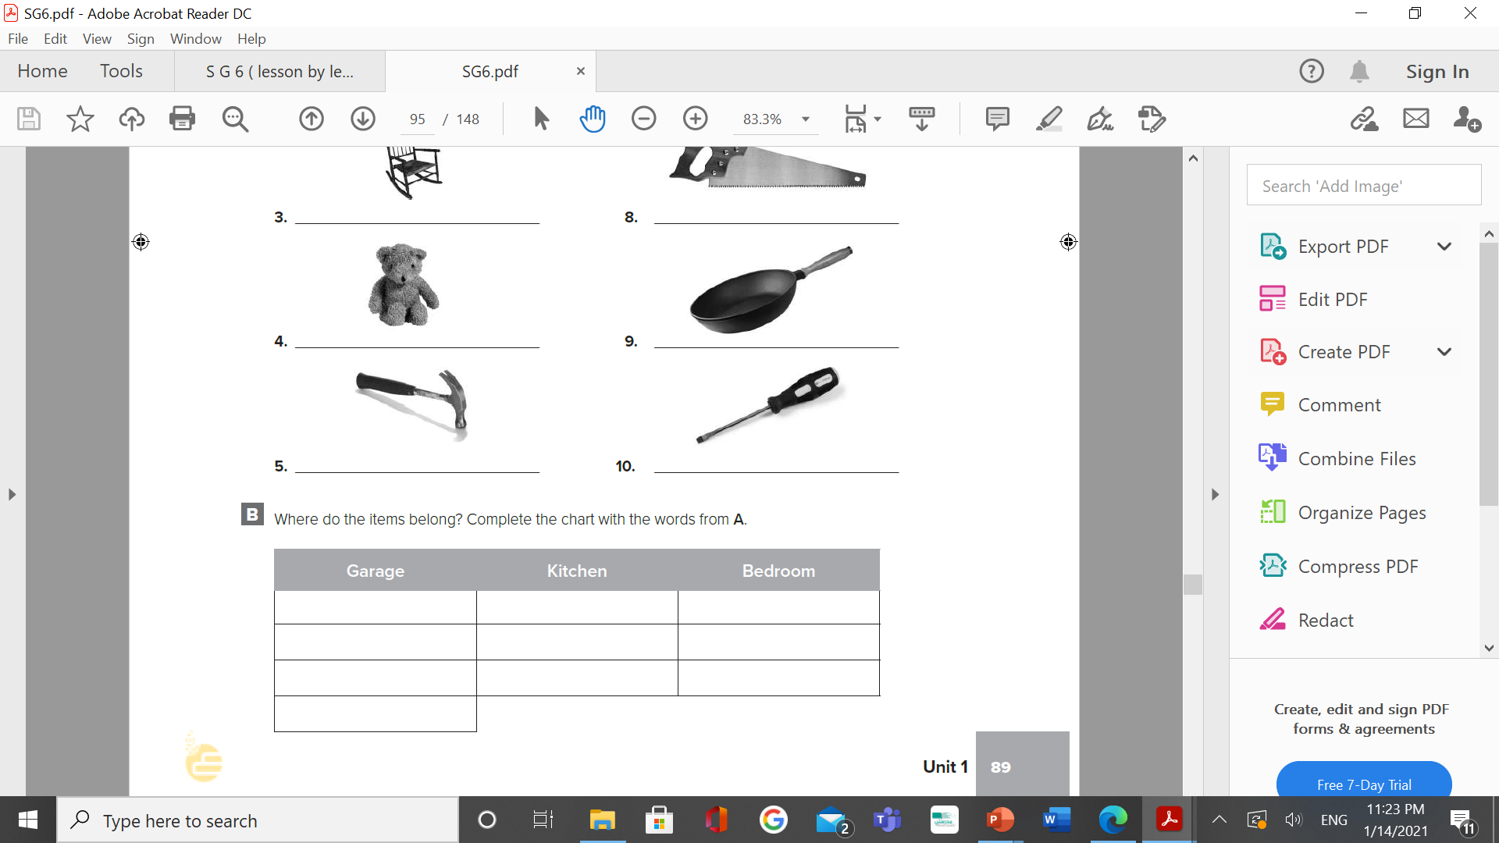
W. B. p. 89
pliers
teapot
rocking chair
hammer
pot
teddy bear
saw
frying pan
fan
screwdriver

