Slide 1






1 Listen & discuss 2 pair work
Today:
Date:
- -
Page 64
By: Dalal Al-Juaid

Slide 2


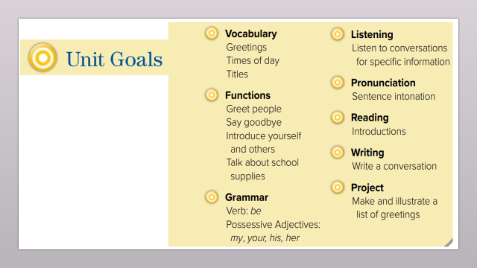
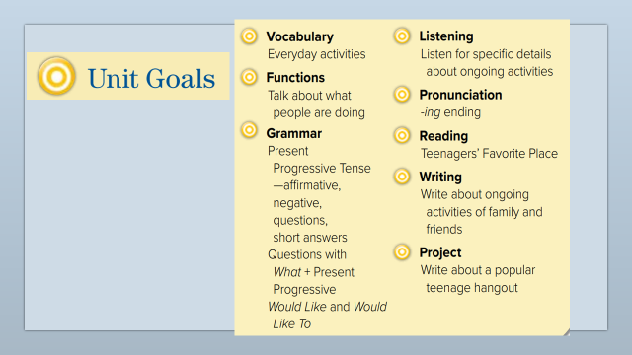
describe activities which others are doing
name things at a place
Warm up
1-Listen
use the new words
New words
Quick check
Ask & answer about people
2-Pair work

Slide 3
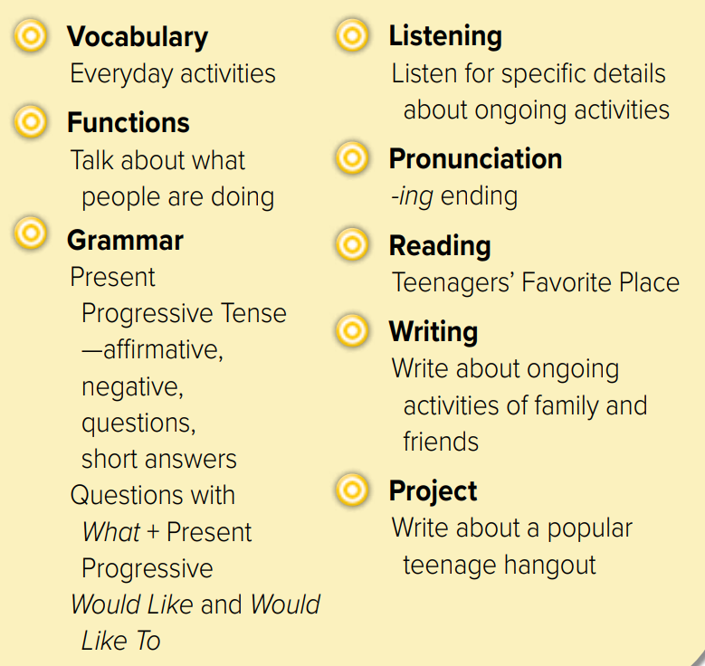
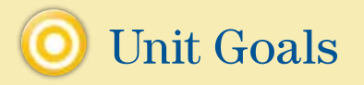

Slide 4





what is this?
Warm up
what can you see?
1-Listen
New words
Quick check
2-Pair work

Slide 5

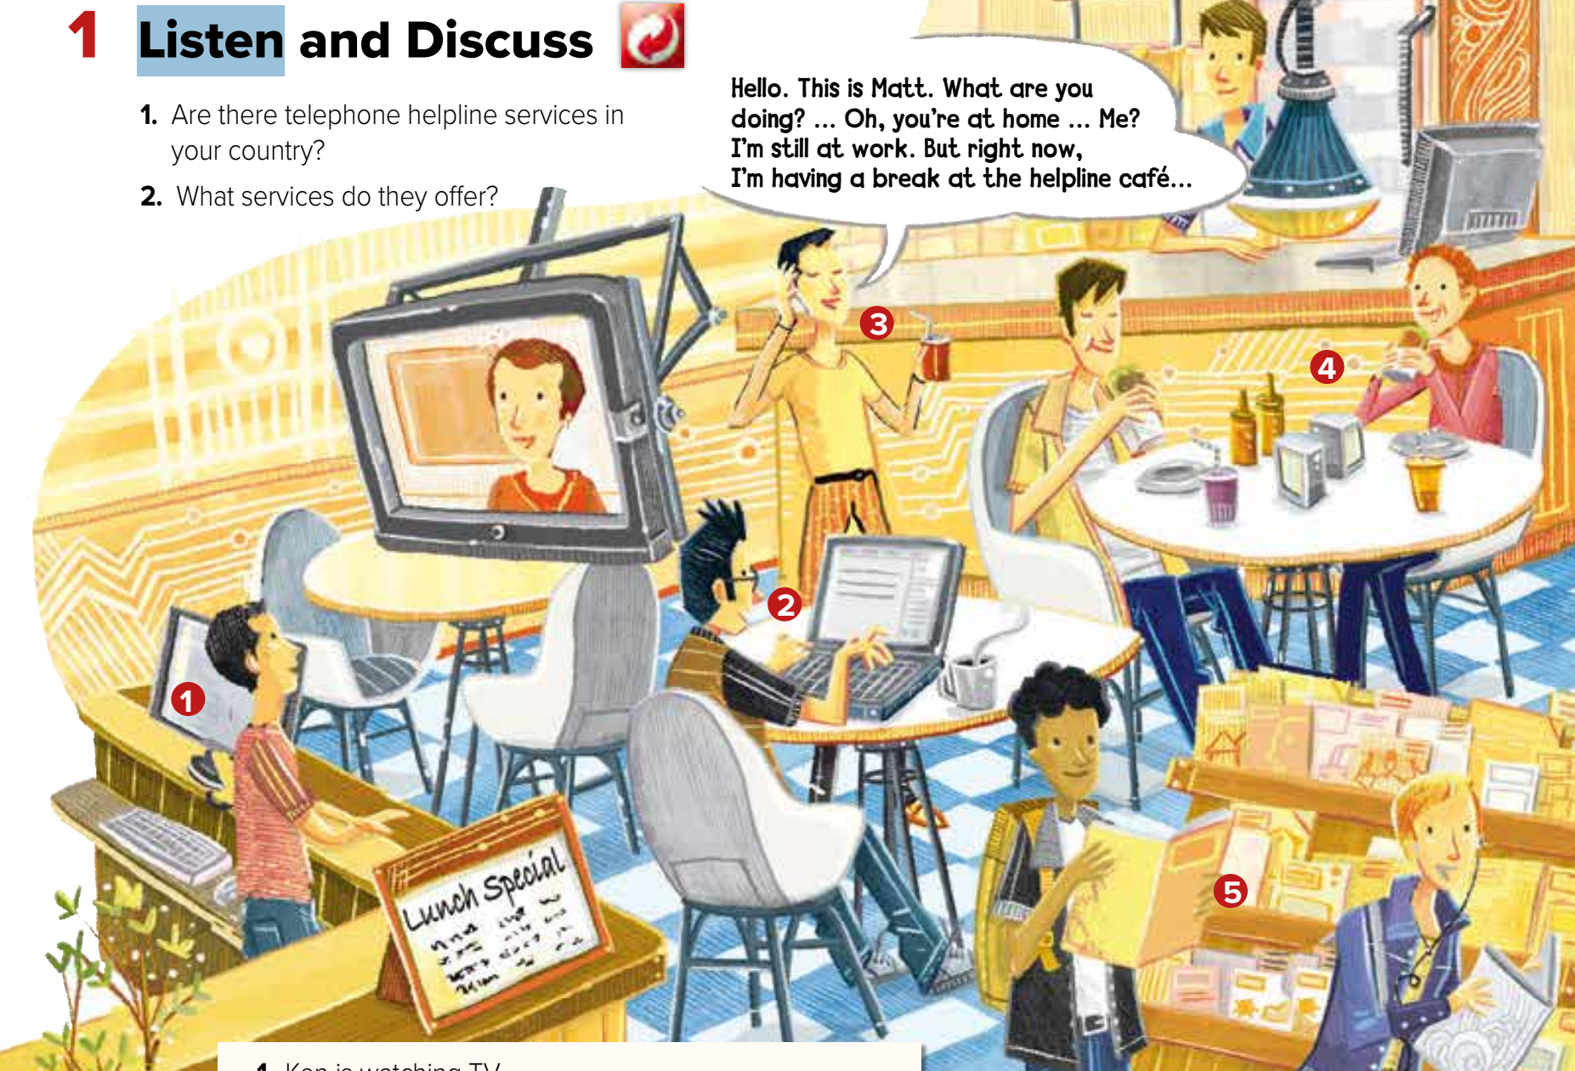

What are the people doing?
Page 64
Warm up
1-Listen
New words
Quick check
2-Pair work

Slide 6
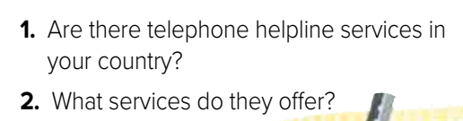
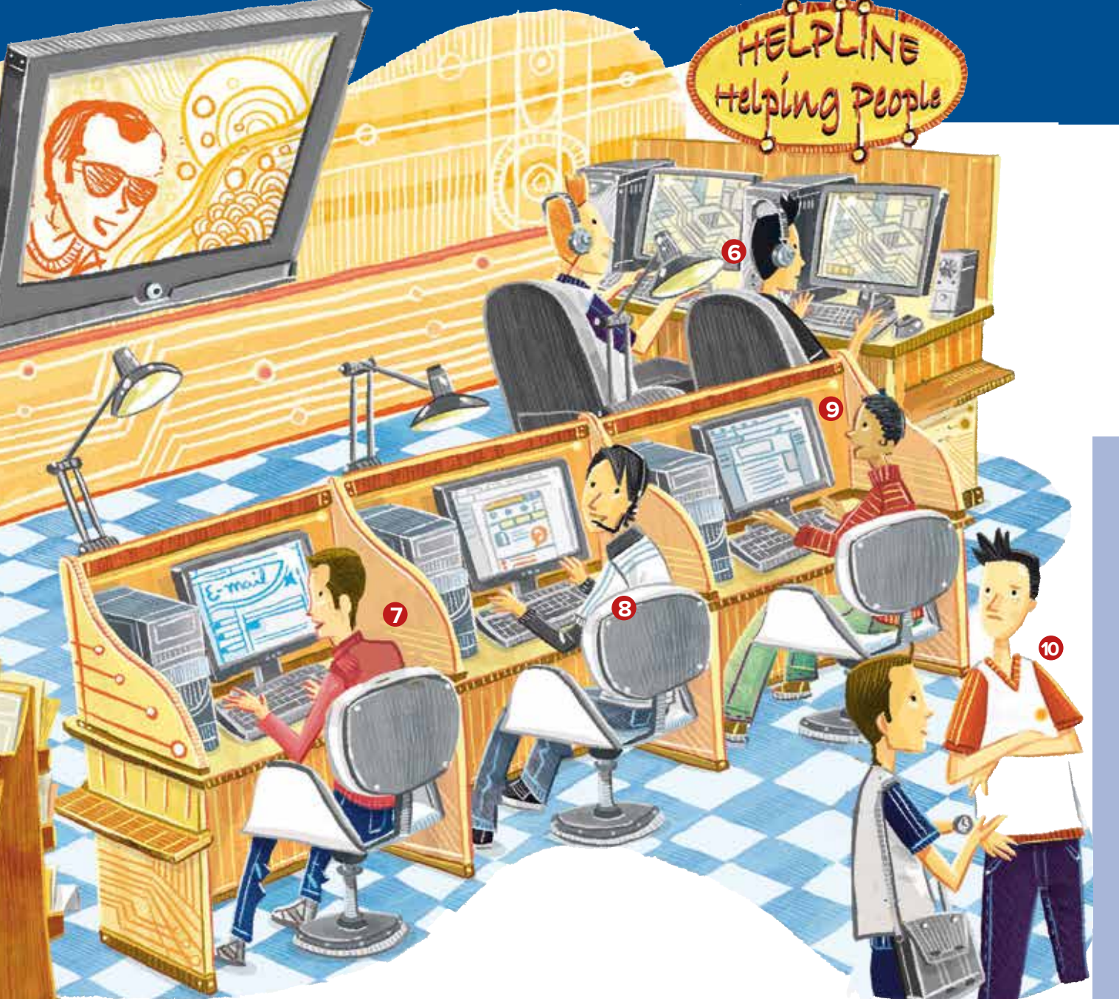
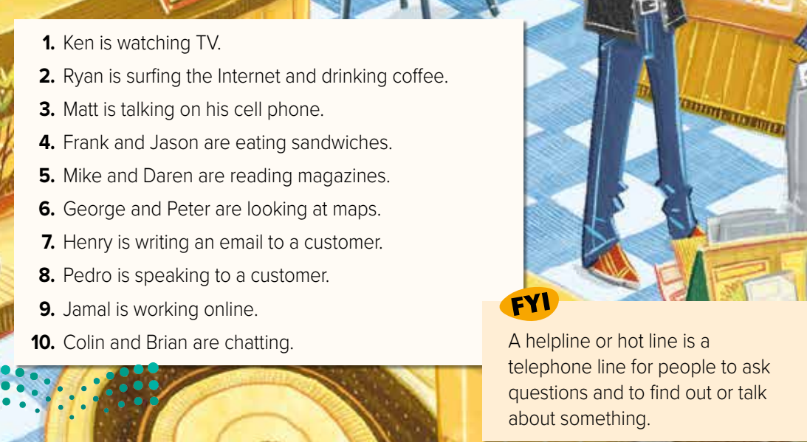
Page 65
What are they doing?
What’s he doing?
Warm up
1-Listen
New words
Quick check
2-Pair work

Slide 7










Page 64
Find the VERB
Warm up
1-Listen
New words
Quick check
2-Pair work

Slide 8
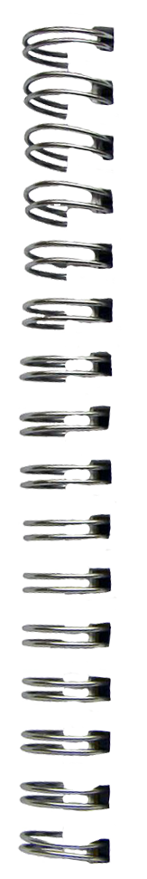




New Words
helpline
Hot line to ask questions
break
Stop work
Surf internet
chat
talk
customer
magazine
#
break
..........

Slide 9
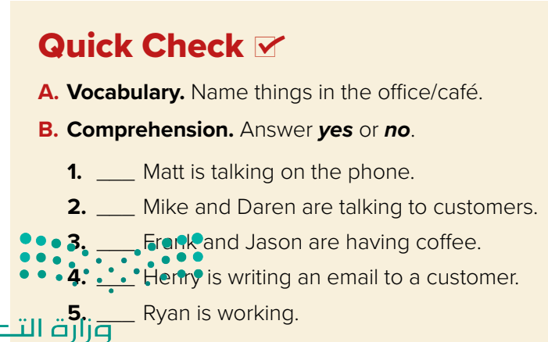



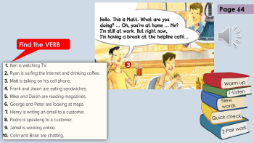
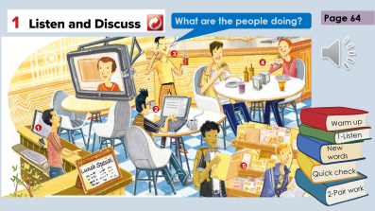
computers
tables, chairs, TV
magazines
food, drinks
cell phone
Think pair share
yes
no
Warm up
no
1-Listen
New words
yes
no
Quick check
2-Pair work

Slide 10



Lets play
Warm up
1-Listen
New words
Quick check
2-Pair work

Slide 11


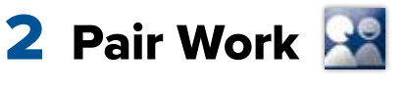
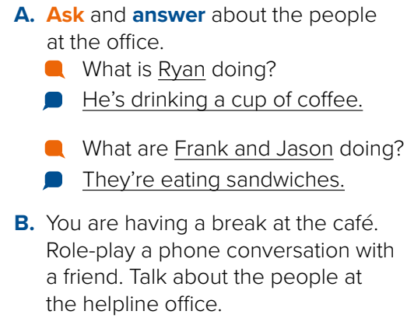
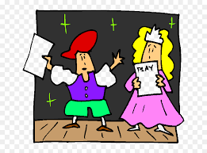
What is 911 for in KSA?
Role paly
Warm up
1-Listen
New words
Quick check
2-Pair work

Slide 12
Write in your notebook
Like final test أسئلة للاختبار النهائي
Choose:
Mmmmmmm ………. mmmmmmm
( ssss – ssss – sssss)
Make a question

Slide 13





page 217 Ex(A)
for practice new words
Warm up
1-Listen
New words
Quick check
2-Pair work

Slide 14
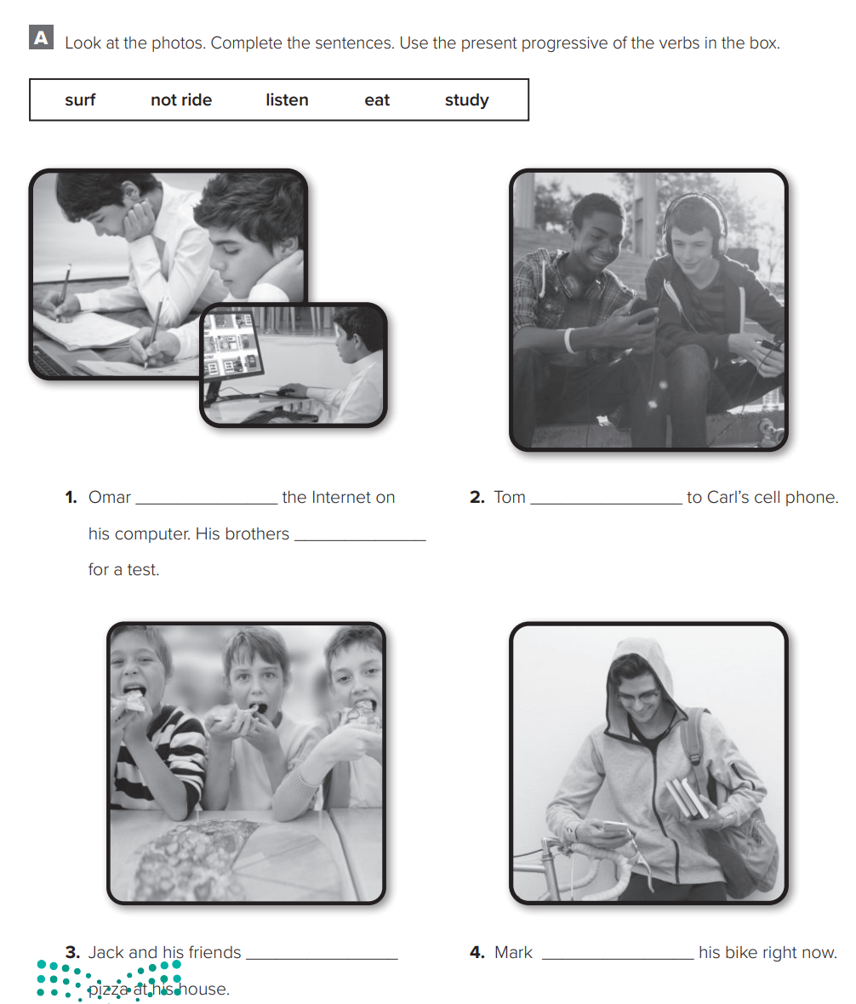
p.217
is surfing
is listening
are studying
Warm up
1-Listen
New words
Quick check
are eating
isn’t riding
2-Pair work

