Slide 1


Revision:
Unit 7

Slide 2
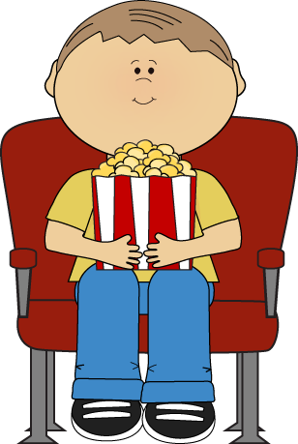
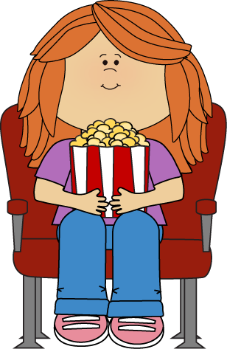
was
were
were
There………… two children.

Slide 3
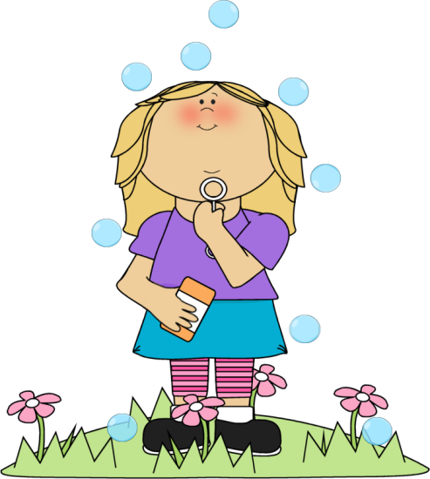

was
were
was
I………… in my garden.

Slide 4
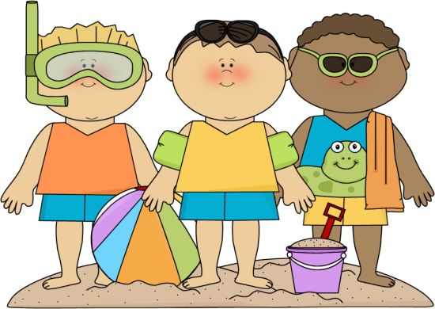
was
were
were
They ……… on the beach.

Slide 5
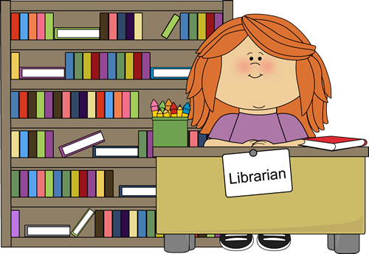
someone
no one
Someone
…….…… is in the library.

Slide 6

Page: 62

Slide 7
Objectives:
At the end of the lesson, students will be able to:
Answer questions about the conversation.
Answer questions about them selves.

Slide 8
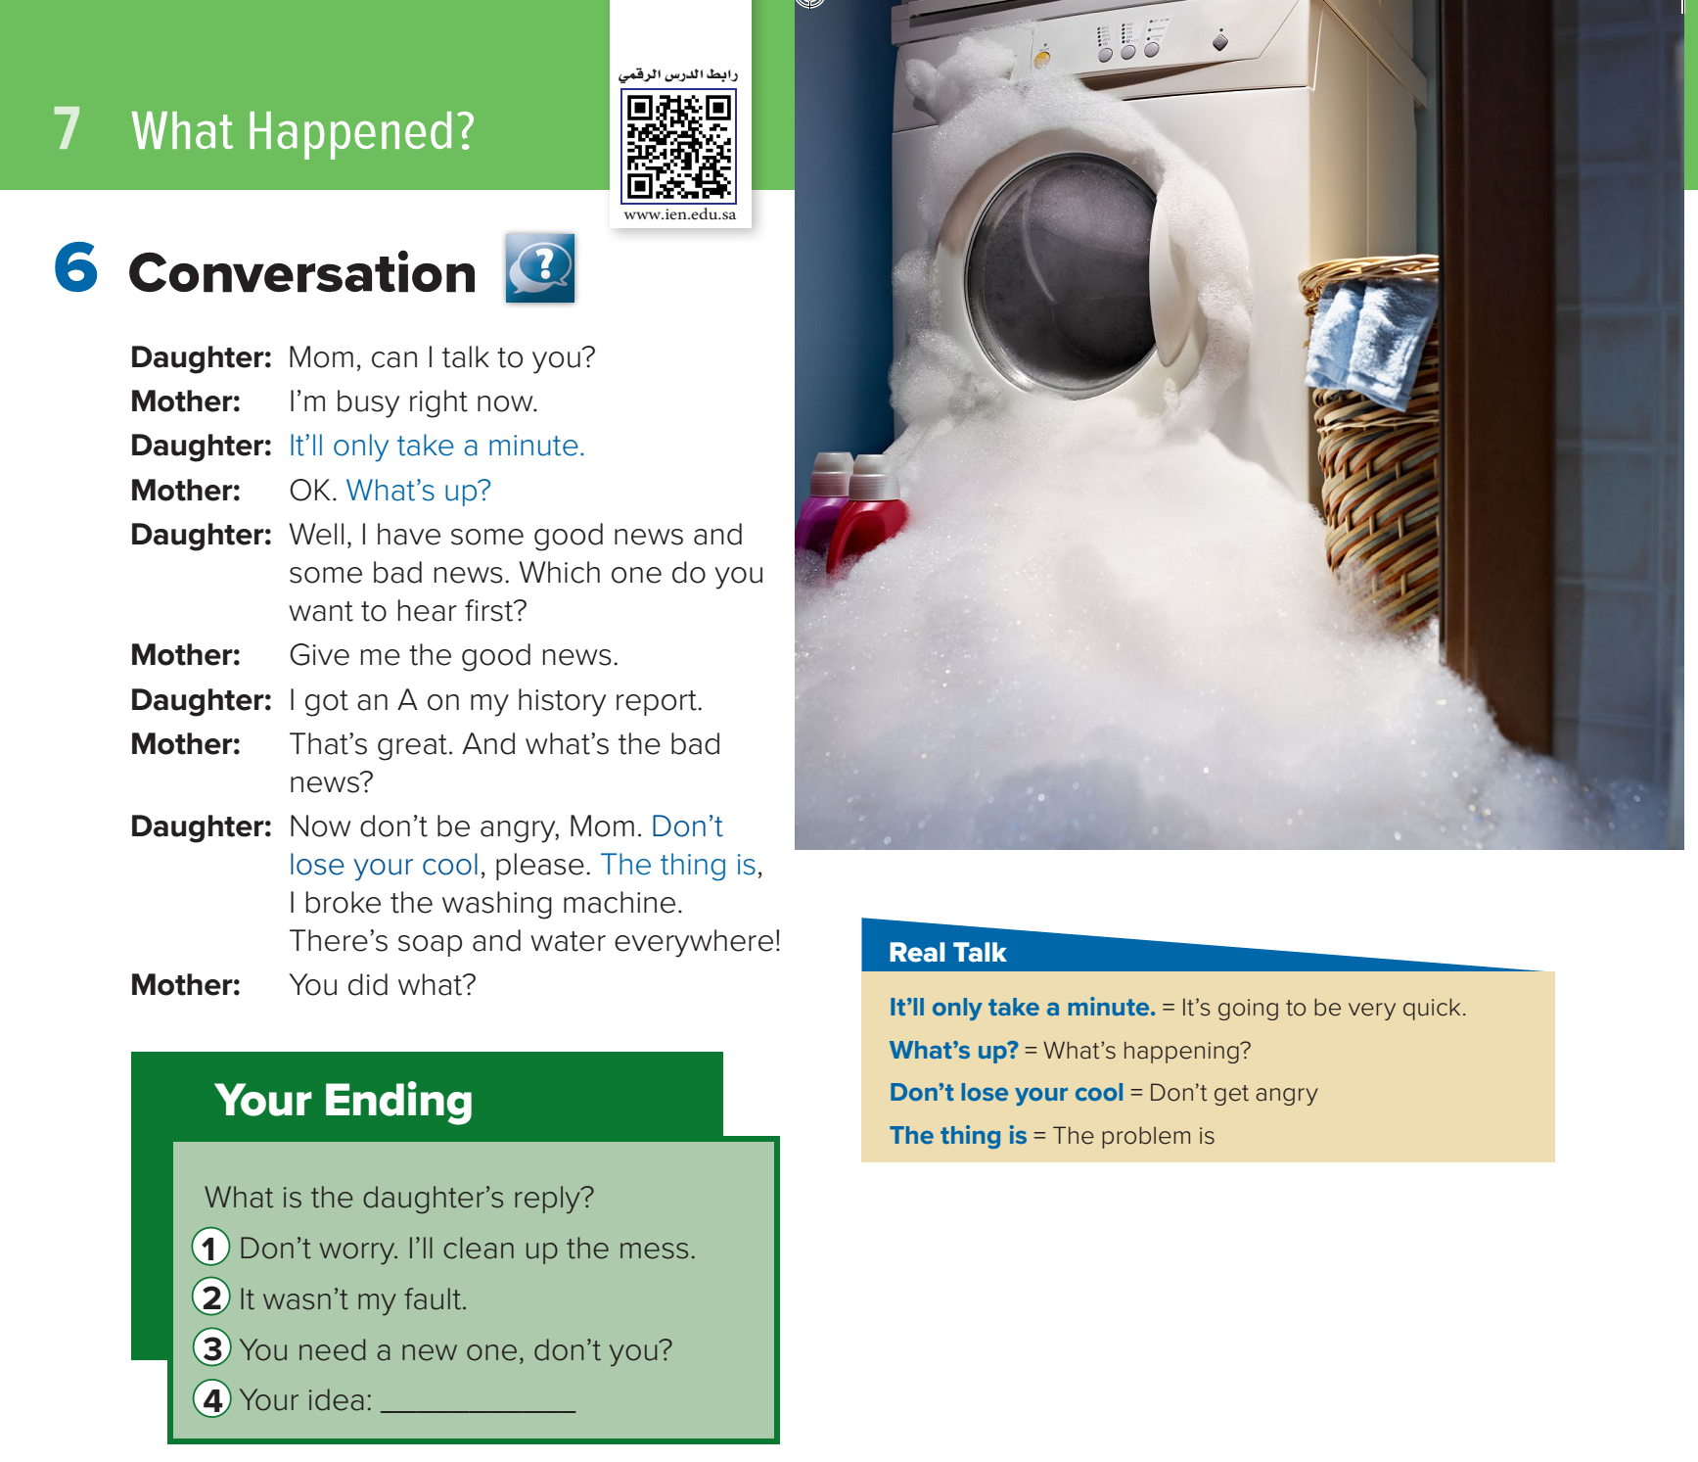


Who are talking?

Slide 9
Find:
angry
history
bad
feeling
subject
good X

Slide 10
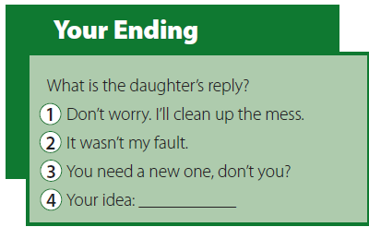

Slide 11

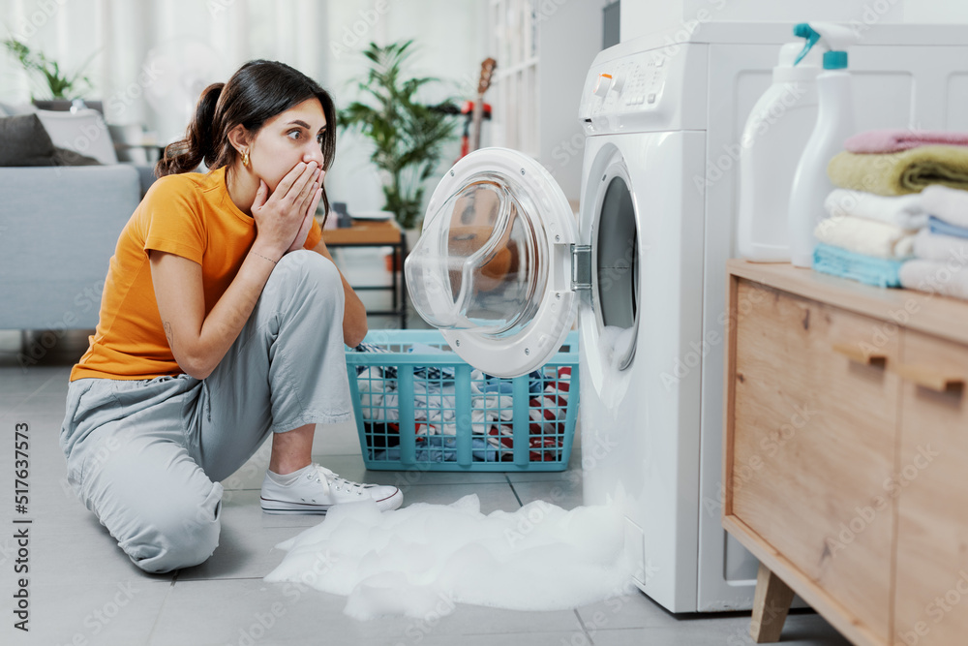
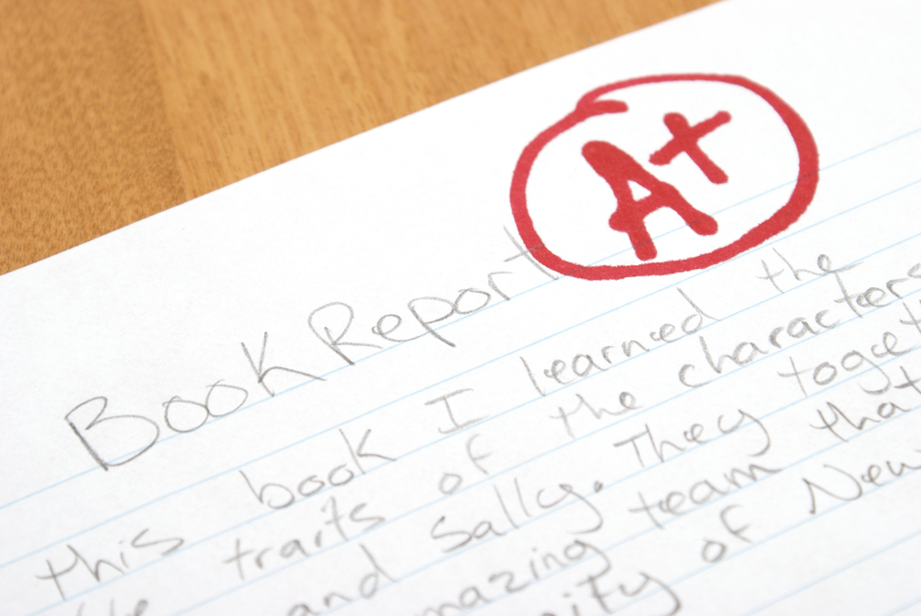
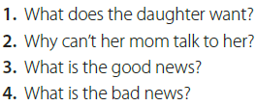
1.She wants to talk to her mother.
2.She’s busy.
3.The daughter got an A on her history report.
4.The daughter broke the washing machine.

Slide 12
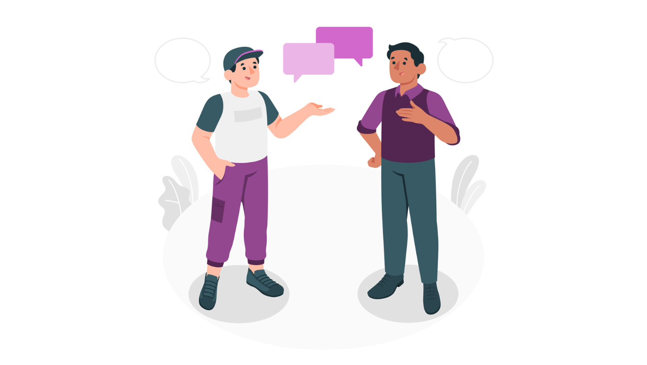
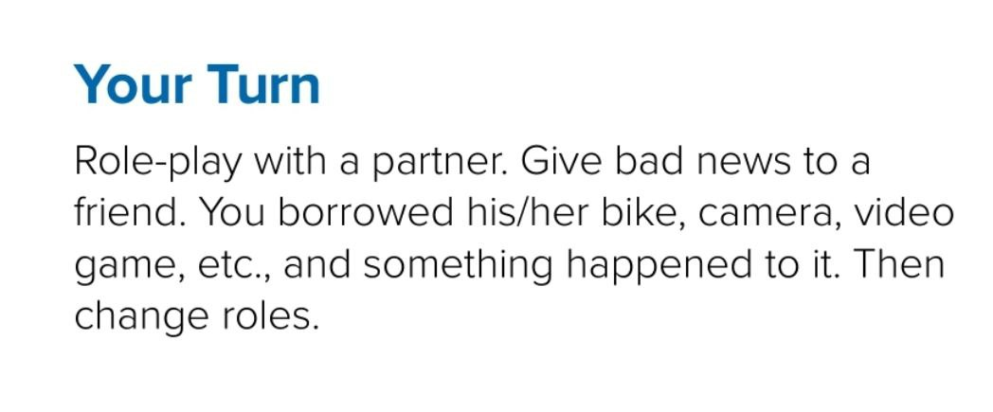
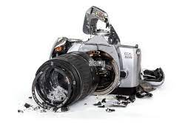
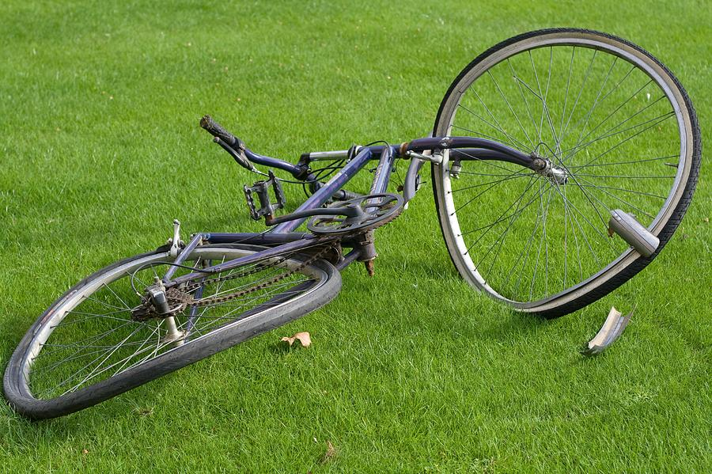

Slide 13
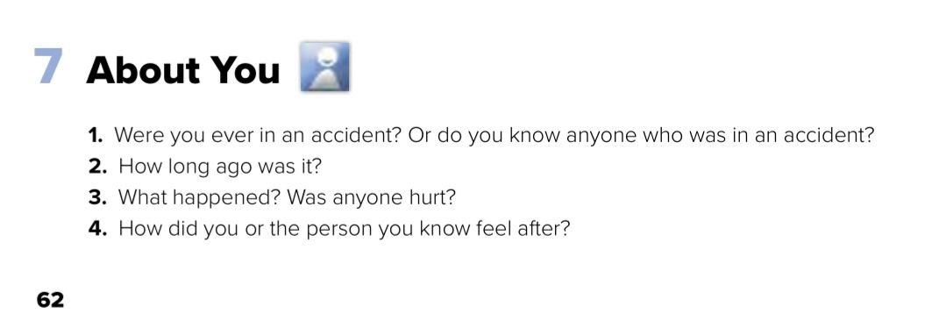
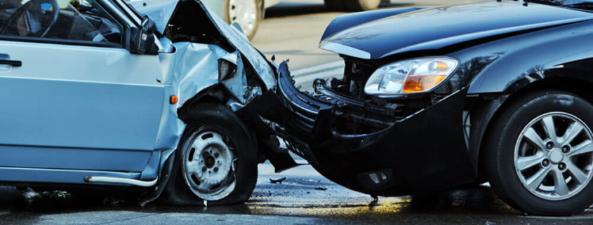
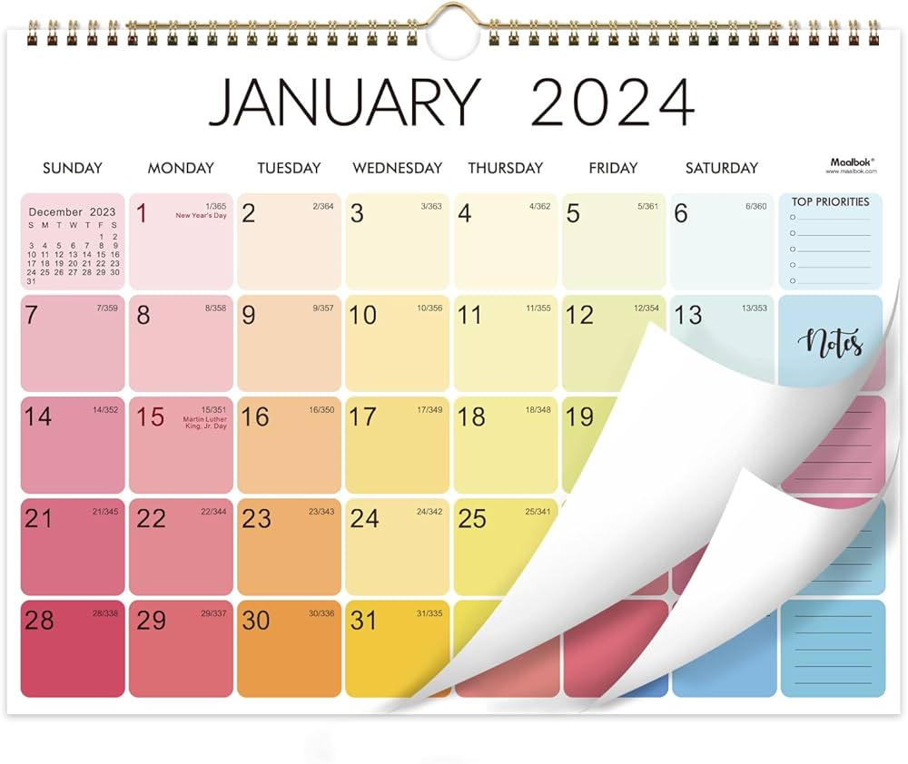
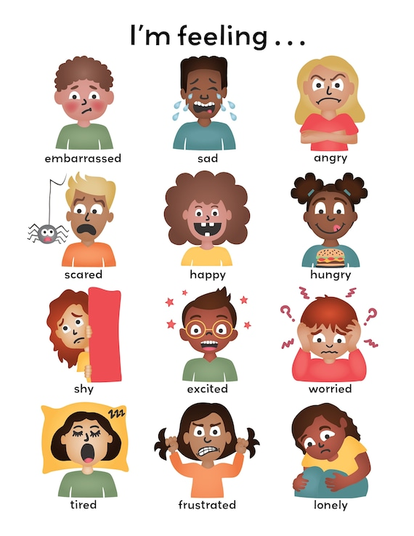
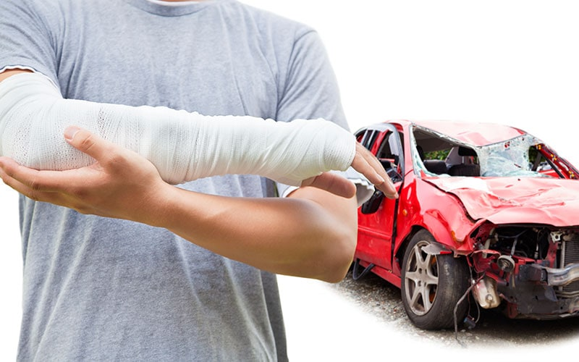

Slide 14



Homework:

