Slide 1
Unit5
Working 9 to 5
Form, Meaning& Function
Mega Goal 2.2
Done by: Entisar Al-Obaidallah

Slide 2
Lesson Objectives
Form correct tag questions.
Ask for Information with Can, Could and Would.
Make Requests with Can, Could and Would.
Express Obligation with Must, Mustn’t, Have to.
Express Necessity and Lack of Necessity with Have to, Need to, Needn’t, Don’t have to, Don’t Need to.

Slide 3
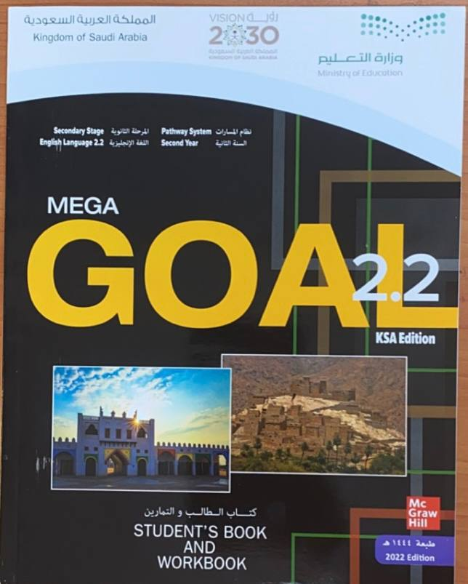
Open
Your student’s book Pages ( 82- 83 )

Slide 4
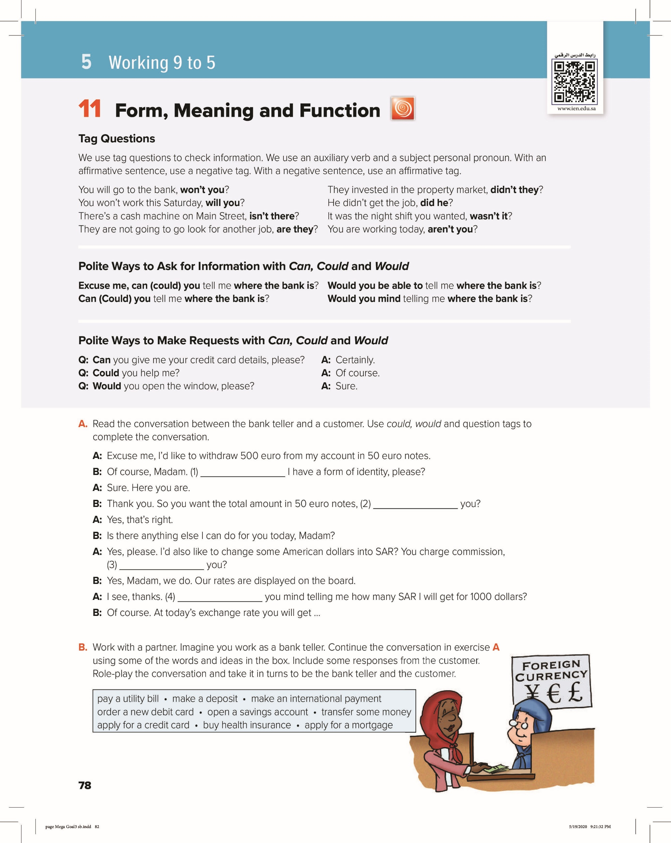
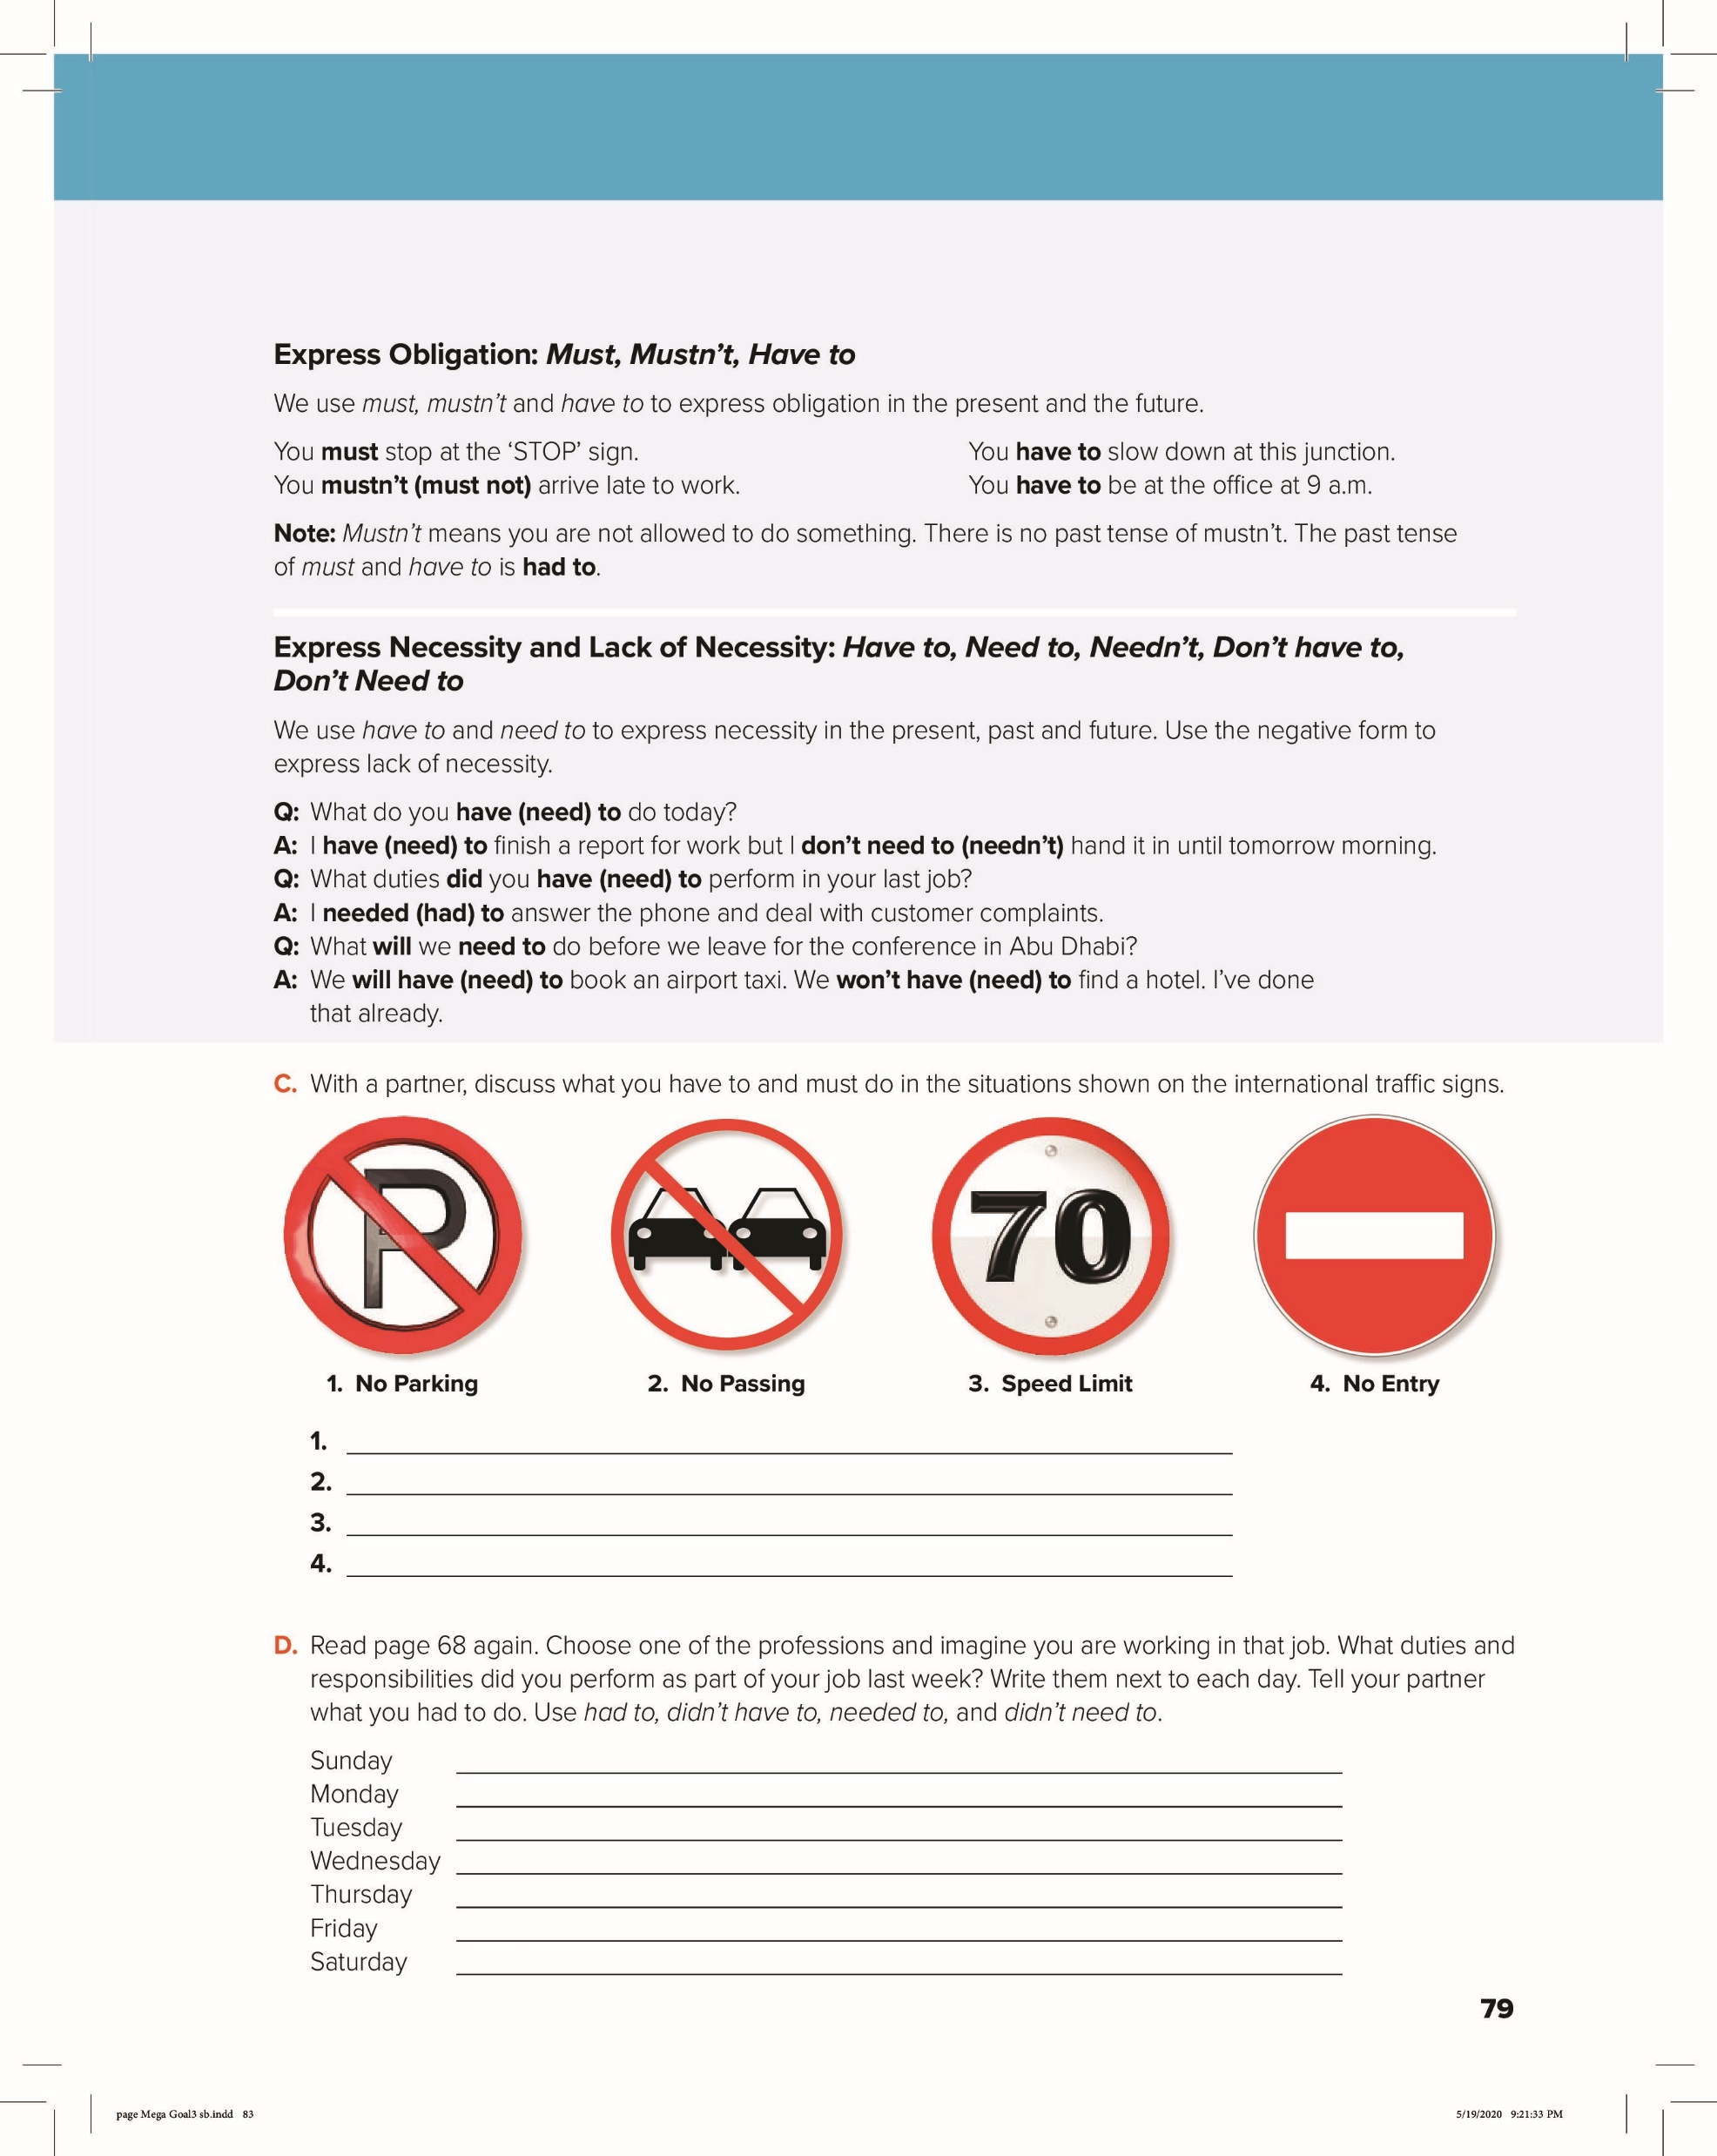

Slide 5
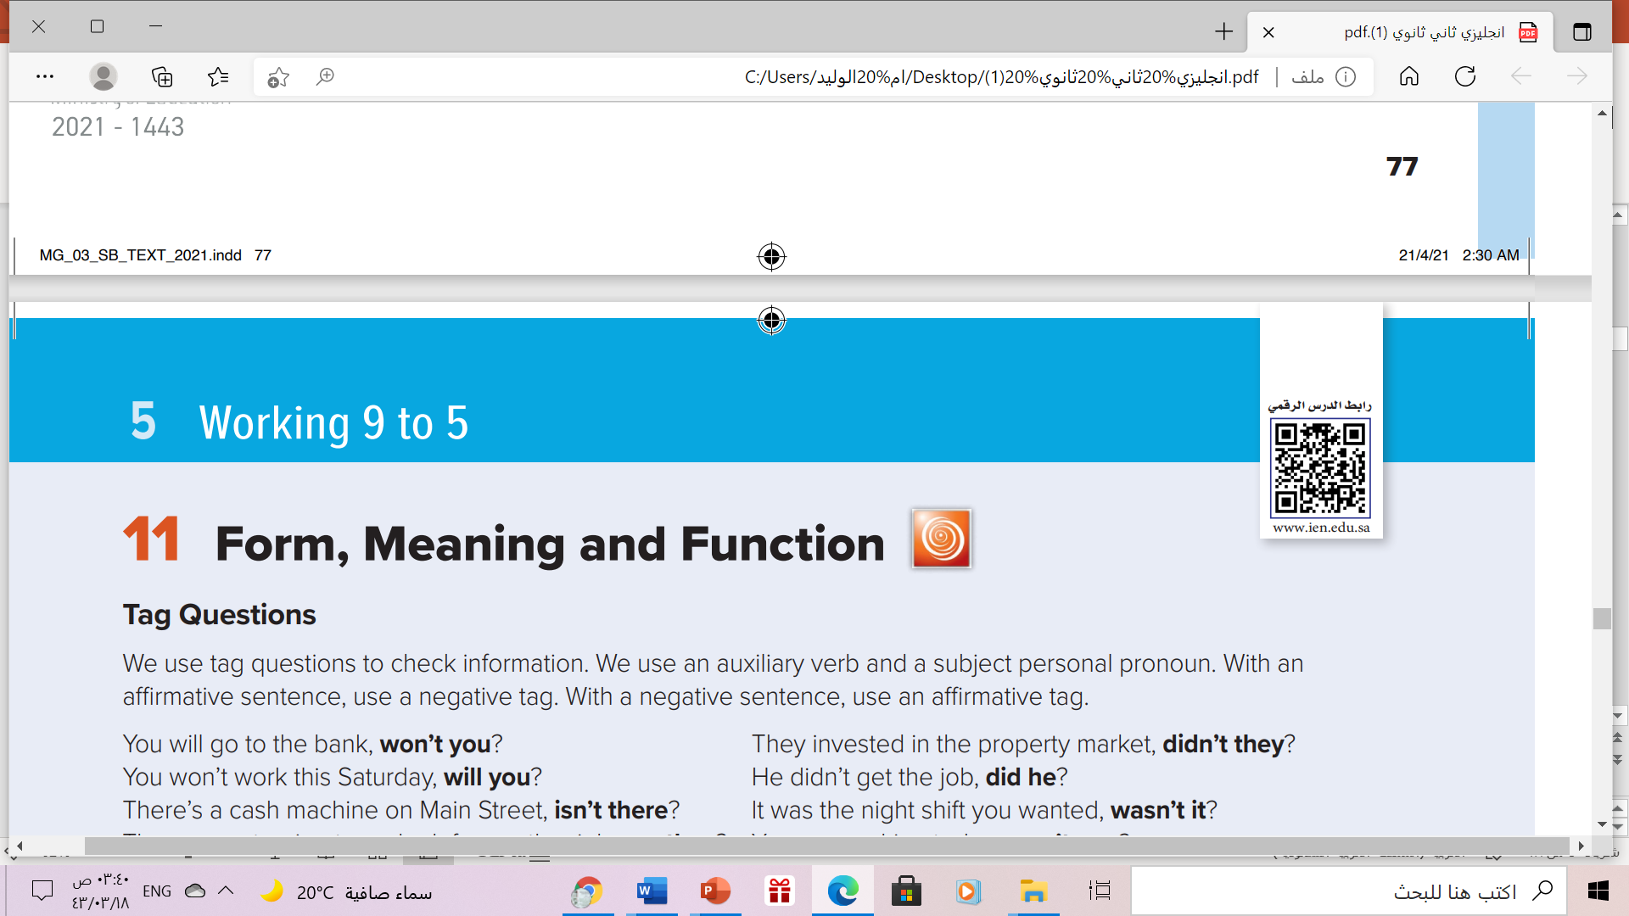

The Form of Tag Question
Affirmative sentence(+)
Short form (not)
subject
Auxiliary verb
…… ,
Auxiliary verb ( n’t)
subject
,
,
,
Example:
She is our English teacher, isn’t she?
Yes, he is
positive(+)
positive(+)
Negative(-)
Comma

Slide 6
The Form of Tag Question
Negative sentence(-)
subject
Auxiliary verb (not)
…… ,
Auxiliary verb
,
subject
,
,
Example:
She isn’t our English teacher , is she?
No, she isn’t
positive
Negative
Comma
Negative

Slide 7
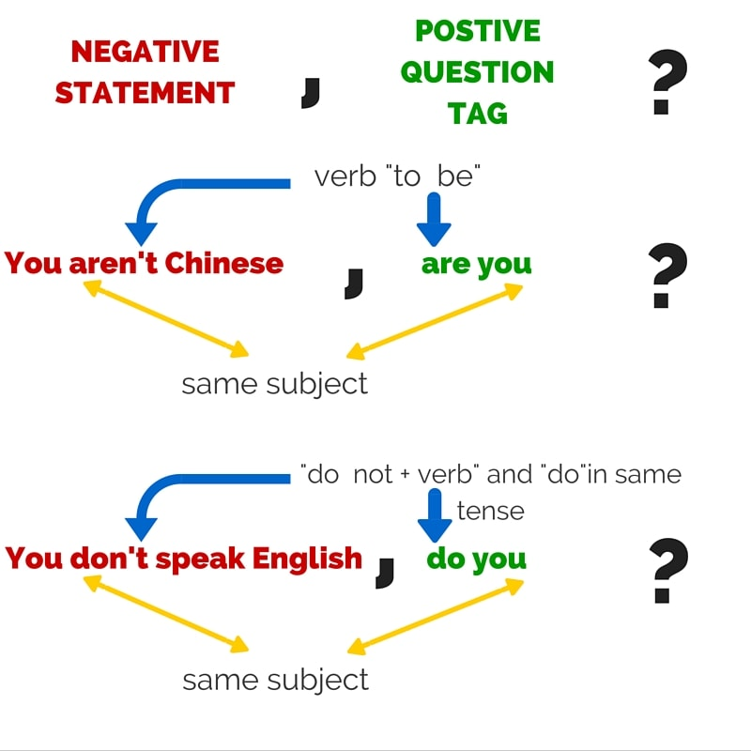
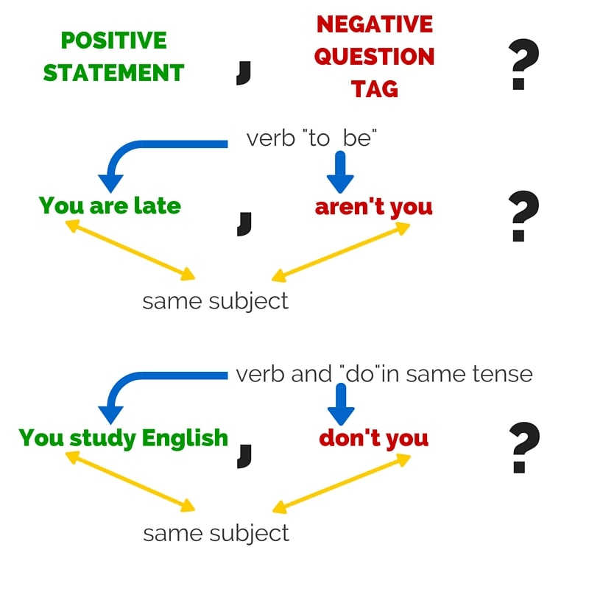

Slide 8
The Form of Tag Question
If there is helping verb:
If the main clause has an auxiliary verb in it, you use the same verb in the tag question.
(+) Affirmative
(-) Negative
(+) Affirmative
She is lovely person , isn’t she?
Yes, she is
(-) Negative
(+) Affirmative
(-) Negative
She isn’t lovely person , is she?
No, she isn’t

Slide 9

If there is No helping verb:
If there is NO auxiliary verb (in the present simple and past simple) use do / does / did (just like when you make a normal question).
(+) Affirmative
(-) Negative
(+) Affirmative
She eats the cake , doesn’t she?
Yes, she does
(-) Negative
(+) Affirmative
(-) Negative
She doesn’t eat the cake , does she?
No, she doesn’t

Slide 10


Slide 11


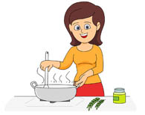

Complete the tag questions with the correct tag.
aren’t they
They are best friends, ?
She cleans the room, ?
doesn’t she
She is a good cooker, ?
isn’t she
They didn’t buy many clothes, ?
did they

Slide 12
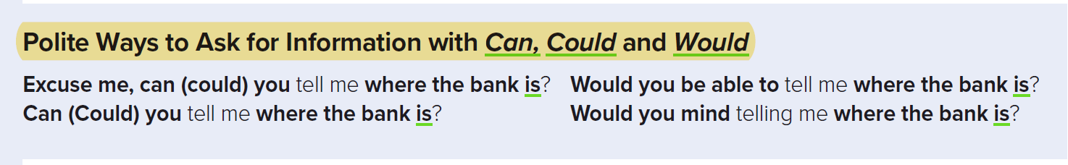
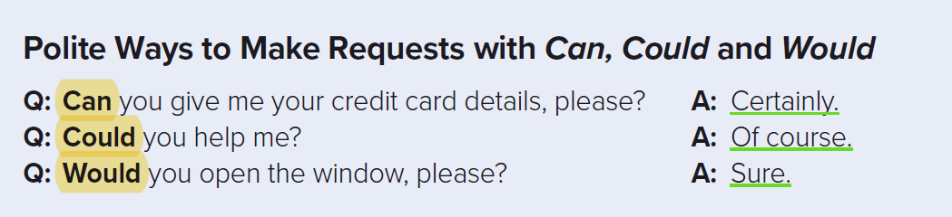

Slide 13

Can / Could
don’t
don’t
Would

Slide 14
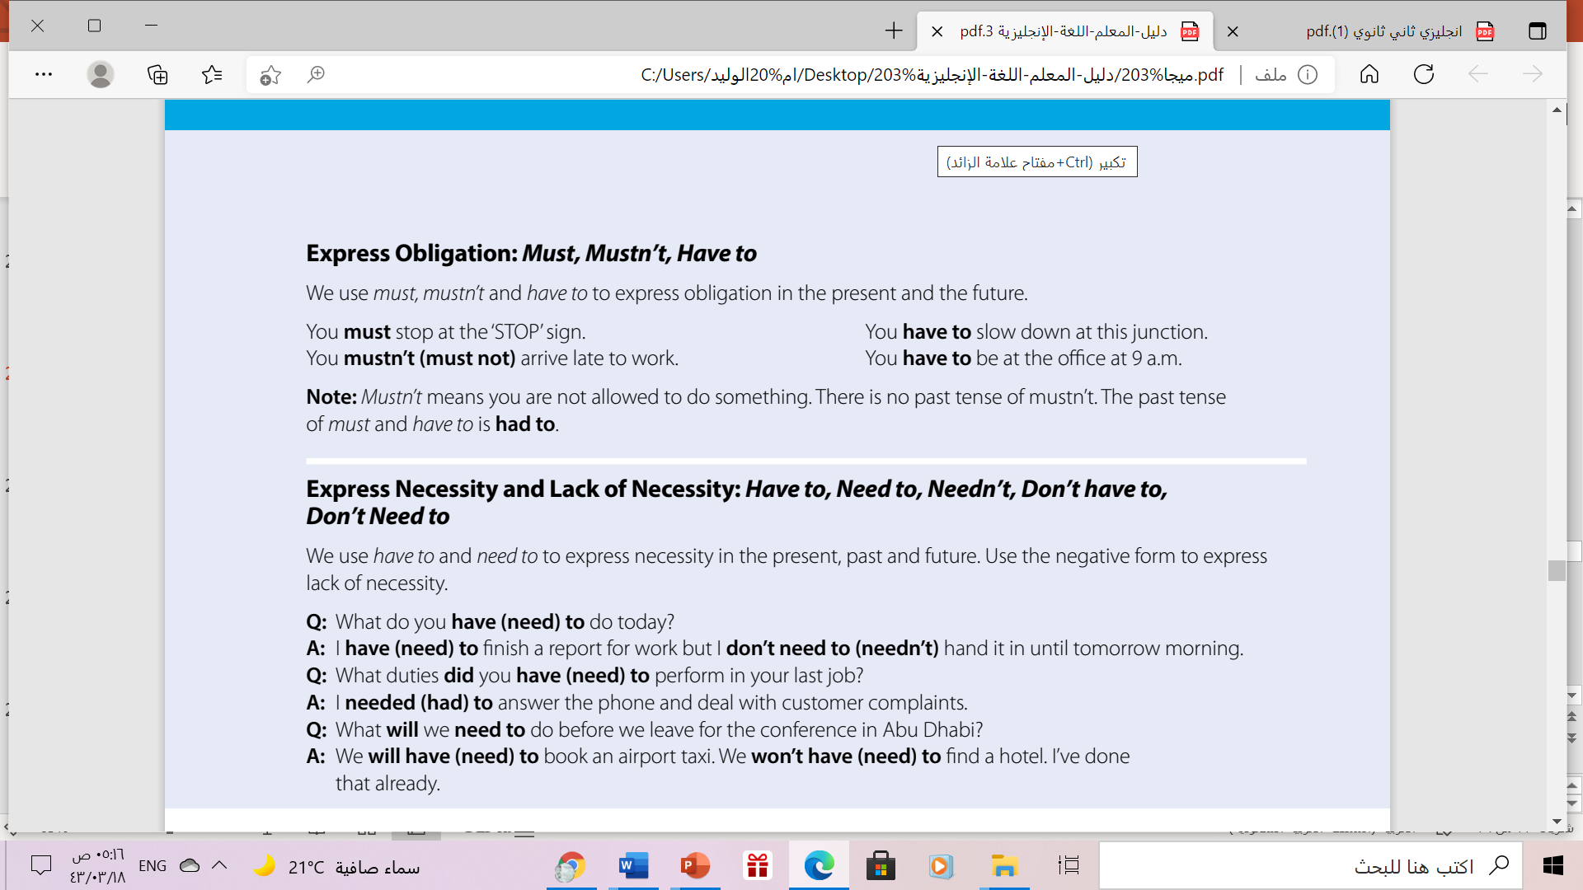

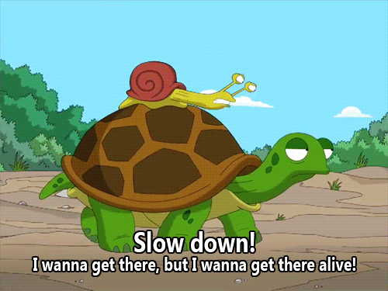

Example:
You must stop at the ‘STOP’ sign.
You have to slow down at this junction.
You mustn’t (must not) arrive late to work.
You have to be at the office at 9 a.m.
Note:
Mustn’t = not allowed to do something.
No past tense of mustn’t.
The past tense of must and have to ➔ had to.

Slide 15
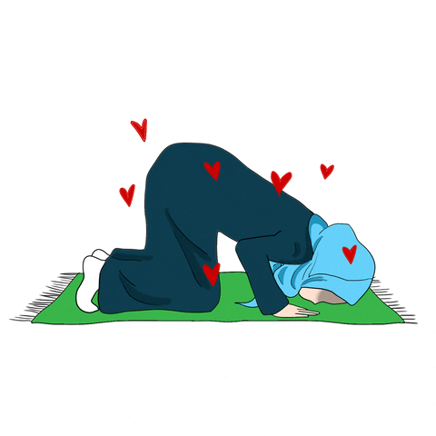
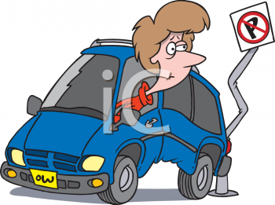

Complete using “ must” , “ mustn’t’” :
Can / Could
must
Muslims …………..............…....... pray five times a day.
mustn’t
You ………….................. stop here. The sign says " No Parking"
You ………………………… arrive late to work.
mustn’t

Slide 16
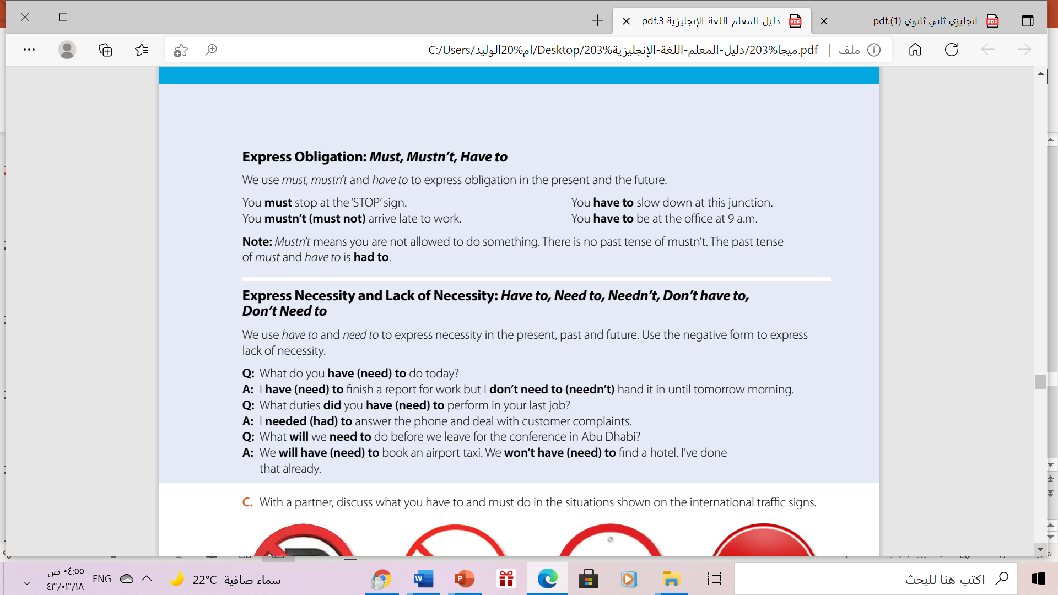

have to, need to, needn’t, don’t have to, don’t need to
Use have to and need to ➔ express necessity.
Use needn’t, don’t have to, don’t need to ➔ express lack of necessity.
Example:
I have to finish a report for work.
I need to finish a report for work.
I don’t need to translate it
I needn’t translate it
We will have to book an airport taxi.
We will need to book an airport taxi.

Slide 17

1. You mustn’t / must not park here.
2. You mustn’t / must not overtake on this road.
3. You must not drive faster than 70./ You have to adhere to the speed limit of 70.
4. You must not drive down this road

Slide 18
Home Work
On Workbook pages( 273) ,
exercise ( M)

Slide 19

Thank you!

