Slide 1

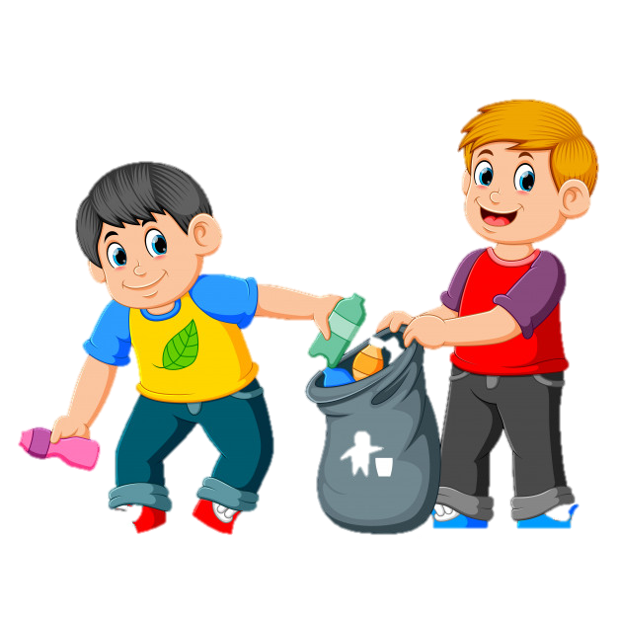

02
MEGA GOAL 2.2
Going Green
04 Conversation
By: Essa Al Hussaini

Slide 2


Lesson
Goals
Find the meaning of new words
Explain the main idea of Going Green
1
2
3
4
Form a correct suggestion
List the reasons for recycling

Slide 3
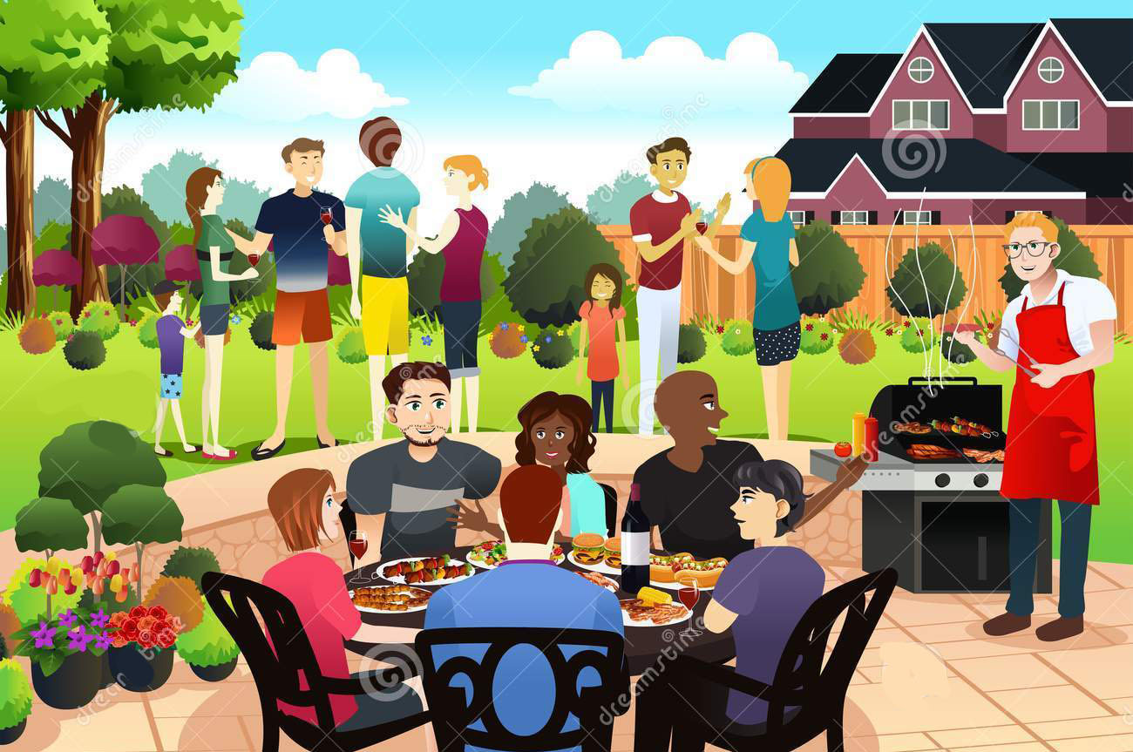
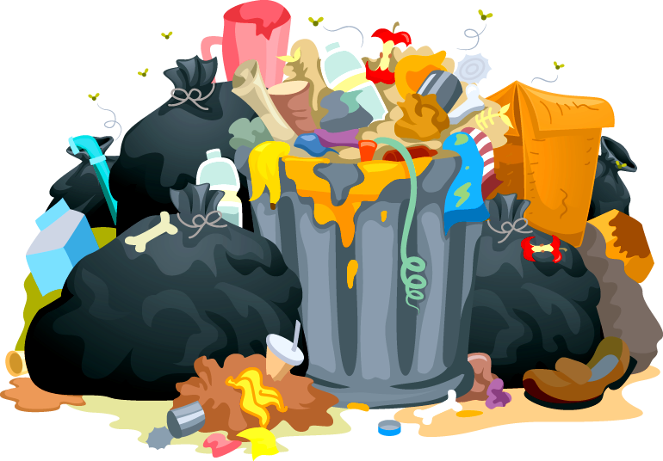
What do you think has been happening here?
Notes:
People were having a barbecue or a picnic and threw all the cans and bottles in the trash

Slide 4
Do you usually chuck like that?

Slide 5
Recycling ..
EASY to do?
or a HASSLE ?

Slide 6
.. a hard effort to recycle?
.. or a piece of cake?

Slide 7
… benefits of recycling?
NOTE:
Notes:
reduces the amount of waste
Conserves natural resources
Increases economic security by tapping a domestic source of materials
Prevents pollution by reducing the need to collect new raw materials
Saves energy
Supports Saudi manufacturing and conserves valuable resources
Helps create jobs in the recycling and manufacturing industries in Saudi

Slide 8
Don’t like recycling?!
What’s your excuse?

Slide 9
What do you do when you see someone throwing something away on the street?

Slide 10



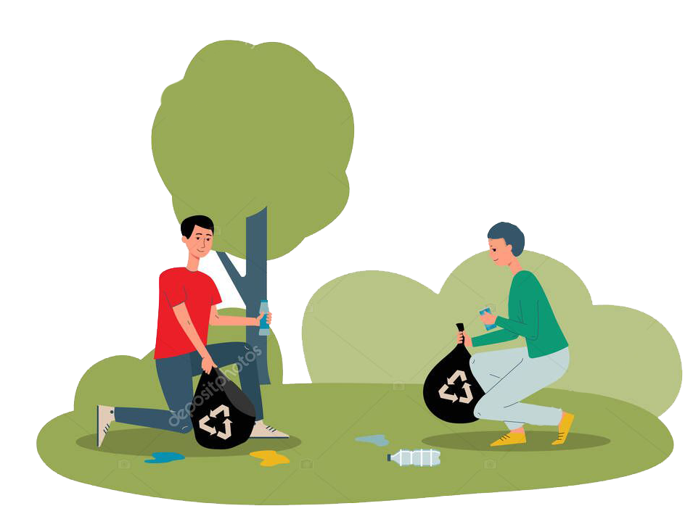
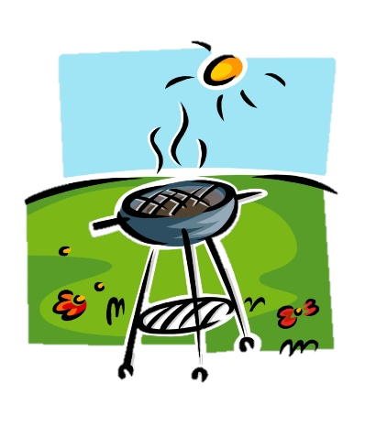
BOOKS CLOSED
You are going to listen to a conversation between Ibrahim and Jasim, cleaning up after a party.

Slide 11
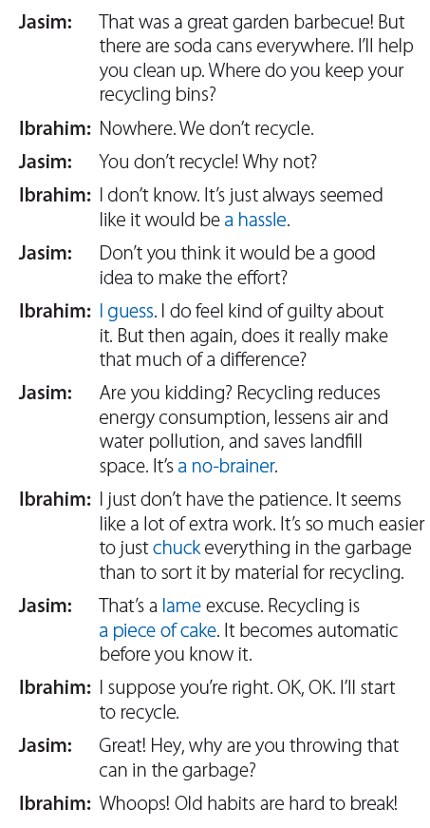


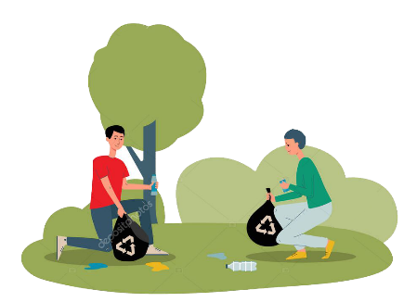
20
Listen & Read along

Slide 12
20
What is it
that Ibrahim thinks is a
hassle?
recycling

Slide 13
20
What does Jasim mean when he says that Ibrahim is giving
a lame excuse?
What’s
a no-brainer according to Jasim?
How does
Ibrahim’s voice sound when he says “I guess”?
a weak excuse
a little
bored
recycling

Slide 14
Real talk
something that is inconvenient to do
a hassle
I guess
a no-brainer
an unenthusiastic way of agreeing with someone
a question or problem that has an obvious
answer or solution

Slide 15
Real talk
throw out
chuck
bad, inadequate
a piece of cake
lame
very easy

Slide 16
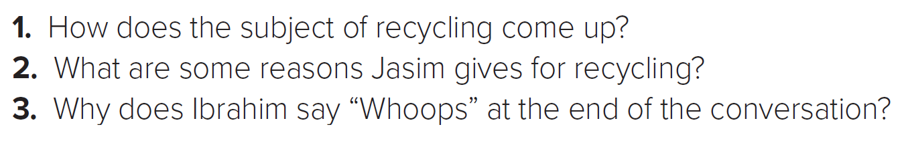
About the Conversation
1
2
3
Jasim and Ibrahim are cleaning up after a party and there are soda cans everywhere.
* Recycling reduces energy consumption
* Lessens air and water pollution
* Saves landfill space.
Because Ibrahim accidentally threw a can into the garbage rather than recycling it.

Slide 17

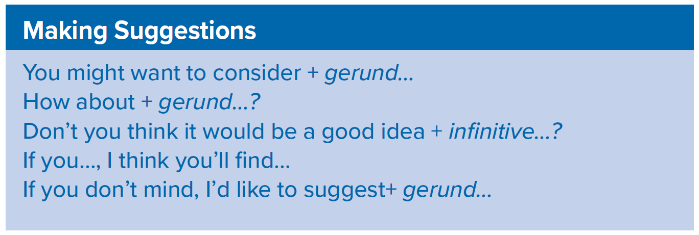
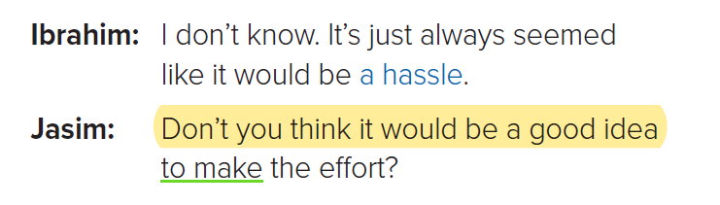
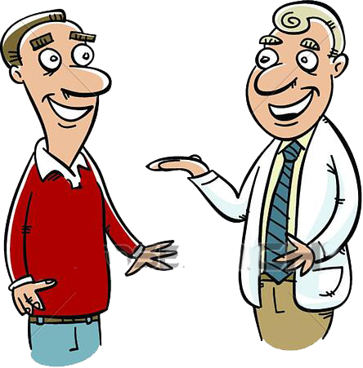
Which expression does Jasim use in the conversation?
Your Turn
a student to read aloud the directions
Phrases used
as an introduction to give a suggestion not an order
expression + infinitive…?

Slide 18
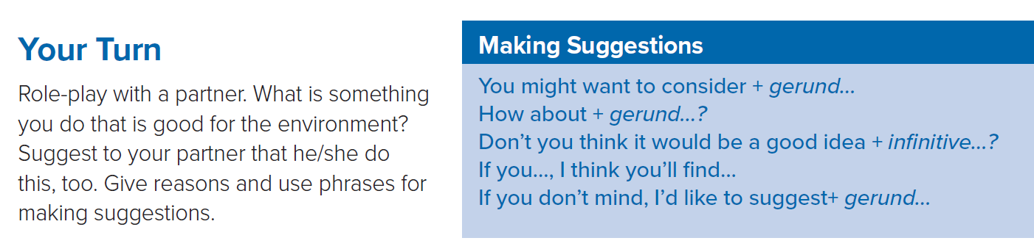
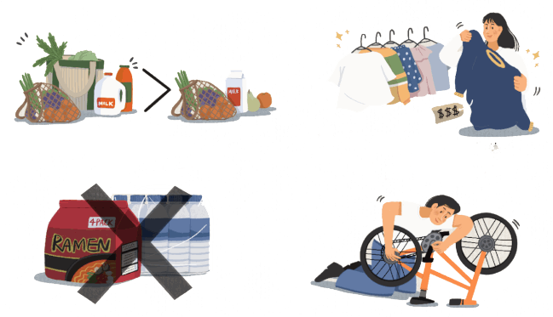


1
2
NOTE
3
4
Notes:
Brainstorm with the class a couple of ideas for topics they can use for their conversations.
Reduce the amount you consume
Buy well-designed, long-lasting products and services
Don't buy packaged goods
Fix, don't replace

Slide 19



https://wordwall.net/ar/resource/7333822

Slide 20
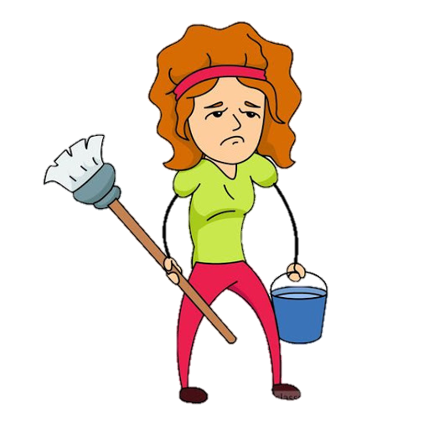
Complete with a "Real Talk" phrase:
She doesn't like to clean her room. She thinks it is a ....
I guess
a no-brainer
a hassle

Slide 21

Complete with a "Real Talk" phrase:
Could you solve it?
Yes, it was ....
guess.
a no-brainer
chuck

Slide 22
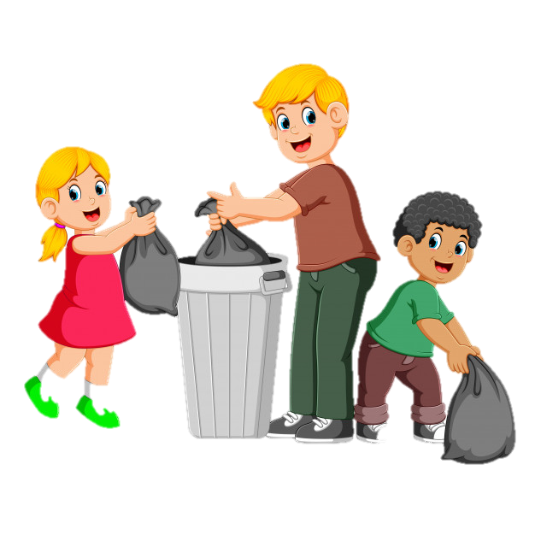
Complete with a "Real Talk" phrase:
We ____ trash in the garbage.
chuck
hassle
lame

Slide 23

Complete with a "Real Talk" phrase:
How could you solve it quickly?
It’s …….
lame
a piece of cake
a hassle

Slide 24

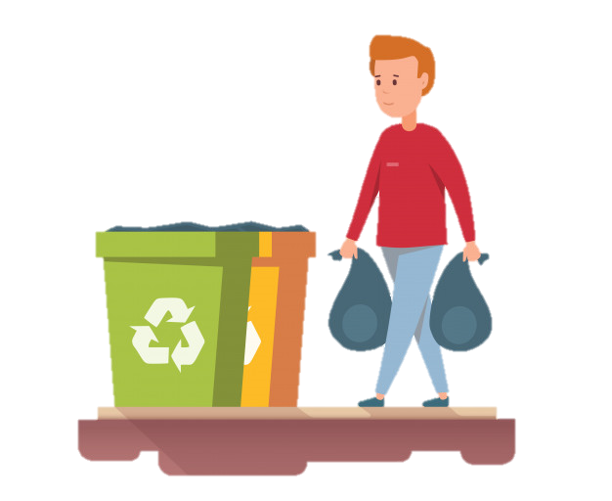
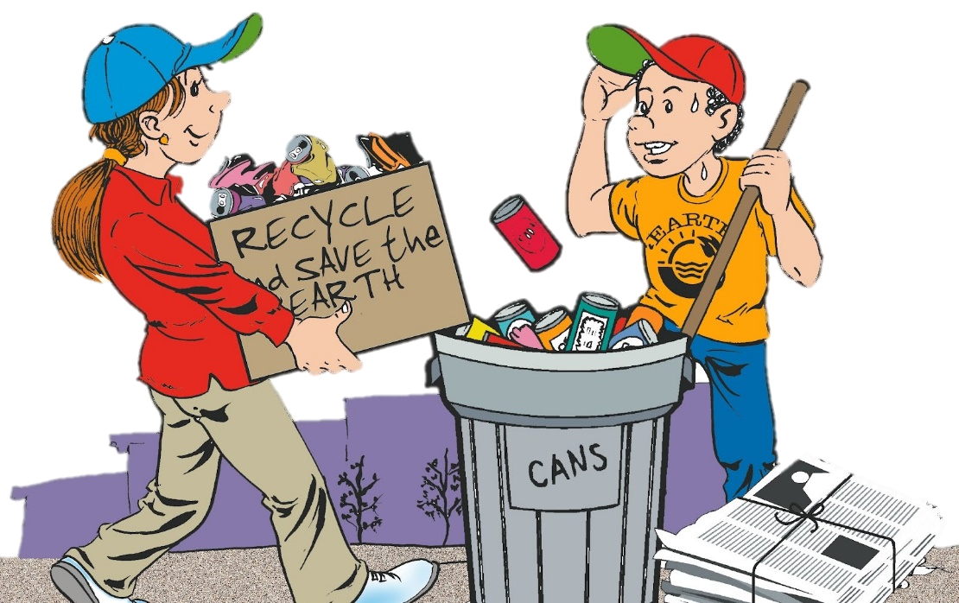
Keep Your Environment Clean
Keep Green, Keep Clean

Slide 25

THANK YOU
Lesson done by: Essa Al Hussaini

Slide 26

02
MEGA GOAL 2.2
Going Green
05, 06, 07 Listening, Pronunciation and Vocabulary
By: Essa Al Hussaini

Slide 27
Lesson
Goals
listen for specific information
Practice reading the thought groups
1
2
3
4
Find the true information about glass recycling
match the words with their meanings

Slide 28

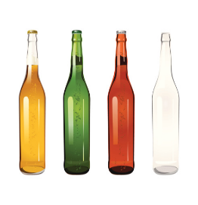
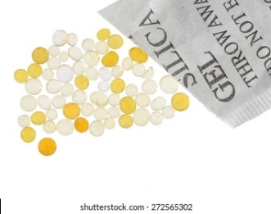
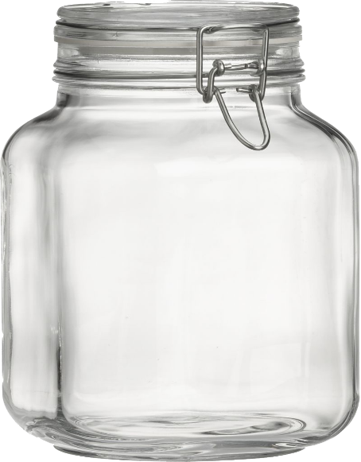

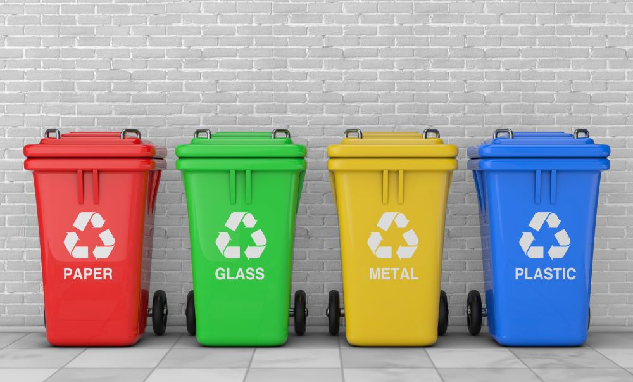
What do you know about glass?
Made from?
Can be recycled or not?
Melts at ____ temp degree Celsius?
Takes ____ years to decompose?
Notes:
People were having a barbecue or a picnic and threw all the cans and bottles in the trash

Slide 29



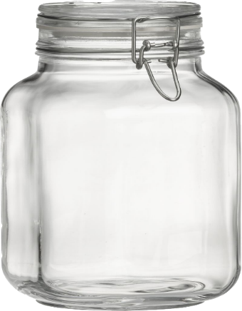

1
2
3
Can you say
What each pic shows?
Glass Bottles
Silica
Sand
4
5
6
Jar
Recycling Bins
Crushed Glass

Slide 30



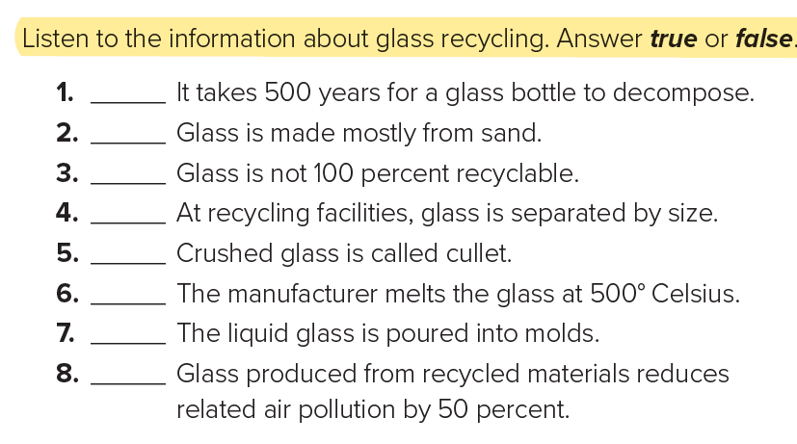
5 Listening
21
False
True
False
False
True
False
True
False

Slide 31

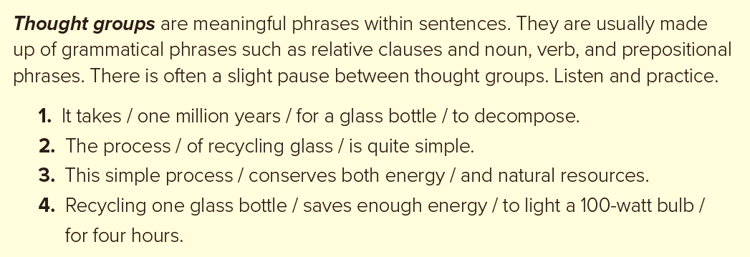
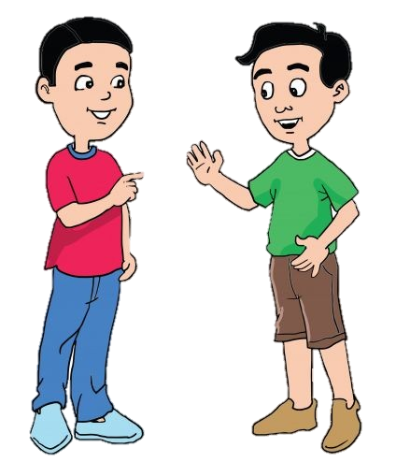
6 Pronunciation
https://www.youtube.com/watch?v=cmOdquDxDpg
Notes:
Thought group: a group around 2-5 words that make a unit of meaning

Slide 32

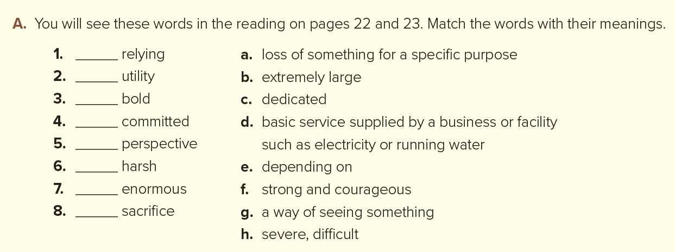

7 Vocabulary Building
e
d
f
c
g
h
b
a

Slide 33
Keep Your Environment Clean
Keep Green, Keep Clean

Slide 34
THANK YOU
Lesson done by: Essa Al Hussaini

