Slide 1
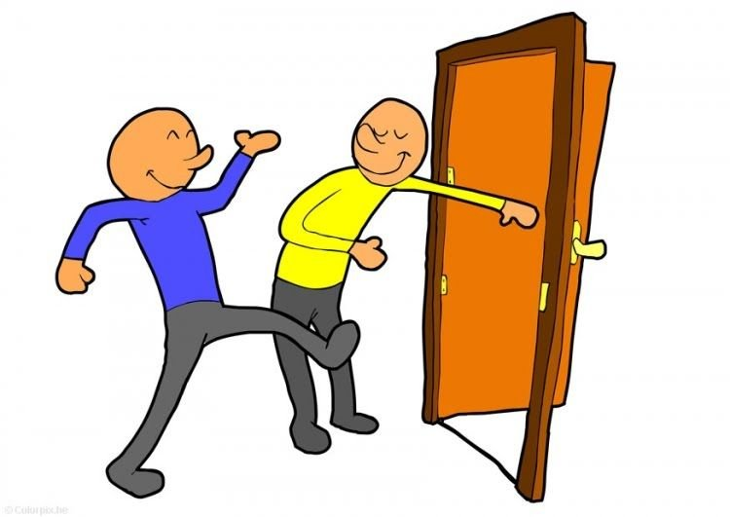
Mega Goal 2.2
U: 1 L:11
Form, Meaning and Function
Done by: Essa Al Hussaini

Slide 2
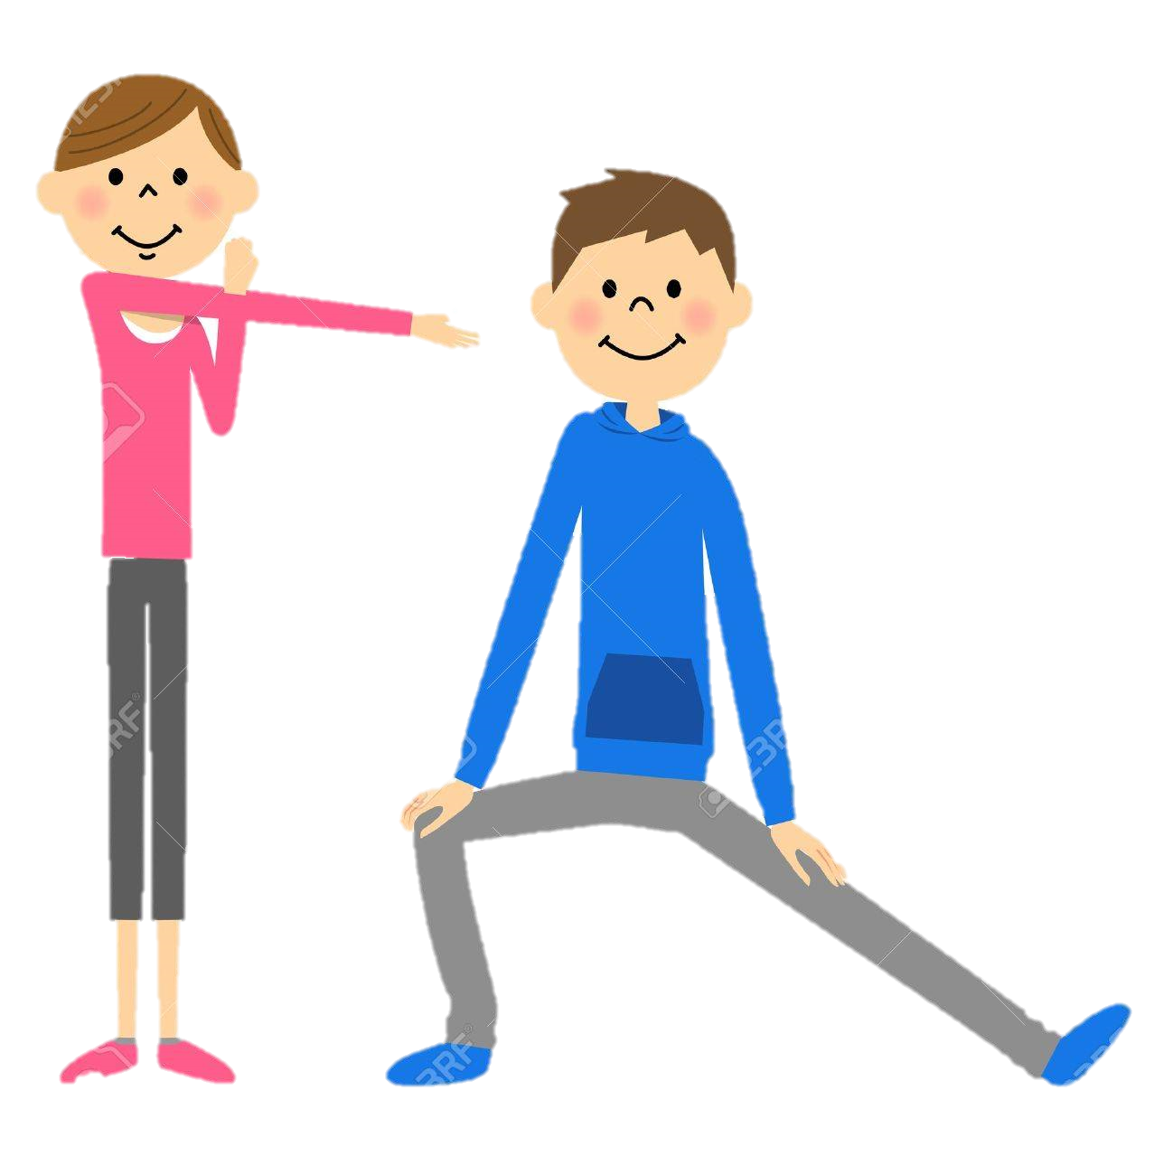

Warming up

Slide 3


Let’s check what you know
You will go to the bank , won’t you?
You will go to the bank , won’t you?
You will go to the bank , won’t you?
You will go to the bank , won’t you?
You will go to the bank , won’t you?
You will go to the bank , won’t you?
You will go to the bank , won’t you?
You will go to the bank , won’t you?
You will go to the bank , won’t you?
You will go to the bank , won’t you?
a sentence?
two parts?
both parts are negative?
a question?
a negative?
a mini question?
a negative?
a full stop?
same auxiliary verb?
same subject?

Slide 4

Determine the two parts in the structure
Part 1
Part 2
He is our English teacher, isn’t he?

Slide 5
Determine the two parts in the structure
Statement
Tag Question
He is our English teacher, isn’t he?

Slide 6
Tag Questions
USED to check information. We use an auxiliary verb and a subject personal pronoun. With an affirmative sentence, use a negative tag. With a negative sentence, use an affirmative tag.
Tag Question
He is our English teacher, isn’t he?

Slide 7
Tag Questions
USED to check information. We use an auxiliary verb and a subject personal pronoun. With an affirmative sentence, use a negative tag. With a negative sentence, use an affirmative tag.
Statement
Tag Question
He is our English teacher, isn’t he?
Yes, he is
He isn’t our English teacher, is he?
No, he isn’t

Slide 8
(+) Affirmative
(-) Negative
(+) Affirmative
He is our English teacher, isn’t he?
Yes, he is
( - )
(+)
( - )
He isn’t our English teacher, is he?
No, he isn’t

Slide 9

Tag Questions
USED to check information. We use an auxiliary verb and a subject personal pronoun. With an affirmative sentence, use a negative tag. With a negative sentence, use an affirmative tag.
You will go to the bank , won’t you?
You won’t work this Saturday , will you?
There’s a cash machine on Main Street , isn’t there?
They are not going to go look for another job , are they?
They invested in the property market , didn’t they?
He didn’t get the job , did he?
It was the night shift you wanted , wasn’t it?
You are working today , aren’t you?

Slide 10
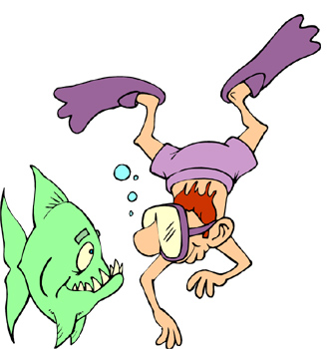
Practice 1
Complete the tag questions with the correct tag.
Example: You can swim, …
can’t you?
isn’t it?
It is high enough, …
It won’t break, …
We don’t have enough food, …
He didn’t bring the helmets, …
She hasn’t given us the right parachutes, …
We should check the map, …
Our guide, Bob, does this all the time, …
will it?
do we?
did he?
has she?
shouldn’t we?
doesn’t he?

Slide 11

Complete each tag question, then answer each
don’t
Yes, I do
You play football, …………………. you ?
……………………………..
doesn’t
Yes, he does
He plays football , ………………….. he?
……………………………..
didn’t
Yes, they did
They played football , ………………….. they?
……………………………..

Slide 12
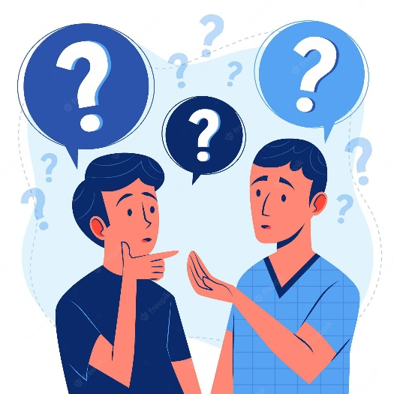
Polite Ways to Ask for Information
Polite / impolite ways?
HOW to make them in Polite ways?
Where is the bank?
What is your name?

Slide 13
Polite Ways to Ask for Information
with Can, Could and Would
Excuse me, can you tell me where the bank is?
Could you tell me where the bank is?
Would you be able to tell me where the bank is?
Would you mind telling me where the bank is?
Where is the bank?

Slide 14

Polite Ways to make Request
with Can, Could and Would
Can you drive me home, please?
Could you help me?
Would you open the window, please?
A: Certainly.
A: Of course.
A: Sure.

Slide 15
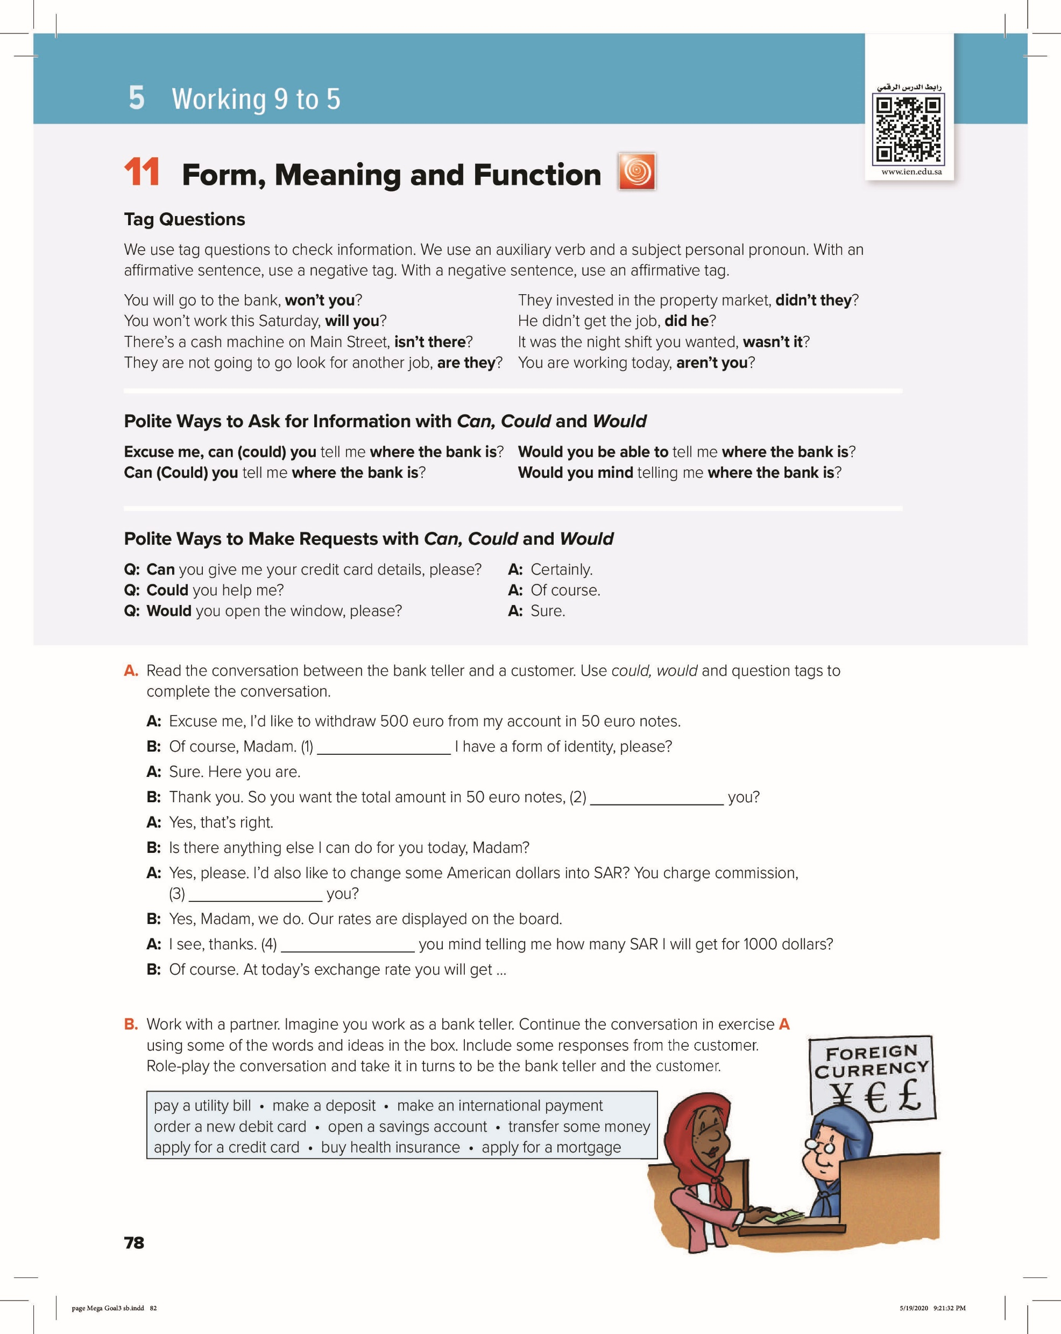
Can / Could
don’t
don’t
Would
12

Slide 16

WORKBOOK
85

Slide 17
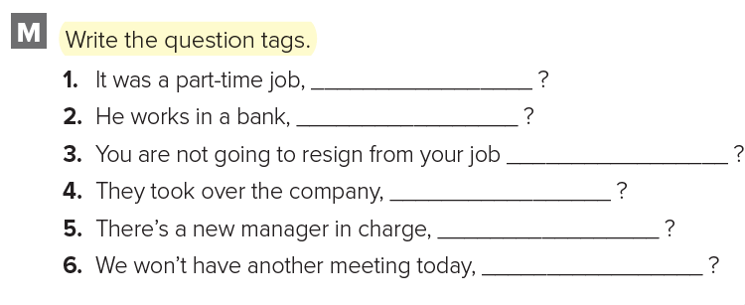
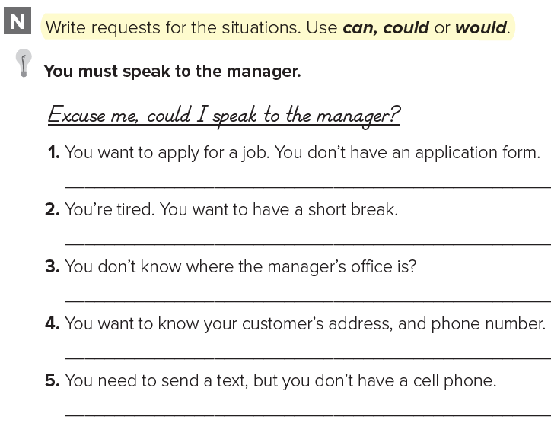
WB
wasn’t it
doesn’t he
85
are you
didn’t they
isn’t there
will we
Could I have an application form?
Could / Can I take a short break?
Excuse me, can you tell me where the manager’s office is?
Would you mind telling me your address, and phone number?
Would you be able to lend me your phone to send a text?

Slide 18
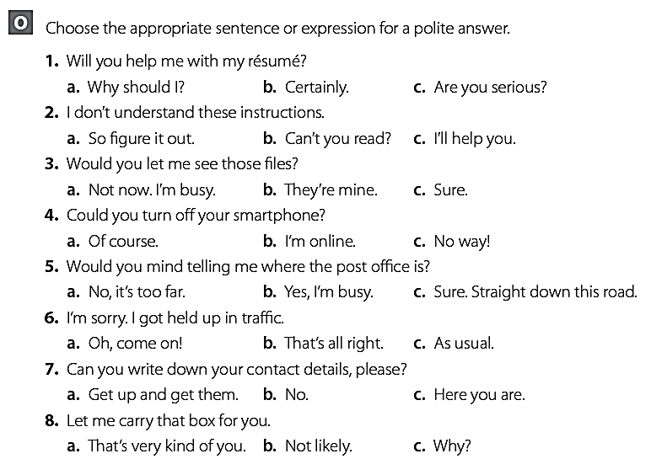
WB
85

Slide 19

Lesson done by: Essa Al Hussaini

Slide 20
Mega Goal 3
U: 5 L:11
Express Obligation:
Must, Mustn’t, Have to
Express Necessity & lack of Necessity:
have to, need to, needn’t, don’t need to, don’t have to
Done by: Essa Al Hussaini

Slide 21

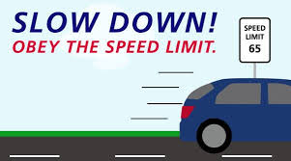
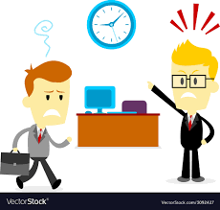
must, mustn’t, have to
to express obligation in the present and the future
You must stop at the ‘STOP’ sign.
You have to slow down at this junction.
You mustn’t (must not) arrive late to work.
You have to be at the office at 9 a.m.
Note:
Mustn’t = not allowed to do something.
No past tense of mustn’t.
The past tense of must and have to ➔ had to.
Notes:
Must = personal obligation
Have to = impersonal obligation (by other)

Slide 22

Express Necessity and Lack of Necessity
have to, need to, needn’t, don’t have to, don’t need to
Use have to and need to ➔ express necessity.
Use needn’t, don’t have to, don’t need to ➔ express lack of necessity.
I have to finish a report for work.
I need to finish a report for work.
I don’t need to hand it
I needn’t hand it
We will have to book an airport taxi.
We will need to book an airport taxi.
We will must book an airport taxi.
He has to finish a report for work.

Slide 23
I have to finish a report for work.
I need to finish a report for work.
I had to finish a report for work.
I needed to finish a report for work.

Slide 24
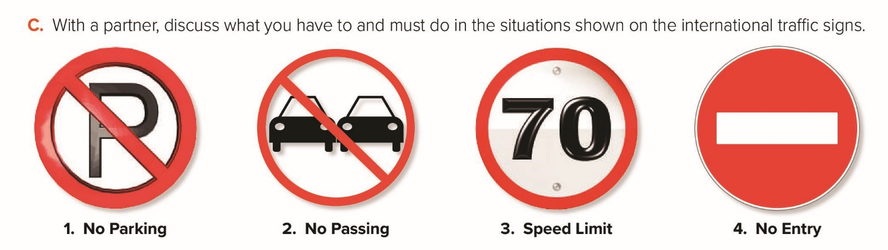
1
2
3
4
You mustn’t/must not park here.
You mustn’t pass on this road. // You mustn’t overtake on this road.
You mustn't drive faster than 70. // You have to adhere to the speed limit of 70.
You mustn’t enter this road. // You mustn’t drive down this road.
79

Slide 25
WORKBOOK
86

Slide 26
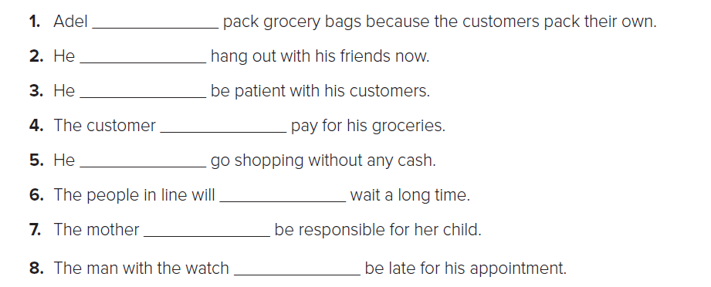
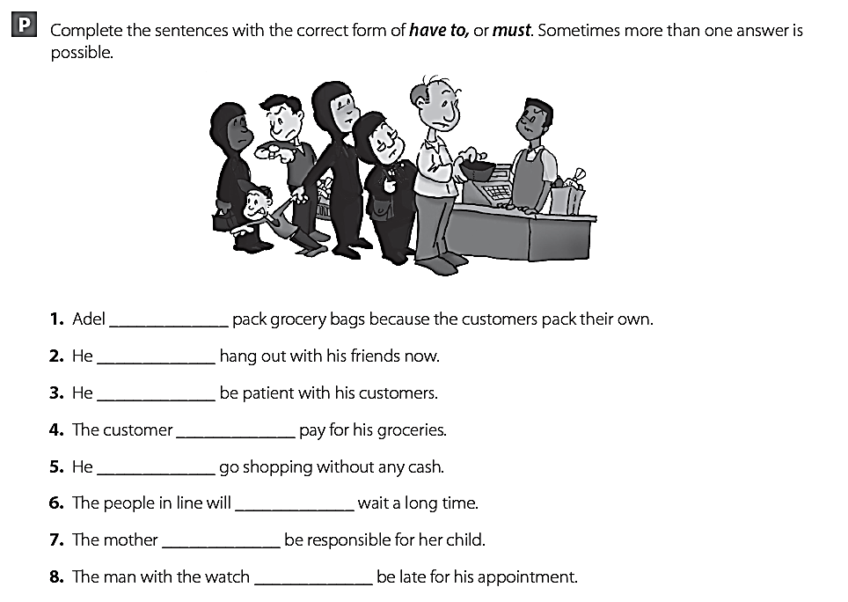
doesn’t have to
mustn’t
has to
must
mustn’t
have to
has to
mustn’t
86

Slide 27
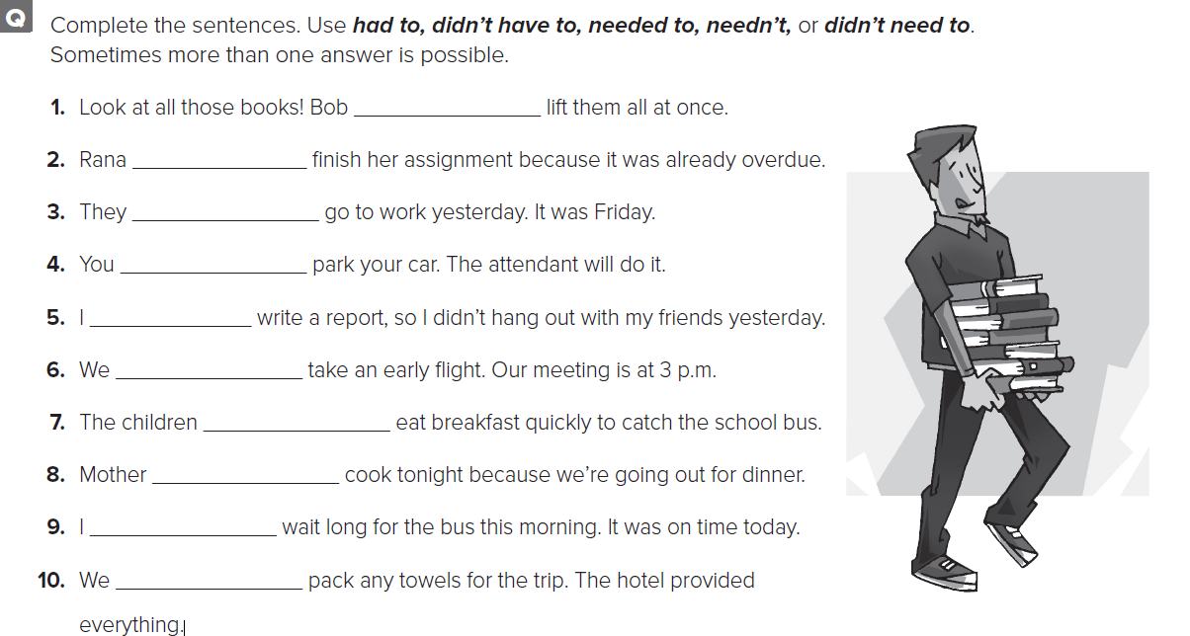
didn’t have to
had to
didn’t have to
needn’t
had to
needn’t
had to
needn’t
didn’t need to
needn’t
86

Slide 28
Lesson done by: Essa Al Hussaini

