Slide 1
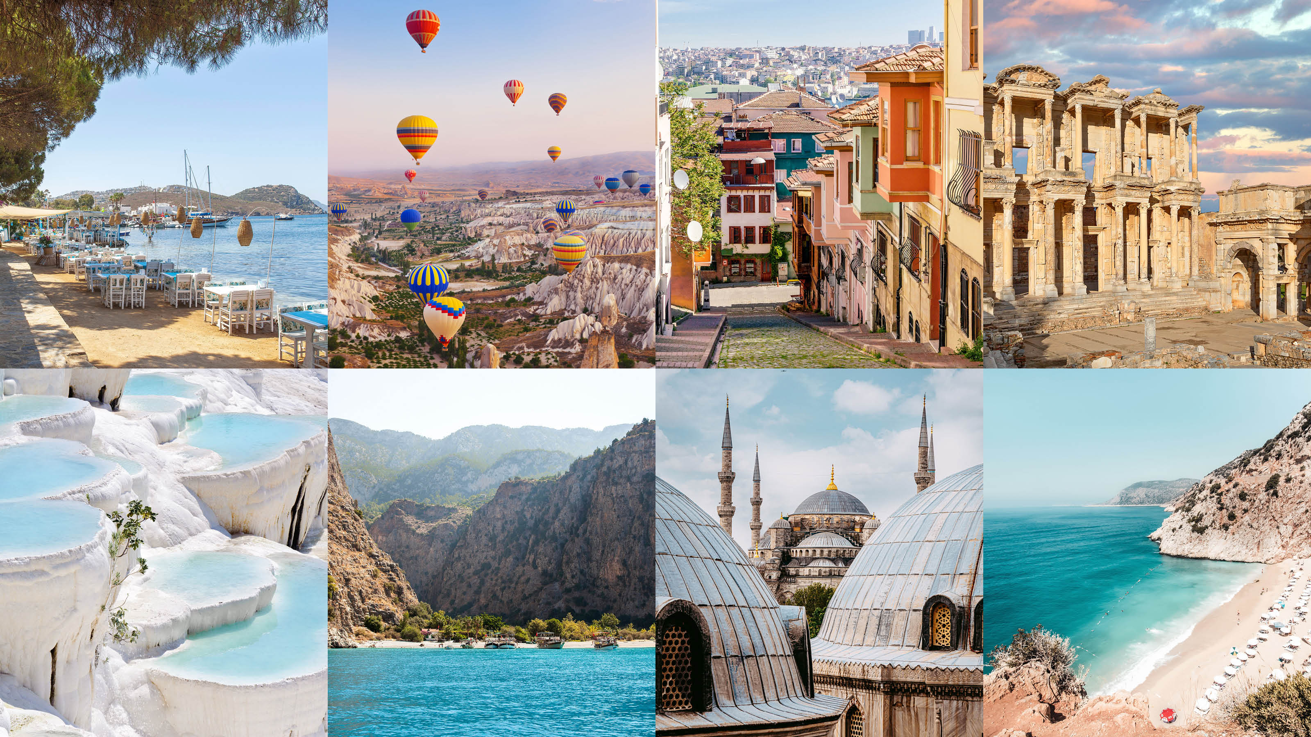

Unit 6
Where It Is ?
Grammar
Page 60, 61

Slide 2

Comparing
with
as…as
Comparative
&
Superlative
Indirect
Questions

Slide 3
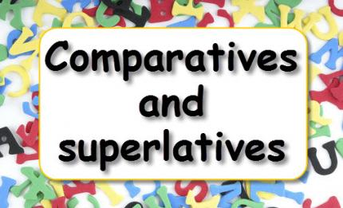

Slide 4
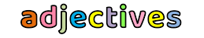
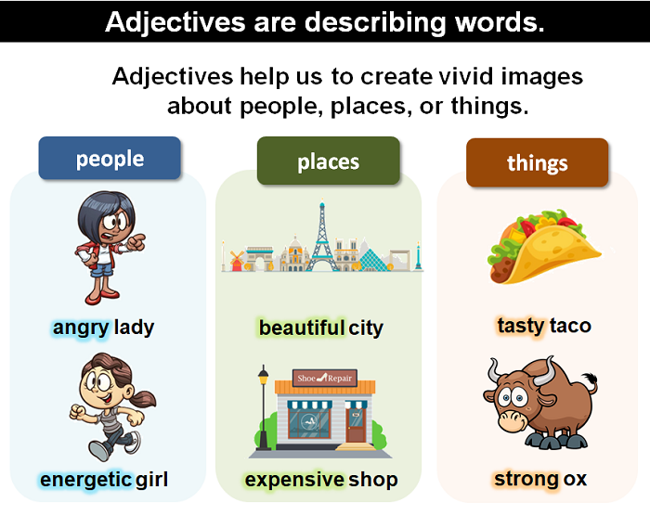

Slide 5
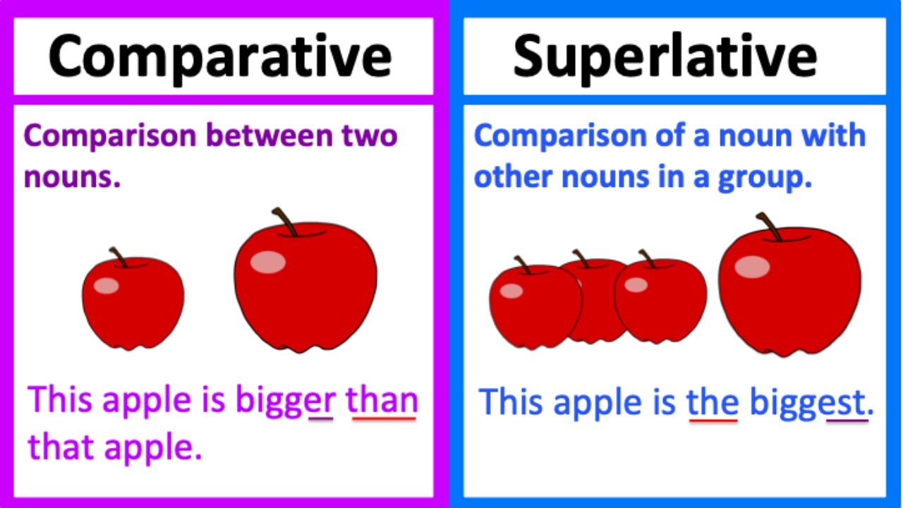

Slide 6
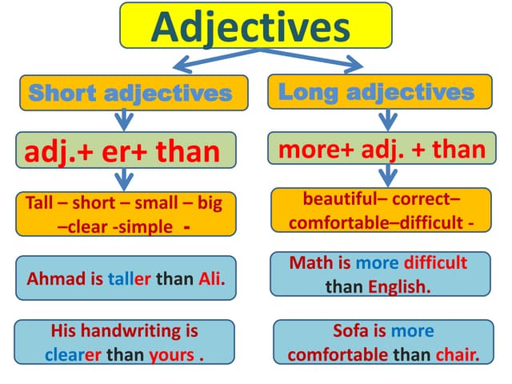

Comparative
Superlative
Comparative
Superlative
adj-er + than
the + adj-est
more+ adj+ than
the +most + adj
Ahmad is the tallest
Math is the most difficult subject

Slide 7
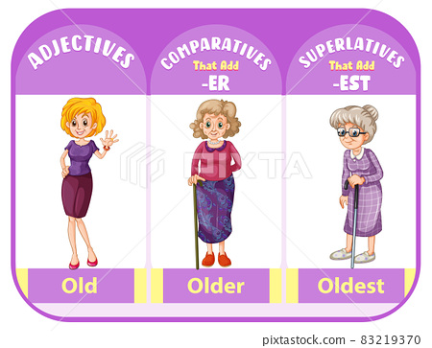
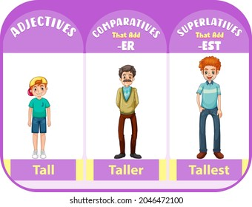
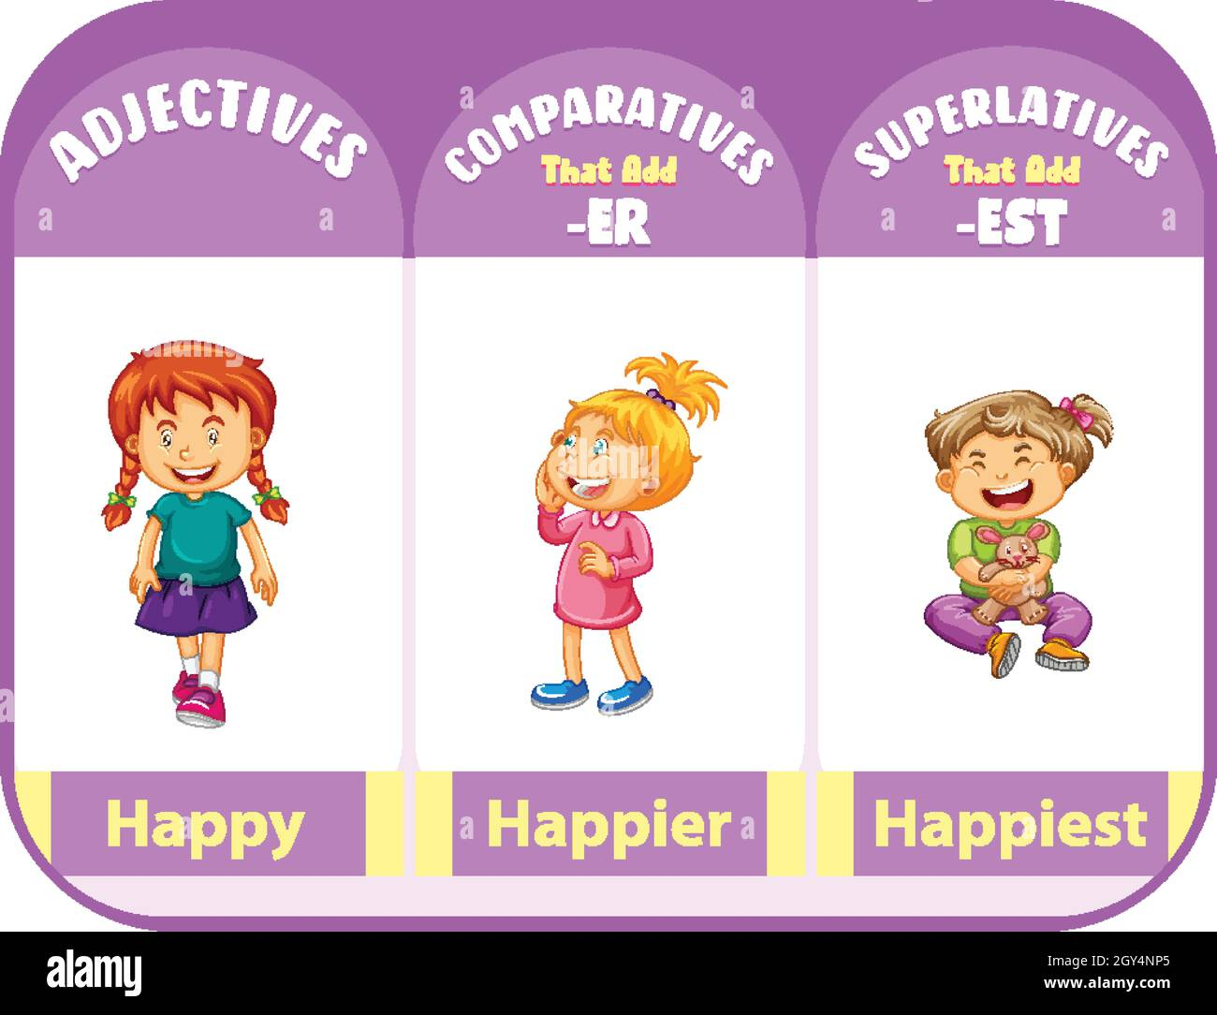
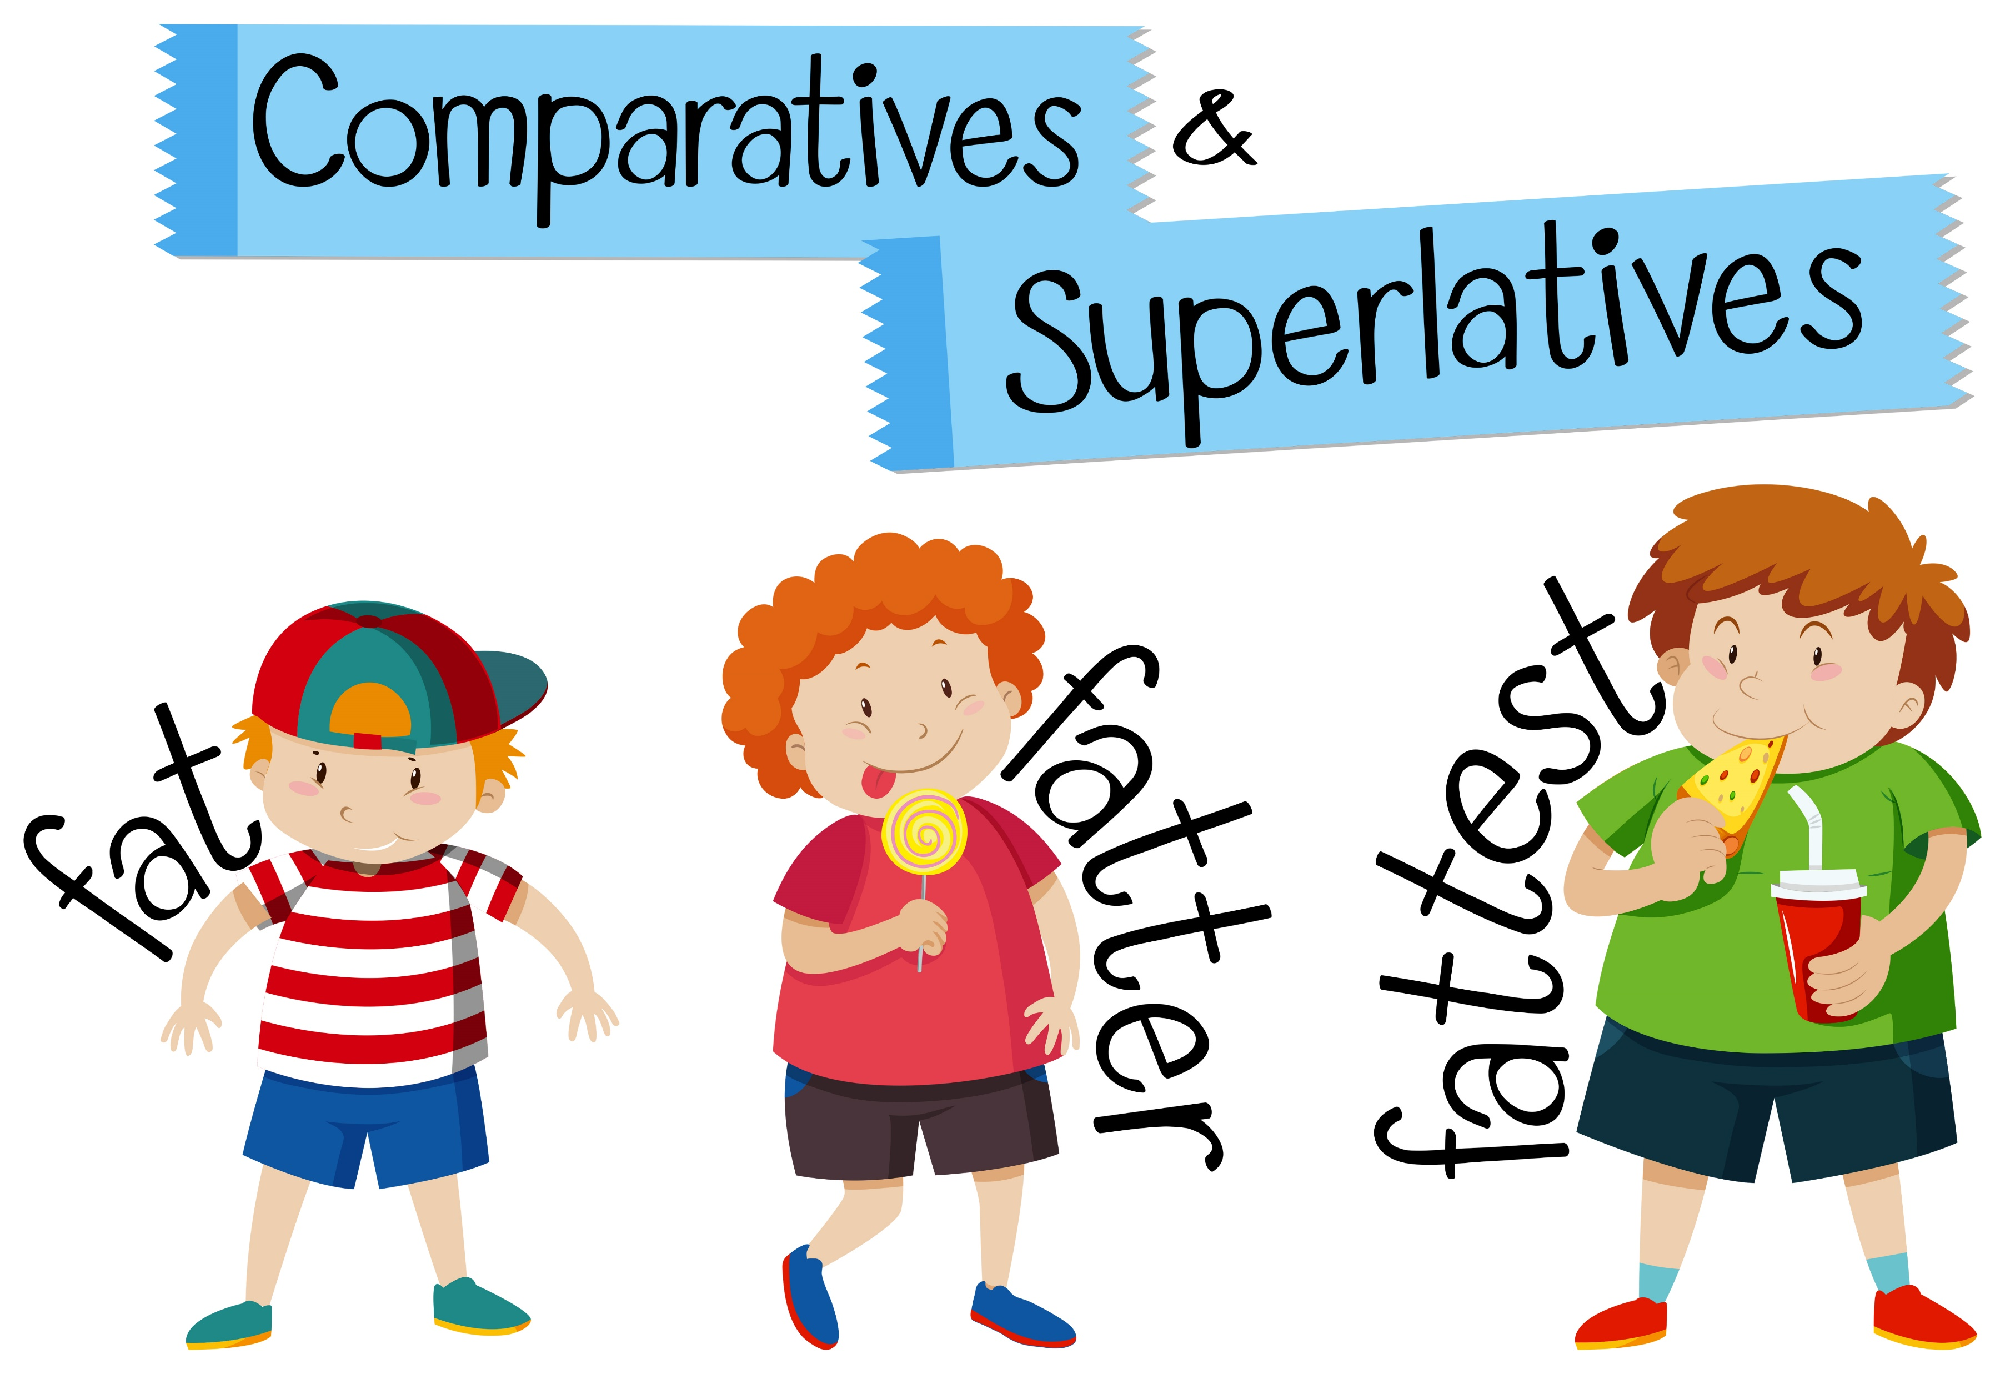

Slide 8
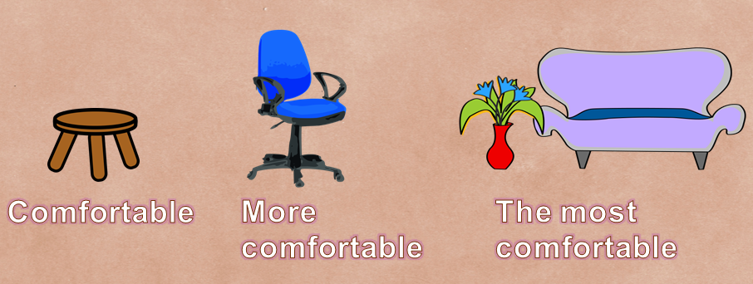
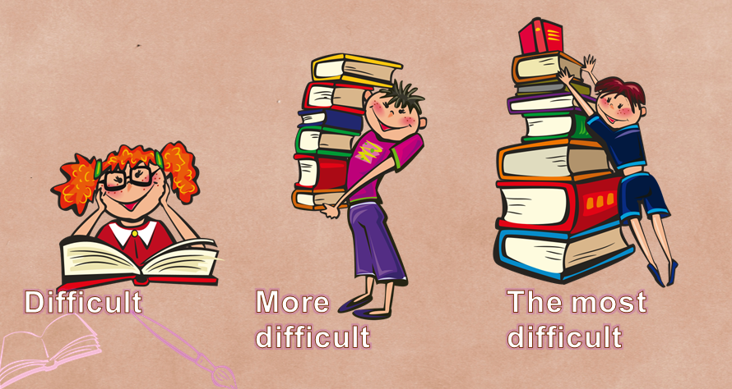

Slide 9
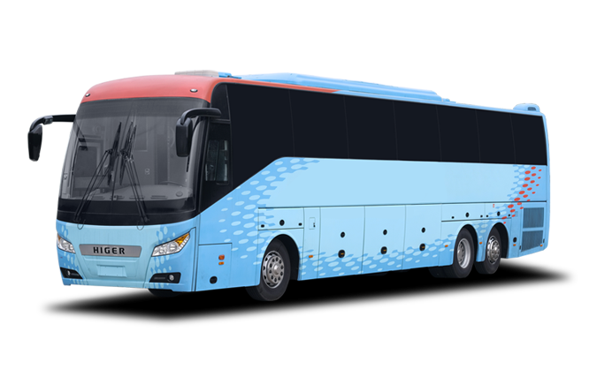
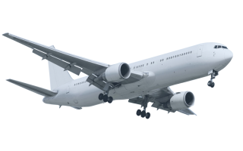
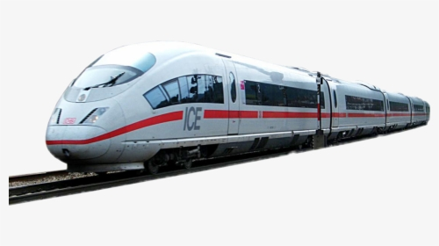


bus
train
plane
The train is faster
than the bus
The plane is
the fastest
The bus is fast
fast

Slide 10
bus
train
plane
Bus tickets are expensive
Train tickets are
more expensive
than the bus tickets
Plane tickets are the most expensive
expensive

Slide 11
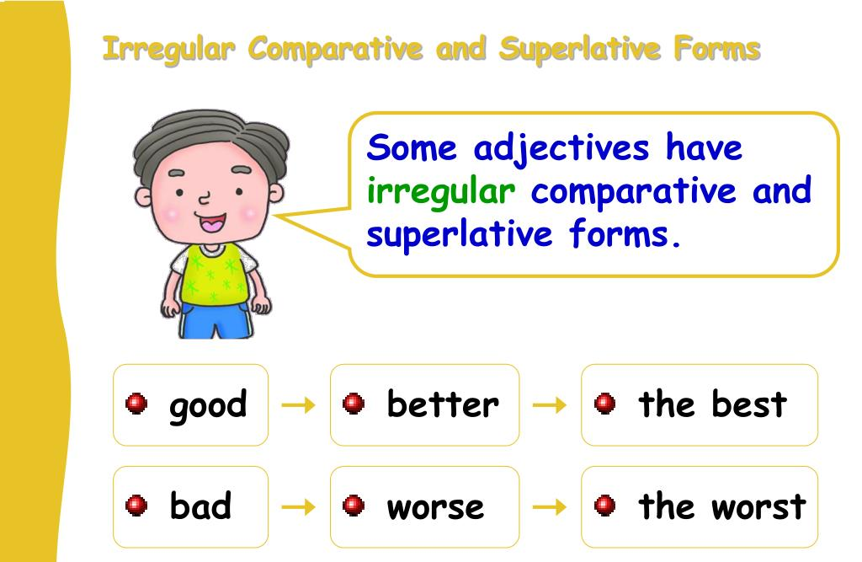

Slide 12
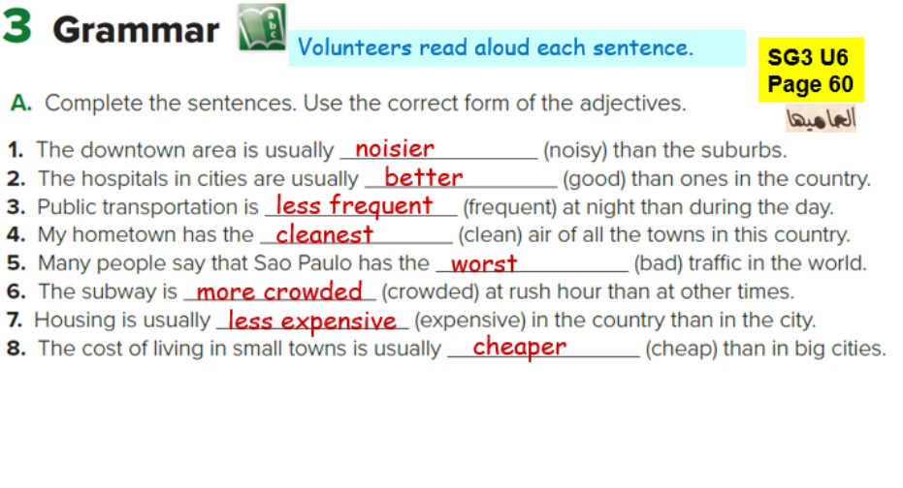

Slide 13
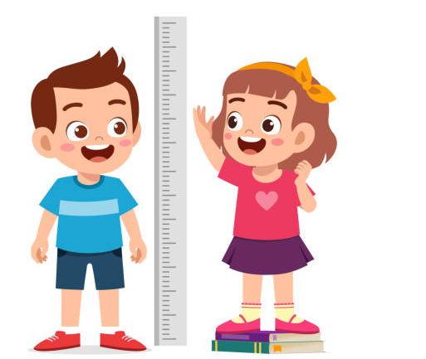
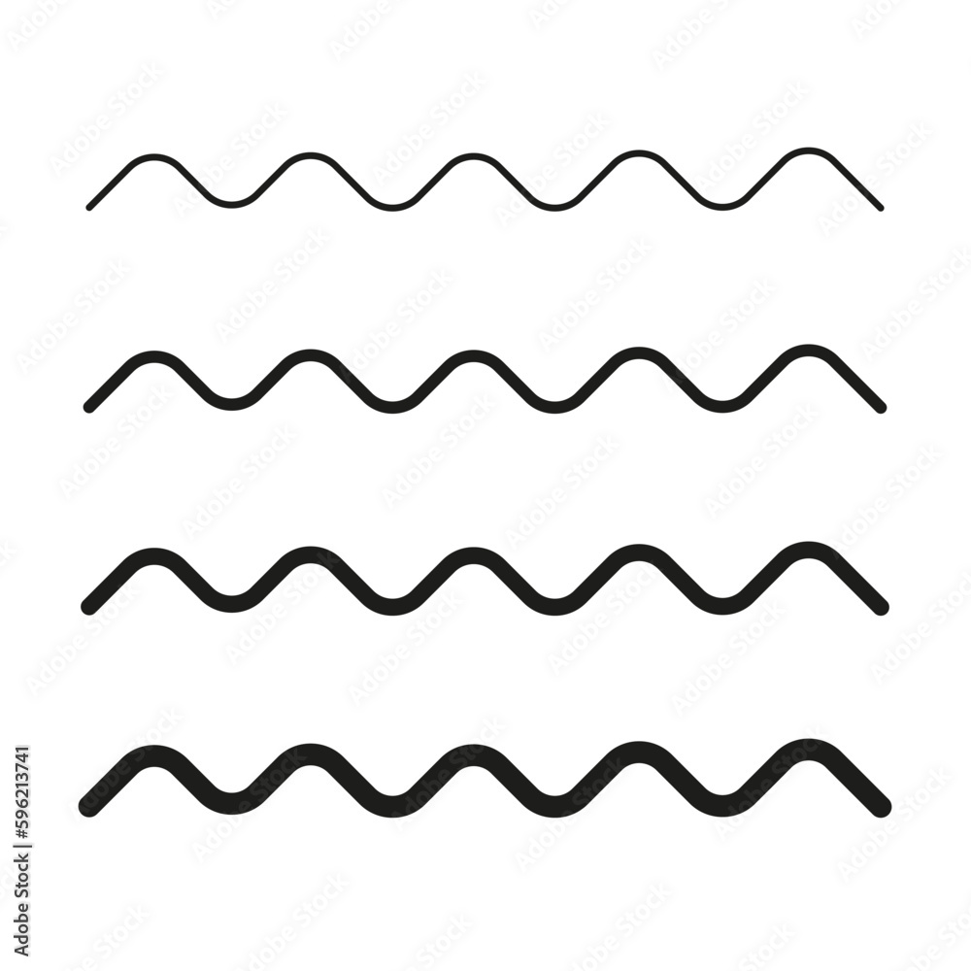
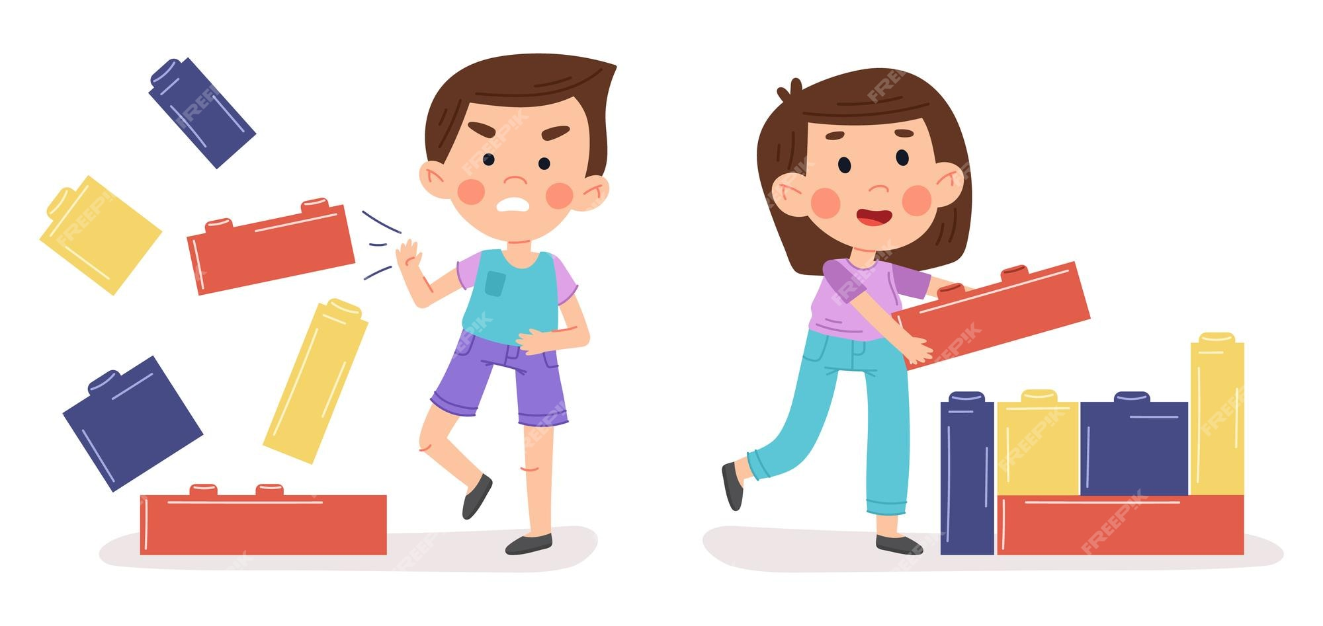
Ahmad is as tall as Dana
Ahmad is not as good as Dana

Slide 14
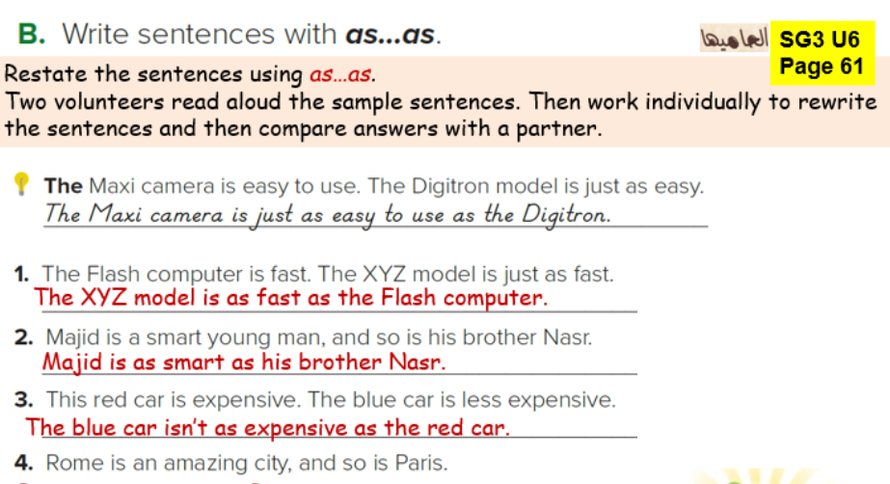


Slide 15
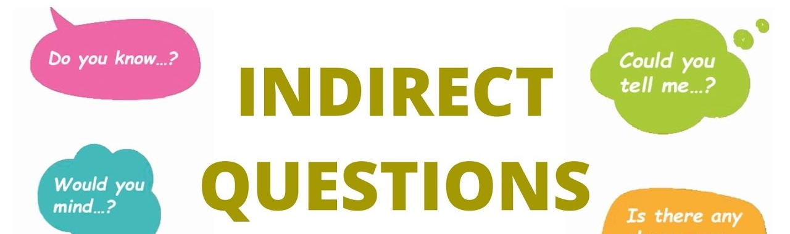

Slide 16

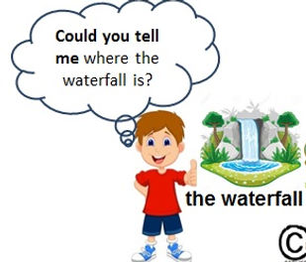
Where is the waterfall ?

Slide 17
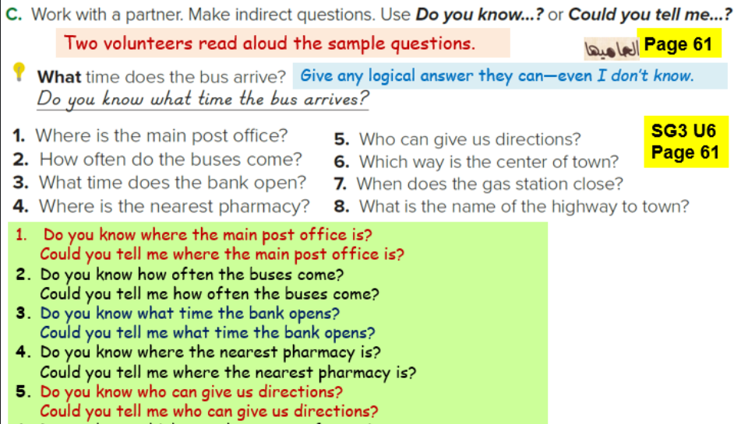

Slide 18
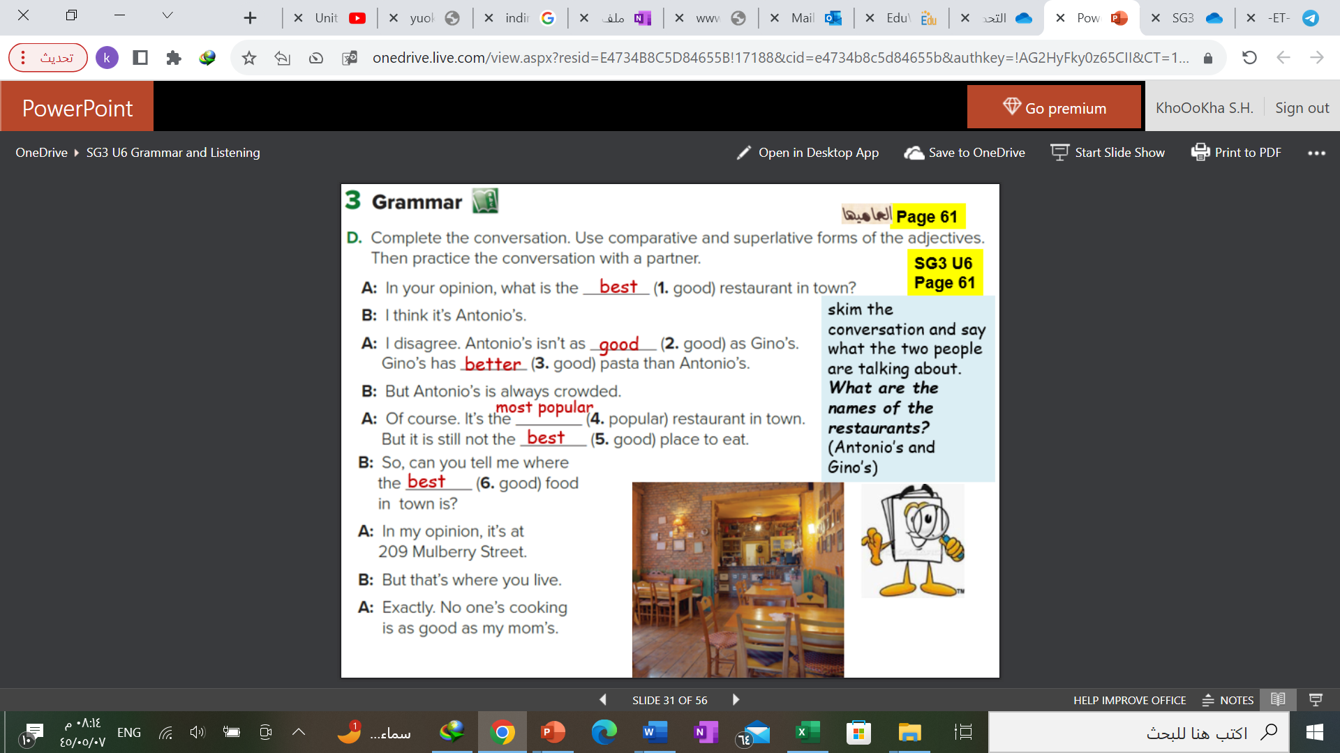

Slide 19


Page 204 C
Page 205 E
Page 206 G, H
Tr.Kholud

Slide 20
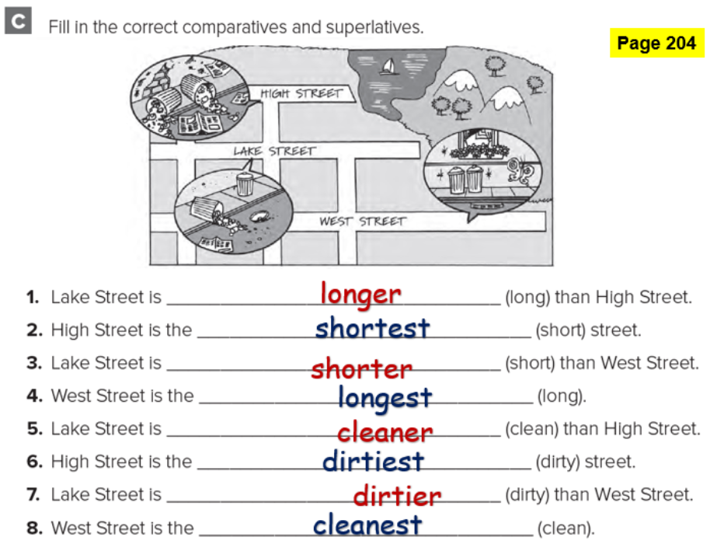

Slide 21
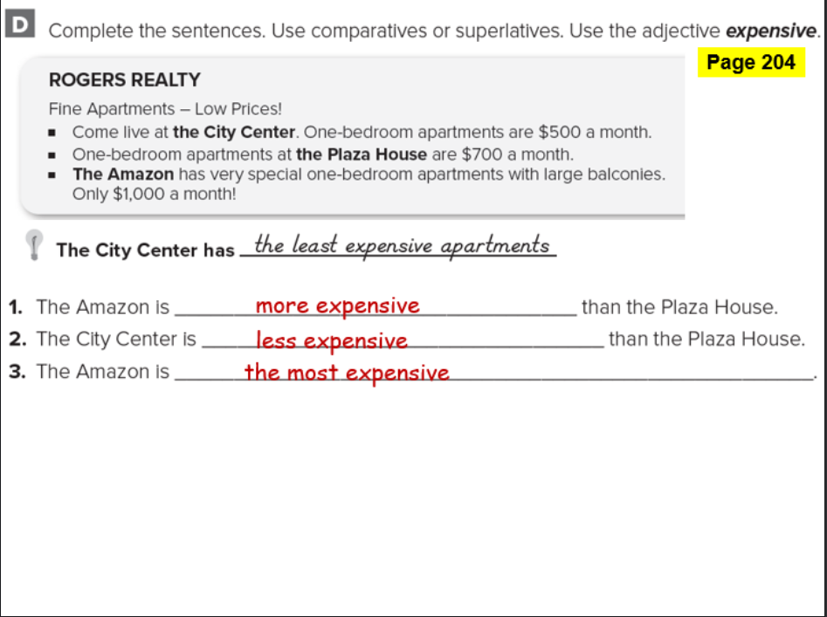

Slide 22
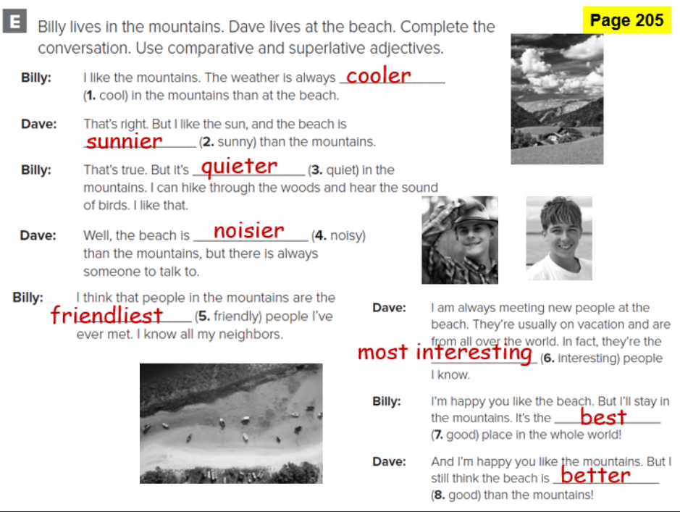

Slide 23
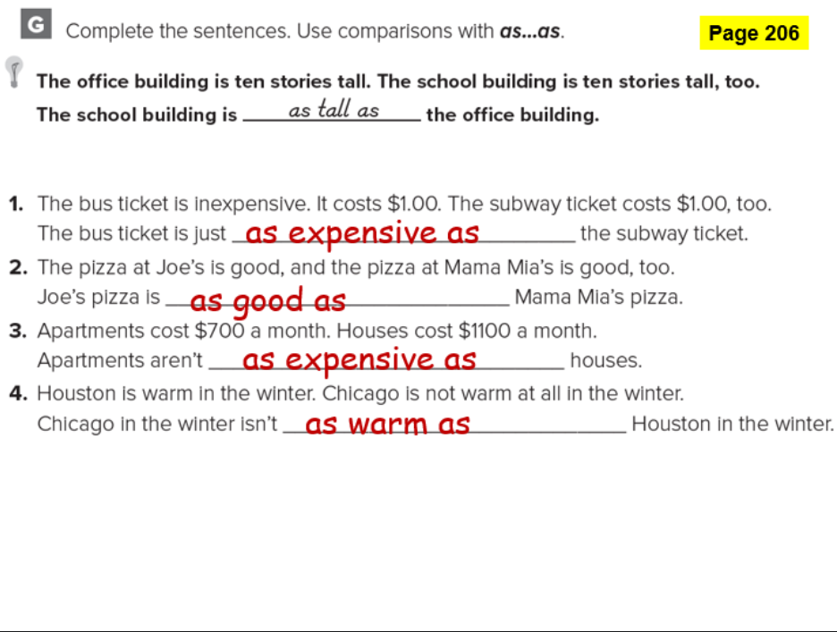

Slide 24
