Slide 1
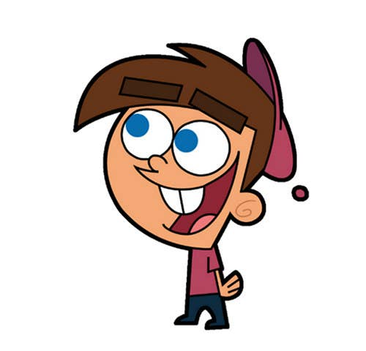


Welcome to class

Slide 2
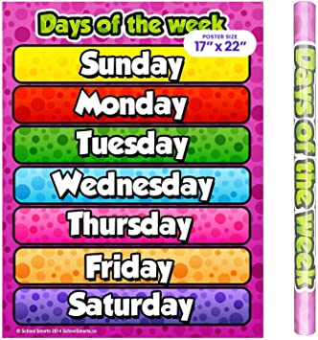

Slide 3


Slide 4
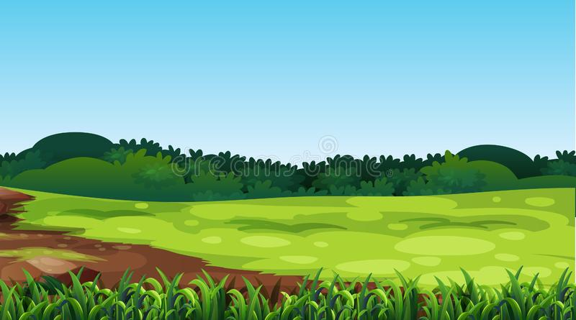
Unit 4
Beautiful Nature
Pages 2,3

Slide 5
Nature

Slide 6



listen
Snake
Plastic bag

Slide 7
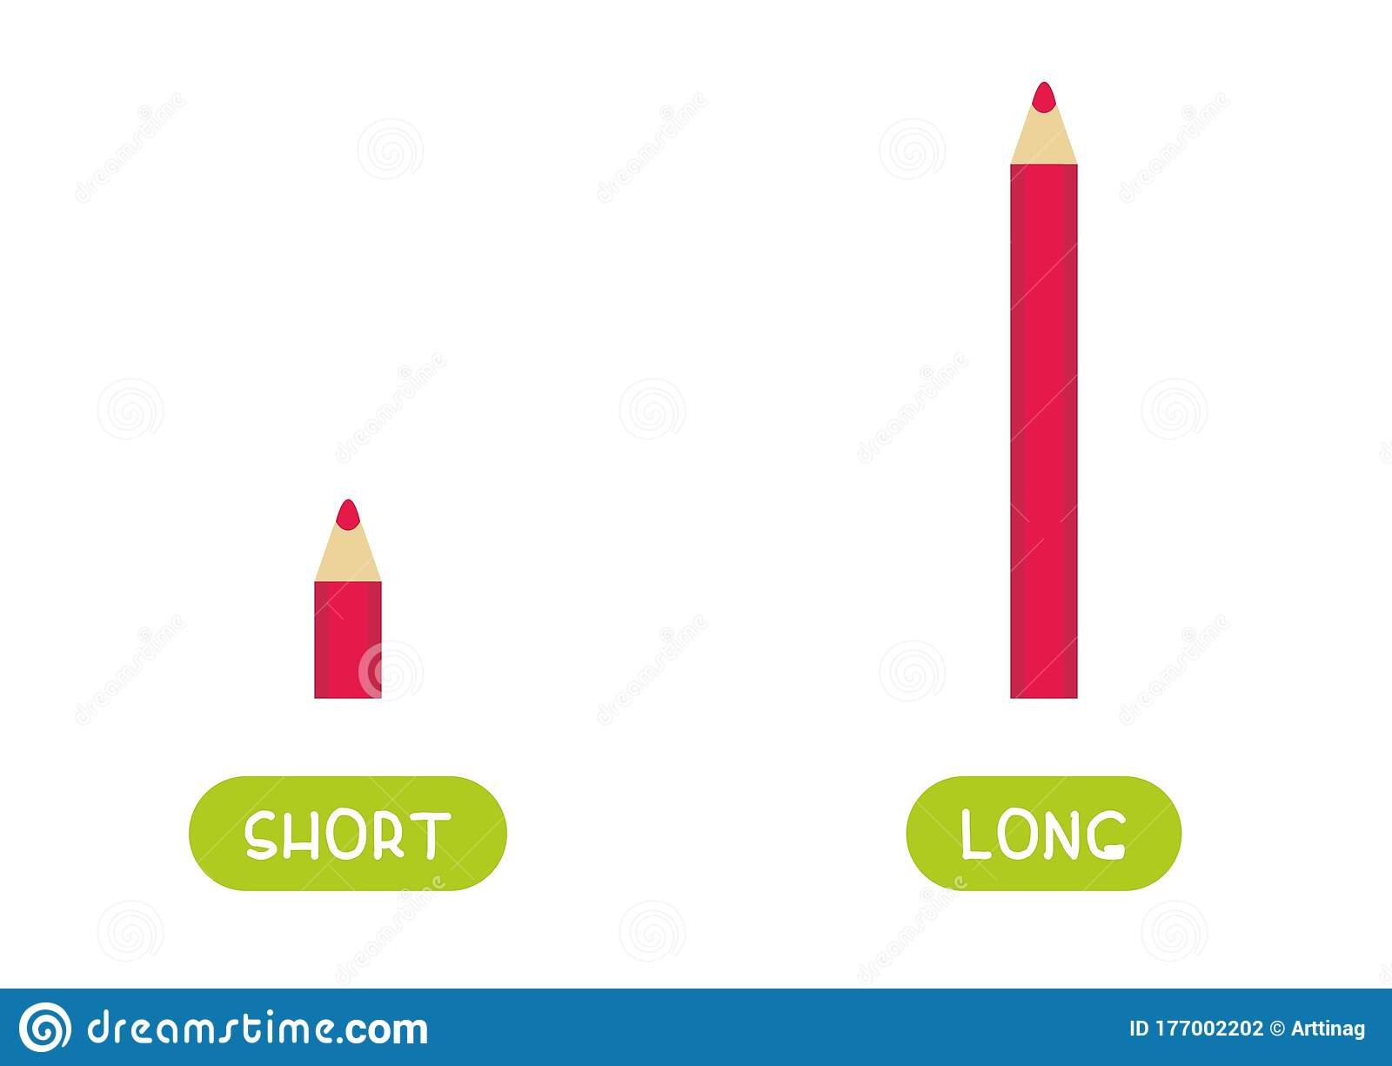
listen
short
long

Slide 8
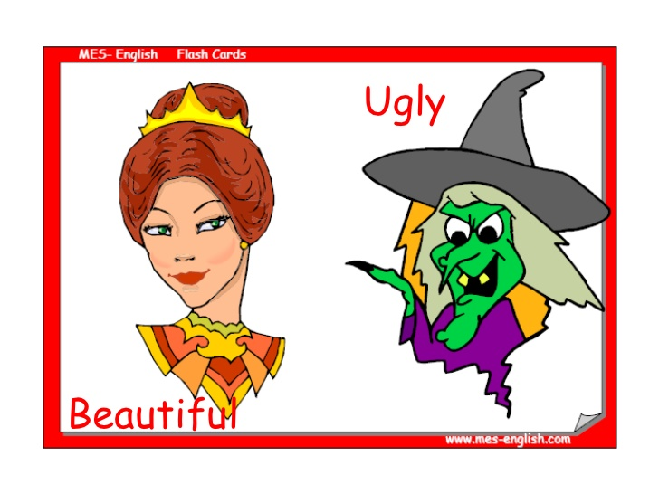
listen

Slide 9
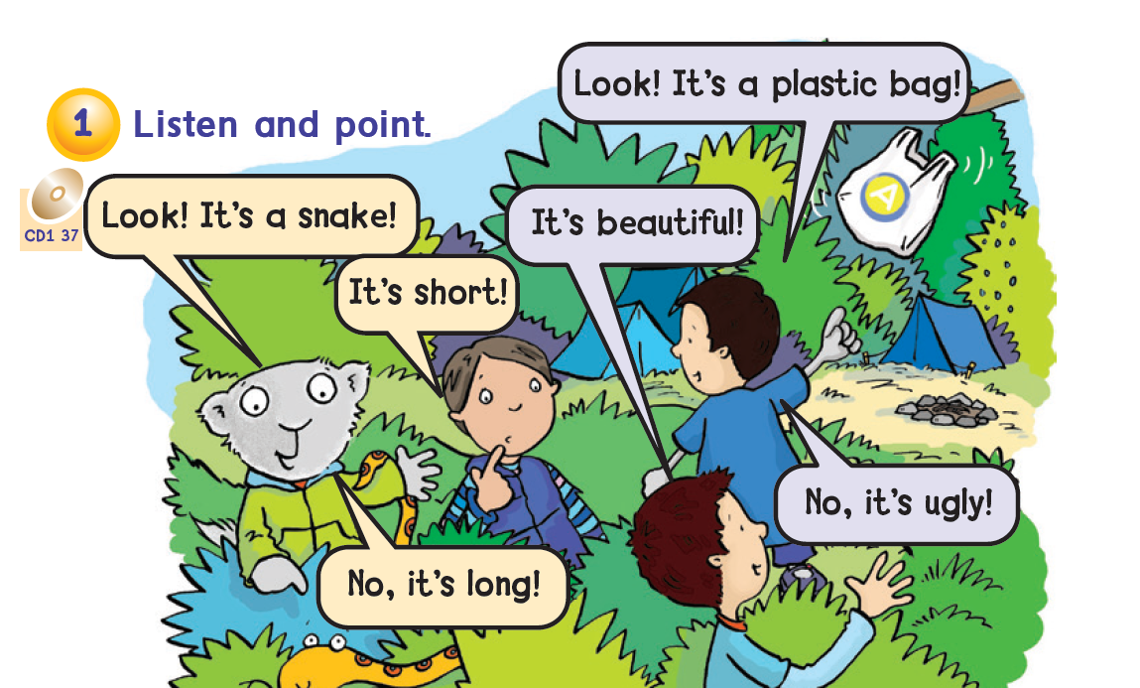

Page 2

Slide 10
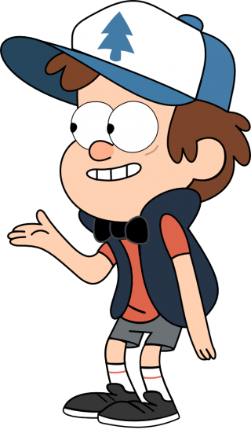
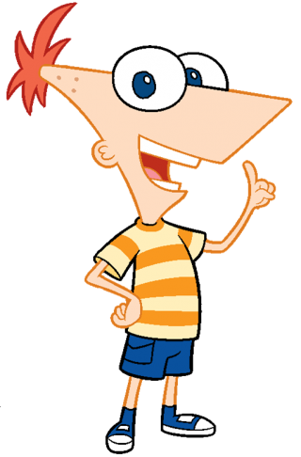
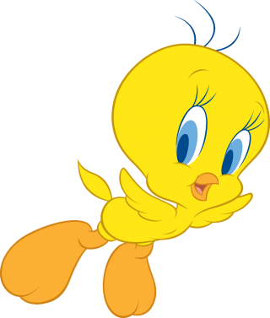

Choose a character

Slide 11
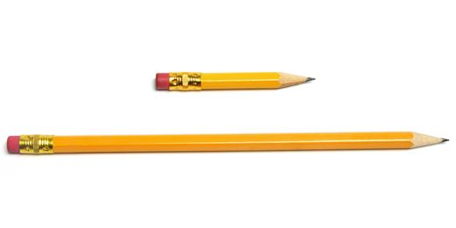

Short - long
It`s___________

Slide 12
Short - long
pencil
It is a___________
It`s___________

Slide 13
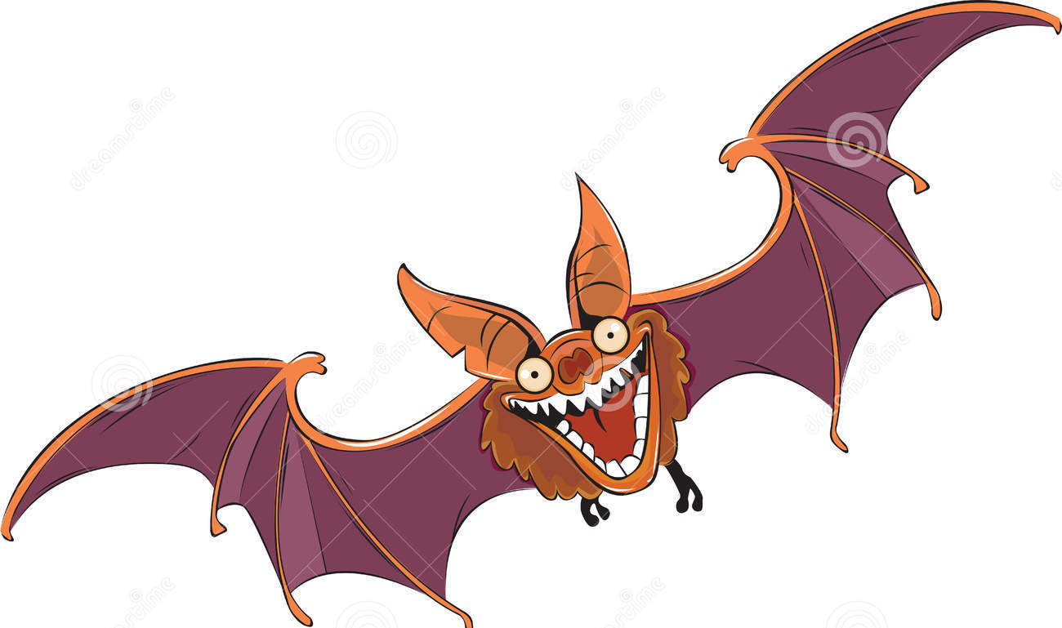
Beautiful - ugly
bat
It is a___________
It`s___________

Slide 14

bird
Beautiful - ugly
It is a___________
It`s___________

Slide 15




Pick a shape

Slide 16
Pencils
Short - long
They are___________
They are___________

Slide 17
Short - long
Pencils
They are___________
They are___________

Slide 18
Beautiful - ugly
bats
They are___________
They are___________

Slide 19
birds
Beautiful - ugly
They are___________
They are___________

Slide 20

Say the word
long

Slide 21
Say the word
ugly

Slide 22
Say the word
short

Slide 23
Say the word
beautiful

Slide 24
Say the word
They are

Slide 25


Slide 26
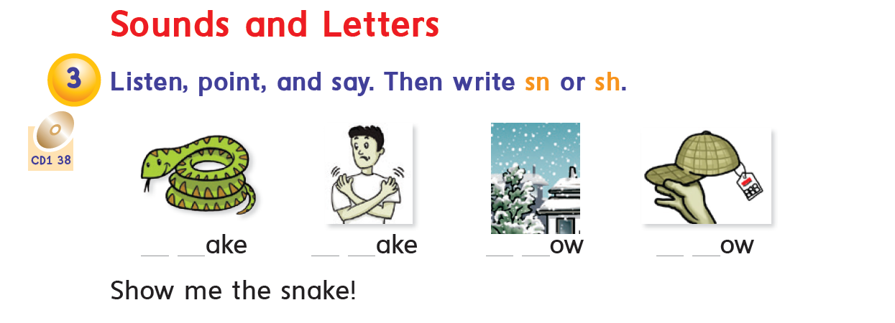

Slide 27

2
3
1
4

Slide 28
2
3
1
4

Slide 29

Read the word
snake

Slide 30
Read the word
show

Slide 31
Read the word
snow

Slide 32
Read the word
shake

