Slide 1






4 listening
5 pronunciation
6 conversation
7 about you
Today:
Date:
- -
Page 59
By: Dalal Al-Juaid

Slide 2


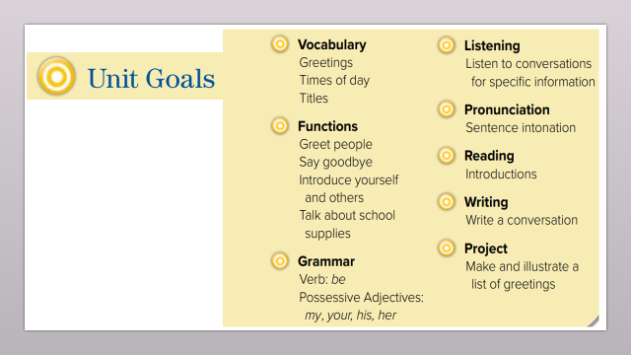
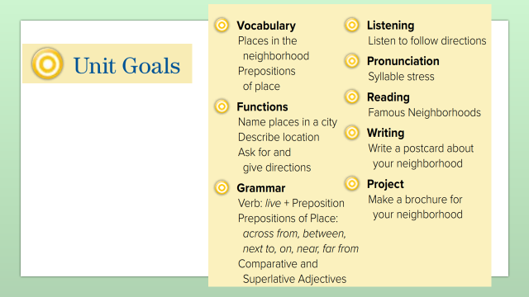
write the names of the places after listening to their description
answer questions from the conversation
Warm up
answer personal questions
take turns telling others how to get home

Slide 3
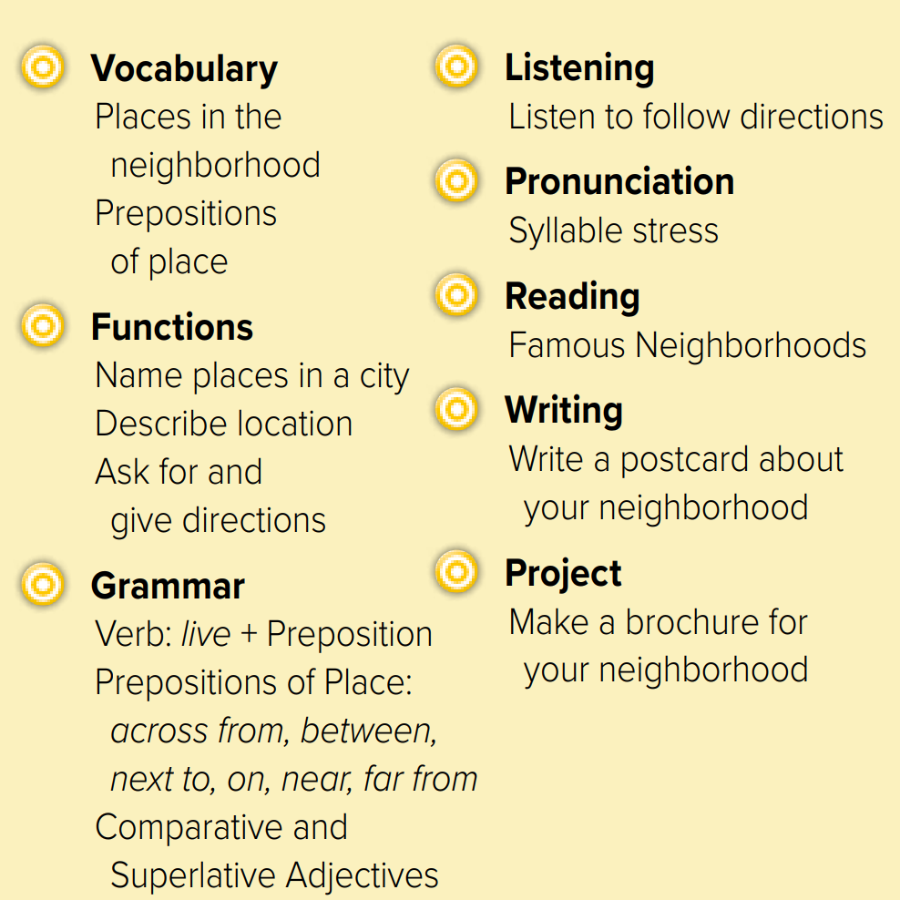
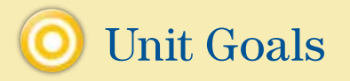

Slide 4
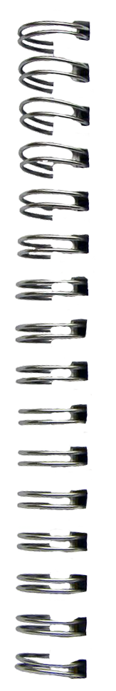
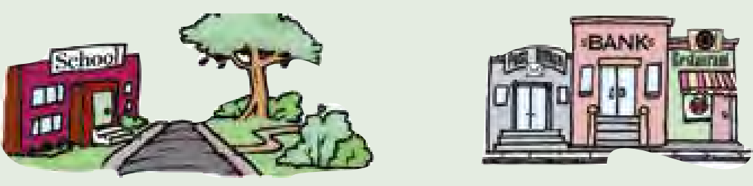

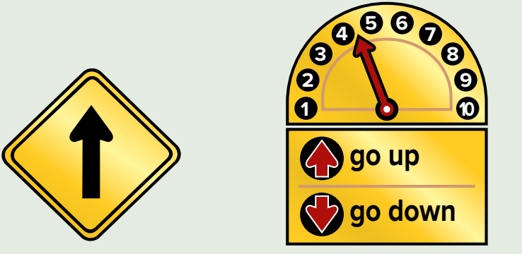
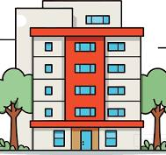



Revision
Where is the school?
Where is the bank?
…..
…..
…….
#
Turn left
..........

Slide 5








Answer with emoji
Warm up
supermarket
restaurant
bookstore
mall
pharmacy

Slide 6
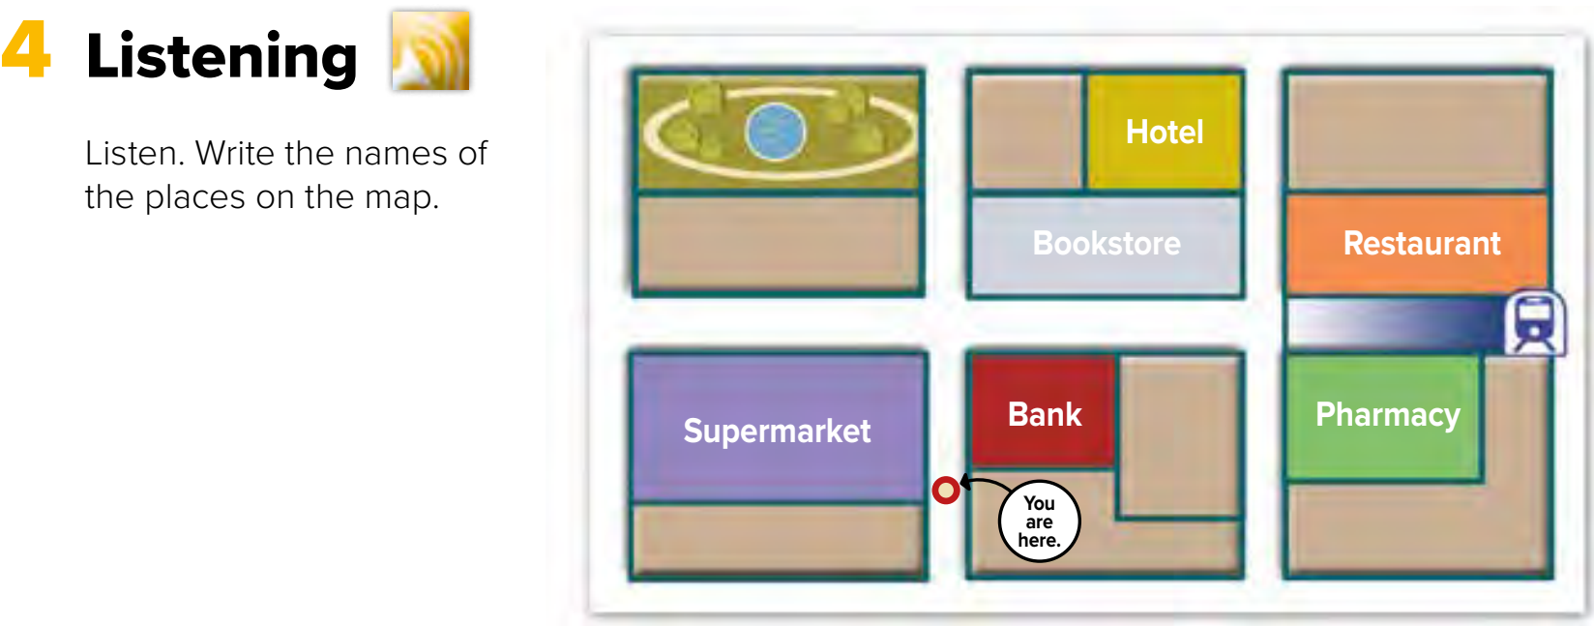





Page 59
1. English school
3. Subway stop
2. Café
What places are already on the map?
4. Convenience store
Warm up
Think pair share

Slide 7
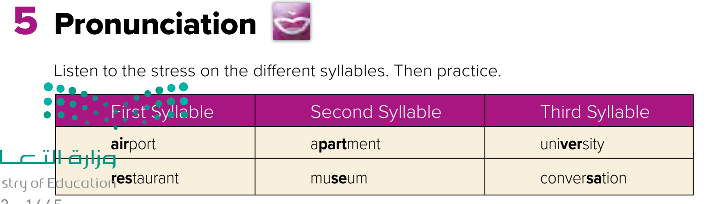


Page 59
Remember
bookstore
Warm up
Listen
repeat

Slide 8
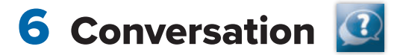
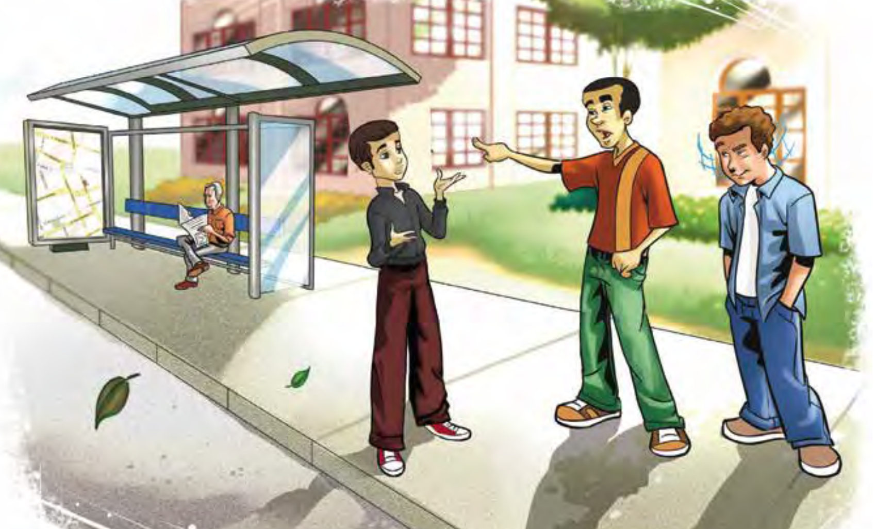

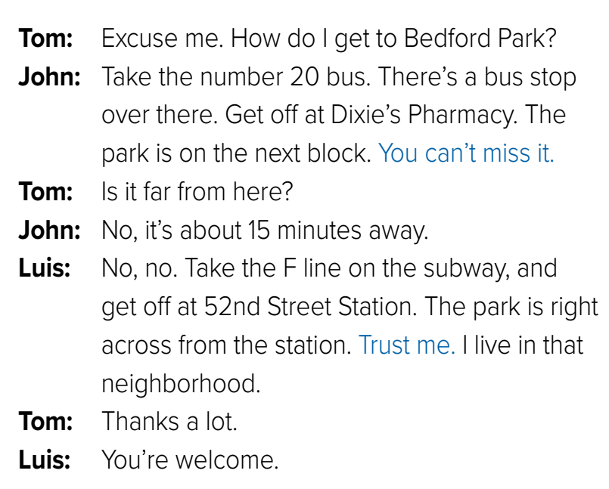
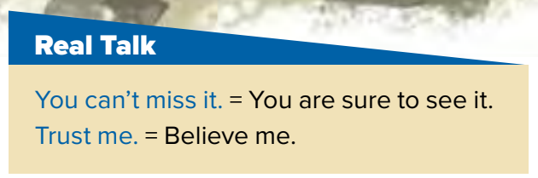
Page 60
Where are they?
What do you think they’re talking about?
Role paly
Warm up
To miss = not to see

Slide 9


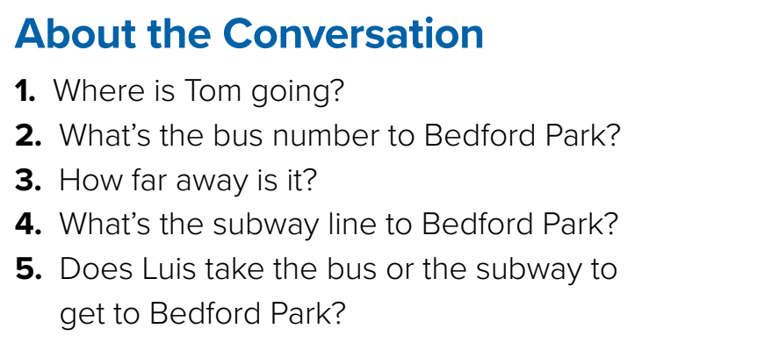
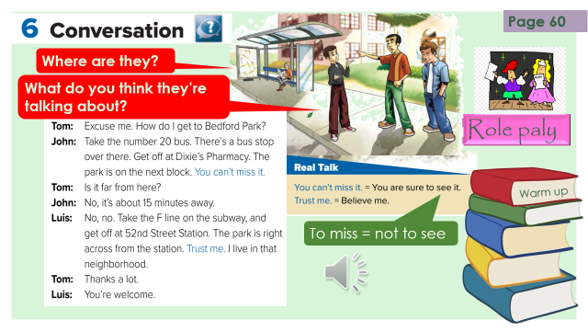
What’s new in Taif?
To Bedford park
Bus 20
About 15 minutes away by bus
The F line
Warm up
He takes the subway
Think pair share

Slide 10
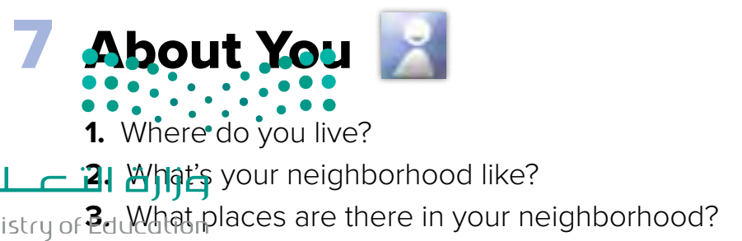
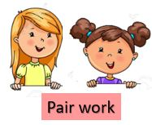
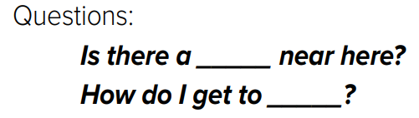

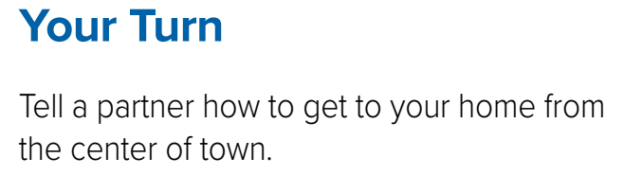
Ask & Answer
Warm up
How do I get to your house from our school?

Slide 11



Lets play
Warm up

Slide 12
Write in your notebook
Like final test أسئلة للاختبار النهائي
Choose:
Mmmmmmm ………. mmmmmmm
( ssss – ssss – sssss)
Make a question

Slide 13
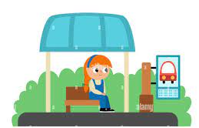



Bus stop
New Words
block
subway
miss
Not to see
Over there
#
here
get off
#
take

Slide 14





page 215 Ex(F )
for practice grammar
Warm up

Slide 15
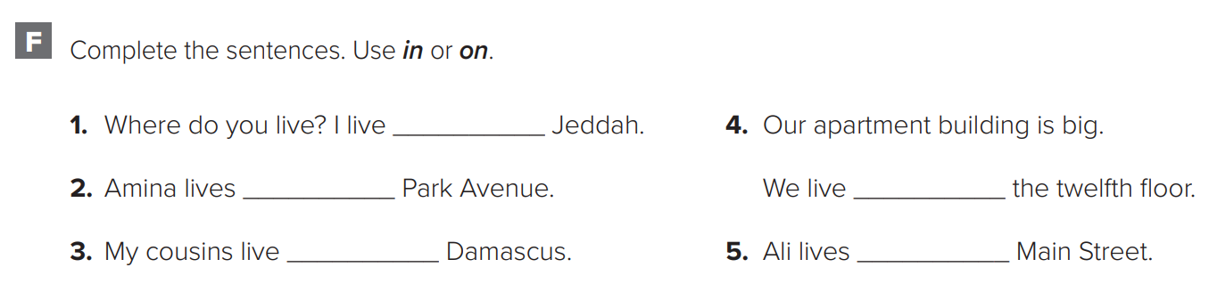
in
on
on
in
on
Warm up
p.215

