Slide 1




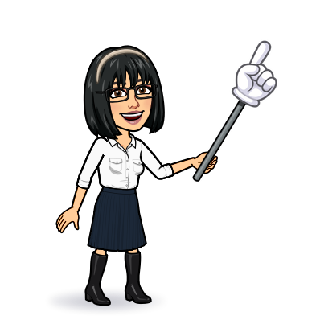

8 reading
Today:
Date:
- -
Page 61
By: Dalal Al-Juaid

Slide 2

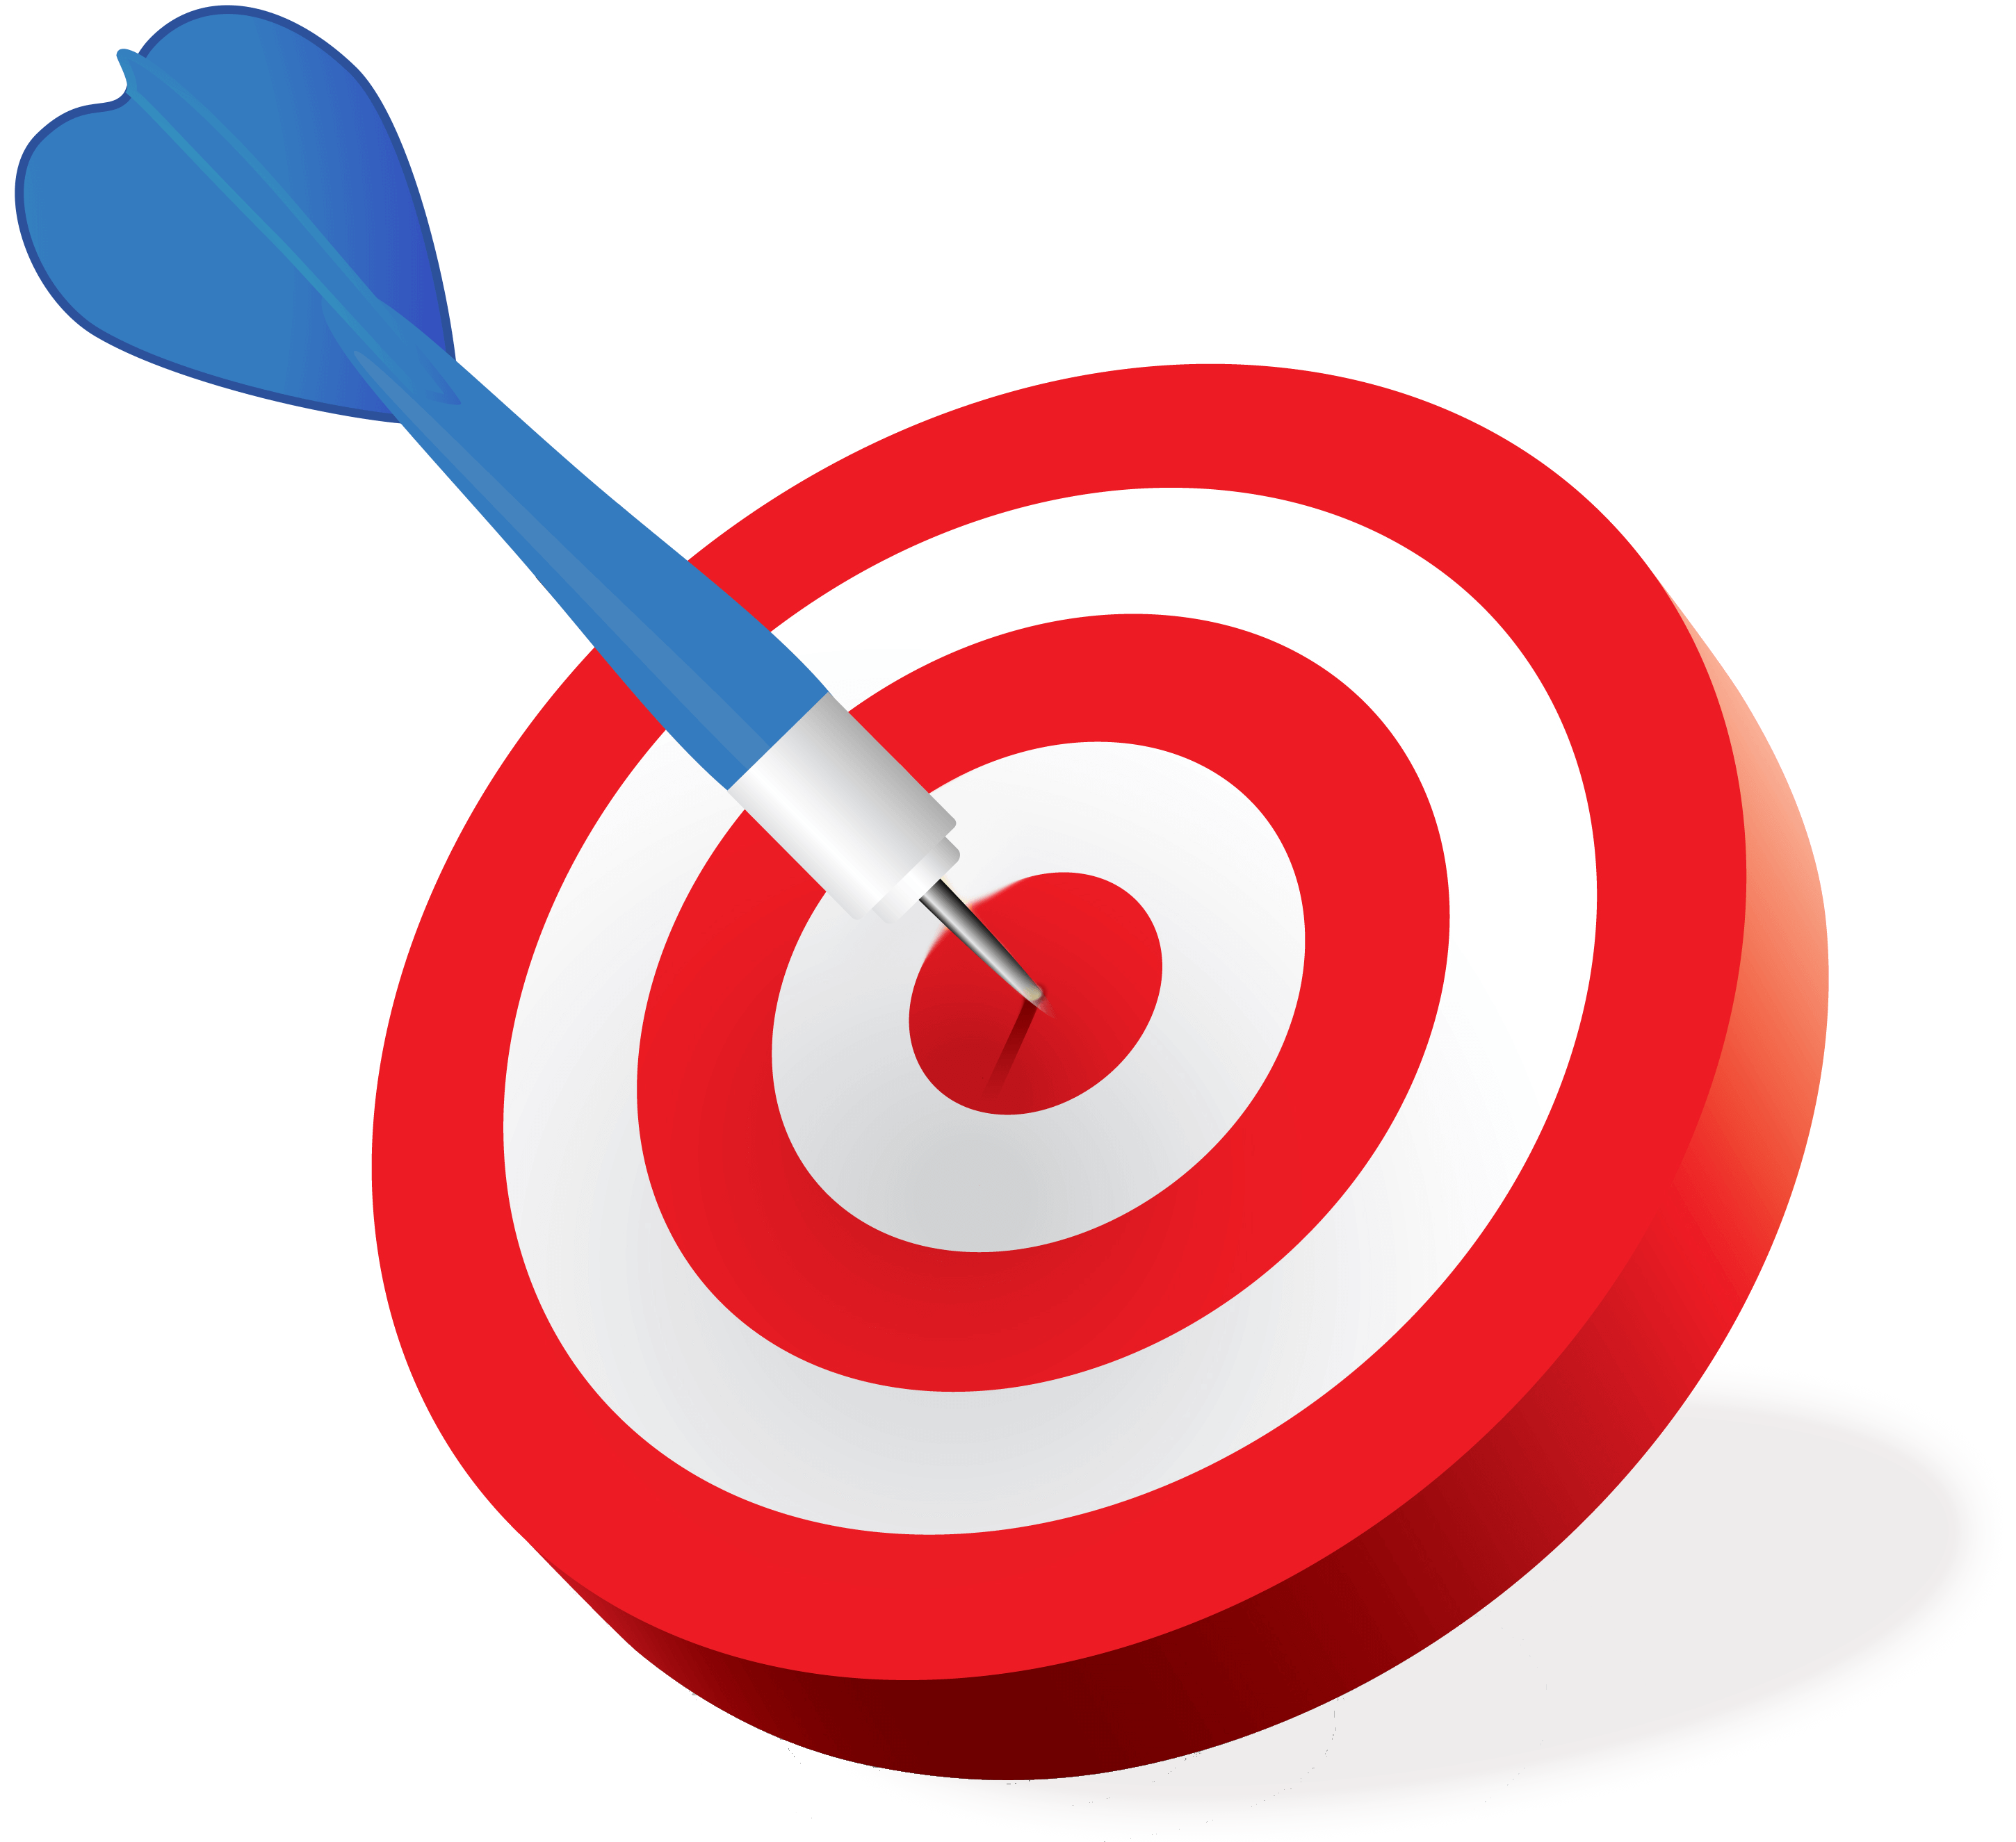
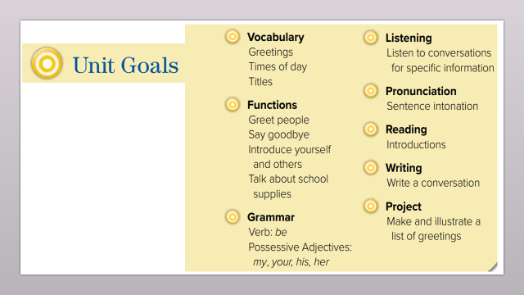
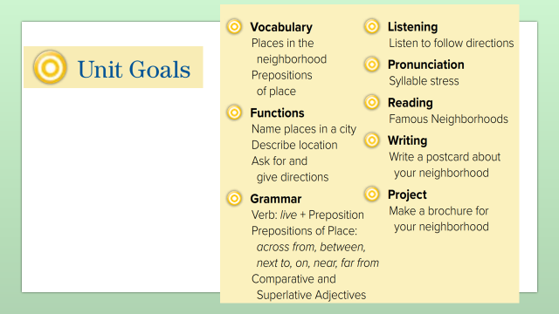
read about famous neighborhoods
compare neighborhoods to find similarities
Warm up
answer T – F questions about text
Use the new words

Slide 3
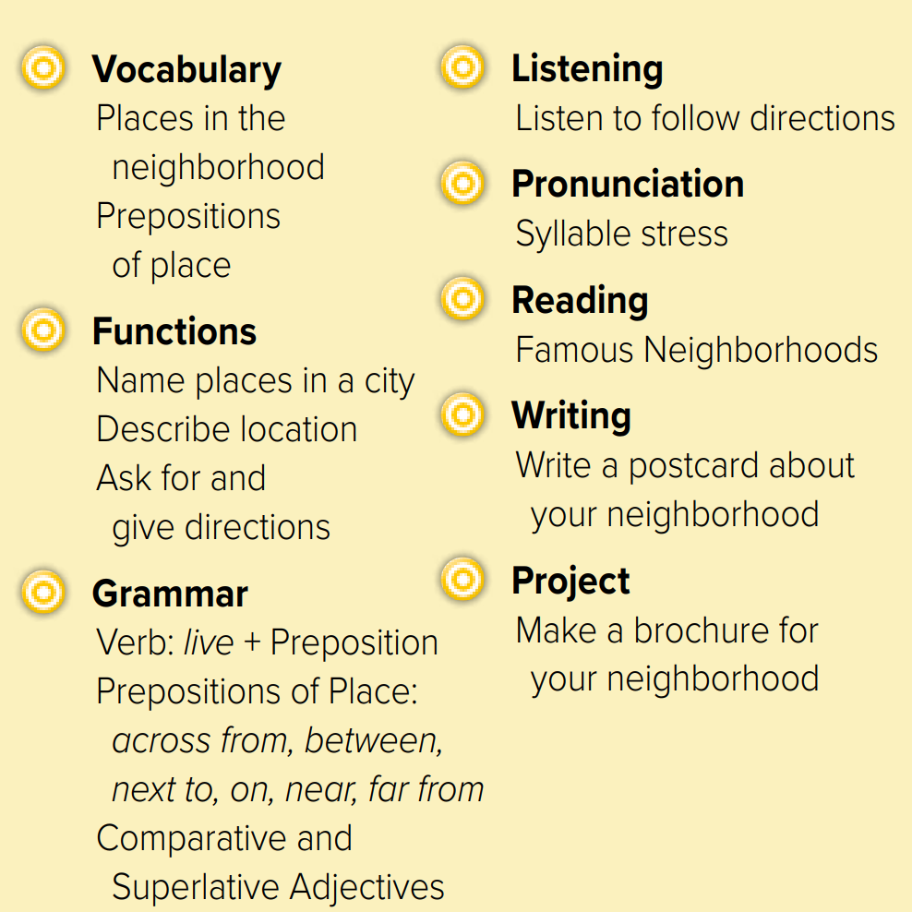
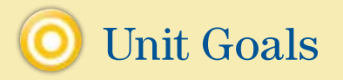

Slide 4
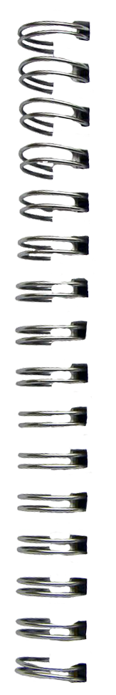
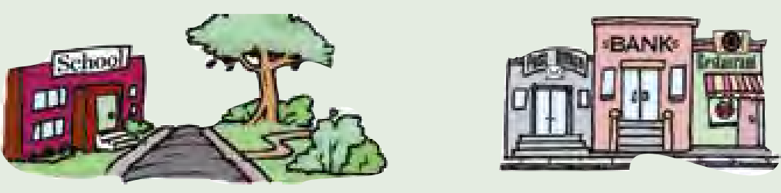

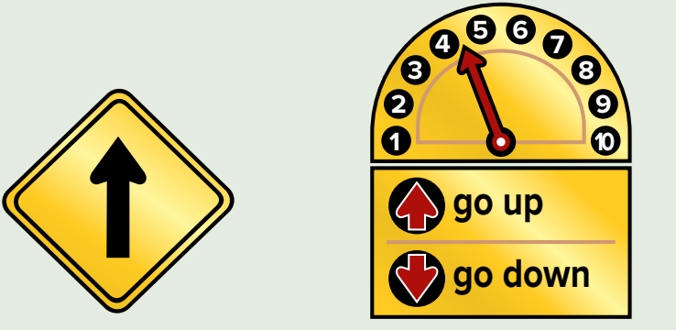
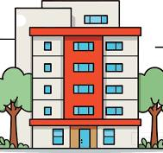
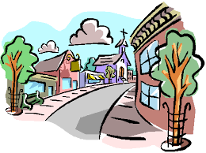
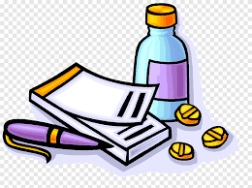

Revision
Where is the school?
Where is the bank?
…..
…..
…….
#
Turn left
..........

Slide 5


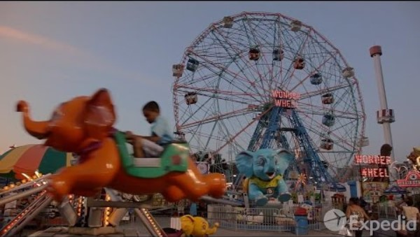
Warm up

Slide 6

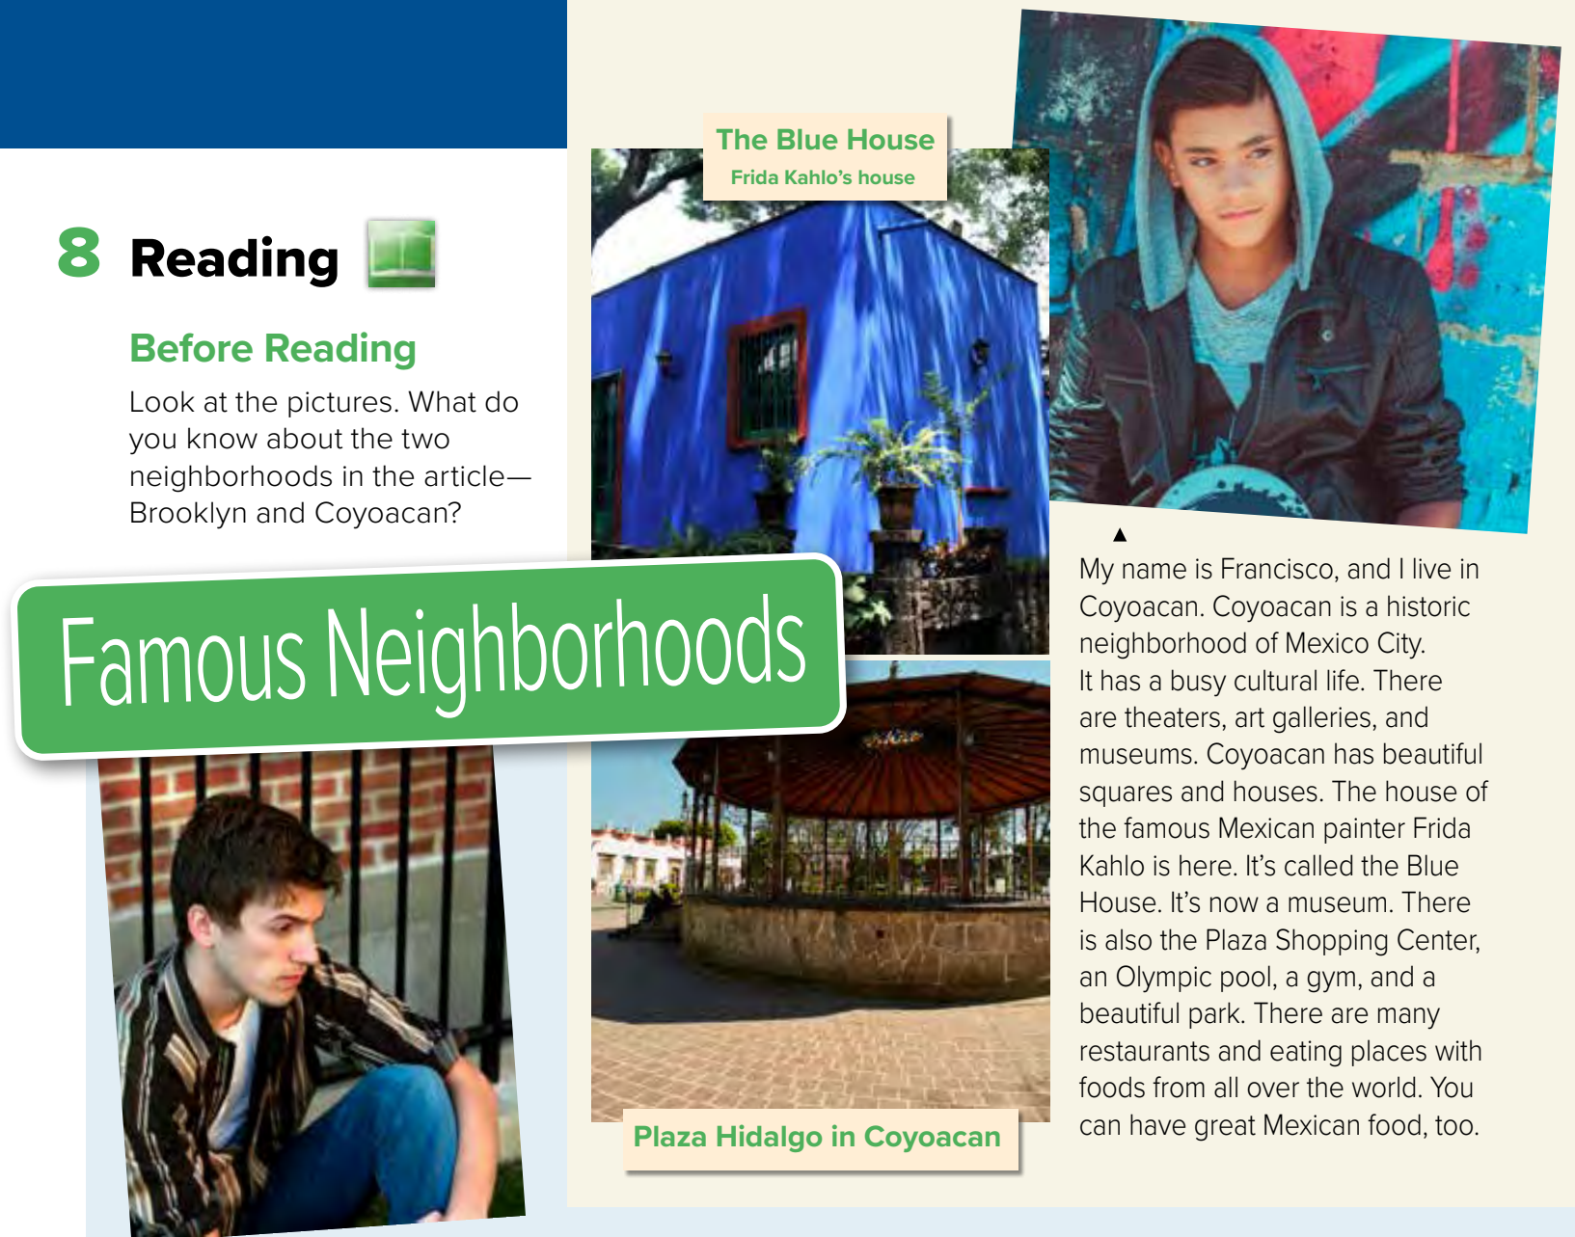
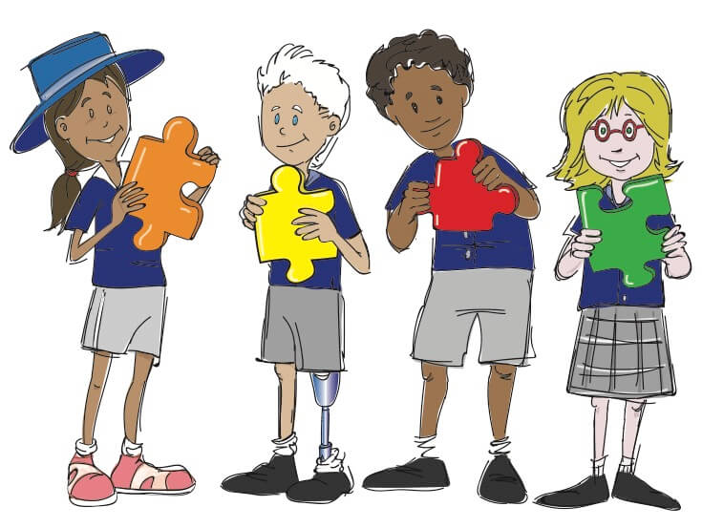
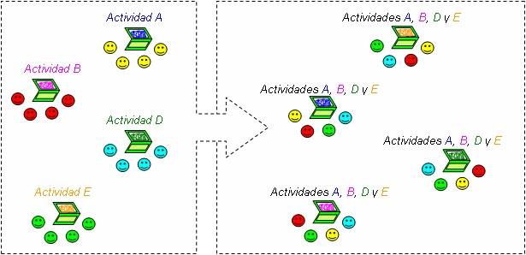
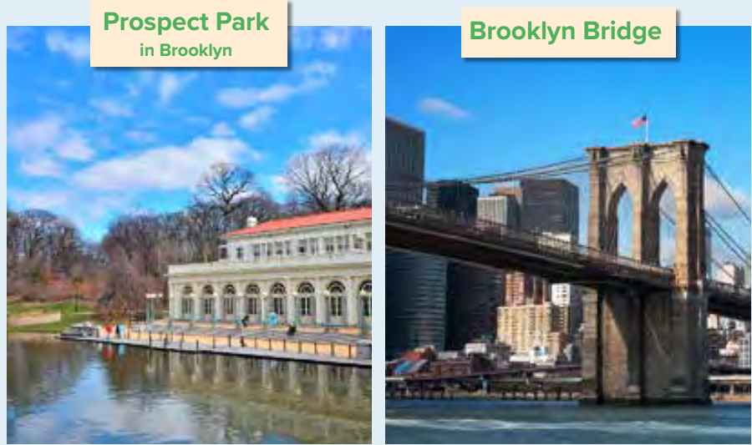
Work in pairs
Jigsaw
Look at picture
Warm up

Slide 7
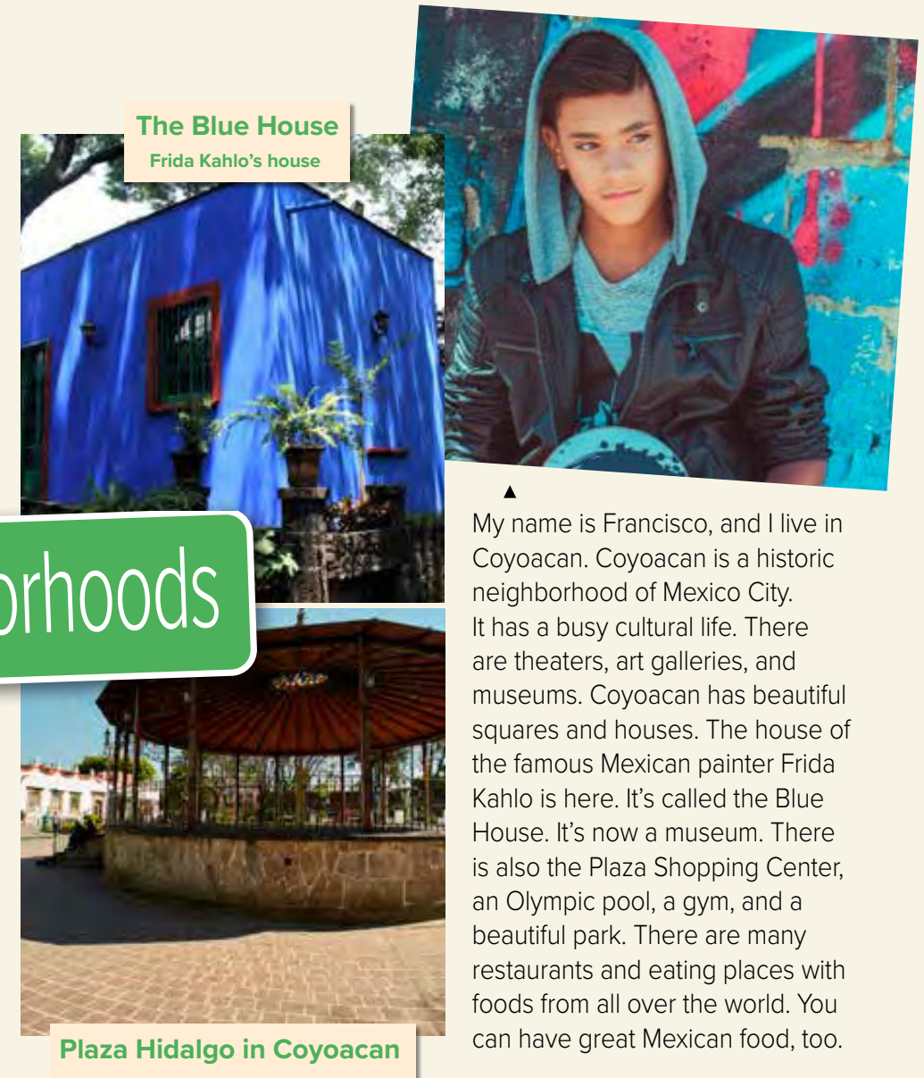








Page 61
Choral reading
Warm up

Slide 8
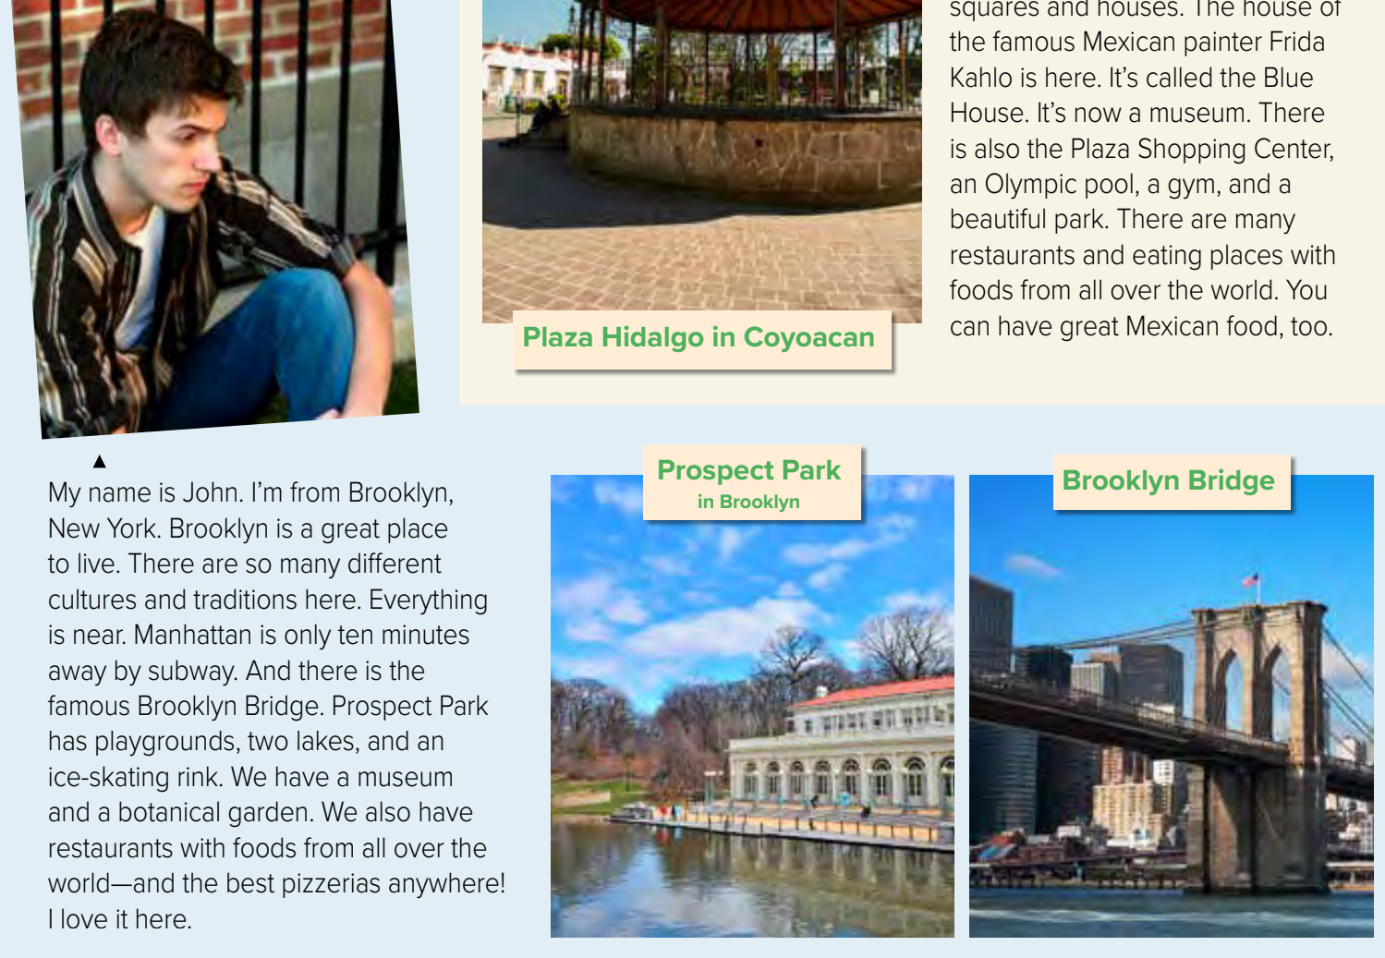





Page 61
Choral reading
Warm up

Slide 9
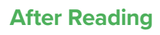
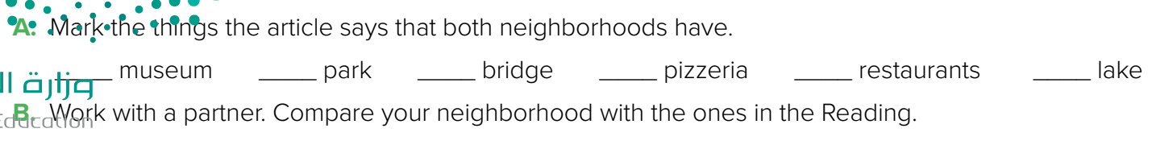


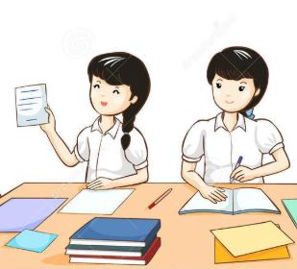
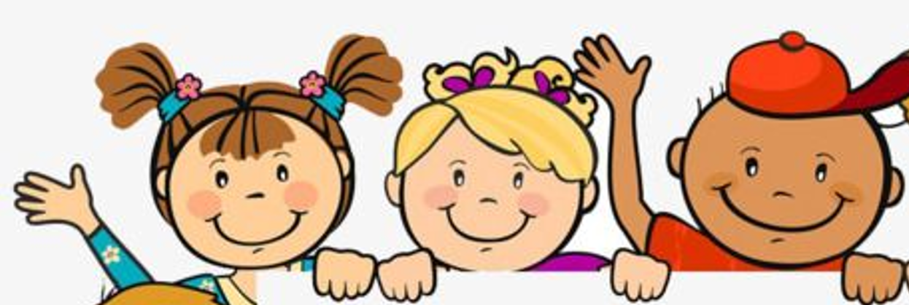
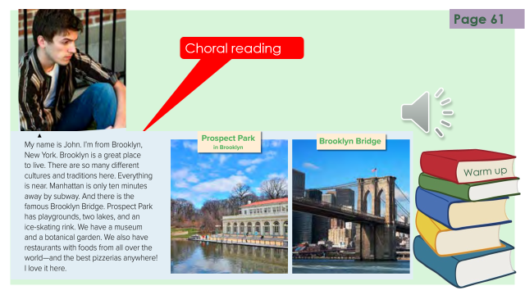

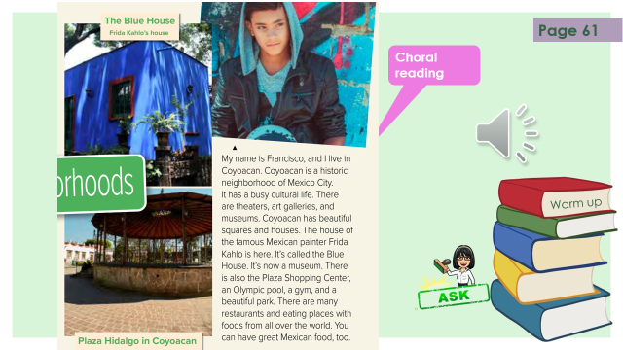
Warm up
Think pair share
What’s new in Taif?

Slide 10
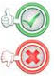

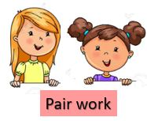

 | 1- John is from Mexico city
 | 2- Brooklyn is in New York
 | 3- in Brooklyn, everything is near
 | 4- Prospect Park has 5 lakes
 | 5- John doesn’t love his city
 | 6- Francisco lives in Mexico City
 | 7- Coyoacan has a busy life
 | 8- The blue house is for John
 | 9- There are no museums in Coyoacan
 | 10- the food in Francisco’s neighborhood is great
3 class group
Warm up
Surprise game

Slide 11

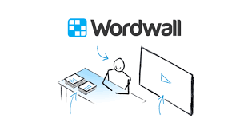
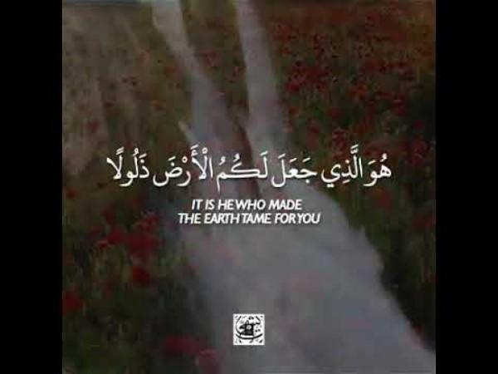
Lets play
Warm up

Slide 12
Write in your notebook
Like final test أسئلة للاختبار النهائي
Choose:
Mmmmmmm ………. mmmmmmm
( ssss – ssss – sssss)
Make a question

Slide 13
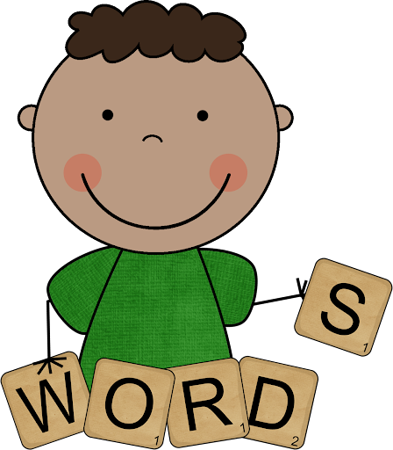
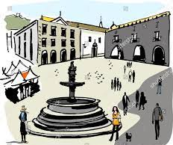
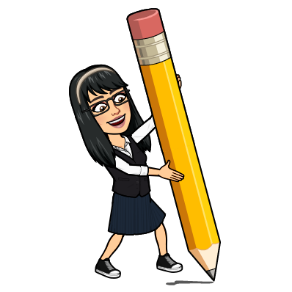
famous
New Words
known
cultures
painter (n)
Artist
historic
old
square
there
#
here

Slide 14

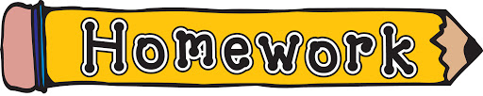



page 215 Ex(G )
for practice reading
Warm up

Slide 15
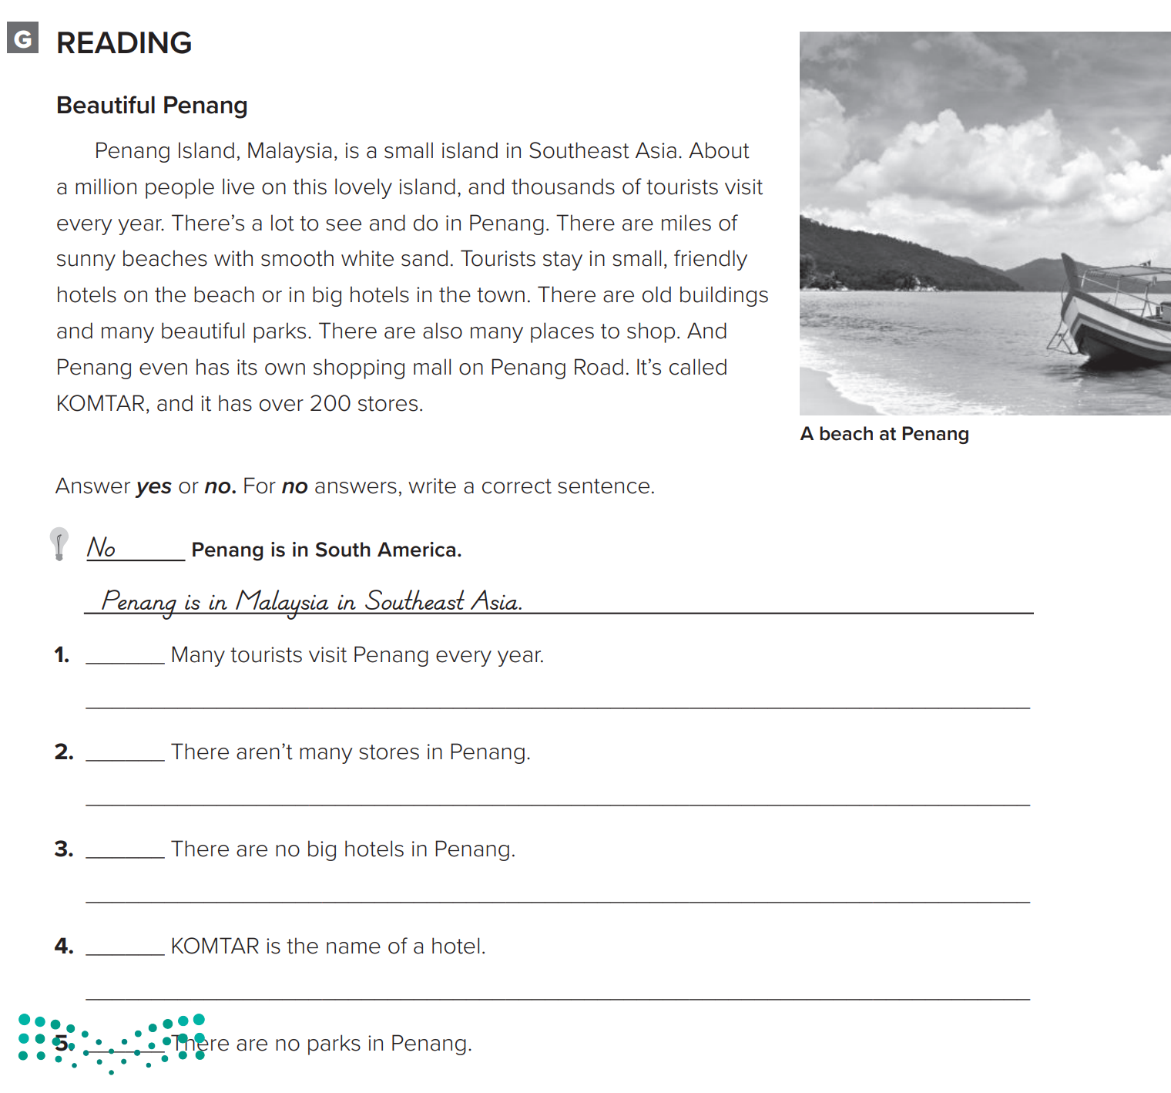

Slide 16
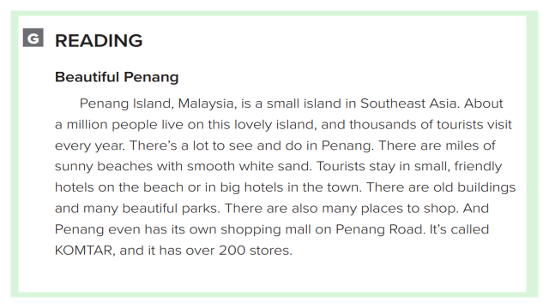
p.215
yes
no
There are over 200 stores
no
There are big hotels
Warm up
no
It’s the name of the shopping mall
no
There are many beautiful parks

