Slide 1

Mega goal.3.2 Do you really need it? Reading Speaking

Slide 2


Quick Check

Slide 3
Objectives
1
2
Find the meaning of new words
List the ads they see everyday
3
4
Answer questions about the text
Classify the main ideas of the text
5
6
Compare between two different commercials
Demonstrate the situation without ads

Slide 4
Reading

Slide 5
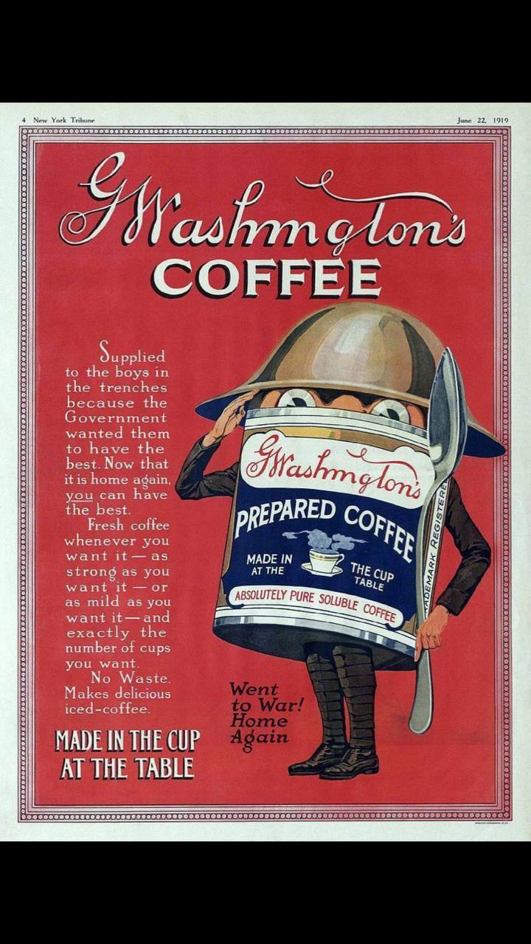

How many ads do you see a day?

Slide 6
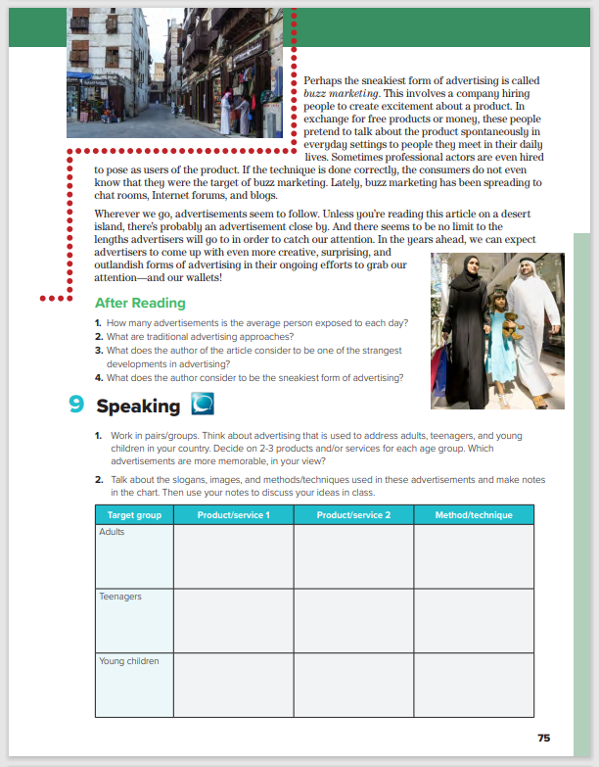
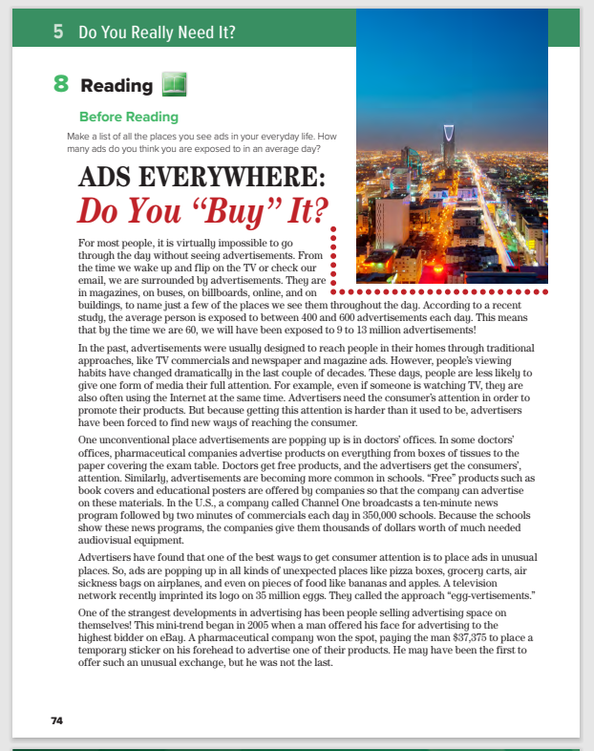

Students Book.
P.74-75

Slide 7
Jeddah
6
Riyadh
7
1
2
3
…………….Paragraphs?
…………….Title?
4
…………….Pictures?
5
Why is Buy in quotation marks?
Do you recognize these cities?
Notes:
that buy has two meanings in this title. The first meaning is to purchase something. The second, more idiomatic meaning is to accept, believe, or support something.
Do you see many advertisements in these cities? What do they advertise?

Slide 8
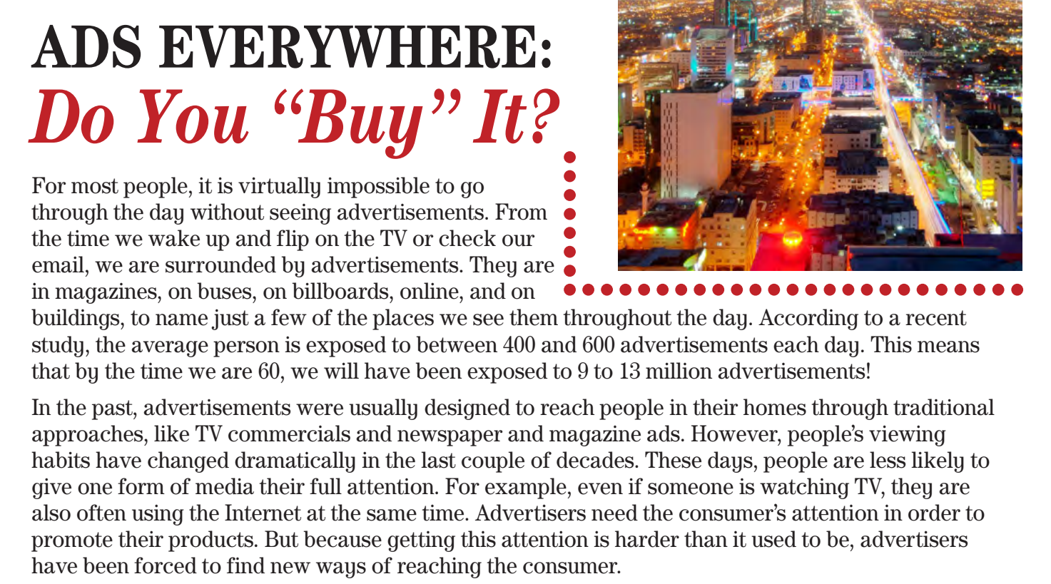
READING STRATEGY Previewing

Slide 9
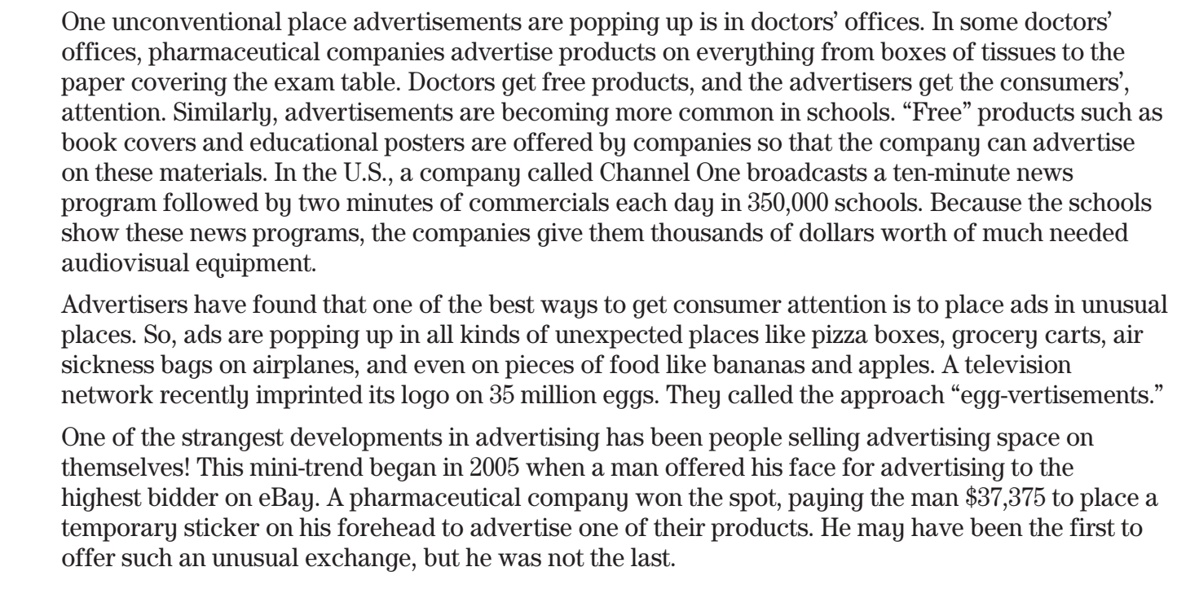
What do you think you will learn in this paragraph?
about the amount of advertisements people see in a day
What do you think you will learn in this paragraph?
how advertisements reach people today

Slide 10
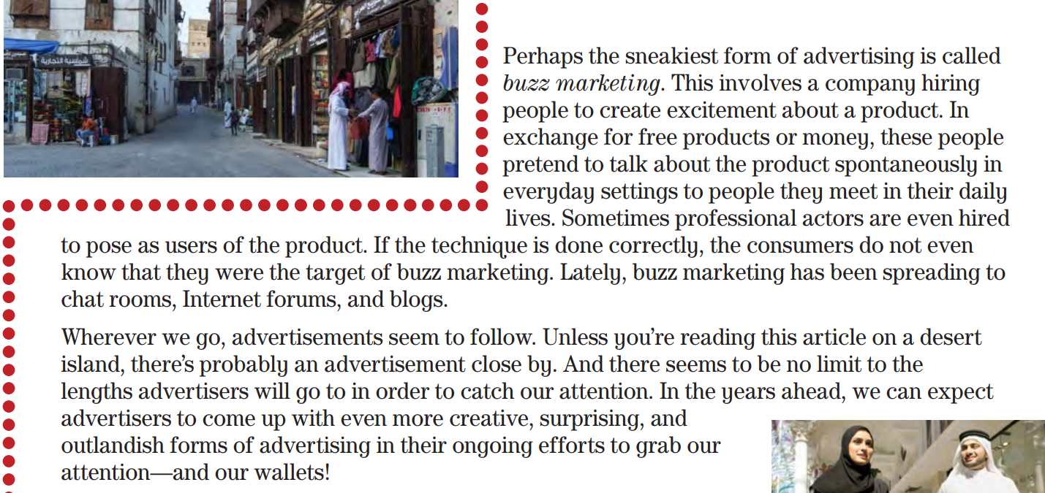
What do you think you will learn in this paragraph?
What do you think you will learn in this paragraph?

Slide 11
What do you think you will learn in this paragraph?

Slide 12



Read as long as you listen
Notes:
that buy has two meanings in this title. The first meaning is to purchase something. The second, more idiomatic meaning is to accept, believe, or support something.
Do you see many advertisements in these cities? What do they advertise?

Slide 13
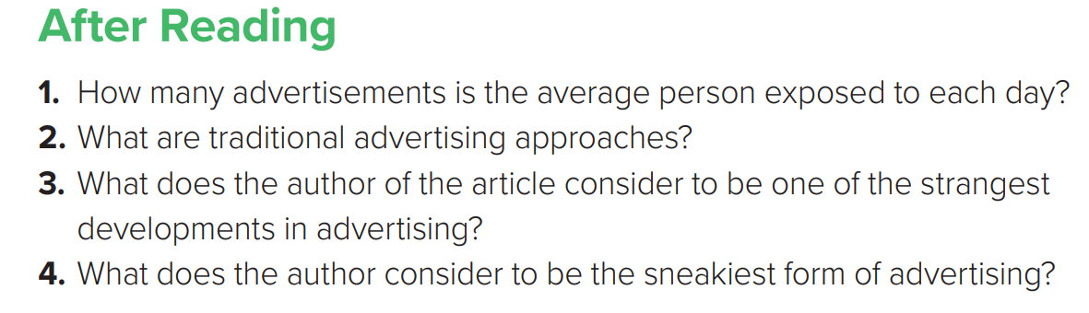
1.The average person is exposed to between 400 and 600 advertisements each day.
2. TV commercials, newspaper ads, and magazine ads are traditional advertising approaches.
3. Selling advertising space on one’s body is a strange development in advertising.
4. Buzz marketing is considered the sneakiest form of advertising.

Slide 14
Speaking

Slide 15
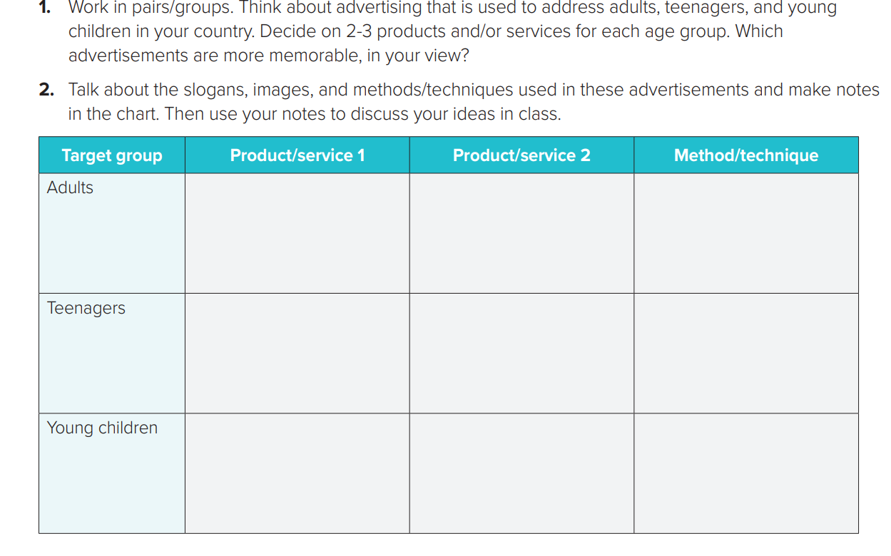

Slide 16
Quick Check

Slide 17
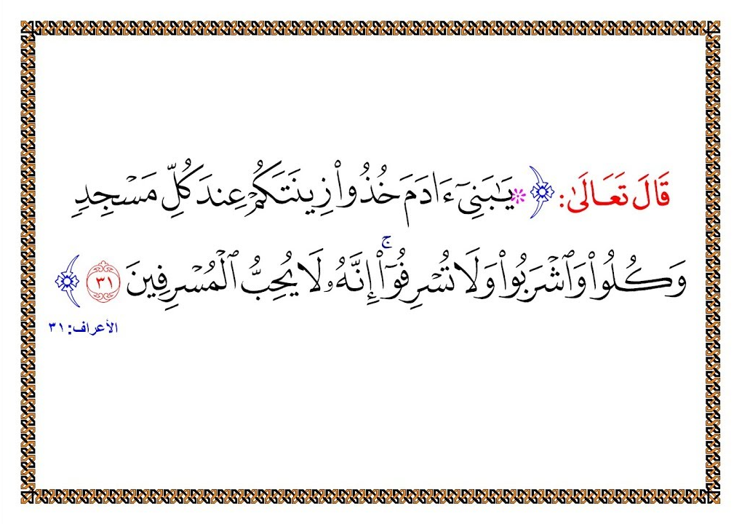

Slide 18

Tr. Hissah Alotaibi

