Slide 1

Mega goal.3.2
Do you really need it? listen & discuss

Slide 2
Objectives
1
2
Describe a memorable advertisement
Match new words with their meanings
3
4
Name the advertisement that appeals to the reader’s desire to be special
Choose the advertisements that use statistics to sell their .products
5
6
Create an advertisemen
Point out the unnecessary item they bough

Slide 3

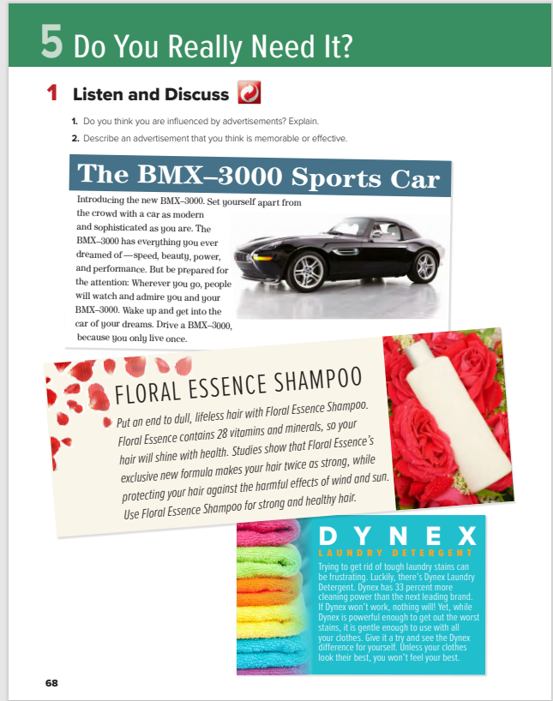





What do you think the unit will be about?

Slide 4
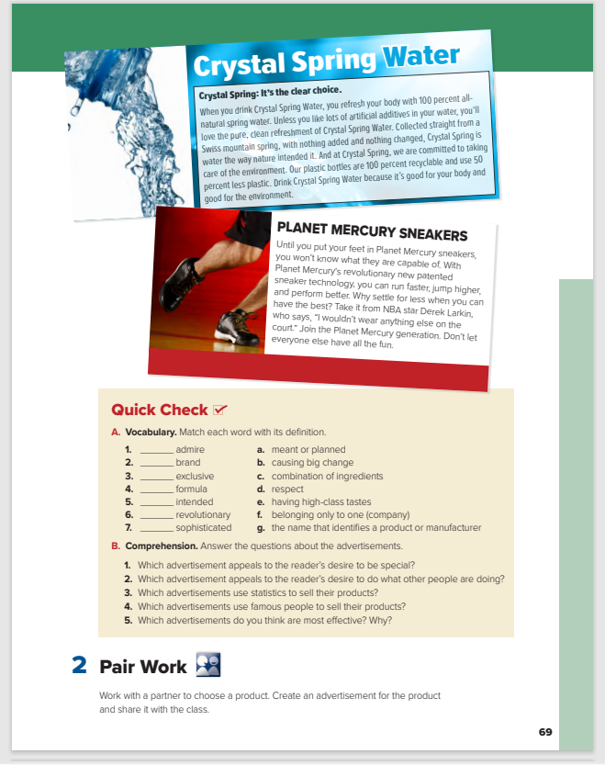
Students Book
P.68-69

Slide 5
What do you think the unit will be about?
(advertising and consumer products)
When you want to buy something, do you ever ask yourself Do I really need this?
What is the purpose of advertisements?
to make people buy things

Slide 6
Do you think you are influenced by advertisements? Explain.
2. Describe an advertisement that you think is memorable or effective.

Slide 7



listen with your books closed

Slide 8
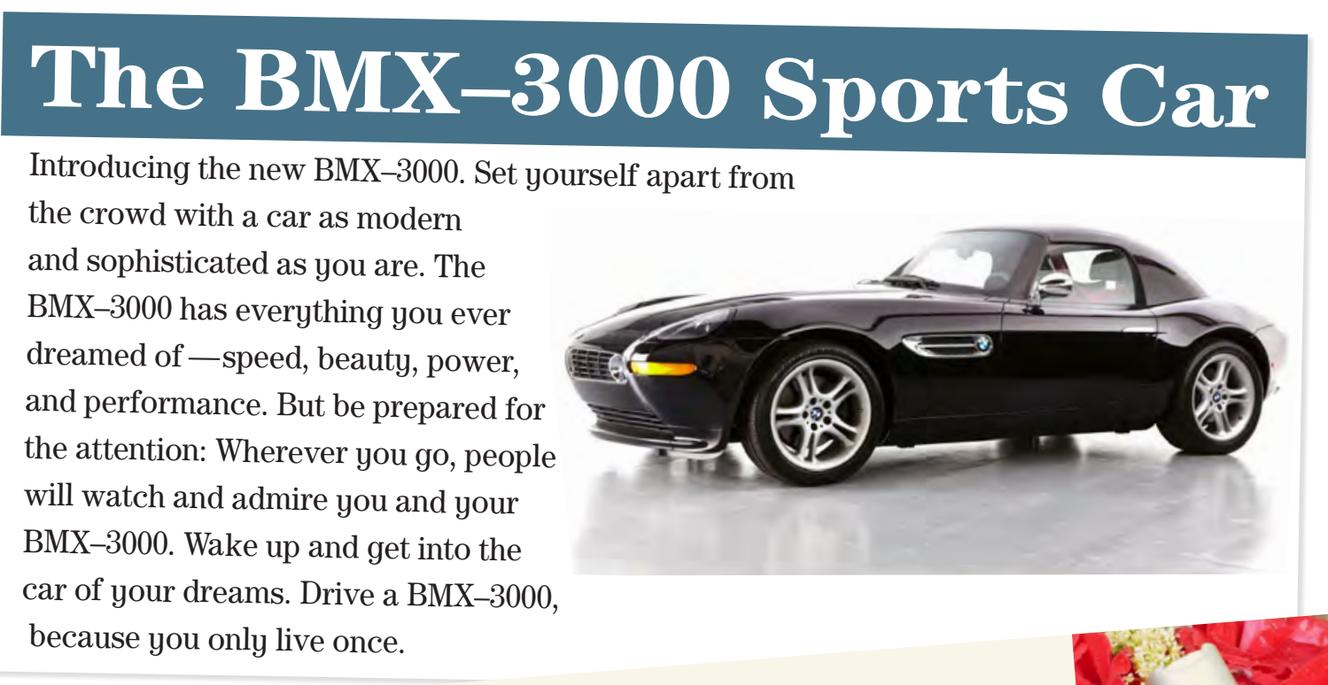
Open your books

Slide 9
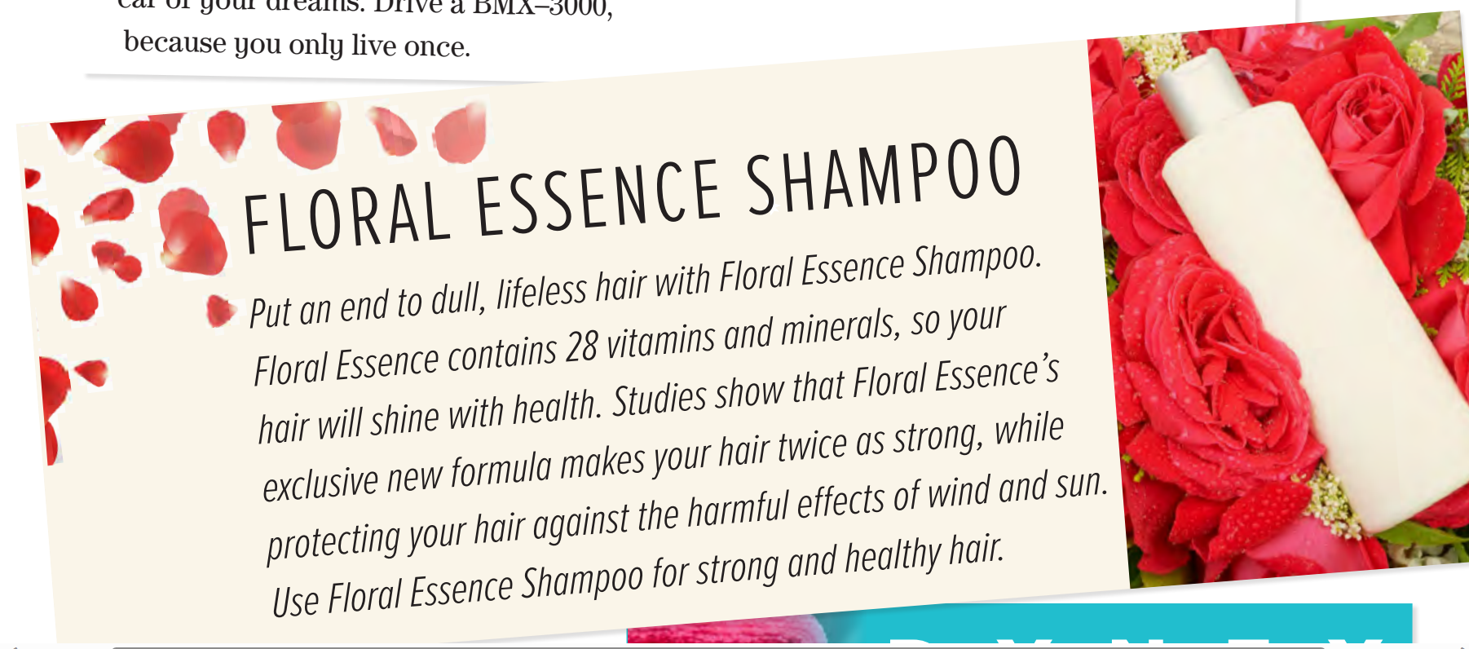
What kind of car is this?
What will happen if you drive this car?
a fast, beautiful sports car

Slide 10
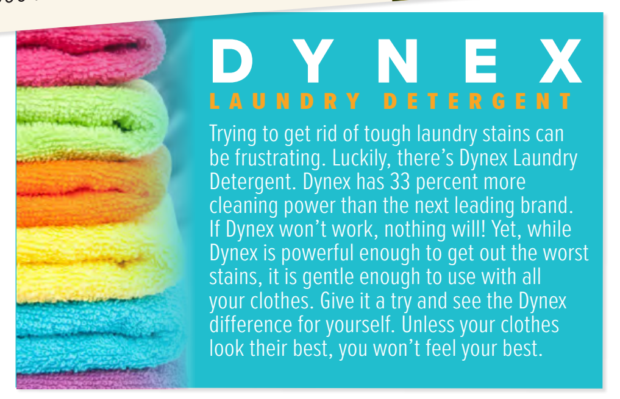
What will happen if you use this shampoo? What have studies shown?

Slide 11
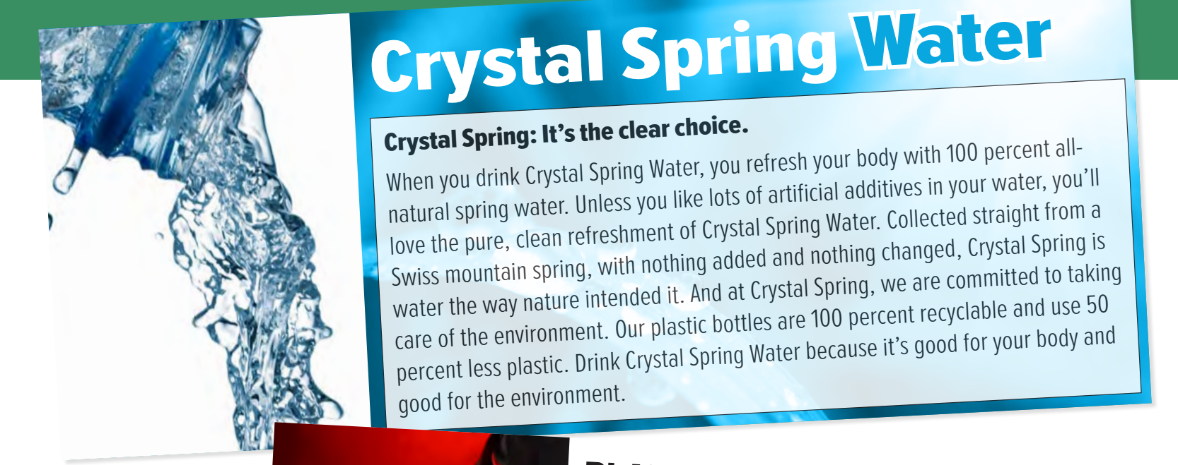
Why is this detergent better than others?
What can this detergent do?
(It contains more cleaning power.

Slide 12
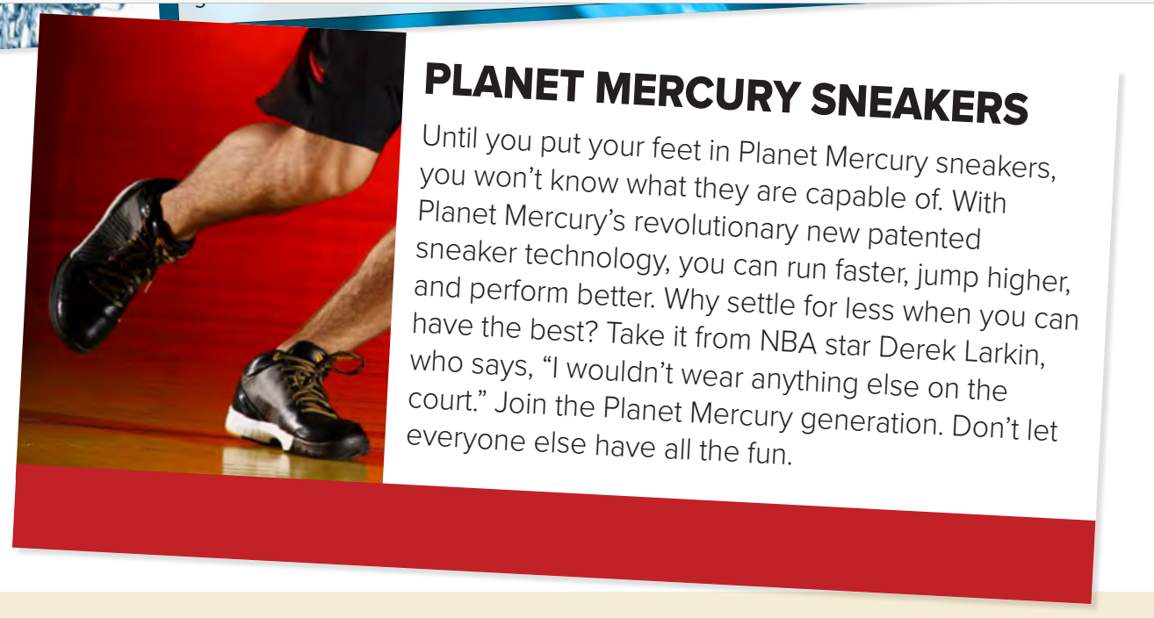
How is Crystal Spring Water different? Where does it come from?
What else is special about it?
It is all-natural with no additives
It is good for the environment

Slide 13
If you wear these sneakers, what will you be able to do?
Who wears these sneakers?

Slide 14
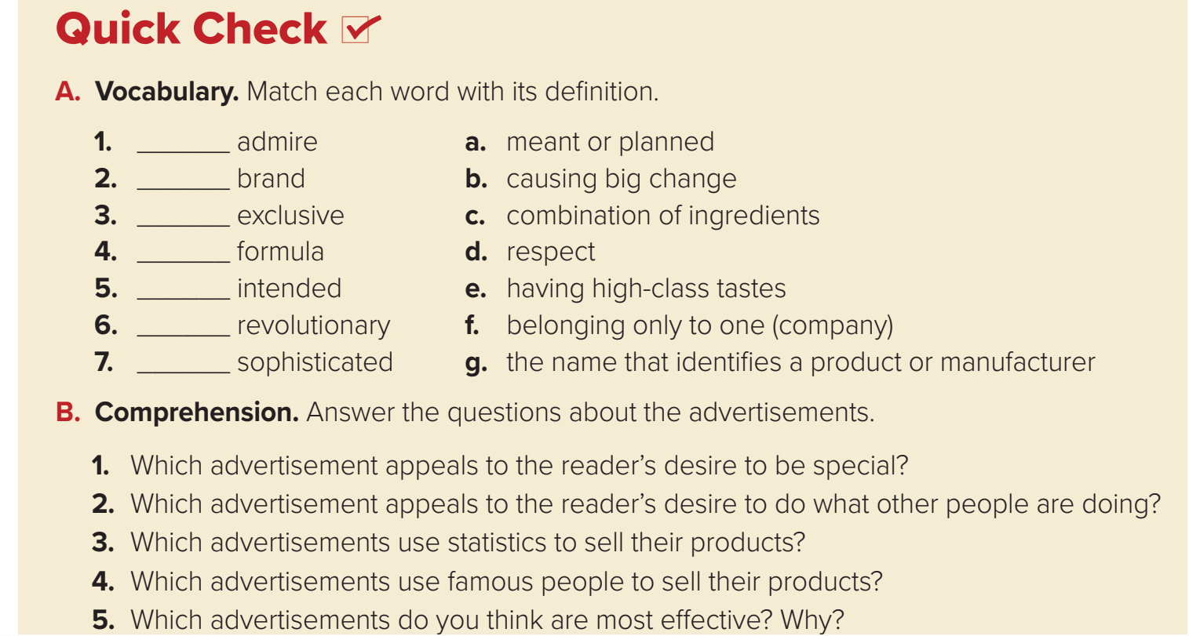
d
g
f
c
a
b
e

Slide 15
1.BMX–3000 Sports Car
2. Planet Mercury Sneakers
3. Dynex Laundry Detergent and Crystal Spring Water
4. Planet Mercury Sneakers
5. I think the ad for the BMX–3000 Sports Car is the best because it makes me want to buy one.

Slide 16

Pair work
Work with a partner to choose a product. Create an advertisement for the product and share it with the class.

Slide 17
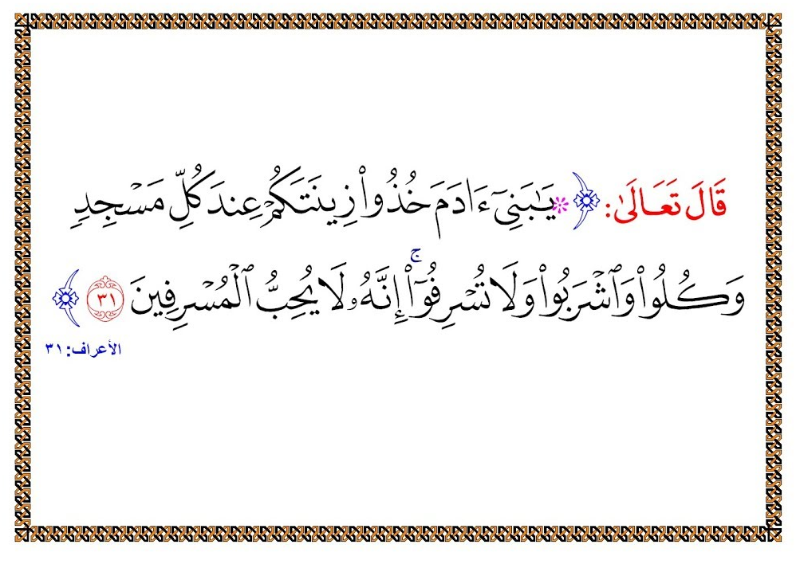

Slide 18

Tr. Hissah Alotaibi

