Slide 1
MEGA GOAL 2
Term 2

Slide 2
UNIT 5
Workbook Answer

Slide 3
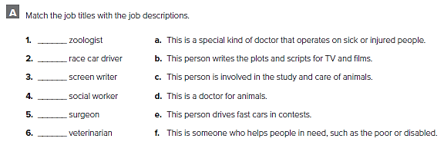
c
e
b
f
a
d

Slide 4
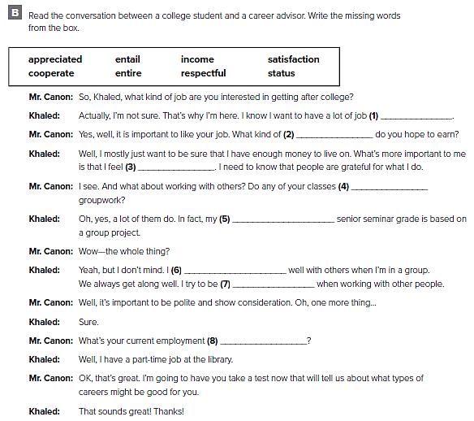
satisfaction
income
appreciated
entail
entire
cooperate
respectful
status

Slide 5
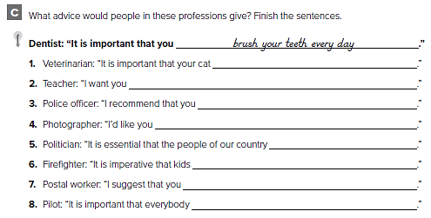
الإجابات من الممكن أن تختلف
take this medicine every day
to do your homework
stay out of the street
to stay still
vote for me
not play with matches
send this first-class mail
wear a seatbelt

Slide 6
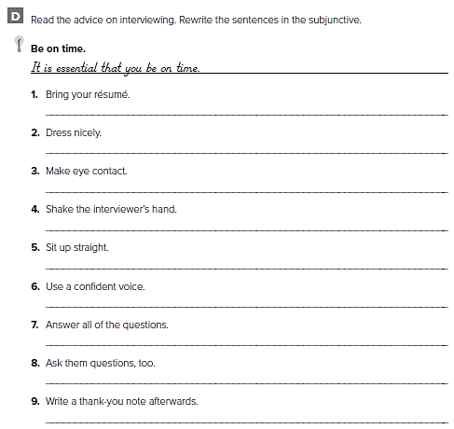
I recommend that you bring your résumé.
It is important that you dress nicely.
It is imperative that you make eye contact.
It is essential that you shake the interviewer’s hand.
It is important that you sit up straight.
I suggest that you use a confident voice.
It is essential that you answer all of the questions.
I recommend that you ask them questions, too.
I suggest that you write a thank-you note afterwards

Slide 7
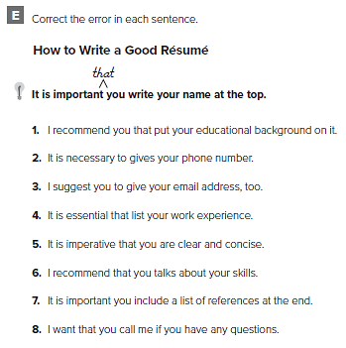
that you put
give
that you give
that you list
that you be clear
talk
that you include
want you to call

Slide 8
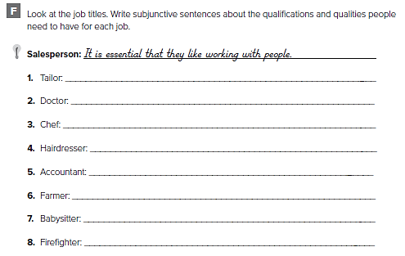
الإجابات من الممكن أن تختلف
It is important that they know how to sew.
It is necessary that they go to medical school.
It is essential that they like to cook.
I recommend that they like talking to people.
It is important that they are good at math.
It is important that they like working outside.
It is essential that they be good with children.
It is necessary that they be healthy and strong

Slide 9
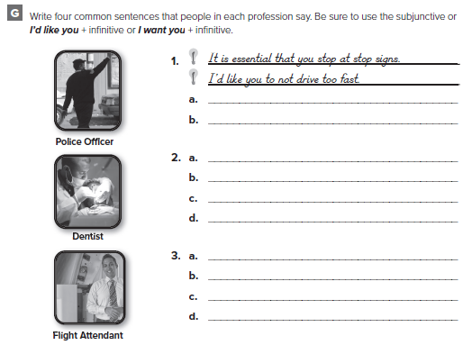
الإجابات من الممكن أن تختلف
I want you to clean your teeth.
It is important that you don't eat sweets.
It is necessary to wear a seatbelt.
It is important that you not use a phone

Slide 10
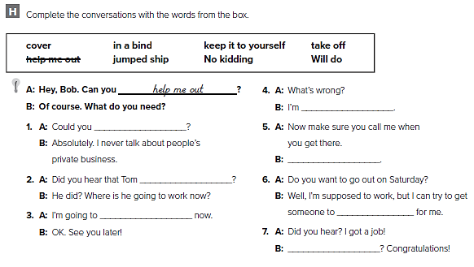
in a bind
Keep it to yourself
will do
jumped ship
take off
cover
No kidding

Slide 11
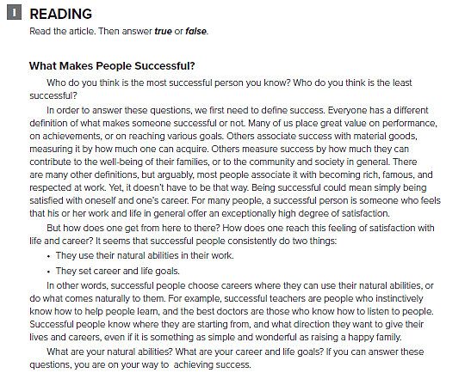

Slide 12
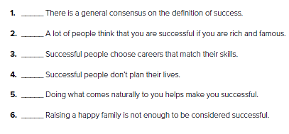
F
T
T
F
T
F

Slide 13
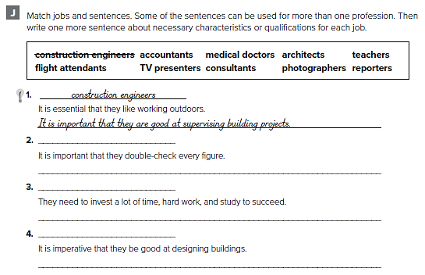
accountants
It is necessary that they keep records meticulously
medical doctors
We expect them to cure us
architect
It is essential that they have an eye for style and design

Slide 14
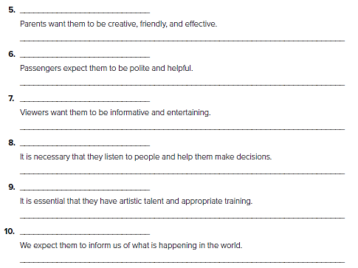
teachers
It is necessary that they take work home
flight attendants
It is imperative that they be courteous and efficient
TV presenters
They need to pay attention to the way they look
consultants
It is important that they listen carefully
photographers
It is necessary that they have an eye for details
reporters
It is imperative that they check information before using it

Slide 15
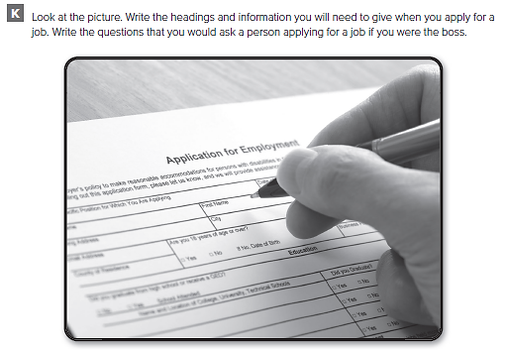

Slide 16
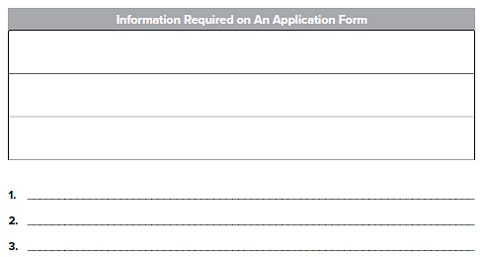
First name
Family name
Address
Have you ever worked in this kind of area before?
Where were you trained?
Why did you leave your last job?
الإجابات من الممكن أن تختلف

Slide 17
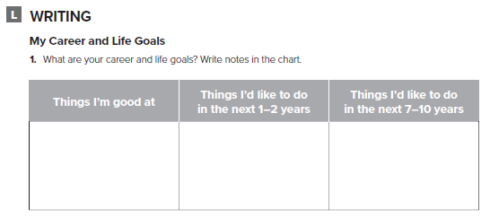
تحدث عن أحلامك المهنية

Slide 18
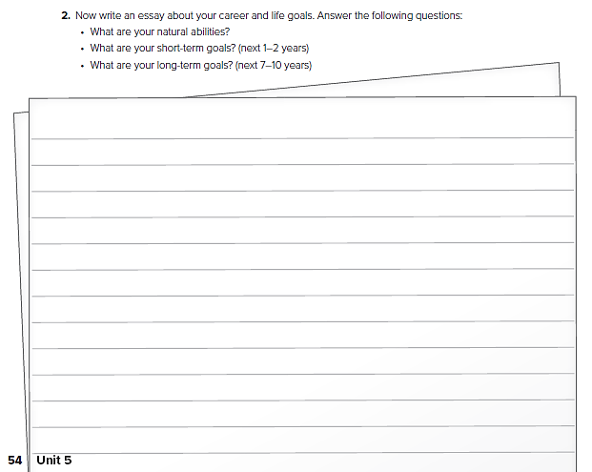
قم بكتابة مقال عن أهدافك في الحياة

Slide 19
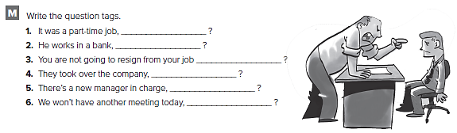
wasn’t it
doesn’t he
are you
didn’t they
isn’t there
will we

Slide 20
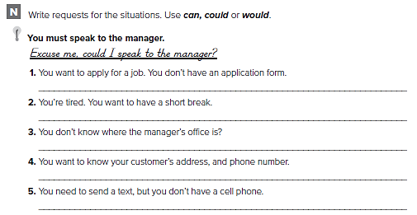
الإجابات من الممكن أن تختلف
Could I have an application form?
Could/Can I take a short break?
Excuse me, can you tell me where the manager’s office is?
Would you mind telling me your address, and phone number?
Would you be able to lend me your phone to send a text?

Slide 21
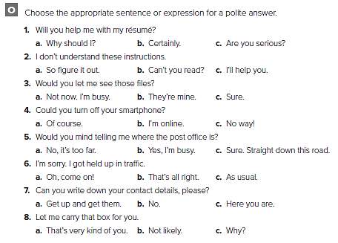

Slide 22
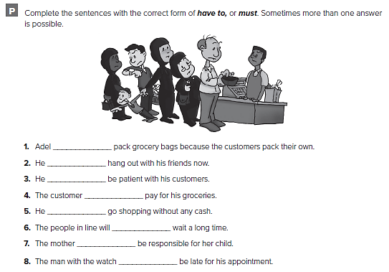
doesn’t have to
mustn’t
has to
must
mustn’t
have to
has to
mustn’t

Slide 23
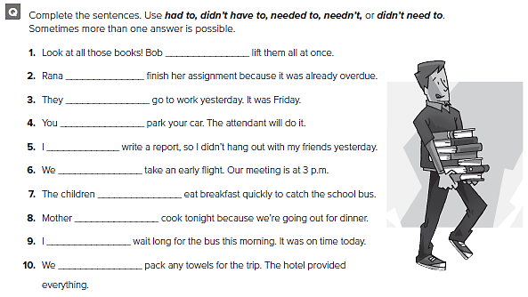
didn’t have to
had to
didn’t have to
needn’t
had to
needn’t
had to
needn’t
didn’t need to
needn’t

Slide 24
Prepared by
Teacher :
Bader Alshehri

