Slide 1


Welcome to class
T.

Slide 2



Slide 3





workbook
Pages 75 , 76

Slide 4
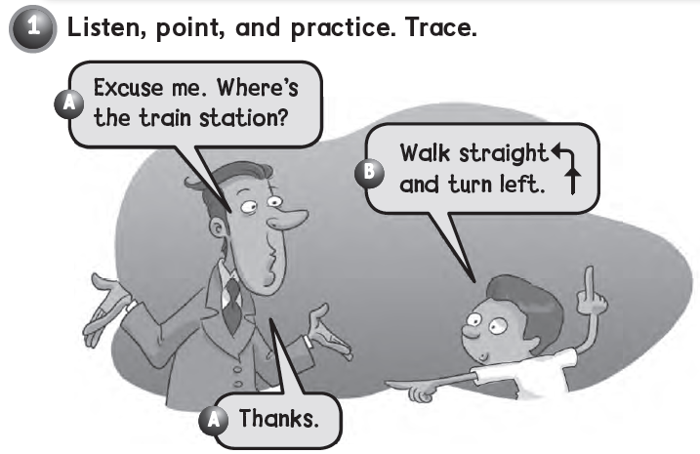
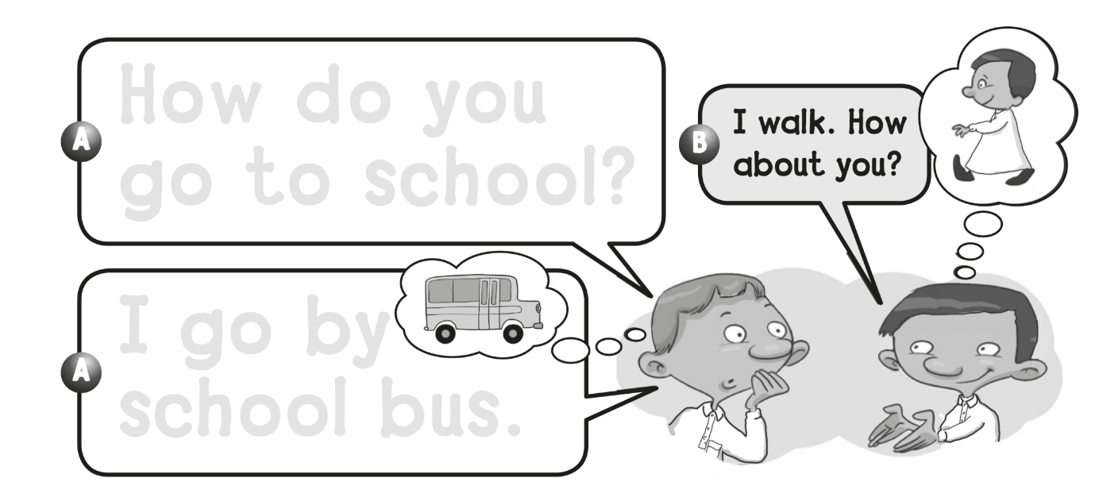
How do you
go to school ?
I go by
school bus .

Slide 5
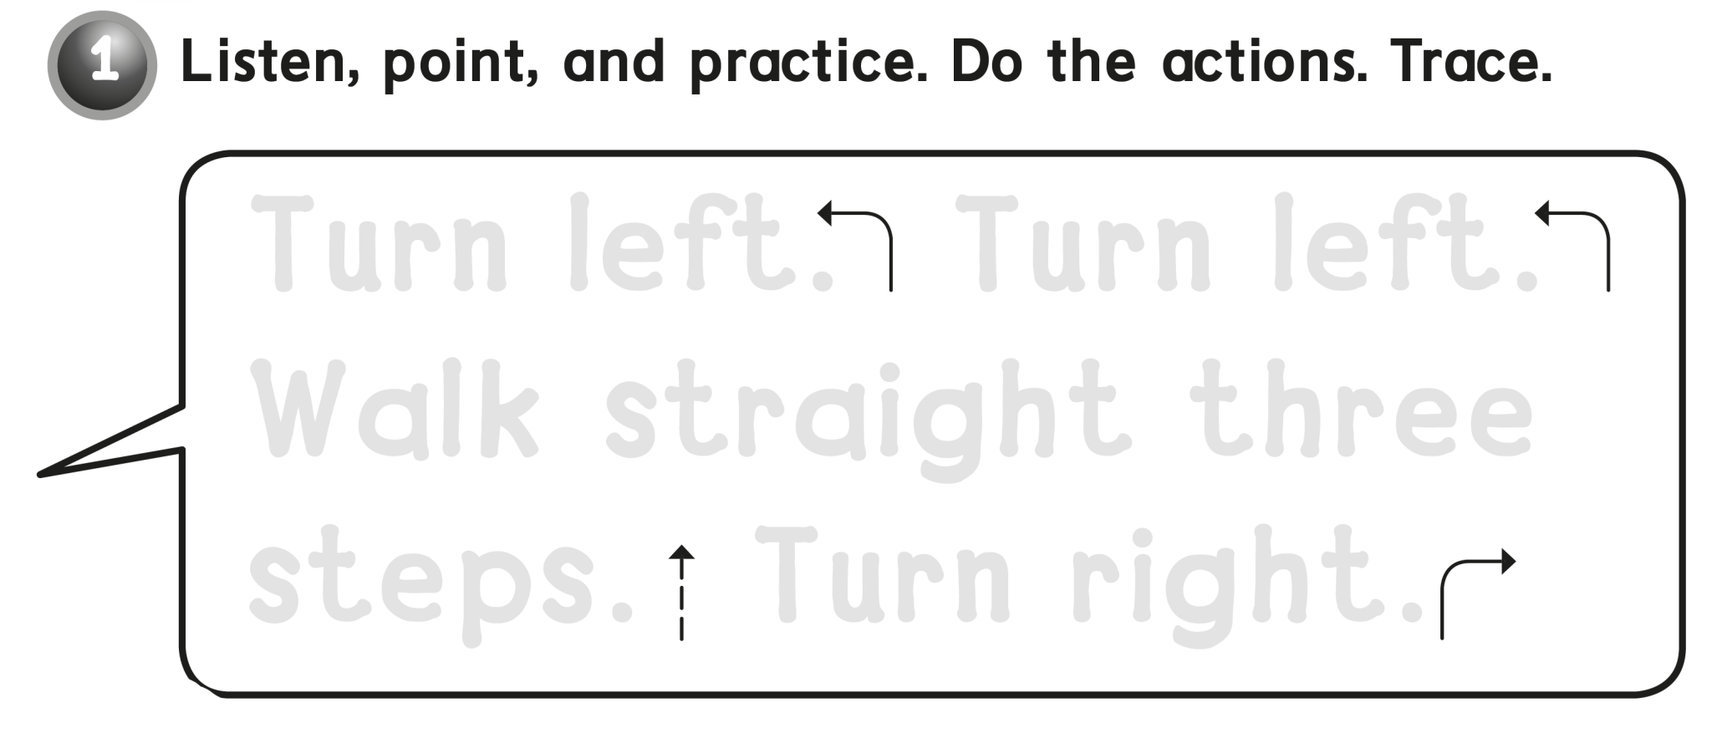
Turn left . Turn left .
Walk straight three
Steps . Turn right .

Slide 6
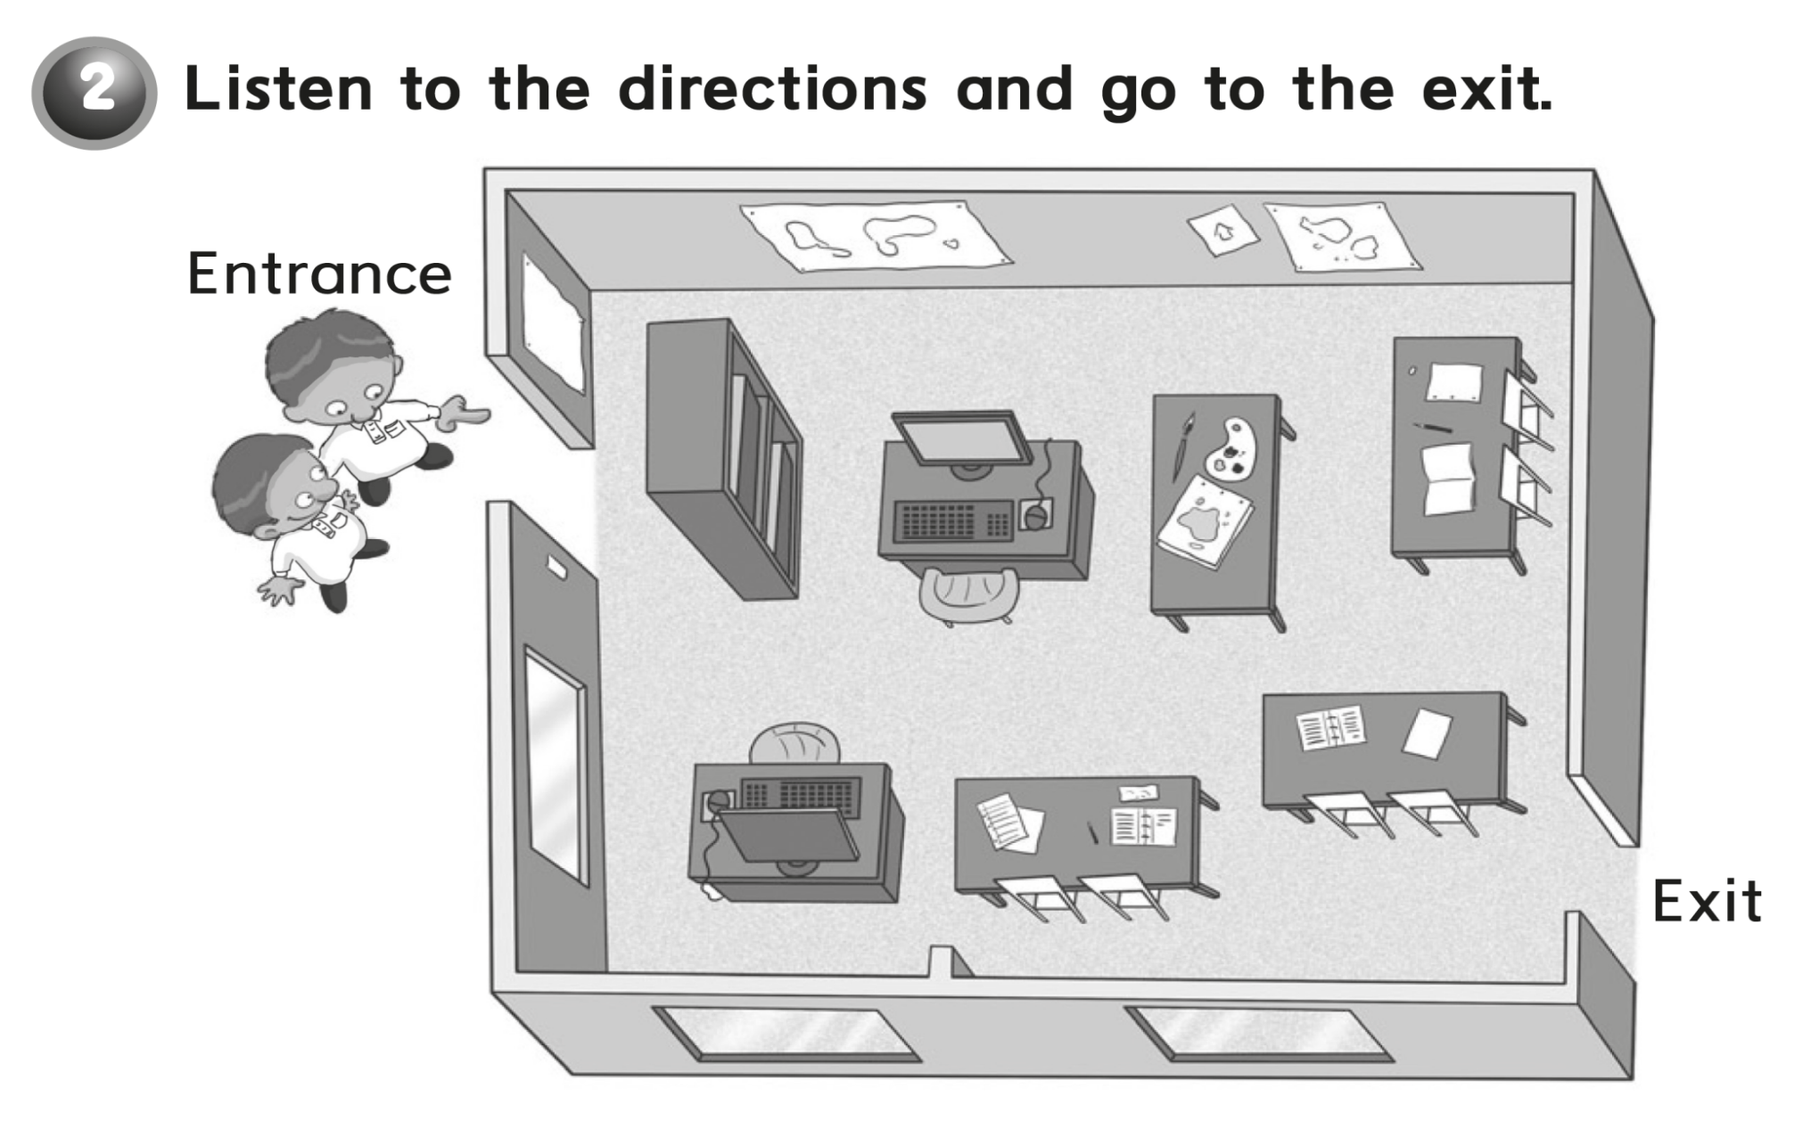


Slide 7
workbook
Pages 77 , 78

Slide 8
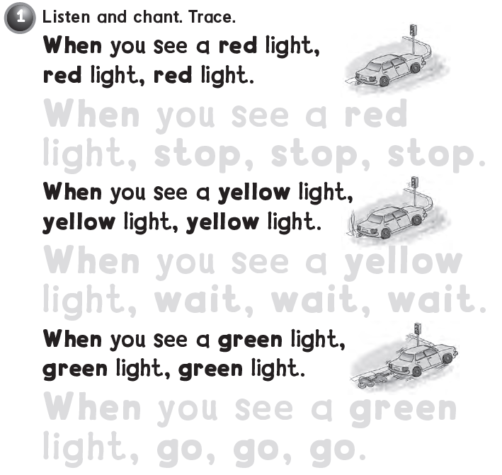
When you see a red
light , stop , stop , stop .
When you see a yellow
light , wait , wait , wait .
When you see a green
light , go , go , go .

Slide 9
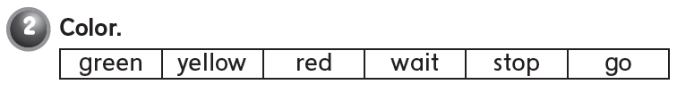

Slide 10
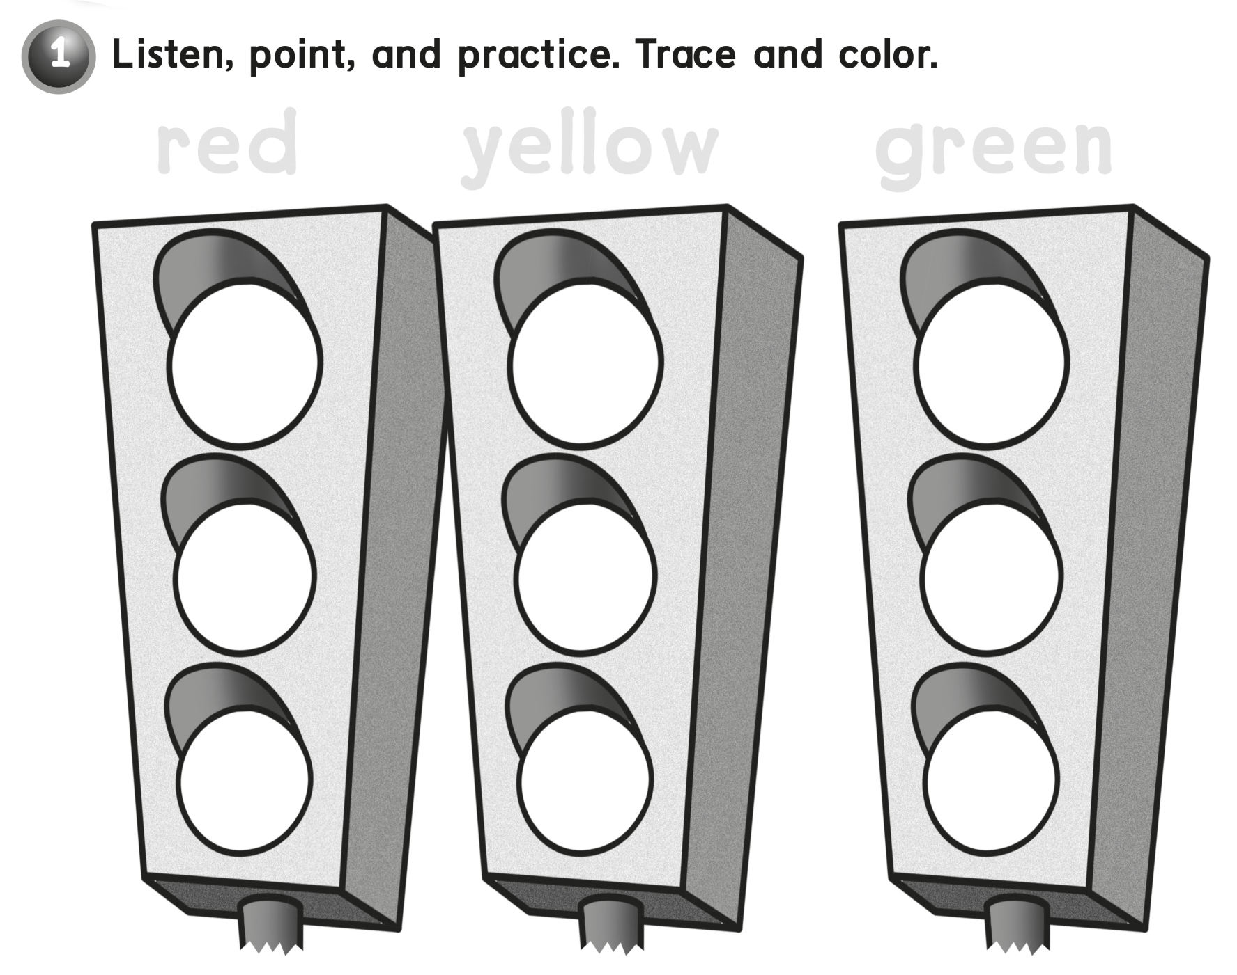
red
yellow
green

Slide 11
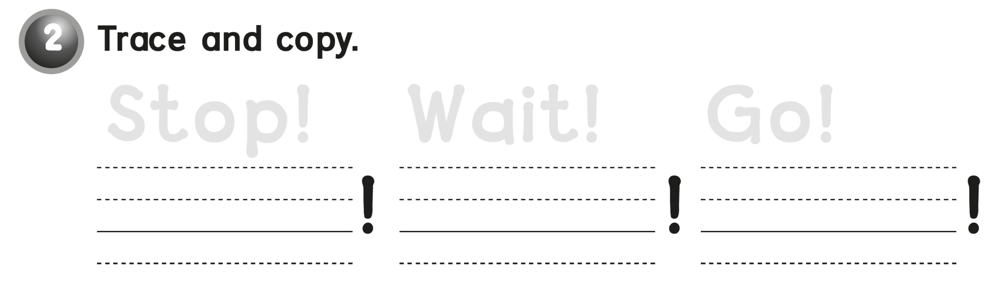
Stop !
Wait!
Go !
Stop
Wait
Go

Slide 12
workbook
2^{nd &} 3^{rd Grade}
Pages 79 , 80

Slide 13

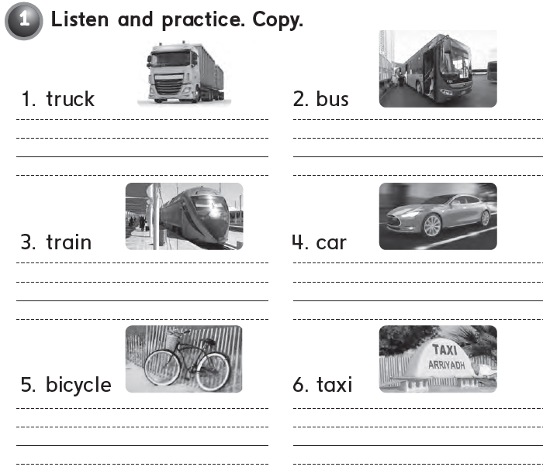
Truck
Bus
Train
Car
Bicycle
Taxi

Slide 14
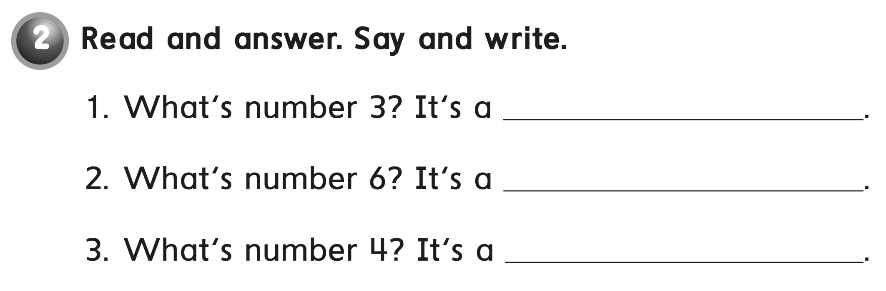
train
taxi
car

Slide 15

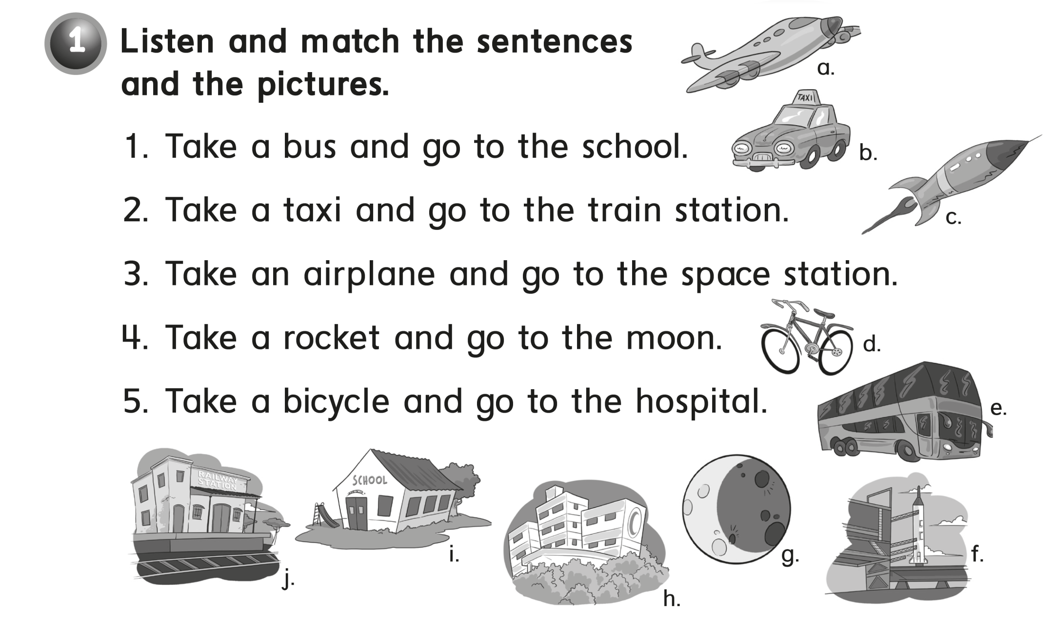
e - i
b – j
a – f
c – g
d – h

Slide 16
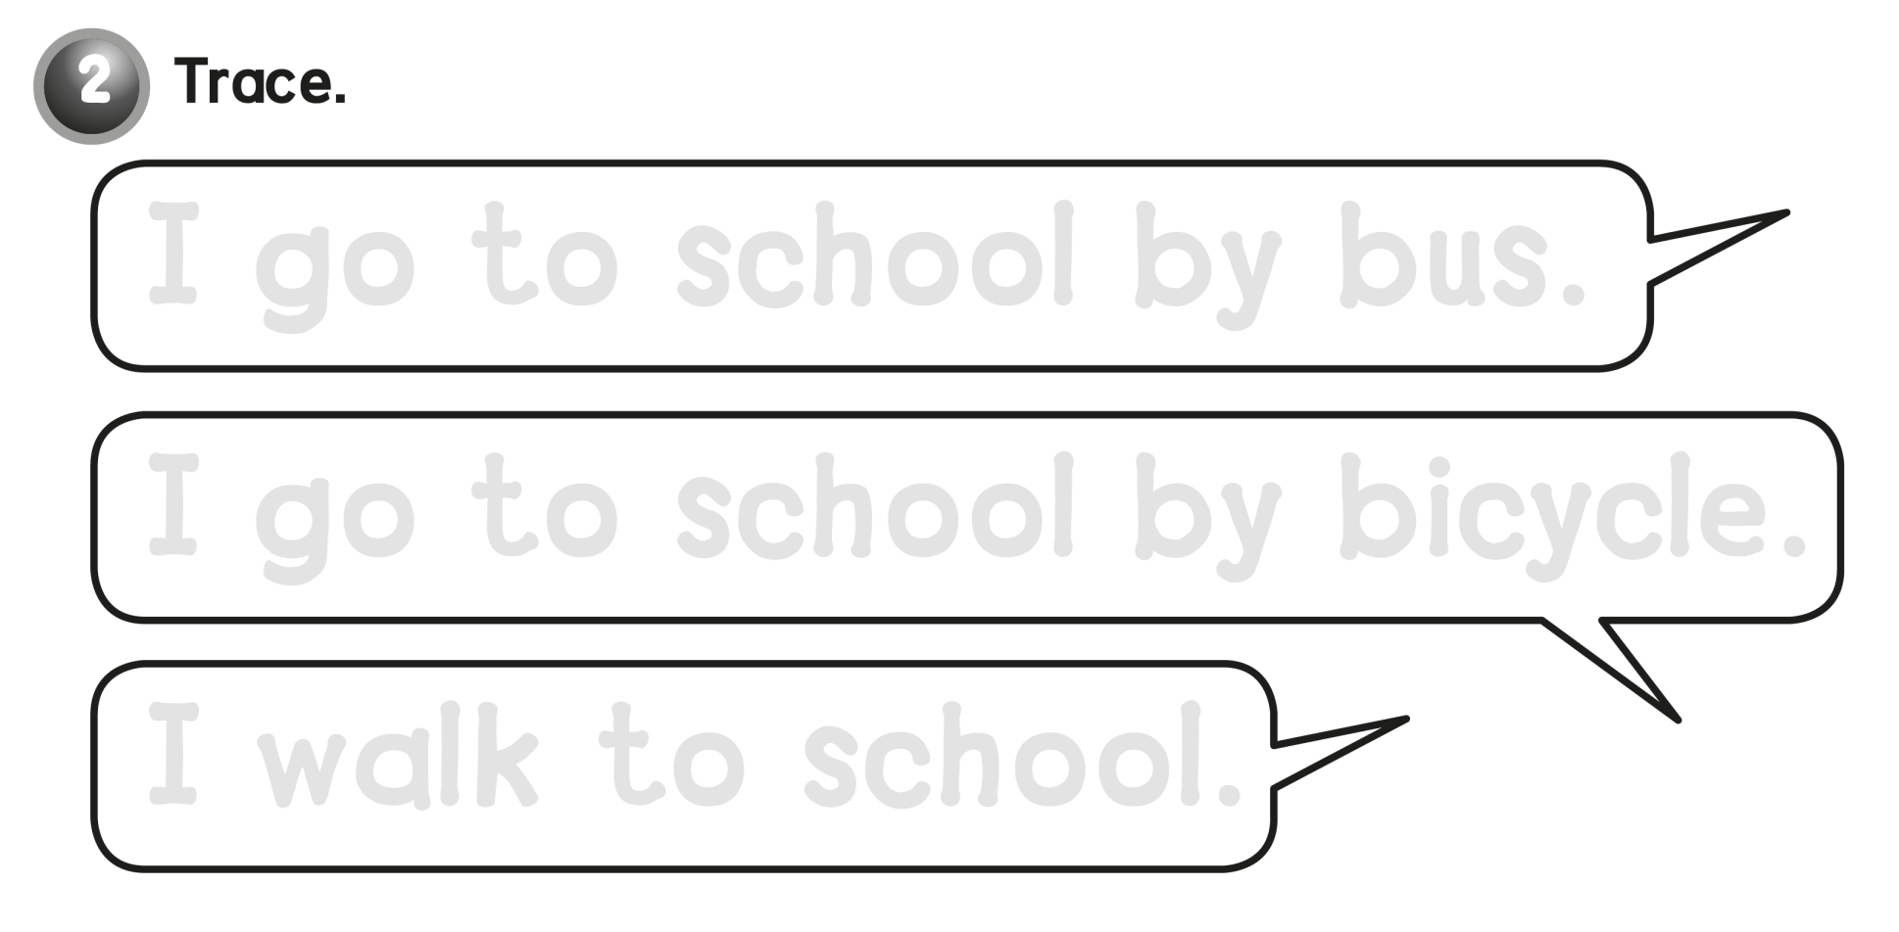
I go to school by bus .
I go to school by bicycle .
I walk to school .

Slide 17
workbook
Pages 81 , 82

Slide 18
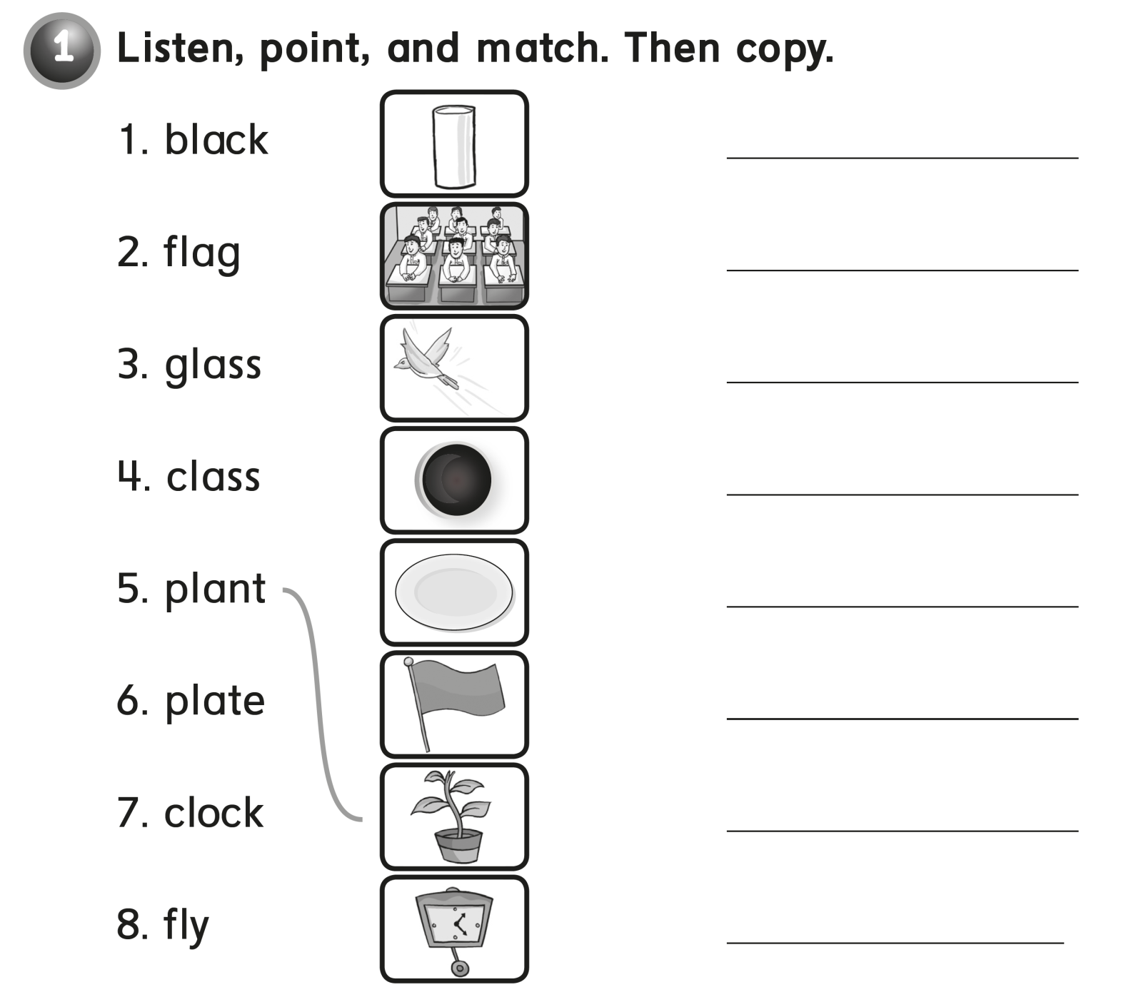

glass
class
fly
black
plate
flag
plant
clock

Slide 19
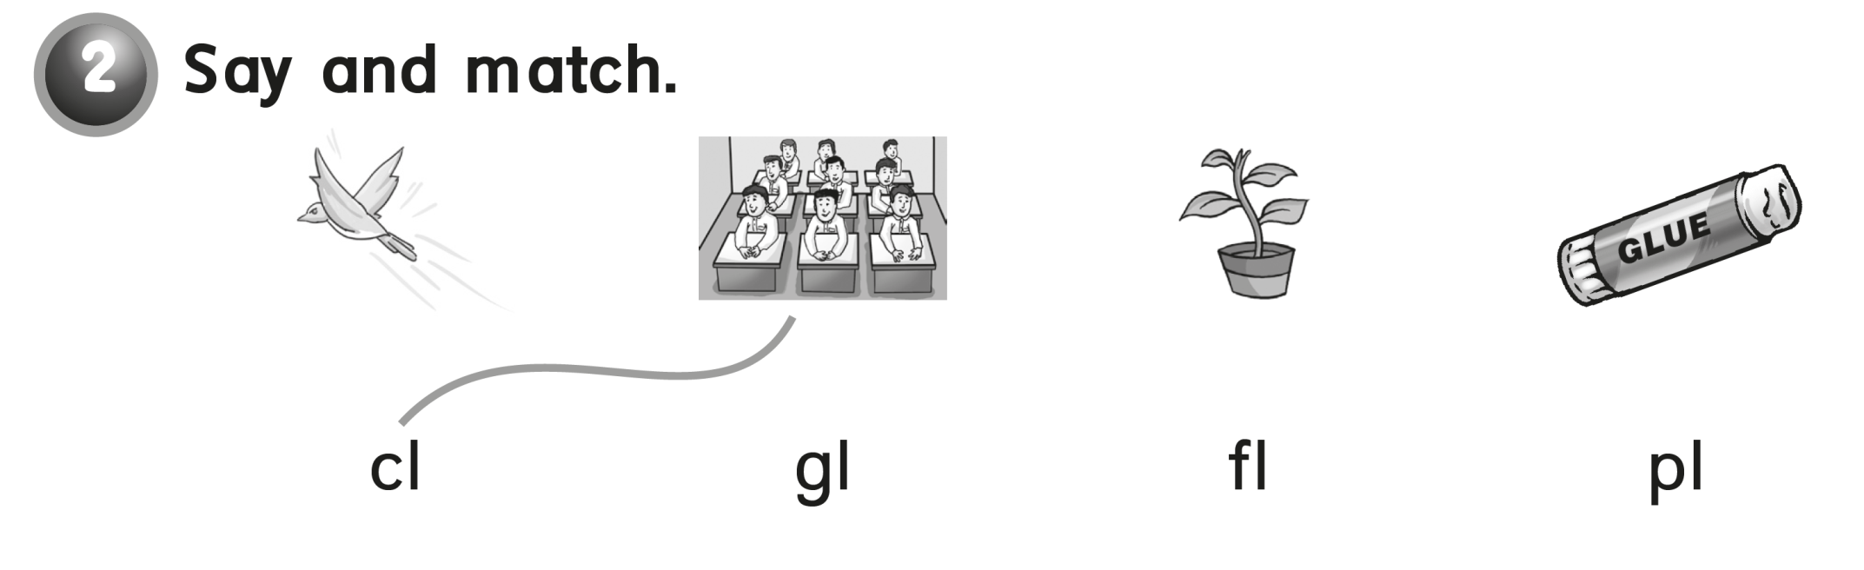

Slide 20

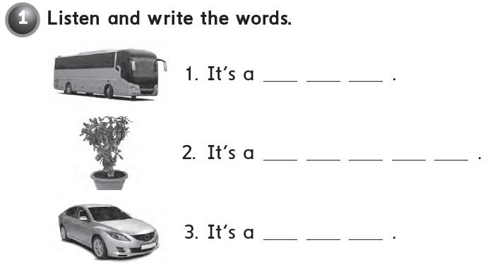
b u s
p l a n t
c a r

Slide 21
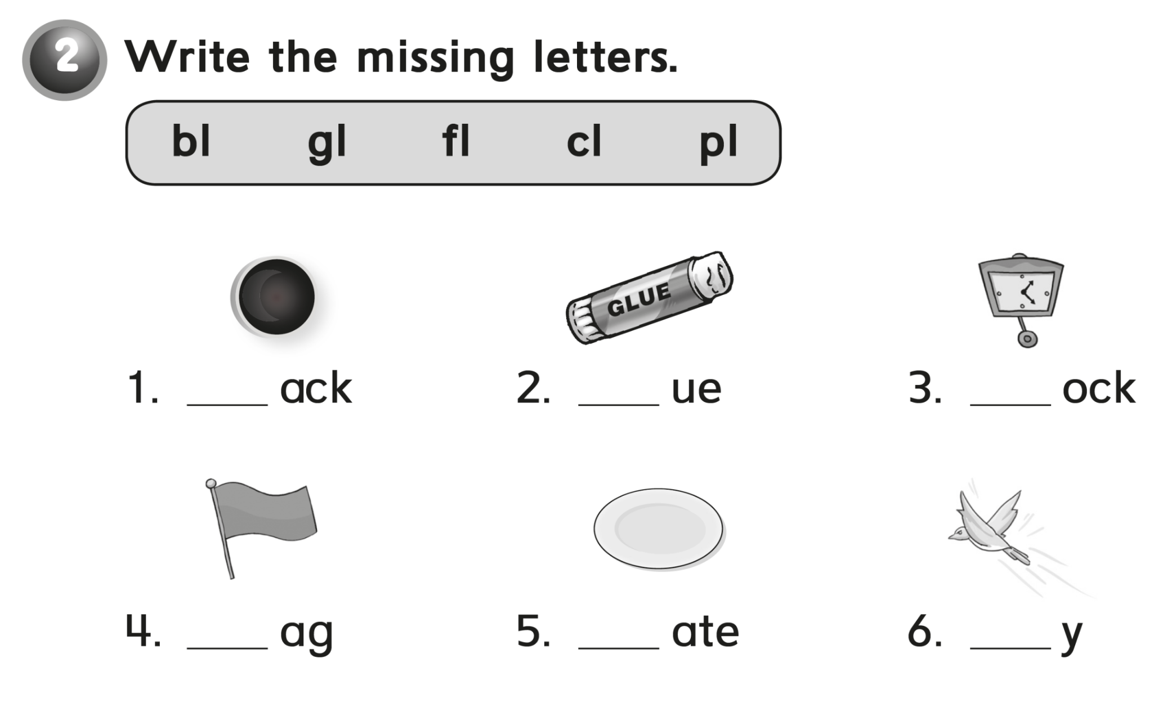
bl
gl
cl
fl
pl
fl

Slide 22


