Slide 1


Welcome to class
T.

Slide 2



Slide 3





workbook
Pages 67 , 68

Slide 4
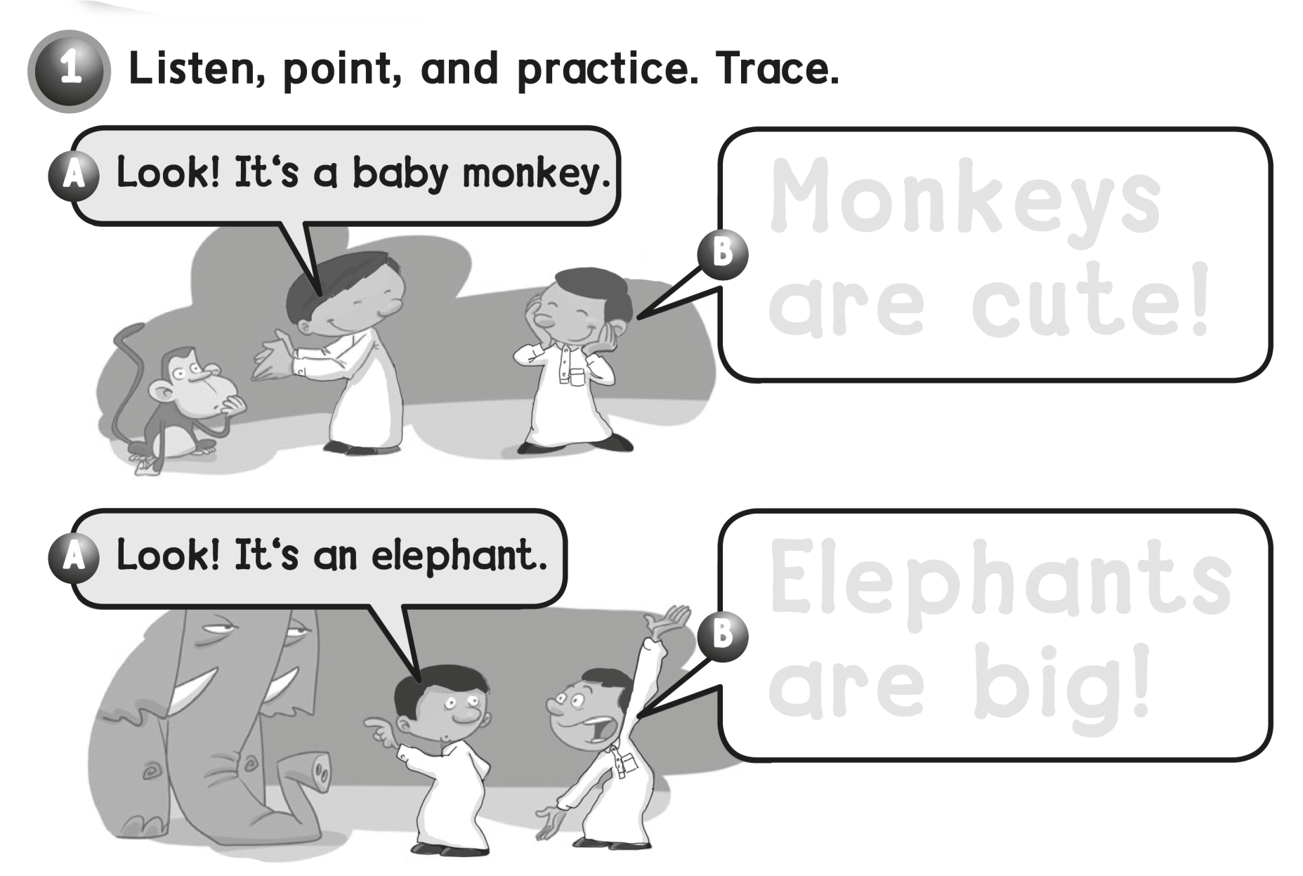
Monkeys
are cute !
Elephants
are big !

Slide 5
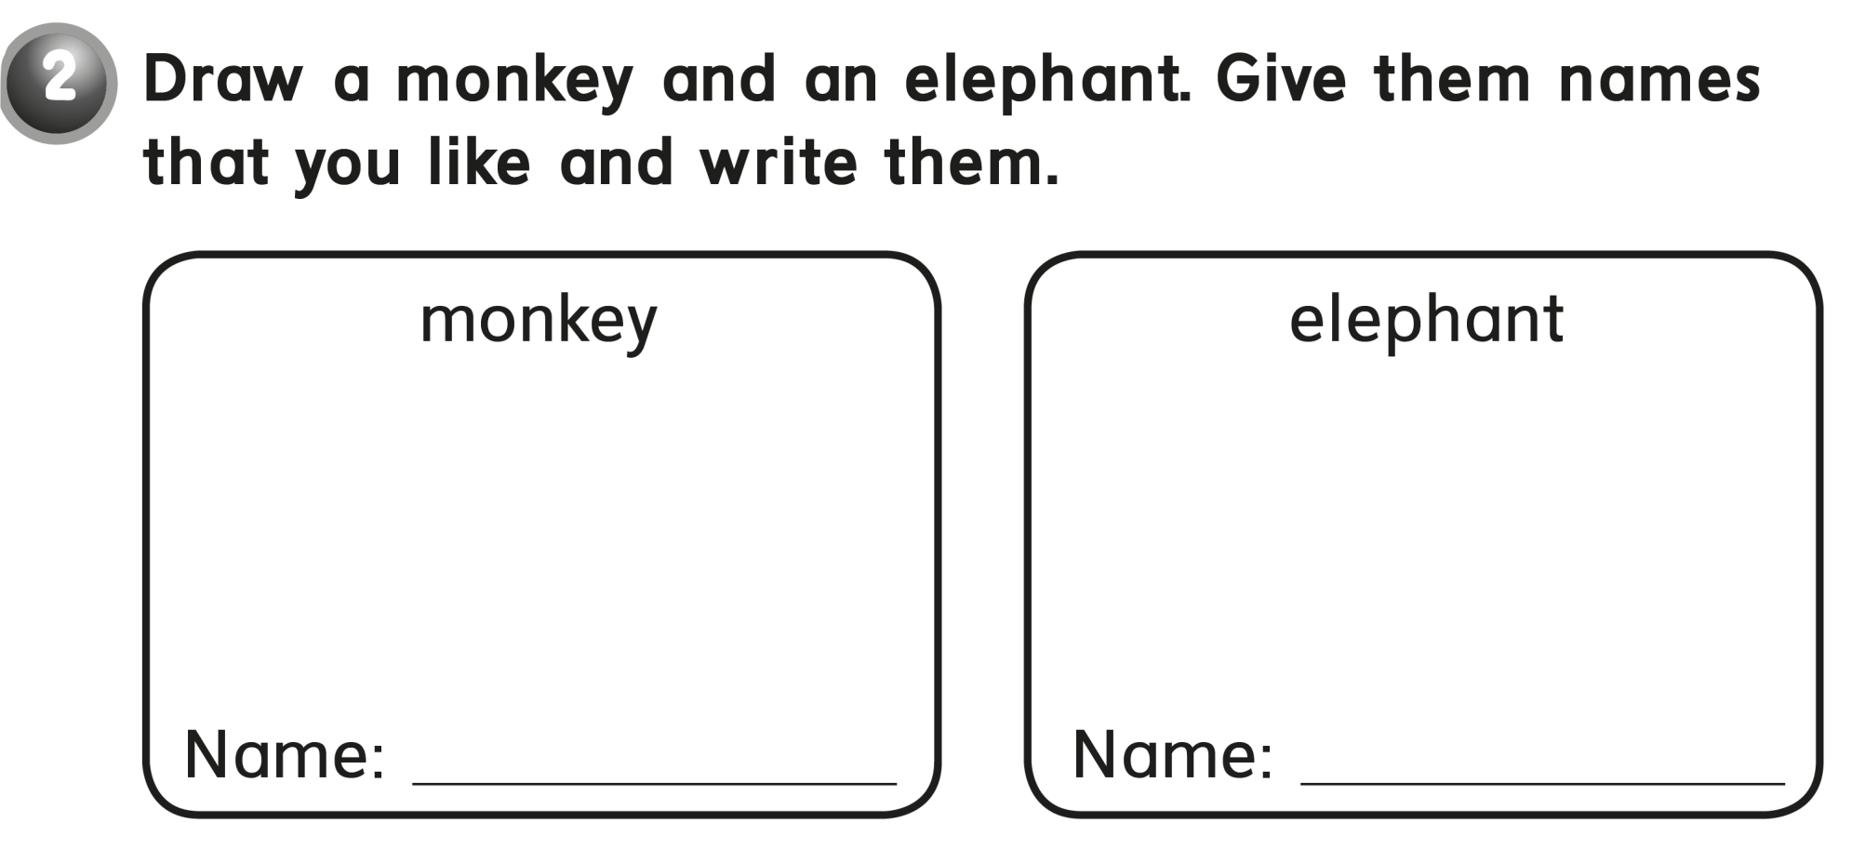
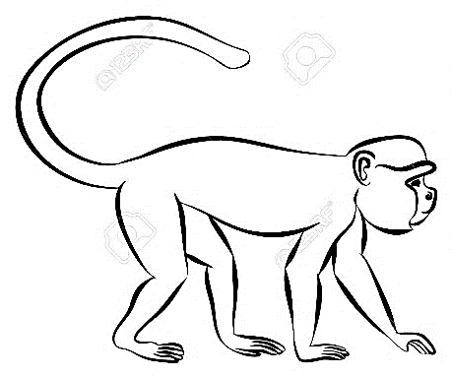
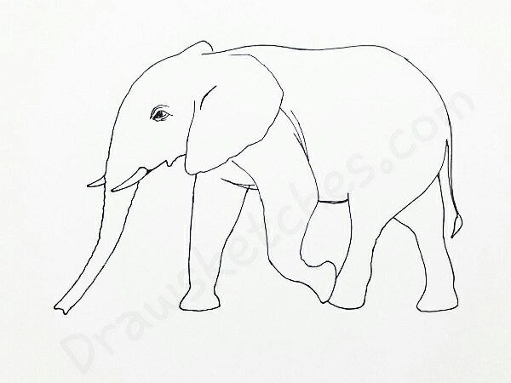
Any Name
Any Name

Slide 6
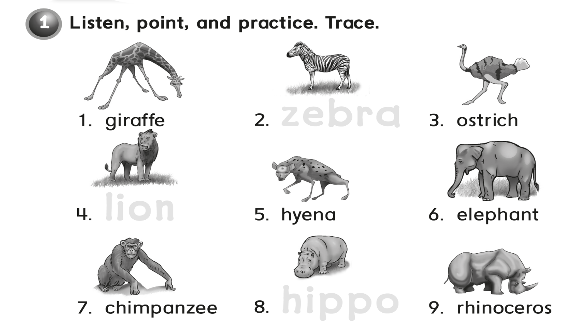
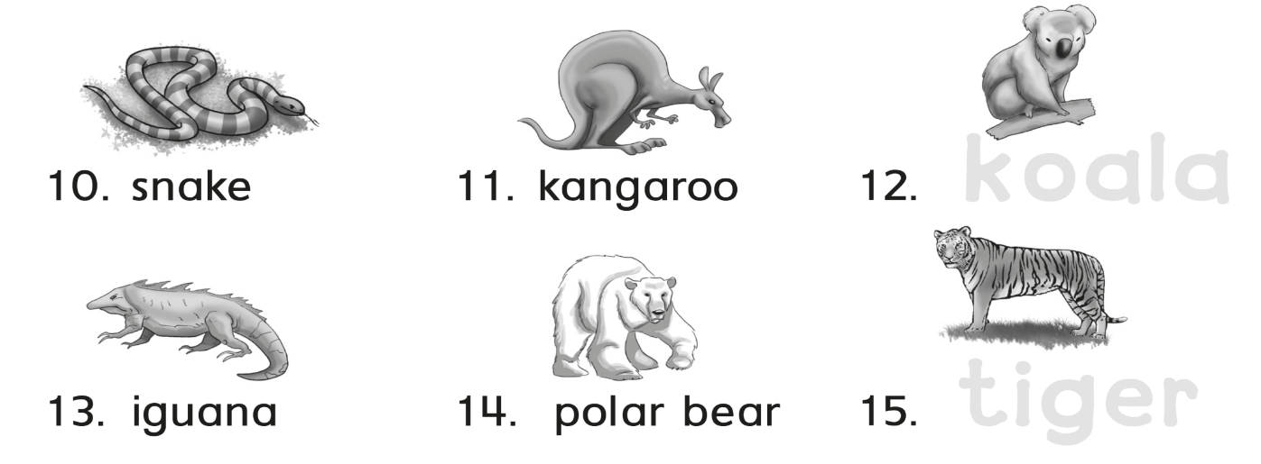
zebra
lion
hippo
koala
tiger

Slide 7
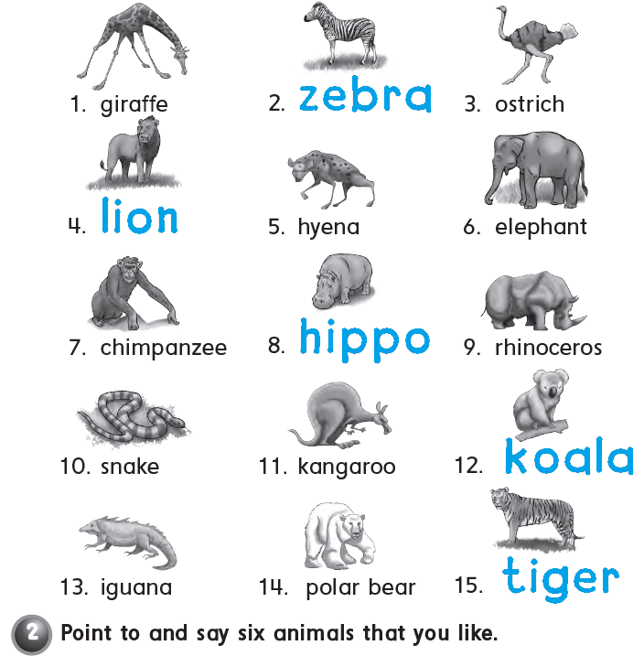

Slide 8
workbook
Pages 69 , 70

Slide 9
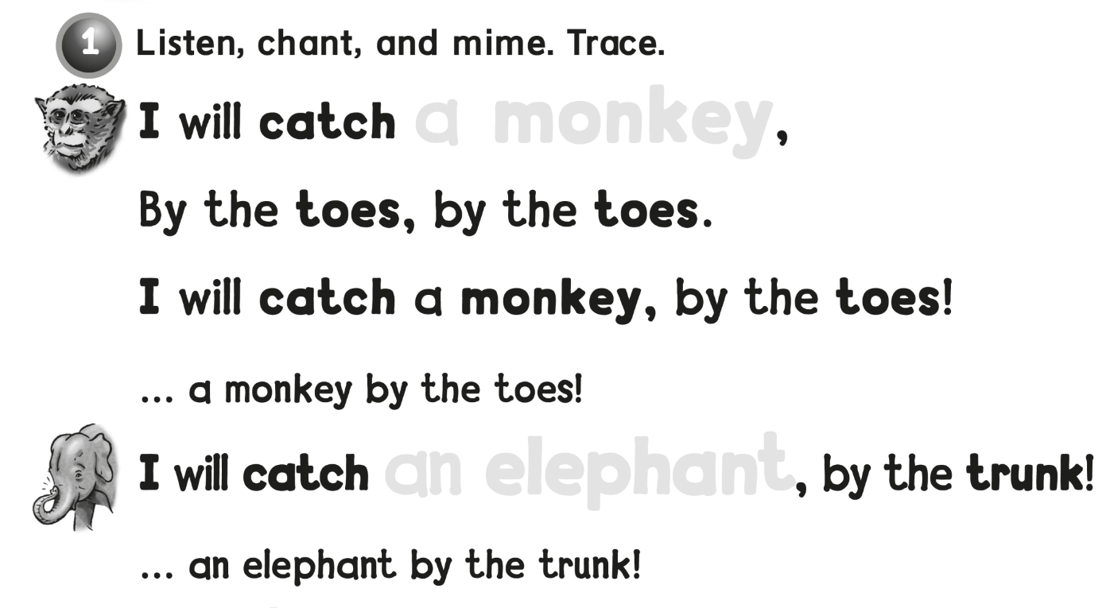
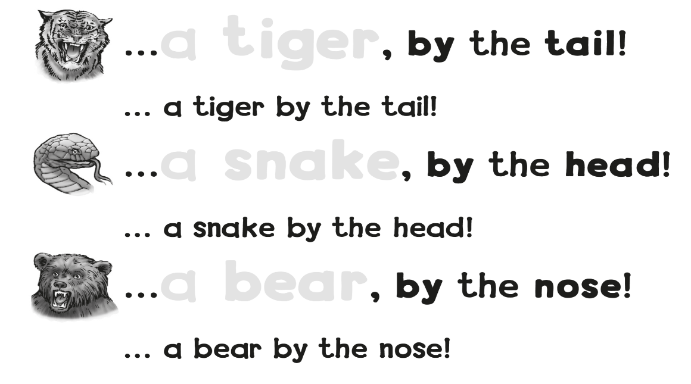
a monkey
an elephant
a tiger
a snake
a bear

Slide 10
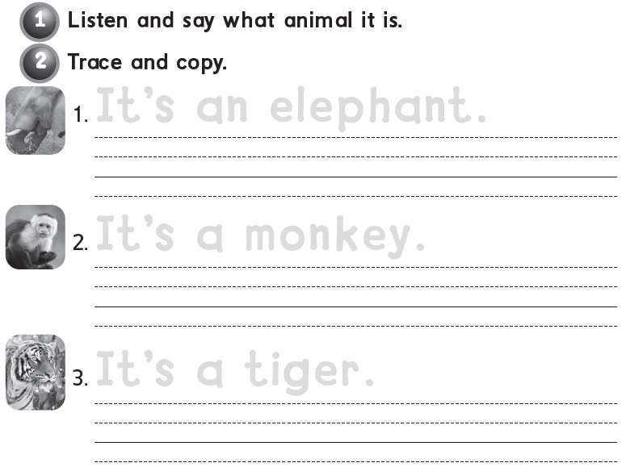
It’s an elephant .
It’s an elephant .
It’s a monkey .
It’s a monkey .
It’s a tiger .
It’s a tiger .

Slide 11
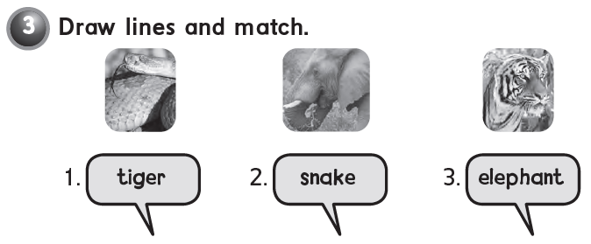

Slide 12
workbook
Pages 71 , 72

Slide 13
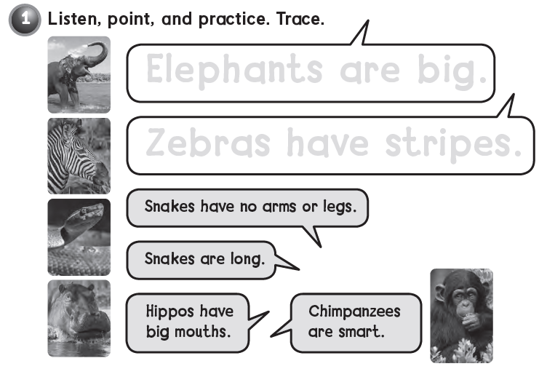
Elephants are big .
Zebras have stripes .

Slide 14
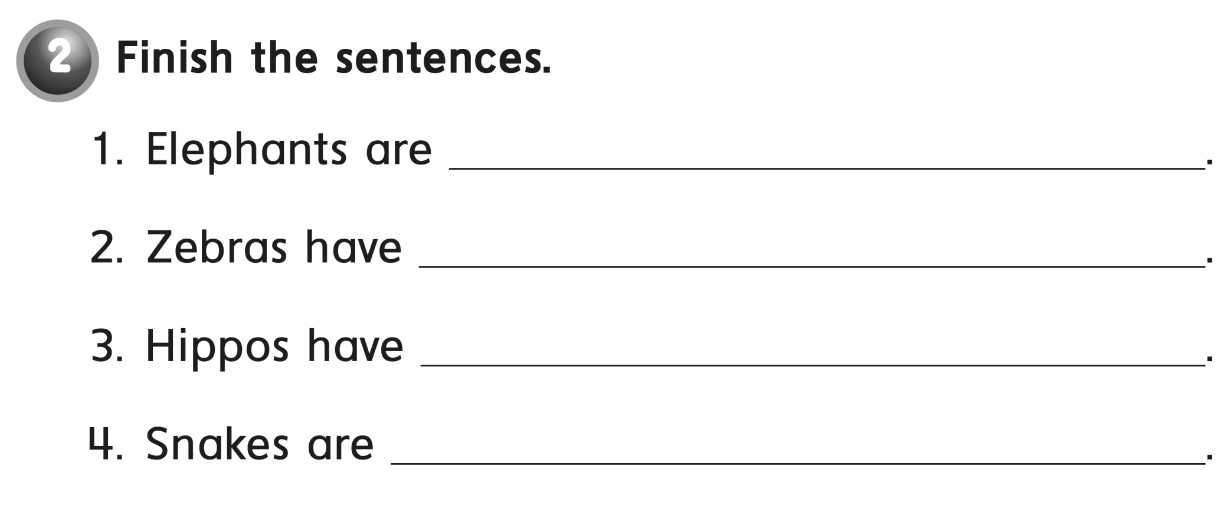
big .
stripes .
big mouths .
long .

Slide 15
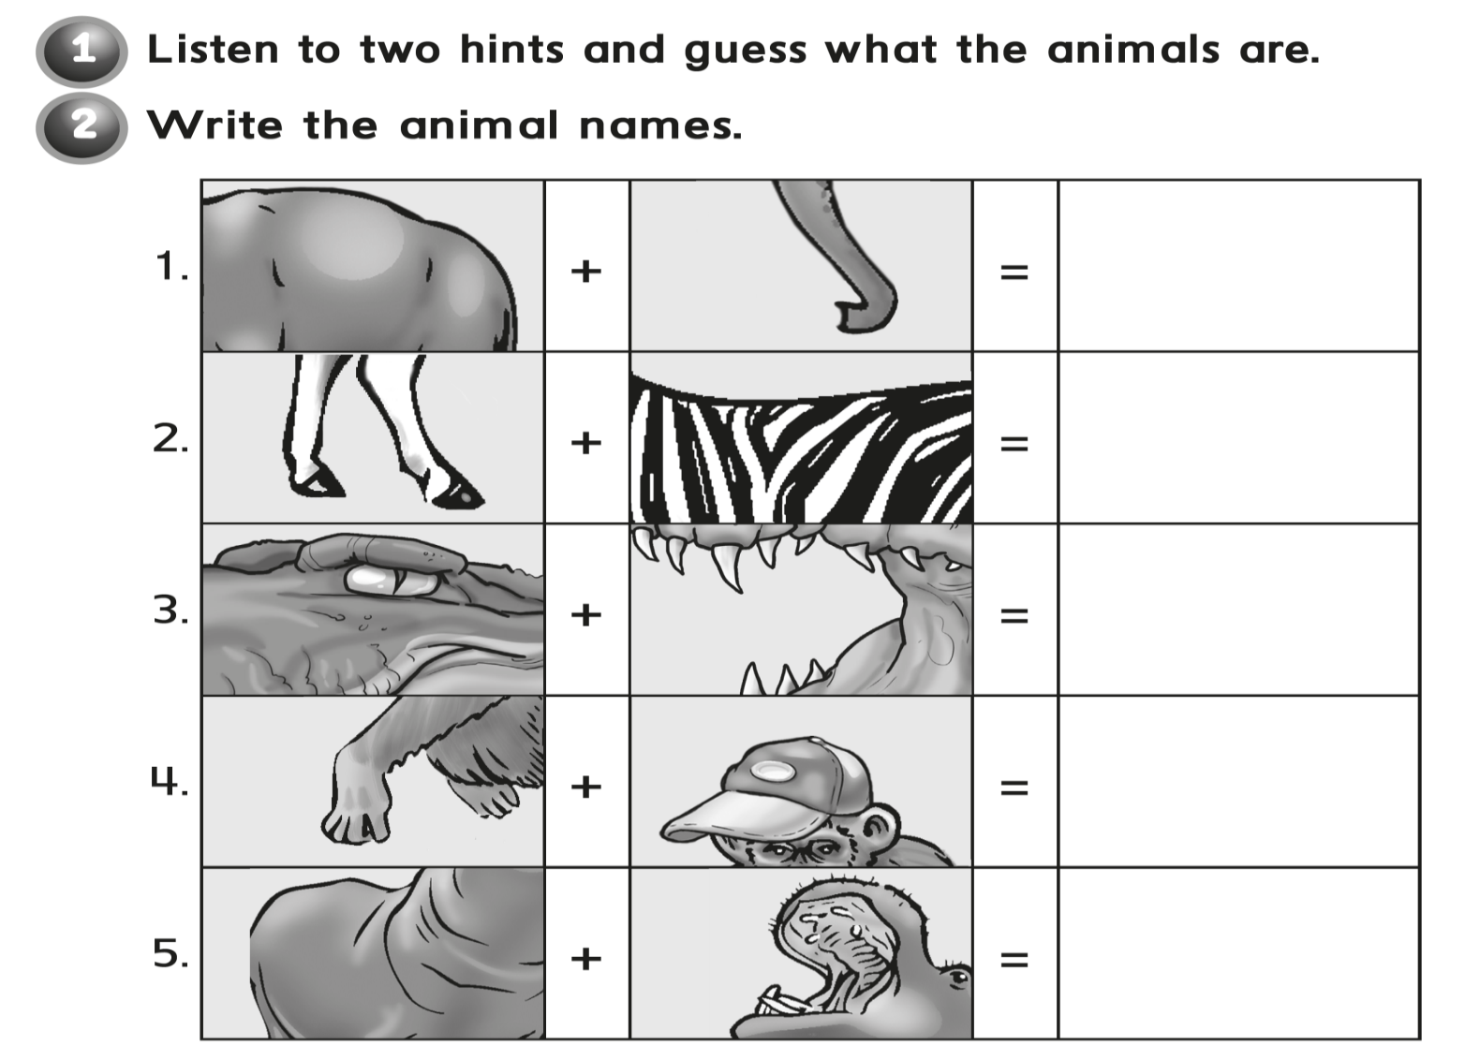
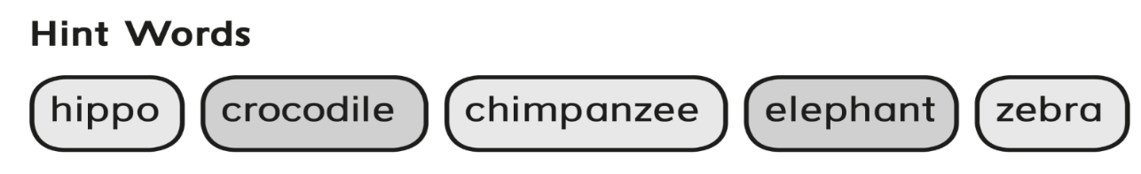
elephant
zebra
crocodile
Chimpanzee
hippo

Slide 16
workbook
Pages 73 , 74

Slide 17
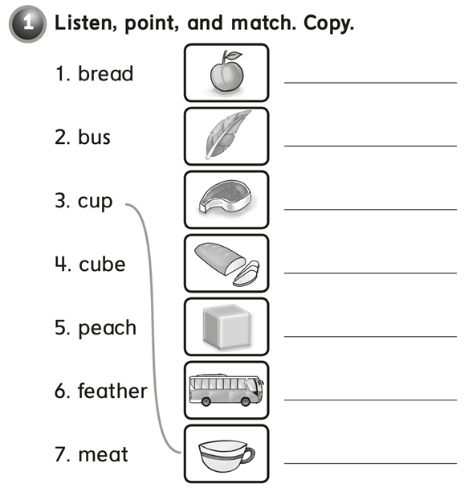
peach
feather
meat
bread
cube
bus
cup

Slide 18
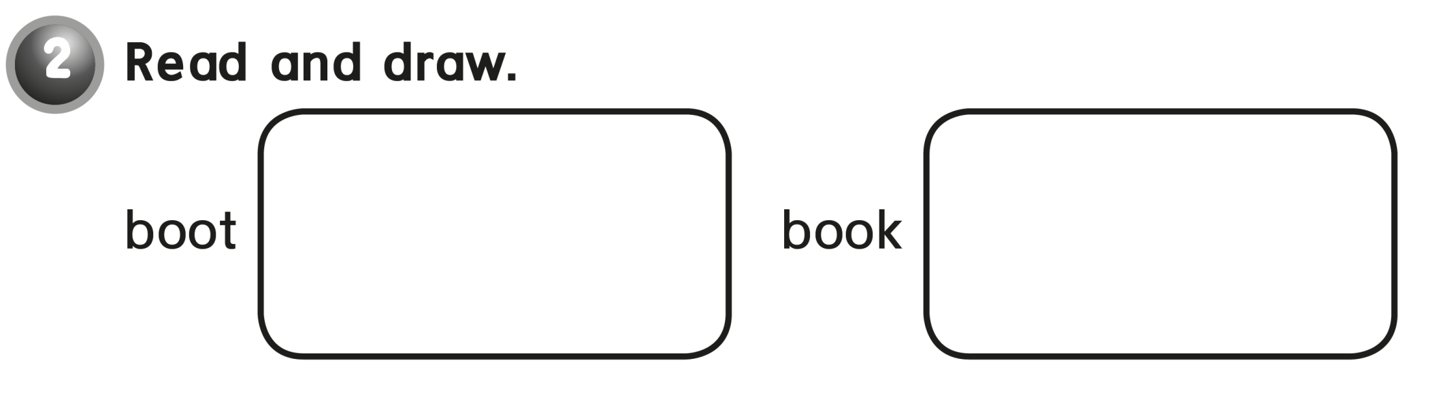
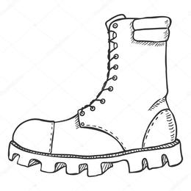


Slide 19
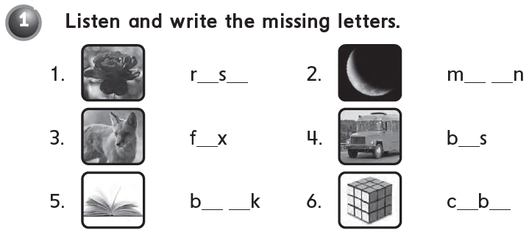
o e
o o
o
u
o o
u e

Slide 20
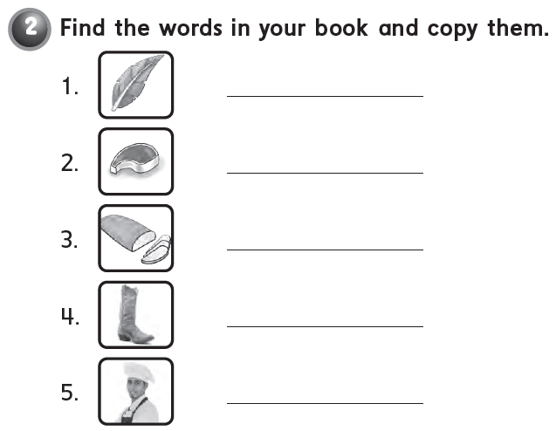
feather
meat
bread
boot
cook

Slide 21


