Slide 1


Welcome to class
T.

Slide 2



Slide 3




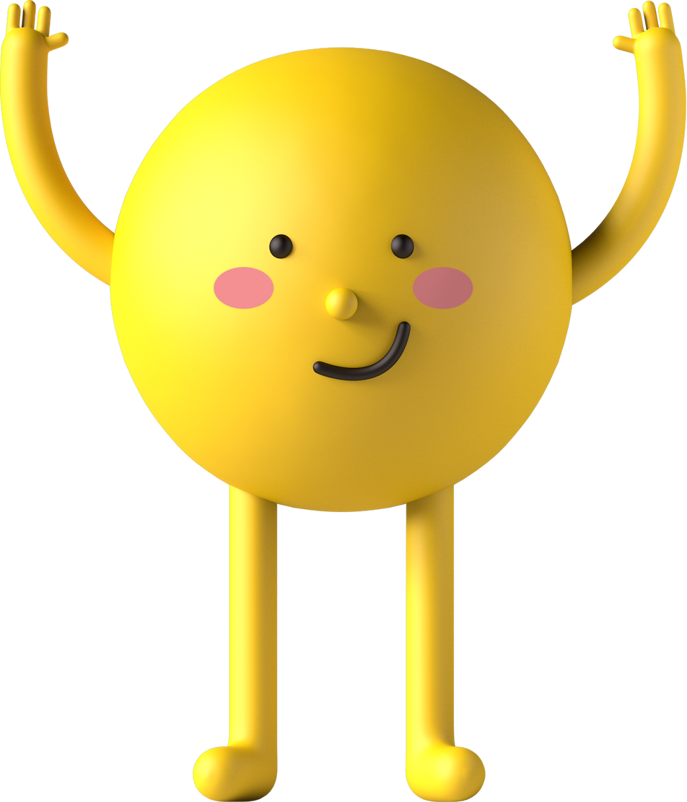
workbook
Pages 59 , 60

Slide 4
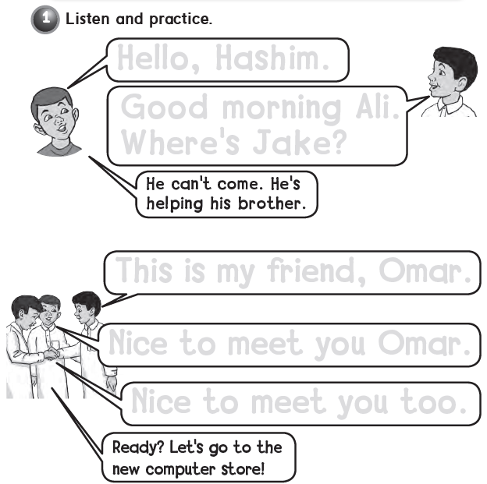
Hello , Hashim
Good morning Ali .
Where’s Jake ?
This is my friend Omar .
Nice to meet you Omar .
Nice to meet you too .

Slide 5

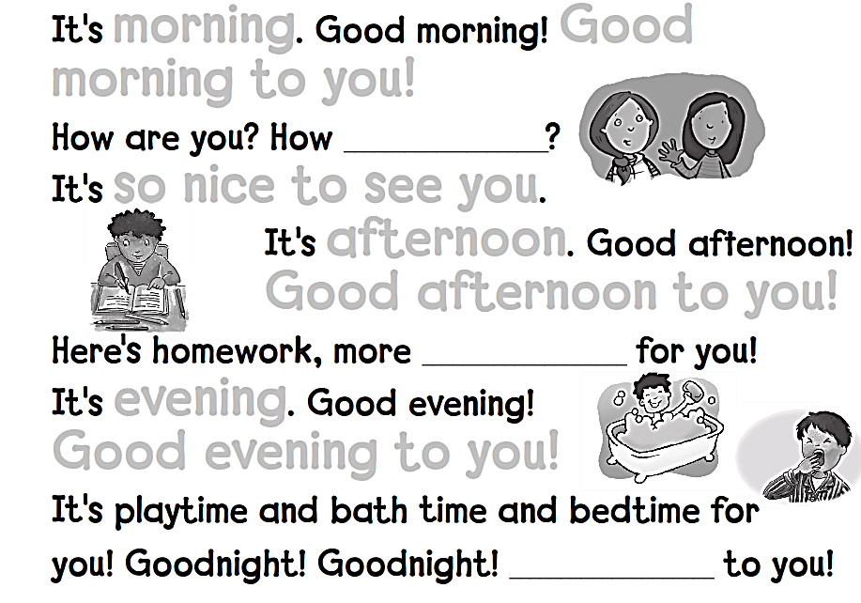
morning Good
morning to you !
are you
so nice to see you
afternoon
Good afternoon to you !
homework
evening
Good evening to you !
Goodnight

Slide 6
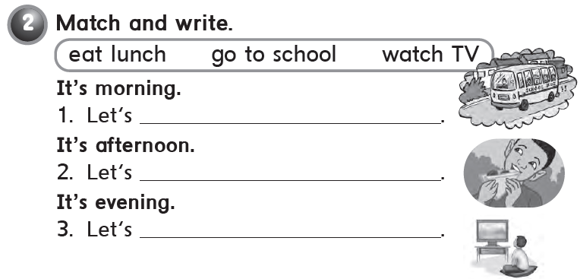
go to school
eat lunch
watch TV

Slide 7
workbook
Pages 61 , 62

Slide 8
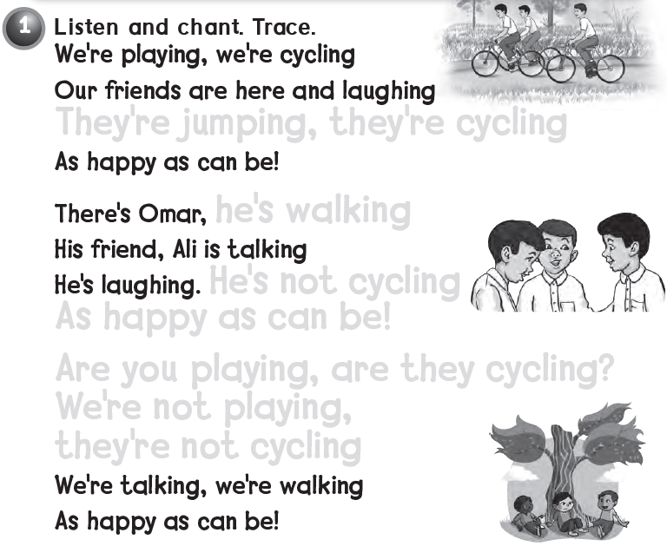
They’re jumping , they’re cycling
he’s walking
He’s not cycling
As happy as can be !
Are you playing , are they cycling ?
We’re not playing ,
they’re not cycling

Slide 9

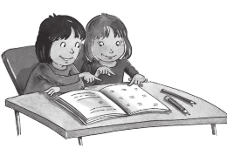
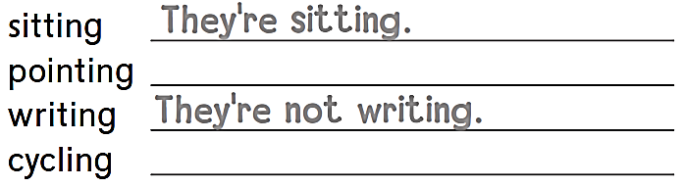
They΄re pointing
They΄re not cycling

Slide 10

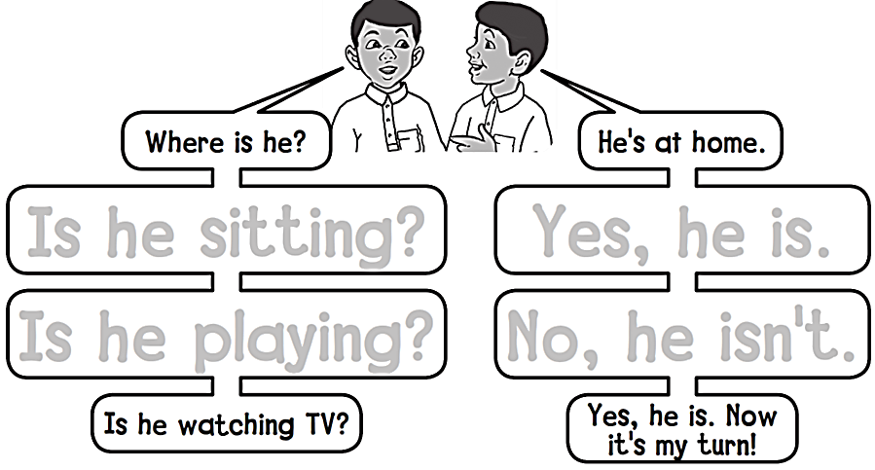
Is he sitting? Yes, he is.
Is he playing? No, he isn’t.

Slide 11

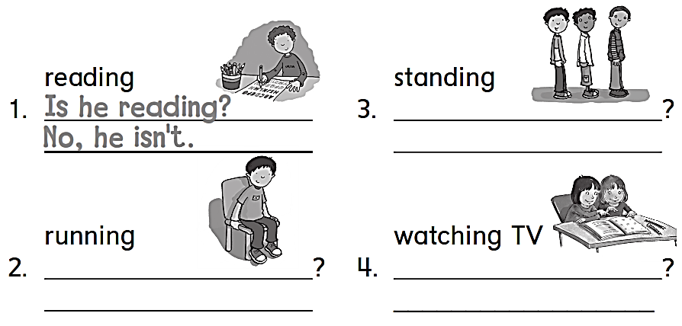
Are they standing
Yes , they are
Is he running
Are they watching TV
No , he isn’t
No , they aren’t

Slide 12
workbook
Pages 63 , 64

Slide 13

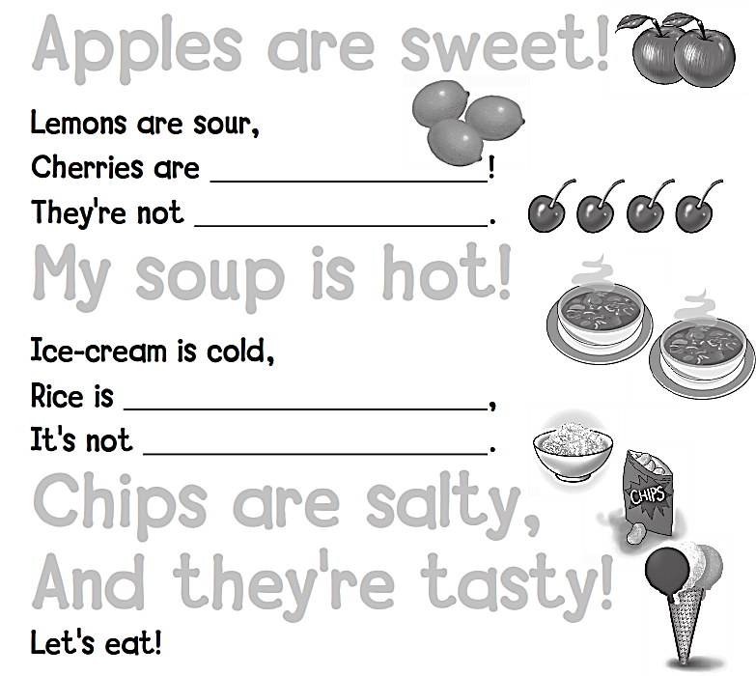
Apples are sweet !
sweet
sour
My soup is hot !
hot
cold
Chips are salty ,
And they’re tasty !

Slide 14
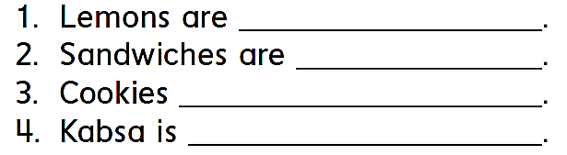
sour
tasty
are sweet
hot

Slide 15

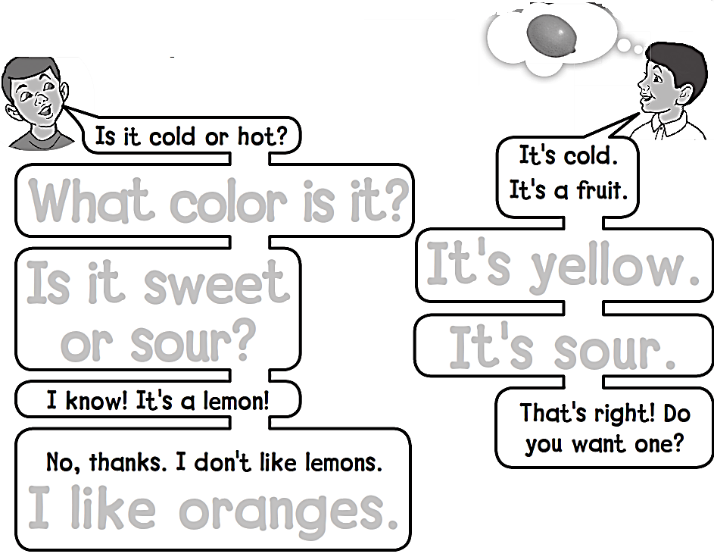
What color is it ?
Is it sweet
or sour ?
It’s yellow .
It’s sour .
I like oranges .

Slide 16
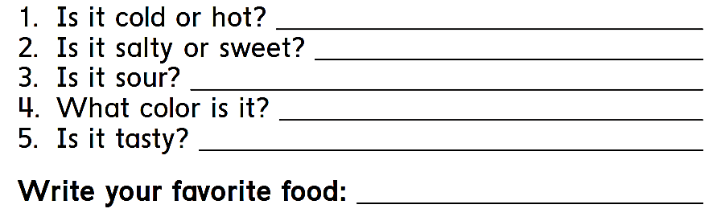
It is hot
It is salty
No , it isn’t
It is white and brown
Yes , it is
Kabsa

Slide 17
workbook
Pages 65 , 66

Slide 18

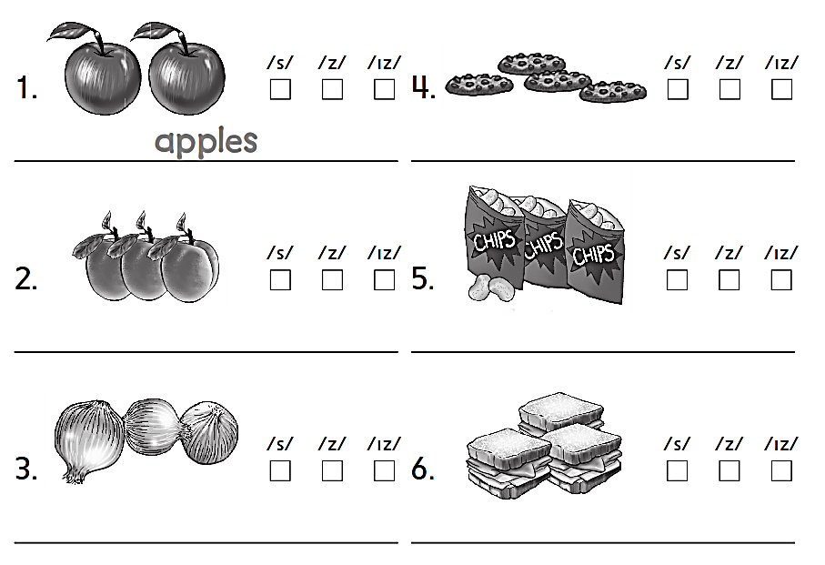

Cookies
Apricots
Chips
Onions
Sandwiches

Slide 19

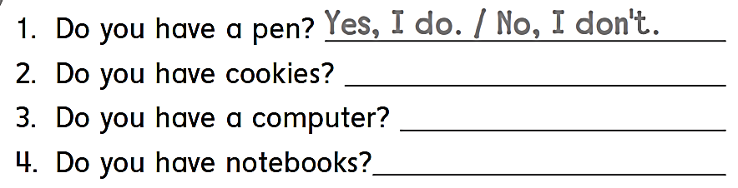
No , I don΄t
Yes , I do .
Yes , I do .

Slide 20

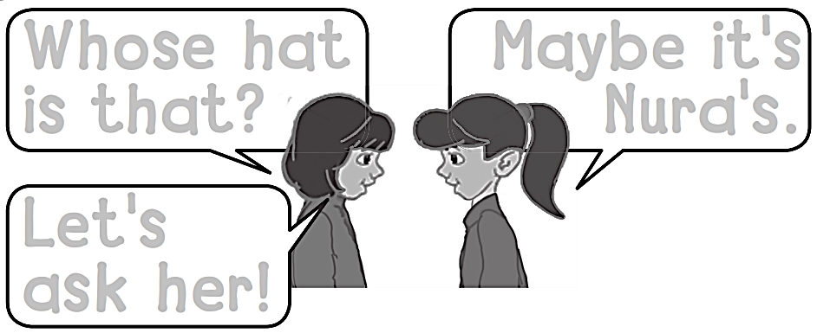
Whose hat
is that ?
Maybe it’s
Nora's.
Let’s
ask her !

Slide 21

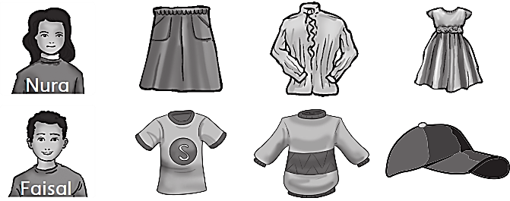
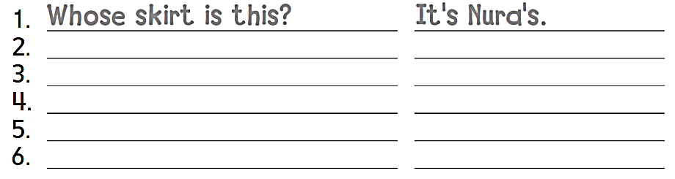
Whose blouse is this ?
It΄s nura΄s
Whose dress is this ?
It΄s nura΄s
Whose t-shirt is this ?
It΄s faisal΄s
Whose sweater is this ?
It΄s faisal΄s
Whose cap is this ?
It΄s faisal΄s

Slide 22


