Slide 1


Welcome to class
T.

Slide 2

1
Unit 2

Slide 3




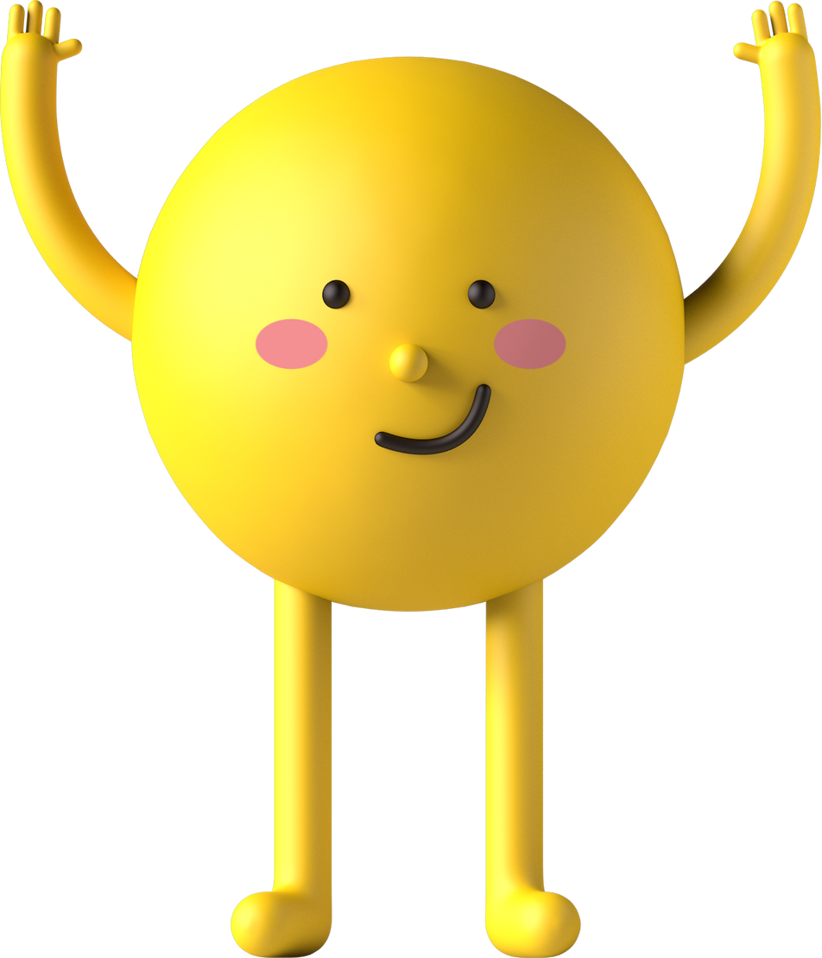
workbook
Pages 57 , 58

Slide 4

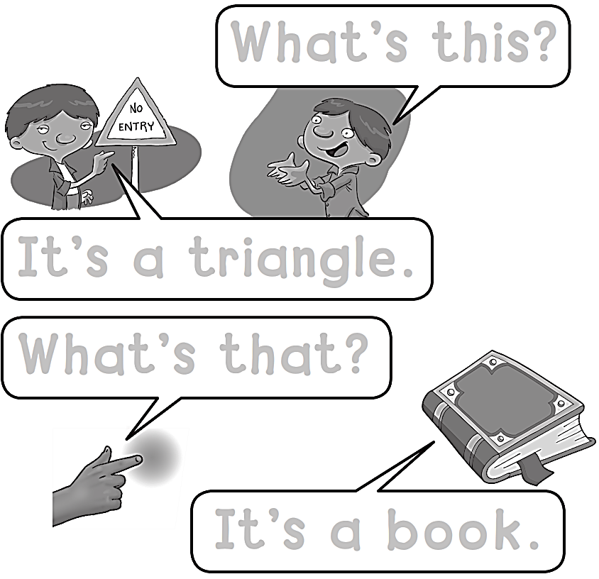
What’s this ?
It’s a triangle.
What’s that?
It’s a book .

Slide 5

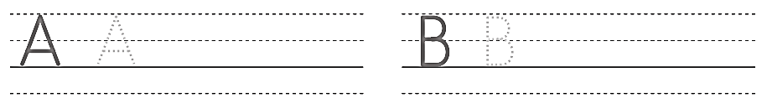
A A A A
B B B B

Slide 6

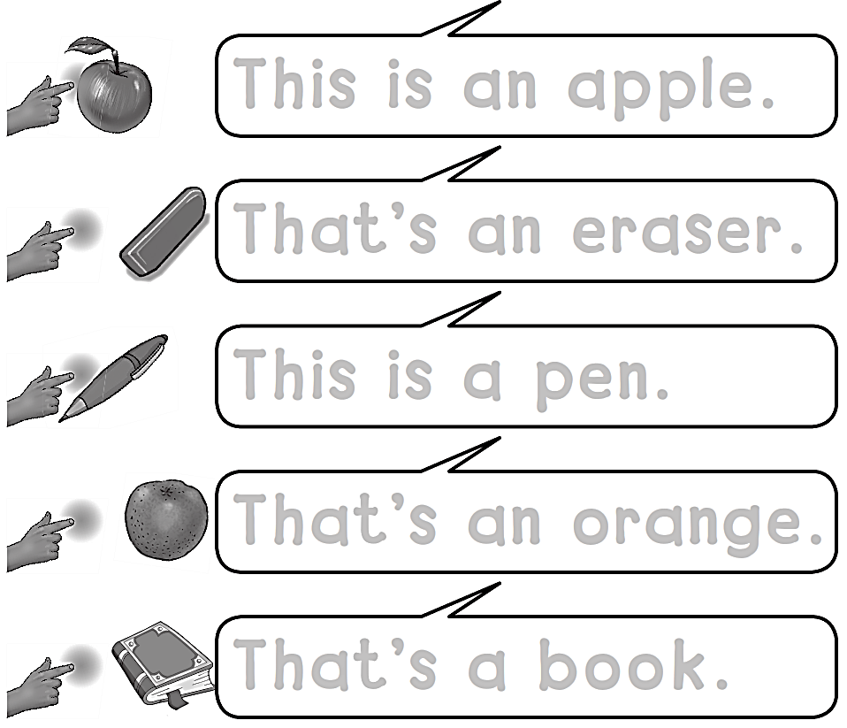
This is an apple .
That’s an eraser .
This is a pen.
That’s an orange .
That’s a book .

Slide 7
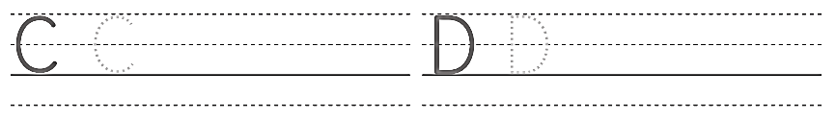
C C C C
D D D D

Slide 8
workbook
Pages 59 , 60

Slide 9

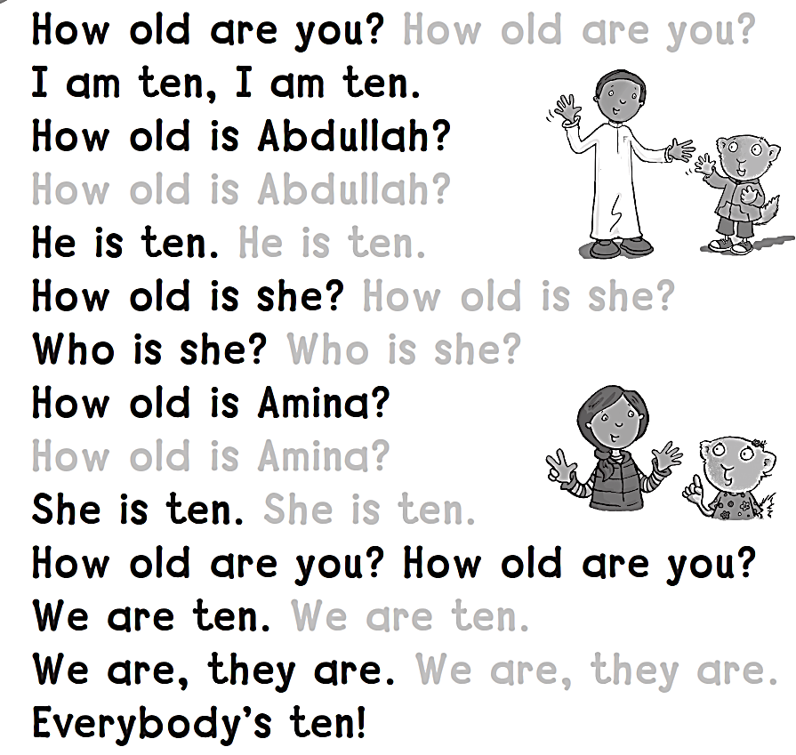
How old are you ?
How old is Abdullah ?
He is ten .
How old is she ?
Who is she ?
How old is Amina ?
She is ten .
We are ten .
We are , they are .

Slide 10
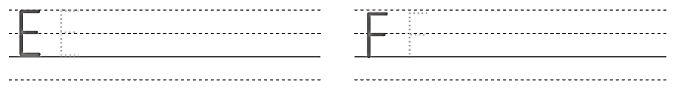
E E E E
F F F F

Slide 11

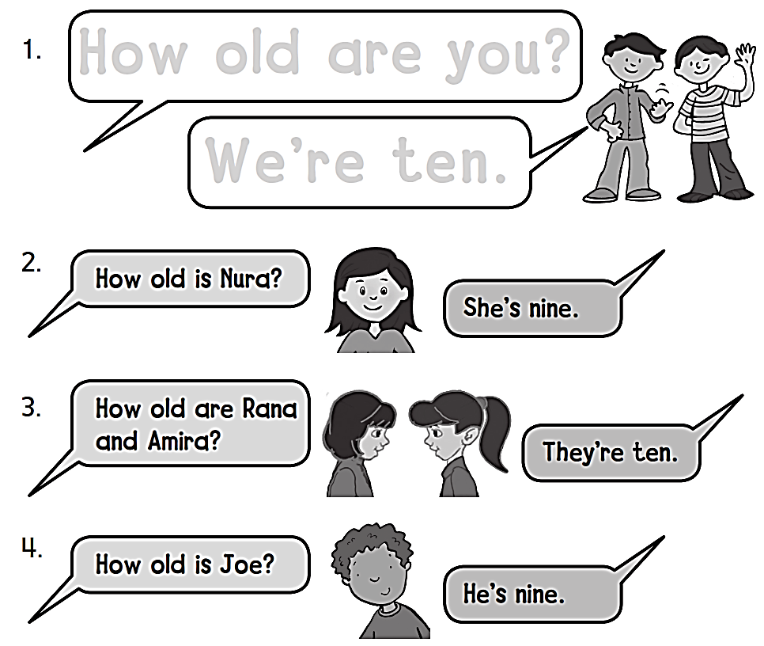
How old are you ?
We’re ten .

Slide 12
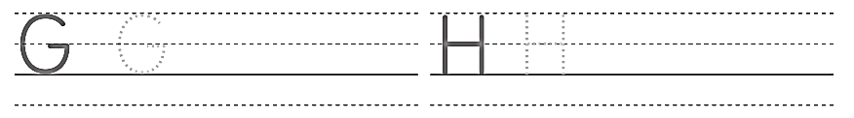
G G G
H H H H

Slide 13
workbook
Pages 61 , 62

Slide 14
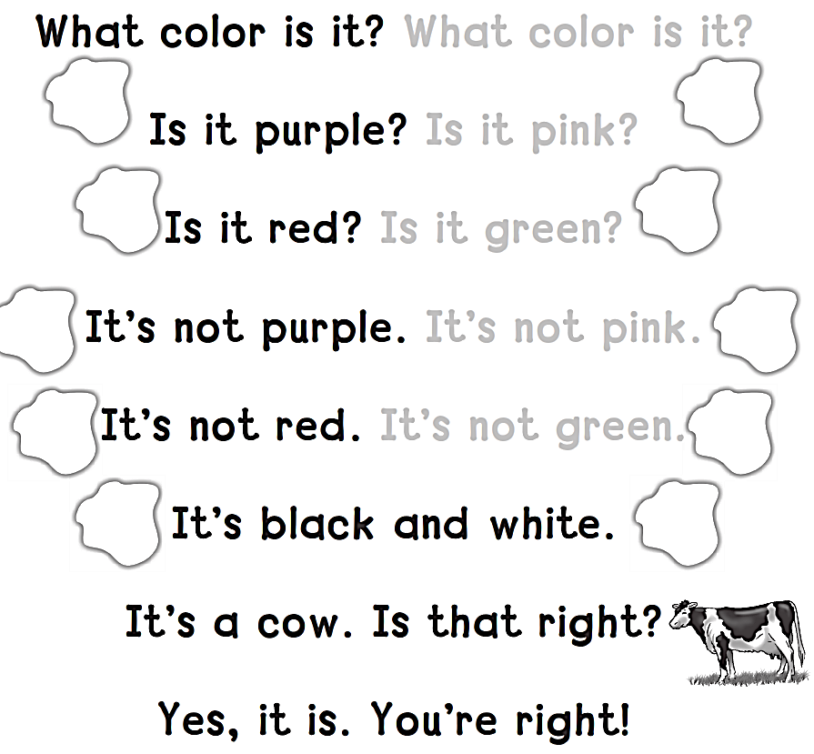
What color is it ?
Is it pink ?
Is it green ?
It’s not pink .
It’s not green .

Slide 15
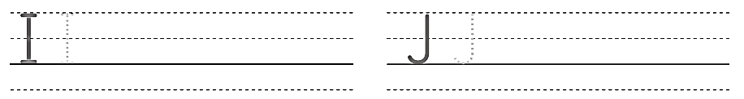
I I I I I
J J J J J

Slide 16

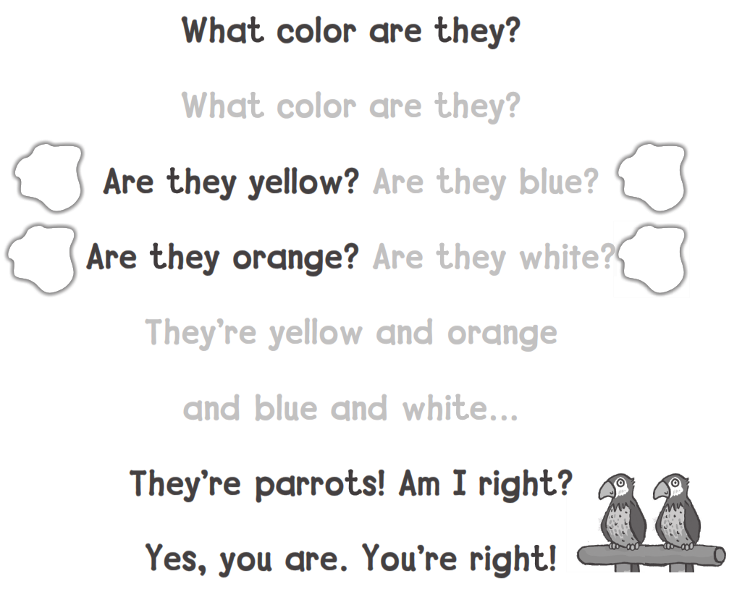
What color are they ?
Are they blue ?
Are they white ?
They’re yellow and orange
and blue and white …

Slide 17
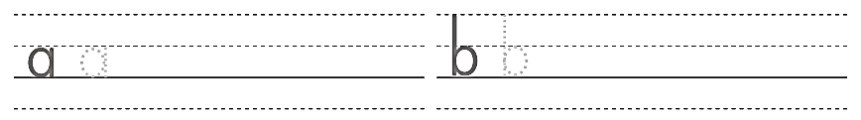
b b b b b
a a a a a

Slide 18
workbook
Pages 63 , 64

Slide 19

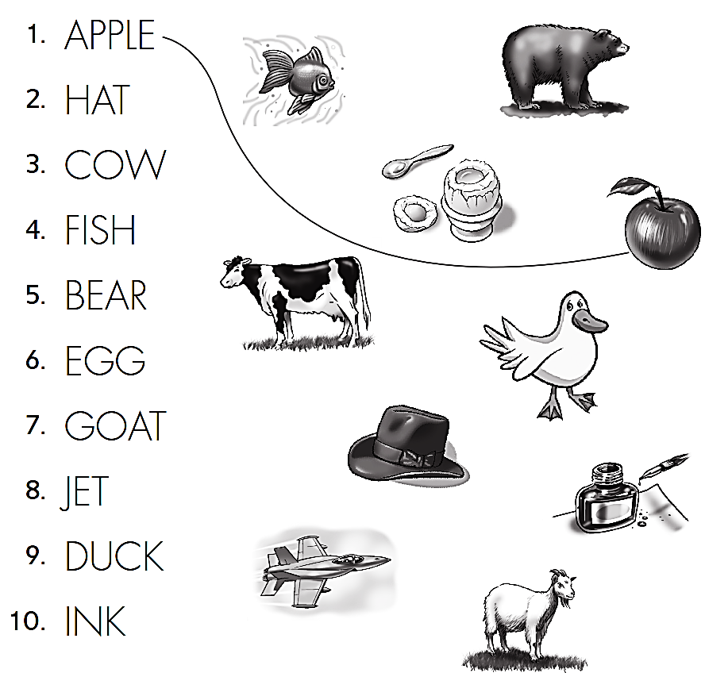

Slide 20
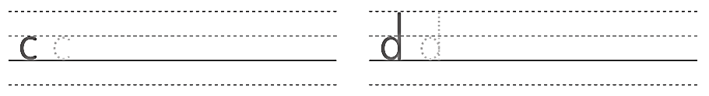
d d d d
c c c c c

Slide 21

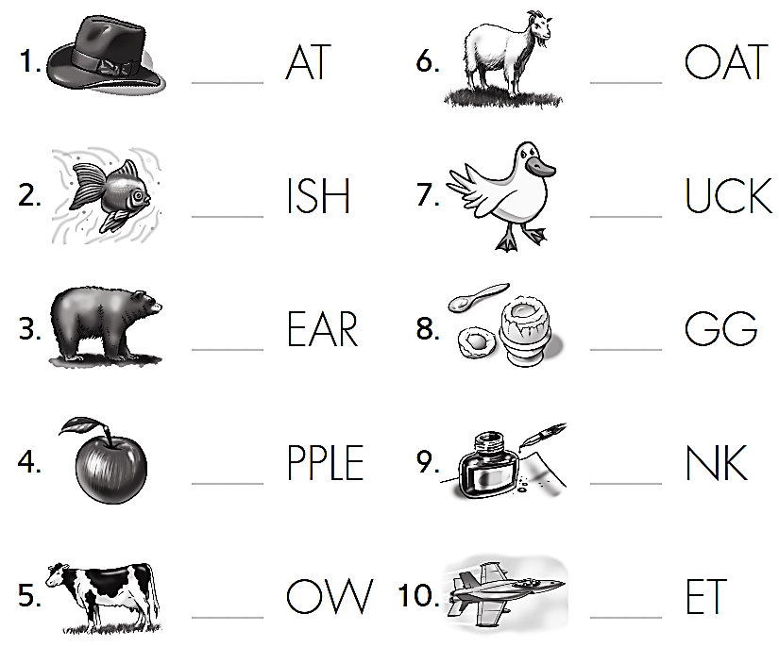
H
G
F
D
B
E
A
I
C
J

Slide 22
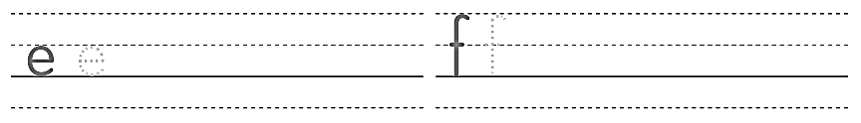
f f f f f f f
e e e e e e

Slide 23


