Slide 1


Slide 2


Slide 3

Unit -1-
Working 9 to 5

Slide 4
1 Listen and Discuss
2 Pair Work

Slide 5

Lesson Objectives
The students will be able to :
1 – Match the job descriptions with the photos .
2 – Match words with their meaning .
3 – Discuss the qualities of a good job .
4 – Name the job according to given clues .
5 – Name the job according to a description.

Slide 6
What do they have in common?
Job
Career
Work
business
Profession

Slide 7
Name some jobs you see

Slide 8
Or
Rewarding
Unsatisfying

Slide 9


Slide 10

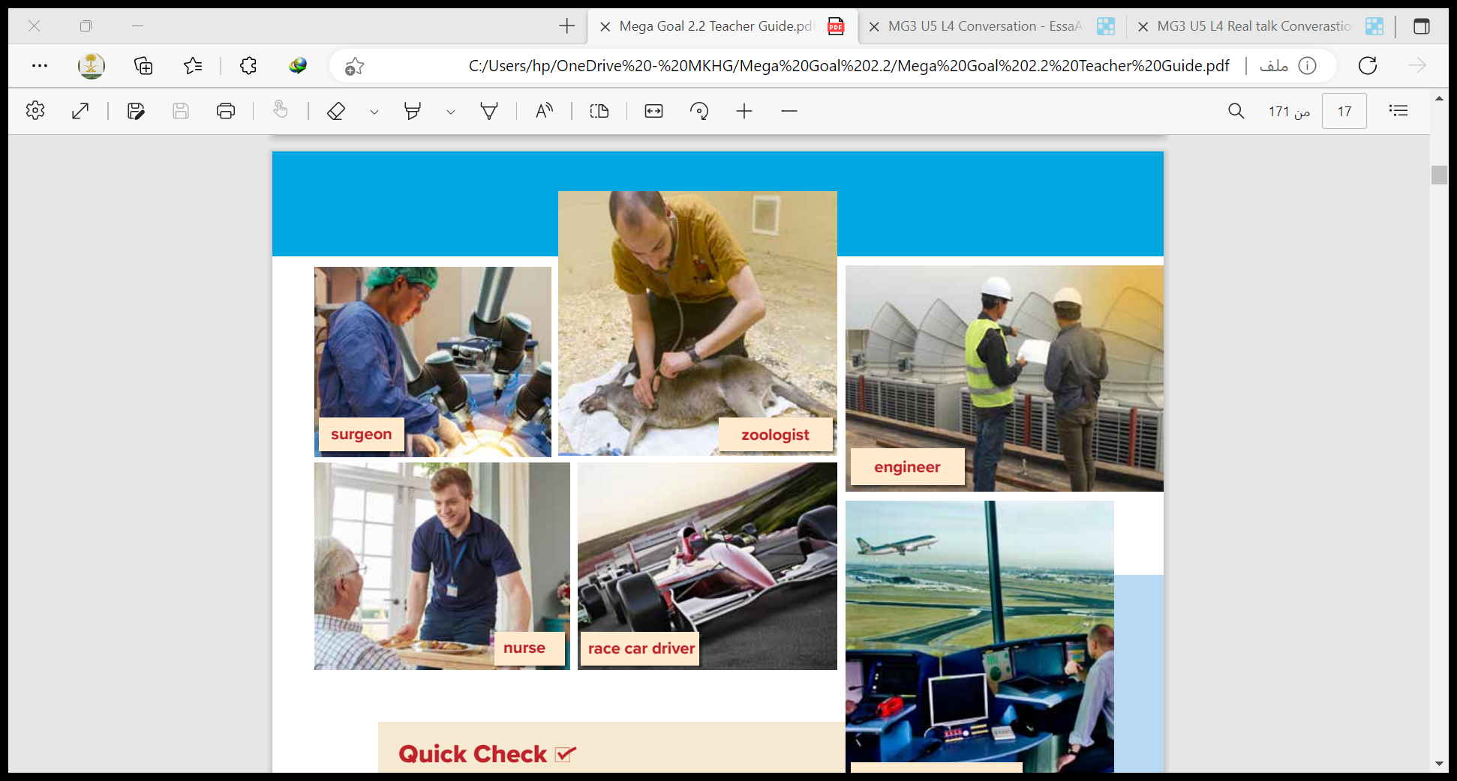
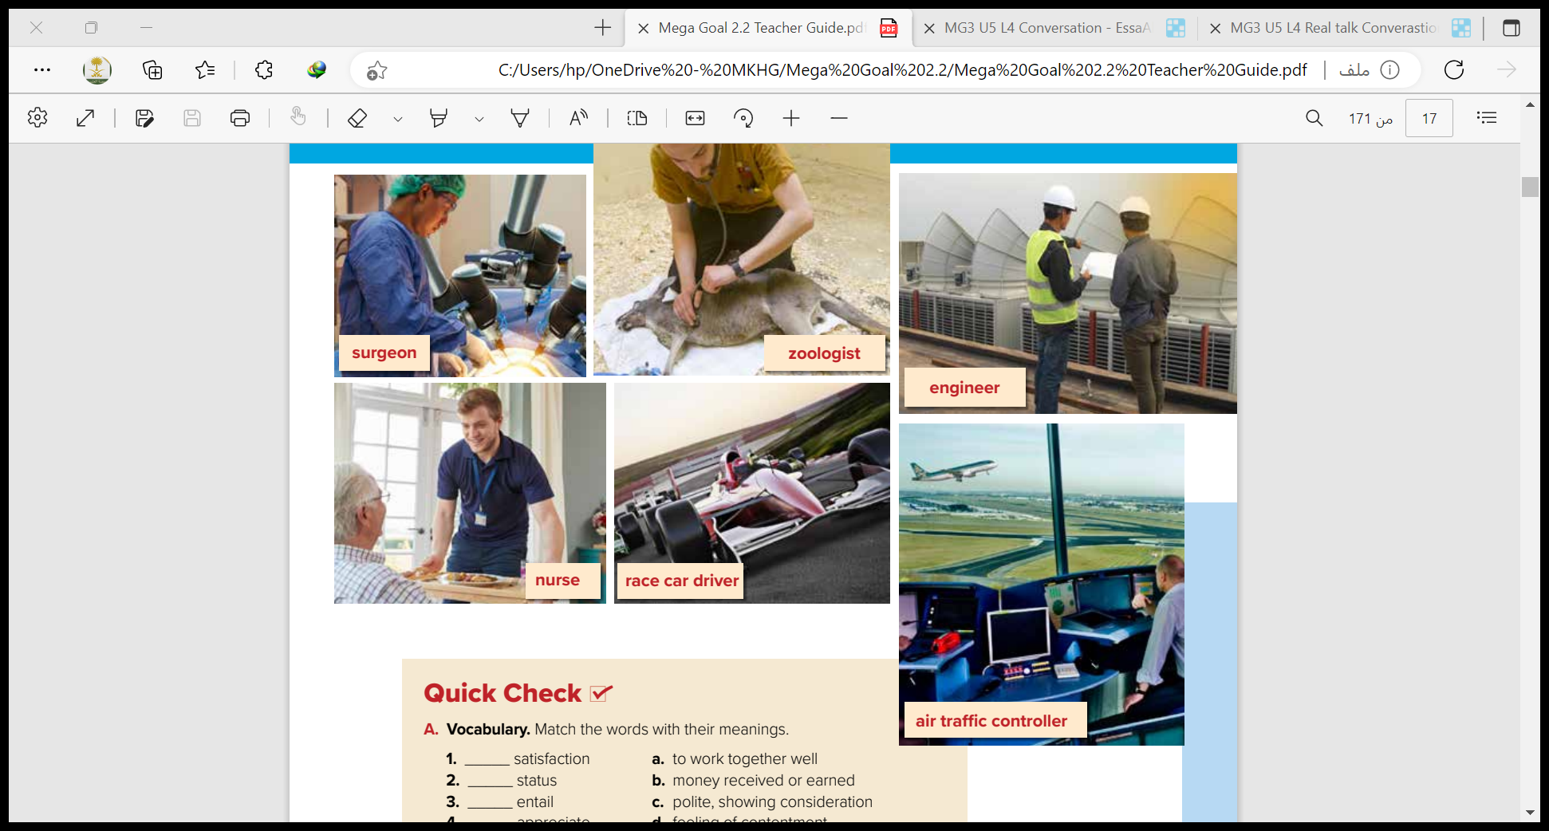


Slide 11
What does each job entail?

Slide 12
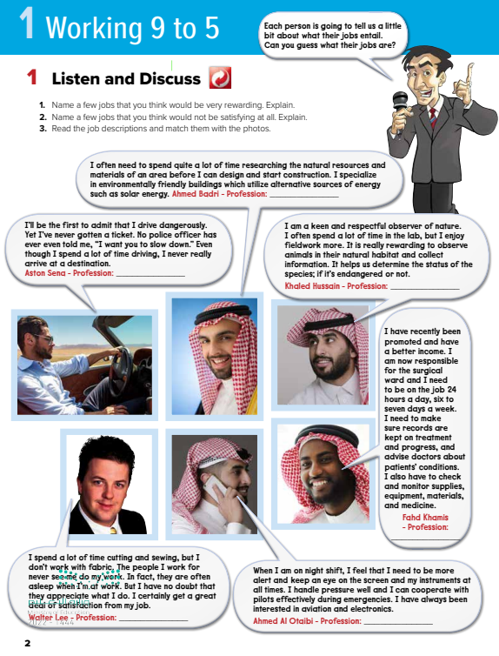

Slide 13
race car driver

Slide 14
engineer

Slide 15
zoologist

Slide 16
surgeon

Slide 17
air traffic controller

Slide 18
nurse

Slide 19
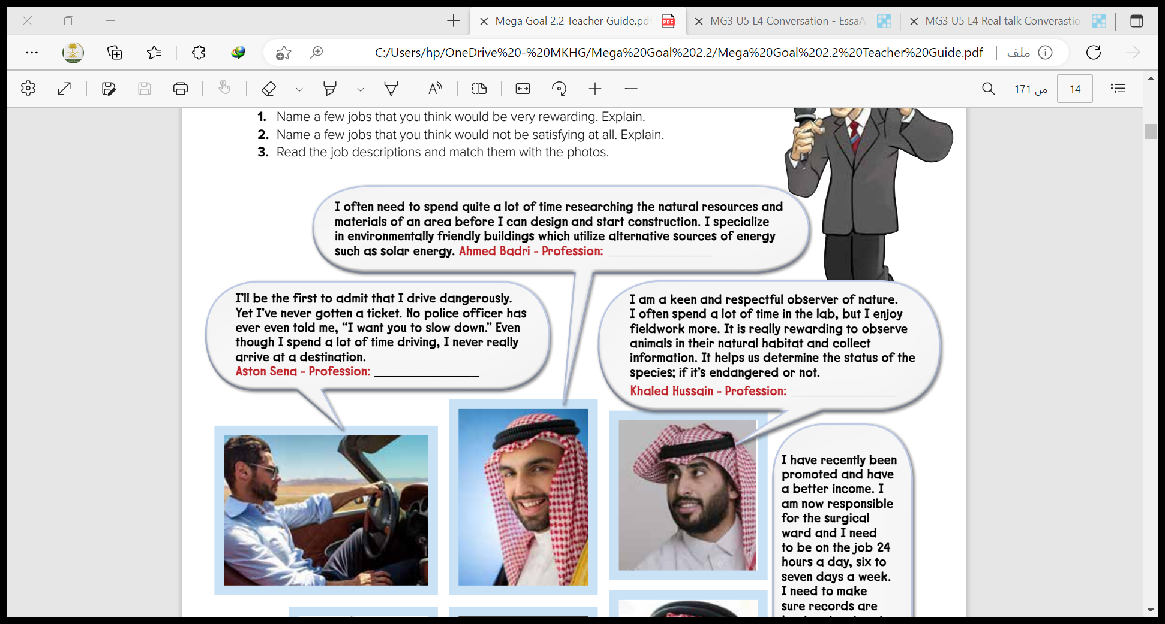
New Words
a person who sees or notices someone or something
the natural environment where an animal or plant lives or grows
the place where a person is going

Slide 20
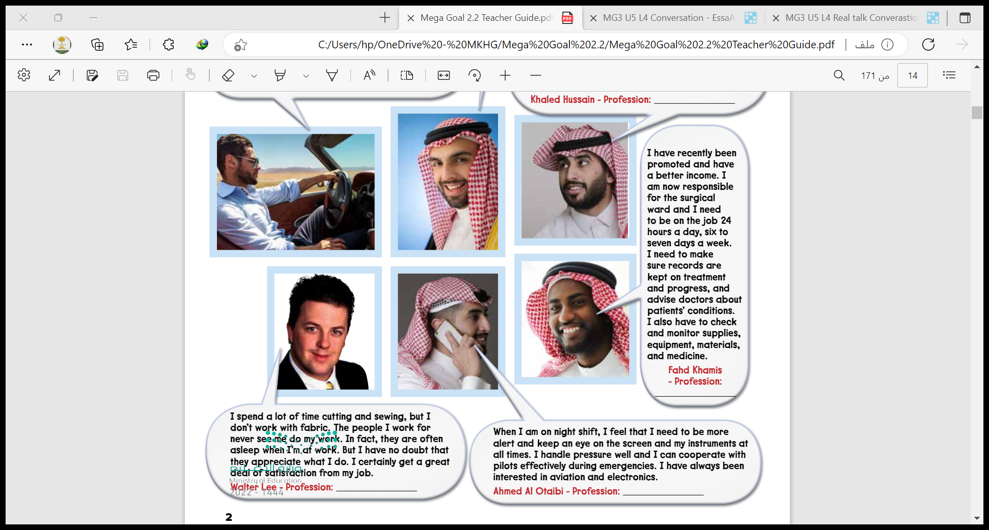
action of putting pieces of fabric together or
fixing clothes with a needle and thread (A surgeon cuts and sews a person’s body.)
cloth; material that most clothes are made of
to carefully watch or check a situation or
something that changes

Slide 21
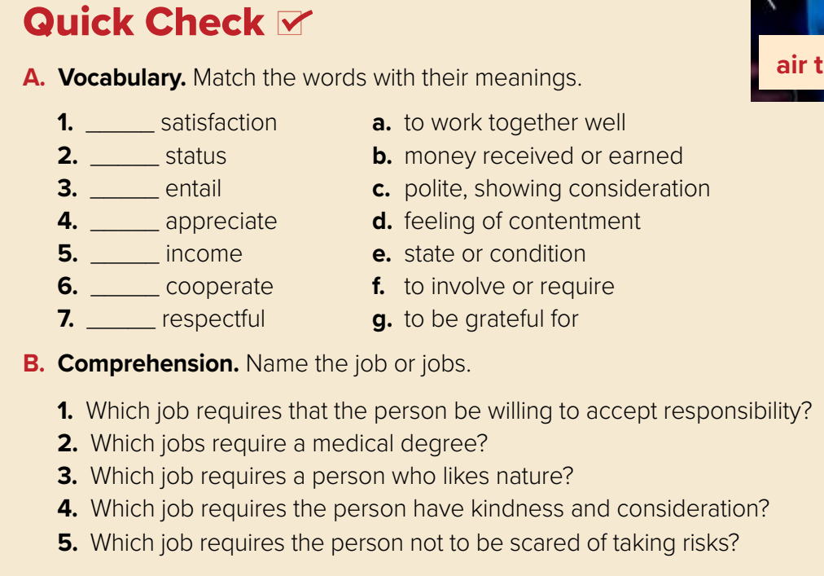
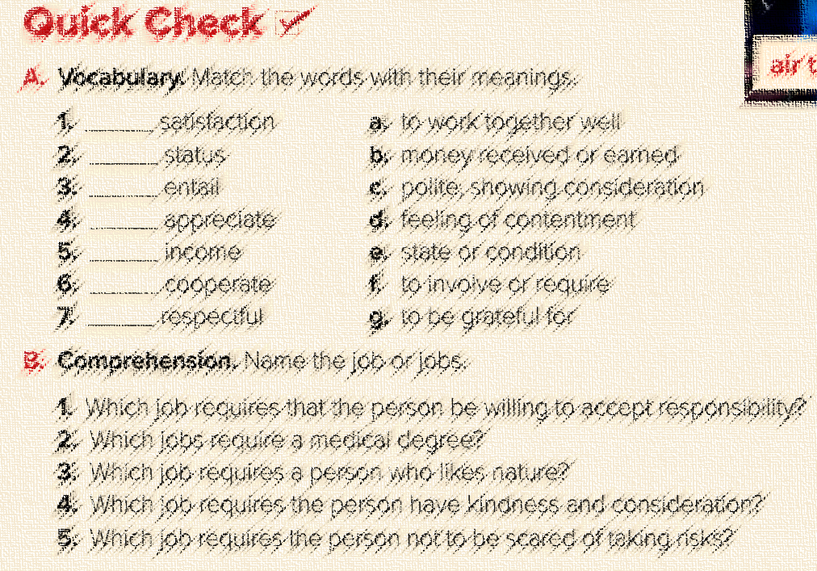
d
e
f
g
b
a
c
1-air traffic controller
2- surgeon
3- zoologist
4-nurse
5-race car driver

Slide 22


