Slide 1

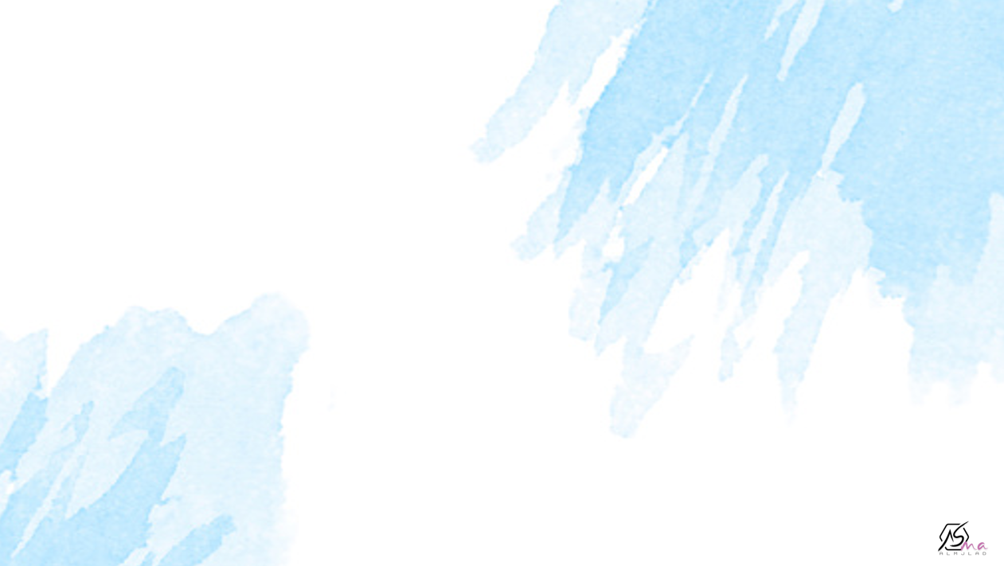
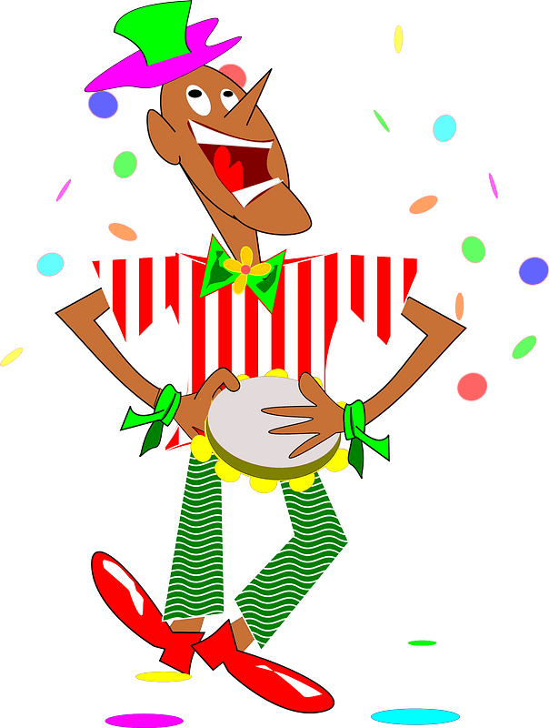

Form meaning and function
By: ET Asma Almjlad

Slide 2
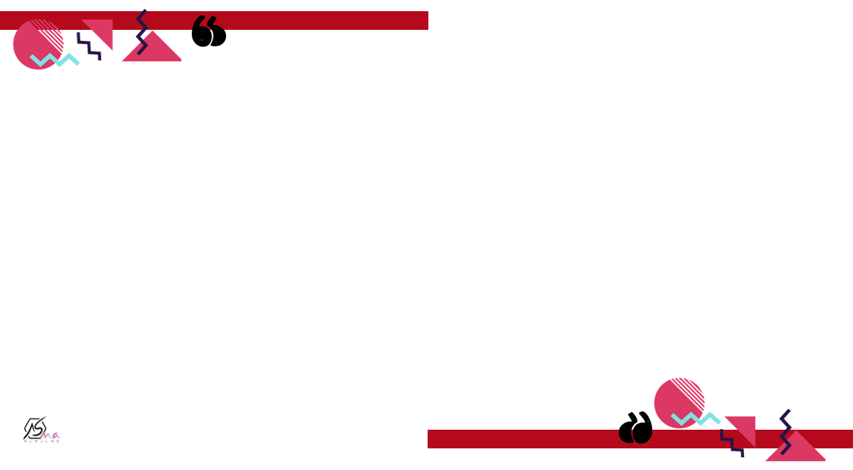

objectives
Express wishes, regret, and criticism.
Use “such…that / so…that" with objectives
Use "can’t, could, couldn’t, must, may, or might" to make suppositions.

Slide 3
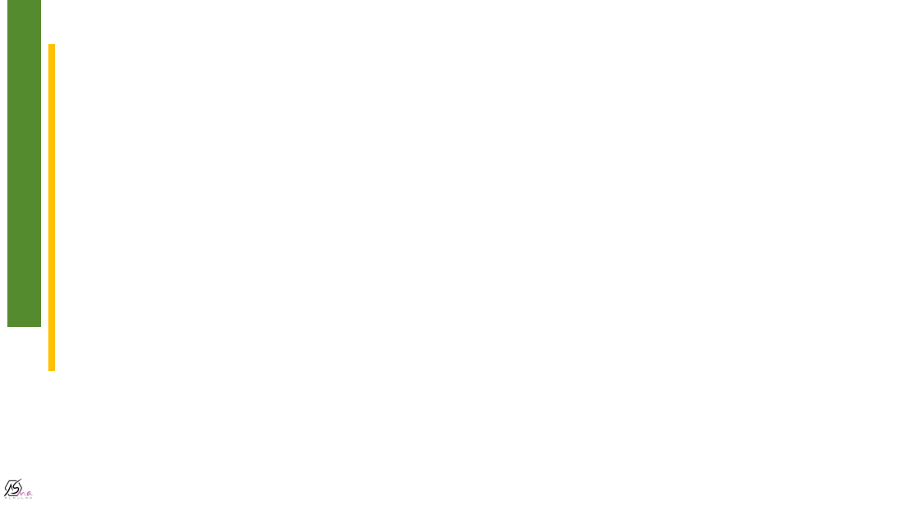
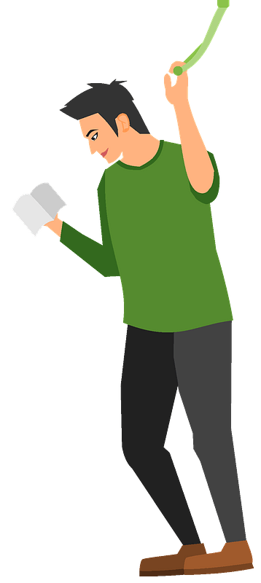
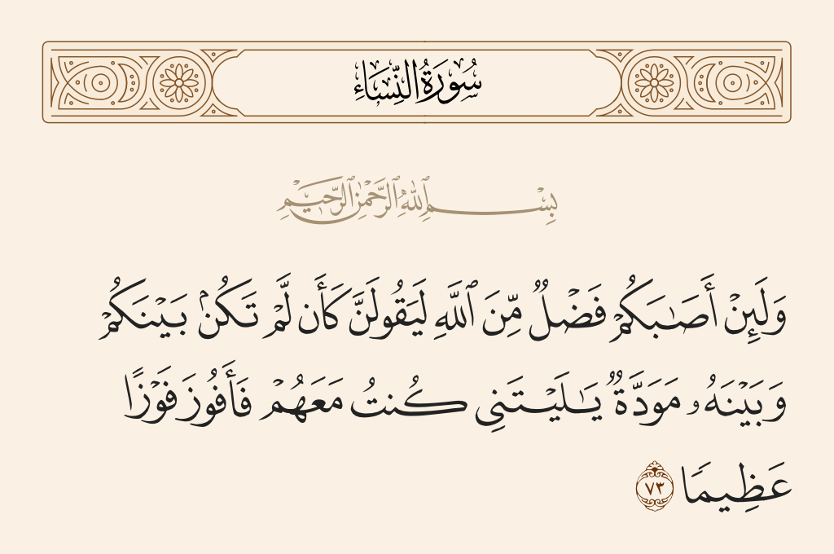

Slide 4
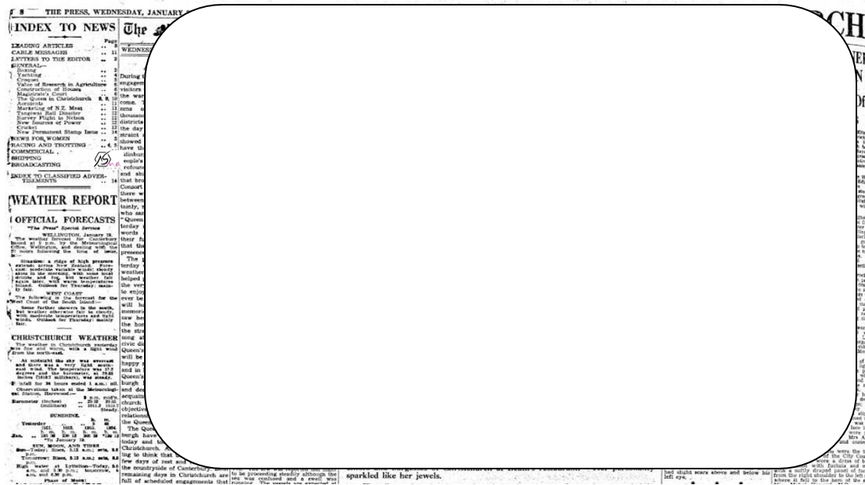
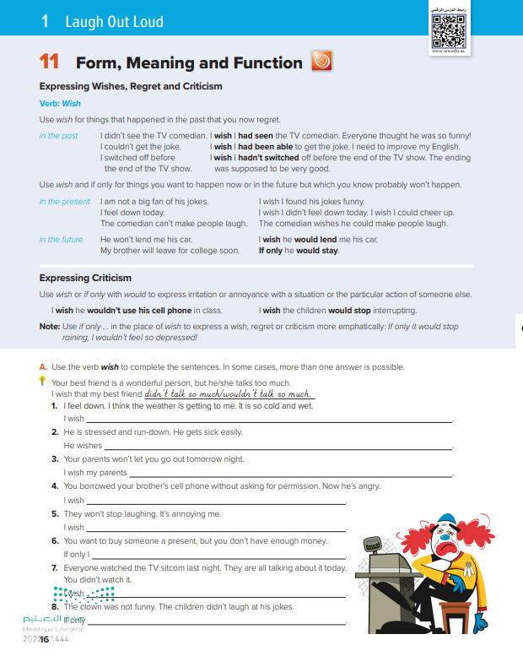
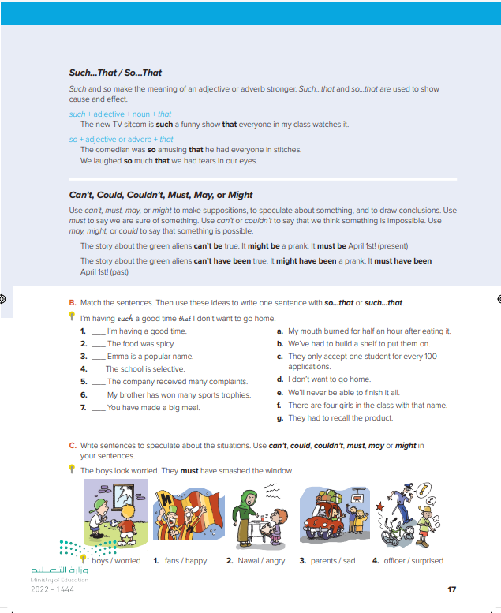


@ page 16+17

Slide 5
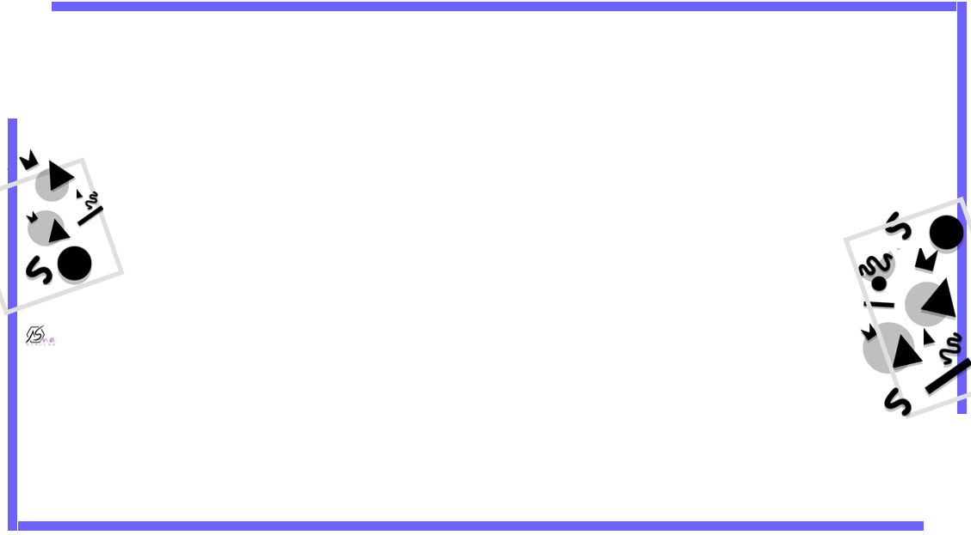

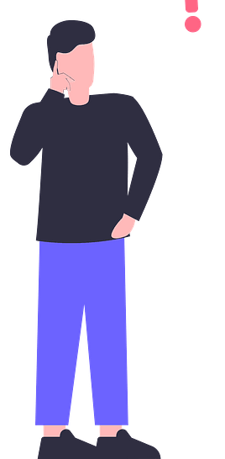
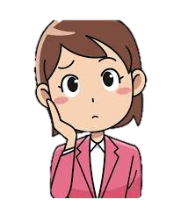
My friends travelled to Jeddah yesterday
Past simple
I wish I had travelled with you

Slide 6
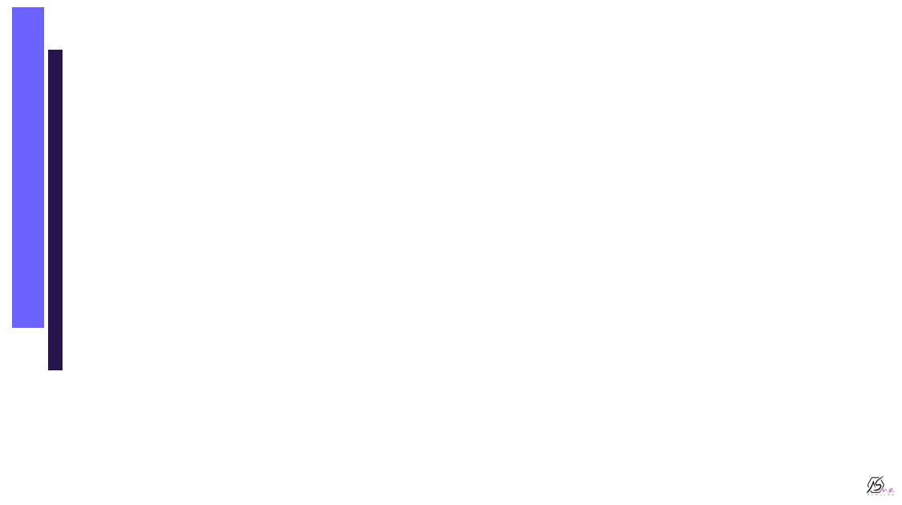
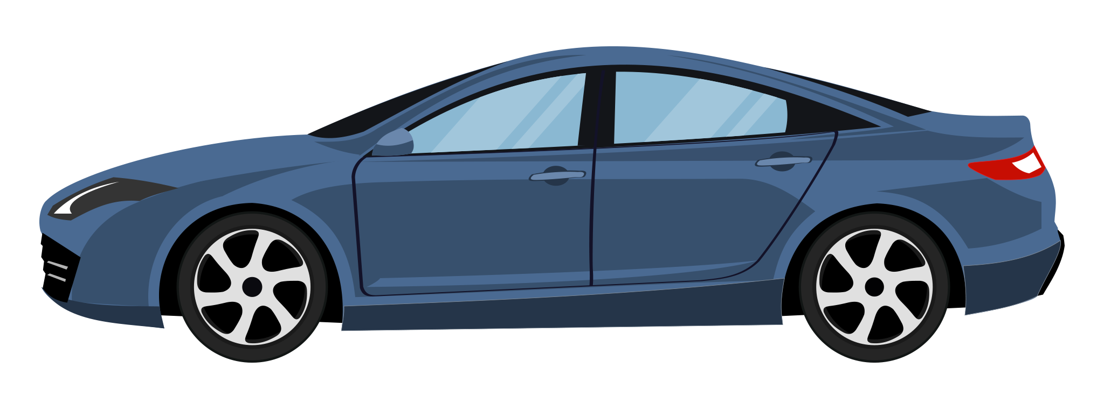
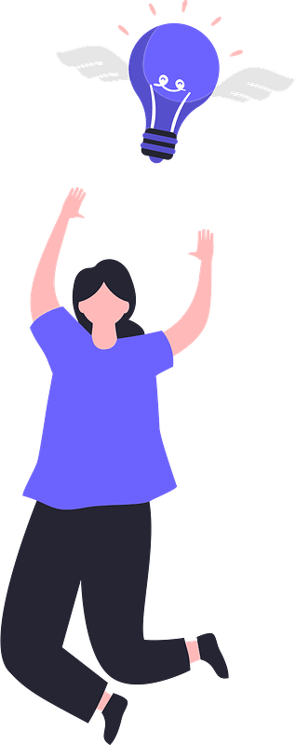
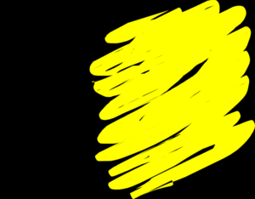
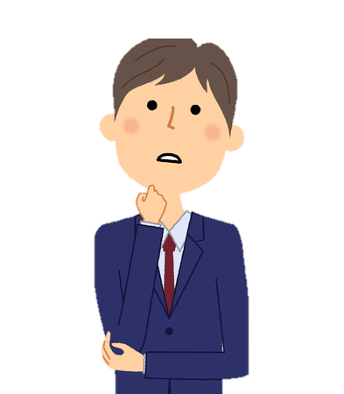
I don’t have a car
I Wish I had a car
Present simple

Slide 7
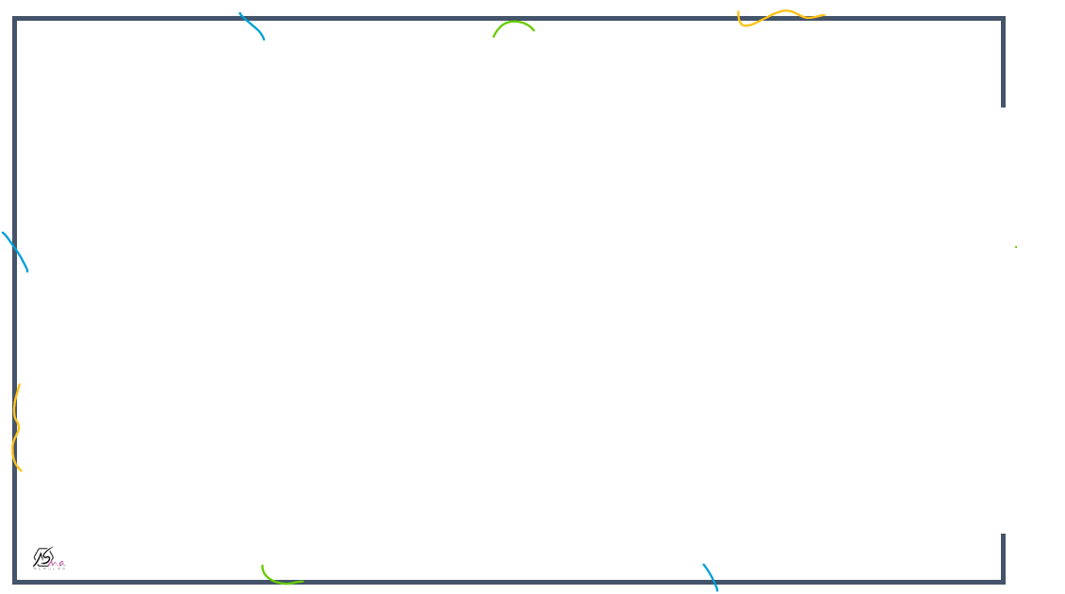

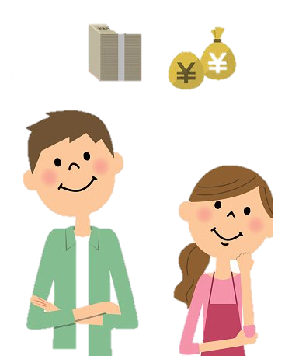
I wish I were rich
We don’t have a lot of money

Slide 8
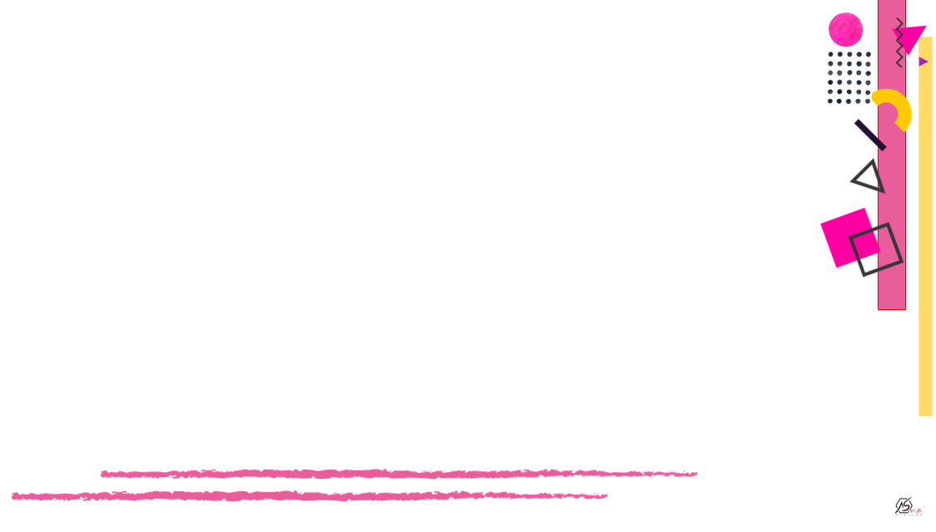


future
I wish it would rain any time soon

Slide 9
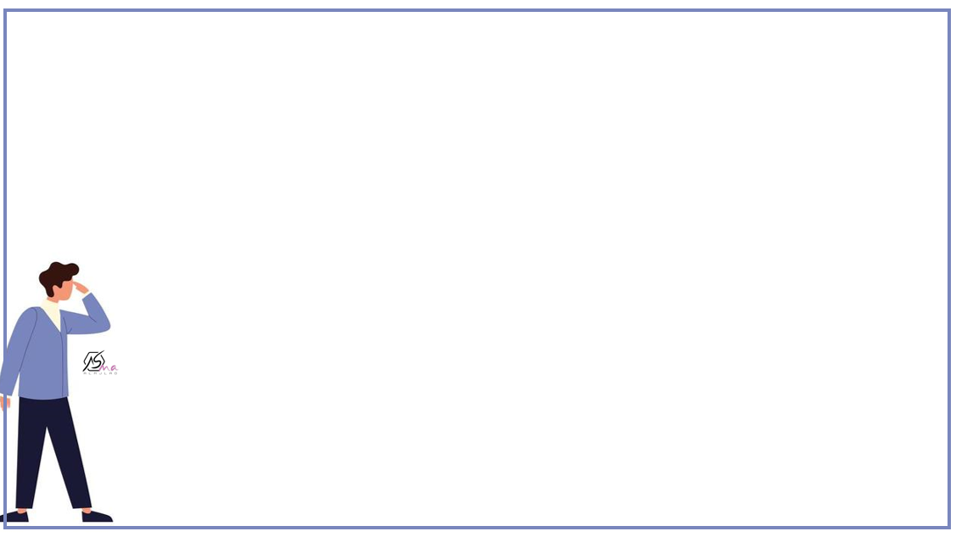

Use wish for things that happen in the past that you now regret
We can use were with all pronouns
Expressing whishes and regret
Use wish if only for things that you want happen now or in the future but which know probably won’t happen
I cheated in the exam
I wish I hadn’t cheated in the exam.
Past past participle
Present past simple
Future present ( would _ inf )
I am not tall
I wish I were taller.
He will use his phone soon
I wish he wouldn’t use his phone in the class.

Slide 10
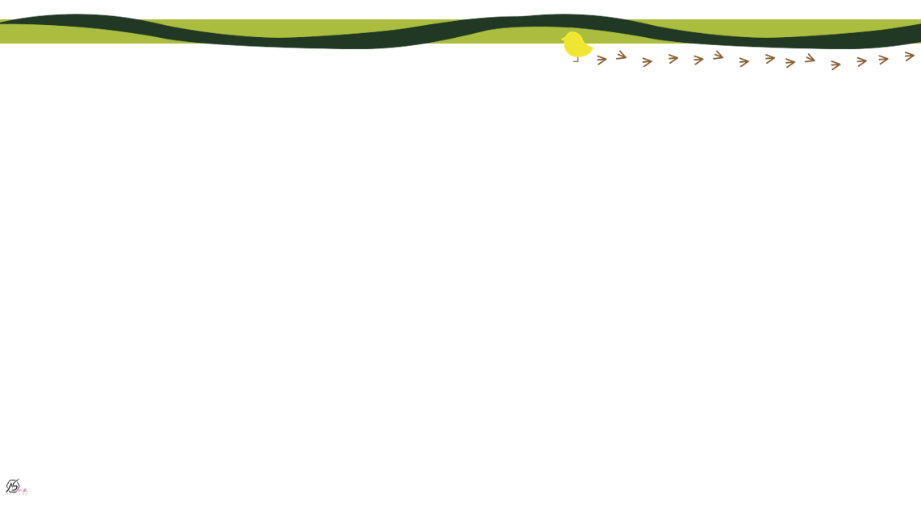
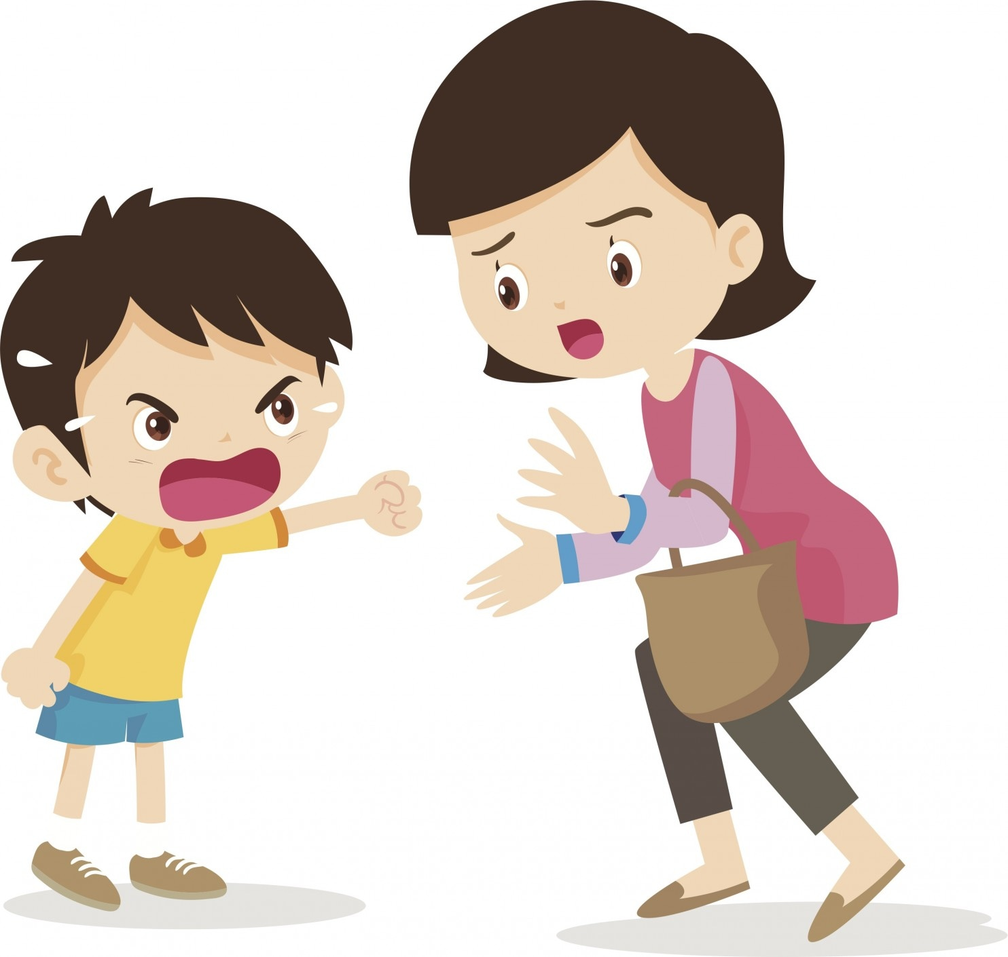

I wish he would stop shouting
to express annoyance or irritation with a situation
Expressing criticism

Slide 11
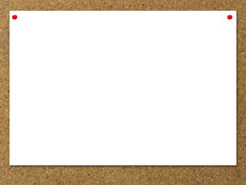






Find the fib
I don’t play sports . I wish I play sports

Slide 12
Find the fib
I ate so mush food yesterday . I wish I hadn’t eat so much

Slide 13
Find the fib
I wish we was in Paris now

Slide 14
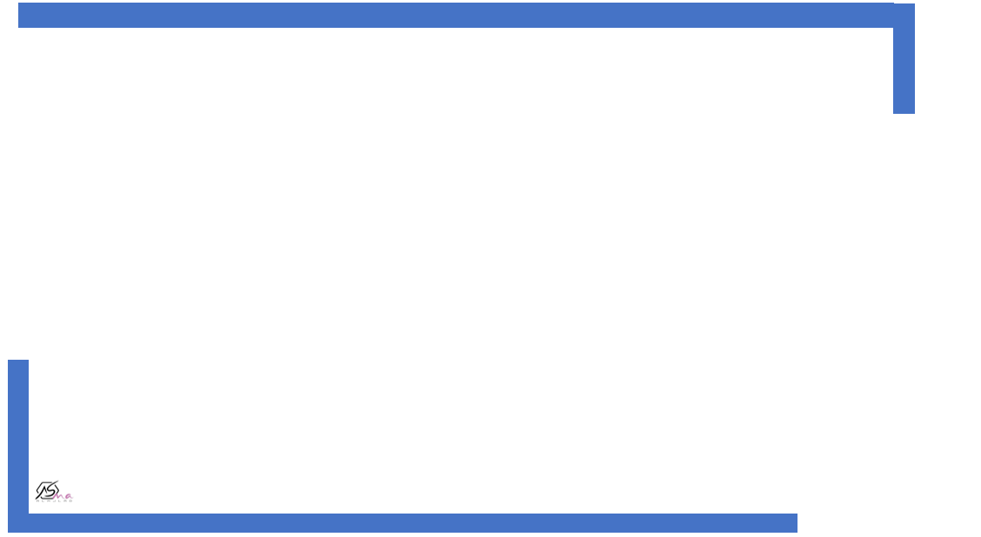
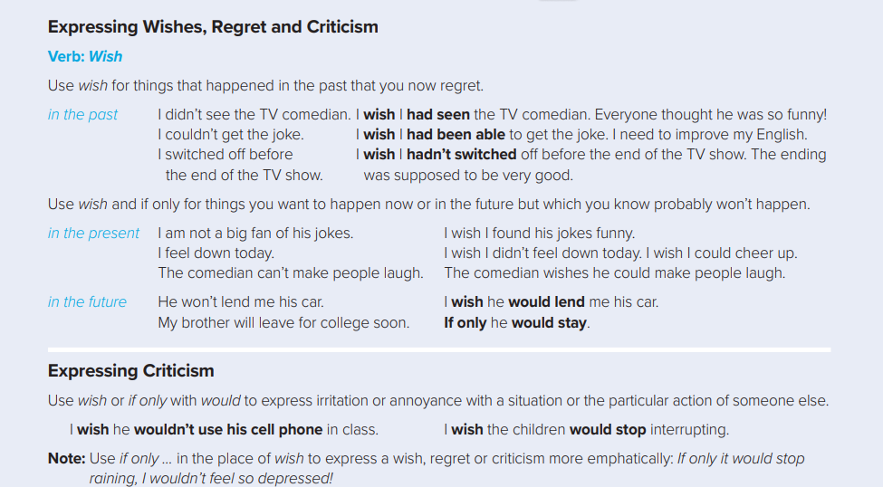
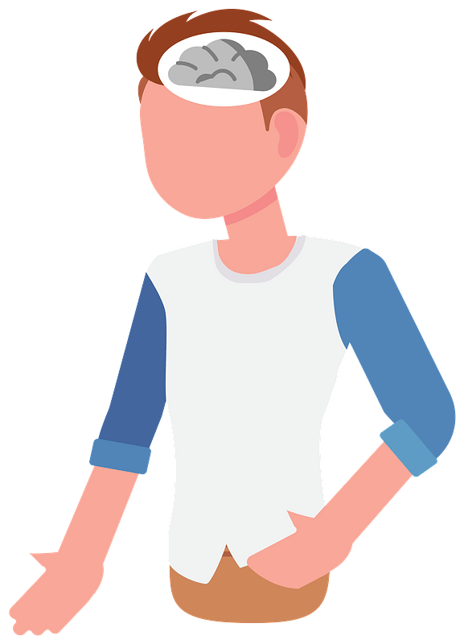

Slide 15
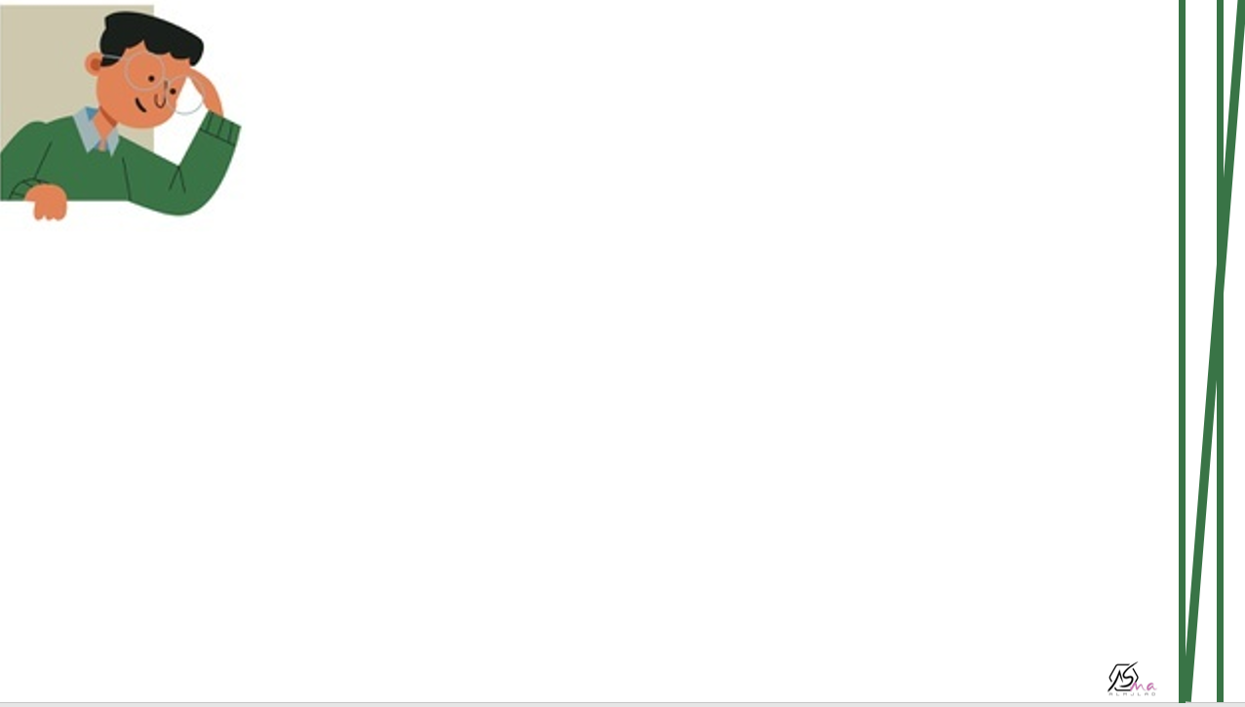
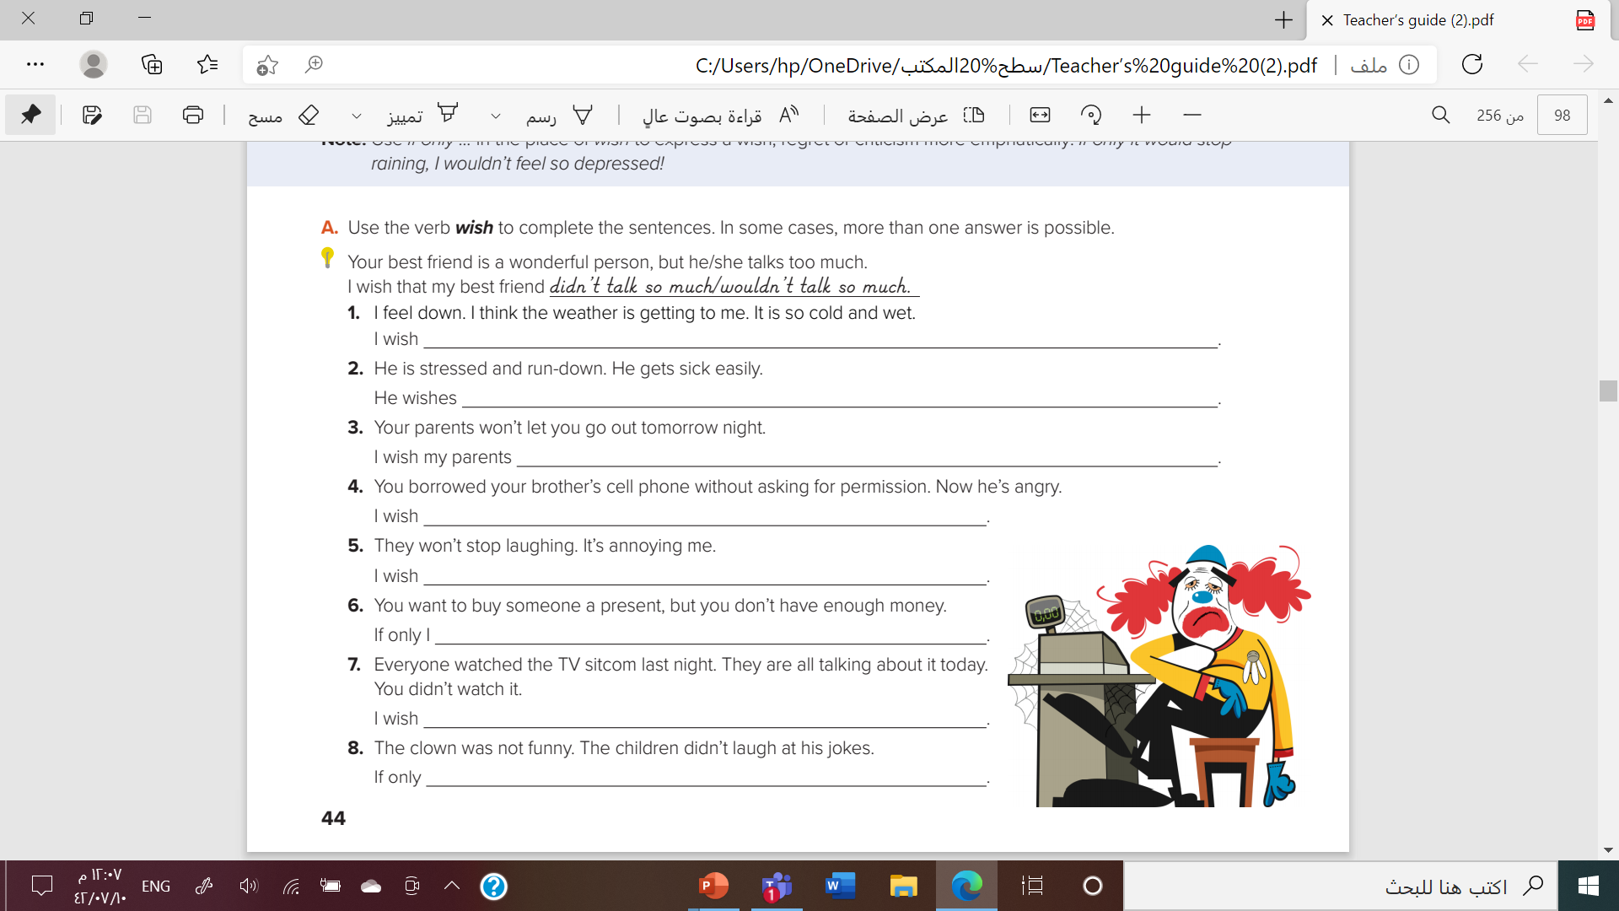
It wasn’t so cold and wet . Or I wish I wasn’t so down
He wasn’t so run-down and stressed Or he wishes he wouldn’t get sick so early
Would let me go out tomorrow .
I hadn’t taken my brother cell phone without asking permission
they would stop laughing
had enough money to buy that present
I had watched the TV sitcom
Clown was funnier . The children would lough

Slide 16
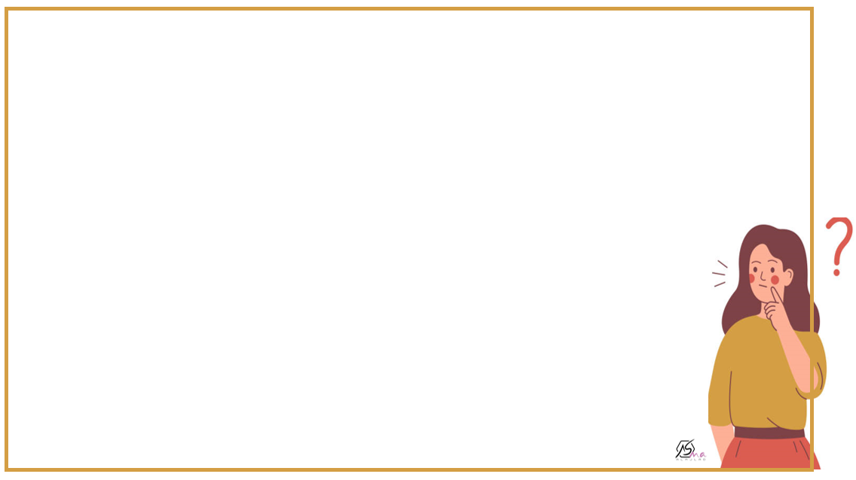
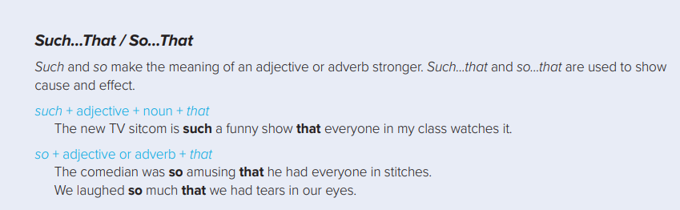
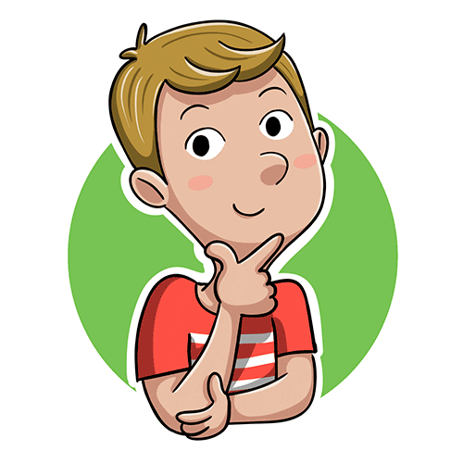

Slide 17
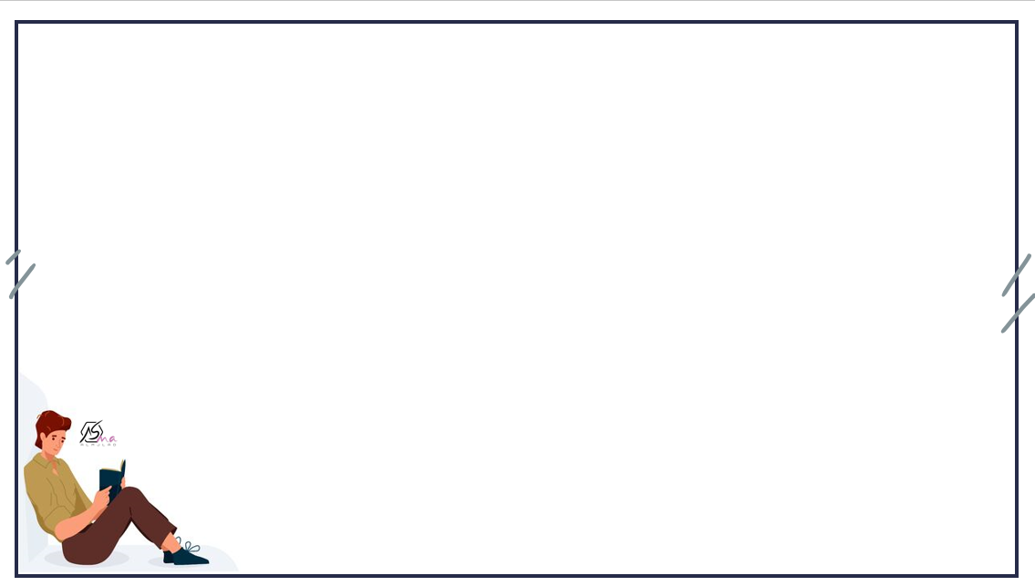
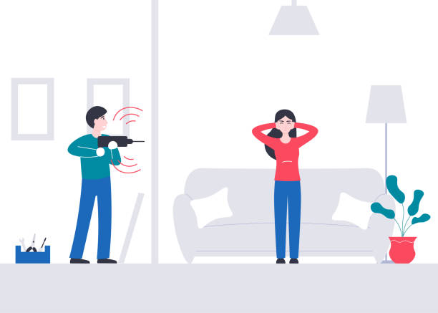
This machine works loudly
adv
This machine works so loudly that I have a headache
I have a headache

Slide 18
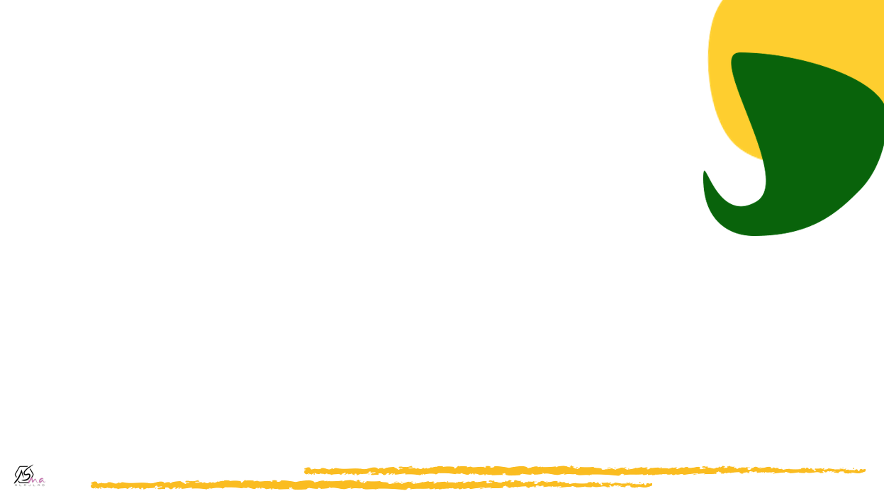
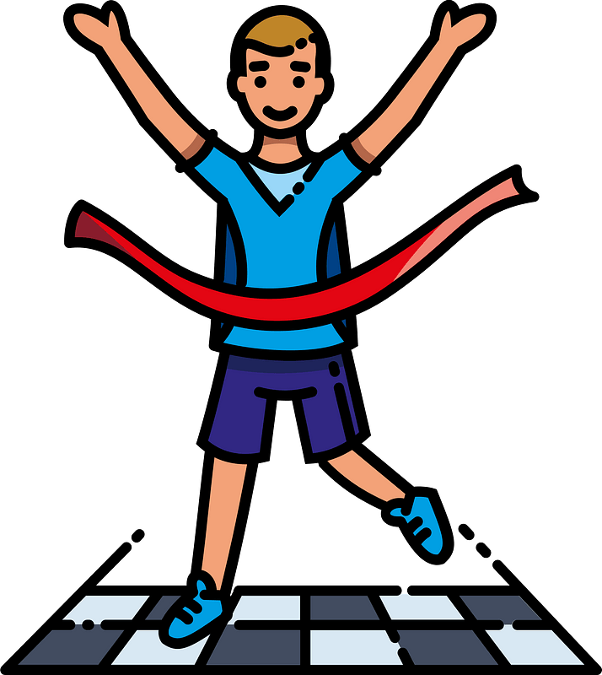


He is fast
Adj
He is so fast that he won the race.
He won the race

Slide 19
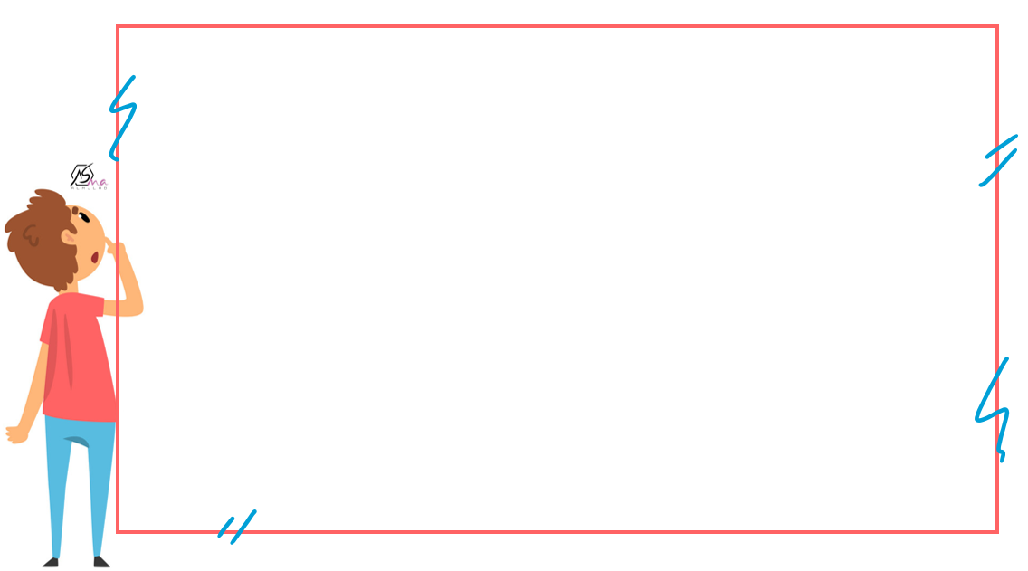
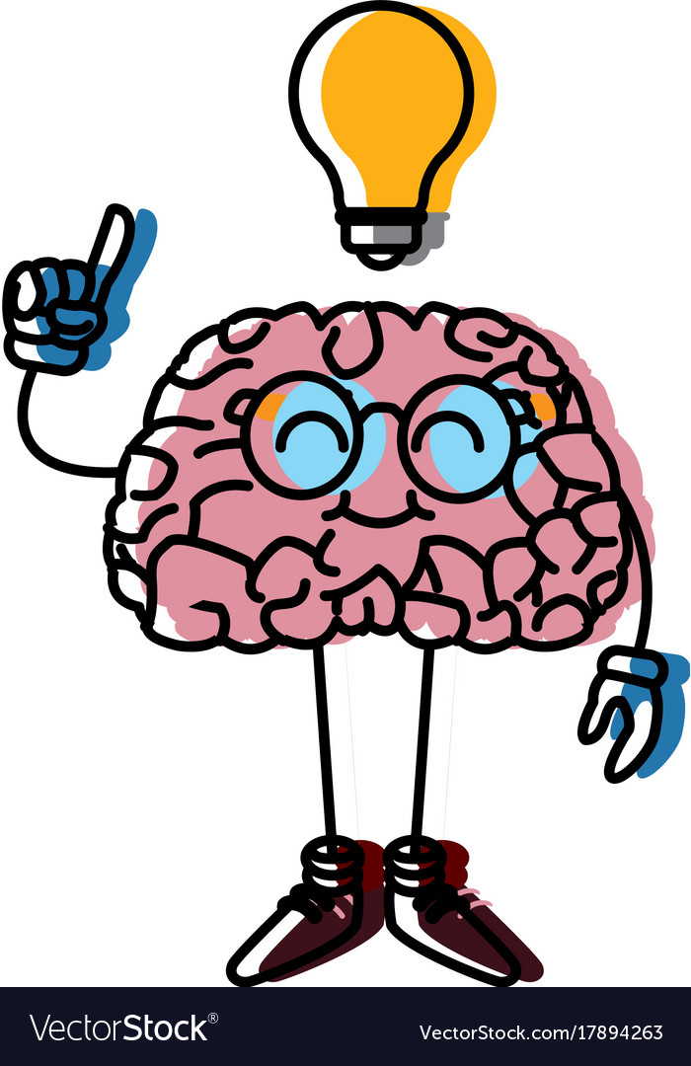
He is so fast that he won the race.
This machine works so loudly that I have a headache
Make a mind map

Slide 20



So much ……that
So many ……that
It uses with plural count nouns
Apples - books -
It uses with Noncount nouns
- Time - noise -
she has so much Homework that she can’t go to the park.
He has so many books that he can’t hardly carry them
Complete:
I drink so …………..coffee that I couldn’t sleep well
Complete:
There are so ……..…cars that we couldn’t park,
Much
MANY

Slide 21
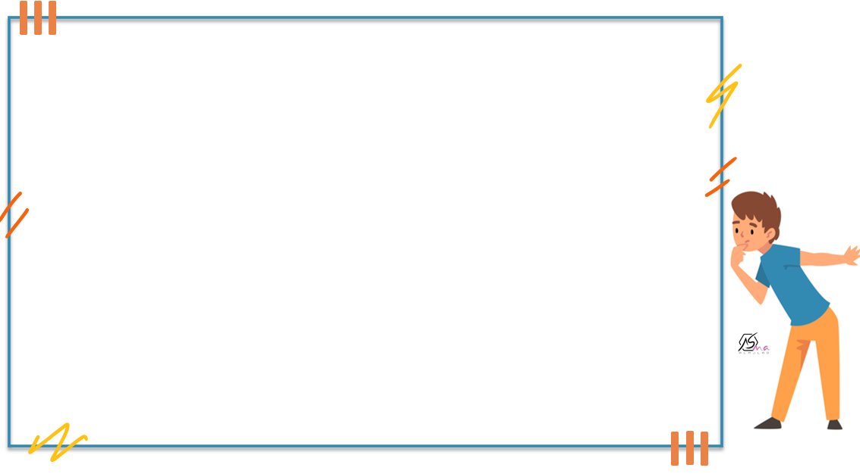
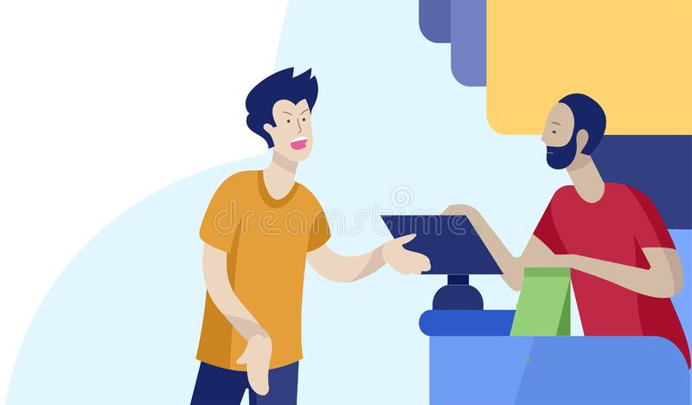
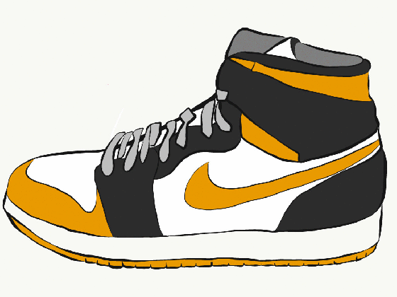
They wear such cheap shoes that I bought

Slide 22
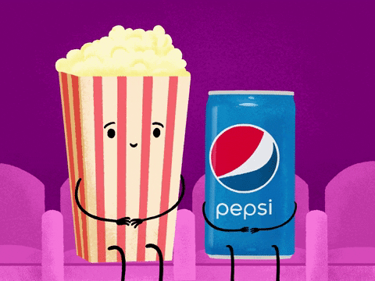
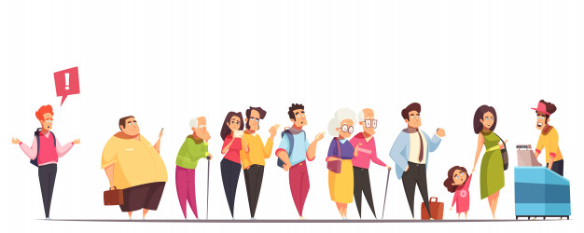


It was such a good movie that many people watches it.
Adj + noun

Slide 23


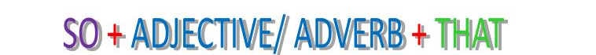
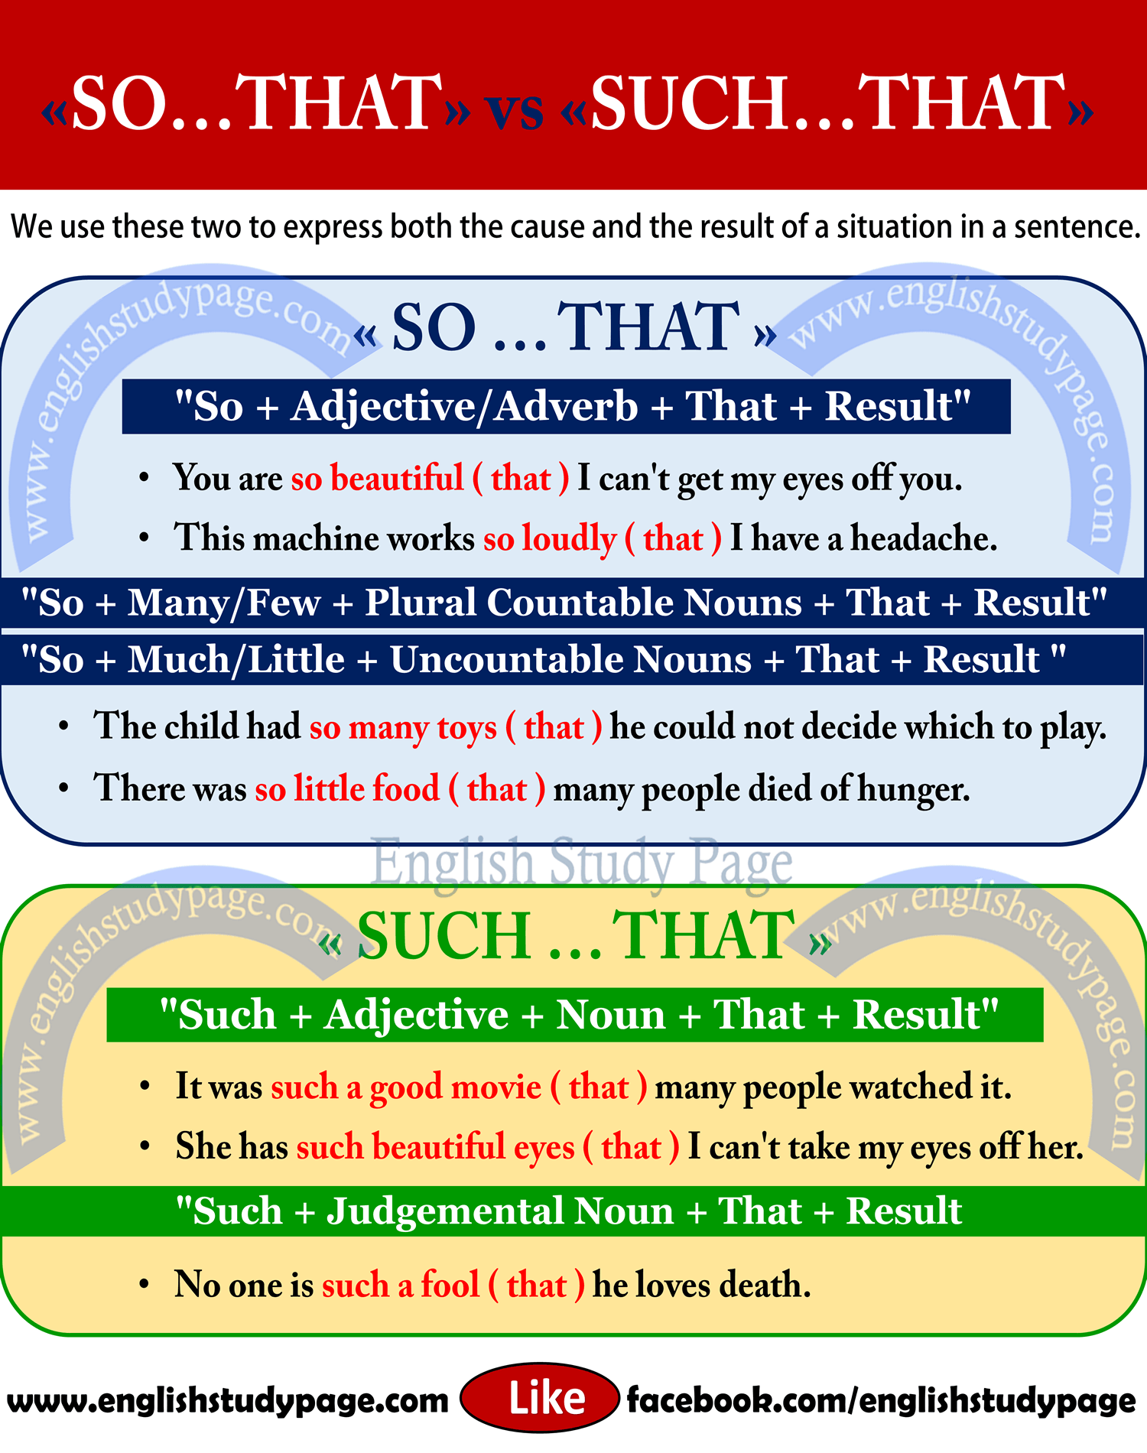
So.…..that
such …..that
So many +count noun + that
So much + Noncount noun + that
Make the meaning of an adj or adv stronger
Summarize
Used to show cause or effect

Slide 24
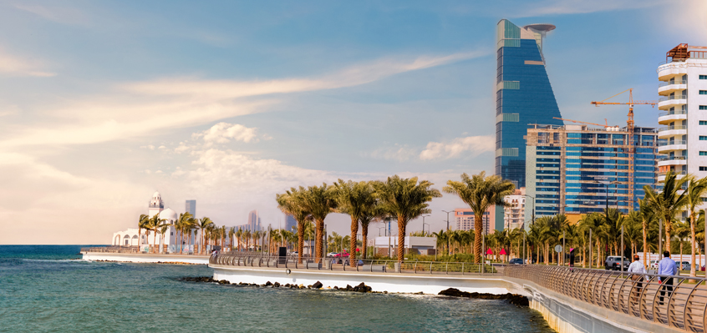
Jeddah is such a beautiful city that
we visit it every month.

Slide 25


Slide 26


I was
(so- such)
tired that I fell asleep in the sofa.
It was
( such – so)
nice weather that we spend the whole day outside
1
2
He eats so
( many – much )
sugar that he may be a diabetic
It was
( such – so)
easy question that every body can answer it
4
3

Slide 27
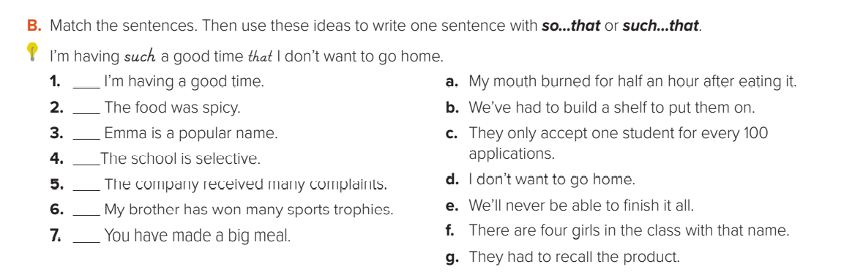

Slide 28
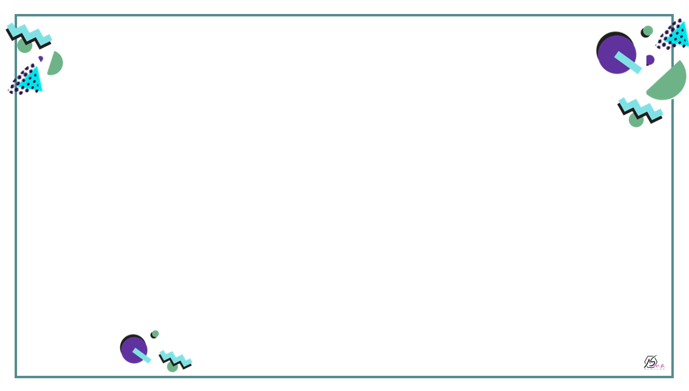
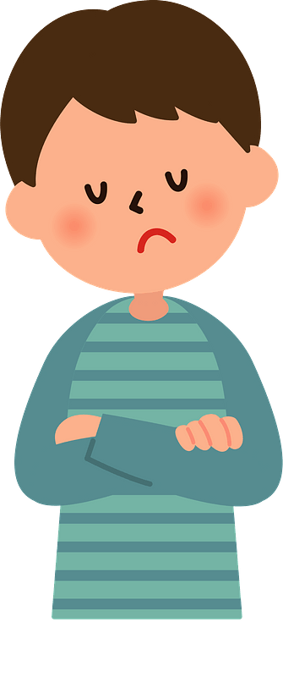
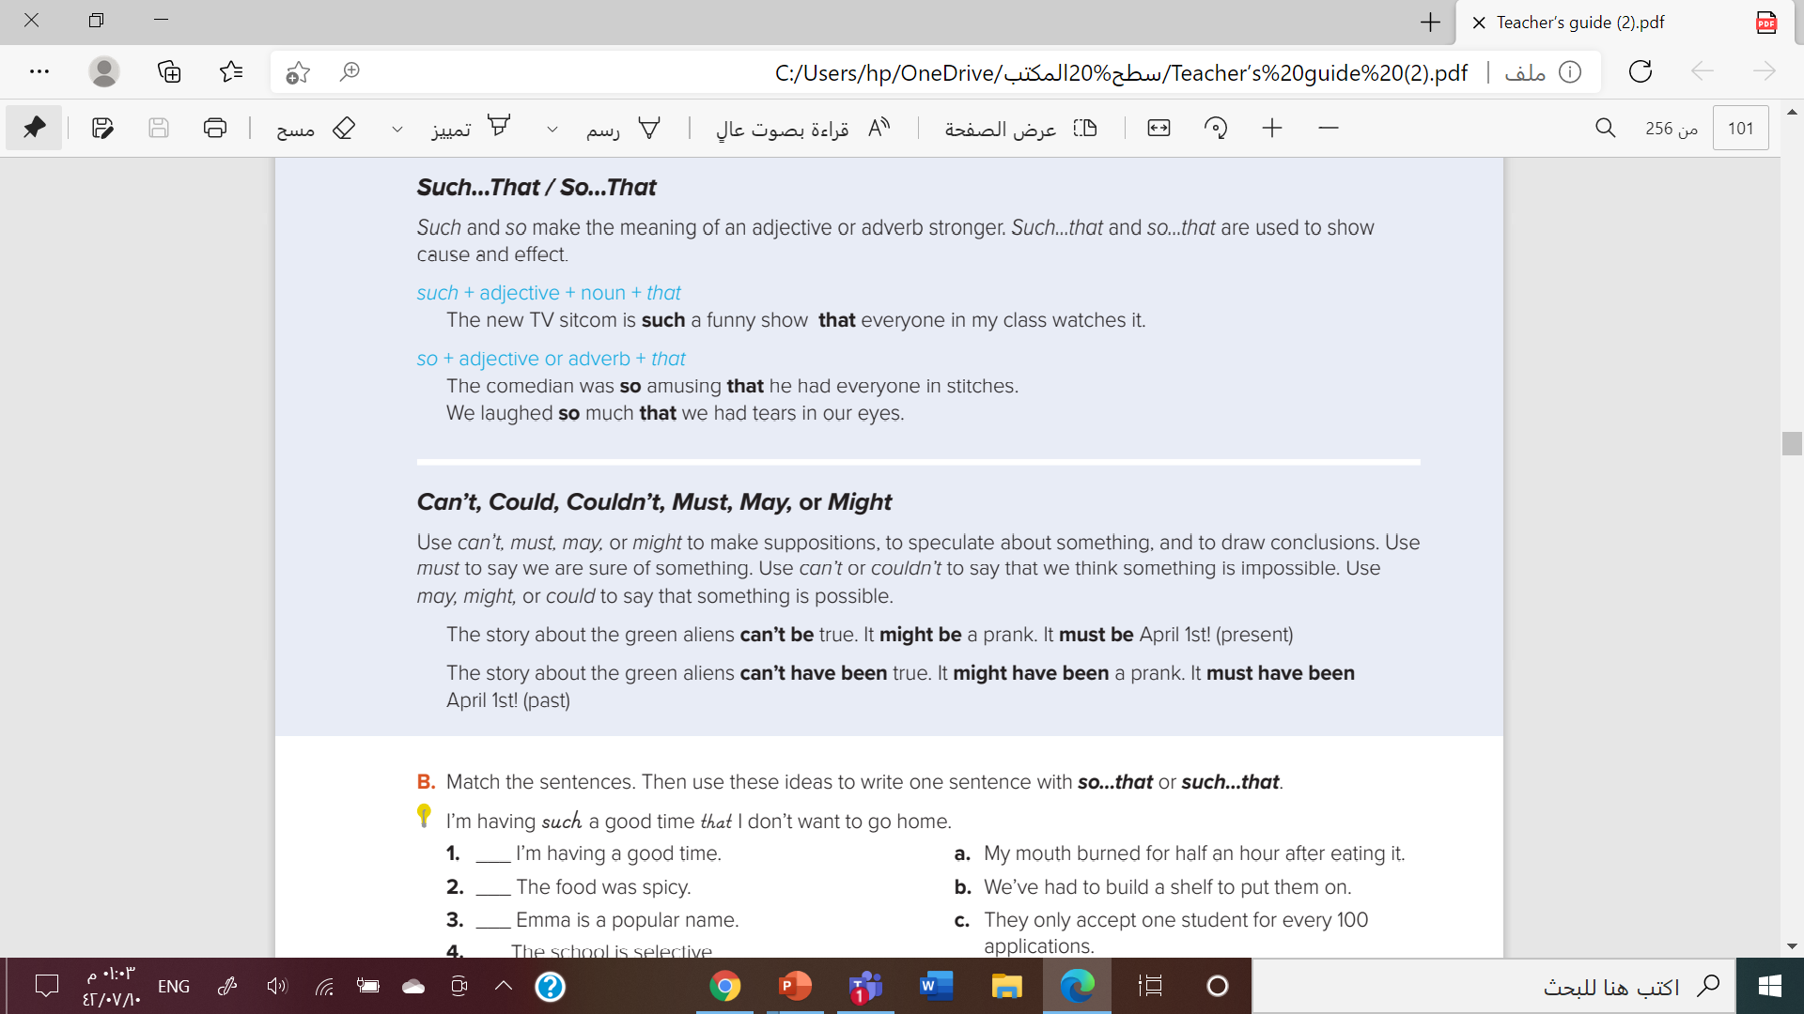

Slide 29





Are they happy?
Do you think their team win?

Slide 30


The boy looks worried
He must break the window

Slide 31

The teacher looks angry
The student mayn’t do the H.W

Slide 32

He looks late
He may have a meeting

Slide 33


It can’t be rain. There isn’t a cloud in the sky
Use can’t to say that
we think something is impossible.

Slide 34



Deductive reasoning strategy

Slide 35


Then complete
he looks…..
sad
surprised
bored

Slide 36

Then complete
They look…..
sad
happy
angry

Slide 37




Slide 38




Slide 39




