Slide 1
Unit 3
Laugh out Loud
Listen & Discuss
Done by: Entisar Al-Obaidallh

Slide 2
Goals of Lesson
01
02
Discuss
Listen
03
04
Guess
Write
the topic of jokes and humor
for specific information
the meaning of the new words
a joke about two people and perform it

Slide 3


W arm Up
Do you remember this acronym ..
What does it mean?
It means : Laugh Out Loud

Slide 4
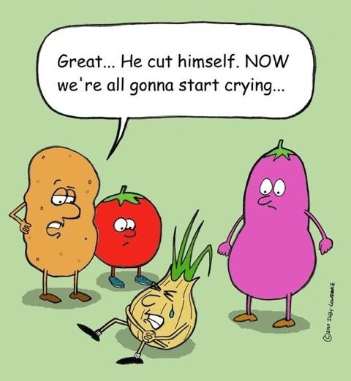

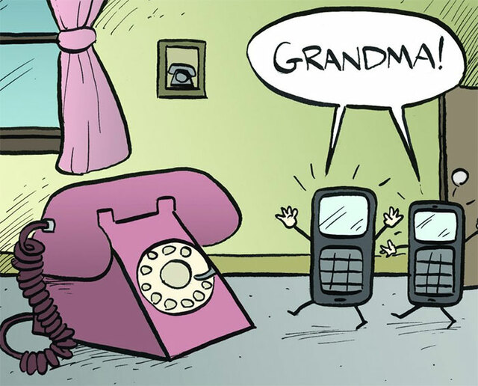

What are these??
These are jokes

Slide 5

W arm Up
A joke is :something said or done to cause laughter

Slide 6
W arm Up
What TV show or comedian makes you laugh the most? Why?
What is the funniest joke you know?
What do you think makes a joke funny?

Slide 7
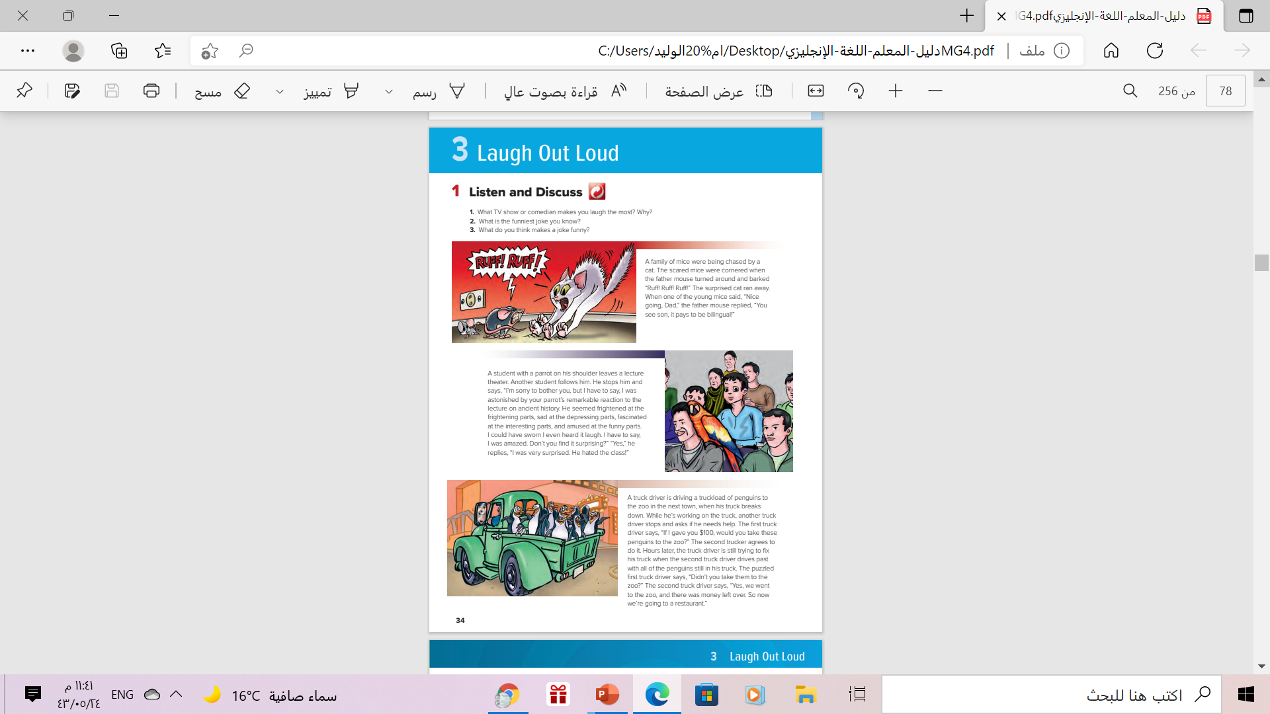
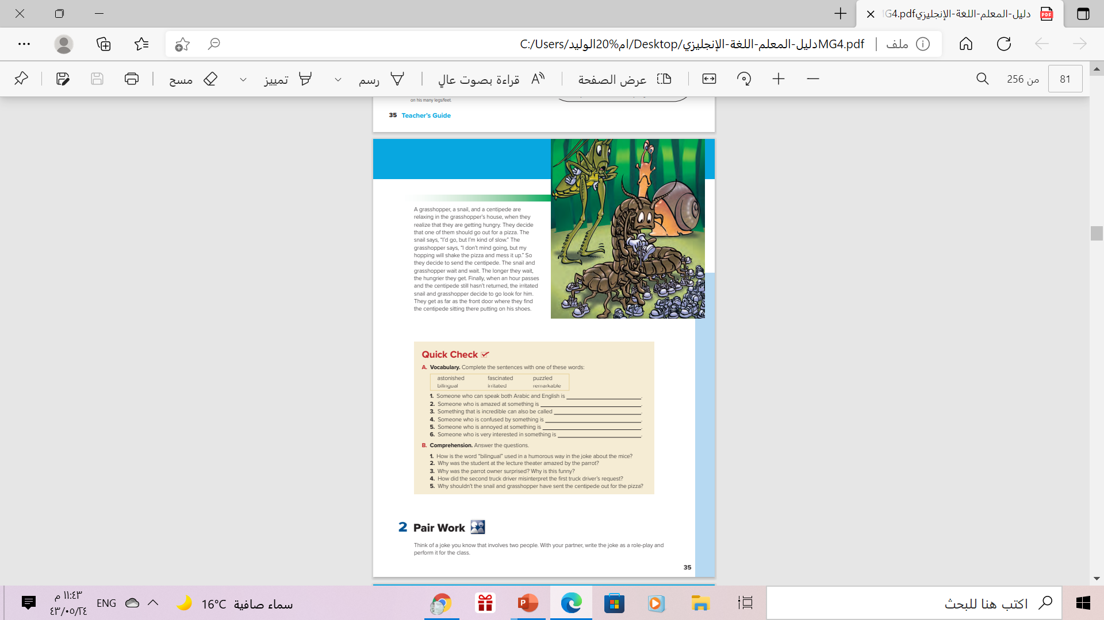

Book Open
Page 34

Slide 8
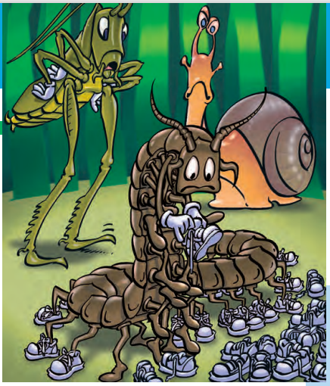
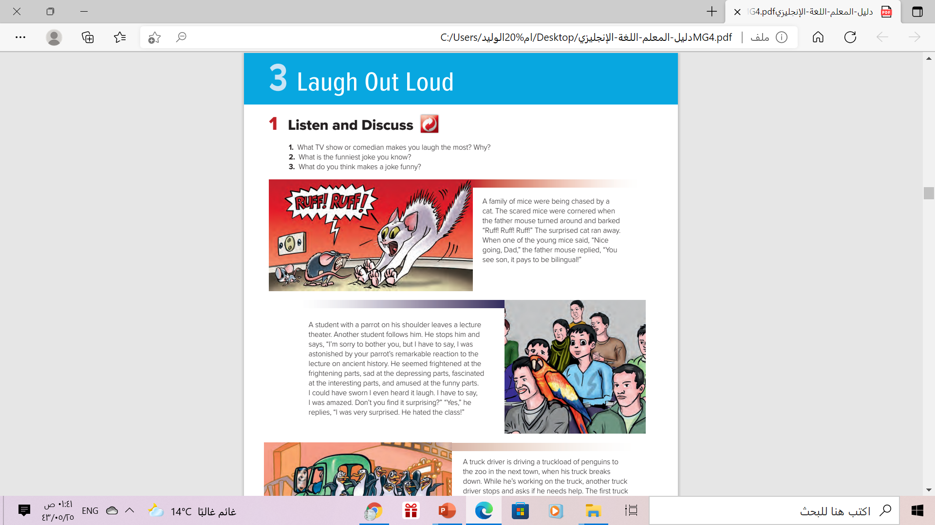
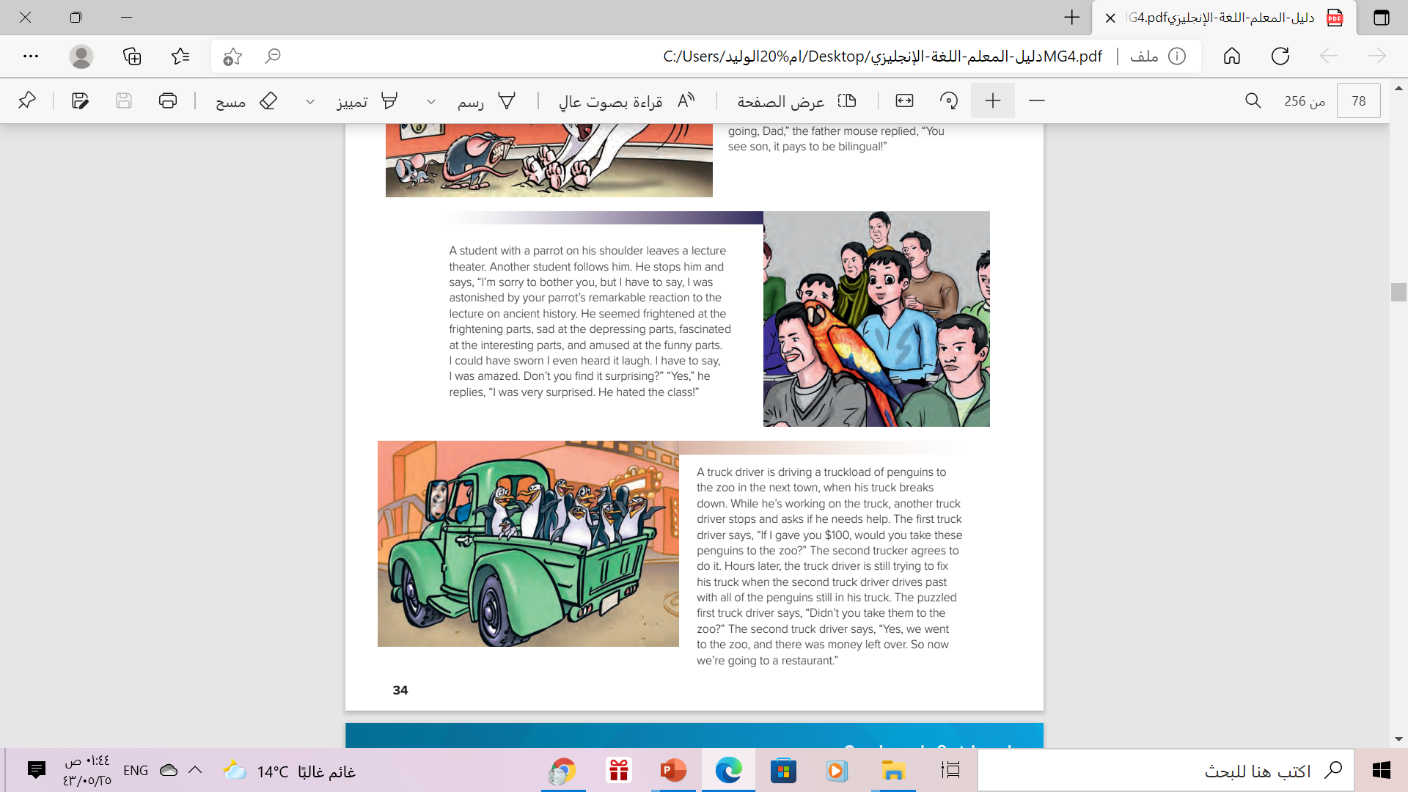
a cat and a mouse
a snail, a grasshopper, and a centipede
What animals are the jokes about ?
penguins
a parrot

Slide 9

Read along as you listen

Slide 10

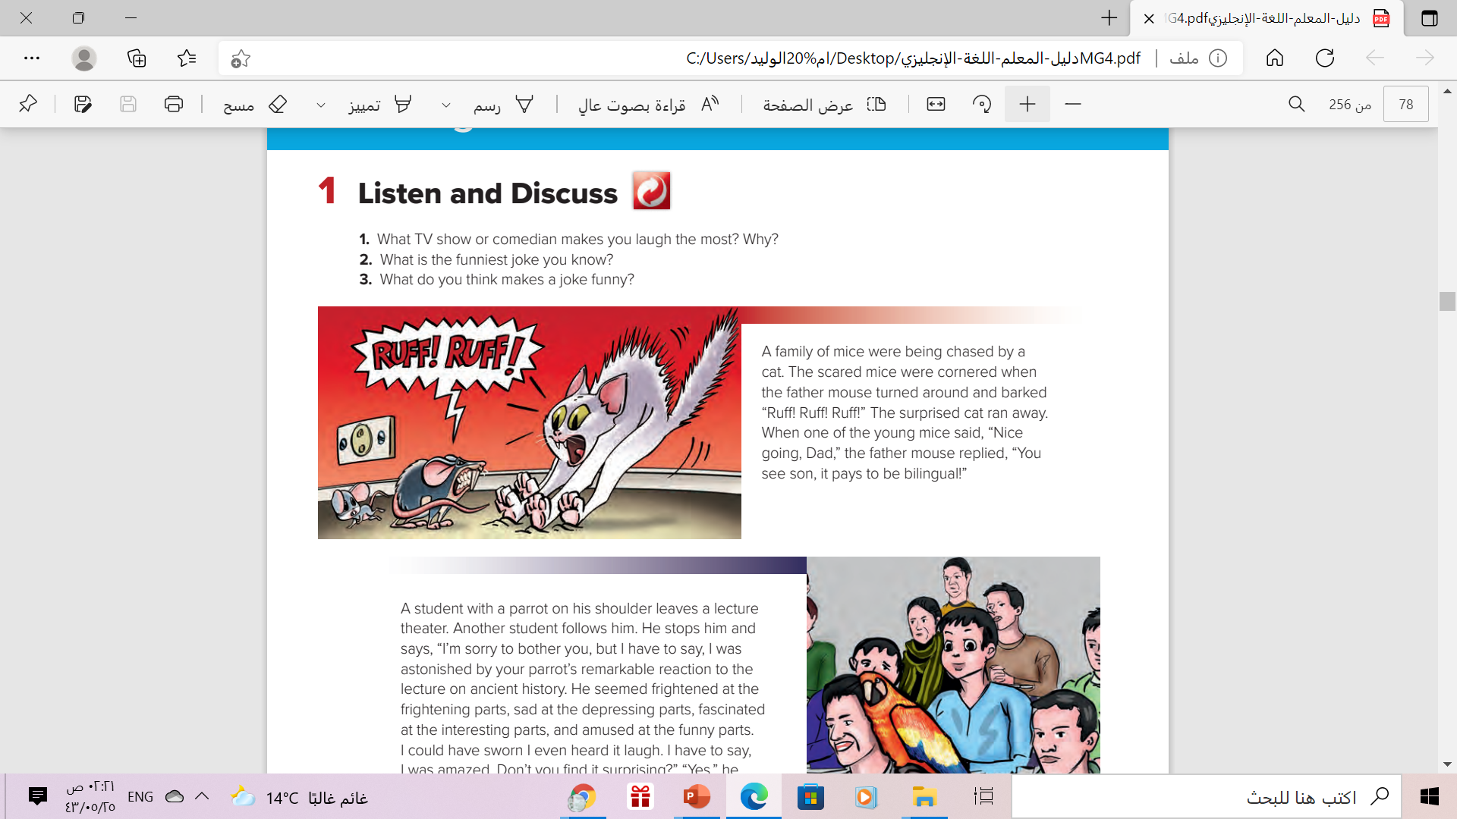
How did the mouse scare
the cat?
by speaking a dog’s language

Slide 11
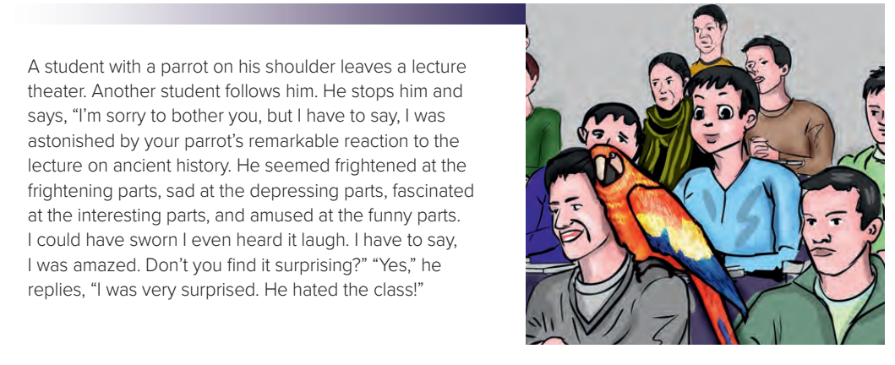
Why was the woman amazed?
because the parrot understood the lecture

Slide 12
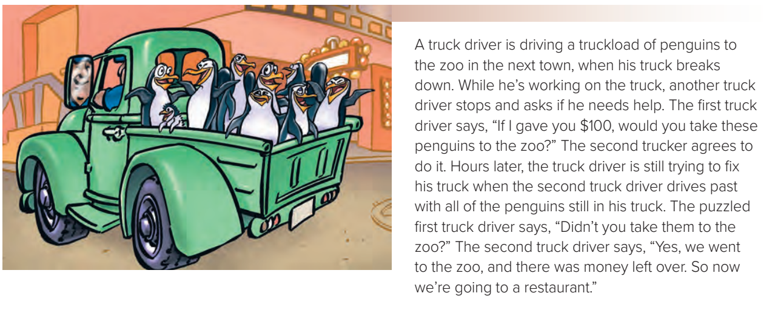
Why was the truck driver is confused?
because the man returned with the penguins

Slide 13
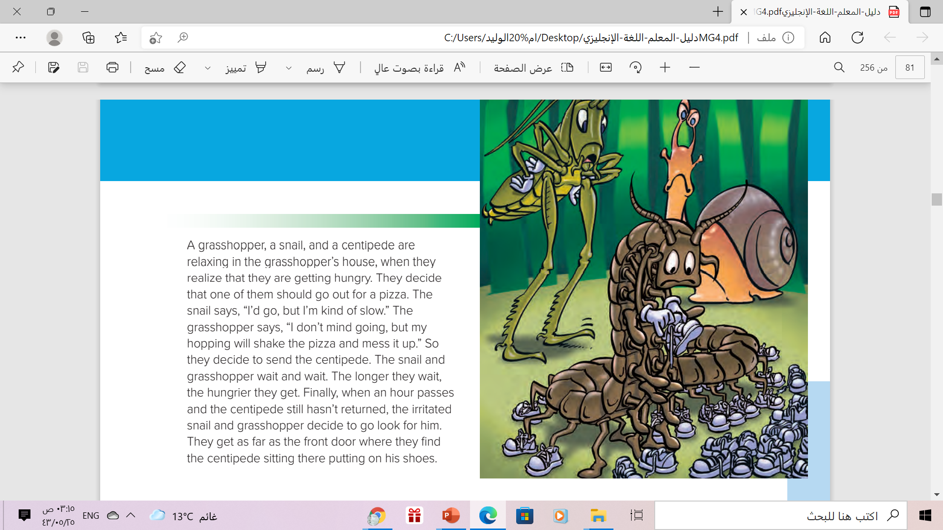
Why were the grasshopper and the snail annoyed?
because the centipede was taking a long time to get the pizza

Slide 14
Which jokes did you understand?
Which didn’t you understand? Why?
Which jokes did you think were funny? Why
Which jokes weren’t funny? Why not?

Slide 15



Slide 16
A word means
Speaking two languages

Slide 17
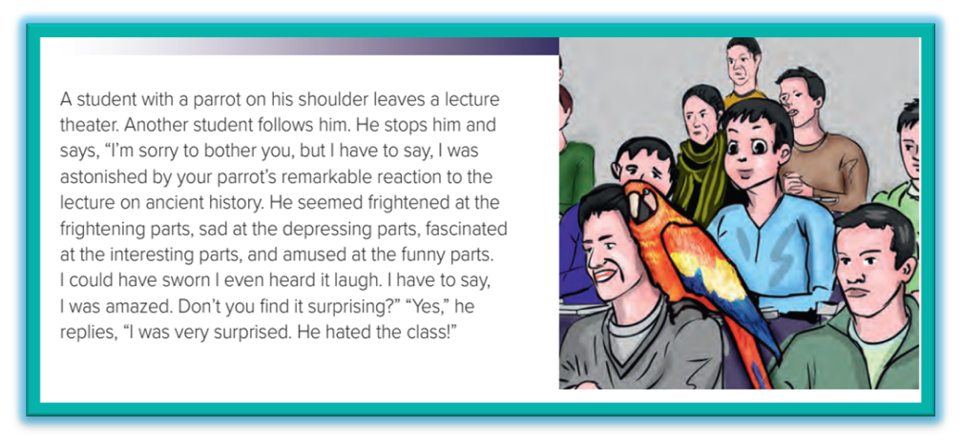
A word means
amazed or very surprised
A word means
unusual and noticeable
A word means
very interested in

Slide 18
A word means
confused

Slide 19
A word means
annoyed

Slide 20

Culture Note
Humor often relates to the history and culture of a particular country or
region.
Therefore, people from different cultures will find different situations
funny.
What most people of one country consider funny, people of another
country may not.
Jokes also often depend on playing with the words of a language.
This is why translating a joke effectively from one language to
another can be impossible in some cases

Slide 21

Book Open
Page ( 35 )

Slide 22
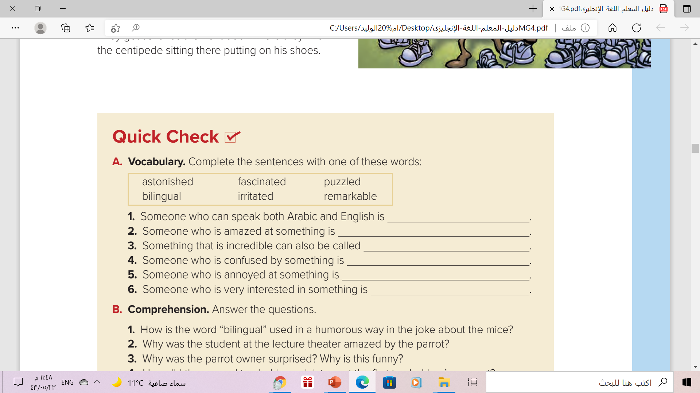
bilingual
astonished
remarkable
puzzled
irritated
fascinated

Slide 23
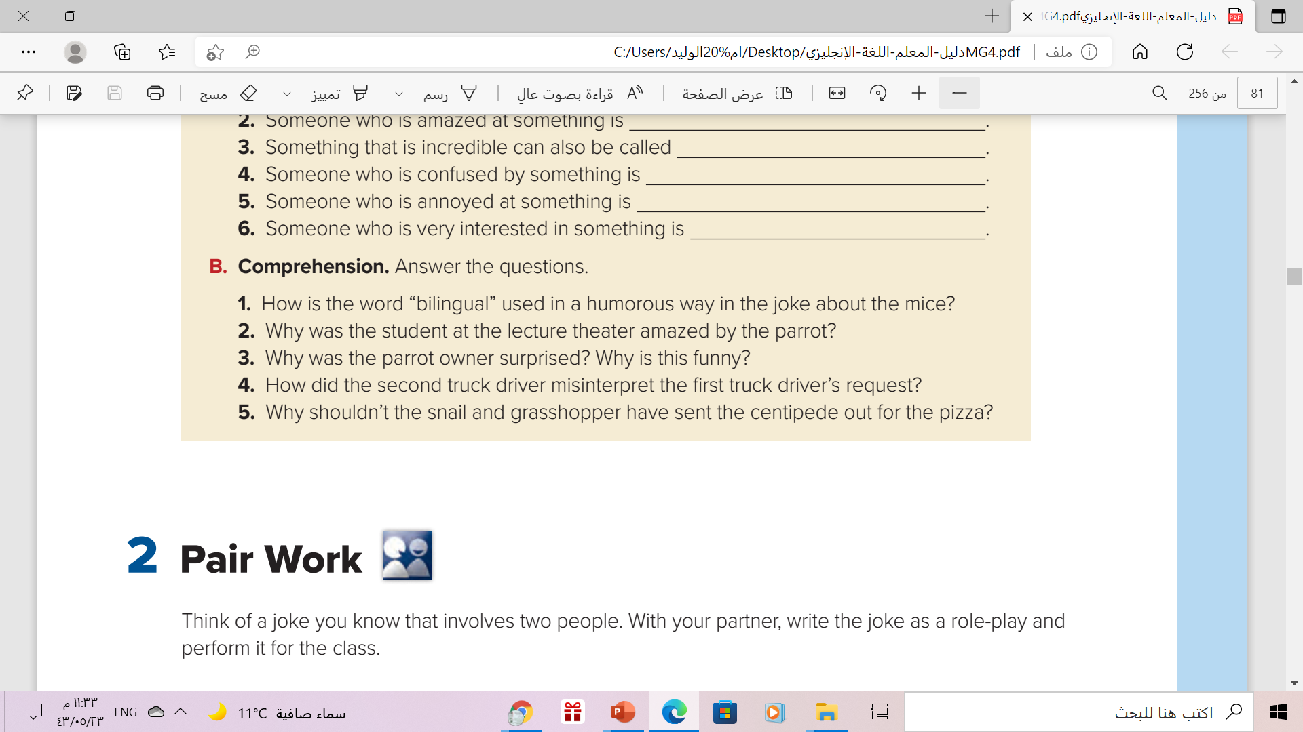
1. It implies that “cat” and “mouse” are two different languages.
2. The parrot showed human reactions to the lecture, as if he understood everything.
3. The owner was surprised that the parrot liked the lecture so much since he didn’t like the class. It’s funny because we don’t expect a parrot to attend classes.
4. He took the penguins to the zoo for a visit, rather than leave them there to be an exhibit.
5. Because it takes a long time for the centipede to put shoes on his many legs/feet

Slide 24


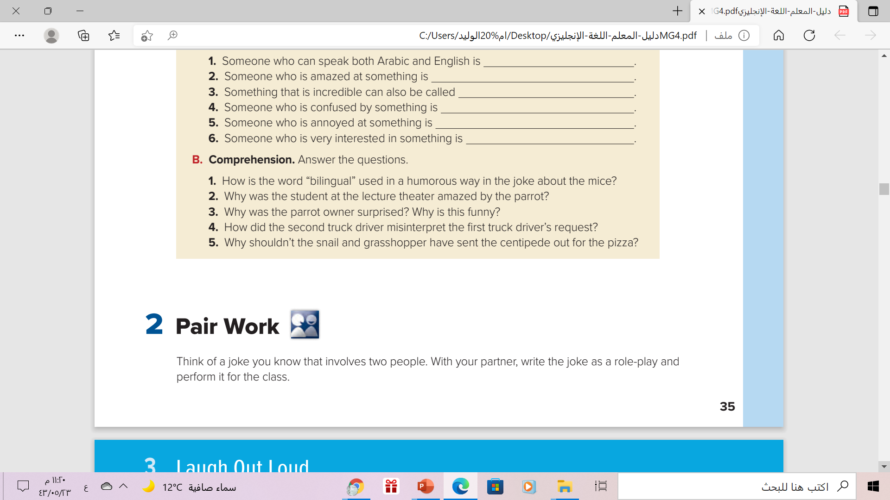



Slide 25

Remeber

Slide 26

Home work
Workbook , page ( 21 ).
exercise ( A )

Slide 27

Thank You!

