Slide 1



Mega Goal 4
Unit 1 - There’s No Place Like Home
11 Form, Meaning & Function
By: Essa Al Hussaini

Slide 2
Objectives
Ask for direction
Ask for repeating information
Apply "will" in offers and promises
01
02
03
04
05
06
Describe a direction
Apply "can" and "will" in requests
Write time clauses in the future tense

Slide 3




Warm Up
How to give directions?
How to ask for directions?
?
Sure.
Go straight & take the second left. You’ll see the school ahead.
I am looking for
the local school.
Can you tell me
where it is?

Slide 4
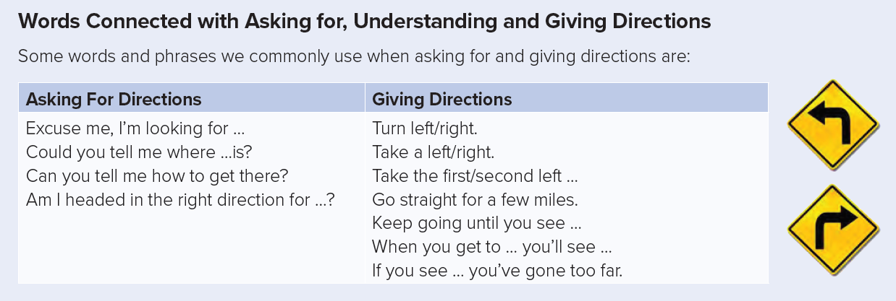
Excuse me,
_ _ _ _ _ _ _

Slide 5
Of course,
_ _ _ _ _ _ _

Slide 6
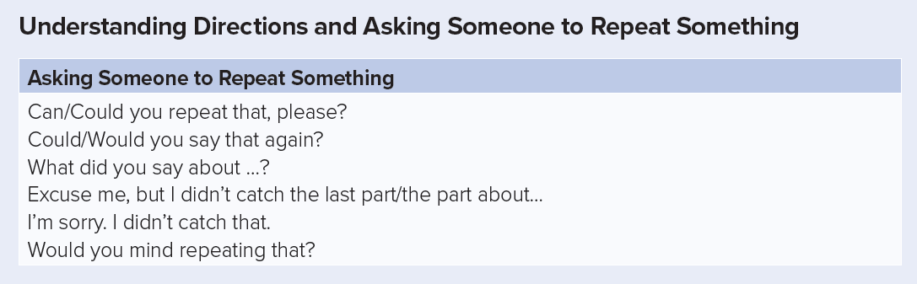



https://wordwall.net/play/9994/148/935

Slide 7

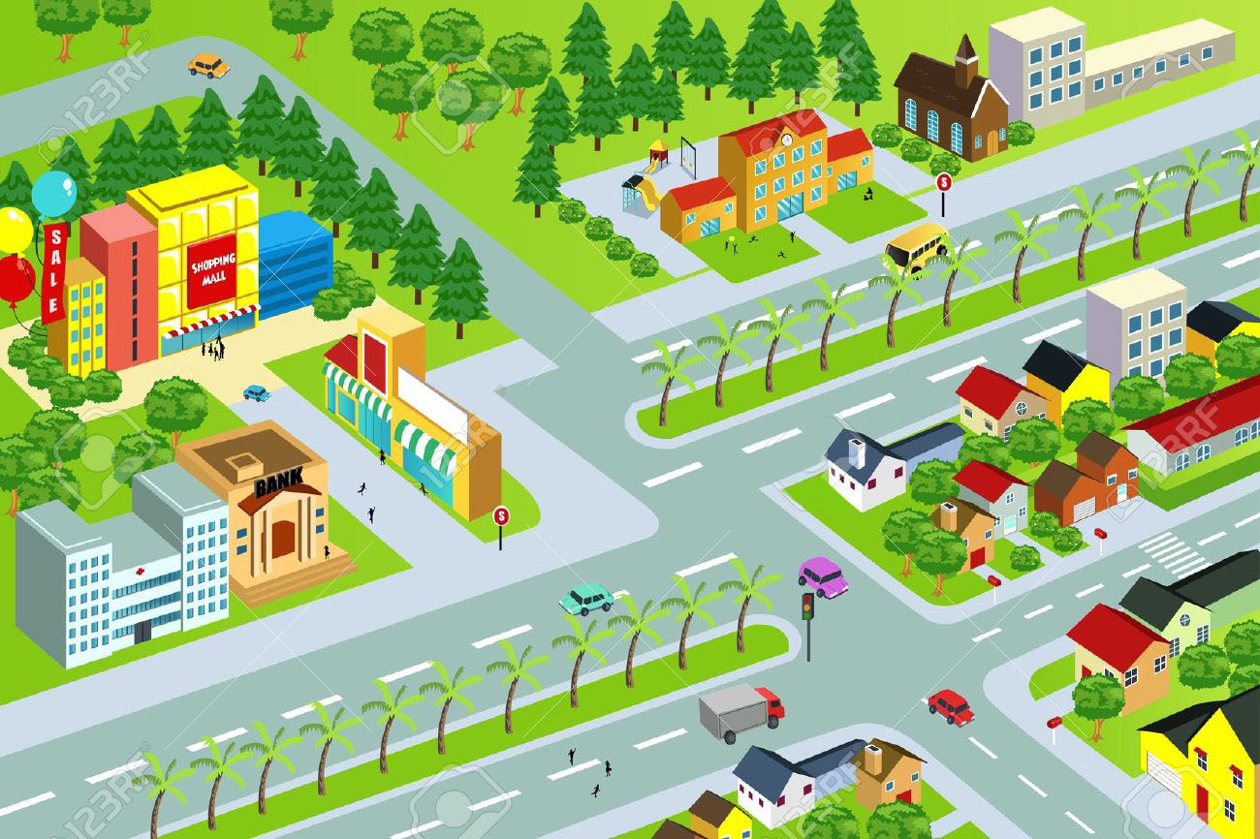

Role Play
Gym
Ask for …
Give …
Ask to …
cafe
school
Mall
Book
20 St.
Ahssa St
Fruit
Restuarant
Mega Goal St.
Essa’s St. E
ice cream
Essa’s St. W

Slide 8
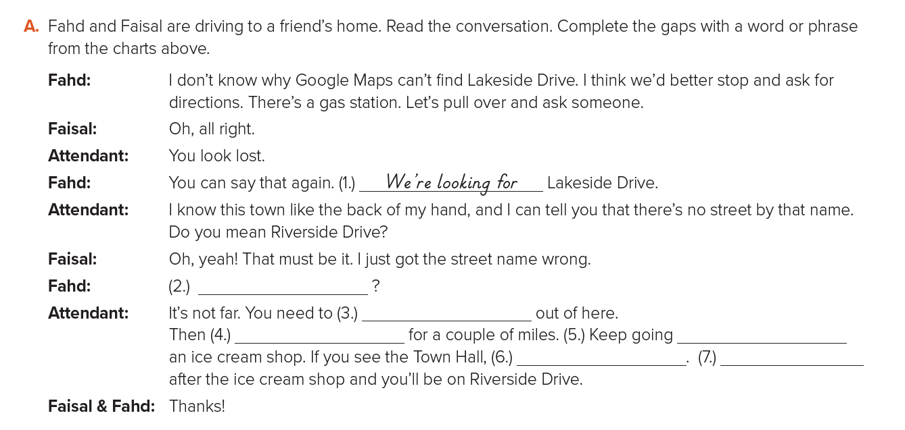

St Book @ 16
Can you tell us how to get there?
turn right
go straight
until you see
you’ve gone too far
take the 1st left

Slide 9



https://youtu.be/2JFqKRUB2vc

Slide 10


Expressing
Requests, Offers, Promises, Warnings & Spontaneous Decision
Will you …….?
Can you …….?

Slide 11
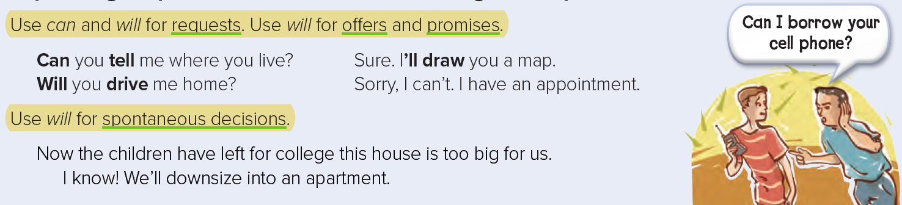

Expressing Requests, Offers, Promises, Warnings & Spontaneous Decision
OK.
I’ll show how to solve it
It’s a difficult exercise?
https://wordwall.net/play/9995/599/802

Slide 12




Expressing Requests, Offers, Promises, Warnings & Spontaneous Decision
Role Play
Can you …….?
Will you …….?
I’ll ……
1
2
3
4
5

Slide 13
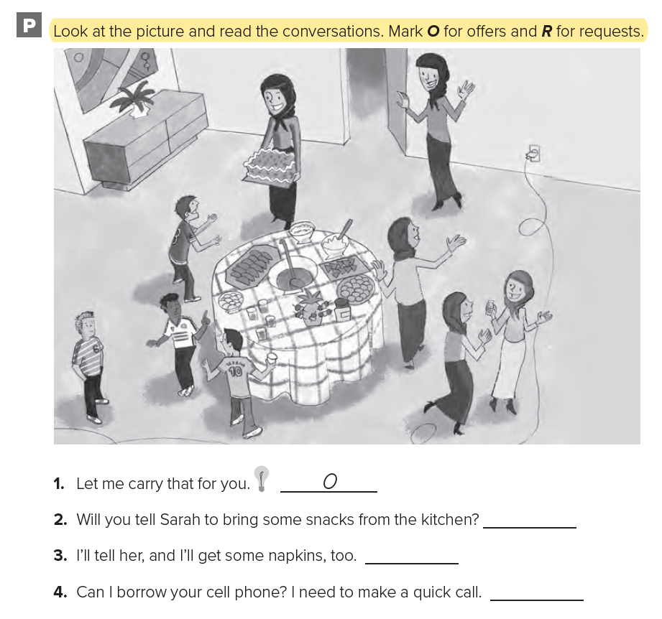
WORKBOOK @ 10
R
O
R

Slide 14

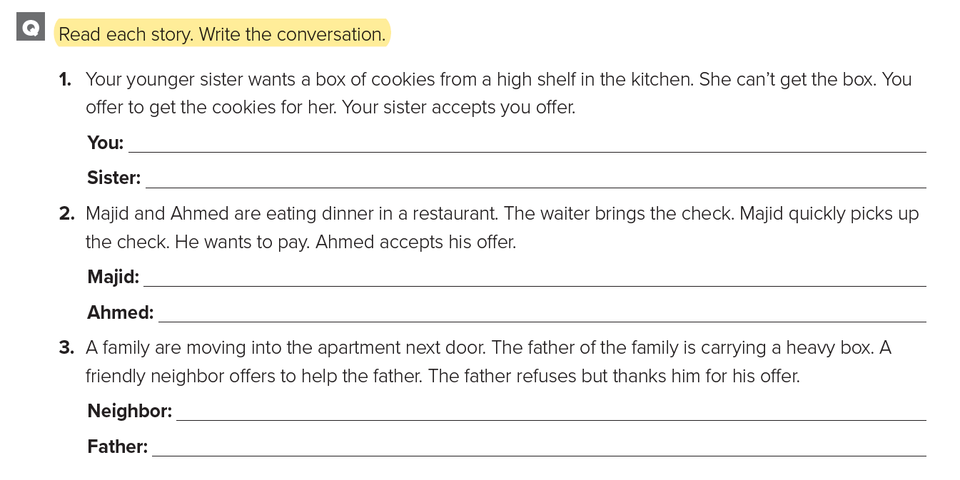
WORKBOOK @ 10
Let me get that for you.
Thanks
I’ll pay the check.
Thank you so much
Can I help you with that?
No, That’s all right. Thank you.

Slide 15
The Future with Dependent Time Clause
When – Before – After – While – Until - While
Quick Check
Name each clause (Time clause / Main Clause )
I’ll help him with his homework while you wash the dishes.
Main Clause
Time Clause
Put the verbs in the correct form
take
will see
When you _____________ (take) the left turn, you _____________ (see) the supermarket.

Slide 16
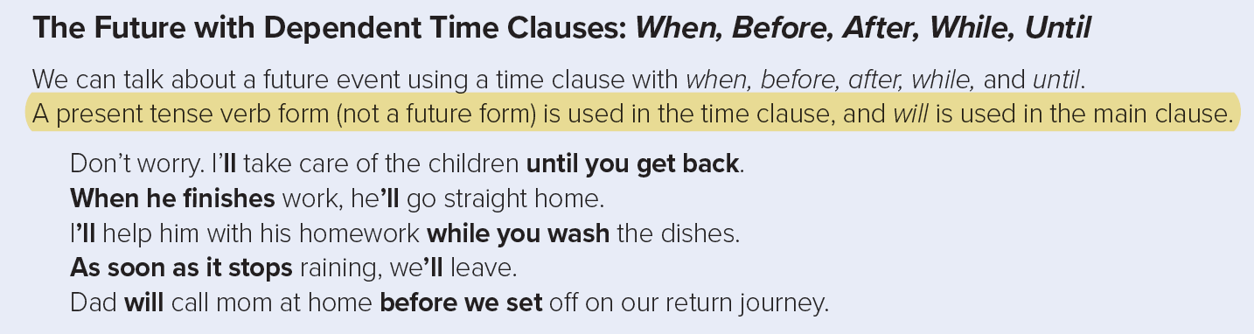
The Future with Dependent Time Clause
When – Before – After – While – Until – While – As soon as

Slide 17
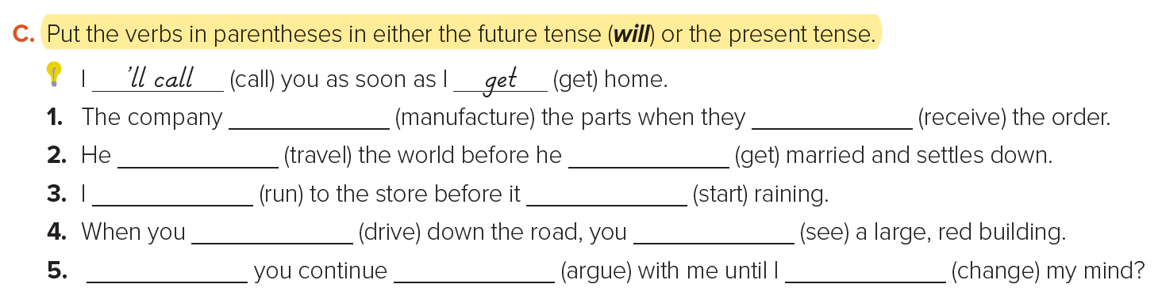
The Future with Dependent Time Clause
When – Before – After – While – Until – While – As soon as
St Book @ 17
will manufacture
receive
will travel
gets
‘ll run
starts
drive
will see
Will
argue
change

Slide 18

The Future with Dependent Time Clause
When – Before – After – While – Until – While – As soon as
https://wordwall.net/play/9996/718/225

Slide 19
https://youtu.be/RHVgeNFfzn4

Slide 20



