Slide 1
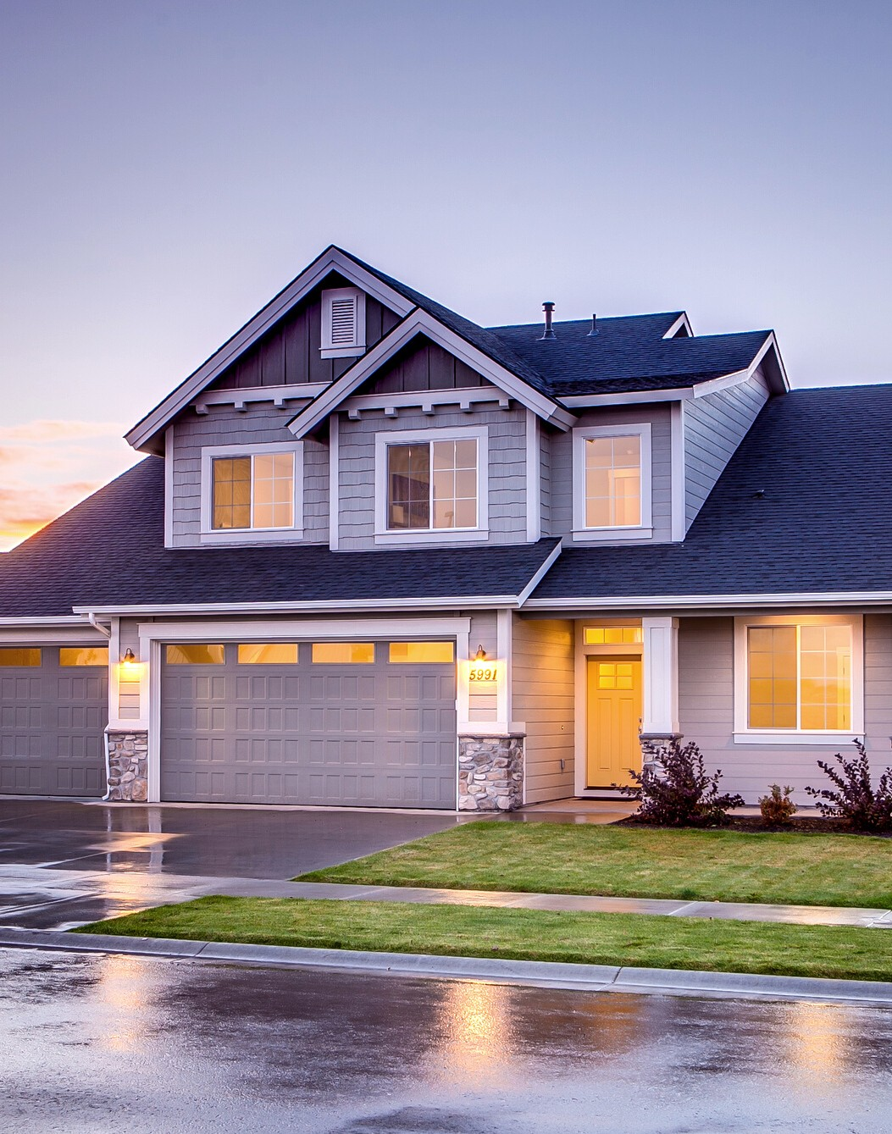
UNIT : 3
There's NO place like home
Conversation + Listening
DONE BY : MARYAM ALSHAREEF

Slide 2

lesson objective :
Read the conversation for specific information .
Answer some questions about the conversation
Match the new vocabulary with its meaning .
Use the “ Real Talk ” in a sentence.
Stress on two-syllable nouns and verbs .

Slide 3
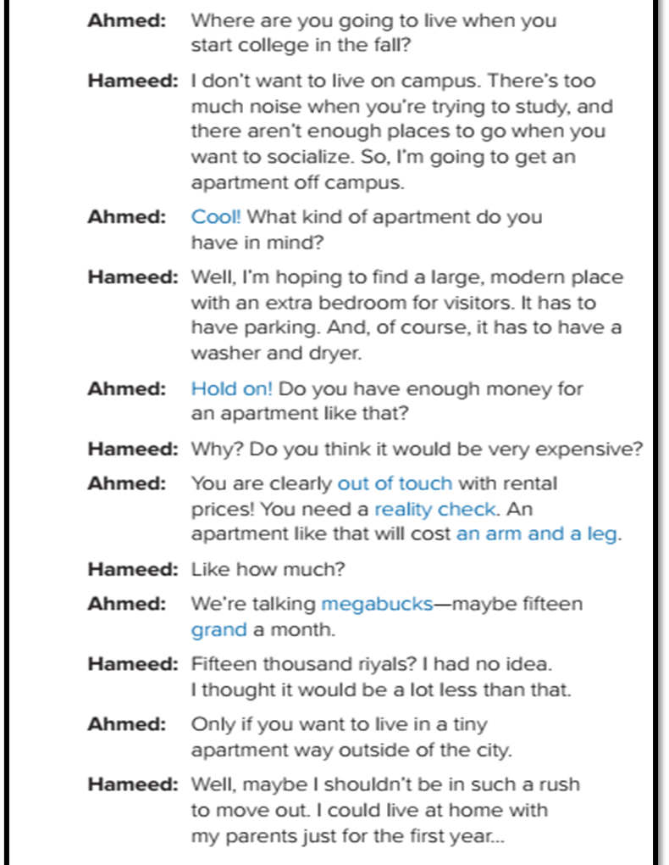



c
o
o
t
n
v
g
e
n
r
i
s
a
n
t
e
i
t
o
s
n
i
l

Slide 4
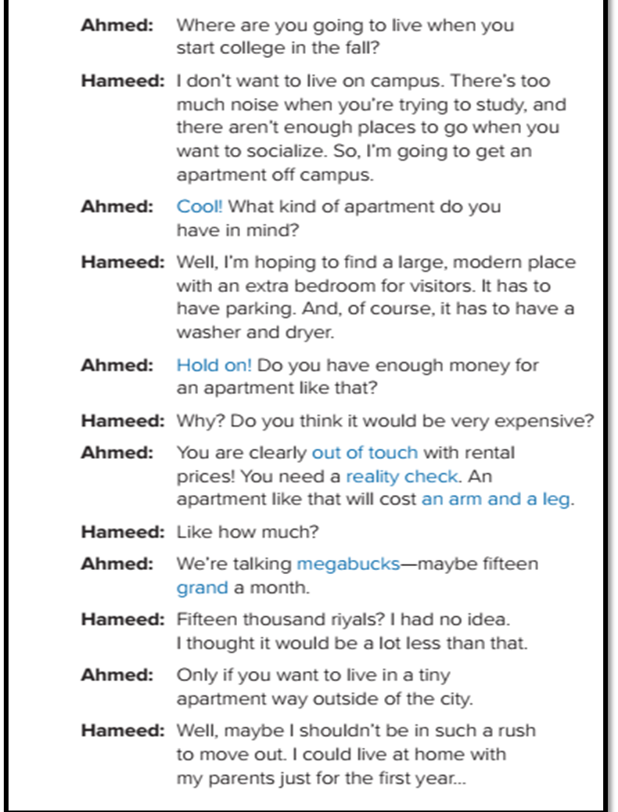
How many persons in this conversation ?
Two persons
Who are they ?
Ahmed & Hameed
What are they talking about ?
Where university students live

Slide 5
Does Hameed want to live on campus ?
No, he doesn’t
Why ?
ther's too much noise and there aren't enough place to socialize
What kind of apartment does Hameed have in mind ?
a large modren place with extra bedroom for vistors

Slide 6

No, he doesn’t .
Does Hameed have a realistic idea with rental prices?
What does Hameed decide after knowing the rental prices?
living at home with his parents

Slide 7



Who said: cool !
Ahmed
Who said: hold on
Ahmed
Who said: out of touch
Ahmed

Slide 8

Who said: reality check
Ahmed
Who said: an arm and
a leg
Ahmed
Who said: megabucks
Ahmad

Slide 9
REAL TALK

Slide 10
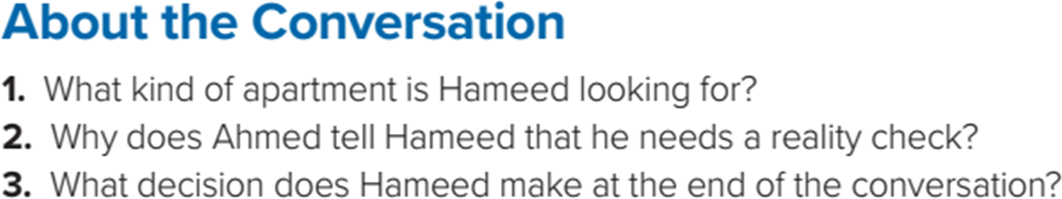
He wants a large modern apartment off campus with an extra bedroom, parking, and a washer and dryer.
He will not be able to afford an apartment like that.
He decides to keep living at home for another year

Slide 11
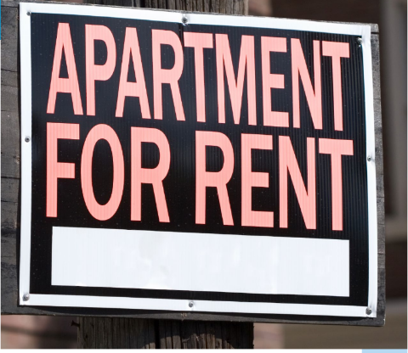
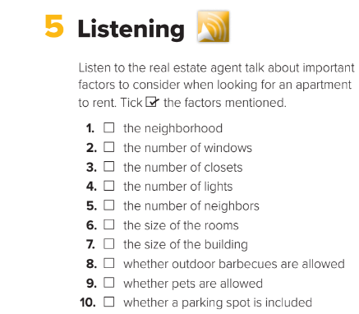


Slide 12
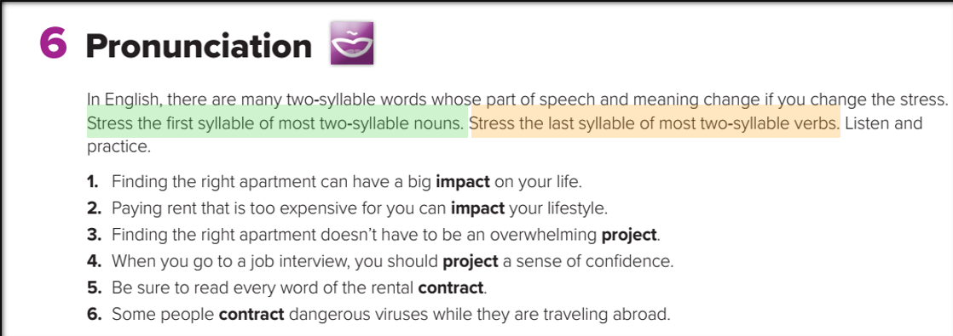

Slide 13
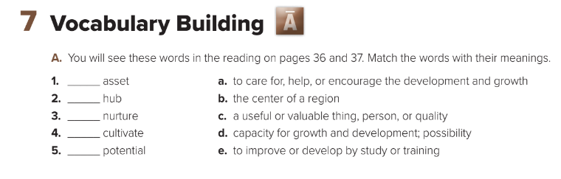
C
B
A
E
D

Slide 14
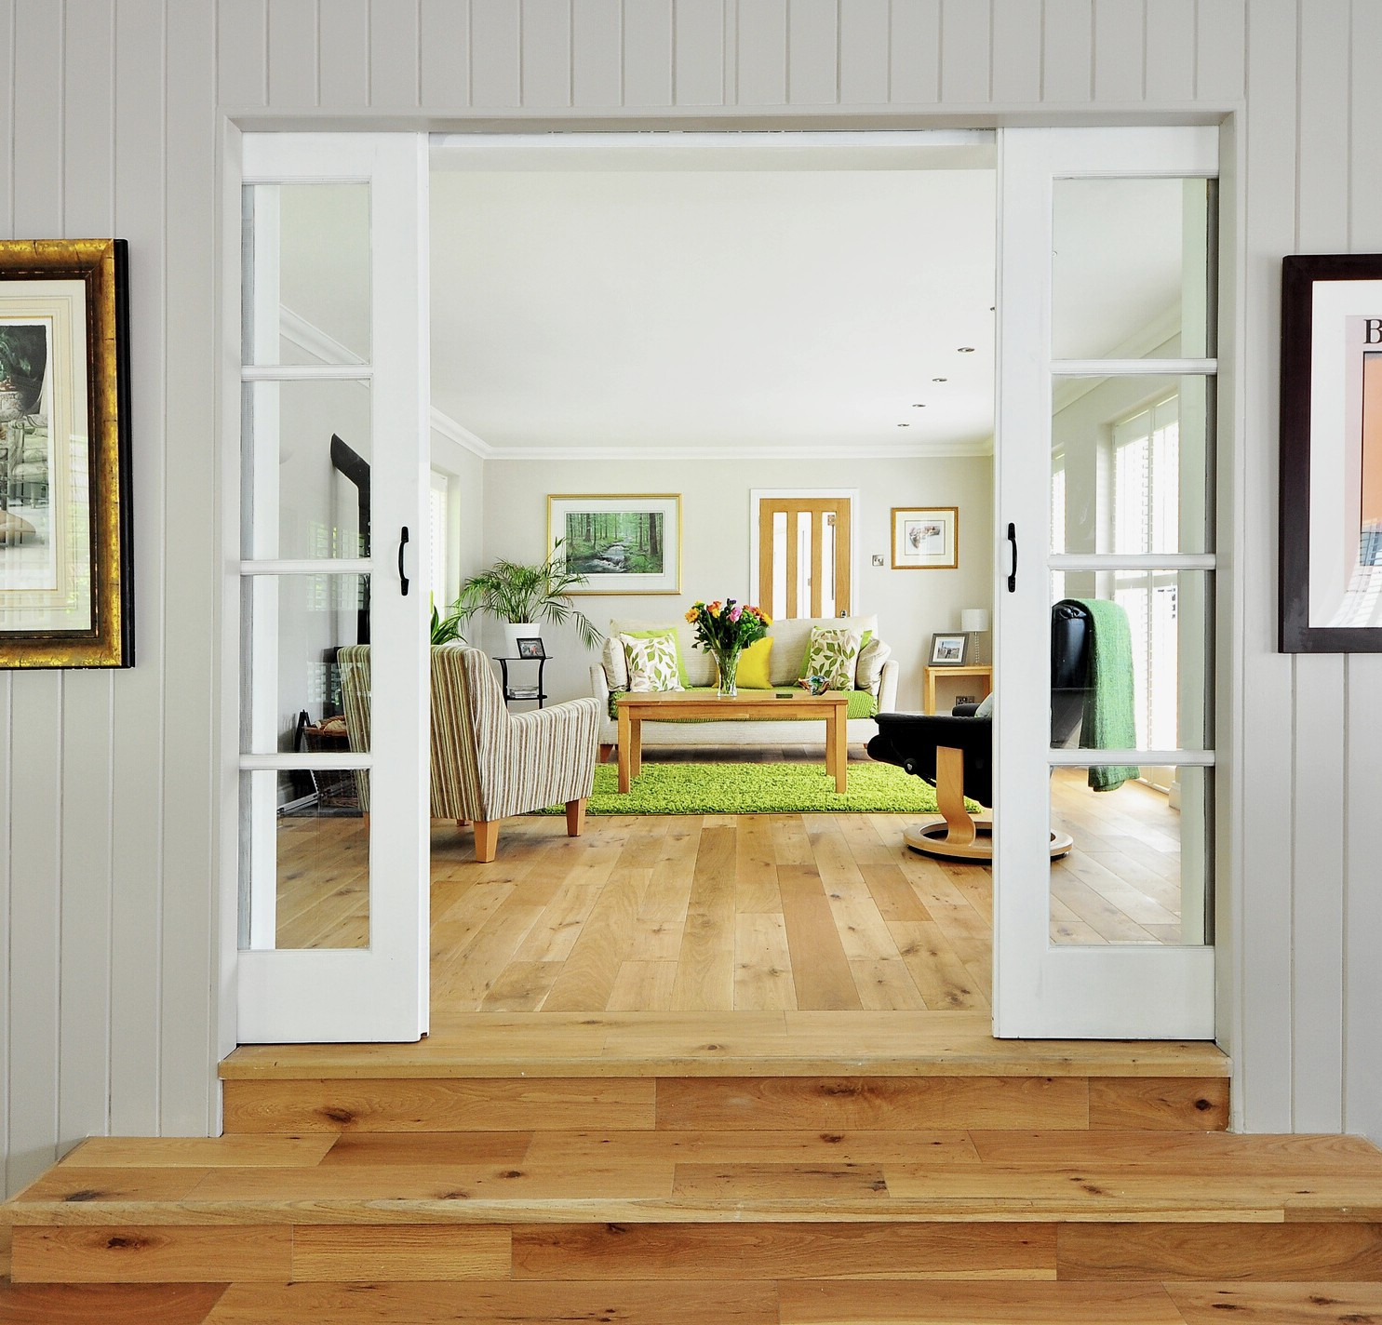
HOME WORK :
p. 100
exercise i

Slide 15

Thanks a lot

