Slide 1


06
MEGA GOAL 3
Form, Meaning & Function
11 Simple Present Tense / Present Progressive
By: Essa Al Hussaini

Slide 2

Lesson
Goals
Recognize the usage of present simple and present progressive
Apply time expressions in a present tense sentence
1
2
3
4
Use the simple present tense correctly
Use the present progressive correctly

Slide 3
What’s the difference?
Simple Present Tense
Present Progressive Tense
I play football.
I play football.
I am playing football.
I am playing football.

Slide 4
When do we use ….?
Simple Present Tense
Present Progressive Tense
I play football.
I am playing football.
Used: for facts, things that are true in general , habits or routines
Water boils at 100 °C.
A cat has four legs.
Riyadh is the capital of KSA.
He plays football everyday.

Slide 5
When do we use ….?
Present Progressive Tense
I am playing football.
Used: for actions occurring now or for a temporary situation
She is studying now.
I live in Al Ahssa, but I am living in Riyadh this week.

Slide 6
When do we use ….?
Simple Present Tense
Present Progressive Tense
I play football.
I am playing football.
Used: for facts, things that are true in general , habits or routines
Water boils at 100 °C.
A cat has four legs.
Riyadh is the capital of KSA.
He plays football everyday.
Used: for actions occurring now or for a temporary situation
She is studying now.
I live in Al Ahssa, but I am living in Riyadh this week.

Slide 7

Form
Simple Present Tense
(He, She, It, Ali, Sara)
add –s at the end of the verb
Present Progressive Tense
Subject + main verb …
I play football everyday.
He plays football everyday.
A cat has four legs.
Riyadh is the capital of KSA.
Spelling Rules for adding -s
1. Most verbs: add -s (designs, organizes).
2. Verbs ending in s, x, z, ch, sh:
add -es (relaxes).
3. Verbs do and go: add -es (does, goes).
4. Verbs ending in a consonant + y: (Study)
change the y to i and add -es (studies).
5. Verbs ending in a vowel + y: (enjoy)
add -s (enjoys).

Slide 8
Negative
Simple Present Tense
when using doesn’t
Use base form of the verb
NO –s added at the end of the verb
Present Progressive Tense
Subject don’t / doesn’t main verb …
I don’t play football.
He doesn’t plays football.
A cat doesn’t has have four legs.
Hofuf isn’t the capital of KSA.
I
You
We
They
He
She
It

don’t
doesn’t


Slide 9
Question
Simple Present Tense
Present Progressive Tense
Do / Does subject + main verb …?
Do you play football everyday?
Does he play football everyday?
Does the cat have four legs?
Is Riyadh the capital of KSA?

Slide 10
Time Expression
Simple Present Tense
Present Progressive Tense
such as …
always
usually
often
sometimes
every day .. week .. month
daily
I play football every day.
He usually goes to bed early.

Slide 11
Time Expression
Present Progressive Tense
such as …
I’m playing football now
We are currently studying for the final exams.
right now
now
at the moment
at present
currently
these days *
Notes:
these days
often used in present progressive, and it can be used in simple present depends on the speaker's situation
a temporary action (progressive)
or a normal habit that continue for a long time (simple)

Slide 12
NOTE
Present Progressive Tense
I’m liking pizza.
I like pizza.
They are preferring to recycle soda cans.
They prefer to recycle soda cans.
* presenter view
Some verbs are not often used
believe forget
hear know
like love
need prefer
remember see
understand want realize
https://www.englishcoursemalta.com/learn/english-verbs-that-cannot-be-used-in-the-continuous-or-progressive-form/
Notes:
DON’T USE THESE VERBS IN PROGRESSIVE FORM
ENGLISH VERBS THAT CANNOT BE USED IN THE CONTINUOUS OR PROGRESSIVE FORM
Verbs of Emotion: love, hate, prefer, mind, like, dislike, please, surprise, astonish, impress
Verbs of Possession: have, own, want, belong, need, possess, own, owe, include, involve
Verbs used for the Senses: see, hear, smell, seem, sound, taste, look (=seem), appear, be
Verbs of Thought: know, believe, remember, agree, disagree, recognise, think (as in to have an opinion), realise, suppose, mean, understand, concern, feel (as in to have an opinion), wish, promise, imagine, doubt, deny, satisfy, depend, matter, deserve
Verbs of Measurement: contain, consist, fit, lack, measure (as in to have length), weigh (as in to have weight)
The list of verbs above are referred to as Stative or State Verbs.
https://www.englishcoursemalta.com/learn/english-verbs-that-cannot-be-used-in-the-continuous-or-progressive-form/

Slide 13
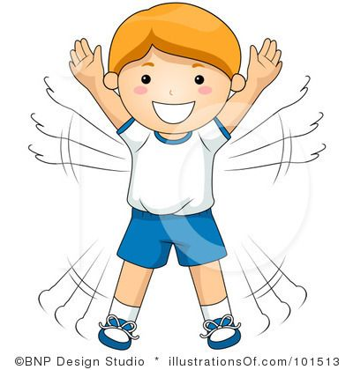
Practice makes Perfect

Slide 14
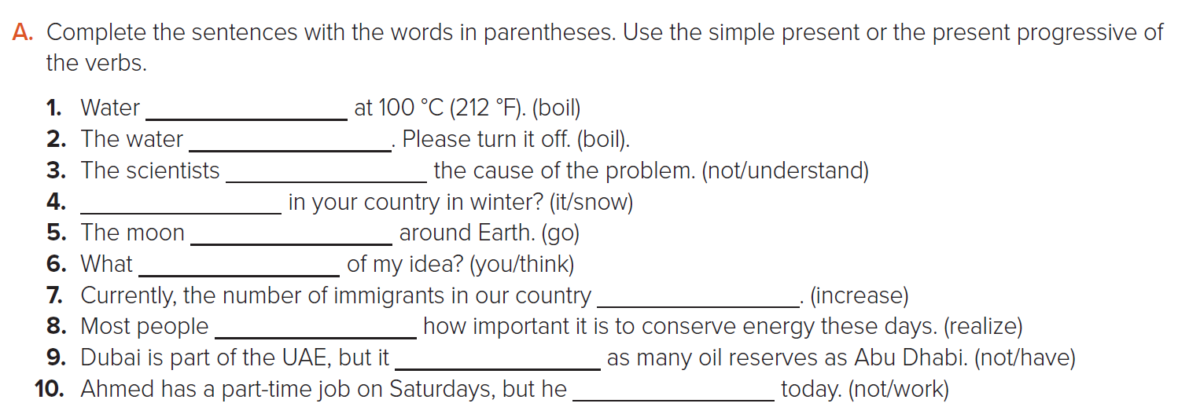

Student’s Book @ 92
boils
is boiling
don’t understand
Does it snow
goes
do you think
is increasing
realize
doesn’t have
isn’t working

Slide 15
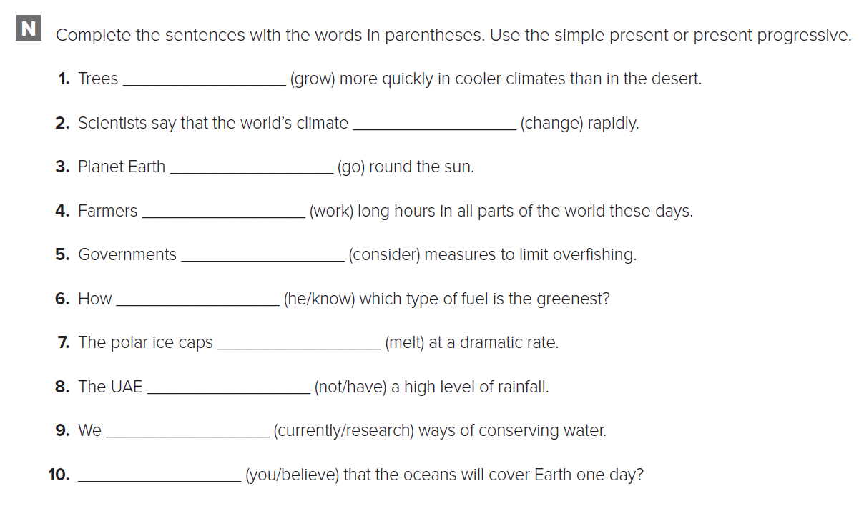

WORKBOOK @ 65
grow
is changing
goes
work / are working
are considering
does he know
are melting
doesn’t have
‘re currently researching
Do you believe

Slide 16
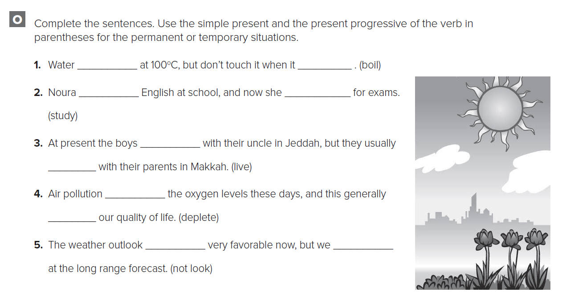
WORKBOOK @ 65
boils
is boiling
studies
is studying
are living
live
is depleting
depletes
doesn’t look
aren’t looking

Slide 17

THANK YOU
Lesson done by: Essa Al Hussaini

Slide 18
06
MEGA GOAL 3
Form, Meaning & Function
11 Conditional Sentences with Present & Future Form
By: Essa Al Hussaini

Slide 19
Lesson
Goals
Use conditional sentences with present
Use conditional sentences with
May / Might
1
2
3
4
Use conditional sentences with future
Use I’d Rather as talking on preferences

Slide 20
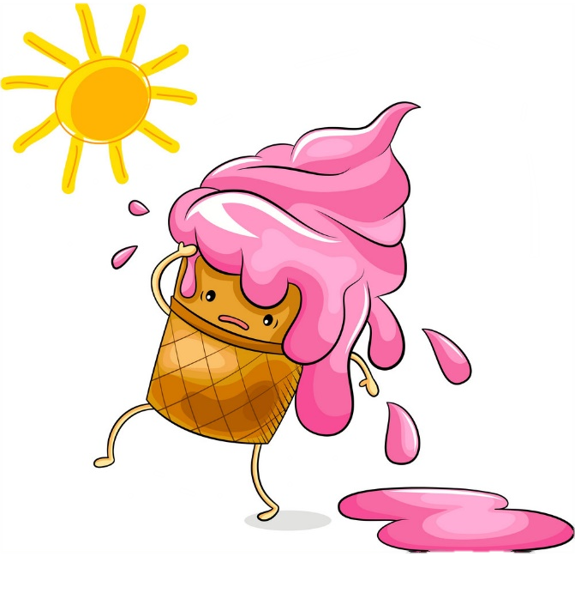


conditional
If
Sometimes we want to ..
talk about Causes & Results
whenever
in this case …
is used

Slide 21


How many sentence ….?
How many parts ….?
If you study hard, you will pass.
Clause
Cause clause
If clause
Clause
main clause
Result clause

Slide 22
… meaning still same?
If you study hard, you will pass.
You will pass if you study hard.
✗
You will pass if you study ,
You will pass , if you study.
If you study hard you will pass.

Slide 23

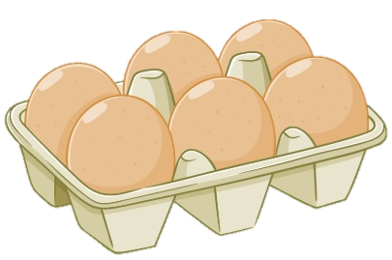
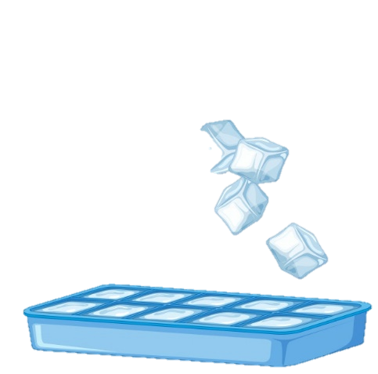
Present Facts (ZERO If conditional )
result always happen
Use the simple present tense in both clauses
If you cook an egg in the microwave, it explodes.
If you put water in the freezer, it becomes ice.

Slide 24

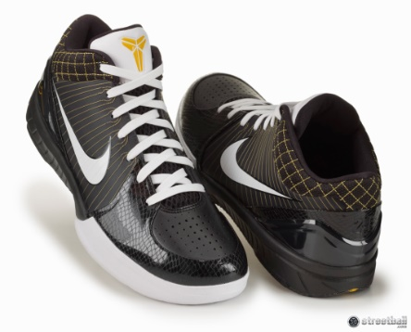
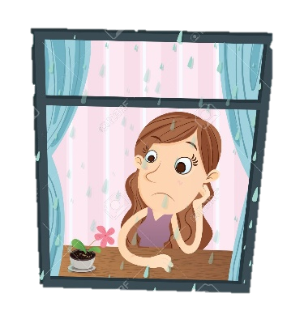
Future Facts (1st If conditional )
might happen in the future; certain
Use if .. simple present , will / be going to ..
If I have enough money, I will buy new shoes.
If it rains tomorrow, she is going to satay at home.

Slide 25

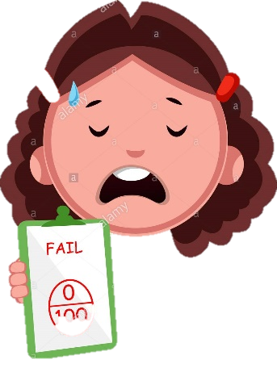

May / Might
Possible to happen,
NOT certain
Use if .. simple present , may / might ..
If she doesn’t study, she may fail the exam.
If you don’t go to college, you might not get a good job .

Slide 26


Form | Use
Non-Example | Example
to talk about things that are always true;
result always happen
If + simple present, … simple present
Present Facts
If
If you freeze water, it turn into ice.
If you freeze water, it is turning into ice.
If you freeze water, it will turn into ice.

Slide 27
Form | Use
Non-Example | Example
to talk about things that might happen in the future; certain
If + simple present, … future
Future Facts
If
If it rains, I will stay at home
If it rains, I stay at home
If it will rain, I will stay at home

Slide 28
Form | Use
Non-Example | Example
to talk about things that Possible to happen,
NOT certain
If + simple present, … may / might
May
Might
If you go to that market, you might find some milk.
If you might go to that market, you find some milk.

Slide 29



I’d rather (= I would rather)
talking about preferences
Use I’d rather + inventive
Would you rather go to the mall now or later?
I’d rather go now.

Slide 30
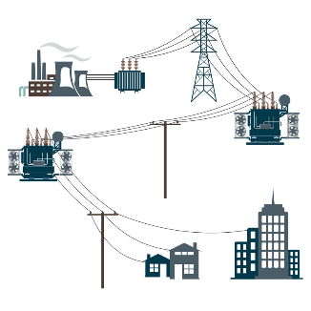
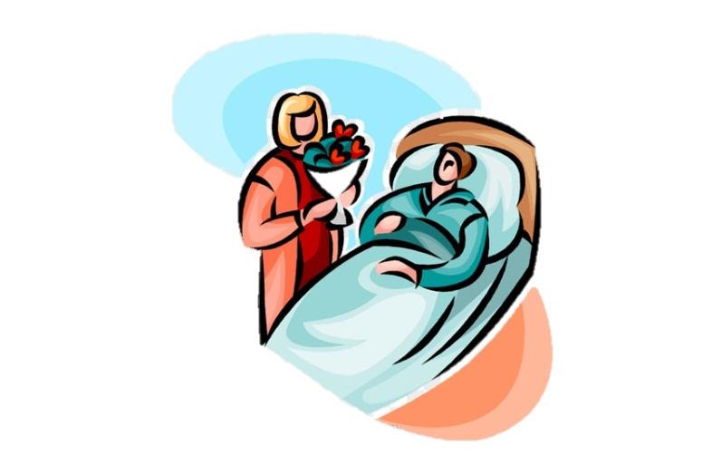
I’d rather (= I would rather)
talking about preferences
Use I’d rather + inventive
talking
I'd rather talk about Living off the Grid.
I’d rather visit Sara tonight.
visiting

Slide 31
Practice makes Perfect

Slide 32
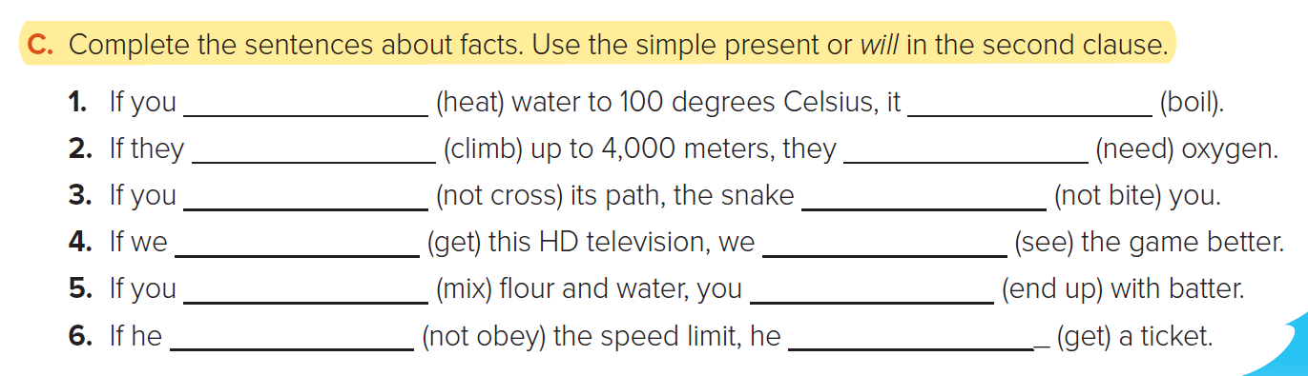

Student’s Book @ 93
heat boils
Climb will need
don’t cross will not bite
get will see
mix end up
doesn’t obey will get

Slide 33
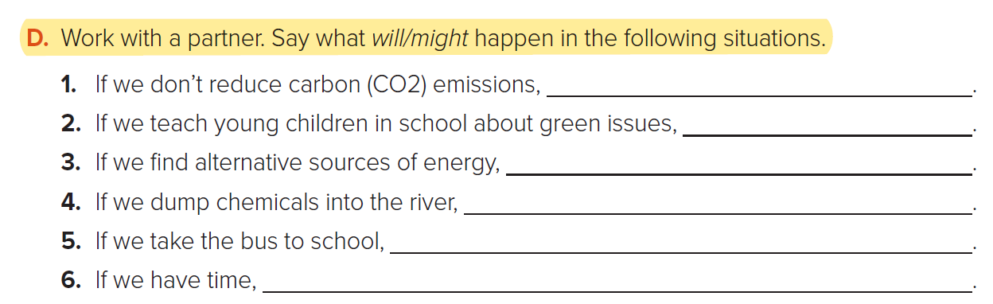
Student’s Book @ 93
global warming will get worse
they will protect the environment.
we will reduce carbon emissions
the fish will die
we will save money on petrol
we might go shopping.
we will go shopping.

Slide 34
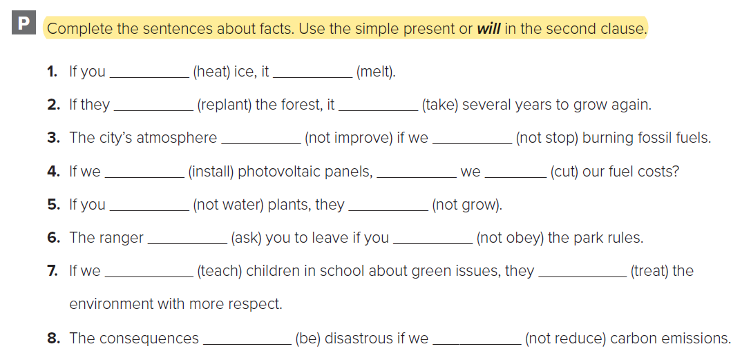
WORKBOOK @ 66
heat melts
replant will take
won’t improve don’t stop
install will cut
don’t water won’t grow
will ask don’t obey
teach will treat
will be don’t reduce

Slide 35
THANK YOU
Lesson done by: Essa Al Hussaini

