Slide 1
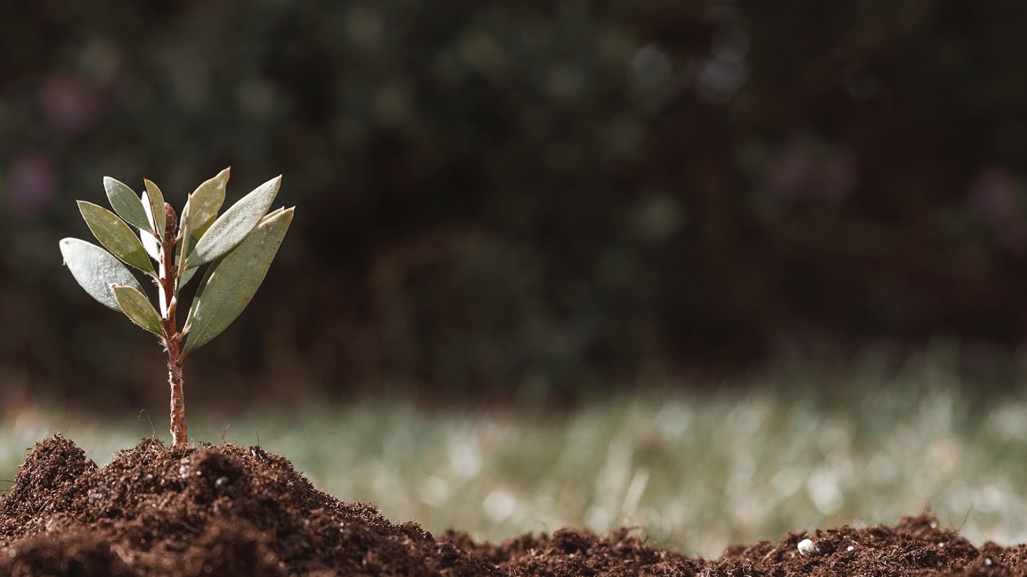
Going Green !
Reading

Slide 2
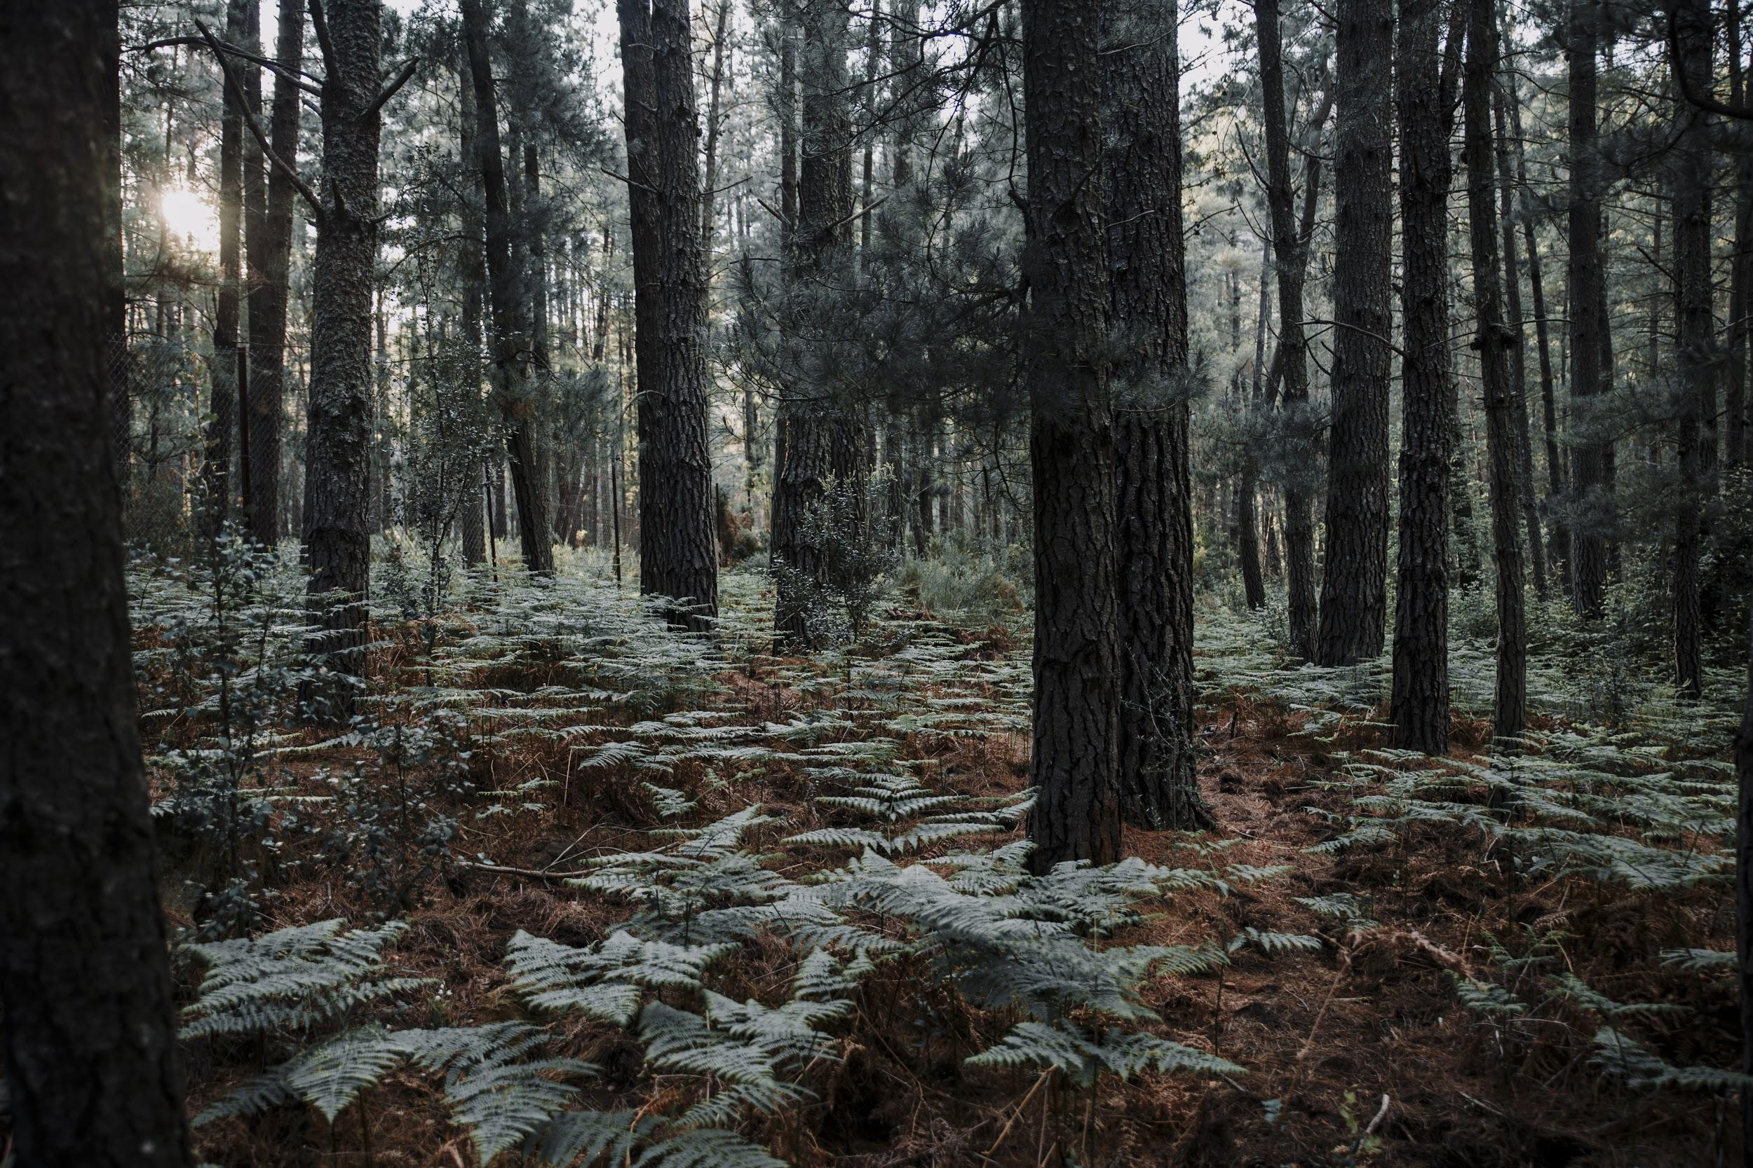
Lesson objectives
•1 Compare life with and without green power.
•2 Find ways our country can replace utilities.
•5 Write ways to reduce waste.
• 6 Find reasons people live off the grid.
•3 List some essential public utilities.
•4 Explain wind energy.

Slide 3
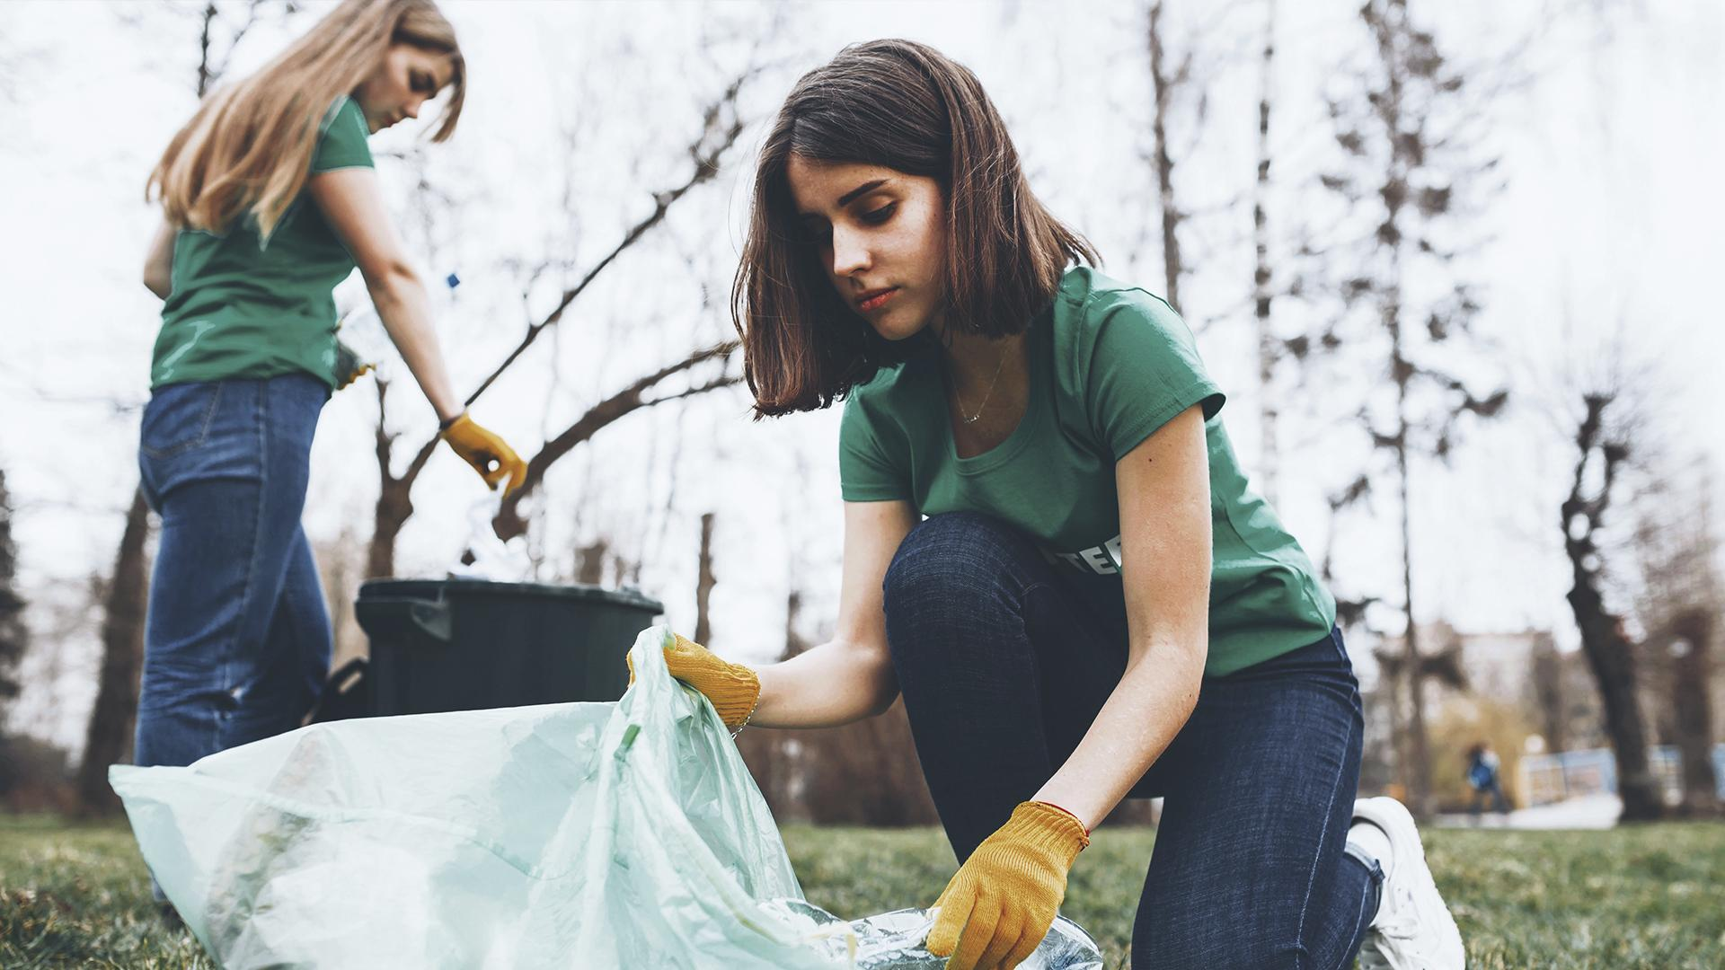
Going green

Slide 4

What is the meaning of going green

Slide 5
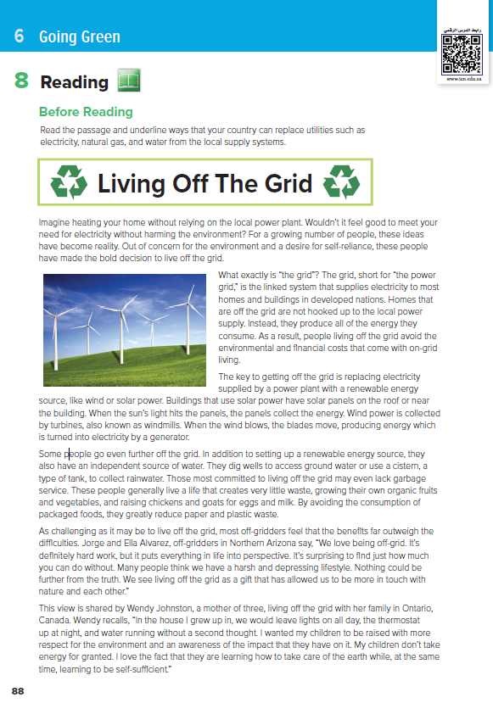
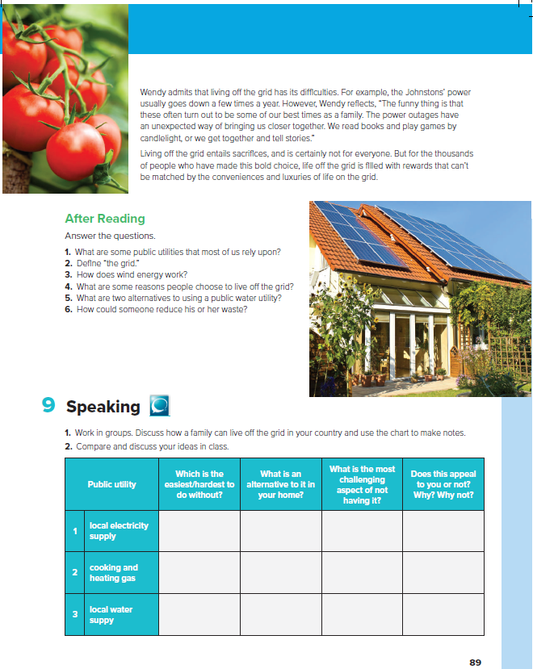
7
8
1
2
.. the title?
.. the title mean?
3
Picture shows …?
4
.. # of paragraphs?
5
6

Slide 6
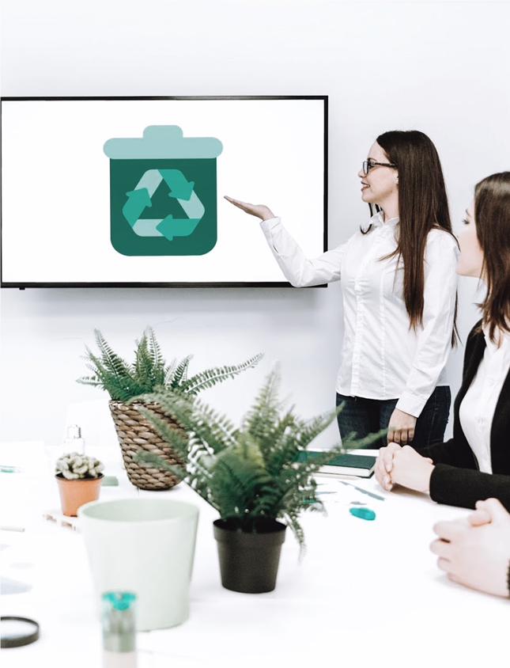

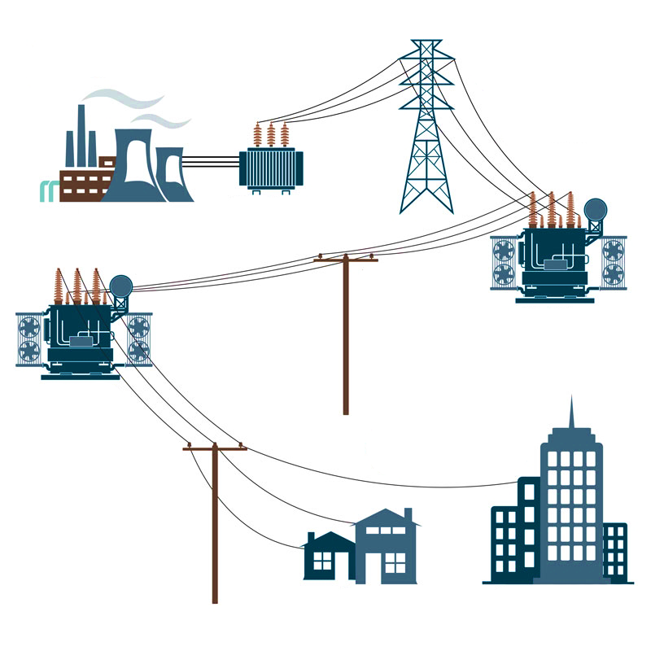
Read along as you listen

Slide 7
Public utilities
1.Short for the power grid
Linked system
that
What is the grid ??
electricity
Natural gas
water
Supplies electricity
To most homes
The bold decision
is
To live off the grid

Slide 8

The key to getting off the grid is …..
Replacing
electricity
with
Solar and wind power

Slide 9
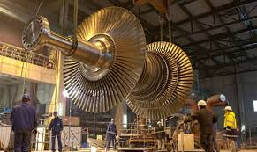
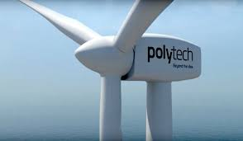

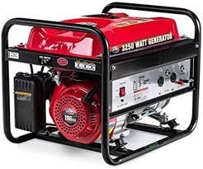
wind energy is collected by turbines
“ windmills”. When the wind blows, the blades move,
producing energy which turned into electricity by a generator
How does wind energy work

Slide 10
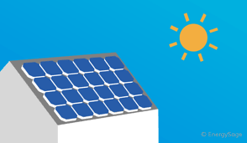
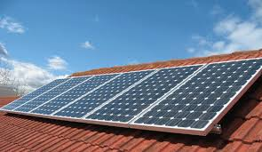
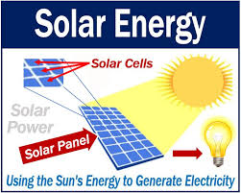
When the sun light hits the panels
the panels collect the energy.
How does solar energy work

Slide 11
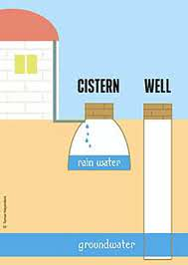
water
What are two alternatives to using a public water utility?

Slide 12
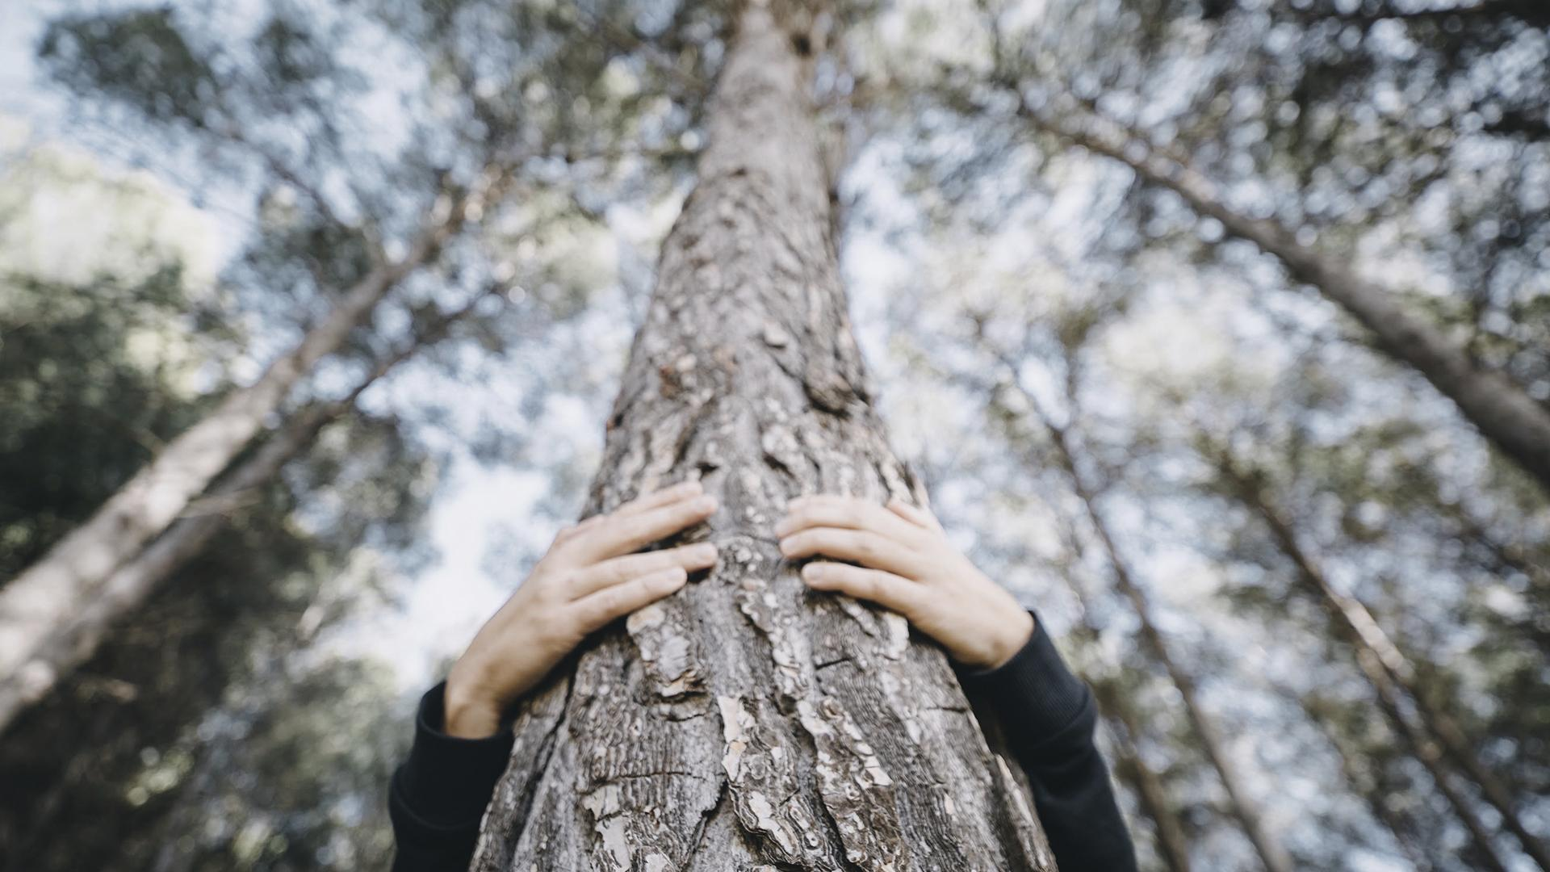
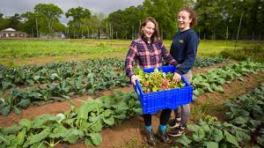
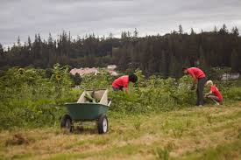
Living off the Grid

Slide 13
How could they reduce the waste?
1
2
3
4
Growing their own organic fruits and vegetables
Raising chickens and goats for eggs and milk
Avoid the consumption of packaged foods
They reduce plastic and paper waste

Slide 14
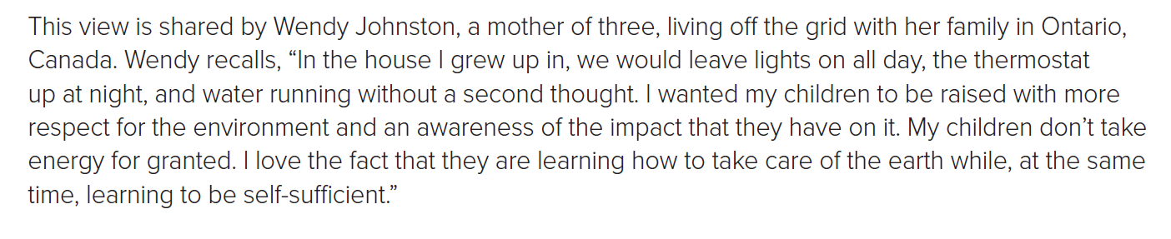
6
Who does the pronoun “they” refer to?
What are two things Wendy wants for her children?
Wendy Johnson’s children

Slide 15
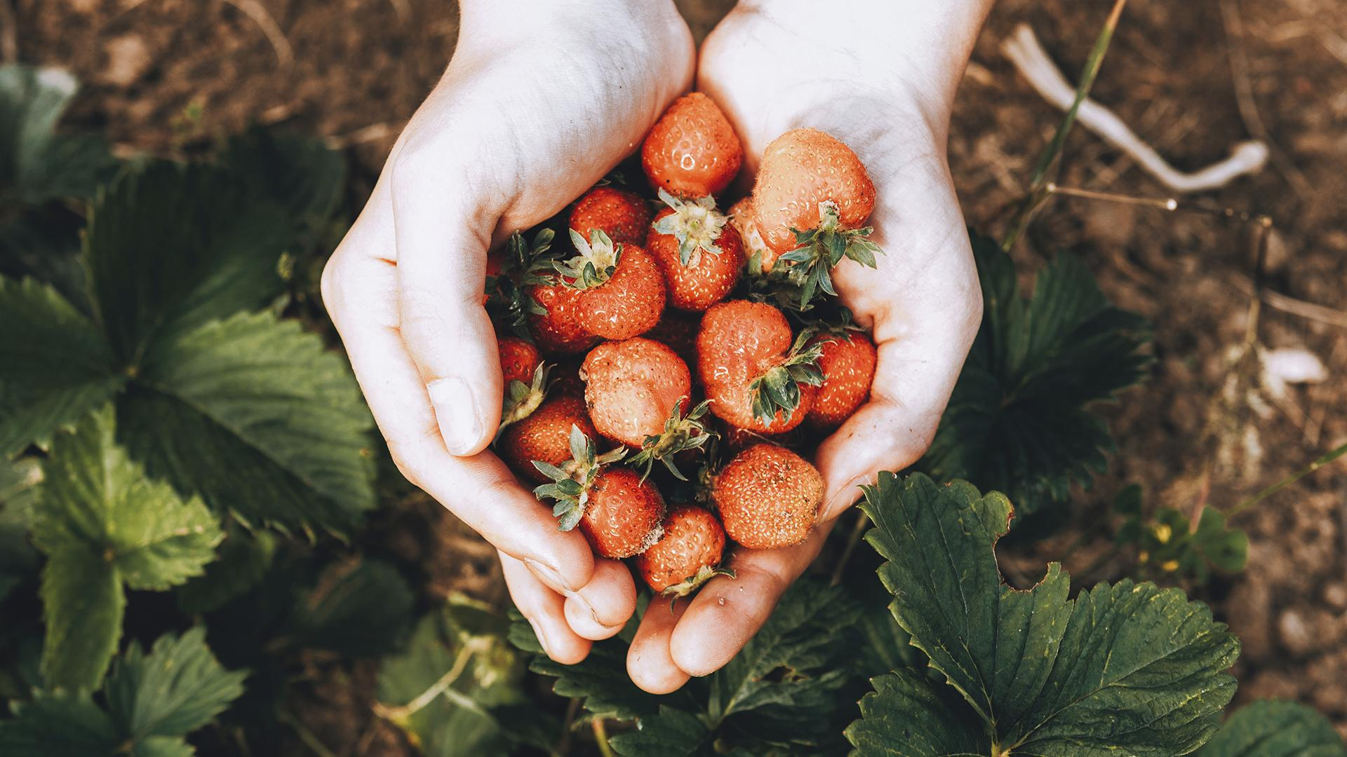
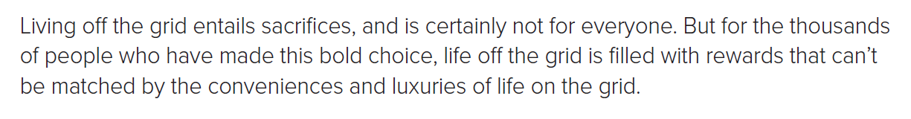

the decision to live off the grid
What is the “bold choice” referred to? ?
8
… “can’t be matched” means?
Not like;
one thing is much better than another

Slide 16

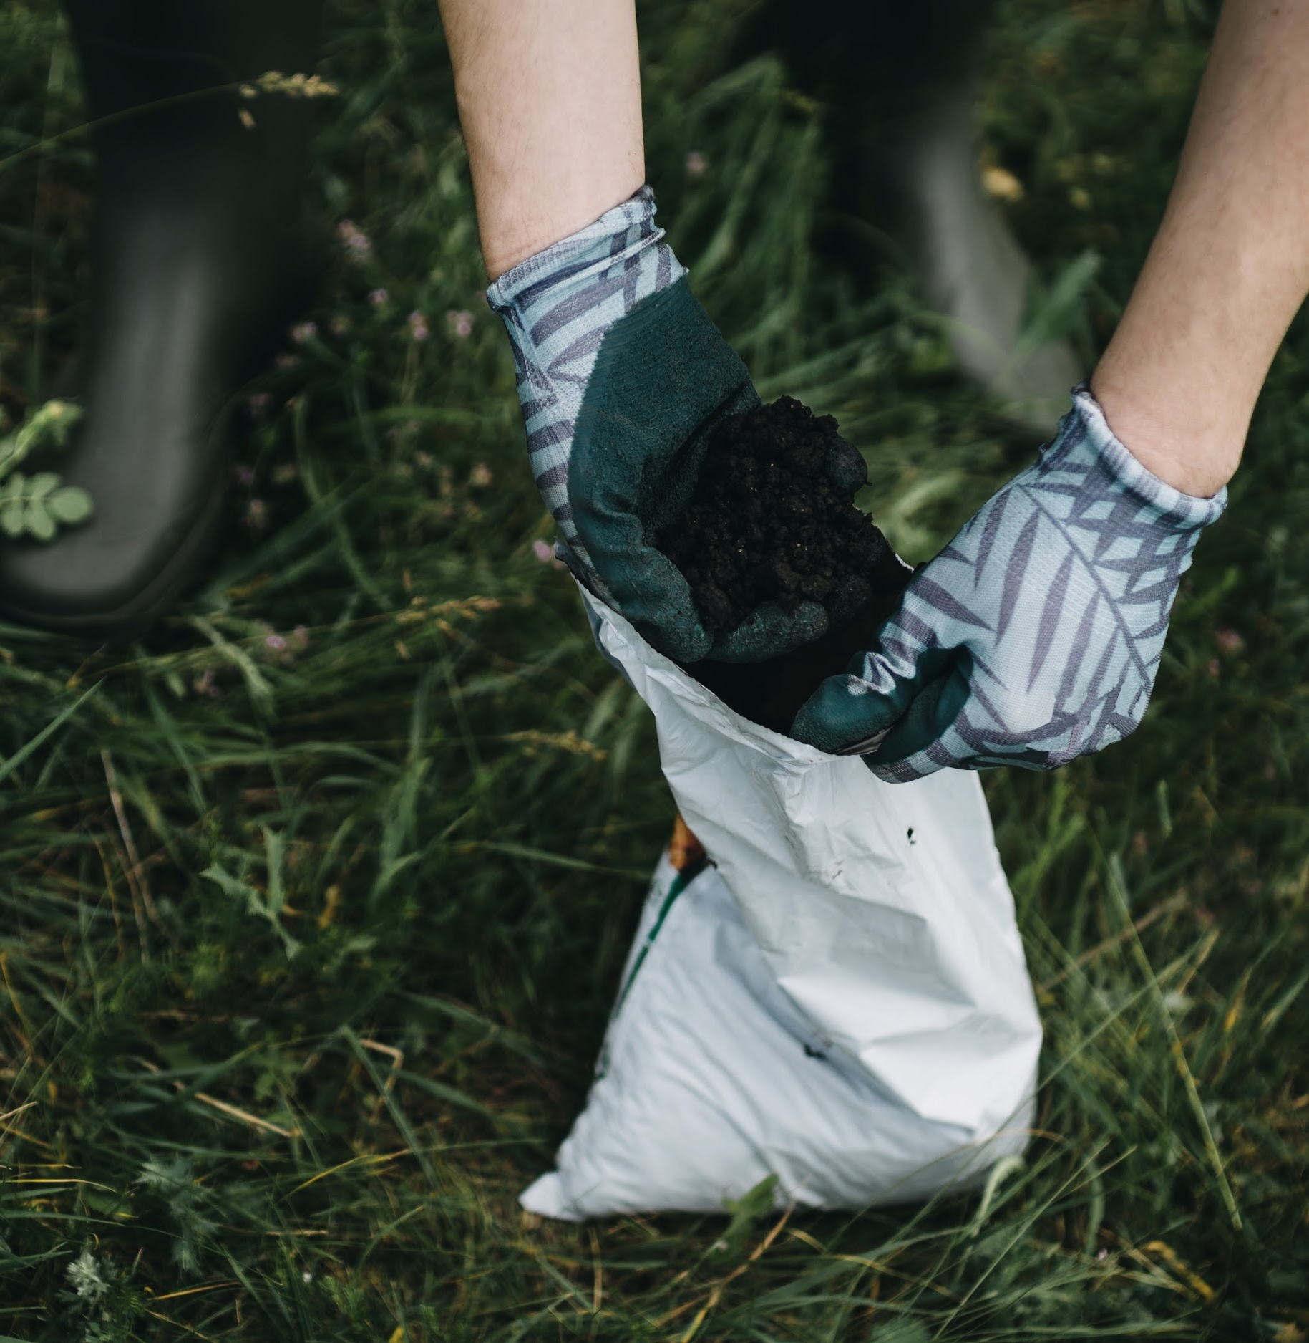

After Reading Answer the questions.
1. What are some public utilities that most of us rely upon?
2. Define “the grid.”
3. How does wind energy work?
The linked system that supplies electricity to most homes and buildings in developed nations
When the wind blows windmills turn producing energy which is turned into electricity by a generator
Electricity , natural gas and water

Slide 17

4. What are some reasons people choose to live off the grid?
5. What are two alternatives to using a public water utility?
6. How could someone reduce his or her waste?
Concern for the environment and a desire for self- reliance
A private well or a cistern to collect rain water
By growing their own fruits and vegetables and raising and tending animal for food

Slide 18

Choose
Reasons people choose to live off the grid are...
desire for self-reliance
concern for the environment
waste garbage.

Slide 19

True / False
True
The word "without a second thought" means “without thinking”
False

Slide 20
True / False
True
We can reduce waste by eating packaged food.
False

Slide 21
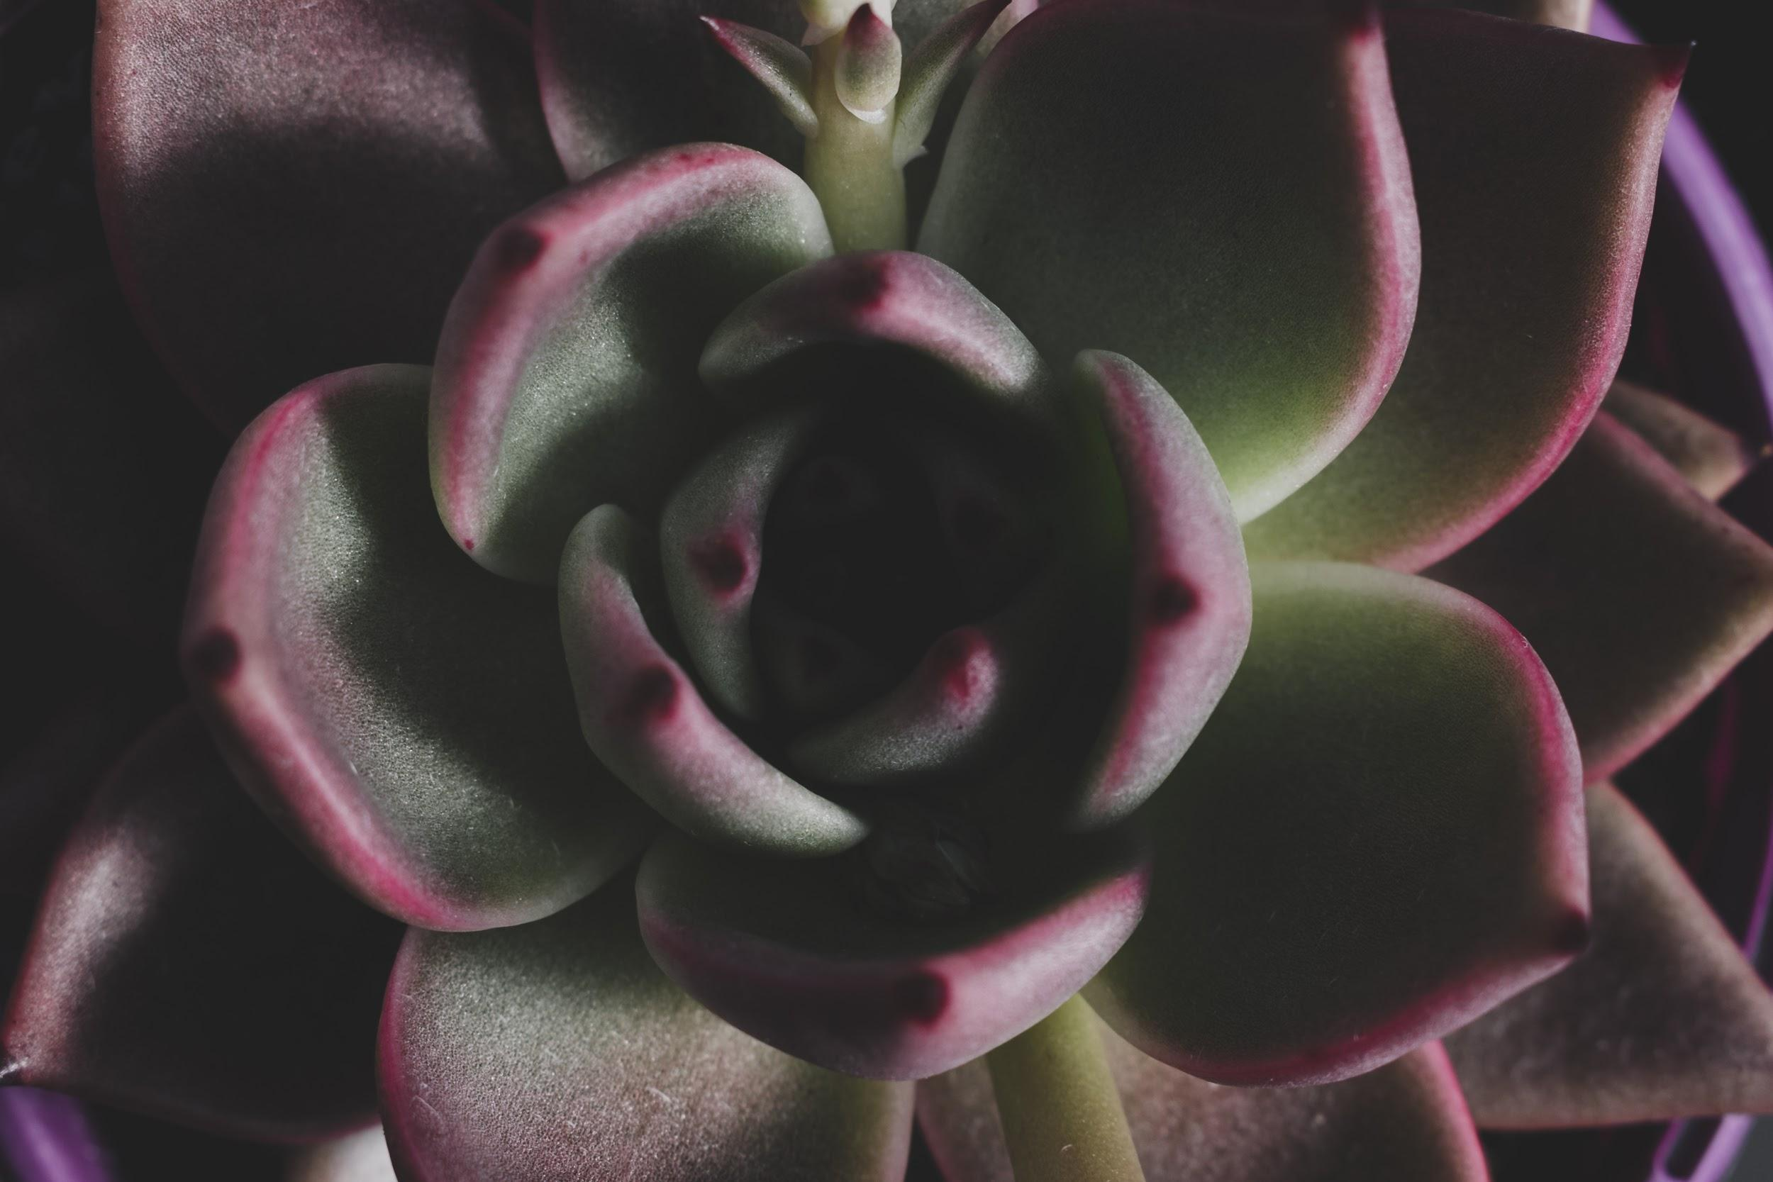

Keep Your Environment Clean
((كُلُوا وَاشْرَبُوا مِنْ رِزْقِ اللَّهِ وَلا تَعْثَوْا فِي الأرْضِ مُفْسِدِينَ))
Go Green,
Keep Clean

Slide 22

The End

