Slide 1
Mega Goal 2.2
U: 1
Working 9 to 5
Reading
By: Yousef Hilal Alyazedi

Slide 2
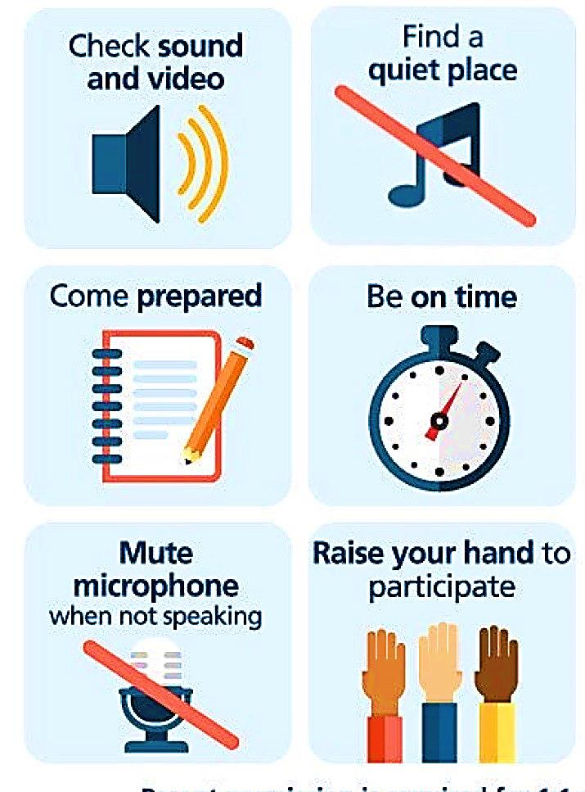
Online Classroom Rules

Slide 3



Slide 4


Lesson Objectives
The students will be able to :
1 – Name some unusual jobs .
2- List job responsibilities .
3 – describe some jobs.
4 – Find the meaning of new words in the article .
5 – Find expressions in the articles .

Slide 5
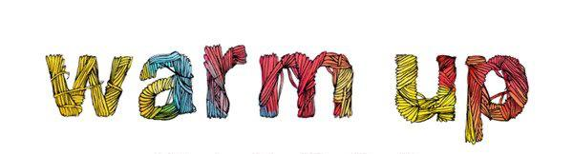
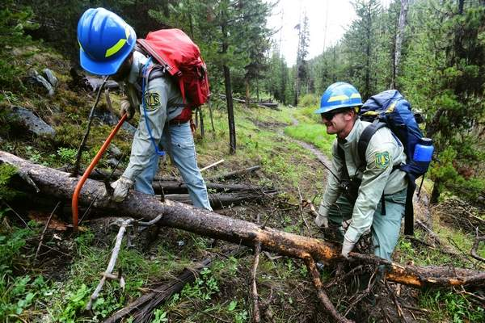
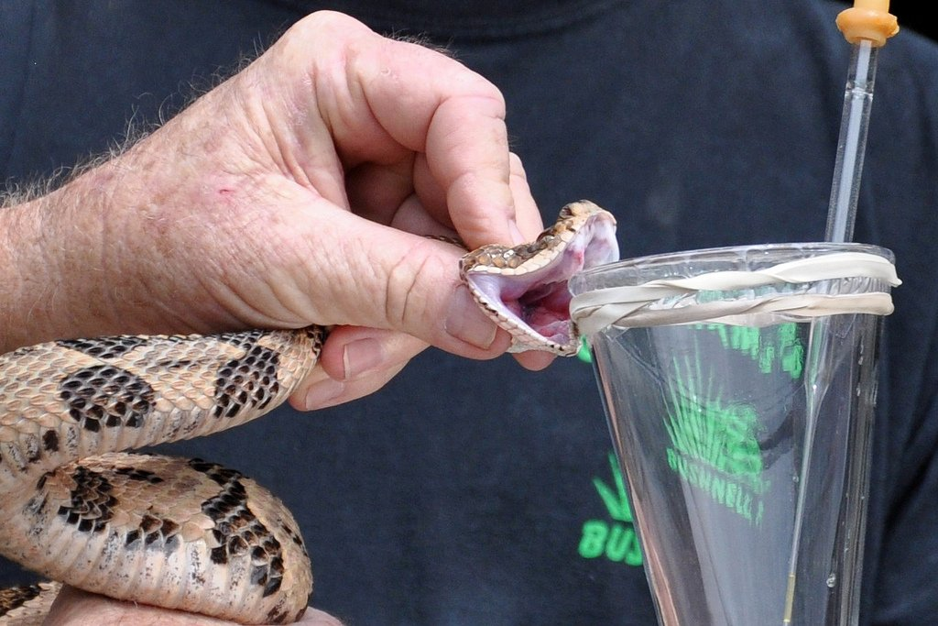
What are the most unusual jobs you’ve ever heard of ?

Slide 6
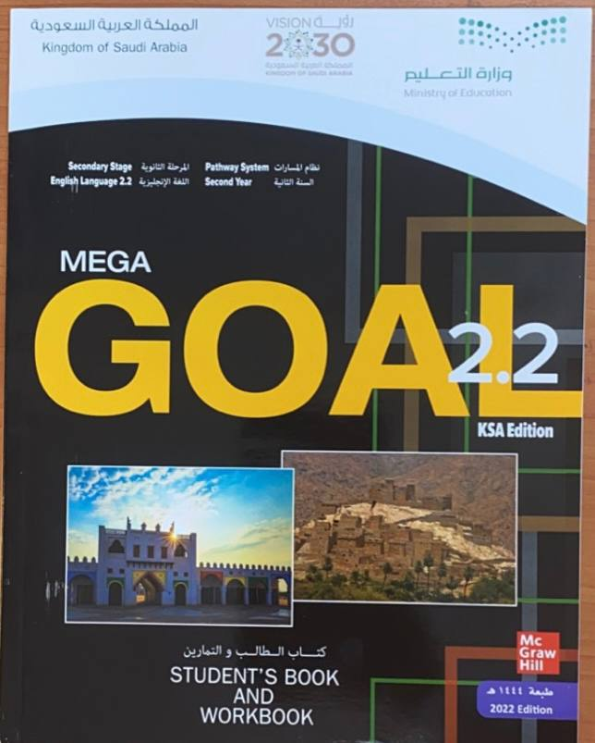

Open your Student’s book at page: 2

Slide 7

Our reading strategy is
Jigsaw Reading

Slide 8
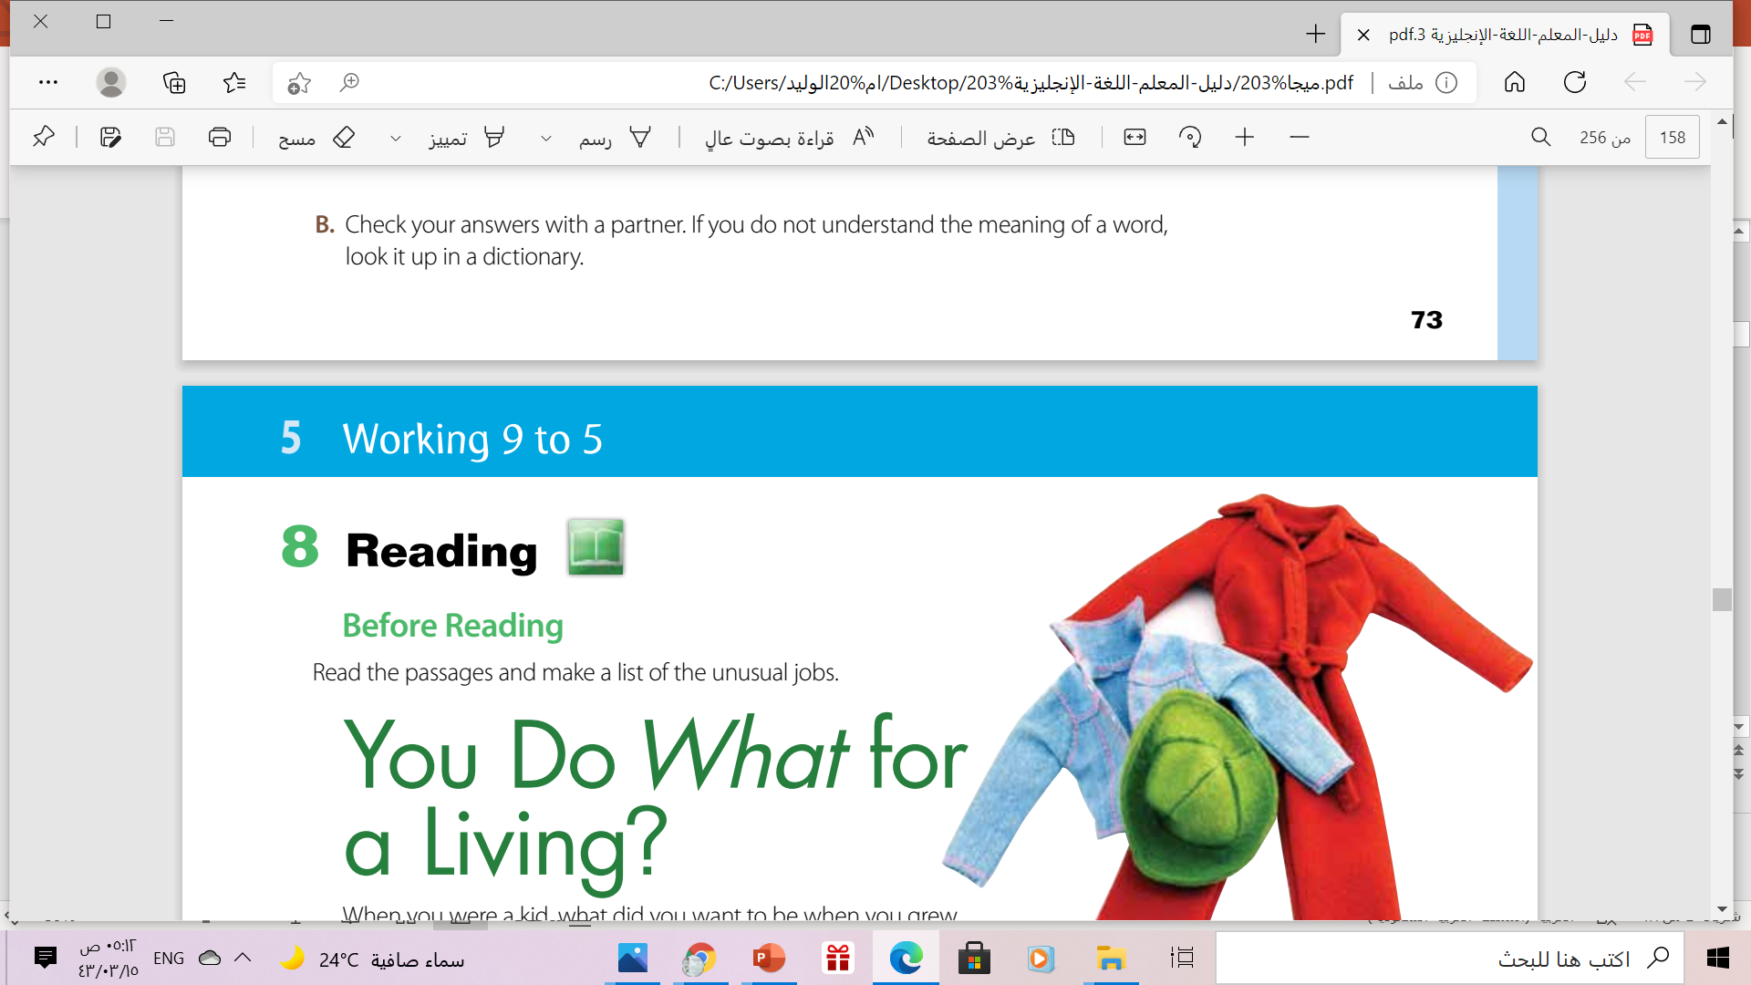

Slide 9
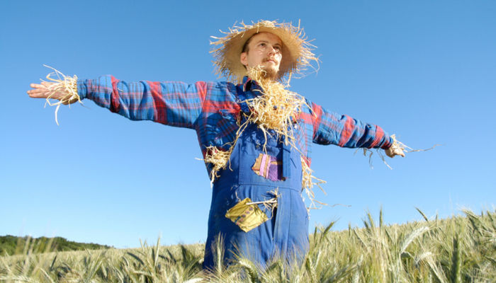
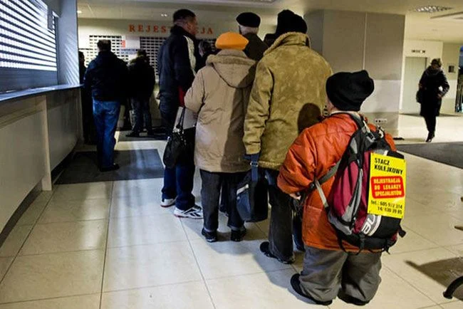
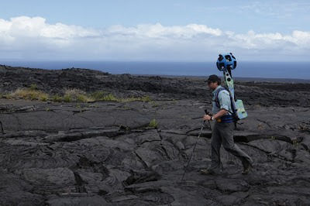
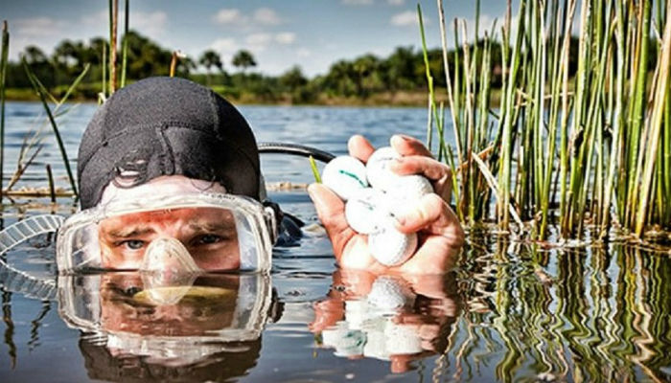
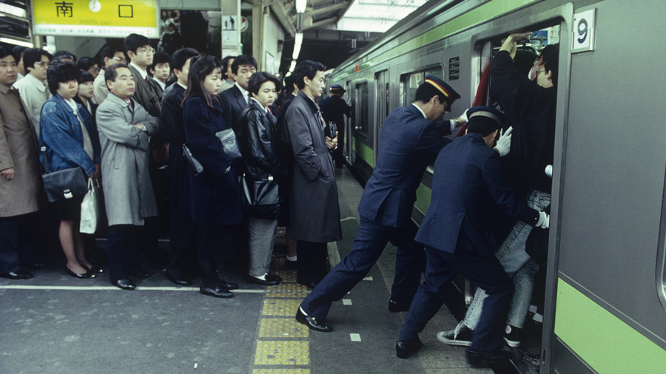
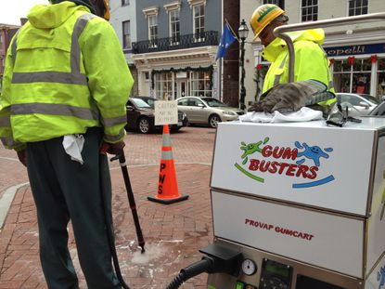
SOME unusual jobs
Human Scarecrow
Stand in line
Google maps trekker
Golf ball diver
Train pusher
Gum buster

Slide 10
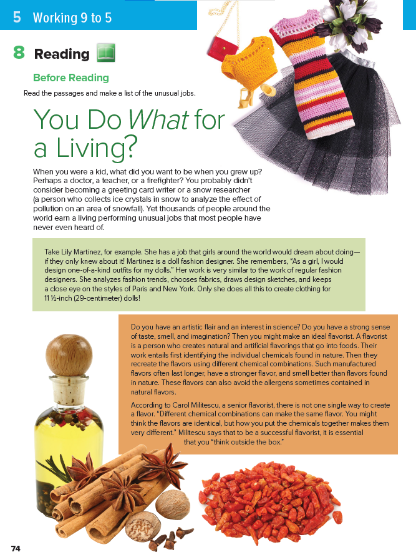
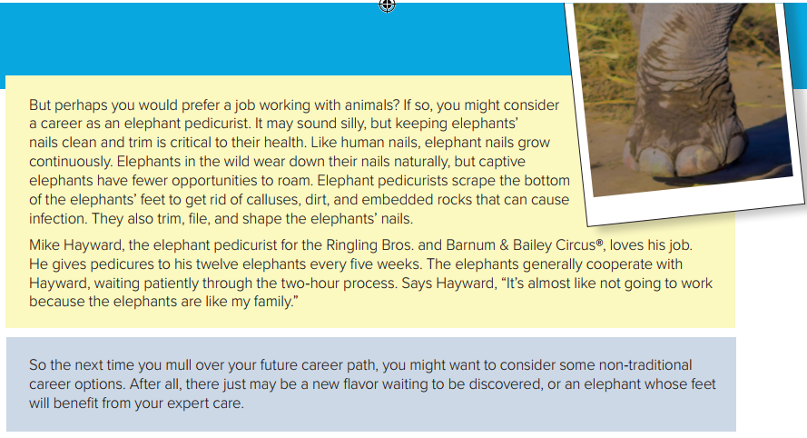
5
1
6
2
7
3
What’s the title ?
How many paragraphs ?
4
What do the pictures refer to ?

Slide 11

people sometimes ask a question in this way when they are surprised by something they’ve heard.
You did what ?
They went where ?

Slide 12


Read
along as you
Listen

Slide 13
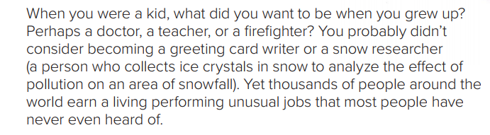
What jobs does the paragraph mention ?
Who is a snow researcher ?

Slide 14
3
Mike Hayward
1
Lily Martinez
2
Carol Militescu
Person’s name in each section ?

Slide 15

Each student will read only one section
Jigsaw Reading
What does each person do ?
What does each person’s entail ?
What does each person say about the job?

Slide 16
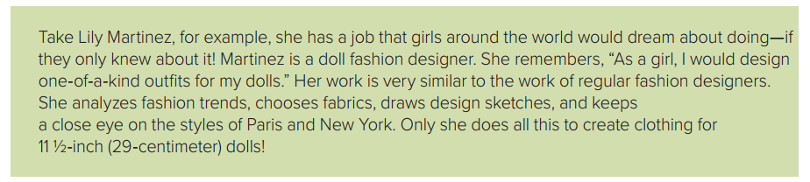
What does Martinez do ?
What does her job entail ?
What does she say about her job ?

Slide 17
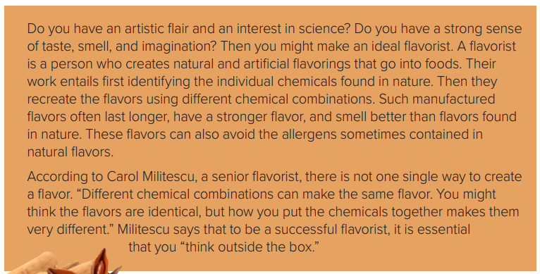
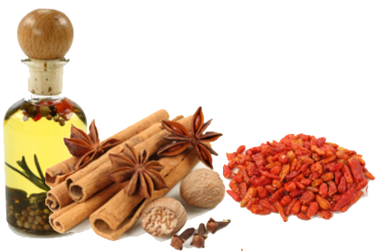
What does Carol Militescu do ?
What does his job entail ?
What does he say about his job ?

Slide 18
Open your Student’s book at page: 9

Slide 19
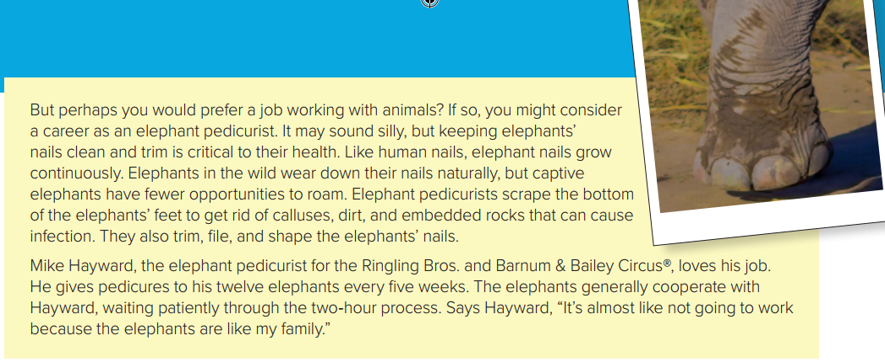
What does Mike Hayward do ?
What does his job entail ?
What does he say about their job ?

Slide 20
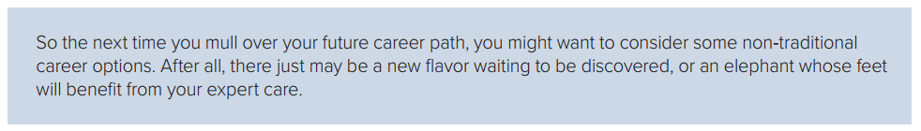

Slide 21
Additional Vocabulary Practice
Find 4 nouns relate to the work a fashion designer does.
Find an expression that means unique.

Slide 22
Additional Vocabulary Practice
Find 4 adjectives to describe flavor.
Find an expression that means to come up with unusual ideas

Slide 23
Additional Vocabulary Practice
Find a two-word verb that means to become less or smaller because of constant use .
Find 4 verbs that are used to describe
what a pedicurist does to an elephant’s feet and nails .

Slide 24
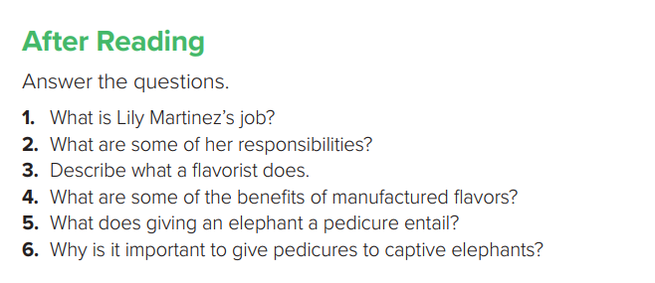
1. She is a fashion designer for doll clothing .
2. She studies fashion trends, chooses fabrics, draws pictures of her designs, and watches fashion shows .
3. A flavorist makes natural and artificial flavorings to put into food .
4. Manufactured flavors last longer, have stronger flavor, smell better, and have fewer allergens .
5. An elephant pedicure entails scraping the bottom of the elephant’s feet to get rid of calluses, dirt, and rocks, and trimming, filing, and shaping the nails.
6. Captive elephants cannot wear down their nails naturally, and rocks and dirt in their feet can cause infections .

Slide 25
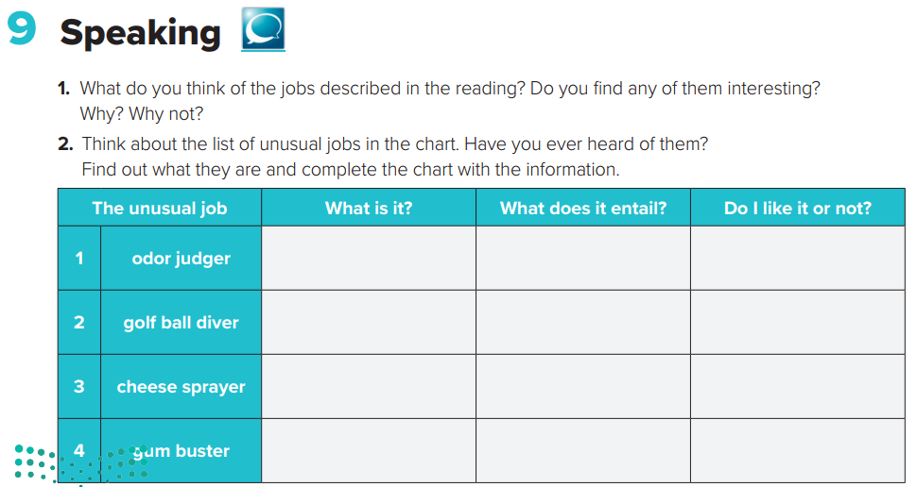
People who can distinguish and compare smells
successfully
testing odors coming from people’s armpits, mouths, or feet
A person who collects golf
ball from under water
Diving into ponds and lakes on golf courses looking for golf balls
A person who give people their popcorn with butter and salt
spraying popcorn or similar similar foods with melted cheese
A person who clean gum
off the public places
removing chewing gum from sidewalks, streets, and other areas

Slide 26
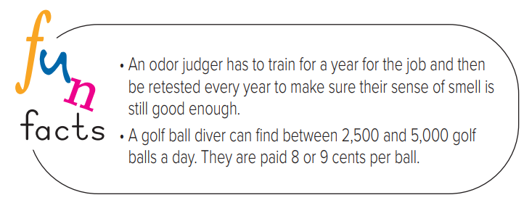

Slide 27

Workbook P. 81
Exercise I

Slide 28
