Slide 1

Revision Unit 2
Done By: Entisar Al-Obaidallah

Slide 2
انطلق

Slide 3


They enjoy….to music.
listen
listens
listening

Slide 4
Please, remember………..your homework
brings
to bring
bringing

Slide 5
Our train………..at 9:00 a.m.
leaves
left
leaving

Slide 6
He is …..lunch now
ate
eats
eating

Slide 7
If it ….tomorrow, we will stay at home.
rain
rains
raining

Slide 8
If Sara doesn't study hard, she may….the exam.
fail
fails
failed

Slide 9
The odd word …..
having
using
open

Slide 10
Pollution is the ………… of many environment problems.
organic
source
grid

Slide 11
……… food is produced entirely without chemicals.
organic
source
bold

Slide 12
The meaning of relying on …..
large
difficult
Depending on

Slide 13
The meaning of harsh……
strong
difficult
large

Slide 14
The opposite of harmful…
harmless
careless
useless

Slide 15
The opposite of “ glossy”….
useless
natural
matt

Slide 16
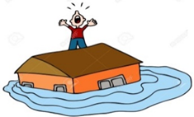
The picture shows…
diving
flooding
sinking

Slide 17

The picture shows….
recycle
reuse
reorder

